Slide 1
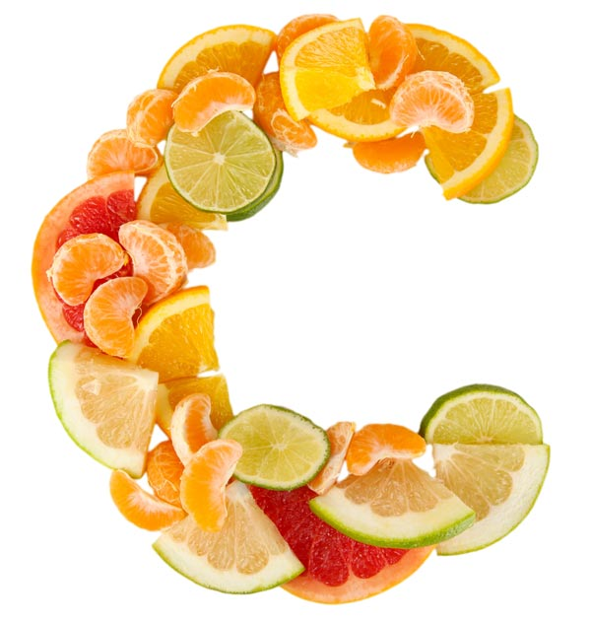
VITAMIN

Slide 2
Chemistry
The active form is “Ascorbic acid”.
It is a water soluble vitamin and is easily destroyed by heat, alkali and storage. In the process of cooking, 70% of vitamin C is lost.
It is a strong acid due to dissociation of ‘H’ at c2 &c3.

Slide 3
Strong reducing property due to double bonded carbon( all the function of it is due to this property)
Only L-ascorbic acid and dehydroascorbic acid have antiscorbutic activity. The D-ascorbic acid has no activity.

Slide 4
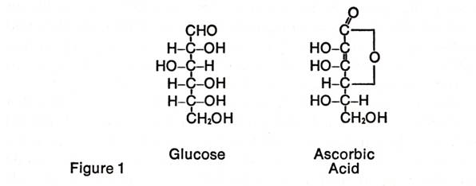
Structurally similar to glucose.

Slide 5
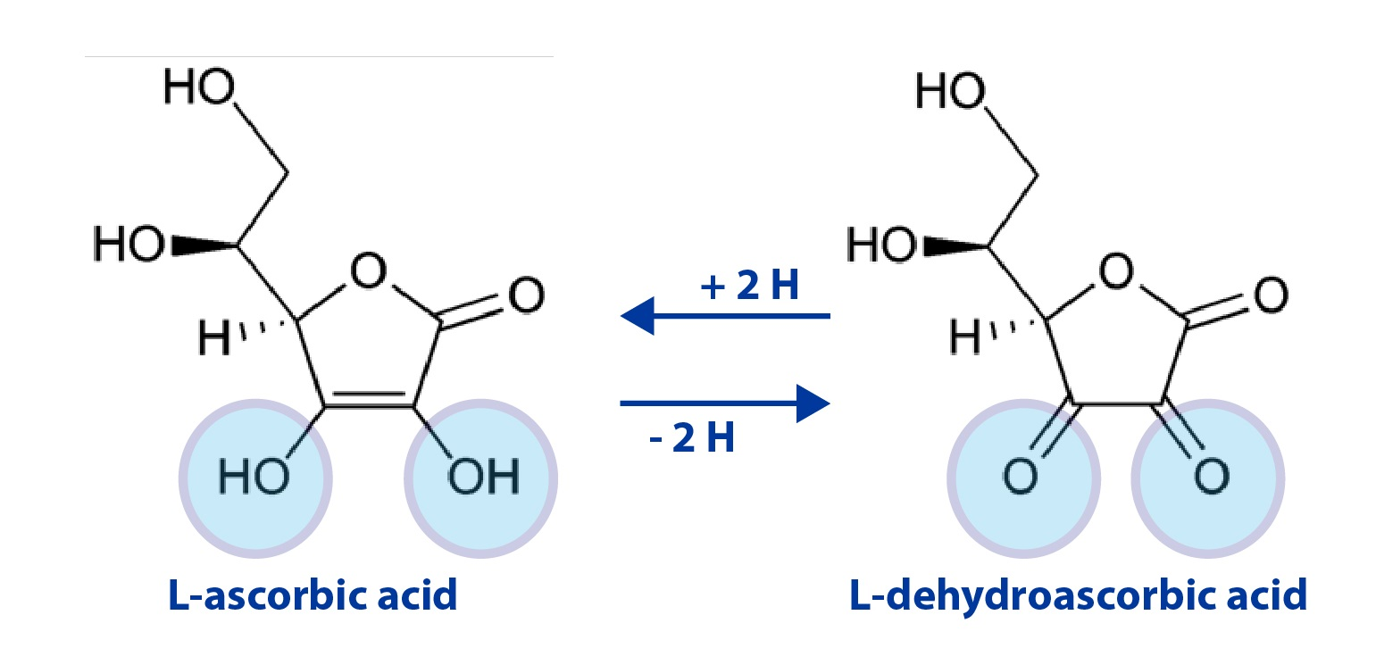

Slide 6
Source
It can be synthesized by glucuronic acid pathway in most animals.
It is not synthesized in Human, higher primates, bats as there is a block gulono lactone oxidase step. The gene for synthesis of this enzyme is absent.
Rich source are Amla ( Indian gooseberry-700 mg/100 gm), guava-300 mg/100 gm,
Citrous fruits-orange,lime,lemon
leafy vegetables- cabbage,cauliflower,germinating seeds,green peas,beans,potato,tomatos

Slide 7
RDA
Infants- 30mg/day
Adults- 75mg/day
Pregnancy-100 mg/day
lactation -150 mg/day.

Slide 8
Absorption
It is readily absorbed from small intestine , peritoneum and subcutaneous tissues .

Slide 9
Excretion
It is excreted in urine.
It is partly excreted unchanged and partly as oxalic acid.
Most of the oxalates in urine are derived from ascorbic acid , and the rest from glycine metabolism.
It is a strong reducing agent and hence the Benedict’s test will be positive.

Slide 10
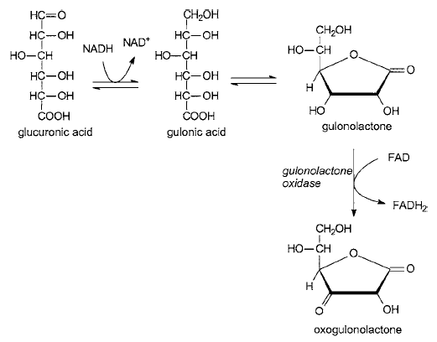
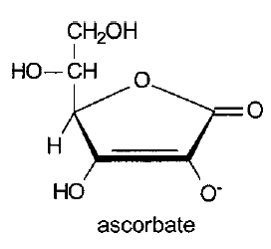
BIOSYNTHESIS

Slide 11
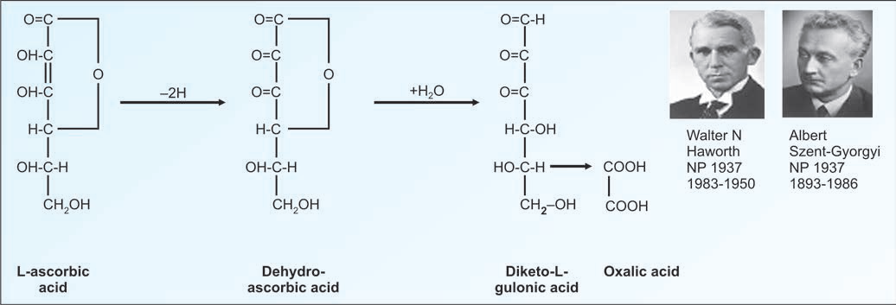
Catabolism

Slide 12
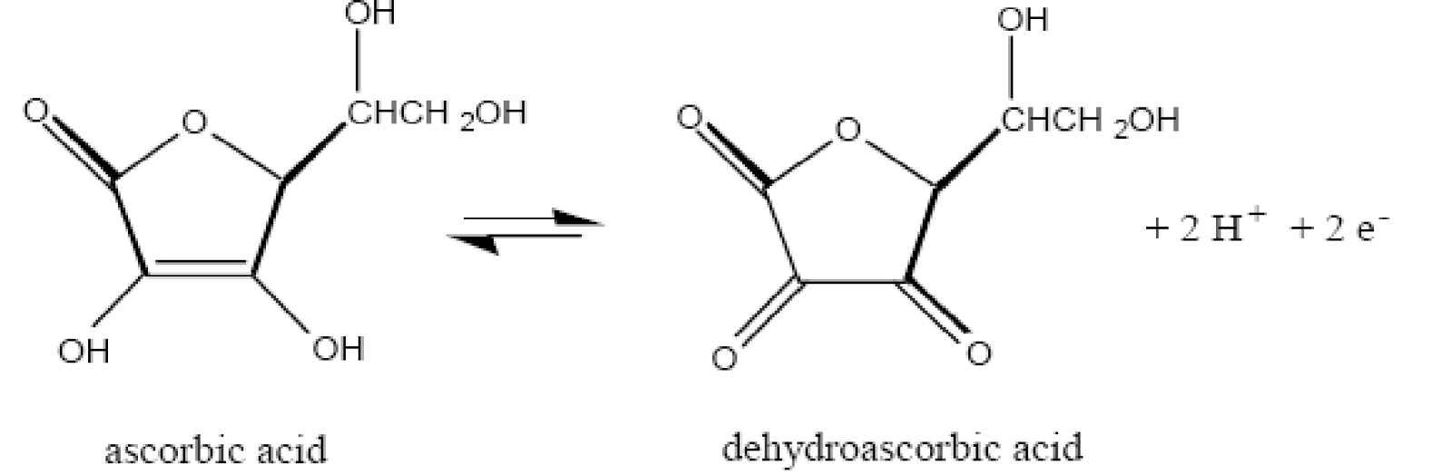
Biochemical function
Reversible oxidation – reduction: It can change between ascorbic acid and dehydro ascorbic acid. Most of the physiological function is due to this property.

Slide 13
2. Hydroxylation of proline and lysine
Ascorbic acid is necessary for the post-translational hydroxylation of proline and lysine residues
Hydroxyproline and hydroxylysine are essential for the formation of cross links in the collagen, which gives the tensile strength to the fibres.
This process is necessary for the normal production of supporting tissues such as osteoid, collagen and intercellular cement substance of capillaries.

Slide 14
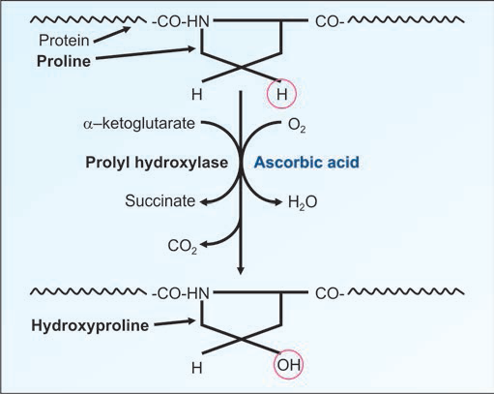

Slide 15
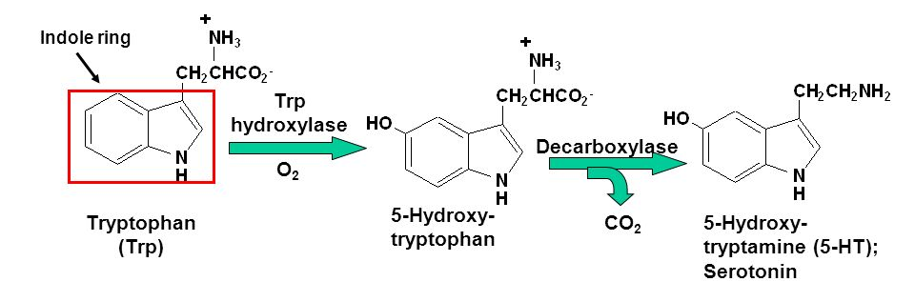
3. Tryptophan metabolism
Ascorbic acid is necessary for the hydroxylation of tryptophan to 5-hydroxy tryptophan. This is required for the formation of serotonin.

Slide 16
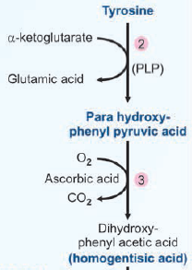
4. Tyrosine metabolism
Vitamin C helps in the oxidation of parahydroxy phenyl pyruvate to homogentisic acid.
Enzyme-p-OH phenyl pyruvate hydroxylase

Slide 17
5. Iron Metabolism
Enhances the absorption of iron from intestine.
Ascorbic acid reduces ferric iron to ferrous state, which is preferentially absorbed.

Slide 18
6. Hemoglobin metabolism
It is useful for reconversion of met hemoglobin ( ferric state ) to hemoglobin( ferrous state).
Met hemoglobin is unavailable for oxygen transport.

Slide 19
7. Folic acid metabolism
Ascorbic acid is helping the enzyme folate reductase to reduce folic acid to tetrahydrofolic acid. Thus it helps in the maturation of RBC.

Slide 20
8. Steroid synthesis
Large quantities of vitamin C is present in adrenal cortex. Vitamin C is depleted when gland is stimulated by ACTH. Hence plays a role in adrenal steroidogenesis.
Helps in the synthesis of bile acids from cholesterol.

Slide 21
9. Phagocytosis: It stimulates phagocytic action of leukocytes and helps in the formation of antibodies.
10. Cataract : It is concentrated in the lens of eye. Regular intake of vit C reduces the risk of cataract formation.

Slide 22
11. Anti-oxidant property
As an anti-oxidant, it may prevent or reduces risk for cancer formation.

Slide 23
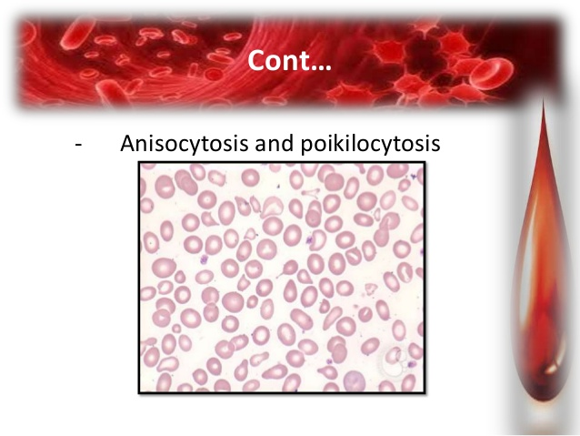
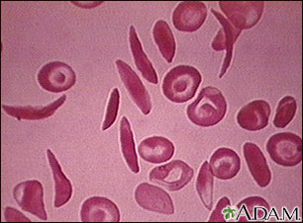
Deficiency manifestation
Anemia : It causes microcytic, Hypochromic anemia. Poikilocytosis-(Shape) and anisocytosis(Size) are also common.
Cause of Anemia:
Loss of blood by hemorrhage
decreased iron absorption
decreased tetrahydrofolic acid
accumulation of met hb

Slide 24
Bone
Deficiency results in the failure of the osteoblasts to form intercellular substance, osteoid.
Without the normal ground substance, the deposition of bone is arrested.
The resulting scorbutic bone is weak and fractures easily.
Painful swelling of joints may prevent locomotion of the patient.

Slide 25
Hemorrhagic tendency
Due to vitamin deficiency, collagen is abnormal and intercellular cement substance is brittle.
So capillaries are fragile, leading to tendency of bleeding by minor pressure.
Subcutaneous hemorrhage may be manifested as petechiae in mild cases( this is helpful for clinical test) and as ecchymoses or hematoma in severe cases.

Slide 26
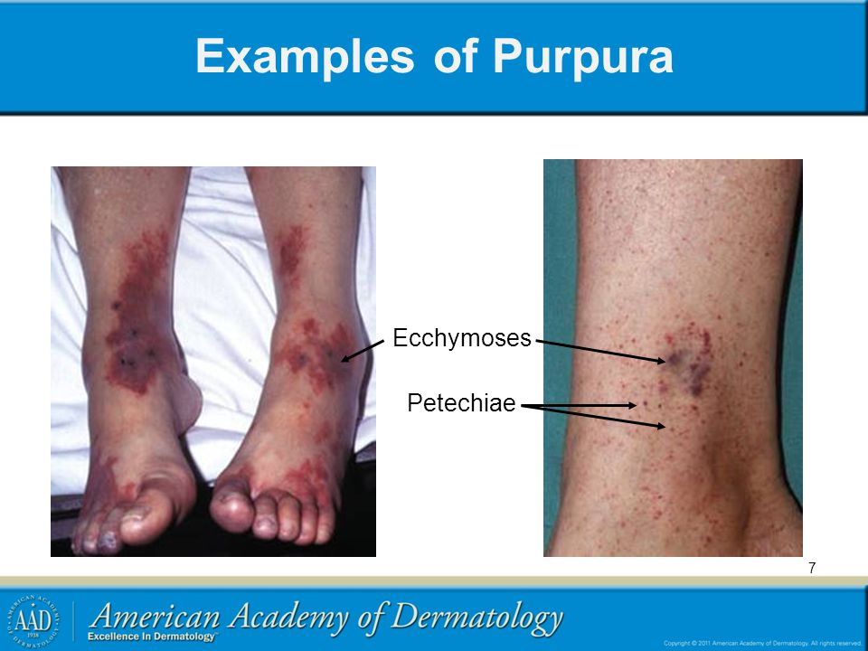

Slide 27
Internal hemorrhage
In severe cases , hemorrhage may occur in the conjunctiva and retina.
Internal bleeding may be seen as epistaxis, hematuria or malena.

Slide 28
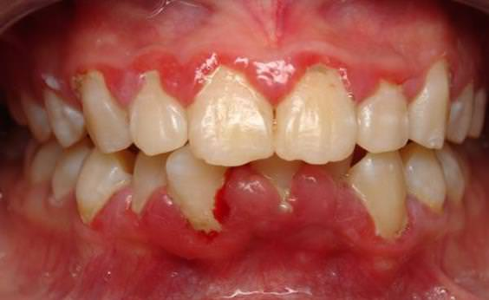
Scurvy: gross deficiency of vit C
Gums become swollen, spongy, painful.
The pulp is separated from the dentine and finally teeth are lost due to bacterial infection also.
Wound healing may be delayed.

Slide 29
Infantile scurvy
Infants between 6 to 12 months of age( period in which weaning from breast milk), the diet should be supplemented by vitamin C.
The infant cries when touched, especially when its legs or arms are moved or lifted.
Extreme tender swellings may be felt at the end of the long bones.

Slide 30
Therapeutic use
Vitamin supplementation is beneficial in preventing infections. It also has antioxidant property hence helpful in many diseases.
Healing of wounds, treatment of ulcer, trauma and burns.

Slide 31
Toxic effect
Rare, water soluble vitamin
> 2000 mg/day- long time cause Overload of iron because vitamin C helps in absorption of iron.

Slide 32
Case study
History: 52 year old man, heavy smokers, eating plenty of eggs ,meat & fried food , but no fruits and vegetables. He was feeble and listless with recurrent attack of cold and URI. He also told about his wounds taking long time to heal.
Examination: On examination he showed pallor, swelling of gums, bleeding under the nails. Several cutaneous bleeding spots on lower extremities, particularly on thighs.

Slide 33
Investigation : Hb 8.2 gm/dl( Normal range : 12-16 gm/ dl
Peripheral smear : Peripherial smear showed red cells were small size( microcytic) and abnormally pale ( hypochronic)
Radiological investigation : femur showed evidence of osteoporosis.

Slide 34
Q A) Suggest most probable diagnosis? What further investigation would you perform to confirm your diagnosis?
Q B) Out line the biochemical basis of the clinical feature of this patient?
QC)What is the effect of smoking habit of the patient on his condition?
QD) Would you recommend high dose of vit C for treatment of common cold & URI?

Slide 35
Q A) Suggest most probable diagnosis? What further investigation would you perform to confirm your diagnosis
vit C deficiency hence scurvy.
Investigations to be done :
1. Plasma Vit C (Normal Range: 23- 57 µmol/ l)
You will get level lower than the above range.

Slide 36
2. Determination of Vit C concentration in the Buffy layer ( Leucocytes & platelets)
*It is better indicator and is expressed as µg/ 10 leucocytes. ( Normal Range : 21 to 57 µg/ 10 leucocytes.
3. Vit C saturation Test: Exogenous vit C is administered. As tissues take up more of vit C, less is excreted in urine in case of vit C deficiency.

Slide 37
Q B) Out line the biochemical basis of the clinical feature of this patient?
Collagen synthesis is affected.
Hence rupture of the vessels.
Anemia due to blood loss.
Iron absorption affected hence hypochromic microcytic RBC.

Slide 38
QC)What is the effect of smoking habit of the patient on his condition?
Smoking increases the turn over of vit C and its catabolism . Hence Vit C requirement is increased.
Free radicals are generated due to smoking…for anti oxidant effect, vit C is required more.

Slide 39
QD) would you recommend high dose of vit C for treatment of common cold & URI?
Though the recommended high dose of vit C is 1 to 2 gm/day for common cold. There is lack of any biochemical evidence. On the other hand high dose of Vit C could lead to oxalate stone formation.
Body gets accustomed to high dose so when high dose is withdrawn Frank Scurvy develops.

Slide 40
MCQS
1. Deficiency of Vitamin C leads to
A) Xerophthalmia
B) Rickets
C) Beri beri
D) None

Slide 41
2. Human body can not form Vitamin C.
A) True
B) False

Slide 42
3. Biochemical role of vitamin C includes
a) Tyrosine metabolism
B) tryptophan metabolism
C) Iron metabolism
D) all

Slide 43
4. Vitamin C gives Benedict test Negative
A) True
B) False

Slide 44
5.) which form of vitamin C is active form?
A) D ascorbic acid and dehydroascorbic acid
B) L ascorbic acid and dehydroascorbic acid
C) Both
D) None

Slide 45


