Slide 1
VITAMIN E & K

Slide 2
Vitamins are organic compounds which are required for the proper utilization of the proximate principles of food like carbohydrates, lipids and proteins.

Slide 3
VITAMIN E
Tocopherol
Anti-infertility vitamin
The most potent biological antioxidant.

Slide 4
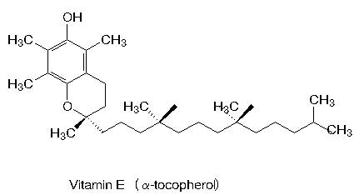
Chemical Nature
They have a chromane ring (tocol) system with an isoprenoid side chain
8 naturally occurring tocopherols named as alpha,beta,gamma.
Active form - α tocopherol - most widest distribution & greatest biological activity.

Slide 5
Sources of Vitamin E
Vegetable oils are rich sources of vitamin E.
e.g.wheat germ oil, sunflower oil, safflower oil, cotton seed oil, etc.
Fish liver oils are devoid of vitamin E.

Slide 6
Metabolism
Normal level 0.5-1 mg/dl
It is absorbed along with other fats and needs the help of bile salts.
Absorbed and transported as chylomicrons.
Stored in adipose tissue.
During catabolism, the chromane ring and side chain may be oxidized and excreted in bile after conjugation with glucuronic acid.

Slide 7
Biochemical Role
Vitamin E is the most powerful natural antioxidant.
Vitamin E is able to quench the lipid peroxidation chain and to protect the plasma membranes from the attack of free radicals.
Vitamin E protects the RBC from hemolysis. Prevents peroxidation thus keeping structural integrity of cells.

Slide 8
Reduces the oxidation of LDL thus reduces the risk of atherosclerosis.
Vitamin E acts as an antimutagen & slows the progression in Alzheimer’s disease.
boosts immune response.
Vitamin E can depress leukocyte oxidative bactericidal activity.
Notes:
Alzheimer’s disease – brain cell degeneration and memory loss

Slide 9
Inter-relationship with Selenium
Selenium is present in glutathione peroxidase; an important enzyme that oxidizes and destroys the free radicals.
Selenium has been found to decrease the requirement of vitamin E and vice versa.
They act synergistically to minimize lipid peroxidation.

Slide 10
Deficiency Manifestations
In rats, inability to produce healthy ovum and loss of motility of spermatozoa, hemolysis of red cells, acute hepatic necrosis and muscular dystrophy are observed.
Human deficiency has not been reported. The body vitamin E stores can meet the requirement for several months.
But in volunteers, vitamin E deficiency has been shown to produce increased fragility of RBCs, muscular weakness.

Slide 11
Vit E deficiency is not uncommon in the premature infants but rarely seen in full term infants ( in spite of poor placental transport) because the breast milk is a good source.

Slide 12
Recommended Daily Allowance
Males 10 mg/day
Females 8 mg/day
Pregnancy 10 mg/day
Lactation 12 mg/day.
Pharmacological dose is 200-400 IU / day.
Hypervitaminosis E
At doses above 1000 IU per day, it may cause tendency to hemorrhage, as it is a mild anticoagulant.

Slide 13
VITAMIN K

Slide 14
VITAMIN K
The letter K is the abbreviation of the German word “koagulation vitamin”
STRUCTURE:
They are naphthoquinone derivatives, with a long isoprenoid side chain.
Vitamin K₁ (20 C chain)or phylloquinone- derived from plant
Vitamin K₂ (30 C chain)or menaquinones produced by micro-organisms
Vitamin K₃ or menadione is a synthetic product, which is alkylated form of vitamin K₂.

Slide 15
Sources of Vitamin K
Green leafy vegetables are good dietary sources.
Even if the diet does not contain the vitamin, intestinal bacterial synthesis will meet the daily requirements.

Slide 16
Absorption and Storage
Absorption of vitamin K occurs in the intestine along with chylomicrons. Bile salts are required.
It is stored in the liver and transported in plasma along with beta lipoproteins.

Slide 17
Biochemical Role
Vitamin K is necessary for coagulation.
Factors dependent on vitamin K are Factor II; Factor VII; Factor IX; Factor X.
All these factors are synthesized by the liver as inactive zymogens. They undergo post-translational modification - gamma carboxylation of glutamic acid residues which requires vitamin K as a co-factor.

Slide 18
Vitamin K dependent gamma carboxylation is necessary for the functional activity of osteocalcin.
Osteocalcin is synthesized by osteoblasts and seen only in bone. It is a small protein (40-50 amino acids length) that binds tightly to hydroxy apatite crystals of bone. This binding is dependent on the degree of gamma carboxylation. Osteocalcin also contains hydroxyproline, so it is dependent on both vitamins K and C.

Slide 19
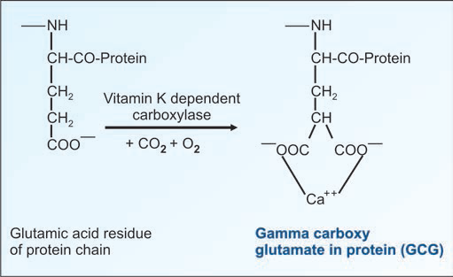
Vitamin K Dependent Carboxylase
It is microsomal enzyme. It requires oxygen, CO2, NADPH and reduced vitamin K.
This process is competitively inhibited by warfarin and dicoumarol.

Slide 20
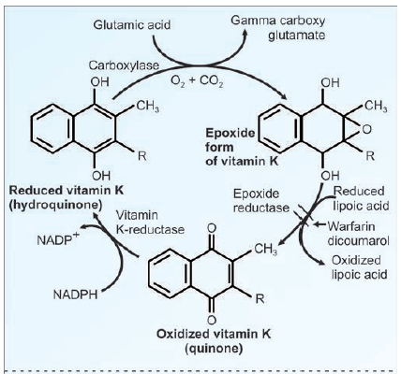
Vitamin K cycle. Dicoumarol, a structural analogue inhibits vitamin K epoxide reductase.

Slide 21
Warfarin and dicoumarol will competitively inhibit the gamma carboxylation system due to structural similarity with vitamin K. Hence they are widely used as anticoagulants for therapeutic purposes.
Treatment of pregnant women with warfarin can lead to fetal bone abnormalities (fetal warfarin syndrome).

Slide 22
Causes for Deficiency of Vitamin K
In normal adults the intestinal bacterial synthesis is sufficient to meet the needs of the body.
Deficiency can occur in conditions of malabsorption of lipids.
This can result from obstructive jaundice, chronic pancreatitis, sprue, etc.
Prolonged antibiotic therapy and gastrointestinal infections with diarrhoea will destroy the bacterial flora and can also lead to vitamin K deficiency.

Slide 23
Clinical Manifestations of Deficiency
Hemorrhagic disease of the newborn is attributed to vitamin K deficiency.
The newborns, especially the premature infants have relative vitamin K deficiency. This is due to lack of hepatic stores, limited oral intake and absence of intestinal bacterial flora.
It is often advised that pre-term infants be given prophylactic doses of vitamin K (1 mg Menadione).

Slide 24
In children and adults, Vitamin K deficiency may be manifested as bruising tendency, ecchymotic patches, mucous membrane hemorrhage, post-traumatic bleeding and internal bleeding.

Slide 25
Prolongation of prothrombin time and delayed clotting time are characteristic of vitamin K deficiency.
Measurement of prothrombin time (PT) is taken as an index of liver function. When liver function is considerably lowered, prolongation of PT occurs due to deficient synthesis of the coagulation factors. In such cases, administration of vitamin fails to restore PT to normal levels.
Notes:
PT : How long it takes blood to clot. – measures extrinsic and common pathway.
CT: Time required by blood to coagulate in vitro. CT involves PT and aPTT

Slide 26
Daily Requirement
Recommended daily allowance is 50-100 mg/day.

Slide 27
Hypervitaminosis K
Hemolysis, hyperbilirubinemia, kernicterus and brain damage are the manifestations of toxicity.

Slide 28
MCQS

Slide 29
1. Which mineral has a sparing effect on Vitamin E levels?
A) Calcium
B)Selenium
C) Magnesium
D) Iron

Slide 30
2. Vitamin K dependent clotting factor is
A) factor 4
B) factor 5
C) factor 7
D) factor 8

Slide 31
3. Hemorrhagic disease of the newborn occurs due to deficiency of
A) vitamin C
B) vitamin A
C) vitamin E
D) vitamin K

Slide 32
4. Malabsorption of lipids leads to deficiency of
A) vitamin E
B) vitamin K
C) vitamin A
D) All of the above

Slide 33
5. Vitamin K dependent epoxide reductase is competitively inhibited by
A) Dicoumarol
B) warfarin
C) Both
D) None

