Slide 1
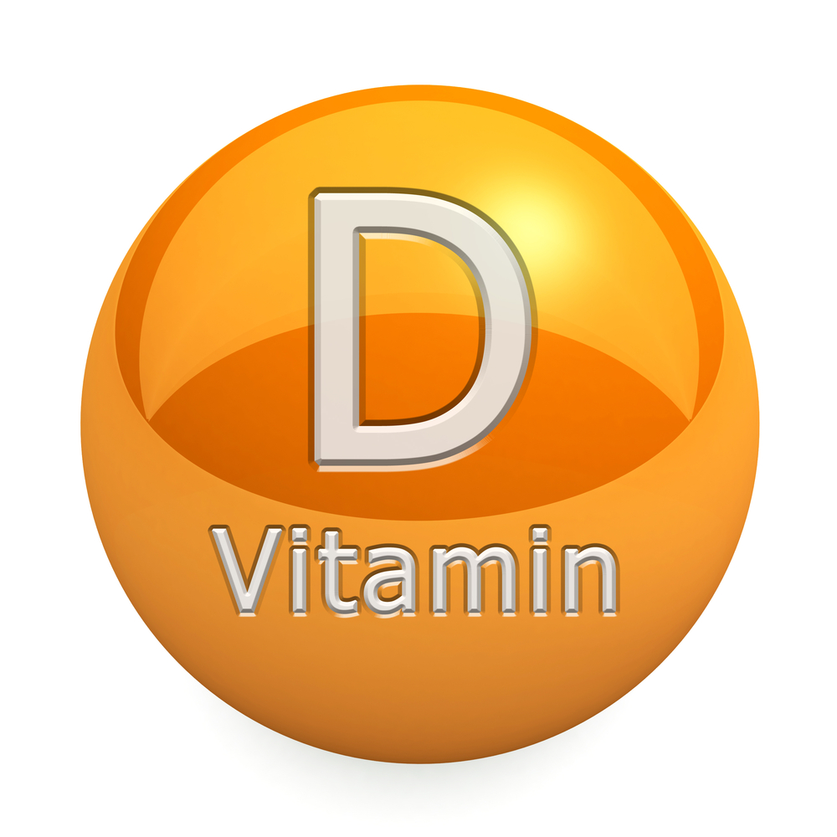

Slide 2
VITAMIN D
It is a fat soluble vitamin
Synthesized by the body after exposure to UV rays or obtained from food sources
It is biologically inactive
Vitamin – D is a sterol, it contains steroid nucleus (Cyclopentanoperhydrophenanthrene ring)
Vitamin – D function like a hormone

Slide 3
Forms of vitamin D:
Vitamin D in the diet occurs in two forms
Vitamin D₂ ergocalciferol
Vitamin D₃ cholecalciferol
Both ergo-calciferol and chole-calciferol are metabolized in liver

Slide 4



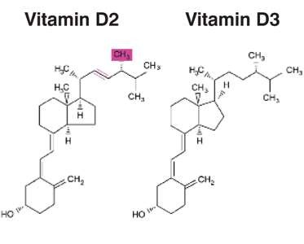
Ergocalciferol (vitamin D2) is formed from ergosterol and is present in plants
CH3

Slide 5
Cholecalciferol (vitamin D3) is found in animals
Both the sterols are similar in structure except that ergocalciferol has an additional methyl group and a double bond
Ergocalciferol and Cholecalciferol are sources for vitamin D activity and are referred as provitamins

Slide 6
SOURCES OF VITAMIN D
  Vitamin D from the Sun
  Vitamin D in Foods
    Fortified milk, butter and cheese, chocolate
    Cereals
    Beef, egg yolks, liver, fish and their oils

Slide 7
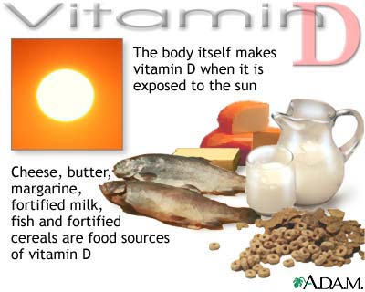

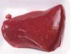
Daily requirement: 12-25 micrograms

Slide 8



During the course of cholesterol biosynthesis 7- dehydrocholesterol is formed as an intermediate
On exposure to sunlight, 7-dehydrocholesterol is converted to cholecalciferol in the skin (dermis and epidermis)
Dark skin pigment (melanin) adversely influences the synthesis of cholecalciferol

Slide 9
Skin is the largest organ in the body
The production of vitamin D in the skin is directly proportional to the exposure to sunlight and inversely proportional to the pigmentation of skin
Excessive exposure to sunlight does not result in vitamin D toxicity since excess provitamin D3 are destroyed by sunlight itself

Slide 10
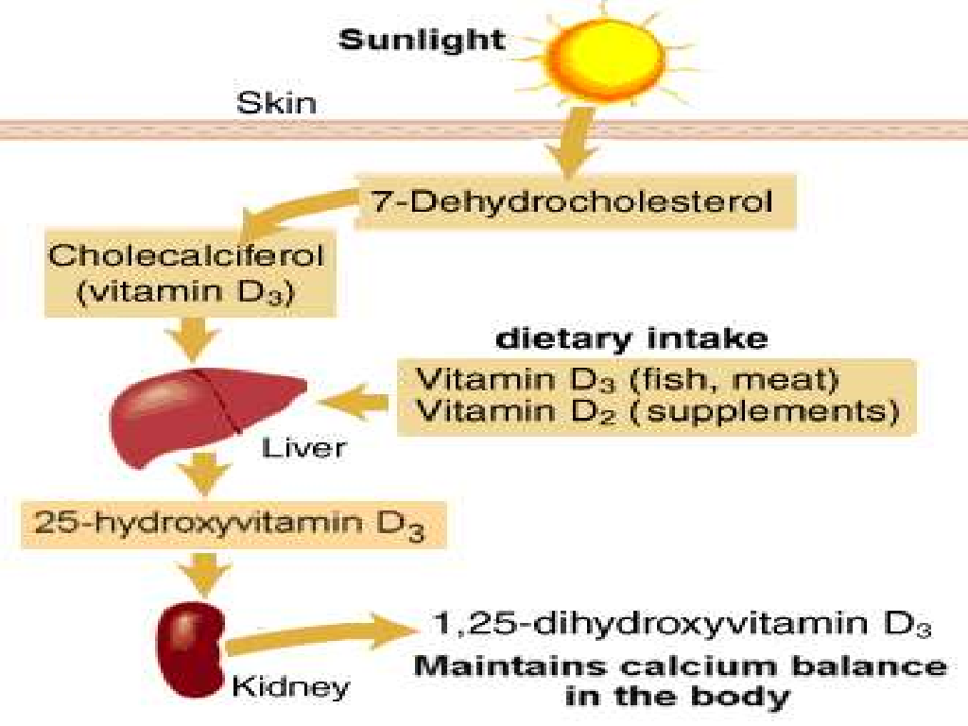

Slide 11
METABOLISM OF VITAMIN D
formation of 1,25-dioh-d₃: vitamins d₂ and d₃ are converted in vivo to the active form of the vitamin d by two sequential hydroxylation reactions.
in liver: the first hydroxylation occurs at the 25-position, and is catalyzed by a specific hydroxylase in the liver. the product of the reaction, 25-hydroxycholecalciferol (25-oh- d₃) or calcidiol, is the predominant form of vitamin d in the plasma and is the major storage form of the vitamin

Slide 12
METABOLISM OF VITAMIN D
In KIDNEY: 25-OH-D₃ is further hydroxylated at the 1st position by a specific 1-α hydroxylase found primarily in the kidney, resulting in the formation of 1,25-diOH-D₃, also called as CALCITRIOL.
Vitamin D is a non-essential nutrient that acts like a hormone in the body.
It is the ACTIVE FORM of vitamin and ACT AS A HORMONE.

Slide 13
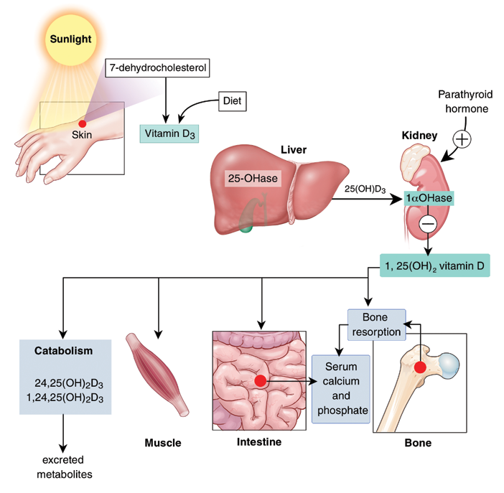
Metabolism Of Vitamin D

Slide 14
REGULATION
Calcitriol is the most potent form of vitamin D.
Its formation is tightly regulated by the level of plasma phosphate and calcium ions.
1-α Hydroxylase activity is increased directly by hypophosphatemia or indirectly hypocalcemia, which triggers the release of parathyroid hormone (PTH).
1-α Hydroxylase activity is also decreased by excess Calcitriol, the product of the reaction.

Slide 15
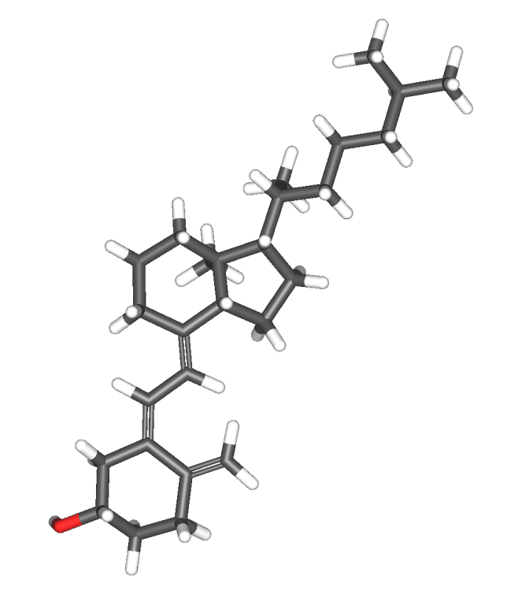
Vit D def.
PTH
PTH mobilizes calcium & phosphorous from bones.
RICKETS
Pliable bones bend especially in weight bearing areas.
Bones lose their mineral content
As a result, bones become soft,poorly mineralized and pliable
Decrease of plasma calcium concentration.
Decrease intestinal absorption & renal tubular reabsorption
Bone deformities : Bow legs,Knock-knee,Harrison’s sulcus,Rickety rosary,Bossing of frontal bones & Pigeon chest

Slide 16
Absorption, Distribution, Metabolism and Excretion
Absorption
  Vitamin D is absorbed from the small intestine as bile salt
Distribution
  Stored in adipose tissue and liver
Metabolism
    Transported to the liver, then kidneys, where it is activated
  Excretion
  Excreted in bile
  Metabolized to water soluble metabolites and then excreted in urine as well

Slide 17
FUNCTIONS OF VITAMIN D
Roles in the Body
  Vitamin D in Bone Growth
    Helps to maintain blood levels of calcium and phosphorus
    Works in combination with other nutrients and hormones
      Vitamin A, vitamin C, vitamin K
      Parathyroid hormone and calcitonin
      Collagen
      Calcium, phosphorus and few others

Slide 18
FUNCTIONS OF VITAMIN D
Roles in the Body
  Vitamin D in Other Roles
    Immune system
    Brain and nervous system
    Pancreas, skin, muscles, cartilage and reproductive organs

Slide 19
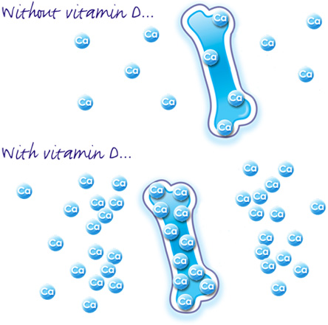
FUNCTIONS OF VITAMIN D
Regulates the Ca and P levels in the blood
Promotes absorption of Ca and P in the intestine
Promotes reabsorption of Ca in the kidneys
High levels of serum Ca and P increase the rate of bone mineralization

Slide 20

prevents tumor genesis
Inhibits proliferation
Inhibits angiogenesis
  Vitamin D is not currently recommended for reducing cancer risk

Slide 21
Activates reabsorption of amino acids, especially proline
Activates the monosaccharides phosphorylation (glycogen synthesis)
Promotes ATP formation

Slide 22
VITAMIN D DEFICIENCY
  Factors that contribute to deficiency
    Dark skin
    Breastfeeding without supplementation
    Lack of sunlight
    Use of nonfortified milk

Slide 23
VITAMIN D DEFICIENCY
  Rickets
    Affects mainly children worldwide
    Deficiency symptoms
      Inadequate calcification of bones
      Growth retardation
      Misshapen bones including bowing of the legs
      Enlargement of the ends of long bones
      Deformities of ribs, rachitic rosary of rickets

Slide 24
VITAMIN D DEFICINECY
  The Elderly Deficiency is :
  Due to inadequate production and activation of vitamin D, a decreased consumption of milk, and having little time in the sun.
  There is an increased risk for bone loss and fractures.

Slide 25
VITAMIN D DEFICIENCY
  Osteomalacia
    Affects adults
    Soft, flexible, brittle and deformed bones
    Progressive weakness
    Pain in pelvis, lower back and legs
  Osteoporosis
    Loss of calcium from the bones due to inadequate synthesis of vitamin D
    Results in a reduced bone density

Slide 26
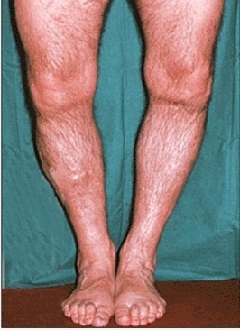
VITAMIN D DEFICIENCY IN ELDERLY

Slide 27
HYPERVITAMINOSIS/ TOXICITY
  Vitamin D from sunlight and food is not likely to cause toxicity.
  High-dose supplements may cause toxicity.
  Toxicity symptoms
    Elevated blood calcium and phosphorus
    Calcification of soft tissues (blood vessels, kidneys, heart, lungs and tissues around joints)
    Demineralization of bones
    Renal stones
    Frequent urination

Slide 28


Slide 29


