Slide 1
XENOBIOTICS
(Metabolism of foreign compounds)
BIOTRANSFORMATION
(Chemical alteration)
DETOXIFICATION

Slide 2
Biotransformation
Detoxification (Toxic into non toxic or less toxic (excretable form)
Entoxication
conversion into more toxic one
(Methanol into formic acid)
Chemical –I Chemical –II
(Toxic compounds) (Non-Toxic, Less toxic)

Slide 3
xenobiotics
Series of biochemical reaction occurring in our body to convert the foreign or toxic compound to non toxic compound or more easily excretable form
Substances that enter the body are changed from hydrophobic to hydrophilic molecules to facilitates elimination.
Xenobiotics can produce a variety of biological effects, including pharmacologic responses, toxicity, immunologic reactions, and cancer.

Slide 4
Sources of Xenobiotics
Compounds accidentally ingested: preservatives, food additives, Adulterants, Pollutants and insecticides.
Drugs
Compounds produced in the body: bilirubin, Bile acids and steroids
Compounds produced by bacterial metabolism: (Histamine, Putrescine, Cadaverine, Tyramine, Tryptamine)

Slide 5
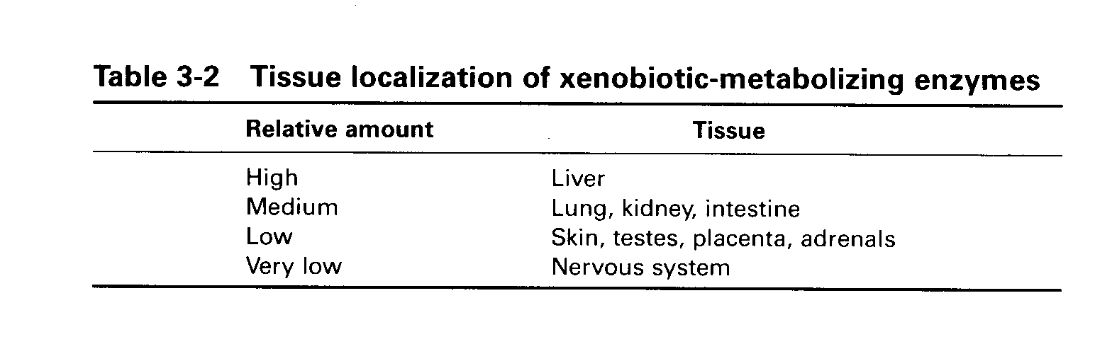
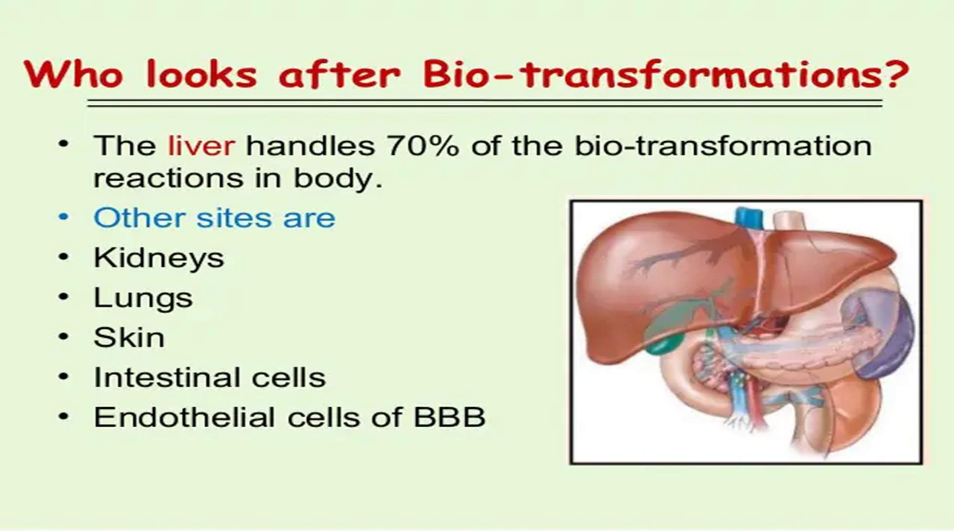
Who looks after Biotransformation?
70% of the biotransformation reaction handles by liver
(Equipped with enzymatic Machinery )

Slide 6
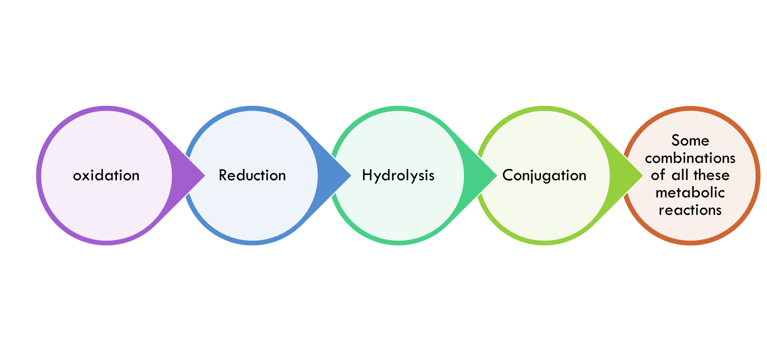
MECHANISM OF biotransformation OF XENOBIOTICS
The pathway for hepatic detoxication include either:

Slide 7
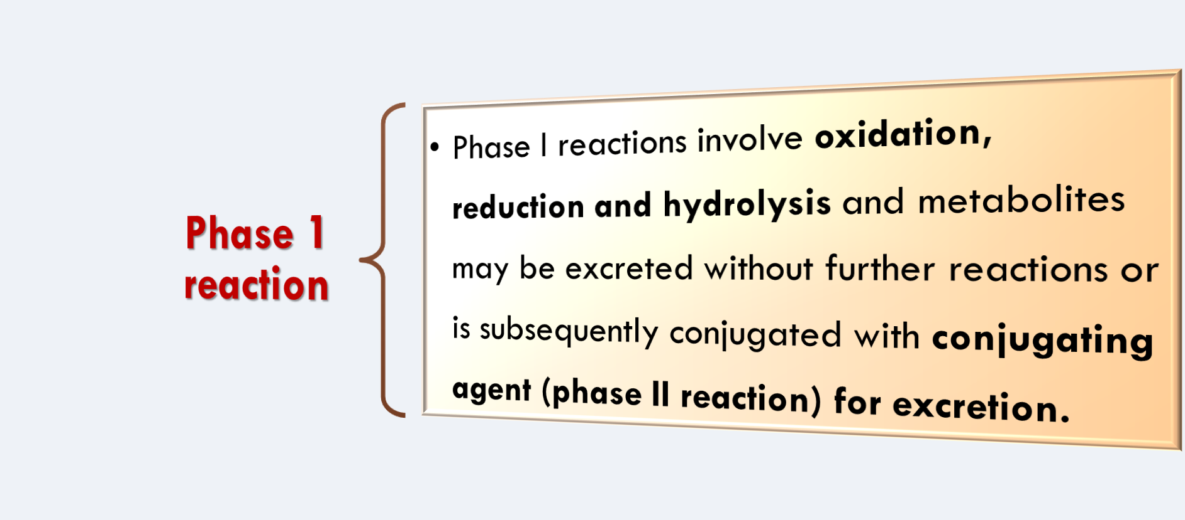
Phase I reactions (group added)

Slide 8
OXIDATION
Most common reaction in the biochemical disposal of foreign substances
A large number of foreign substances which include aldehydes, amines, aromatic hydrocarbons, alcohols and certain drugs are destroyed in the body by oxidation.

Slide 9
Reaction of Phase-1 oxidation include:
Hydroxylation (Main reaction)
Oxidation of aldehyde and alcohol to acids
Oxidation aromatic hydrocarbons to phenol
Oxidative deamination of amines to acids
Oxidative dealkylation of hydrocarbons to acids

Slide 10
PHASE I REACTIONS
Methanol Formic Acid
Ethanol Acetic Acid
Benzoyl Alcohol Benzoic Acid
Benzaldehyde Benzoic Acid
Aliphatic amines Aliphatic acids +Urea
Benzine Phenol
Sulphur Sulphuric acid
Meprobamate Hydroxy meprobamate

Slide 11
Cytochrome P-450
Mixed function oxidase
Monooxygenase (one molecule of oxygen is incorporated into substrate and another reduced to form a water)
NADPH (as a coenzyme)
Phosphatidyl choline (for its action)
20-200 forms
Located in microsomes of liver
Name 450 given because it has maximum absorbance at 450 nm when exposed to CO

Slide 12
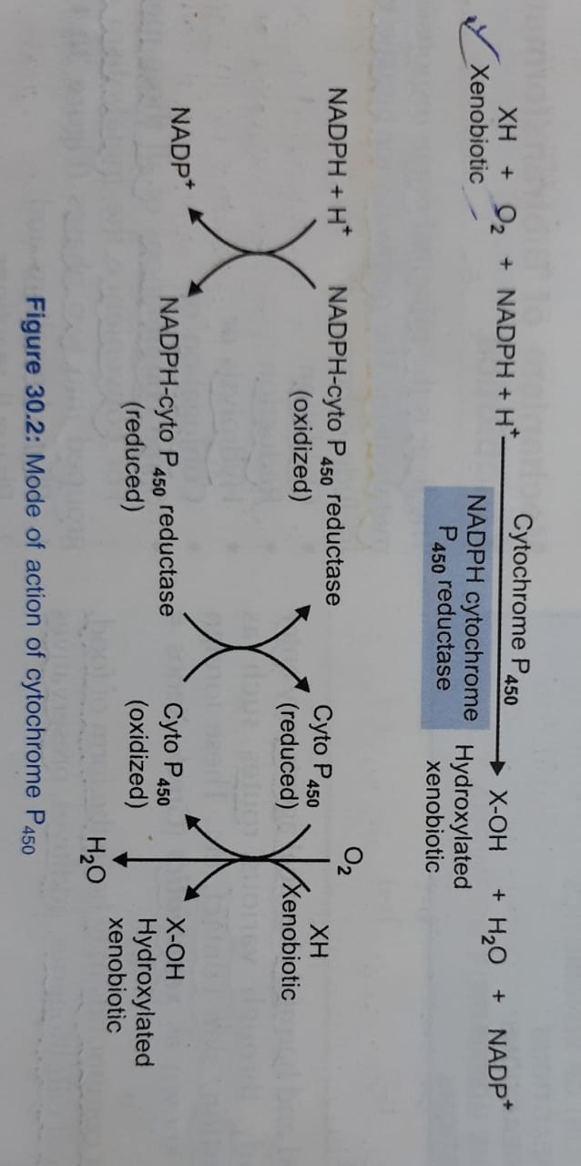
Cytochrome P450- key enzymes of Biotransformation Reactions

Slide 13
Hydroxylation reaction involved in oxidative metabolism of foreign compounds, catalyzed by monoxygenase or cytochorme P450 (Mixed function oxidase)
Microsomal cytochrome P450 enzymes hydroxylate many xenobiotics such as drugs, carcinogens and environmental agents (pollutants).
Drugs that are ingested in humans are metabolized by microsomal cytochrome P450 enzyme.

Slide 14
REDUCTION
Reduction is less common than oxidation.
The major group of compounds which are reduced and detoxified by the liver are azo compounds and nitro compounds. (PNC)
Picric acid Picramic Acid
Nitrophenol Aminophenol
Chloral Trichloro ethanol

Slide 15
With addition of water, toxicants are splitted into two fragments or smaller molecules.
Targets are esters, amines, hydrazines, amides, glycosidic bonds and carbamates.
Aspirin Salicylate + Acidic acid
Atropine tropine + tropic acid
Di isopropyl fluorophosphate (DFP-Nerve gas)
Hydrolysis

Slide 16
Phase II reactions
In phase II, the hydroxylated or other compounds produced in phase I are converted by specific enzymes to various polar (water soluble) metabolites by conjugation reactions.
Conjugation means chemical combination of one compound with some other.
The effect of conjugation is to make the compound more polar (water soluble) and therefore, more easily excreted in the urine or bile.

Slide 17
Phase II reactions
Glycoside conjugation – Glucuronidation
Glycine
Glutathione (GSH)
Glutamine
Sulfate – sulfation
Acylation
  Acetylation
  Amino acid conjugation
  Deacetylation
Methylation
4 G
S
A
M

Slide 18
Conjugating agents
Agents Active forms
Glucuronic acid UDP-glucuronic acid
Sulfate PAPS (3’- phospho
adenosine 5’-
phospho sulfate)
Cysteine Glutathione
Acetic acid Acetyl CoA
Methyl S- Adenosyl Methionine
Glycine
Glutamine

Slide 19
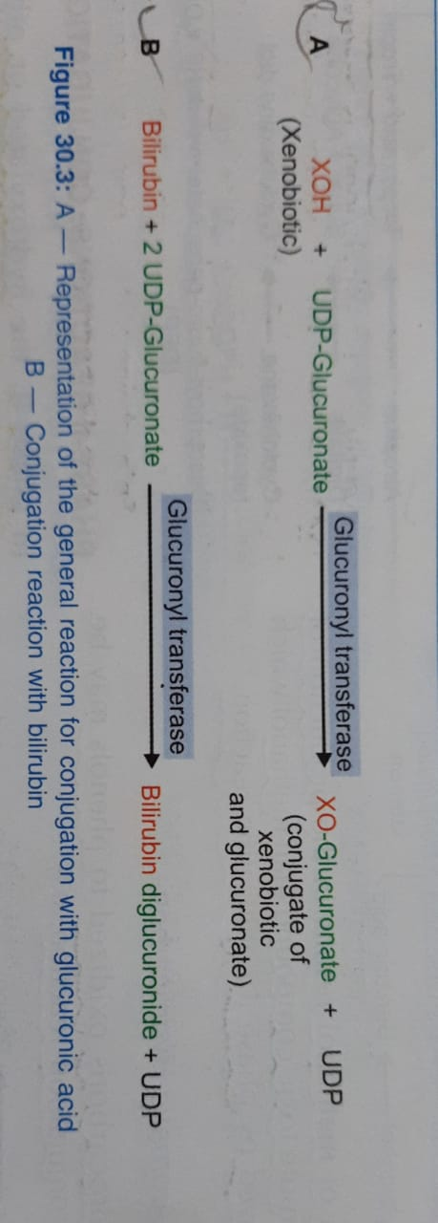
Conjugation with Glucuronic acid:
Glucuronic acid (Bilirubin, Steroids Phenol)
UDP-glucuronic acid

Slide 20
Conjugation with glycine:
Benzoic acid conjugated with glycine to form hippuric acid.
Bile acids also conjugate with glycine/ taurine.
Glycine + Benzoic acid Hippuric acid
Cholic acid Glycocholic acid

Slide 21
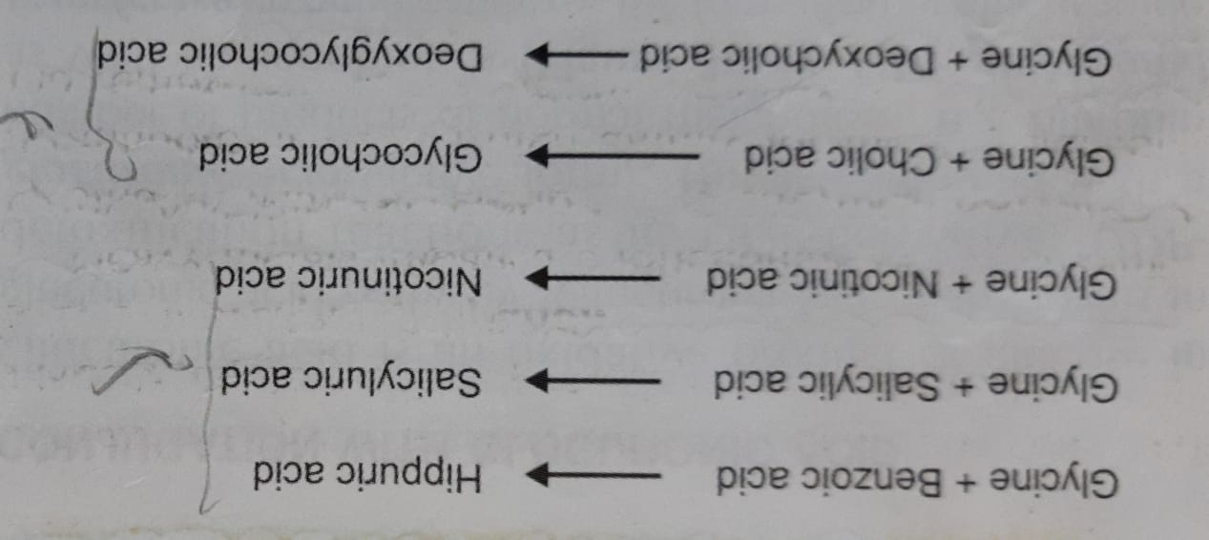
Conjugation with Glycine:

Slide 22
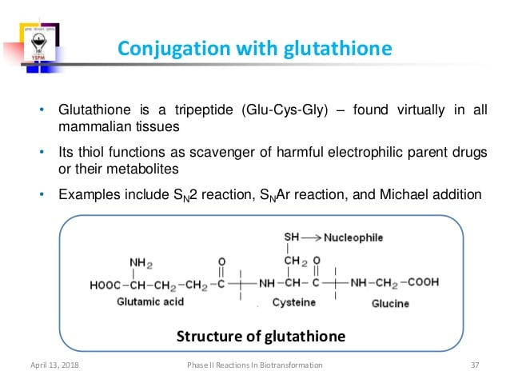
Conjugation with Glutathione:
R-X + Glutathione GS-R + X-H

Slide 23
R-X + Glutathione GS-R + X-H
GS-R + Acceptor cysteinyl glycine-R
+ γ-glutamine acceptor
cysteinyl glycine-R R-cysteine + Glycine
R-cysteine Mercapturic acid +
+ Acetyl CoA CoA
GSH
transferase
GGT
Peptidase
N- acetyl transferase

Slide 24
Conjugation with Glutamine:
Glutamine + Phenylacetate Phenylacetyl
+
glutamate

Slide 25
Conjugation with Sulfate:
Active Sulphate doner:
Phospho adenosine phospho sulphate (PAPS)
Benzine Phenol + Sulphate
Phenyl Sulphate

Slide 26
Acetylation:
Conjugation with acetic acid is taking place with drugs like sulfanilamide, isoniazid and PAS (para amino salicylic acid)
N- acetyl transferases (NAT)
Target: Aromatic amines, sulfonamides
Conjugating moiety: Acetyl group
Co-factor: Acetyl-CoA

Slide 27
Conjugation with Methylation:
Co-factor: S- adenosyl methionine (SAM) – active donor
Methyltransferases
Target: Hydroxyl groups, amines, thiols
Substrates mainly endogenous: Catechols, noradrenalin, histamine
Epinephrin Metanephrine

Slide 28
Conjugation with other amino acids:
Amino acid transferases
Targets: carboxylic acids
Conjugating moieties: glutamine, alanine, taurine, histidine, ornithine
Co-factor: Acetyl CoA (CoASH) and ATP
In cytosol
Phenyl acetic acid is conjugated with glutamine to form phenyl acetyl glutamine.

Slide 29
Phase III reactions
Phase III occurs post phase II, where substances undergo further metabolism and excretion.
ATP binding Cassette
Solute carrier (SLC) transporter (play a role in epithelial permeability and barrier function in the intestine)

Slide 30
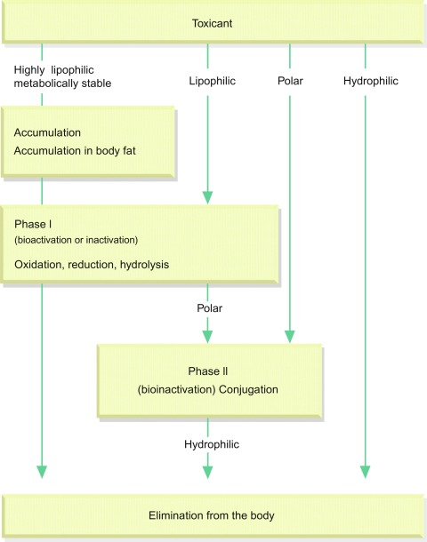
Fate OF XENOBIOTICS

Slide 31
Metabolism of xenobiotics can lead to
lowering their toxicity
increasing their toxicity
their bioactivation
increasing their water solubility
THE GOAL:
inactivation
↑ water solubility
excretion from the body
YES
YES
YES
YES

Slide 32


