Slide 1
Glandular epithelium
Dr. Hetal Vaishnani
Professor
Dept. of Anatomy
SBKSMI & RC

Slide 2
AN70.1 - Exocrine gland, serous, mucous and mixed acini

Slide 3
Specific learning objectives
Identify microscopic structure of exocrine gland and ducts in prepared slide of salivary gland (with H & E stain) under compound light microscope correctly.
Distinguish between serous and mucous acini in prepared slide of salivary gland (with H & E stain) under compound light microscope correctly.
Describe microscopic structure of exocrine gland with diagram and examples

Slide 4
Introduction
A gland is an organ that consist of specialized secretory cells

Slide 5
General features
Glands can be present as discrete organs or in the layers of viscera
It is epithelial in origin
The material secreted by the gland is usually a liquid
Rate of secretion is modulated by nervous and hormonal influences
Star shaped contractile(myoepithelial cells) cells that lies between the secretory cells and the basement membrane

Slide 6
Classification of glands
Based on the number of cells
Unicellular
Multicellular

Slide 7
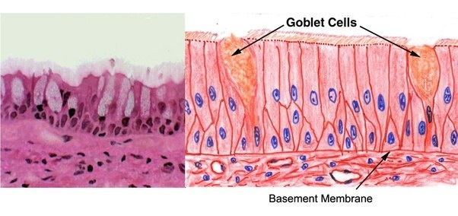
A. Based on the number of cells
Unicellular gland- composed of a single cells
e.g. goblet cells in the respiratory and intestinal tract

Slide 8
A. Based on the number of cells
2. Multicellular gland- composed of many cells
e.g. all glands other than goblet cells
Multicellular glands can be classified as follows:

Slide 9
B. Based on the site of secretion
Exocrine gland – secrets its product onto a surface through ducts
e.g.- salivary duct

Slide 10
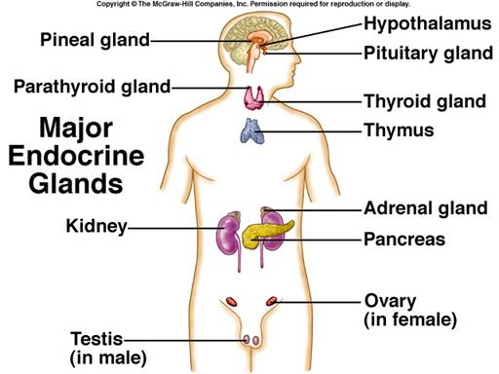
B. Based on the site of secretion
2. Endocrine gland – secrets its product into the bloodsteam
e.g.- thyroid glands

Slide 11
B. Based on the site of secretion
3. Paracrine gland – secrets its product into the local extracellular space affecting the surrounding cells
e.g.- enteroendocrine cells of GIT

Slide 12
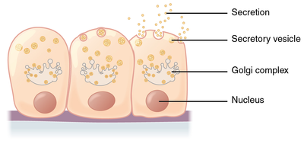
C. Based on the mode of secretion
1. Merocrine - Only cell products are discharged by exocytosis
e.g.- sweat gland, salivary gland, pancreas

Slide 13
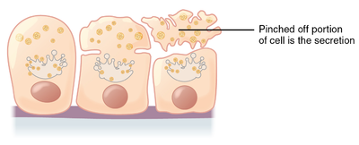
C. Based on the mode of secretion
2. Apocrine - Products accumulate at the apical part of the cell the discharges its apical cytoplasm
e.g.- cells of mammary gland, axilla, ear canal, eye lid, parts of the external genitalia

Slide 14
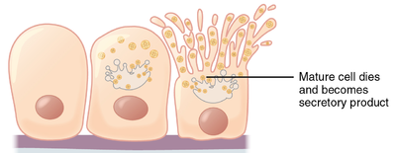
C. Based on the mode of secretion
3. Holocrine - whole cell dies, the discharges go together with the cellular contents
e.g.- sebaceous and tarsal gland cells.

Slide 15
C. Based on the mode of secretion
4. Cytogenous. A product is a complete living cell.
e.g.- gonads (testes and ovaries)

Slide 16
D. Based on the number of ducts and shape of secretory end piece
.
EXOCRINE GLANDS
SIMPLE
COMPOUND
TUBULAR
SACCULAR
Or
ALVEOLAR
BRANCHED
UNBRANCHED
TUBULAR
SACCULAR
Or
ALVEOLAR
TUBULO-ALVEORAL
TUBULAR COILED
TUBULAR BRANCHED
TUBULAR STRAIGHT

Slide 17
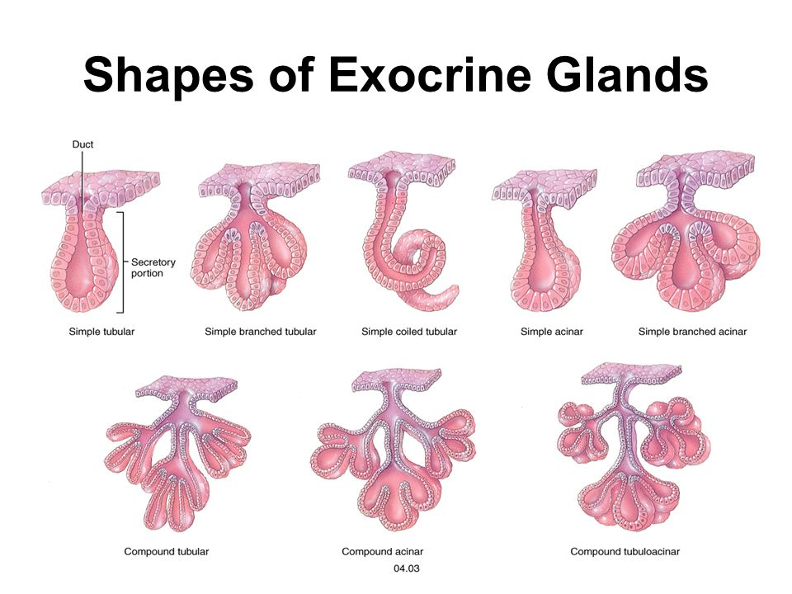
D. Based on the number of ducts and shape of secretory end piece
Simple tubular straight:
e.g.- crypt of Lieberkuhn

Slide 18
D. Based on the number of ducts and shape of secretory end piece
2. Simple coiled tubular :
e.g.- sweat gland

Slide 19
D. Based on the number of ducts and shape of secretory end piece
3. Simple branched tubular :
e.g.- fundic gland of stomach

Slide 20
D. Based on the number of ducts and shape of secretory end piece
4. Simple alveolar :
e.g.- mucous gland of urethra

Slide 21
D. Based on the number of ducts and shape of secretory end piece
5. Simple branched alveolar :
e.g.- sebaceous gland and tarsal gland

Slide 22
D. Based on the number of ducts and shape of secretory end piece
6. Compound tubular :
e.g.-Brunner’s gland of duodenum

Slide 23
D. Based on the number of ducts and shape of secretory end piece
7. Compound alveolar (acinar) :
e.g.- mammary gland

Slide 24
D. Based on the number of ducts and shape of secretory end piece
8. Compound tubulo-alveolar:
e.g.- sub-mandibular gland

Slide 25
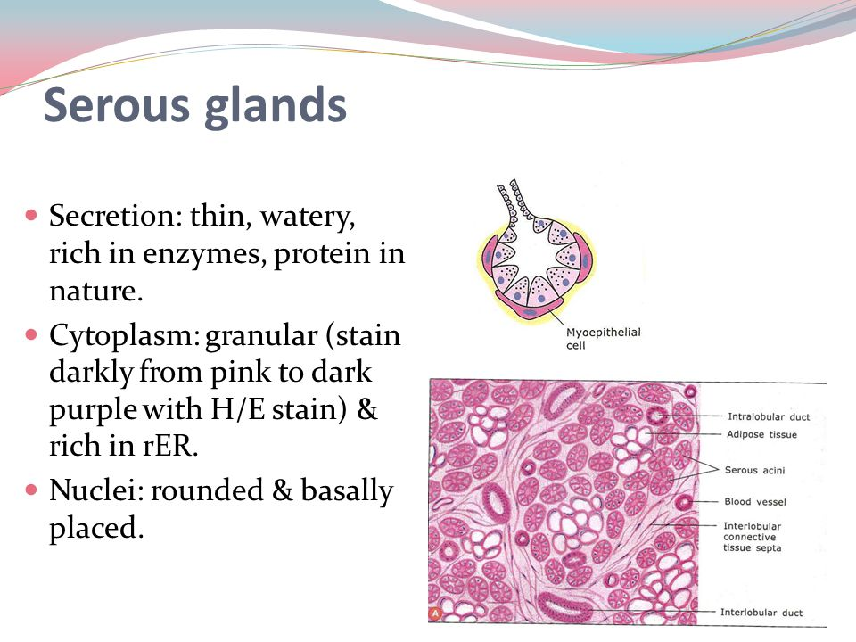
E. Based on the nature of secretion
Serous gland- secretes thin watery material rich in enzymes
e.g.- parotid gland

Slide 26
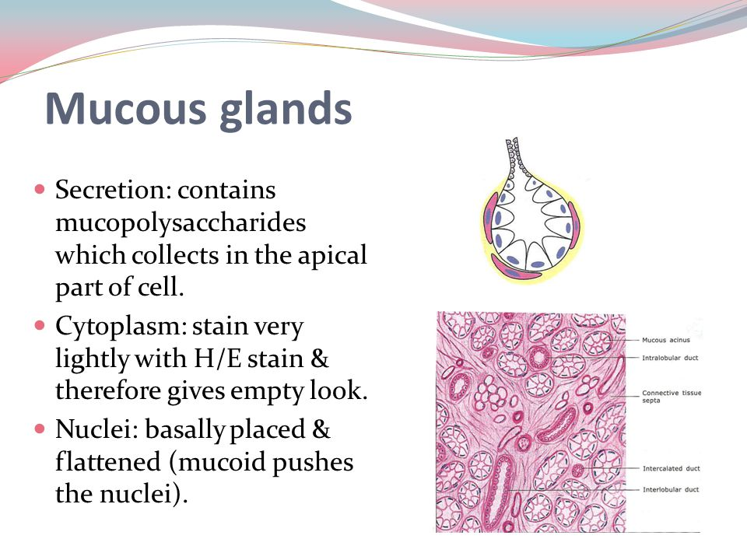
E. Based on the nature of secretion
2. Mucous gland- secretes thick viscous material for protection and lubracation
e.g.- sublingual gland

Slide 27
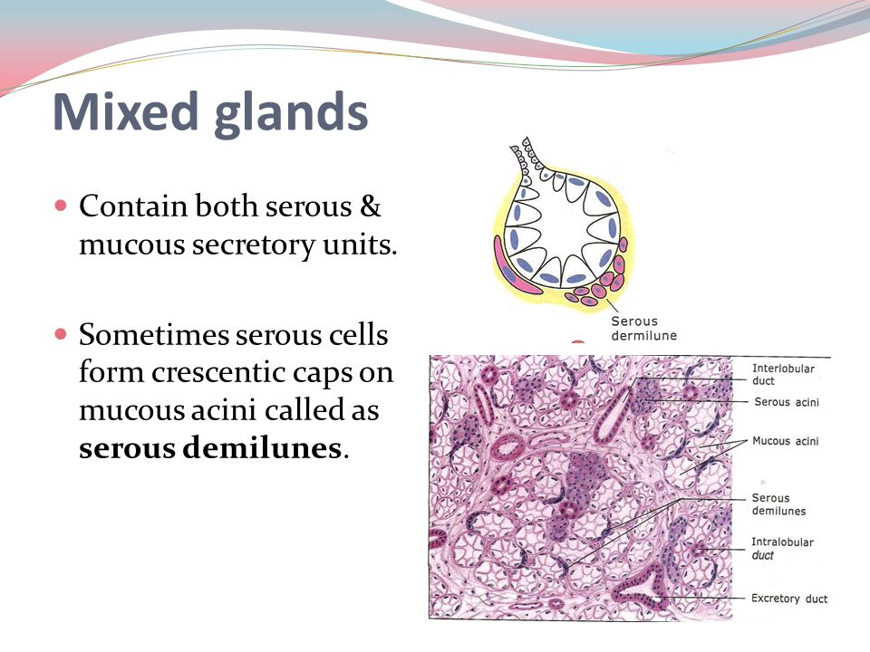
E. Based on the nature of secretion
3. Mixed gland- secretes watery and viscous material from both serous and mucous acini
e.g.- submandibular gland

Slide 28
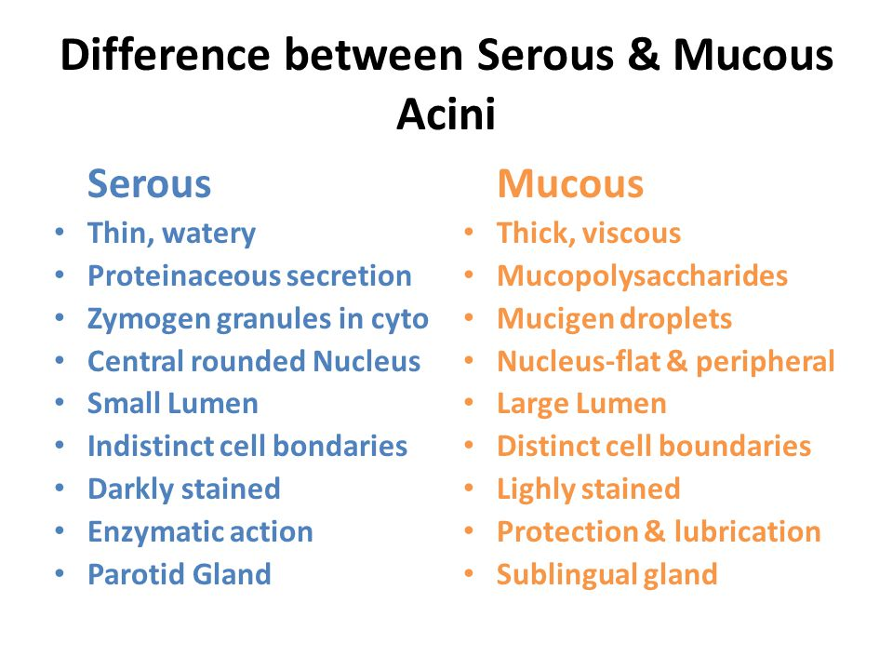

Slide 29
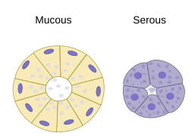
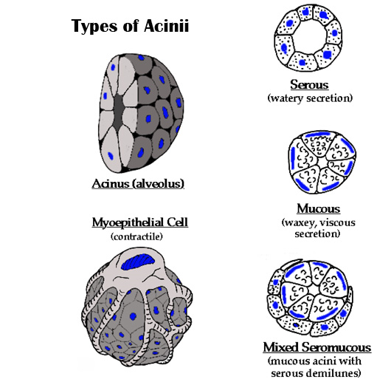
Difference between serous, mucous and mixed acini

Slide 30
Endocrine glands
Unicellular –
e.g.- enteroendocrine cells
Multicellular with the cells surrounded by the connective tissue capsule sending inward septa into unit structures.

Slide 31
Endocrine glands
A. According to the cell arrangement:
i. cord and clump gland – cells are arranged like a bunch of grapes.
ii. Follicle gland - cells are circularly arranged with a central lumen.
iii. Scattered masses – aggregated cells housed in an organ .
.

Slide 32
Endocrine glands
B. According to secretion storage site:
i. Intracellular – secretions are stored inside the cell prior discharge.
ii. Extracellular – secretions are stored outside the cell prior discharge

Slide 33
Function :
1. Secretion.
Exocrine glands secret watery and enzyme components.
Endocrine glands secret hormones.
2. Storage of secretory materials.
3. Protection.
4. Absorption.

Slide 34
For practical in the next week
Draw a diagram- goblet cell and Based on the number of ducts and shape of secretory end piece(8)
Draw a all 3 acini (serous, mucous and mixed)
On the backside of page no. 13 and 14

Slide 35
In which type of a gland product secrets into the bloodsteam?
Exocrine gland
Endocrine gland
Paracrine gland
None

Slide 36
2. Goblet cell is example of which type of gland?
Unicellular
Multicellular
Both A) and B)
None

Slide 37
3. In which type of gland whole cell shed of with it’s secretion?
Merocrine
Apocrine
Holocrine
Cytocrine

Slide 38
4. What is an example of serous gland?
Parotid gland
Submandibular gland
Sublingual gland
None

Slide 39
5. What is an example of simple coiled tubular gland?
Sebaceous gland
Sublingual gland
Parotid gland
Sweat gland

