Slide 1
Respiratory system
Dr. Hetal Vaishnani
Professor
Dept. of Anatomy
SBKSMI & RC

Slide 2
COMPETENCY
AN 25.1- Identify, draw and label a slide of trachea and lung

Slide 3
SLO
Identify microscopic structure of trachea in prepared slide of histology (with H & E stain) under compound light microscope correctly.
Identify intrapulmonary bronchi ,bronchiole and alveoli in prepared slide of lung (with H & E stain) under compound light microscope correctly
Describe microscopic anatomy of trachea and lung with diagram

Slide 4
Functionally the Respiratory System consist of 2 parts:
Conducting Part-responsible for passage of air, filters, warmth and moistens conditioning of the inspired air.
consists of nasal cavities, pharynx, larynx, trachea, bronchi, bronchioles and terminal bronchioles.
Respiratory Part-involved with the exchange of oxygen and CO2 between blood and inspires air
consists of respiratory bronchioles, alveolar ducts, alveolar sacs and alveoli

Slide 5
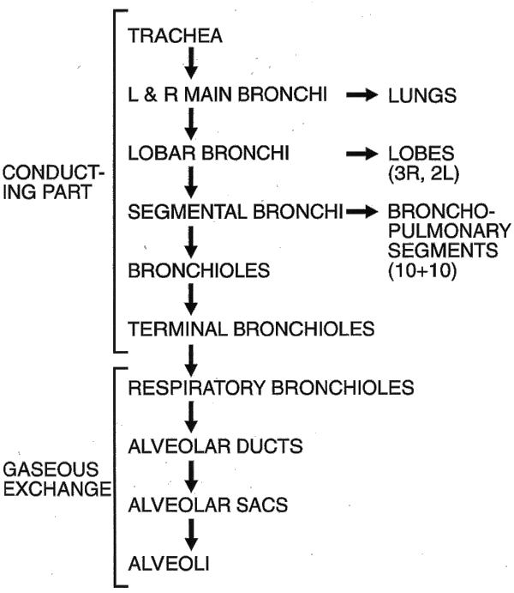

Slide 6
RESPIRATORY SYSTEM HISTOLOGY
Epiglottis
Trachea
Bronchus
-Primary bronchus
-Secondary bronchus
-Tertiary bronchus
Bronchiole
Lung

Slide 7
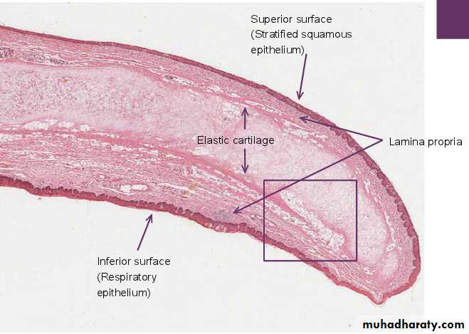
Epiglottis

Slide 8
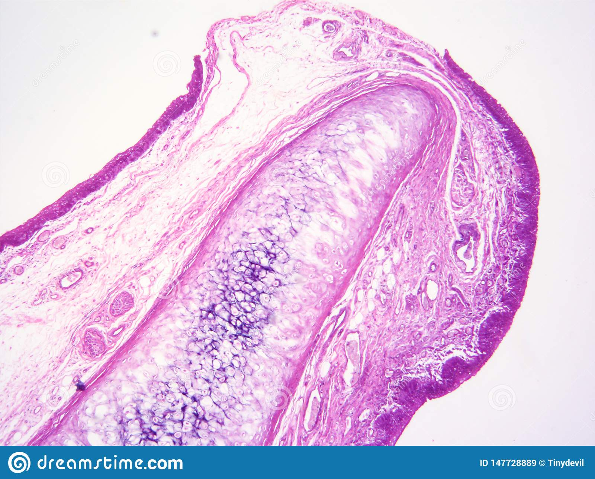
Epiglottis

Slide 9
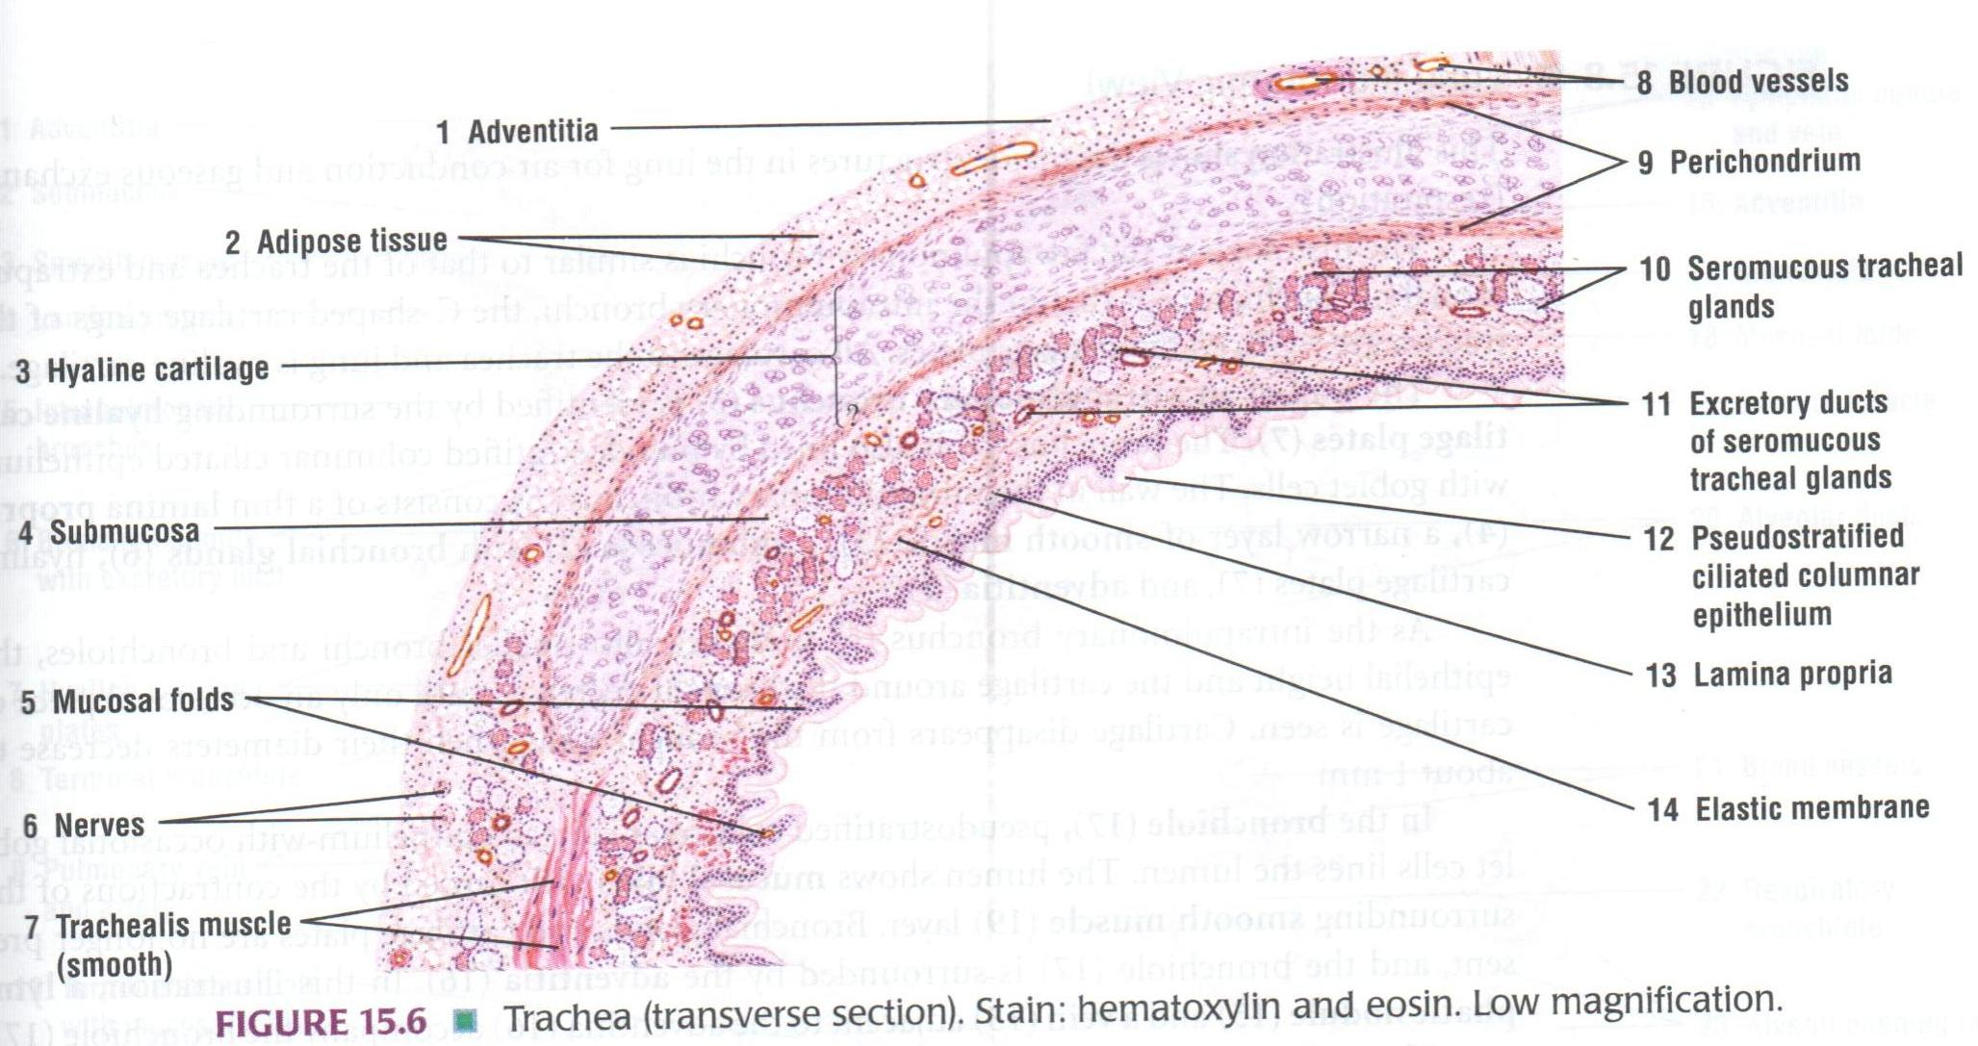
Trachea (T.S. Low Power)

Slide 10
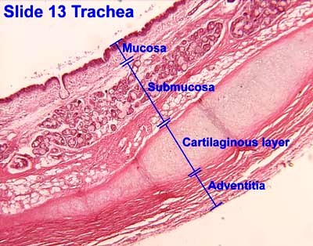
Trachea
Mucosa
-Epithelium
-Lamina propria
Sub mucosa
Cartilage & muscle layer
Adventitia

Slide 11
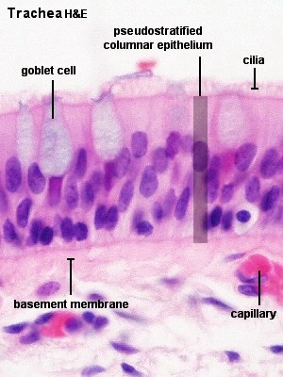
Trachea
Mucosa
Epithelium
-Pseudo stratified ciliated columnar/ Respiratory epithelium
Cells-Ciliated columnar cells
- Goblet cells
-Brush cells
- Basal cells
-Granule (kulchitsky) cells
-Clara cells( bronchiolar cells) surfactant secretion
Lamina propria - Elastic fibers, Lymphocyte, Mast cells, Blood vessels

Slide 12
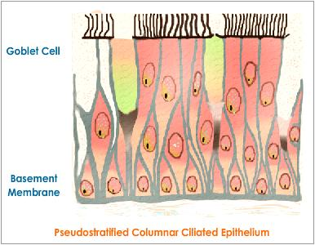

Slide 13
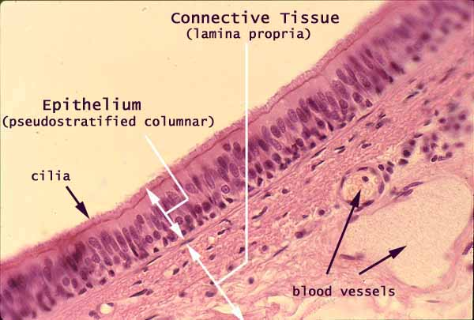
Trachea( T.S. High Power)

Slide 14
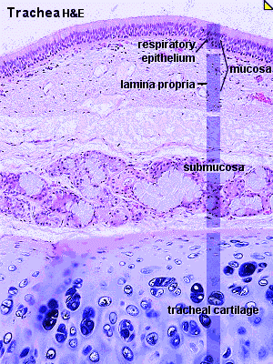
Trachea
Sub mucosa-
Loose connective tissue
Tracheal glands-Mixed (serous &mucus) glands
Blood vessels and ducts
Cartilage & smooth muscle layer-
”C” Shaped hyaline cartilage having perichondrium and chondrocytes
Ends of cartilage connected by smooth muscles
Adventitia-fibro elastic tissue

Slide 15
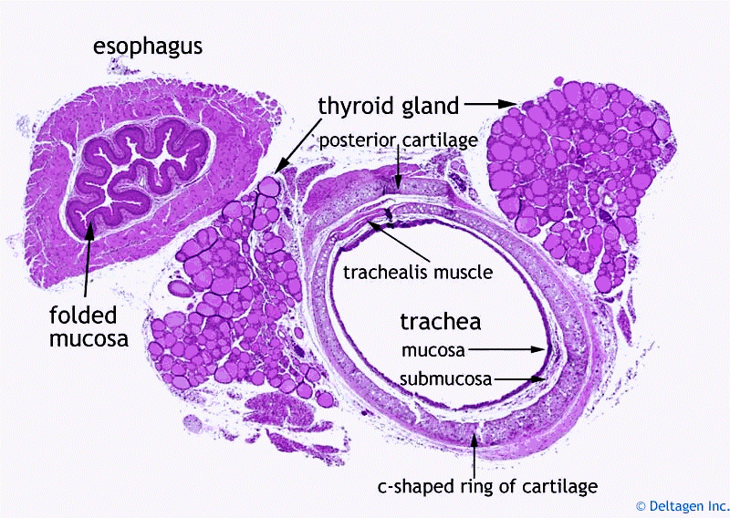

Slide 16
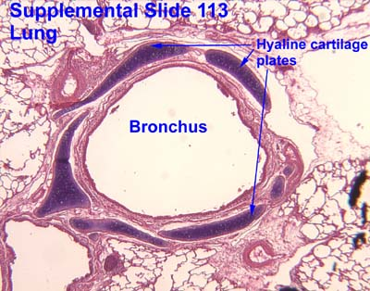
Bronchus
Principal bronchus
-same as trachea
Secondary /Lobar
bronchus
-Irregular hyaline cartilage
-Pseudo stratified ciliated columnar
Tertiary /Segmental bronchus
-Columnar epithelium
-Patches of cartilage

Slide 17
Changes as bronchi become smaller
Cartilage-irregular and smaller. Absent in bronchioles.
Muscle- increases as bronchi becomes smaller.(Spasm of these muscles bring difficulty in breathing in allergic conditions)
Sub epithelial Lymphoid Tissue-increases with decrease in the diameter of bronchi.
Glands-few. Absent in the walls of capillaries.
Epithelium- pseudostratified ciliated columnar epithelium in principal bronchi later simple ciliated columnar, non-ciliated columnar and later cuboidal in respiratory bronchioles

Slide 18
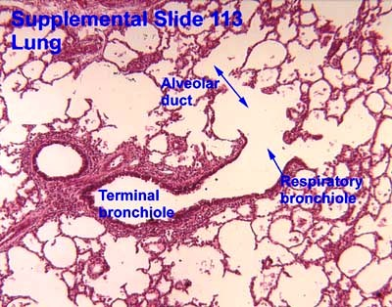
Bronchiole
Terminal bronchiole
-Columnar epithelium
-No cartilage
- smooth muscle +
-Clara cells present
Respiratory bronchiole
-Cuboidal epithelium
-No mucous gland

Slide 19
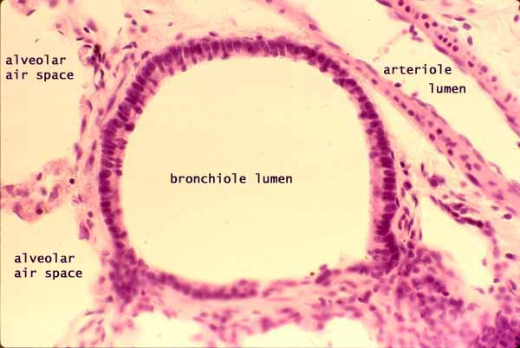
Bronchiole

Slide 20
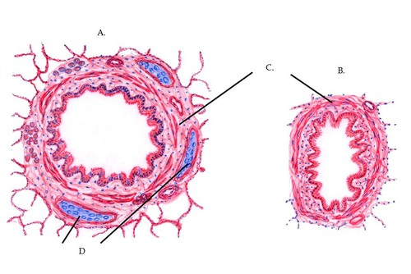
Bronchus and Bronchiole

Slide 21
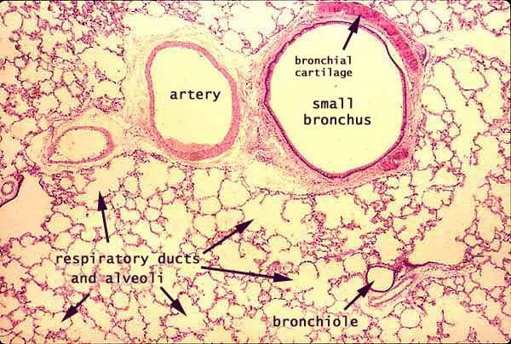

Slide 22
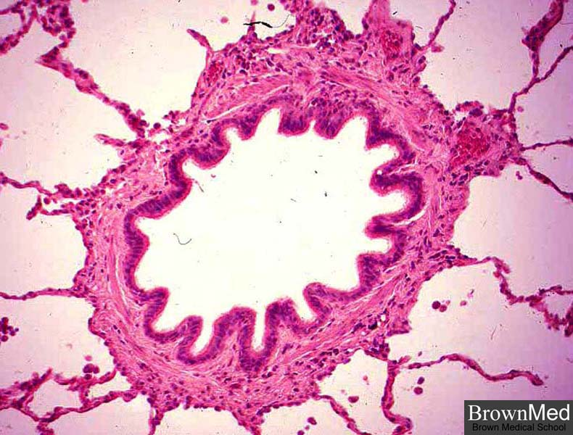
Bronchiole

Slide 23
Differences between Bronchi and Bronchioles
Bronchi
Few glands
Cartilage present
Goblet cells- present
Thin muscle layer
Few clara cells
Elastic fibers present
Bronchioles
No glands
No cartilage
No goblet cells
Thick smooth muscle layer
Presence of Clara cells
Many elastic fibers

Slide 24
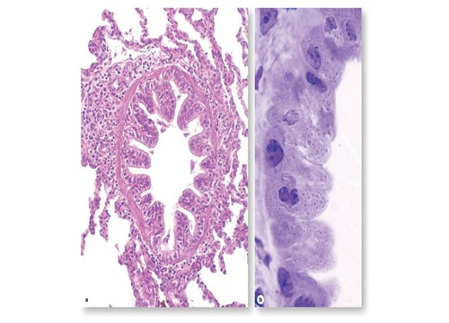
Terminal Bronchiole

Slide 25
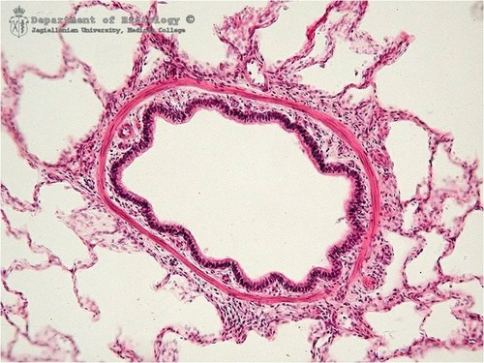
Terminal Bronchiole

Slide 26
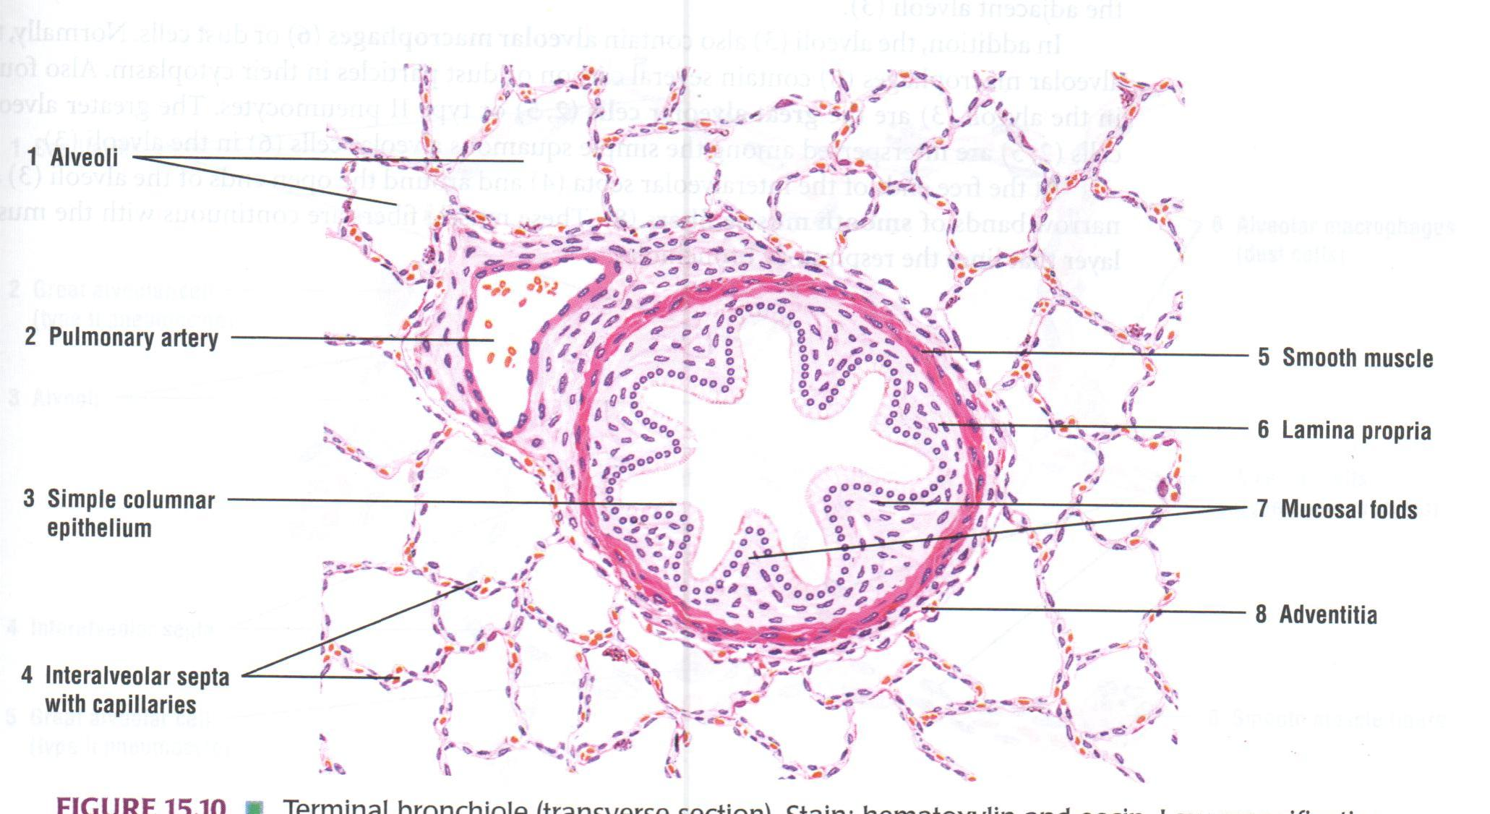

Slide 27
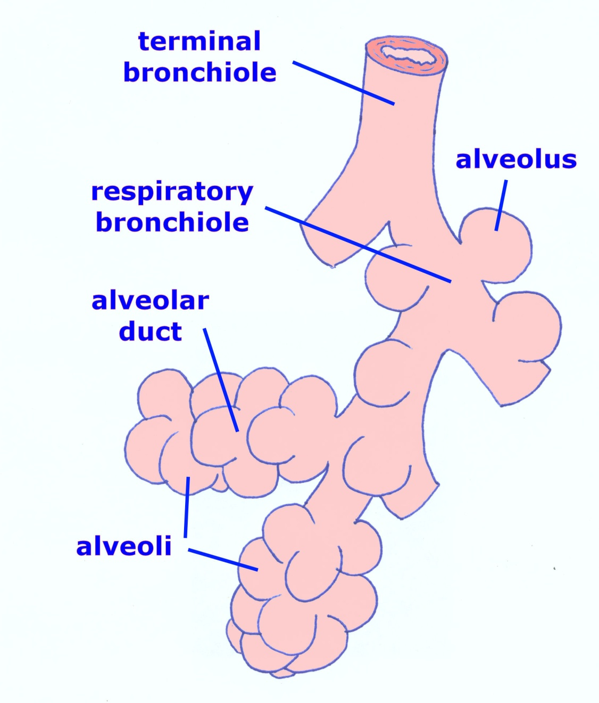

Slide 28
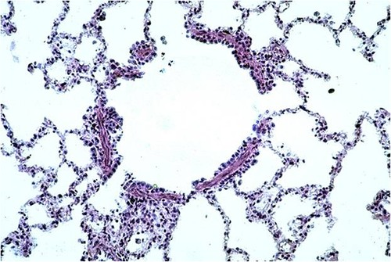
Respiratory Bronchiole

Slide 29
 | Trachea | Bronchus | Tertiary bronchus | Bronchiole | Respiratory bronchiole
Epithelium | Pseudostratified | è | Columnar | è | Cuboidal
Goblet cells | +++ | ++ | ++ | + | Absent
Clara cells | Absent | Absent | Absent | + | +
Muscularis mucosae | Absent | + | ++ | +++ | +++
Mucous glands | +++ | ++ | + | Absent | Absent
Cartilage | +++ | ++ | + | Absent | Absent
Alveoli | Absent | Absent | Absent | Absent | +

Slide 30
Cells seen in the respiratory passages
Goblet cells
Non-ciliated serous cells
Basal cells
Cells of Clara
Brush cells
Argyrophil Cells similar to diffuse endocrine cells of gut
Lymphocytes

Slide 31
Goblet cells: numerous and secrete mucous. Mucous traps the dust particles and is moved by cilliary action towards pharynx.
Non-ciliated serous cells: secretes watery fluid that keeps the epithelium moist
Cells of Clara: are non-ciliated cells predominantly seen in terminal bronchioles. Secrete a fluid that spreads over the alveolar surface forming a film that reduces surface tension. May function as stem cells

Slide 32
Basal cells: Multiply and transform into other cell types replace the lost cells.
Argyrophil cells: cells similar to diffuse endocrine cells of the gut containing granules, secrete hormones and active peptides including serotonin and bombesin.
Lymphocytes and other leucocytes may be present in the epithelium.

Slide 33
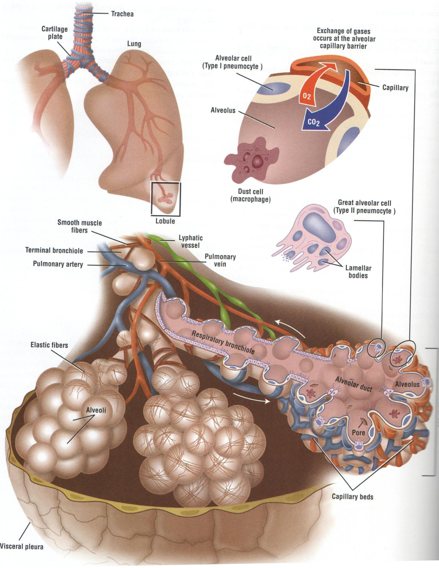

Slide 34
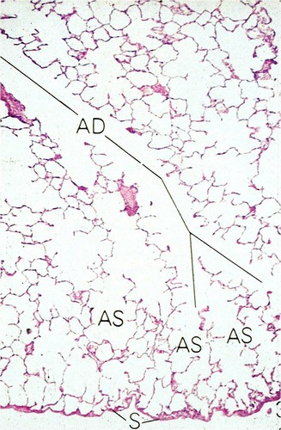
Alveolar Ducts and Alveolar Sacs

Slide 35
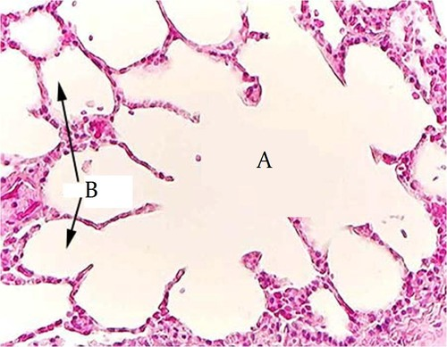
Alveolar Sac

Slide 36
Alveoli
200 million in a normal lung
Total area-75 square meters
Total capillary surface area available for exchange-125square meters
Are spongy and form the parenchyma of lung.
Sac like evaginations present at the terminal end of the bronchial tree.

Slide 37
In section, they resemble a honeycomb
Alveoli are separated by interalveolar septum lying between thin epithelial lining of two neighboring alveoli
Interalveolar septum contains a network of capillaries supported by reticular and elastic fibers, occasionally fibroblasts, macrophages and mast cells.
Septum contains pores(ALVEOLAR PORES OF KOHN) help in passage of air from one alveolus to another, thus equalizing Pressure in the alveoli

Slide 38
Elastic fibers-enable the alveoli to expand during inspiration and passively contract during expiration.
Reticular fibers support and prevent over distention of the alveoli

Slide 39
Cells in the Alveoli
Type I Pneumocytes
Type II Pneumocytes
Macrophages or Dust cells

Slide 40
Pneumocytes
Type I Alveolar or Type I Pneumocytes or Squamous Epithelial cells- Form the lining of 90% of the alveolar surface, numerous, squamous, thinness reduced to 0.05 to 0.2µm, edges of the 2 cells overlap and are uniting by tight junctions- preventing leakage of blood from capillaries to the alveolar lumen
Form Blood Air barrier

Slide 41
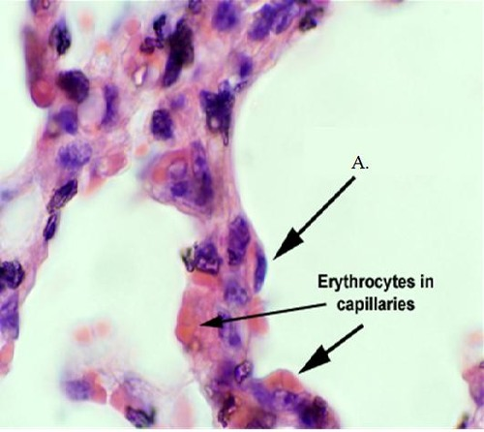
Type I Pneumocytes

Slide 42
Type II Alveolar or Type II pneumocytes
Also known as Septal cells
Rounded or cuboidal secretory cells with microvilli
Secretory granules are made of several layers- Multilamellar bodies.
These lamellar bodies are cytoplasmic inclusions made up of phospholipid which combines with other chemicals to form surfactant & then ooze out of the cell by exocytosis.
Pulmonary Surfactant – is the fluid secreted that spreads over the alveolar surface
These cells can multiply to replace damaged cells.
Surfactant also has bactericidal properties

Slide 43
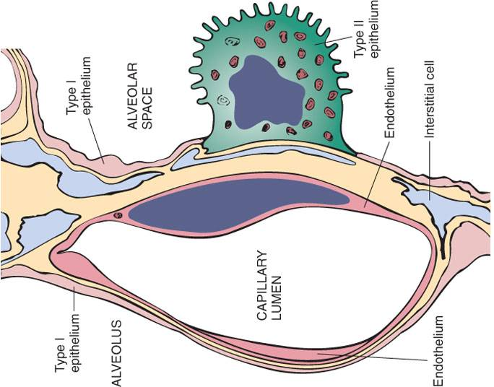

Slide 44
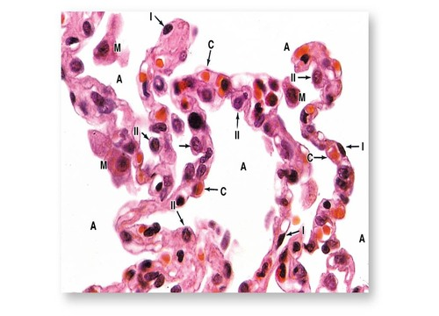
Type I and II Pneumocytes, capillaries and Dust cells

Slide 45
Pulmonary Surfactant
Surfactant contains phospholipids, proteins and glycosaminoglycans, reduces the surface tension and prevents collapse of the alveolus during expiration.
Is constantly renewed.
Removed from the surface by Type I pneumocytes and macrophages
The reduced surface tension in the alveoli decreases the force that is needed to inflate alveoli during inspiration.
Therefore, surfactant stabilizes the alveolar diameters, facilitates their expansion and prevents their collapse by minimizing the collapsing forces

Slide 46
Blood Air Barrier
Consist of a thin layer of surfactant
Cytoplasm of Type I Pneumocytes
Basement membrane of Pneumocytes
Intervening Connective Tissue
Basement membrane of capillary endothelial cell
Cytoplasm of capillary Endothelial cells
Endothelial cells of alveolar capillaries are extremely thin, have numerous projections increasing the surface area of the cell membrane exposed to blood for gaseous exchange. At places the 2 basement membranes are so fused reducing the thickness of Barrier.

Slide 47
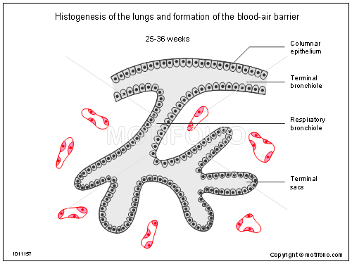

Slide 48
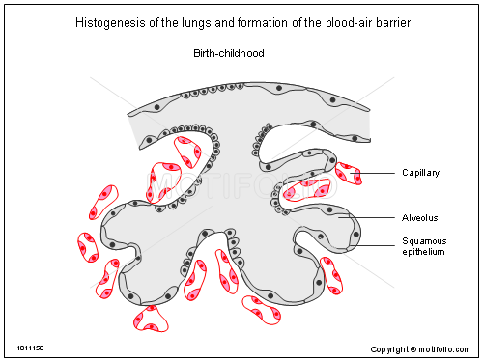

Slide 49
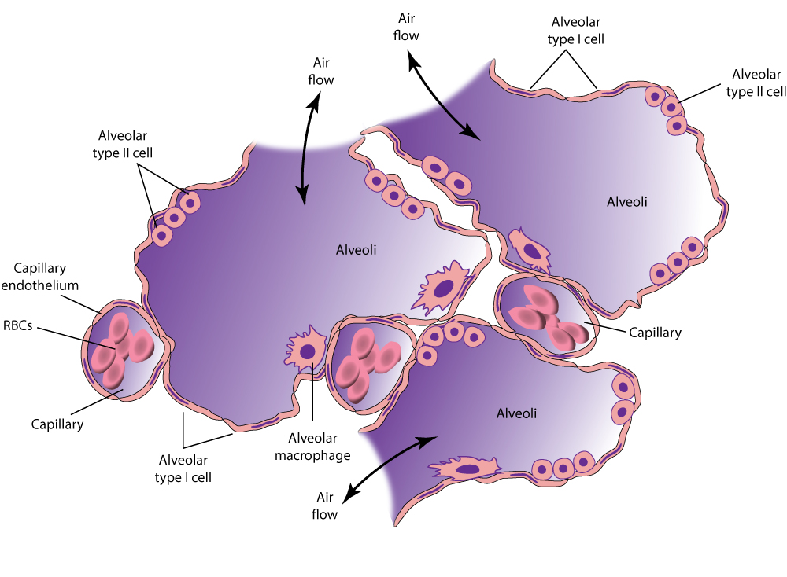

Slide 50
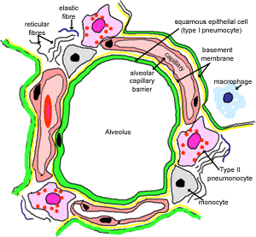
Alveolar Macrophages or Dust cells
Derived from Monocytes and are part mononuclear phagocytic system.
Either seen in the septa or alveoli
Cytoplasm contains phagocytosed inhaled carbon and dust particles
Inhaled carbon and dust particles are passed on to them from pneumocyte I through pinocytic vesicles

Slide 51
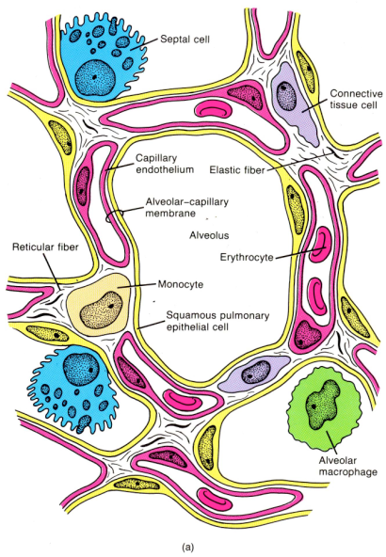
Alveolar Macrophages or Dust cells
Migrate from septum to alveolar surface and are carried to the pharynx through sputum
Main function is to clean the alveoli of invading microorganisms and inhaled particulate matter by phagocytosis

Slide 52
Heart failure cells
In congestive heart failure where pulmonary capillaries are overloaded with blood, the alveolar macrophages phagocytose erythrocytes that escape from capillaries
These cells become red brick in color because of pigment Haemosiderin and are known as heart failure cells.

Slide 53
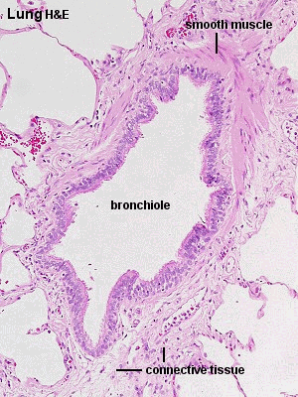

Slide 56
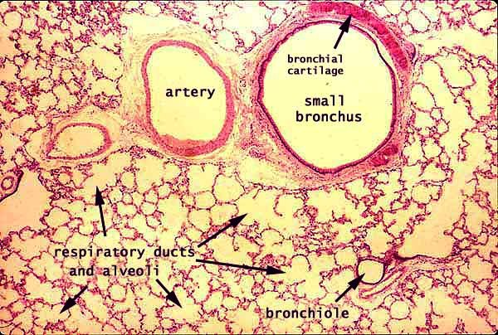
Lung
1-Bronchus and bronchioles are present
2-Alveolar duct and alveoli-
-Simple squamous epithelium
Type 1 Pneumocytes
-Blood Air barrier
Type2 Pneumocytes
- pulmonary surfactant
- lamellar bodies
Type3Pneumocytes (brush cells)
-Basement membrane
-Dust cells (Heart failure cells),
3-Inter alveolar septa & Supportive tissue

Slide 58
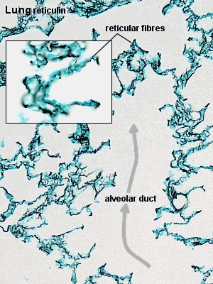

Slide 59
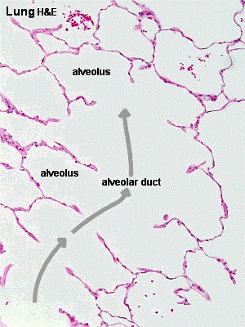

Slide 60
Clinical
Bronchiectasis: Permanent dilatation of bronchi and bronchioles full of mucous. This is caused by tissue destruction secondary to infection.
Respiratory distress syndrome or Hyaline membrane disease: in premature new born babies there is deficiency of surfactant as it is produced in the last week of gestation. They have difficulty in expanding the already collapsed lungs. A fibrin rich eosinophilic material called hyaline membrane lines the respiratory bronchioles and alveolar ducts of babies. Synthesis of surfactant is induced by administration of corticosteroids.

Slide 61
PRACTICAL FOR THIS WEEK
Draw the diagram of trachea in front of page no. 54
Draw the diagram of lung in front of page no. 55

Slide 62
1. Heart failure cells are
Type I Pneumocytes
Type II Pneumocytes
Macrophages
Cells of Clara

Slide 63
2. All of the following are true for Pulmonary Surfactant EXCEPT
Lines the alveolar surface
Forms blood brain barrier
Secreted by Type II alveolar cells
Prevents collapse of lungs

Slide 64
3. Cartilage is seen in
Bronchus
Terminal bronchiole
Respiratory bronchiole
Alveolar duct

Slide 65
4. Cells of Clara are predominantly seen in
Trachea
Primary Bronchus
Secondary Bronchus
Terminal Bronchioles

Slide 66
5. Which of the following does not take part in the formation of Blood Air Barrier?
Type I Pneumocytes
Type II Pneumocytes
Capillary endothelium
Basement membrane of Capillary Endothelium

