Slide 1
EMBRYOLOGY
CARDIOVASCULAR SYSTEM

Slide 2
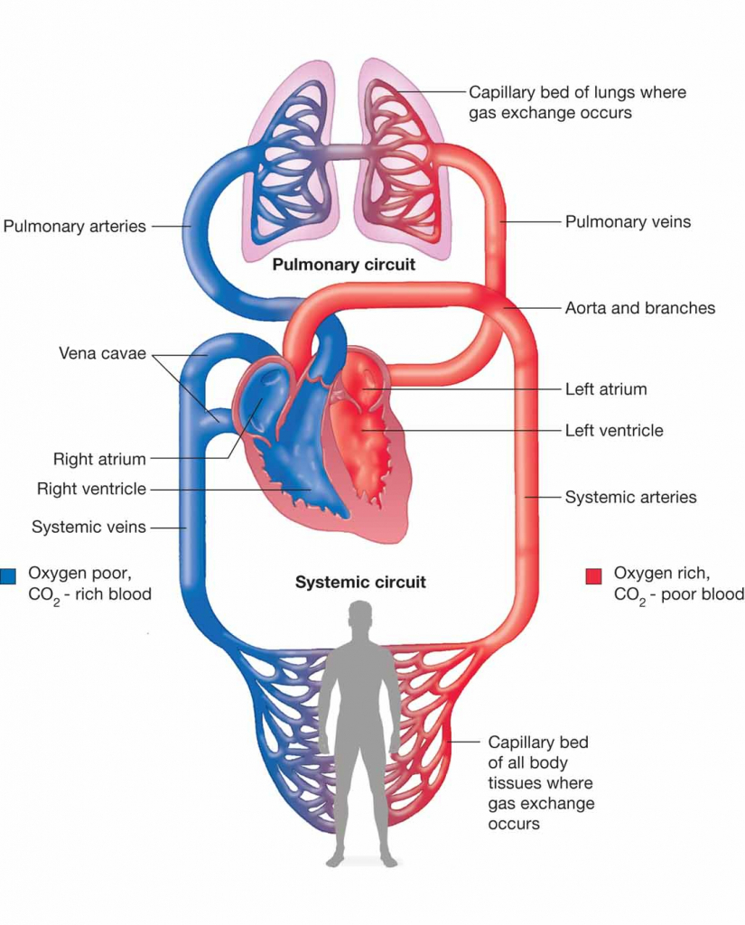
CARDIOVASCULAR SYSTEM :
Heart + blood vessels

Slide 3
CARDIOVASCULAR SYSTEM
Heart:
Inside pericardial sac: Fibrous + Serous
4 Chambers: 2 Atria + 2 Ventricles
Arterial End: Aorta & Pulm Artery
Venous End: SVC, IVC & 4 Pulm Vein

Slide 4
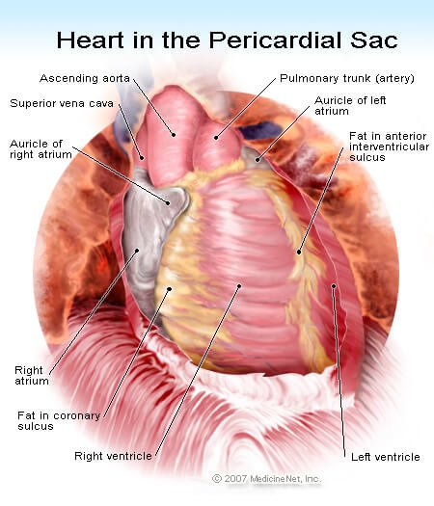

Slide 5
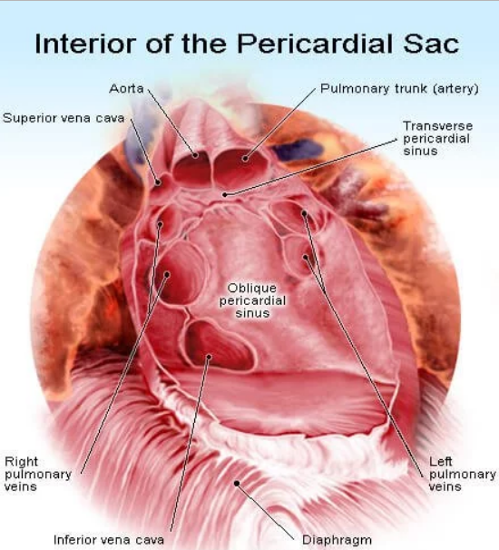

Slide 6
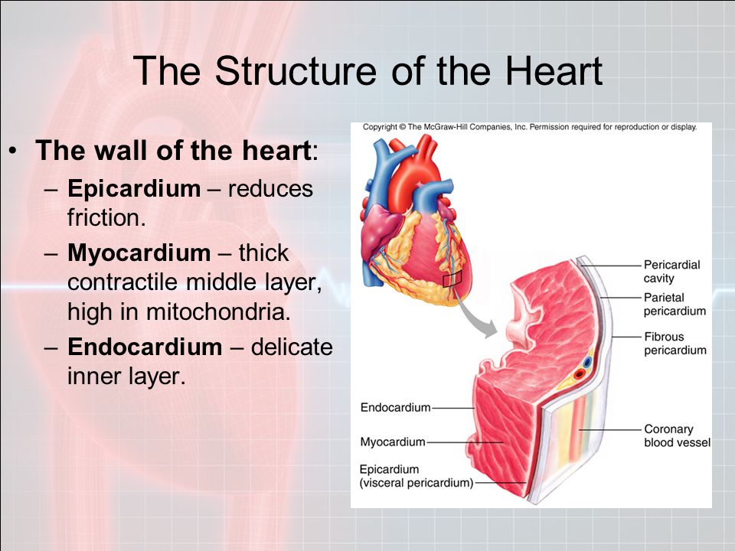

Slide 7
VASCULAR SYSTEM
Vessels: Artery, Veins, Capillaries
Structure of Vessels:
Tunica intima– endothelium
Tunica media – smooth muscles & elastic fibers
Tunica Adventitia- connective tissue

Slide 8
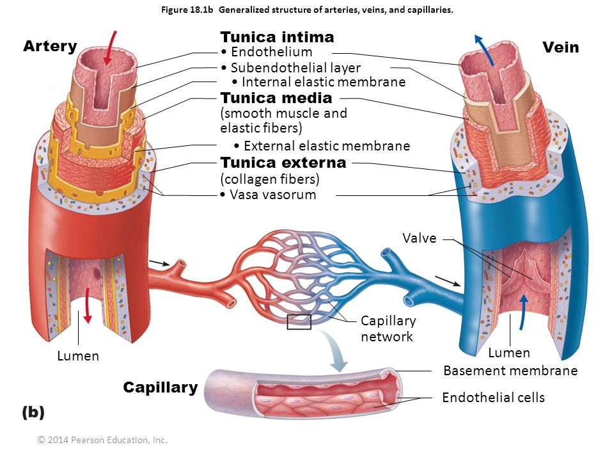

Slide 9
Development of CVS
All components of Heart & Blood vessels (endothelium, surrounding muscles & connective tissue) are mesodermal in origin

Slide 10
EARLY DEVELOPMENT OF CVS
Reason:
Absence of significant amount of yolk in the oocyte and yolk sac
Urgent need of oxygen and nutrition

Slide 11
CVS
    By the end of 2nd week embryonic nutrition is obtained from maternal blood by diffusion through EEC and yolk sac
    During 3rd week primordial uteroplacental circulation develops

Slide 12
Development of
Embryonic Vascular System
It occurs by two processes :
a) Vasculogenesis
b) Angiogenesis

Slide 13
VASCULOGENESIS
    Mesenchymal cells over YS, CS & body of embryo differentiate into haemangioblasts
    These cells from small clusters called blood islands
    Small cavities appear in blood islands
    Angioblasts lining the cavities become flattened to form endothelium
    These endothelium lined cavities fuse to form a network of channels
    This process is called vasculogenesis

Slide 14
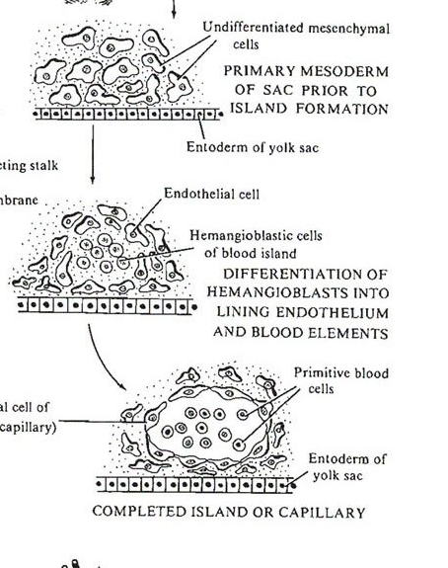

Slide 15
ANGIOGENESIS
    Endothelial budding occurs from these networks of channels
    These endothelial buds form vessels in adjacent areas and fuse with other vessels
    This process is called angiogenesis
    Blood cells – They develop from endothelial cells of blood vessels called hemangioblasts
    They develop in yolk sac and allantois at the end of 3rd week

Slide 16
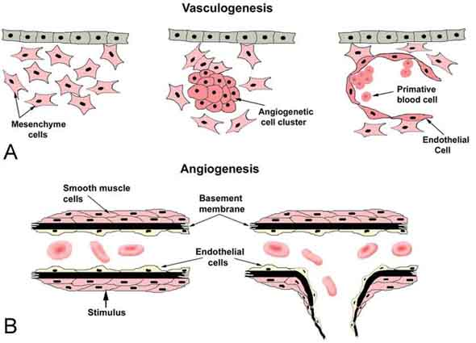

Slide 17
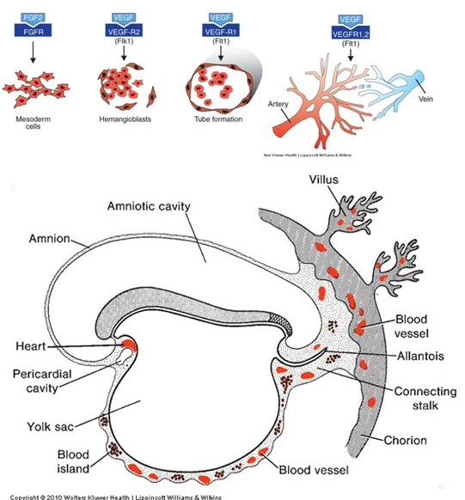

Slide 18
PRIMORDIAL CARDIOVASCULAR SYSTEM
    Initial blood vessels are formed from endothelium (Angiogenesis)
    These rapidly proliferate & interconnected to form a vascular system (Vasculogenesis)
    Primitive heart begins to pump blood thr this network of vessels
    Thus, nutrients from placenta & YS reaches embryo

Slide 19
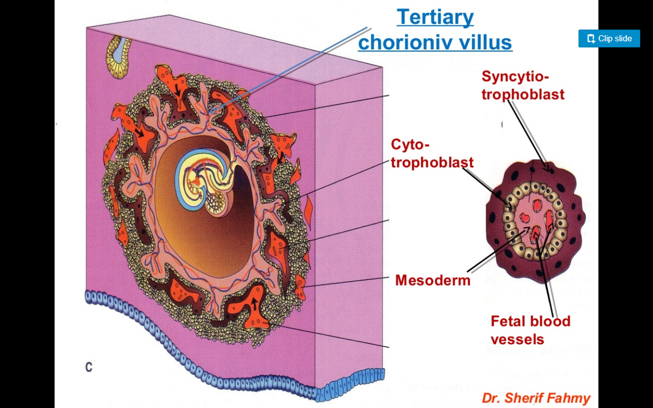

Slide 20
PRIMORDIAL CARDIOVASCULAR SYSTEM
    Pericarial coelom →Intra-embryonic coelom cranial to oro-pharyngeal membrane
    Cardiogenic area: Splanchnic mesoderm in the floor of pericardial coelom

Slide 21
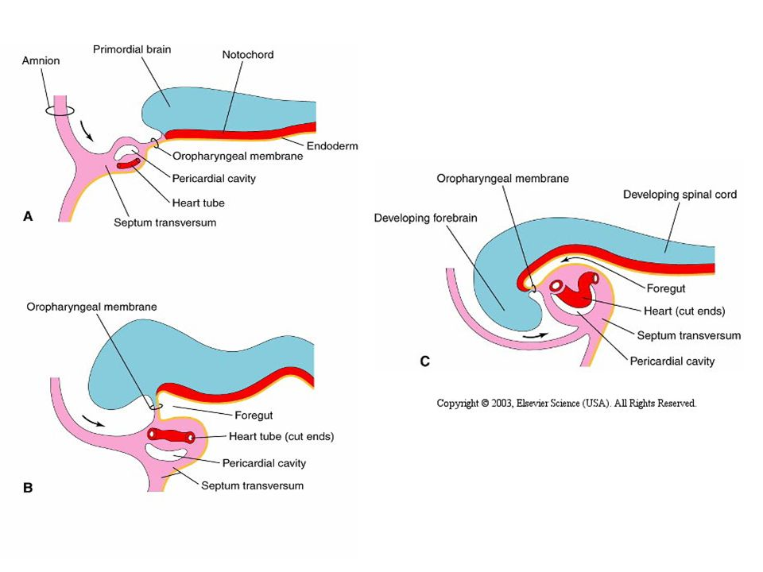

Slide 22
PRIMORDIAL CARDIOVASCULAR SYSTEM
    Heart and great vessels arise from mesenchymal cells in the cardiogenic area during 3rd week
Two longitudinal endothelial lined channels appear in the cardiogenic area called endocardial heart tubes
    These two heart tubes fuse to form primordial heart tube

Slide 24
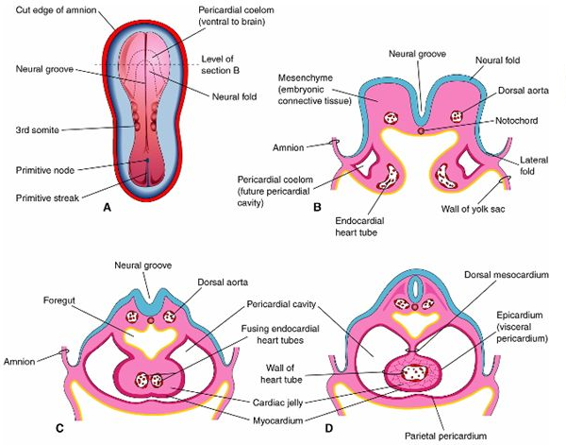

Slide 25
PRIMORDIAL CARDIOVASCULAR SYSTEM
Initially Heart tubes are ventral to pericardial coelom
After head fold, heart tube becomes dorsal to pericardial coelom and ventral to foregut

Slide 26
CVS
    The primordial heart tube joins with blood vessels in the embryo, connecting stalk, chorion and yolk sac to form primordial cardiovascular system
    By the end of 3rd week blood is circulating and heart begins to beat on 21st or 22nd day
    The cardiovascular system is the first organ system to reach functional state

Slide 27
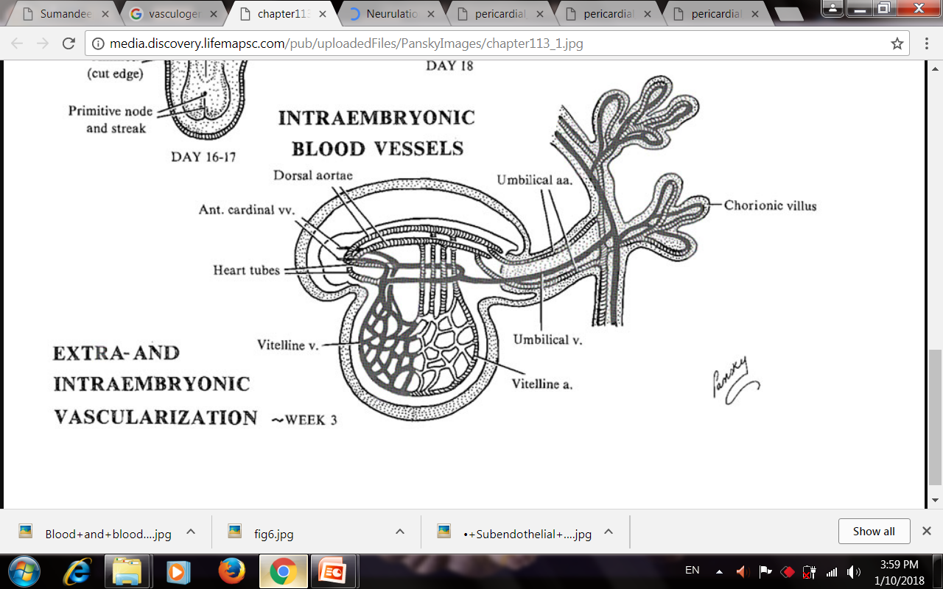

Slide 28
Development of pericardial cavity
Heart tube invaginates pericardial coelom from dorsal side
Splanchnopleuric mesoderm lining dorsal side of pericardial cavity proliferates to form thick layer – Myoepicardial mantle

Slide 29
Development of pericardial cavity
Myocardial mantle (splanchnic mesoderm) give rise to – myocardium & visceral layer of serous pericardium
Parietal layer of serous pericardium & fibrous pericardium develops from somatic mesoderm

Slide 30
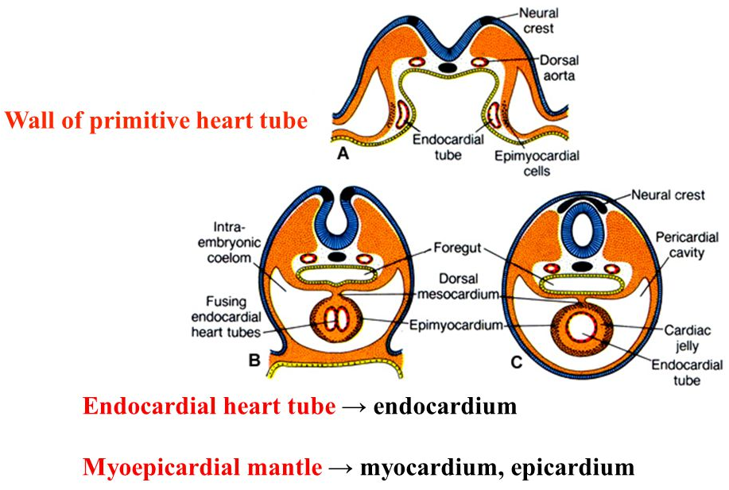

Slide 31
Mesocardium
Initially heart tube is suspended from dorsal wall of pericardial cavity by two layers of pericardium – Dorsal mesocardium
Later it disappears – heart tube lies free in pericardial cavity, suspended by its two ends

Slide 32
Q1 Cardiovascular system develops from which germ layers?
Ectoderm + Endoderm
Endoderm
Endoderm + Mesoderm
Mesoderm

Slide 33
Q 2 Heart tubes develops from
Splanchnic mesoderm of cardiogenic area
Somatic Mesoderm of cardiogenic area
Septum transversum
All of the above

Slide 34
Q 3 After Head folding
Heart tube become ventral to pericardial coelom
Heart tube become dorsal to foregut
Pericardial coelom becomes ventral to heart tube
Septum transversum comes cranial to cardiogenic area

Slide 35
Q 4 Visceral pericardium develops from
Myoepicardial mantle
Somatic Mesoderm of cardiogenic area
Septum transversum
Splanchnic Extra embryonic mesoderm

Slide 36
Q 5 Fibrous pericardium develops from
Splanchnic mesoderm of cardiogenic area
Somatic Mesoderm of cardiogenic area
Septum transversum
All of the above

Slide 37
Title | Author / Journal | Material | Resuly | Conclusions
Defective angiogenesis, endothelial migration, proliferation, and MAPK signaling in Rap1b-deficient mice | Magdalena Chrzanowska-Wodnicka, Anna E. Kraus, Daniel Gale, Gilbert C. White II and Jillian VanSluys Blood 2008 111:2647-2656; doi: https://doi.org/10.1182/blood-2007-08-109710 | Perturbations of angiogenesis occur in cancer, diabetes, ischemia, and inflammation. While much progress has been made in identifying factors that control angiogenesis, the understanding of the precise molecular mechanisms involved is incomplete | At the molecular level, activation of 2 MAP kinases, p38 MAPK and p42/44 ERK, important regulators of endothelial migration and proliferation, was decreased in Rap1b-deficient endothelial cells in response to VEGF stimulation. | These studies provide evidence that Rap1b is required for normal angiogenesis and reveal a novel role of Rap1 in regulation of proangiogenic signaling in endothelial cells.

