Slide 1
Development of CVS
Transverse sinus of pericardium
Bending of heart tube

Slide 2
Formation of blood vessels: from mesenchyme covering YS, CS & body of embryo during 3rd week - Vasculogenesis & Angiogenesis
Formation of two endothelial lined tubes, one on either side, in splanchnic mesoderm of cardiogenic area.
Later the two tubes fuse to form one heart tube
CVS first system to start functioning

Slide 3
The heart tube has an arterial end and a venous end
Heart starts beating on 22-23rd day
Blood flow starts in 4th week

Slide 4
Formation of pericardial cavity from IEC
Formation of myocardium & visceral pericardium from splanchnic mesoderm
Formation of parietal pericardium & fibrous percardium from Somatic mesoderm

Slide 5
Dorsal mesocardium
& Transverse sinus
  The heart elongates and invaginates pericardial cavity and becomes suspended by dorsal mesocardium
  The central part of mesentery degenerates forming a communication between right and left sides of pericardial cavity
  This communication is called transverse sinus of heart

Slide 6
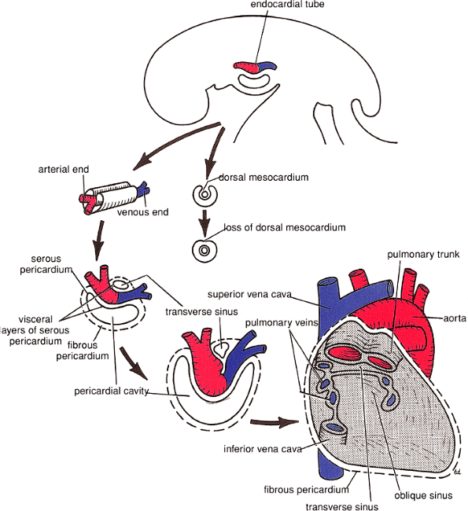

Slide 7
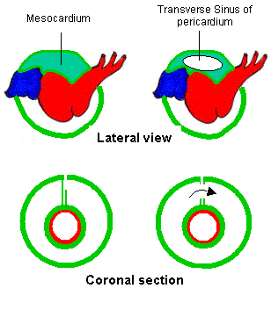

Slide 8
Parts of heart tube
The tubular heart elongates and forms alternate dilations and constrictions
In cranio-caudal sequence these dilations are:
Bulbus cordis
Ventricle
Atrium
Sinus venosus

Slide 9
Bulbus cordis:
Proximal 1/3rd
Middle 1/3rd : Conus
Distal 1/3rd : Truncus arteriosus

Slide 10
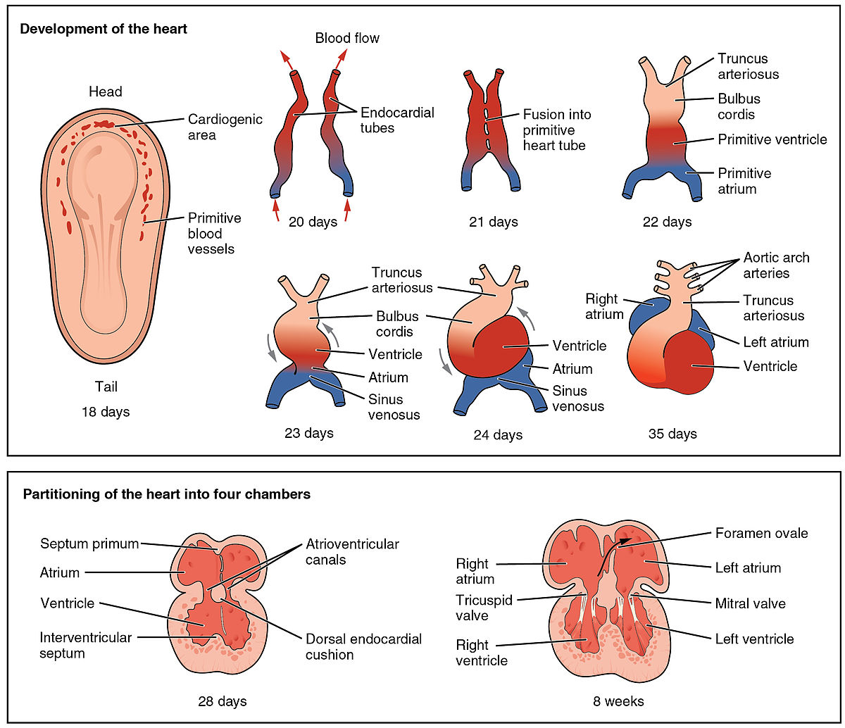

Slide 11
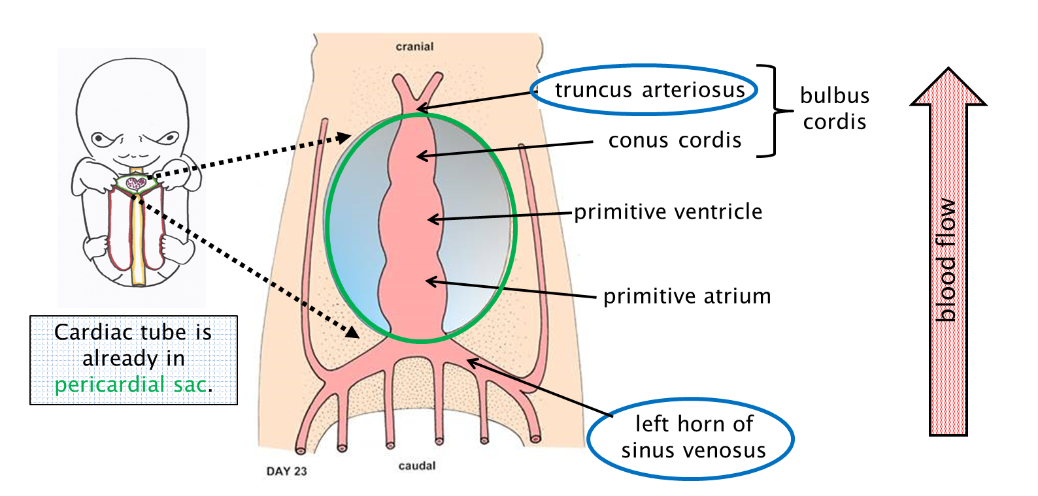

Slide 12
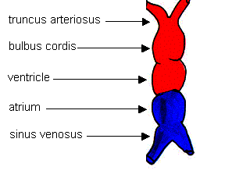

Slide 13
Two ends of Heart tube
The heart tube has an arterial end and a venous end
Truncus arteriosus constitutes Arterial end
The venous end is formed by primitive atrium into which sinus venosus opens

Slide 14
Arterial End
  The truncus arteriosus is continuous cranially with aortic Sac from which
  ↓
  Aortic arch arteries (Pharyngeal arch arteries ) arise
  ↓
  which continues with RT & LF dorsal aortae

Slide 15
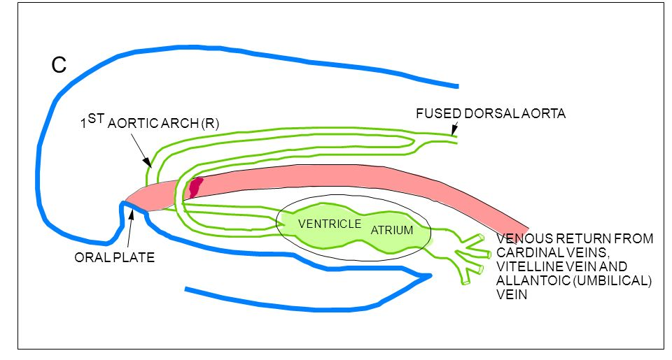

Slide 16
Venous End
  Sinus venosus has two horns: Right and left
  These are embedded in septum transversum
  The sinus venosus receives following veins –
  Common cardinal veins – receive blood from embryo
  Umbilical veins – receive blood from chorion
  Vitelline veins – receive blood from yolk sac

Slide 17
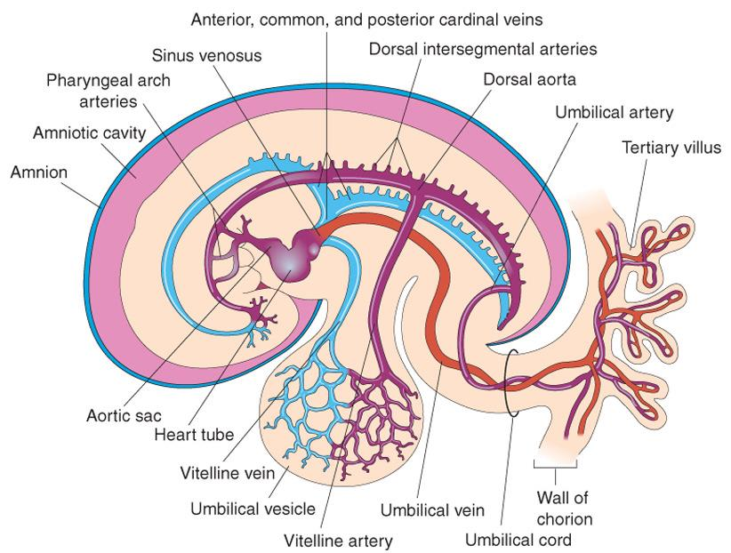

Slide 18
Two ends : Fixed
  The cranial end of the heart is fixed by pharyngeal arches
  The atrium and sinus venosus are embedded in septum transversum hence fixed

Slide 19
Changes in the heart tube
(Tube Bends)
At this stage: bulbus cordis and ventricle lie within pericardial cavity
↓
Bulbus cordis grow faster in a ventral direction than other regions
↓
Therefore heart bends upon itself to form a U shaped bulboventricular loop

Slide 20
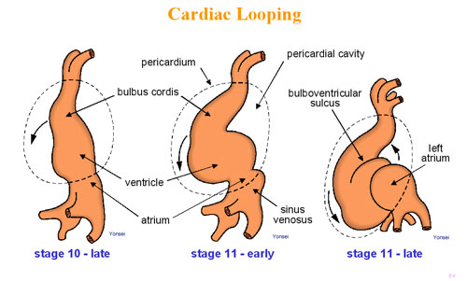

Slide 21
Changes in the heart tube
Bulboventricular loop formation
↓
atrium and sinus venosus are freed from septum transversum
↓
come to lie behind truncus arteriosus, bulbus cordis and ventricle
↓
Thus the heart tube is now S shaped

Slide 22
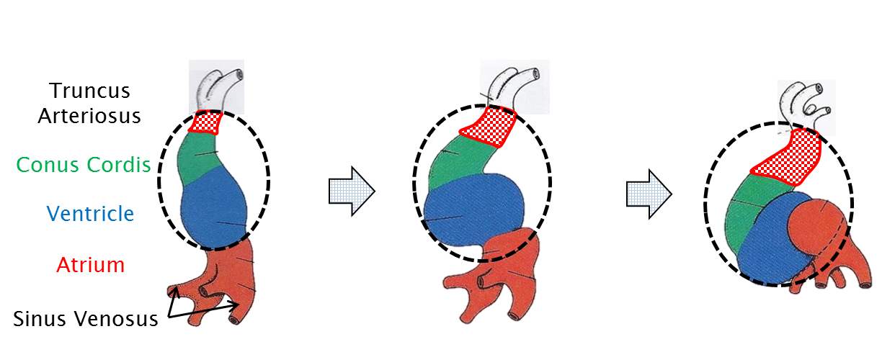

Slide 23
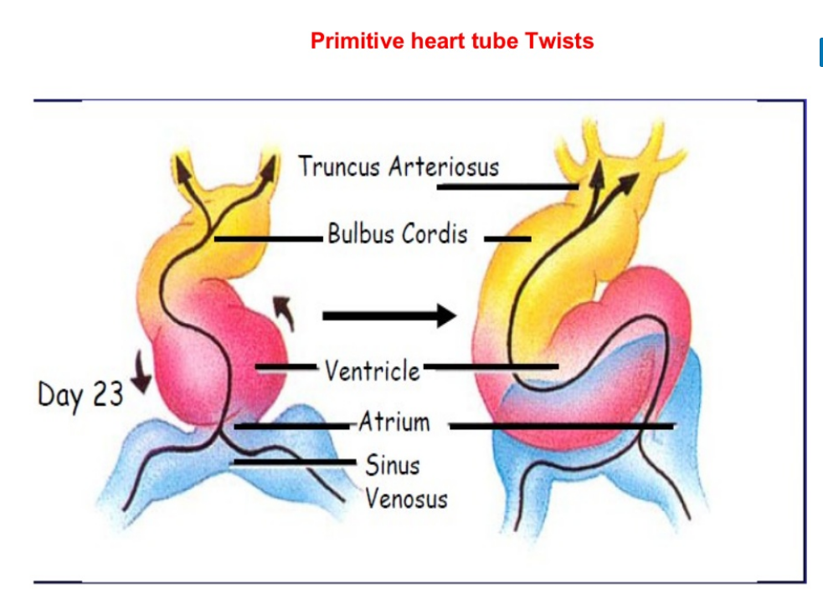

Slide 24
Changes in the heart tube
Formation of bulboventricular loop
↓
bulbus cordis and ventricle are separated by a bulboventricular sulcus
↓
sulcus becomes shallow and disappears
↓
bulbus cordis is absorbed into ventricle to form a single chamber

Slide 25
Changes in the heart tube
The ventricle communicates :
cranially with truncus arteriosus and
dorsally with atrium through atrio-ventricular canal
The atrial chambers which lie behind the ventricle expand and project on either side of truncus arteriosus
As a result, the exterior of developing heart assumes its definitive shape

Slide 26
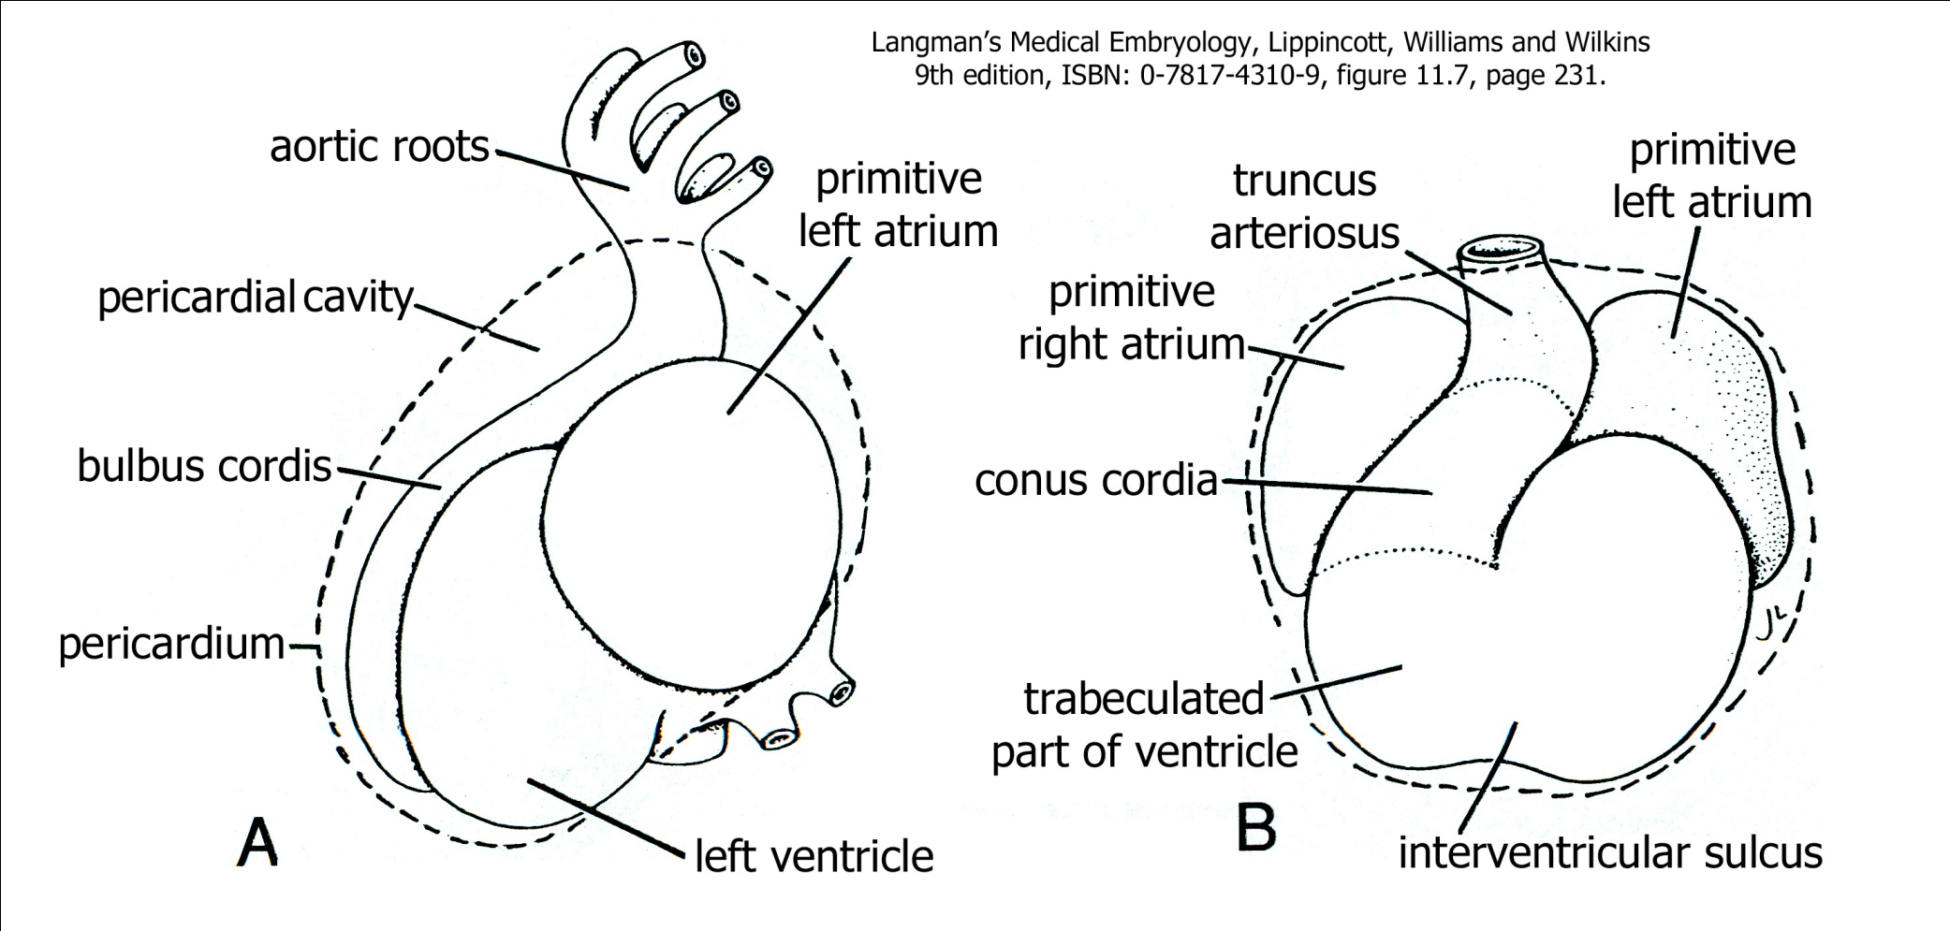

Slide 27


Slide 28
At this point in development:
The single straight heart tube has been modified so that the original caudal, venous end (the atrium) has moved cranially and posterior to the ventricle.
The atrium and the ventricle are still common chambers.

Slide 29
Septation of Atrioventricular Canal
The AV canal connect common atrium and ventricle
↓
masses of tissue (endocardial cushions) from dorsal & ventral wall of AV canal grow towards each other & fuse
↓
AV canal is divided into two canals, a Rt and LF atrioventricular canal
↓
Fused endocardial cushions forms - Septum Intermedium

Slide 30
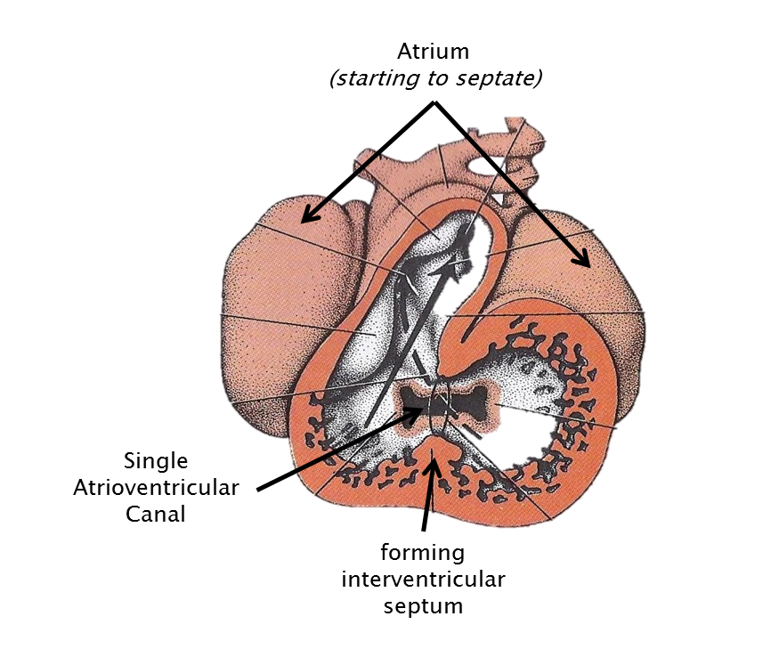

Slide 31
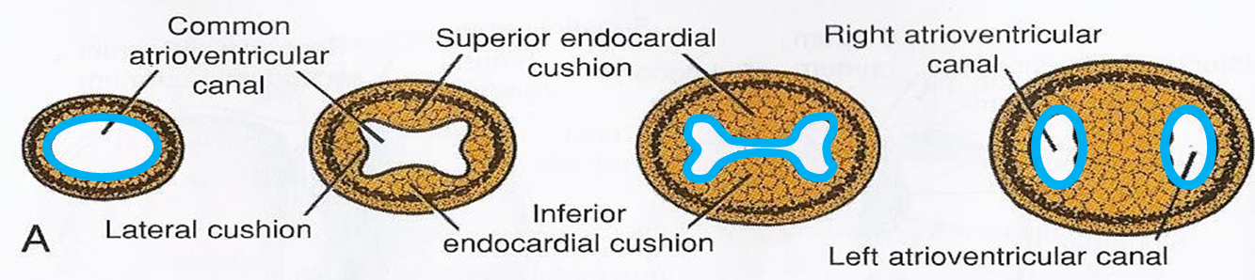
Endocardial Cushions

Slide 32
Q 1 Arterial end of heart is formed by
Ventricle
Atrium
Truncus
Bulbus

Slide 33
Q 2 Central part of Dorsal mesocardium disappears to form
Atrioventricular canal
Transverse sinus
Septum intermedium
Fibrous pericardium

Slide 34
Q 3 Vitelline vein which opens into sinus venous, brings blood from
Yolk sac
Placenta
Body of embryo
Amniotic cavity

Slide 35
Q 4 Which part of heart tube gets absorbed into ventricle to form a common chamber?
Atrium
Truncus
Bulbus
Sinus venosus

Slide 36
Q 5 Septum intermedium separates
Rt & LF Ventricle
Atrio ventricular canals
Horns of sinus venosus
Rt & LF Atrium

Slide 37
Title | Author / Journal | Material | Results | Conclusion
A novel role for VEGF in endocardial cushion formation and its potential contribution to congenital heart defects | Y. Dor, T.D. Camenisch, A. Itin, G.I. Fishman, J.A. McDonald, P. Carmeliet, E. Keshet Development 2001 128: 1531-1538; | However, cardiac expression of VEGF is also robustly augmented during hypoxic insults, potentially mediating the well-established teratogenic effects of hypoxia on heart development. | We report that during normal heart morphogenesis VEGF is specifically upregulated in the atrioventricular (AV) field of the heart tube soon after the onset of endocardial cushion formation (i.e. the endocardium-derived structures that build the heart septa and valves). | Together, these results suggest a novel developmental role for VEGF as a negative regulator of endocardial-to-mesenchymal transformation that underlies the formation of endocardial cushions. Moreover, ischemia-induced VEGF may be the molecular link between hypoxia and congenital defects in heart septation.

