Slide 1
Dr K M Parmar
Anatomy of Stomach
Different type of vagotomy
Lymphatic spread in carcinoma of stomach
Date 26/04/21

Slide 2
STOMACH
Synonyms: Gaster (in Greek); venter (in Latin).
The stomach is the widest and most distensible part of the
alimentary canal between the esophagus and the duodenum.
The main functions of stomach are:
1. Forms a reservoir of food.
2. Mixes food with gastric secretions to form a semi fluid substance called chyme.
3. Controls the rate of delivery of chyme into the small intestine to allow proper digestion and absorption in the
small intestine.
4. Hydrochloric acid secreted by the gastric glands destroys
bacteria present in the food and drink.
5. Castle’s intrinsic factor present in the gastric juice helps in the absorption of vitamin B12 in the small intestine.

Slide 3
LOCATION
The stomach is situated in the upper left part of the abdomen occupying left hypochondriac, umbilical, and epigastric regions.
It extends obliquely from the left hypochondriac region into the epigastric region.
Most of the stomach lies under cover of the left costal
margin and lower ribs.
Shape
The stomach is mostly “J” shaped. Its long axis passes
downward, forward, and to the right and finally backward and slightly upward.
It tapers from the fundus on the left of the median plane to the narrow pylorus slightly to the right of the median plane.

Slide 4
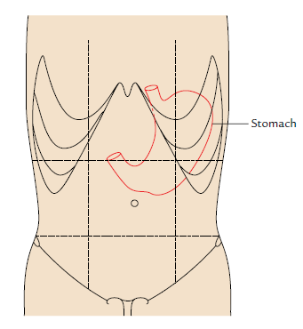
Location of the stomach (demarcated by red line).

Slide 5
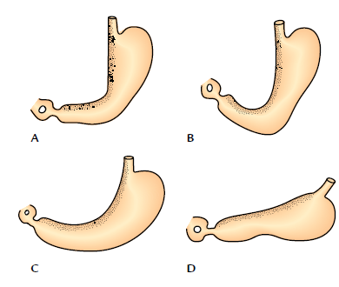
“Types” of shape of the stomach as seen in barium meal X-ray of abdomen: A, reversed L-shaped; B, J-shaped; C, semilunar shaped; D, steer-horn shaped.

Slide 6
N.B.
• Both the shape and position of the stomach vary greatly
according to the build of an individual. It is:
1. High and transverse (steer-horn type) in short obese persons.
2. Low and elongated in tall and weak persons.
• Even in the same individual the shape of the stomach depends upon the:
1. Volume of fluid or food it contains.
2. Position of body (erect or supine position).
3. Phase of respiration.
• The shape of the stomach is studied by radiographic examination using barium meal. Generally, four types of shape of the stomach are seen in barium meal X-ray
(A) reversed “L” shaped, (B) “J” shaped, (C) semilunar shaped, and (D) steer-horn shaped.

Slide 7
Size and Capacity
Length: 10 inches.
Capacity: The capacity of the stomach is variable as the stomach is highly distensible:
1. At birth the capacity is only 30 ml (1 ounce).
2. At puberty the capacity is 1000 ml (1 L).
3. In adults the capacity is 1500 to 2000 ml.

Slide 8
EXTERNAL FEATURES
The stomach presents the following external features (Fig. 7.3):
1. Two ends: Cardiac and pyloric.
2. Two curvatures: Greater and lesser.
3. Two surfaces: Anterior (anterosuperior) and posterior
(posteroinferior).
Ends
Cardiac End (Upper End)
It joins the lower end of the esophagus and presents an orifice called cardiac orifice.
Pyloric End (Lower End)
It joins the proximal end of the duodenum and presents an
orifice called pyloric orifice.
The stomach is relatively fixed at upper and lower ends but mobile in between.

Slide 9
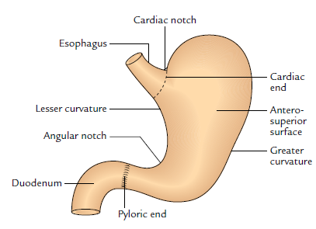
External features of the stomach.

Slide 10
Cardiac and pyloric orifices of the stomach
Cardiac orifice | Pyloric orifice
It is at the junction between the lower end of the esophagus and stomach, and marks the level at which curvatures begin | It is at the junction between the pyloric end of the stomach and first part of the duodenum
It is situated to the left of the median plane behind the left 7th costal cartilage, 2.5 cm from its junction with the sternum at the level of lower border of T11 | It is about 1.5 cm to the right of median plane at the lower border of L1 (i.e., transpyloric plane)
It does not have an anatomical sphincter but is guarded by the physiological sphincter | It has anatomical pyloric sphincter formed by the thickening of a circular coat of muscle assisted by a deep set of longitudinal fibres of the stomach

Slide 11
N.B.
• The cardiac end of the stomach is less mobile and less likely to vary in position whereas the pyloric end of the stomach is more mobile and more likely to vary in position.

Slide 12
Curvatures
The stomach presents two curvatures—lesser and greater.
Lesser Curvature
It is concave and forms the shorter right border of the stomach.
The most dependent part of this curvature—the angular notch/incisura angularis, indicates the junction of the body and pyloric part.
The lesser curvature provides attachment to the lesser omentum.

Slide 13
Greater Curvature
It is convex and forms the longer left border of the stomach.
At its upper end this curvature presents a cardiac notch which separates it from the left aspect of the esophagus.
The greater curvature provides attachment to the greater omentum, gastrosplenic, and gastrophrenic ligaments.
Surfaces
Anterosuperior (Anterior) Surface
It faces forward and upward.
Posteroinferior (Posterior) Surface
It faces backward and downward.

Slide 14
PARTS
The stomach has four parts :
1. Cardiac part (or cardia).
2. Fundus.
3. Body.
4. Pyloric part.
Cardiac Part
It is the part around the cardiac orifice.
Fundus
The fundus is the upper dome-shaped part of the stomach
situated above the horizontal plane drawn at the level of cardiac notch.
Superiorly, the fundus usually reaches the level of the left 5th intercostal space just below the nipple, hence gastric pain sometimes imitates the pain of angina pectoris.
The cardiac notch lies between the fundus and the esophagus.

Slide 15
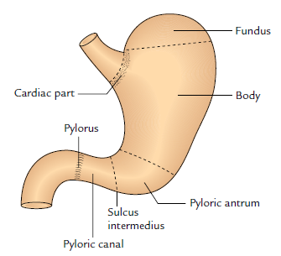
Parts of the stomach.

Slide 16
N.B.
• The fundus is generally distended with gas/air, which is
clearly seen as a radiolucent shadow under the left dome of the diaphragm in a skiagram.
• Traube space: It is a topographic area overlying the
fundus of the stomach which is tympanic on percussion.
It is bounded superiorly by the lower border of the left
lung, inferiorly by the left costal margin, on the left side
by the lateral end of the spleen, and on the right side by
the lower border of the left lobe of the liver.
Body
The body is the major part of the stomach between the
fundus and the pyloric antrum. It can be distended
enormously along the greater curvature.

Slide 17
Pyloric Part
The pyloric part is the funnel-shaped outflow region of the stomach.
A line drawn downward and to the left from an angular notch to the greater curvature separates it from the body.
It extends from the angular notch to the gastroduodenal junction.
It is divided into three parts: pyloric antrum, pyloric canal, and pylorus.
1. Pyloric antrum is the proximal wide part which is separated from the pyloric canal by an inconstant sulcus, sulcus intermedius present on the greater curvature.
It is about 3 inches (7.5 cm) long and leads into the pyloric canal.

Slide 18
2. Pyloric canal is a distal narrow and tubular part measuring
1 inch (2.5 cm) in length.
It lies on the head and neck of the pancreas.
3. Pylorus (Greek gatekeeper) is the distal most and
sphincteric region of the pyloric canal.
The circular muscle fibres are markedly thickened in this region, which control the discharge of stomach contents through the pyloric orifice into the duodenum.
N.B.
• The position of the pyloric orifice is indicated on the surface by (a) a circular sulcus—pyloric constriction produced by the underlying pyloric sphincter or pylorus; and (b) the prepyloric vein of Mayo on the anterior surface of the pylorus.

Slide 19
RELATIONS
Peritoneal Relations
The stomach is covered by the peritoneum except where blood vessels run along its curvatures and a small area (called bare area of the stomach) posteriorly near the cardiac orifice.
The bare area of the stomach is directly related to the left crus of the diaphragm.
The peritoneal folds extending from the lesser and greater curvatures of the stomach to other structures are as follows

Slide 20
1. Lesser omentum, extends from the lesser curvature of the stomach to the liver.
2. Greater omentum, extends from the lower two-third of the greater curvature to the transverse colon.
3. Gastrosplenic ligament, extends from the upper onethird of the greater curvature (i.e., fundus) to the spleen (near the hilum).
4. Gastrophrenic ligament, extends from the uppermost part of the fundus to the diaphragm.

Slide 21
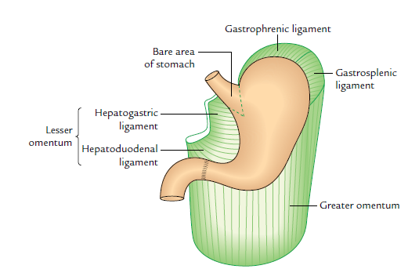
Peritoneal relations of the stomach.

Slide 22
Visceral Relations
1. Relations of the anterior (anterosuperior) surface
(a) On the right side this surface is related to the gastric
impression of the left lobe of the liver and near the
pylorus to the quadrate lobe of the liver.
(b) The left half of this surface is related to the diaphragm and rib cage.
(c) The lower part of this surface is related to the
anterior abdominal wall.
N.B. Gastric triangle: It is a triangular area of the stomach in contact with the anterior abdominal wall.
It is bounded on the left side by the left costal margin, on the right side by the lower border of the liver, and inferiorly by the transverse colon.
In complete esophageal obstruction, gastrostomy is performed in this area to feed the patient.

Slide 23
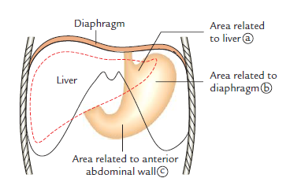
Anterior relations of the stomach.

Slide 24
2. Relations of the posterior (posteroinferior) surface:
This surface is related to a number of structures on the
posterior abdominal wall, which collectively form the
stomach bed . These structures are:
(a) Diaphragm.
(b) Left kidney.
(c) Left suprarenal gland.
(d) Pancreas.
(e) Transverse mesocolon.
(f) Left colic flexure (splenic flexure of colon).
(g) Splenic artery.
(h) Spleen.

Slide 25
Mnemonic: “Dr S3 Kills Patients Mercilessly”
D = diaphragm, S3 = splenic artery, suprarenal gland (left), and splenic flexure, K = kidney (left), P = pancreas, M = mesocolon (transverse).
N.B. All the structures forming the stomach bed are
separated from the stomach by the lesser sac except spleen, which is separated from the stomach by the greater sac of peritoneum.

Slide 26
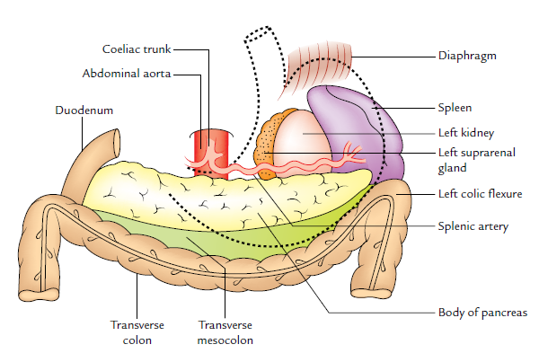
N.B. All the structures forming the stomach bed are separated from the stomach by the lesser sac except spleen, which is separated from the stomach by the greater sac of peritoneum.

Slide 27
INTERIOR OF THE STOMACH
When the stomach is cut open, the interior of the stomach presents the following features:
1. Gastric folds/gastric rugae: The mucosa of an empty stomach is thrown into numerous folds called gastric rugae.
They are longitudinal along the lesser curvature
and irregular in the remaining part.
The rugae are flattened when the stomach is distended.
2. Gastric pits: These are small depressions on the mucosal surface in which open the gastric glands.

Slide 28
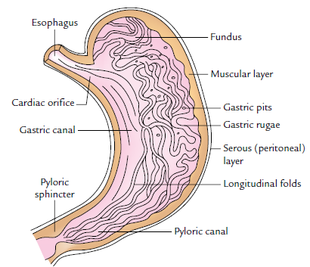
Interior of the stomach showing folds in mucous lining.

Slide 29
2. Gastric pits: These are small depressions on the mucosal surface in which open the gastric glands.
3. Gastric canal (or Magenstrasse): A longitudinal furrow that forms temporarily during swallowing between the longitudinal folds of the mucosa along the lesser curvature.
The gastric canal forms due to firm attachment of the gastric mucosa to the underlying muscular layer, which does not have an oblique layer at this site.
This canal allows a rapid passage of swallowed liquids along the lesser curvature to the lower part before it spreads to the other parts of the stomach.

Slide 30
Thus, the lesser curvature is subject to maximum insult of the swallowed spicy food and irritable liquids (e.g., alcohol), which makes it vulnerable to the gastric ulceration.
The interior of the stomach can be directly examined
in the living person by an endoscope.
The gastric mucosa is reddish brown during life except in the pyloric part, where it is pink.

Slide 31
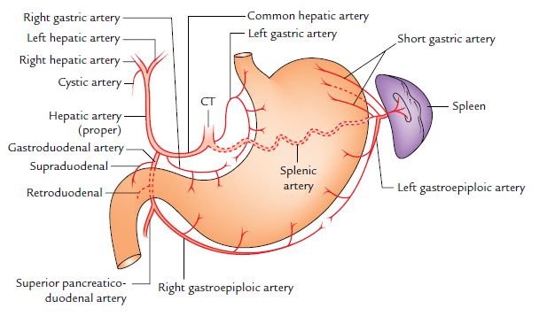
ARTERIAL SUPPLY
Arteries of the stomach (CT = coeliac trunk).

Slide 32
The stomach has rich arterial supply derived from the coeliac trunk and its branches.
The arteries supplying the stomach are:
1. Left gastric artery, a direct branch from the coeliac trunk.
2. Right gastric artery, a branch of the common hepatic
artery.
3. Left gastroepiploic artery, a branch of the splenic artery.
4. Right gastroepiploic artery, a branch of the gastroduodenal artery.
5. Short gastric arteries (five to seven in number), branches of the splenic artery.

Slide 33
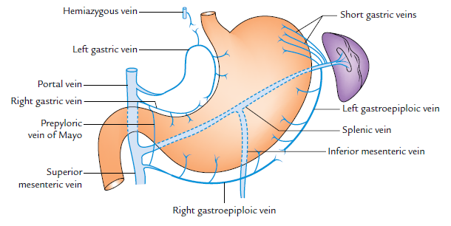
VENOUS DRAINAGE
Venous drainage of the stomach.

Slide 34
The veins of the stomach correspond to the arteries and
drain directly or indirectly into the portal vein.
The veins of the stomach are :
1. Left gastric vein.
2. Right gastric vein.
3. Left gastroepiploic vein.
4. Right gastroepiploic vein.
5. Short gastric veins.
The left and right gastric veins drain directly into the portal vein.
The left gastroepiploic and short gastric veins drain into the splenic vein.
The right gastroepiploic vein drains into the superior mesenteric vein.

Slide 35
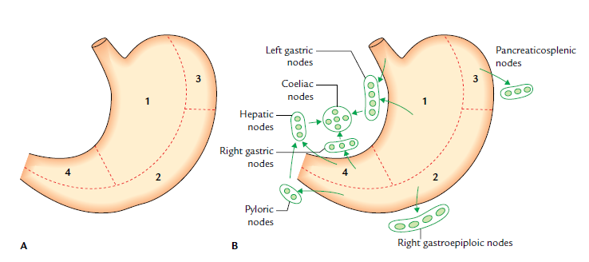
LYMPHATIC DRAINAGE
Lymphatic drainage of the stomach: A, lymphatic territories; B, lymph node groups draining the lymphatic territories of the stomach.

Slide 36
The knowledge of lymphatic drainage of the stomach is clinically very important because gastric cancer (carcinoma of stomach) spreads through the lymph vessels.
For descriptive purposes, the stomach is divided into four lymphatic territories as follows:
First, divide the stomach into right two-third and left one-third by a line along its long axis.
Now divide the right two-third into upper two-third (area 1) and lower one-third (area 4), and left one-third into upper one-third (area 3) and lower two-third (area 2).
In this way, four lymphatic territories are marked out and numbered 1 to 4.
Mode of lymphatic drainage from four lymphatic territories into different groups of lymph nodes is as follows :

Slide 37
1. Area 1 is the largest area along the lesser curvature. The lymph from this area is drained into left gastric lymph nodes along the left gastric artery. These lymph nodes also drain the abdominal part of the esophagus.
2. Area 2 includes the pyloric antrum and pyloric canal
along the greater curvature of the stomach.
(The carcinoma of the stomach most frequently occurs in this area.)
The lymph from this area is drained into right gastroepiploic lymph nodes along the right
gastroepiploic artery and pyloric nodes, which lie in the angle between the first and second parts of the duodenum.

Slide 38
3. Area 3 (also called pancreaticosplenic area) drains into pancreaticosplenic (pancreaticolienal) nodes along the splenic artery.
4. Area 4 includes the pyloric antrum and pyloric canal along the lesser curvature of the stomach.
The lymph from this area is drained into right gastric nodes along the right gastric artery and hepatic nodes along the hepatic artery.
The efferents from all these lymph node groups pass to the coeliac nodes.
Efferents from coeliac nodes enter the cysterna chyli through intestinal lymph trunk.

Slide 39
Clinical correlation
Gastric carcinoma (gastric cancer): It commonly occurs in the region of pyloric antrum along the greater curvature of the stomach.
The gastric cancer spreads by lymph vessels to the left supraclavicular lymph nodes.
The enlarged and palpable left supraclavicular node (Virchow’s node) may be the first sign of gastric cancer (Troisier’s sign).
The cancer cells reach the left supraclavicular lymph node through the thoracic duct.

Slide 40
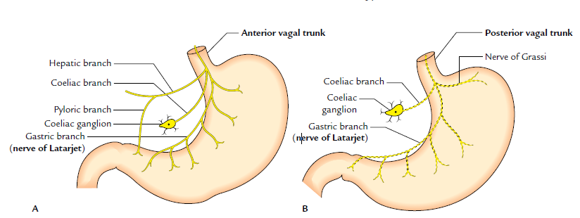
NERVE SUPPLY
Parasympathetic innervation of the stomach: A, distribution of the anterior vagal trunk; B, distribution of the posterior vagal trunk

Slide 41
NERVE SUPPLY
The stomach has both sympathetic and parasympathetic innervation.
Sympathetic Innervation
The sympathetic fibres are derived from T6 to T10 spinal
segments via greater splanchnic nerves, and coeliac and
hepatic plexuses.
They reach the stomach by running along its arteries.
The sympathetic supply to the stomach is (a) vasomotor,
(b) motor to pyloric sphincter, and inhibitory to the
remaining gastric musculature, and (c) serves as the chief pathway for pain sensations from the stomach.

Slide 42
Parasympathetic Innervation
The parasympathetic fibres are derived directly from the vagus nerves.
The anterior vagal trunk derived largely from the left
vagus nerve and partly from the right vagus nerve enters the abdomen on the anterior surface of the esophagus.
Soon after entering the abdomen it gives off three branches in the vicinity of the lesser curvature.

Slide 43
1. Hepatic branch (or branches), which runs in the upper
part of the lesser omentum to the porta hepatis to supply the liver and gallbladder. It also gives a branch to the pyloric antrum.
2. Coeliac branch, which follows the left gastric artery to
the celiac plexus.
3. Gastric branch/nerve of Latarjet (largest of the three
branches), which follows the lesser curvature and
distributes anterior gastric branches to the stomach as
far as the pylorus.

Slide 44
The posterior vagal trunk derived largely from the right
vagus nerve and partly from the left vagus nerve enters the
abdomen on the posterior surface of the esophagus; soon
after entering the abdomen it also gives rise to three types of
branches.
1. Coeliac branch to the coeliac ganglion.
2. Nerve of Grassi is the name given to one or more branches of the posterior vagal trunk which arises at the level of the gastroesophageal junction and supplies the gastric fundus.
3. Gastric branch (nerve of Latarjet) which runs along the
lesser curvature and gives branches to the posterior surface of the stomach.
N.B. The nerves of Latarjet supply the acid and pepsin secreting areas of the stomach.

Slide 45
Clinical correlation
• Vagotomy (a surgical procedure of cutting the vagus nerves): It is done to cure the chronic duodenal ulcers.
There are three different types of vagotomies:
(a) Truncal vagotomy: In this procedure the trunks of both gastric nerves are divided at the lower end of
esophagus.
(b) Selective vagotomy: In this procedure the hepatic
and coeliac branches are preserved but the main
trunks of gastric nerves along with nerve of Laterjet
are cut.

Slide 46
N.B. The above two procedures cause denervation of pyloric antrum with subsequent defect in gastric emptying.
(c) Highly selective vagotomy: In this procedure only
parietal cells of the stomach are denervated.
The nerve of Laterjet is dissected out and cut.
In this procedure gastric emptying is not affected, hence it is regarded by many as the procedure of choice in surgical treatment of duodenal ulcer.
• Gastric pain: It is usually referred to the epigastric region because the stomach is supplied by T6–T10 spinal segments.

Slide 47
Vagotomy
The vagus nerves largely control the secretion of acid by the parietal cells of the stomach.
Since excess acid secretion is the main cause of peptic ulcers, the section of vagal trunks (vagotomy) as they enter the abdomen is carried out to reduce the production of acid.
Vagotomy is of three types:

Slide 48
1. Truncal vagotomy: In this both the vagal trunks
(anterior and posterior) are sectioned at the lower end of the esophagus.
2. Selective vagotomy: In this, the nerves of Latarjet are
selectively cut to denervate the acid and pepsin secreting area of the stomach.
The disadvantage of both truncal and selective vagotomy is that pyloric antrum is denervated.
Consequently the gastric emptying is affected.
3. Highly selective vagotomy: In this only parietal cells of the stomach are denervated by cutting the anterior and posterior gastric branches, particularly the nerve of
Grassi.
The advantage of high selective vagotomy is that nerves of Latarjet and their antral branches are preserved.
As a result, the gastric emptying remains normal.

Slide 49
Q. 1 Widest parts of G I T is ….
a) Esophagus b) Stomach
c) Duodenum d) Jeunum
Q. 2 All following structures forms stomach bed except …
(a) Diaphragm (b) Left kidney
(c) Left suprarenal gland (e) Transverse colon
Q. 3 Which following artery direct branch of coeliac trunk supply blood to stomach.
a) Left gastric artery b) Right gastric artery
c) Left gastroepiploic artery d) Right gastroepiploic artery.

Slide 50
Q. 4 All following structures are interior of stomach except ….
a) Gastric rugae b) Gastric pits c) Gastric canal
d) Angular notch
Q. 5 Venous blood from stomach drain in to …
a) Splenic vein b) Portal vein c) Inferior mesenteric vein d) Superior mesenteric vein.
N B.
For your presence please write correct answer and send M C Q to
kmparmar58@gmail.com

