Slide 1
Dr K M Parmar
Date - 28/07/21
SUBTALAR JOINT (Talocalcanean)
TRANSVERSE TARSAL JOINTS,
INVERSION AND EVERSION,
LIGAMENTS OF FOOT WITH ITS
APPLIED

Slide 2
Subtalar (Talocalcanean) Joints
There are two joints between the talus and calcanean: a) posterior talocalcanean joint and b) anterior talocalcaneonavicular joint.
The posterior talocalcanean joint is often designated as subtalar joint.
It is a plane type of synovial joint. It is formed between the concave facet on the inferior surface of the body of talus and convex facet on the middle one-third of the superior surface of the calcaneum.

Slide 3
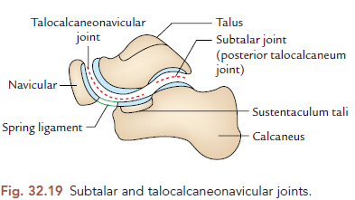

Slide 4
Ligaments
These are: (a) fibrous capsule, (b) lateral and medial
talocalcanean ligaments, (c) interosseous talocalcanean
ligament, and (d) cervical ligament.
The interosseous talocalcanean ligament is thick and very
strong.
It forms the chief bond of union between the talus and calcaneum.
It occupies sinus tarsi and separates the
talocalcanean joint from the talocalcaneonavicular joint.
It extends obliquely from the sulcus tali to the sulcus calcanei.
It becomes taut in eversion.
The cervical ligament is lateral to sinus tarsi.
It extends upward and medially from upper surface of the calcaneum to the tubercle on the inferolateral aspect of the neck of talus.
It becomes taut in inversion.

Slide 5
Talocalcaneonavicular Joint
It is a compound articulation consisting of anterior
talocalcanean and talonavicular joints.
It is roughly a ball and socket type of synovial joint. The articular surface on the rounded head of the talus fits into the socket formed by the calcaneum, navicular, and spring ligament.
Ligaments
These are: (a) fibrous capsule,
(b) spring ligament, and
(c) medial limb (calcaneonavicular part) of bifurcate ligament.

Slide 7
The spring ligament (plantar calcaneonavicular ligament)
is a powerful fibrocartilaginous band, which extends from the anterior margin of the sustentaculum tali to the plantar surface of navicular bone between its tuberosity and articular
margin.
It takes part in forming the socket for the head of the talus.
It is the most important ligament to maintain the medial longitudinal arch.
Its upper surface has a triangular fibrocartilagenous facet for the head of the talus.
Its plantar surface is supported by the tendon of tibialis posterior medially, and by the tendons of flexor hallucis longus and flexor digitorum longus laterally.
The talocalcaneonavicular joint permits the movements of inversion and eversion.

Slide 8
Calcaneocuboid Joint
It is a saddle type of synovial joint.
The opposed articular surfaces of the calcaneum and cuboid are reciprocally concavoconvex.
Ligaments
The ligaments of the joint are: (a) fibrous capsule, (b) lateral limb (calcaneocuboid part) of bifurcate ligament, (c) long plantar ligament, and (d) short plantar ligament.
The bifurcate ligament is Y-shaped.
Its stem is attached to the anterolateral part of the sulcus calcanei.
Its medial limb (calcaneonavicular part) is attached to the dorsolateral surface of the navicular bone and its lateral limb (calcaneocuboid part) to the dorsomedial surface of the cuboid bone.
The two limbs provide support to the joints.

Slide 9
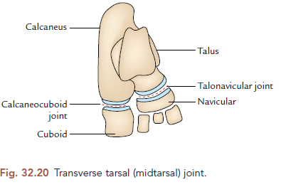

Slide 10
The long planar ligament is the longest ligament.
It is strong and its importance in maintaining the arches of foot
is surpassed only by the spring ligament.
It extends from triangular plantar surface of the calcaneum to the lips of the groove on cuboid and beyond it to the bases of the middle three metatarsals (second to fourth).
It converts the groove on the plantar surface of cuboid into a tunnel for the passage of tendon of peroneus longus. Morphologically, it represents the divorced tendon of the gastrocnemius.
The short plantar ligament (plantar calcaneocuboid ligament)
lies deep to long plantar ligament.
It is broad and extends from the anterior tubercle of calcaneum to the plantar surface of the cuboid behind its ridge.

Slide 11
Transverse Tarsal (Midtarsal) Joint
It is a compound joint consisting of calcaneocuboid and talonavicular joints.
Talonavicular is also a part of talocalcaneonavicular joint.
The calcaneocuboid and talonavicular joints are grouped together because both are placed nearly in the same transverse plane.
However, the two joints have different axes of movements.
The movements of midtarsal joint help in inversion and eversion of the foot.

Slide 13
INVERSION AND EVERSION OF THE FOOT
The inversion and eversion and rotational movements of the foot on the talus.
The inversion is a movement in which the medial border of the foot is raised so that the sole faces medially.
The eversion is a movement in which the lateral border of the foot is raised so that the sole faces laterally.
N.B. There is difference in the relational movements
associated with inversion and eversion when the foot is off the ground and on the ground as given in Table 32.5.

Slide 14
Joints Taking Part
1. Subtalar joint.
2. Talocalcaneonavicular joint } Main joints.
3. Transverse tarsal/midtarsal joint—Accessory joint.
Axis of Movements
The movements of inversion and eversion take place around an oblique axis which runs forward, upward, and medially passing from the back of calcaneum through the sinus tarsi to emerge at the superomedial aspect of the neck of talus.

Slide 15
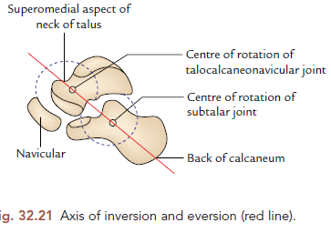

Slide 16
Range of Movements (ROM)
1. The range of movement of inversion is much more
than that of eversion (inversion 30°, eversion 20°).
2. The range of these movements is appreciably increased in plantar flexion of the foot because in this position, the narrow posterior part of the trochlear surface of talus occupies the tibiofibular socket (mortise), which permits some degree of side to side movement of the talus.

Slide 17
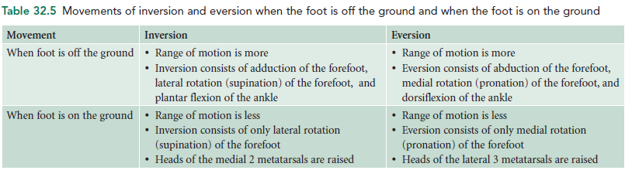

Slide 18
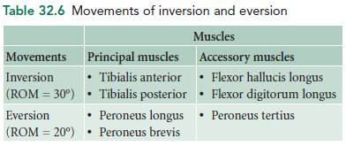

Slide 19
Muscles Producing Movements
The movements of inversion and eversion and muscles producing them are given in Table 32.6.
Functional Significance
The movements of inversion and eversion are necessary for walking on uneven and sloping grounds.
They greatly help the foot in adjusting it to such grounds.
When feet are supporting the body weight, these movements occur in a modified form called supination and pronation.

Slide 20
TARSOMETATARSAL JOINTS
These are plane type of synovial joints.
They are connected by dorsal, plantar, and interosseous tarsometatarsal ligaments.
They are five in number.
The first joint possesses a separate cavity, the second and third together have one cavity.
These joints permit only limited gliding movements.

Slide 21
METATARSOPHALANGEAL JOINTS
These are ellipsoidal type of the synovial joints.
They are connected by the capsular, collateral, plantar, and deep transverse metatarsal ligaments. Two collateral ligaments strengthen the sides of each joint.
These joints permit the slight gliding movements. The deep transverse ligaments (four in number) connect the plantar ligaments of adjacent
metatarsophalangeal joints.

Slide 22
Movements
These joints permit dorsiflexion, plantar flexion, adduction, and abduction.
The range of dorsiflexion is more (50–60°) than that of plantar flexion (30–40°).
The axis of adduction and abduction of the toes passes through the least mobile second metatarsal bone.
The axis of adduction and abduction of fingers passes through the third metacarpal bone.)

Slide 23
INTERPHALANGEAL JOINTS
These are typical hinge joints.
They are connected by the capsular and collateral ligaments.
Movements
These joints permit dorsiflexion and plantar flexion of distal phalanges.

