Slide 1
ROTATOR CUFF,AXILALRY NERVE,WINGING OF SCAPULA
Dr.kinjal Jethva

Slide 2
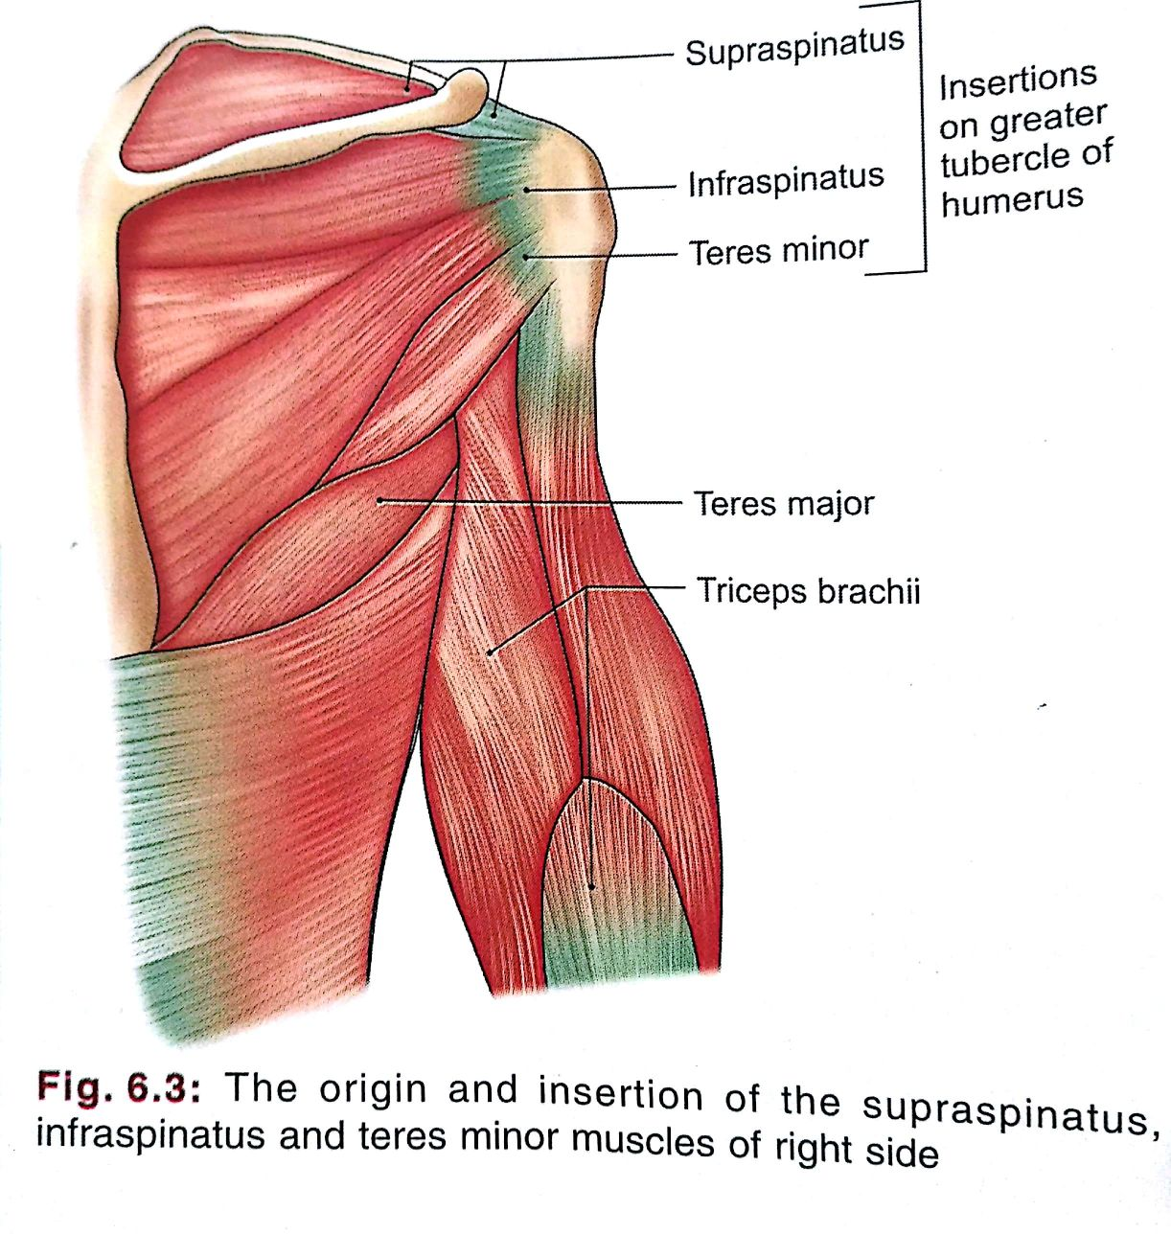
Scapular region muscles

Slide 3
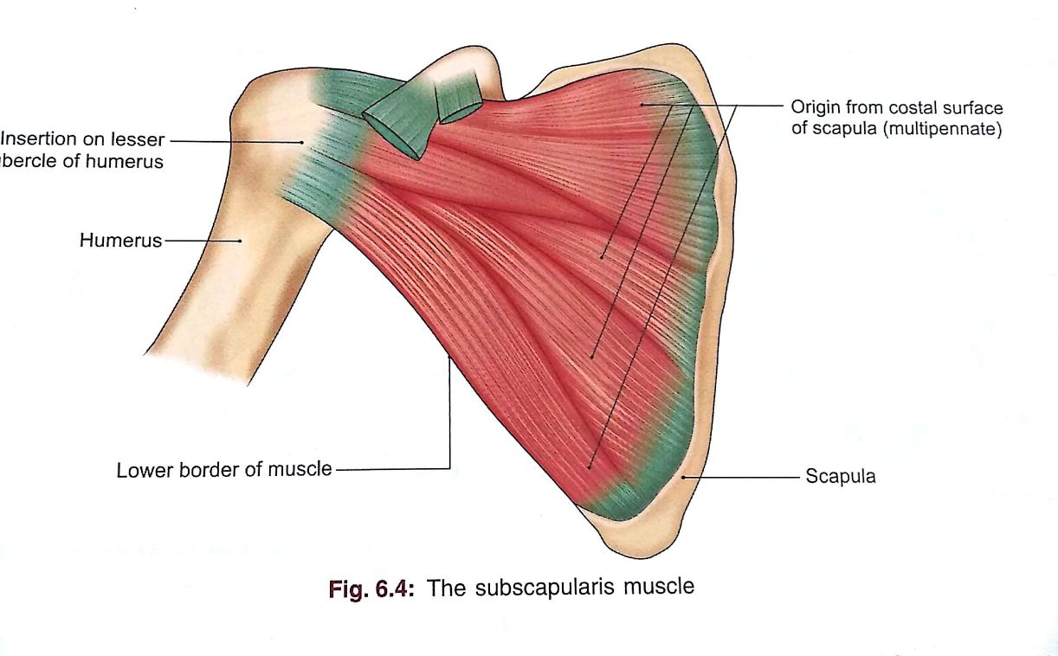

Slide 4
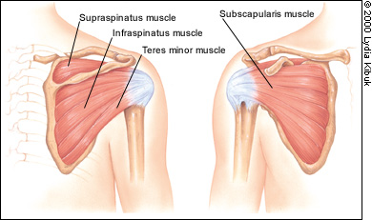

Slide 5
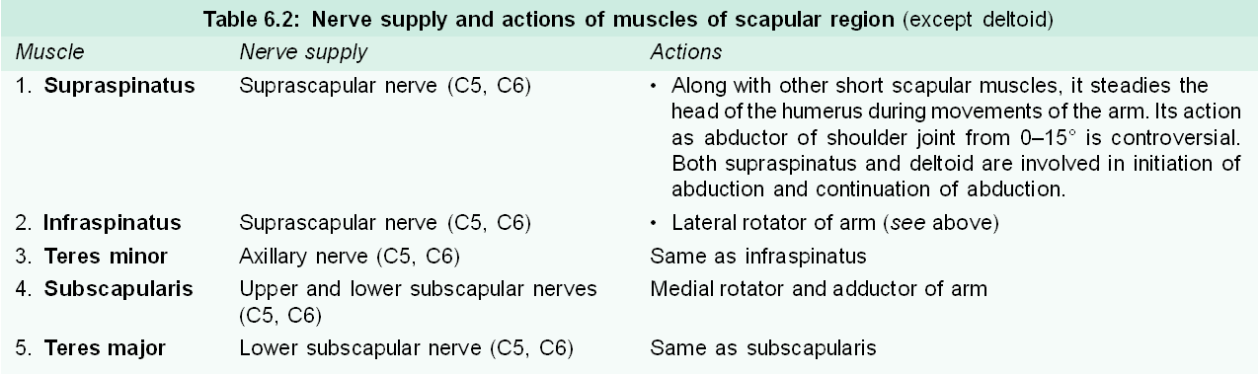

Slide 6
Rotator cuff or Musculotendinous cuff
It is fibrous sheath formed by four flattened tendons which blends with capsule of the joint & strengthen it.
The muscles which form the cuff is origin from scapula & inserted on lesser & greater tubercle.

Slide 7
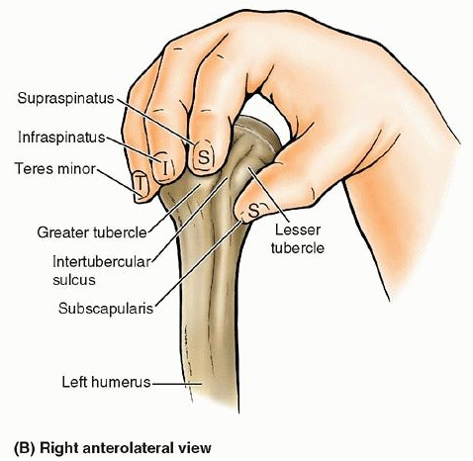
ROTATOR CUFF

Slide 8
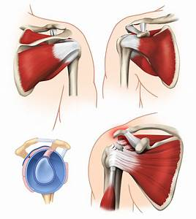

Slide 9
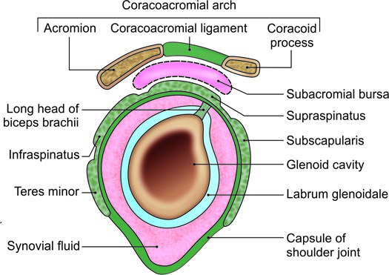
Ant
The musculotendinous cuff of the shoulder

Slide 10
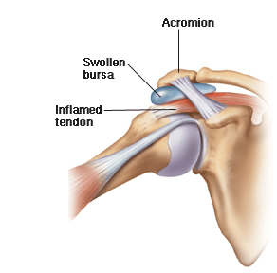

Slide 11
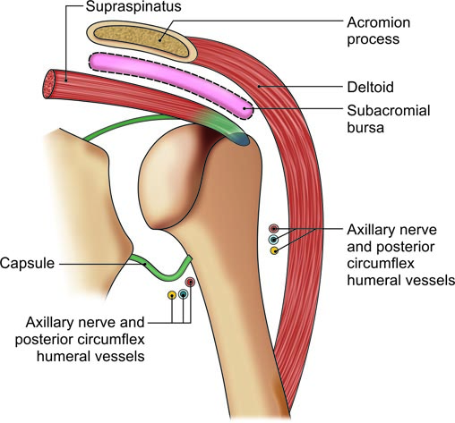
The subacromial bursa as seen in coronal section

Slide 12
Subacromial bursa
This is the largest bursa of the body situated below the coracoacromial arch & deltoid muscle.
Below the bursa there are tendon of the supraspinatous & greater tubercle of the humerus.

Slide 13
During abduction it has great value
It protects tendon of supraspinatous against friction with acromion.
During over head abdduction greater tubercle passes under acromion which facilitated by presence of bursa

Slide 14
The subacromial bursa as seen in coronal section

Slide 16
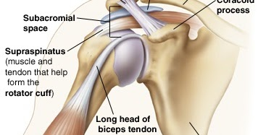

Slide 17
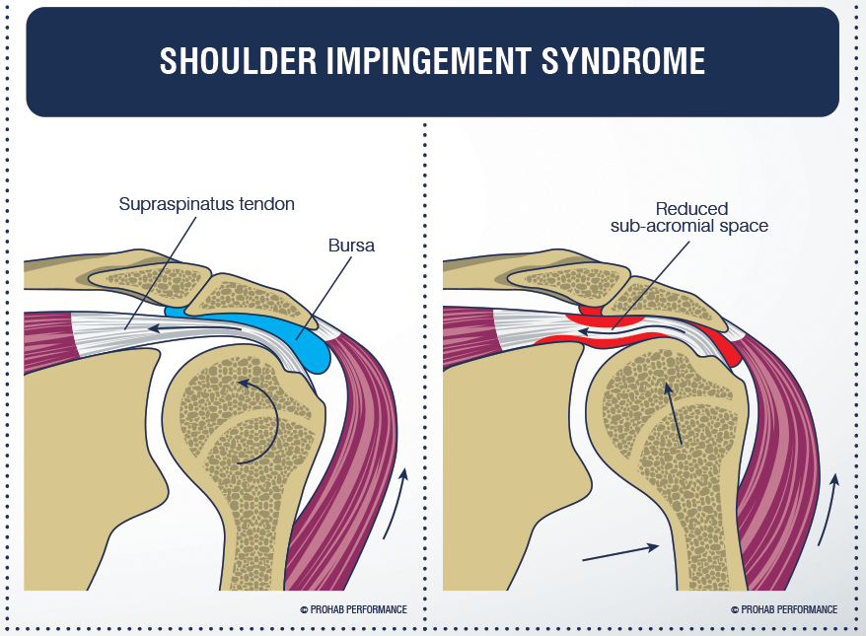

Slide 18
Intermuscular spaces
Potential space formed between triceps muscle, teres major & minor ,scapula, humerus for passage of blood vessels & nerves from anterior to posterior aspect

Slide 19
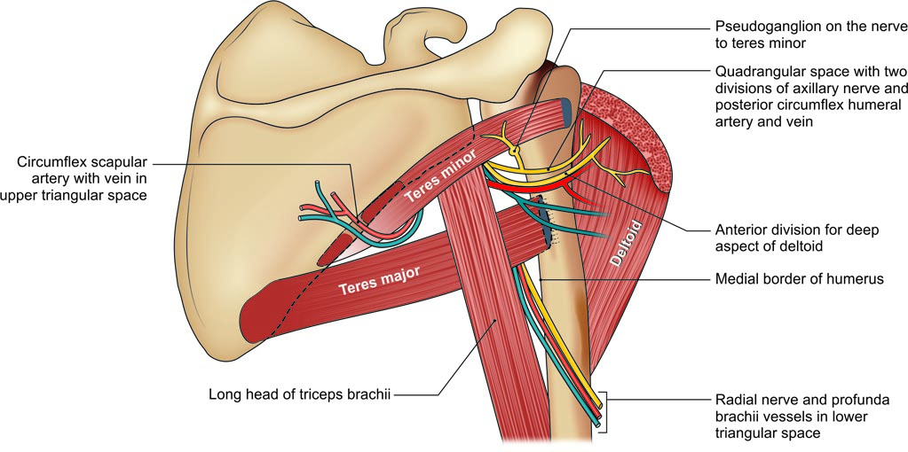
The intermuscular spaces in the scapular region, including the quadrangular, upper triangular and lower triangular spaces

Slide 20
Quadrangular Space
Boundaries
Superior
i. Subscapularis in front.
ii. Capsule of the shoulder joint.
Inferior: Superior border of teres major.
Medial: Lateral border of long head of the triceps brachii.
Lateral: Surgical neck of the humerus.
Contents
i. Axillary nerve
ii. Posterior circumflex humeral vessels.

Slide 21
The intermuscular spaces in the scapular region, including the quadrangular, upper triangular and lower triangular spaces

Slide 22
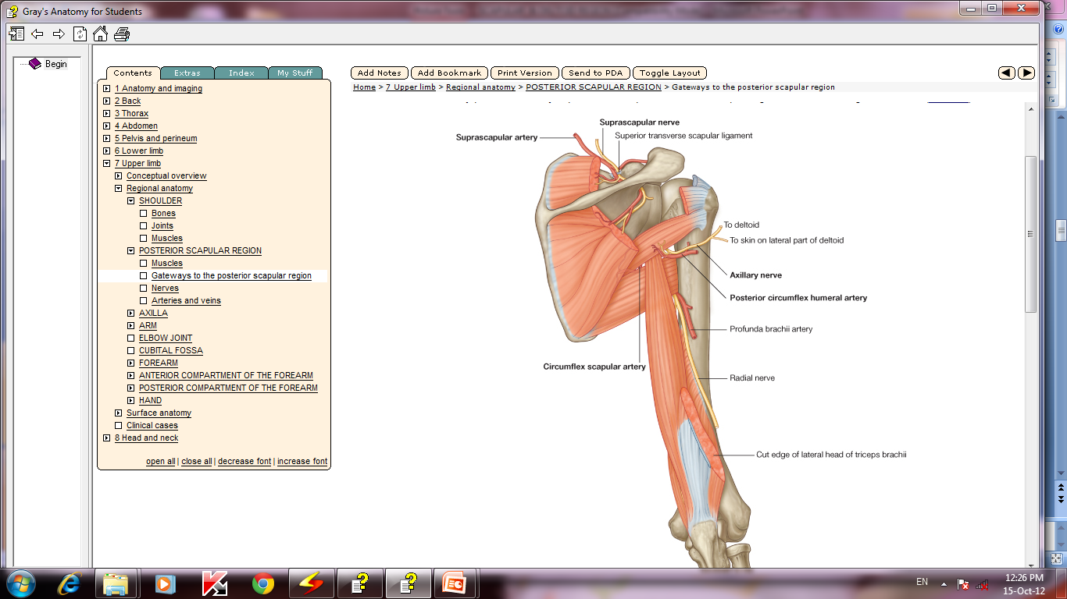

Slide 23
Upper Triangular Space
Boundaries
Superior: Inferior border of teres minor.
Lateral: Medial border of long head of the triceps brachii.
Inferior: Superior border of teres major.
Contents
Circumflex scapular artery.

Slide 24
The intermuscular spaces in the scapular region, including the quadrangular, upper triangular and lower triangular spaces

Slide 26
Lower Triangular Space
Boundaries
Medial: Lateral border of long head of the triceps brachii
Lateral: Medial border of humerus
Superior: Lower border of teres major
Contents
i. Radial nerve
ii. Profunda brachii vessels

Slide 27
The intermuscular spaces in the scapular region, including the quadrangular, upper triangular and lower triangular spaces

Slide 29
AXILLARY OR CIRCUMFLEX NERVE
Axillary nerve is called axillary as it runs through the upper part of axilla.
It is called circumflex as it courses around the surgical neck of humerus to supply the prominent deltoid muscle.
Root Value
Ventral rami of C5, C6 segments of spinal cord.

Slide 30
Course
Axilla
Axillary or circumflex nerve is the smaller terminal branch of posterior cord seen in the axilla.
Quadrangular Space
The nerve passes backwards through the quadrangular space. Here it lies below the capsule of the shoulder joint.

Slide 31
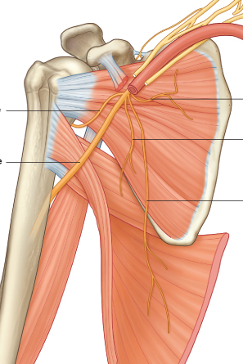
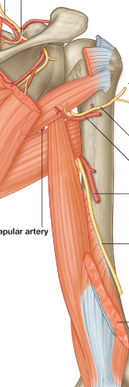
Axillary Nerve (C5-C6)
A
V
Post.cord
LT

Slide 33
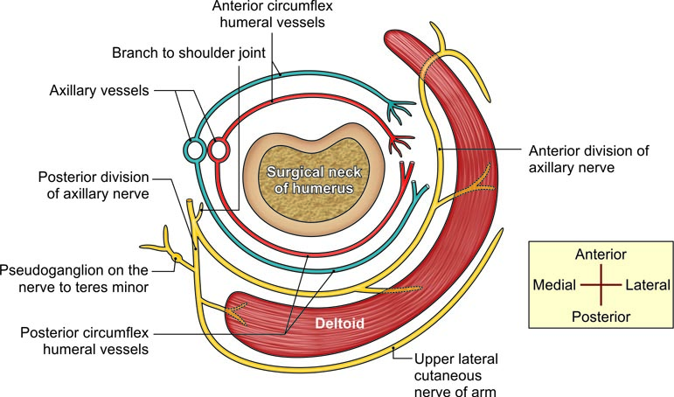
Horizontal section of the deltoid region showing the nerves and vessels around the surgical neck of humerus

Slide 34
Surgical Neck of Humerus
Then it passes behind the surgical neck of humerus where it divides into anterior and posterior divisions.
so it is important because it is involved in fracture of surgical neck of humerus
Branches
The branches of axillary nerve are presented in

Slide 35
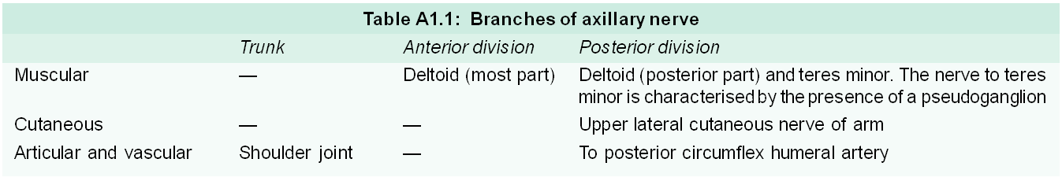

Slide 36
1)RADIAL nerve is passes through
Upper triangular space
Lower triangular space
Quadrangular space
All of the above

Slide 37
2)Axillary nerve is passes through
Upper triangular space
Lower triangular space
Quadrangular space
All of the above

Slide 38
3) Teres minor is supplied by
Upper subscapular
Lower subscapular
Axillary
suprascapular

Slide 39
4) Which nerve has pseudoganglion?
Nerve to teres minor
Lower subscapular
Axillary
suprascapular

Slide 40
5)Which is not a content of quadrangular space
Posterior circumflex vein
Profunda brachi vein
Posterior circumflex artery
Circumflex nerve

Slide 41
Case 3.
A man came to hospital after a car accident. On examination his left shoulder was flattened and head of humerus was palpable on the infra clavicular fossa. X – ray confirmed the anterior dislocation shoulder. For surgical reduction incision was placed in deltopectoral groove.

Slide 42
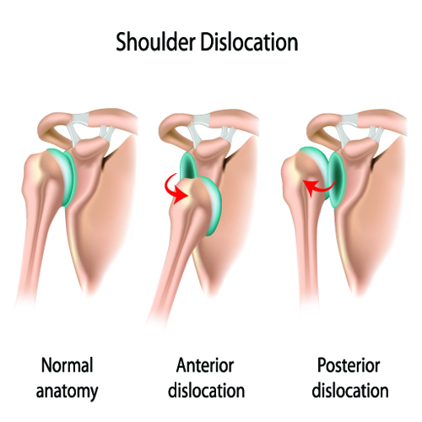

Slide 43
a) Which blood vessel is located in the deltopectoral groove?
b) After retracting deltoid and pectoralis major muscles which bony part of scapula is exposed?
c) Name two muscles attached to this process.
d) Which nerve can get injured?

Slide 44
Case 4
A labourer experienced difficulty in raising the right arm vertically upwards. The doctor asked the man to press his hands against the wall in front. It was found that the medial border and inferior angle of his right scapula became prominent.

Slide 45
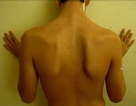

Slide 46
Questions:
a) Which muscle is tested to detect injury to which nerve?
b) Name the deformity of the scapula.
c) How does this nerve enter axilla?
d) What is the action of this muscle?

