Slide 1
VERTEBRAL COLUMN,CURVATURES,INTERVERTEBRAL JOINT,SACROILIAC JOINT,SYMPHASIS PUBIS ,LUMBAR PUNCTURE
DR.NIRALI CHAVDA
11/06/21

Slide 2
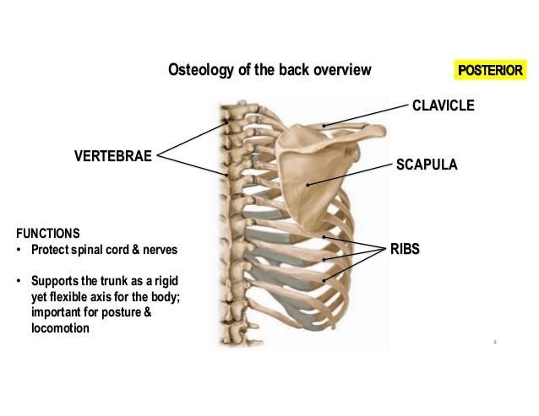

Slide 3
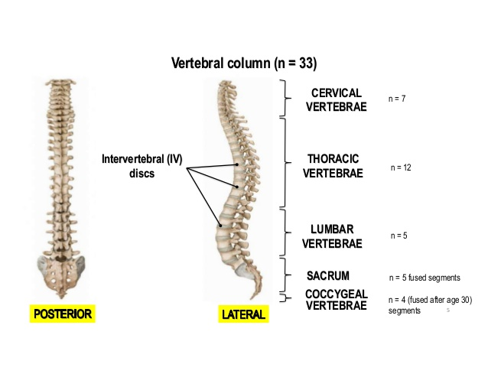

Slide 4
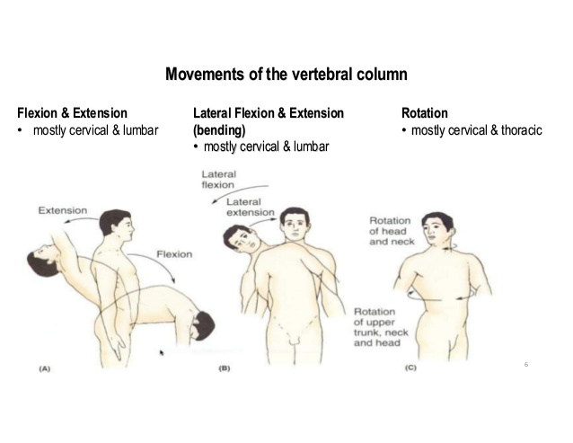

Slide 5
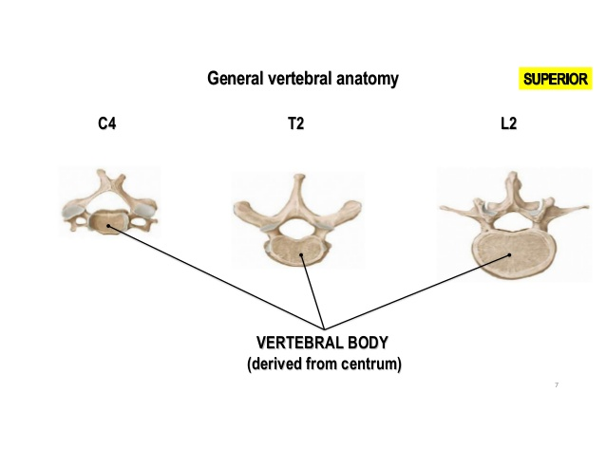

Slide 6
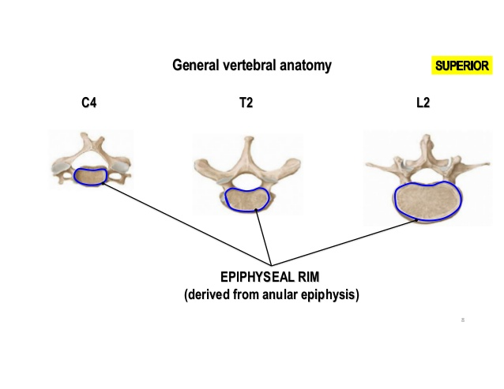

Slide 7
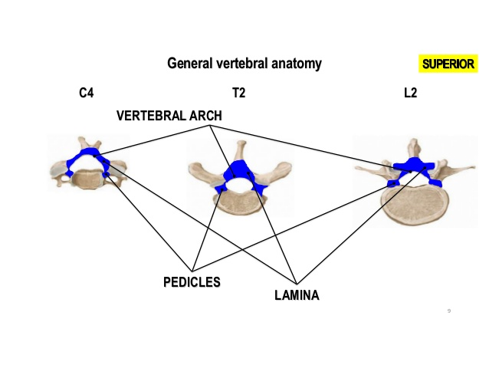

Slide 8
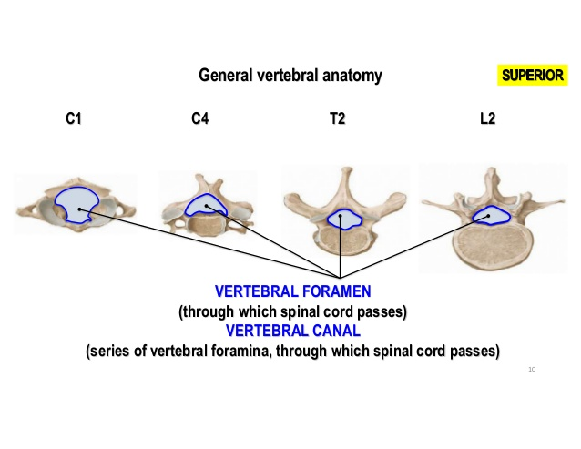

Slide 9
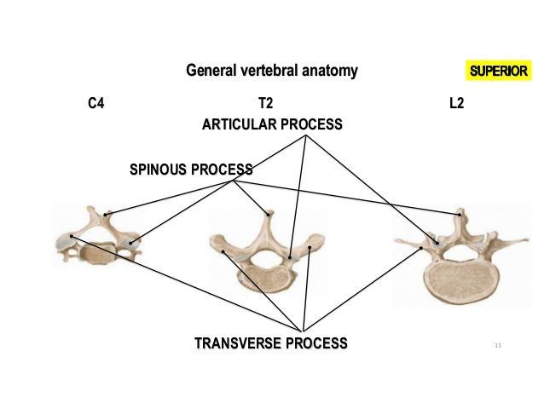

Slide 10
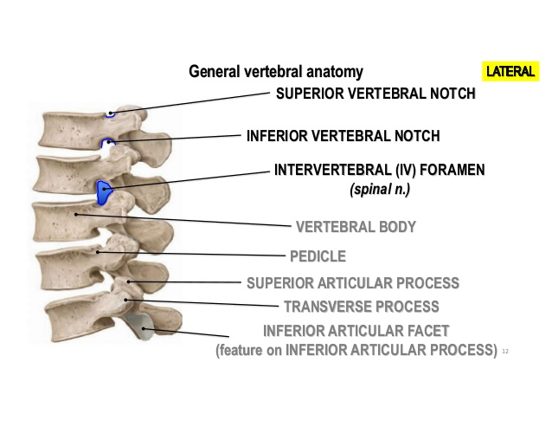

Slide 11
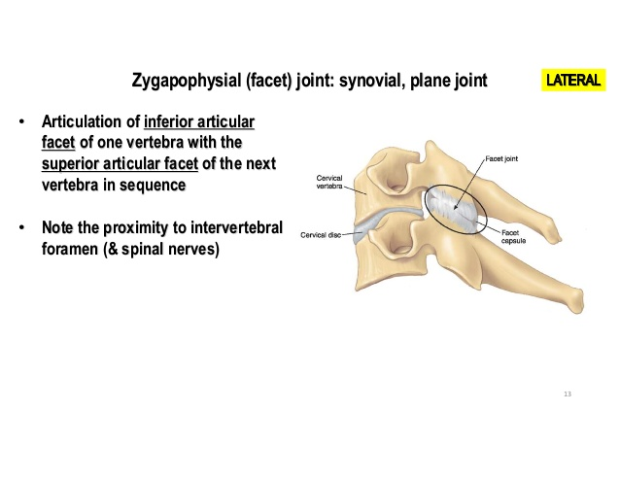

Slide 12
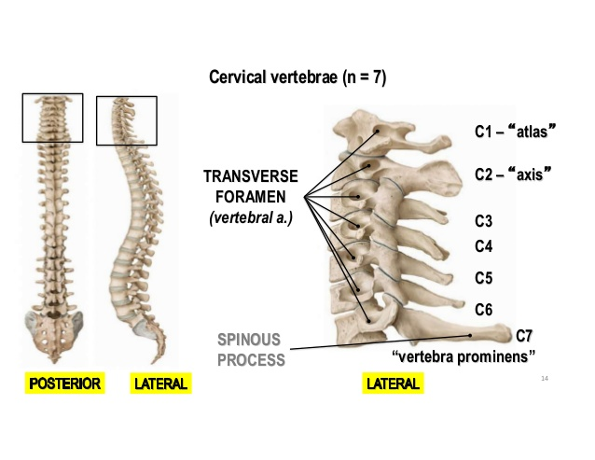

Slide 13
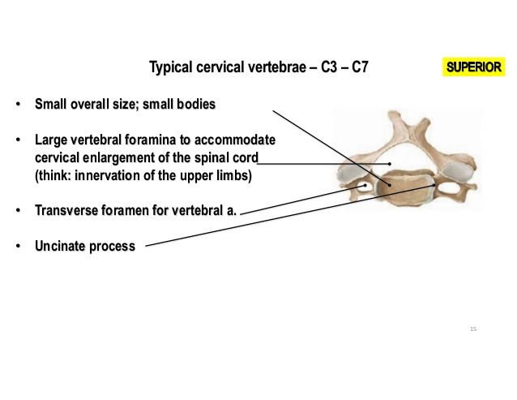

Slide 14
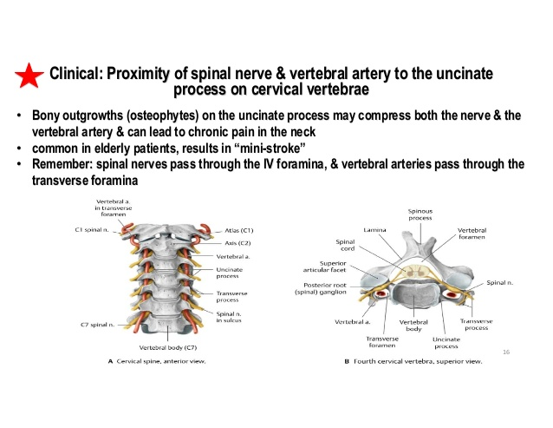

Slide 15
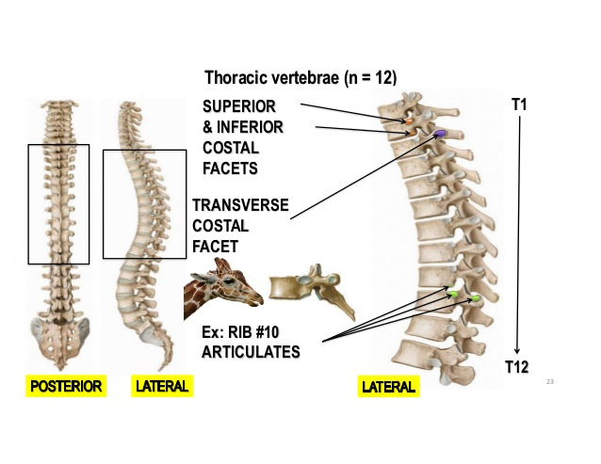

Slide 16
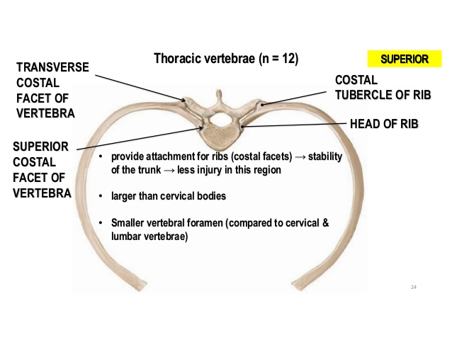

Slide 17
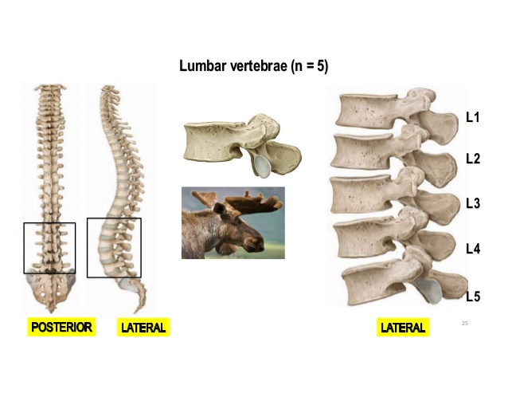

Slide 18
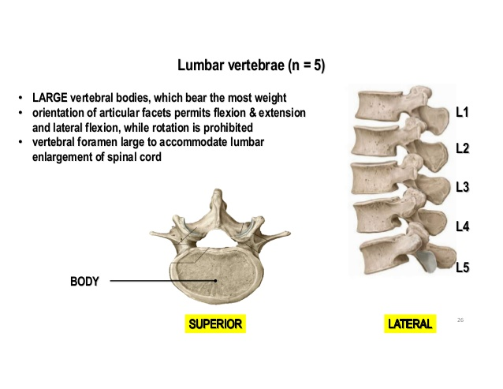

Slide 19
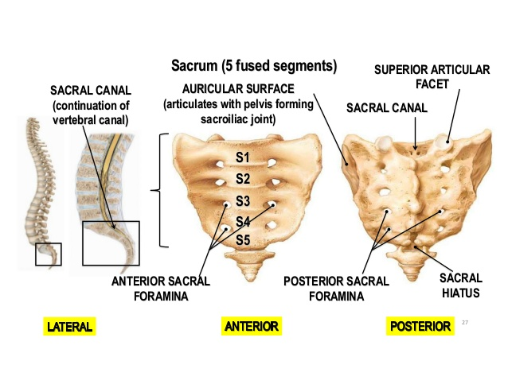

Slide 20
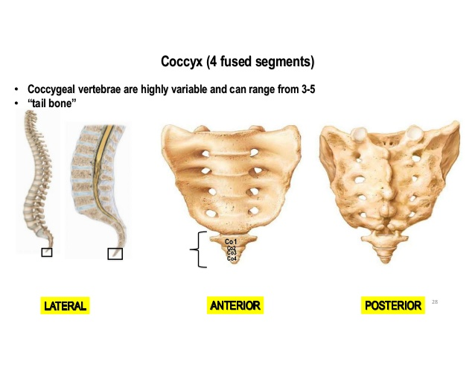

Slide 21
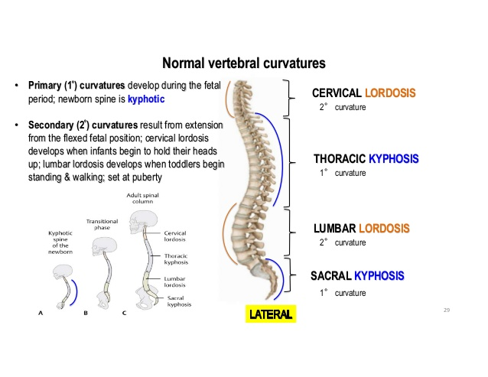

Slide 22
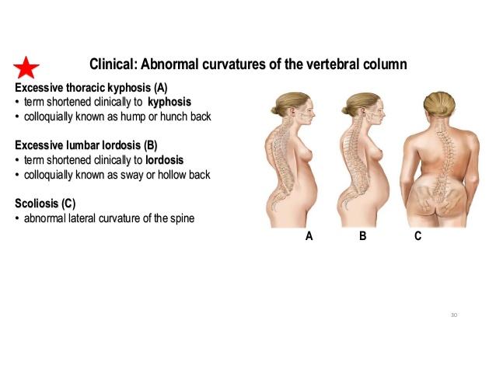

Slide 23
INTERVERTEBRAL JOINTS
are formed(a) between the bodies of the vertebrae, and
(b) between the articular processes of the vertebra.
joints between the bodies of the vertebrae these are secondary cartilaginous joint.
The inferior and superior surfaces of the adjacent vertebral bodies are covered by thin plates of hyaline cartilages, which in turn are united by fibrocartilaginous intervertebral disc.
The disc consists of an outer rim by fibrocartilage—the annulus fibrosus and a central core of gelatinous substance—the nucleus pulposus.
These joints are held together by anterior and posterior longitudinal ligaments of the vertebral column

Slide 24
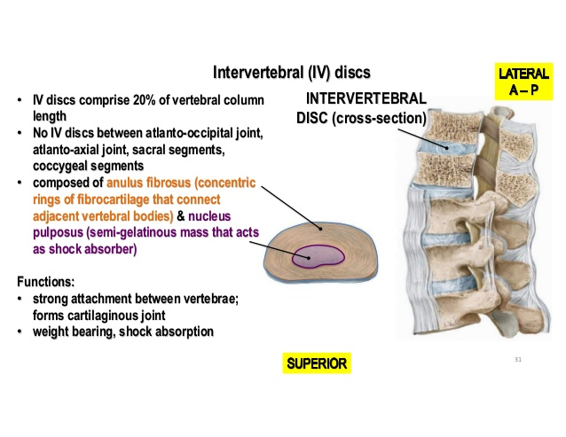

Slide 25
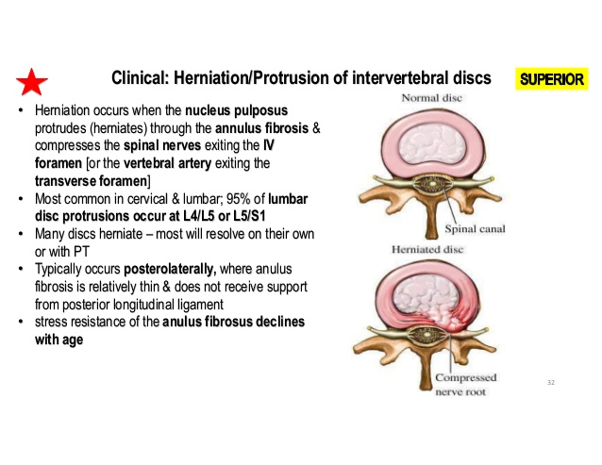

Slide 26
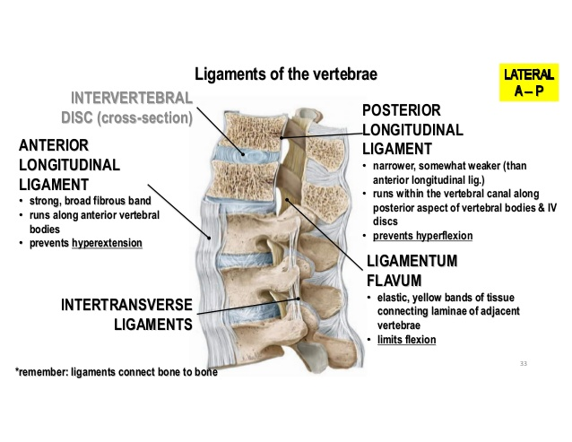

Slide 27
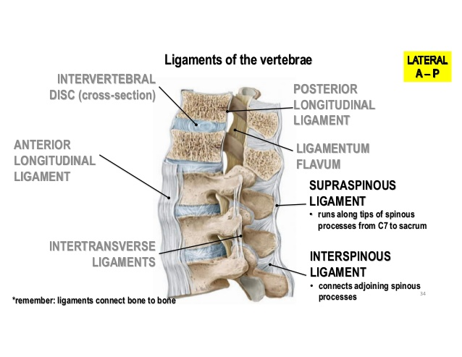

Slide 28
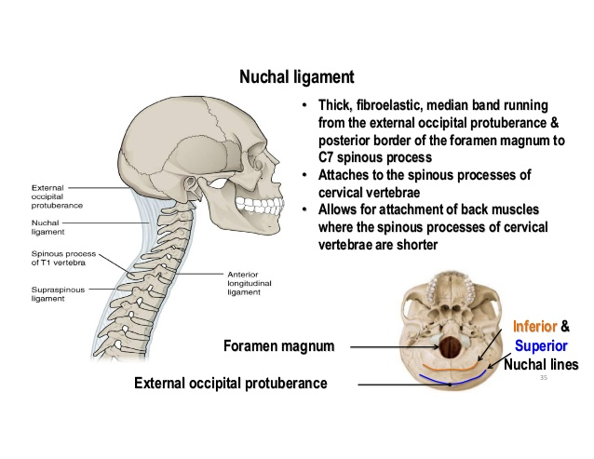

Slide 29
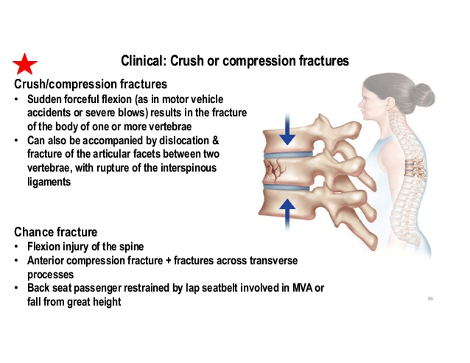

Slide 30
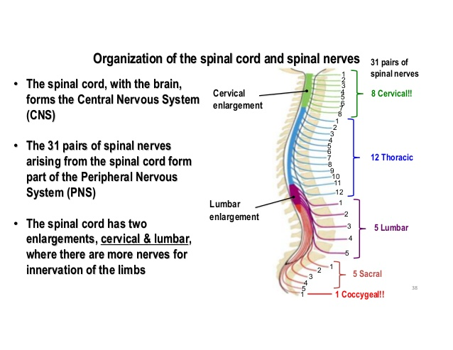

Slide 31
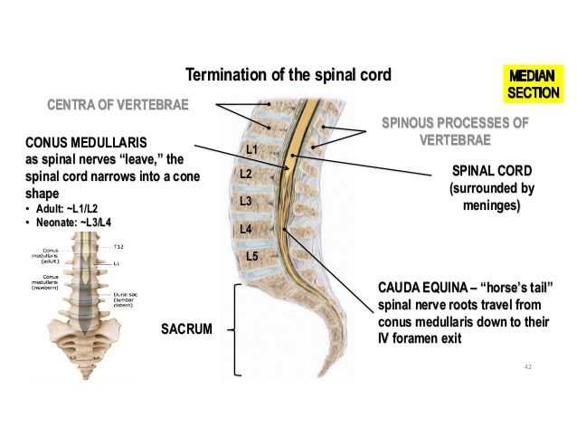

Slide 32
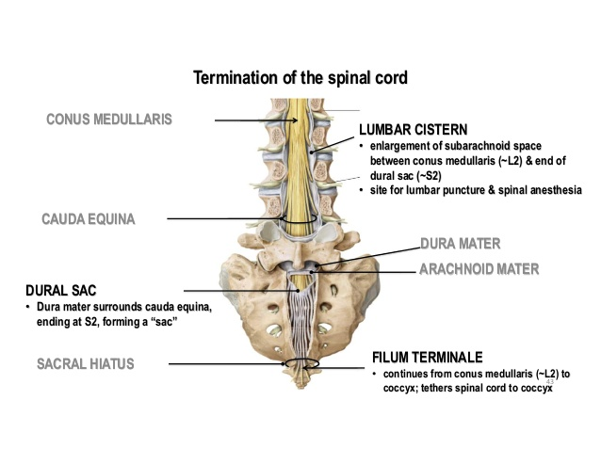

Slide 33
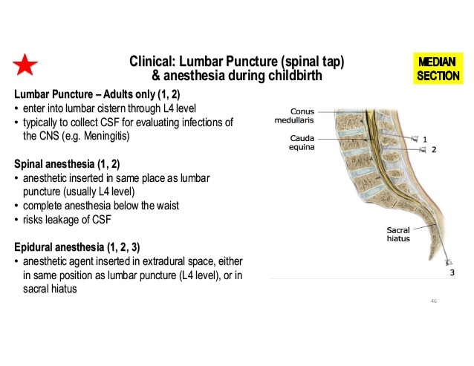

Slide 34
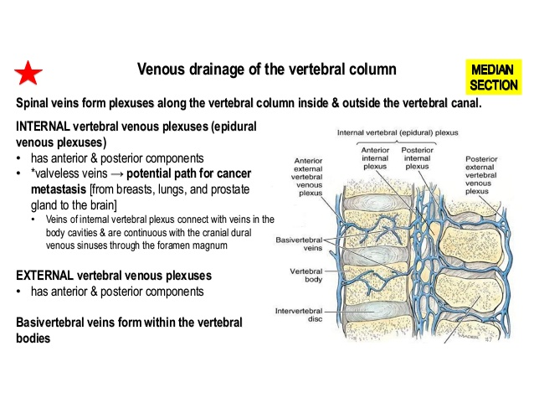

Slide 35
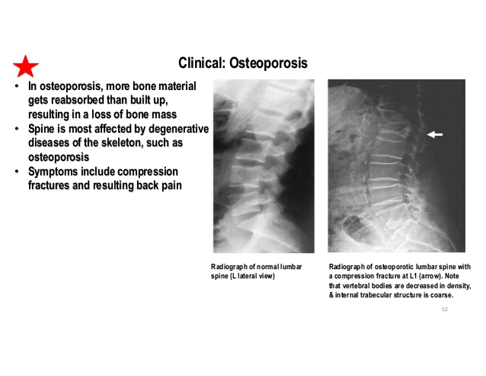

Slide 36
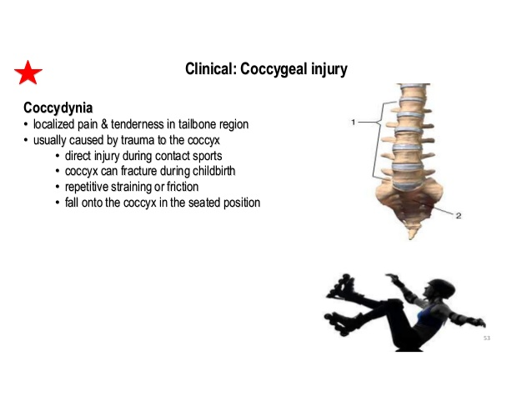

Slide 37
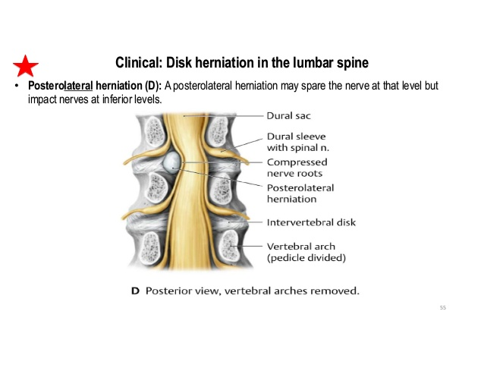

Slide 38
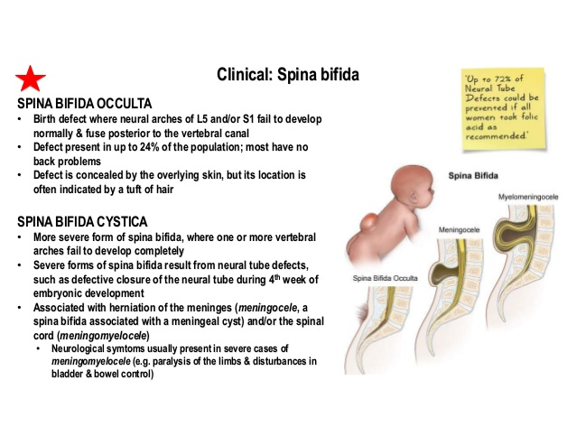

Slide 39
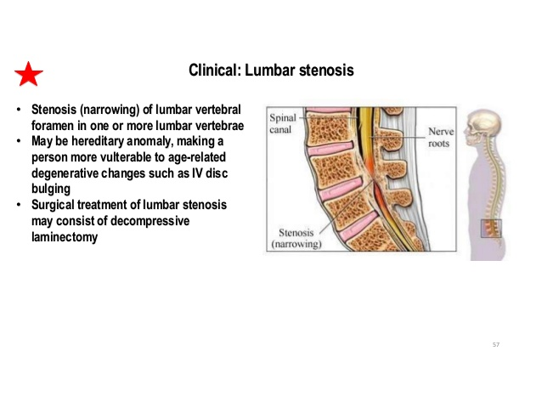

Slide 40
SYMPHYSIS PUBIS
is a secondary cartilaginous joint between the bodies of two pubic bones.
The articular surfaces are covered by a plate of hyaline cartilage which are then united by a disc of fibrocartilage.
The joint is surrounded and strengthened by the fibrous ligaments, especially above and below. The inferior pubic ligament is very strong.

Slide 41
SACROILIAC JOINTS
as plane synovial joints formed by union of the a ilium on each side.
The sacroiliac joint is surrounded and strengthened by the following ligaments:
1. Interosseous sacroiliac ligament.2. Ventral sacroiliac ligament.3. Dorsal sacroiliac ligament.4. Iliolumbar ligaments auricular surfaces of the sacrum and the

Slide 42
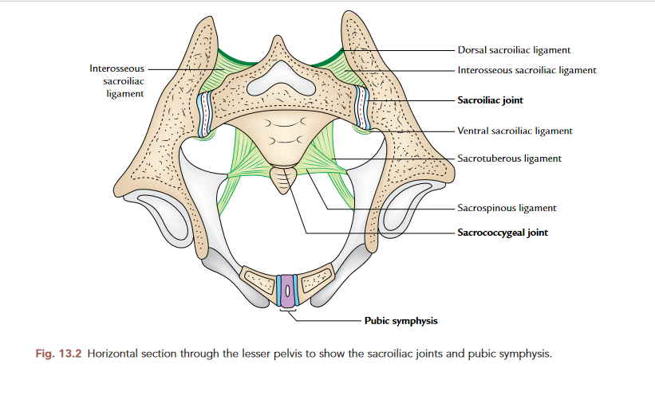

Slide 43
(a) An anterior plane type of synovial joint between the auricular surfaces of the ilium and sacrum.
(b) A posterior syndesmosis between the tuberosities of the sacrum and ilium
The interosseous sacroiliac ligament is the second strongest ligament in the body and connects the irregular bony tuberosities of the sacrum and ilium behind the auricular surfaces.
The ventral sacroiliac ligament connects the ala and pelvic surface of the sacrum with the adjacent part of the ilium.
The dorsal sacroiliac ligament is made up of strong fibrous bands, which connect the posterosuperior iliac spine of ilium with the intermediate sacral crest.
The iliolumbar ligament connects the transverse process of the L5 vertebra to the ilium

Slide 44
Sacrotuberous ligament: is a strong broadband of the fibrous tissue. It has broad upper medial end and narrow lower lateral end.
The upper end is attached from above downward to the posterior superior iliac spine, posterior inferior iliac spine, lower part of the posterior surface, and lateral border of the sacrum, and adjoining upper part of the coccyx. Its lower end is attached to the medial margin of the ischial tuberosity.
Some of the fibres from the lower end are continued on to the ramus of the ischium to form falciform process

Slide 45
Sacrospinous ligament is a triangular sheet of fibrous tissue, with its apex attached laterally to the ischial spine and base attached medially to the side of sacrum and coccyx.
The sacrotuberous and sacrospinous ligaments convert the greater and lesser sciatic notches of the hip bone into greater and lesser sciatic foramina—the two important exits from the pelvis

Slide 46
Stability of the Sacroiliac Region
sacrum hangs from sacroiliac joints forming the posterior wall of the pelvis. The body weight tends to cause forward rotation of the upper end of sacrum and concomitant backward rotation of its lower end
Ligaments resisting forward rotation of the upper end of sacrum are:1. Interosseous sacroiliac ligament.2. Posterior sacroiliac ligament.3. Iliolumbar ligament

Slide 47
Ligaments resisting the backward relation of the lower end of the sacrum are as follows:
1. Sacrotuberous ligament.2. Sacrospinous ligament.3. Sacrococcygeal joint.

Slide 48
MCQ
1.All structures emerge through the sacral hiatus except:
Fifth sacral nerves(b) Coccygeal nerves(c) Filum terminale(d) Spinal meninges
2. The major function of intervertebral discs is to __________
(a) Absorb shock
(b) String the vertebrae together
(c) Prevent injuries
(d) Prevent hypertension

Slide 49
3.Which of the following joints is of synovial variety?
(a) Lumbosacral joint(b) Sacroiliac joint(c) Pubic symphysis(d) Sacrococcygeal joint
4. Which of the following ligaments is the strongest?
Iliolumbar ligament
(b) Interosseous sacroiliac ligament
(c) Sacrospinous ligament
(d) Sacrotuberous ligament

Slide 50
5.Which of the following is the largest segment of the movable part of the vertebral column?
(a) Coccygeal
(b) Cervical
(c) Lumbar vertebrae
(d) Thoracic

