Slide 1
TUBERCULOSIS
DR. JIGNA PATEL
ASST. PROFESSOR
PATHOLOGY

Slide 2
Tissue response in tuberculosis represents classical example of chronic granulomatous inflammation in humans.

Slide 3
INCIDENCE
more common in developing countries of Asia, Africa and Latin America.
In fact, half the total number of cases in the world are shared by India and China.
Other factors contributing to higher incidence of tuberculosis are malnutrition, inadequate medical care, poverty, crowding, chronic debilitating conditions like uncontrolled diabetes, alcoholism and immunocompromised states.

Slide 4
CAUSATIVE ORGANISM
Tubercle bacillus or Koch’s bacillus (named after discovery of the organism by Robert Koch in 1882) called Mycobacterium tuberculosis causes tuberculosis in the lungs and other tissues of the human body.
The organism is a strict aerobe and thrives best in tissues with high oxygen tension such as in the apex of the lung.

Slide 5
M. tuberculosis hominis is a slender rod-like bacillus, 0.5 μm by 3 μm, is neutral on Gram staining, and can be emonstrated by the following methods:
1. Acid fast (Ziehl-Neelsen) staining.
2. Fluorescent methods
3. Culture of the organism from sputum or from any other material in Lowenstein-Jensen (L.J.) medium
4. Guinea pig inoculation method
5. Molecular methods such as nucleic acid amplification (e.g.
PCR)

Slide 6
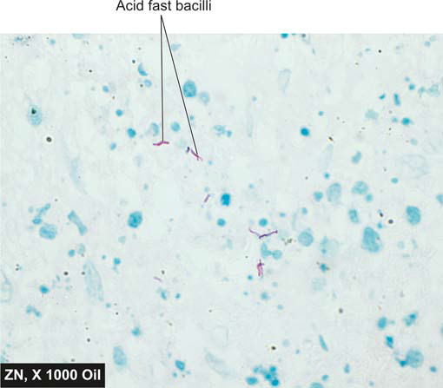
Tuberculosis of the lymph nodes showing presence of acid-fast bacilli in Ziehl - Neelsen staining.

Slide 7
MODE OF TRANSMISSION
1. Inhalation of organisms present in fresh cough droplets or in dried sputum from an open case of pulmonary tuberculosis.
2. Ingestion of the organisms leads to development of tonsillar or intestinal tuberculosis. This mode of infection of human tubercle bacilli is from self-swallowing of infected sputum of an open case of pulmonary tuberculosis, or ingestion of bovine tubercle bacilli from milk of diseased cows.
3. Inoculation of the organisms into the skin may rarely occur
from infected postmortem tissue.
4. Transplacental route

Slide 8
SPREAD OF TUBERCULOSIS
The disease spreads in the body by various routes:
1. Local spread This takes place by macrophages carrying the bacilli into the surrounding tissues.
2. Lymphatic spread Tuberculosis is primarily an infection of lymphoid tissues.
3. Haematogenous spread
4. By the natural passages Infection may spread from:
i) lung lesions into pleura (tuberculous pleurisy);
ii) Transbronchial spread into the adjacent lung segments;
iii) tuberculous salpingitis into peritoneal cavity (tuberculous peritonitis);
iv) infected sputum into larynx (tuberculous laryngitis);
v) swallowing of infected sputum (ileocaecal tuberculosis); and
vi) renal lesions into ureter and down to trigone of bladder.

Slide 9
PATHOGENESIS
(HYPERSENSITIVITY AND IMMUNITY)
Hypersensitivity or allergy, and immunity or resistance, play a major role in the development of lesions in tuberculosis.
Tubercle bacilli as such do not produce any toxins. Tissue Changes seen in tuberculosis are not the result of any exotoxin or endotoxin but are instead the result of host response to the organism which is by way of development of delayed type hypersensitivity (or type IV hypersensitivity) and immunity.

Slide 10
It has been known since the time of Robert Koch that the tissue reaction to tubercle bacilli is different in healthy animal not previously infected (primary infection) from an animal who is previously infected (secondary infection).

Slide 11
Immunisation against tuberculosis
Protective immunisation against tuberculosis is induced by injection of attenuated strains of bovine type of tubercle bacilli, Bacille Calmette- Guérin (BCG)

Slide 12
Tuberculin (Mantoux) skin test (TST)
This test is done by intradermal injection of 0.1 ml of tuberculoprotein, purified protein derivative (PPD).
Delayed type of hypersensitivity develops in individuals who are having or have been previously infected with tuberculous infection which is identified as an indurated area of more than 15 mm in 72 hours; reaction larger than 15 mm is unlikely to be due to previous BCG vaccination.

Slide 13
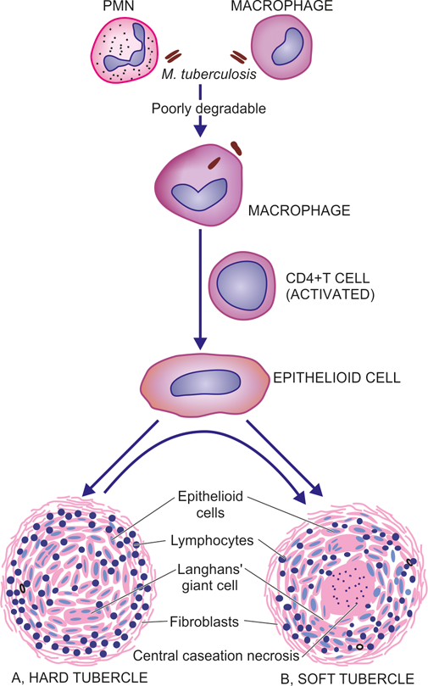
Schematic evolution of tubercle. In fully formed granuloma, the centre is composed of granular caseation necrosis, surrounded by epithelioid cells and Langhans’ giant cells and peripheral rim of lymphocytes bounded by fibroblasts.

Slide 14
TYPES OF TUBERCULOSIS
Lung is the main organ affected in tuberculosis while amongst the extra-pulmonary sites, lymph node involvement is most common.
Depending upon the type of tissue response and age, the infection with tubercle bacilli is of 2 main types: primary and secondary tuberculosis

Slide 15
A. Primary Tuberculosis
The infection of an individual who has not been previously infected or immunised is called primary tuberculosis or Ghon’s complex or childhood tuberculosis.

Slide 16
3 components:
1. Pulmonary component Lesion in the lung is the primary focus or Ghon’s focus. It is 1-2 cm solitary area of tuberculous pneumonia located peripherally under a patch of pleurisy, in any part of the lung but more often in subpleural focus in the upper part of lower lobe.
2. Lymphatic vessel component The lymphatics draining the lung lesion contain phagocytes containing bacilli and may develop beaded, miliary tubercles along the path of hilar lymph nodes.
3. Lymph node component This consists of enlarged hilar and tracheo-bronchial lymph nodes in the area drained. The affected lymph nodes are matted and show caseation necrosis.

Slide 17
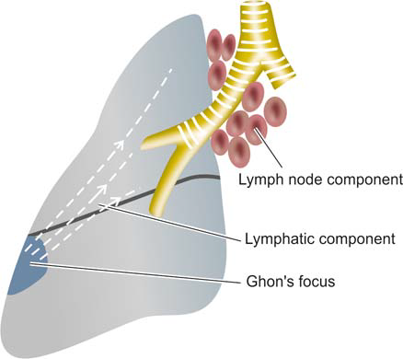
The primary complex is composed of 3 components:
Ghon’s focus, draining lymphatics, and hilar lymph nodes.

Slide 18
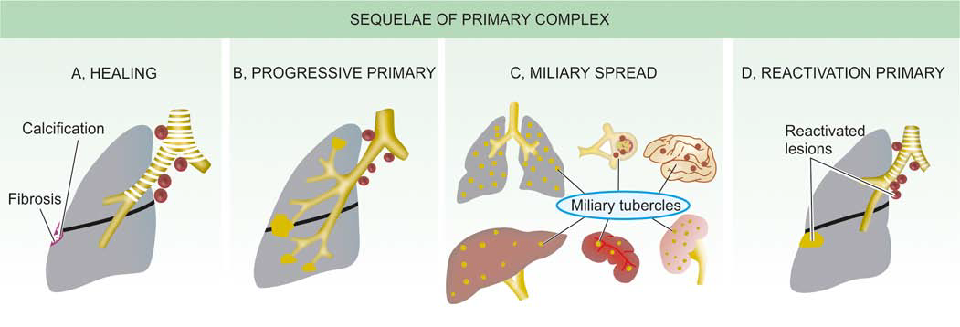
FATE OF PRIMARY TUBERCULOSIS

Slide 19
B. Secondary Tuberculosis
The infection of an individual who has been previously infected or sensitized is called secondary, or post-primary or reinfection, or chronic tuberculosis.
The infection may occur from :
. endogenous source such as reactivation of dormant primary complex; or
. exogenous source such as fresh dose of reinfection by the tubercle bacilli.

Slide 20
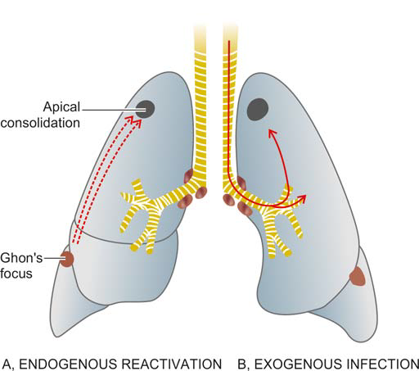
Progressive secondary tuberculosis. A, Endogenous
infection from reactivation of dormant primary complex. B, Exogenous
infection from fresh dose of tubercle bacilli.

Slide 21
FATE OF SECONDARY PULMONARY TUBERCULOSIS
1. The lesions may heal with fibrous scarring and calcification.
2. The lesions may coalesce together to form larger area of tuberculous pneumonia and produce progressive secondary pulmonary tuberculosis.
3. extrapulmonary involvements:
i) Fibrocaseous tuberculosis
ii) Tuberculous caseous pneumonia
iii) Miliary tuberculosis
iv) Tuberculous empyema

Slide 22
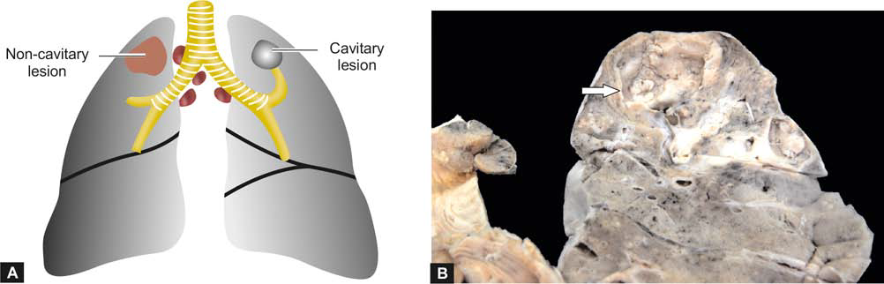
i) Fibrocaseous tuberculosis

Slide 23
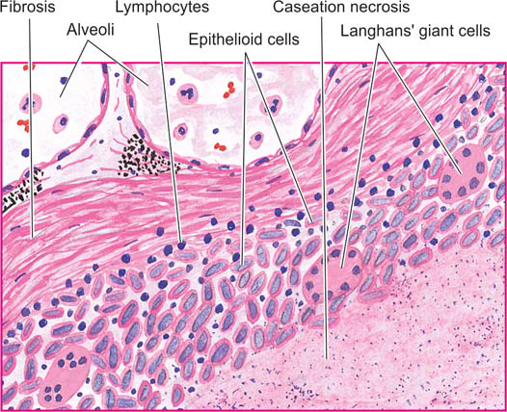
Microscopic appearance of lesions of secondary fibrocaseous tuberculosis of the lung showing wall of the cavity.

Slide 24
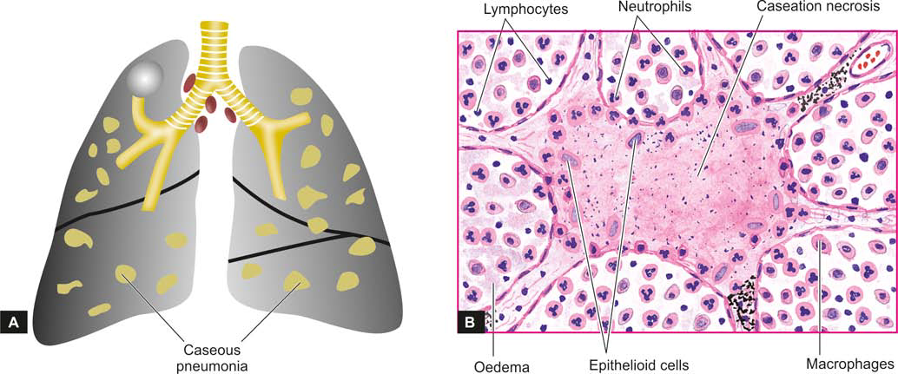
ii) Bilateral tuberculous caseous pneumonia. B, Tuberculous caseous pneumonia showing exudative reaction.

Slide 25
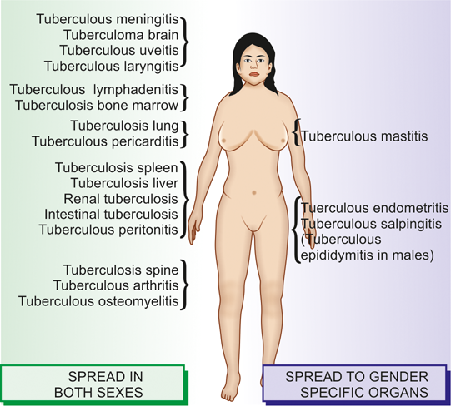
iii) Miliary spread by lymphohaematogenous route.
This is lymphohaematogenous spread of tuberculous infection from primary focus or later stages of tuberculosis.
The spread may occur to systemic organs or isolated organ.

Slide 26
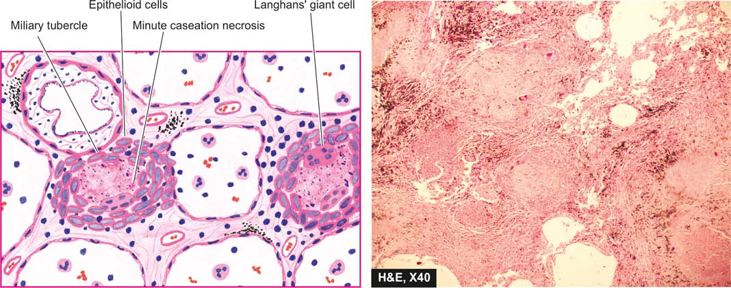
Miliary tubercles in lung having minute areas of central caseation necrosis.

Slide 27
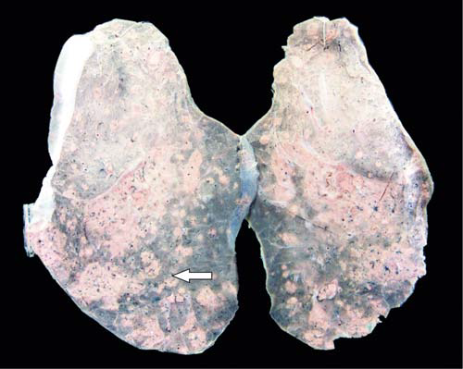
Miliary tuberculosis lung. The sectioned surface of the lung parenchyma shows presence of minute millet-seed sized tubercles.

Slide 28
Clinical Features and Diagnosis of Tuberculosis
The clinical manifestations in tuberculosis may be variable depending upon the location, extent and type of lesions.
1. Referable to lungs—such as productive cough (may be with haemoptysis), pleural effusion, dyspnoea, orthopnoea etc. Chest X-ray may show typical apical changes like pleural effusion, nodularity, and miliary or diffuse infiltrates in the lung parenchyma.
2. Systemic features—such as fever, night sweats, fatigue, loss of weight and appetite. Long-standing and untreated cases of tuberculosis may develop systemic secondary amyloidosis

Slide 29
The diagnosis is made by the following tests:
i) AFB microscopy of diagnostic specimen such as sputum, aspirated material.
ii) Mycobacterial culture (traditional method on LJ medium for 4-8 weeks, newer rapid method by HPLC of mycolic acid with result in 2-3 weeks).
iii) Molecular methods such as PCR.
iv) Complete haemogram (lymphocytosis and raised ESR).

Slide 30
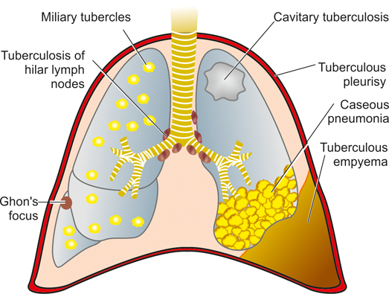
The spectrum of lesions in the lungs and pleura in all types of pulmonary tuberculosis.

Slide 31
☺ THANK YOU ☺

Slide 33
MCQ

Slide 34
1.
TUBERCULOSIS IS AN EXAMPLE OF….
ACUTE INFLAMMATION
CHRONIC NON-SPECIFIC INFLAMMATION
CHRONIC GRANULOMATOUS INFLAMMATION
CHRONIC SUPPURATIVE INFLAMMATION

Slide 35
2.
TUBERCULI BACILLI CAUSE LESIONS BY THE FOLLOWING MECHANISMS:
ELABORATION OF ANDOTOXIN
ELABORATION OF EXOTOXINS
TYPE VI HYPERSENSITIVITY
DIRECT CYTOTOXICITY

Slide 36
3.
TUBERCULOUS BACILLI IN CASEOUS LESIONS ARE BEST DEMONSTRATED IN :
CASEOUS CENTER
MARGINS OF NECROSIS WITH VIABLE TISSUE
EPITHELIOD CELLS
LANGHANS’ GIANT CELLS

Slide 37
4.
MANTOUX TEST IS NEGATIVE IN THE FOLLOWING CONDITIONS EXCEPT.
SARCOIDOSIS
HODGKINS DISEASE
FULMINANT TB
ATYPICAL MYCOBACTERIA

Slide 38
5.
THE FOLLOWING STATEMENTS ARE CORRECT FOR TUBERCLE BACILLI. EXCEPT.
CAN BE CULTURED
ARE ANAEROBIC
THRIVE BEST IN THE APEX OF LUNG
CAUSES WIDE SPECTRUM OF DISEASES.

Slide 39
ANSWERS

Slide 40
1. = C
2. = C
3. =B
4. =D
5. =B

