Slide 1
PNEUMONIA
DR. KUNTAL PATEL
ASST. PROF
PATHOLOGY

Slide 2
Pneumonia is defined as acute inflammation of the lung parenchyma distal to the terminal bronchioles (consisting of the respiratory bronchiole, alveolar ducts, alveolar sacs and alveoli).

Slide 3
CLASSIFICATION
There are several classifi cation schemes
for pneumonias:
I. On the basis of the anatomic region of the lung parenchyma involved, pneumonias are traditionally classifi ed into 3 main types:
1. Lobar pneumonia
2. Bronchopneumonia (or Lobular pneumonia)
3. Interstitial pneumonia.

Slide 4
CLASSIFICATION
II. Based on the clinical settings in which infection occurred, pneumonias are classified as under:
1. Community-acquire pneumonia
2. Health care-associated pneumonia (including hospitalacquired
pneumonia)
3. Ventilator-associated pneumonia
III. Based on etiology and pathogenesis, pneumonias are classified as under
A. Bacterial pneumonia
B. Viral pneumonia
C. Pneumonias from other etiologies.

Slide 5
Lobar Pneumonia
Lobar pneumonia is an acute bacterial infection of a part of a lobe, the entire lobe, or even two lobes of one or both the lungs.
ETIOLOGY Based on the etiologic microbial agent
1. Pneumococcal pneumonia
2. Staphylococcal pneumonia
3. Streptococcal pneumonia
4. Pneumonia by gram-negative aerobic bacteria

Slide 6
MORPHOLOGIC FEATURES
Laennec’s original description divides lobar pneumonia into 4 sequential pathologic phases:
stage of congestion (initial phase),
red hepatisation (early consolidation),
grey hepati sation (late consolidation)
and
resolution.

Slide 7
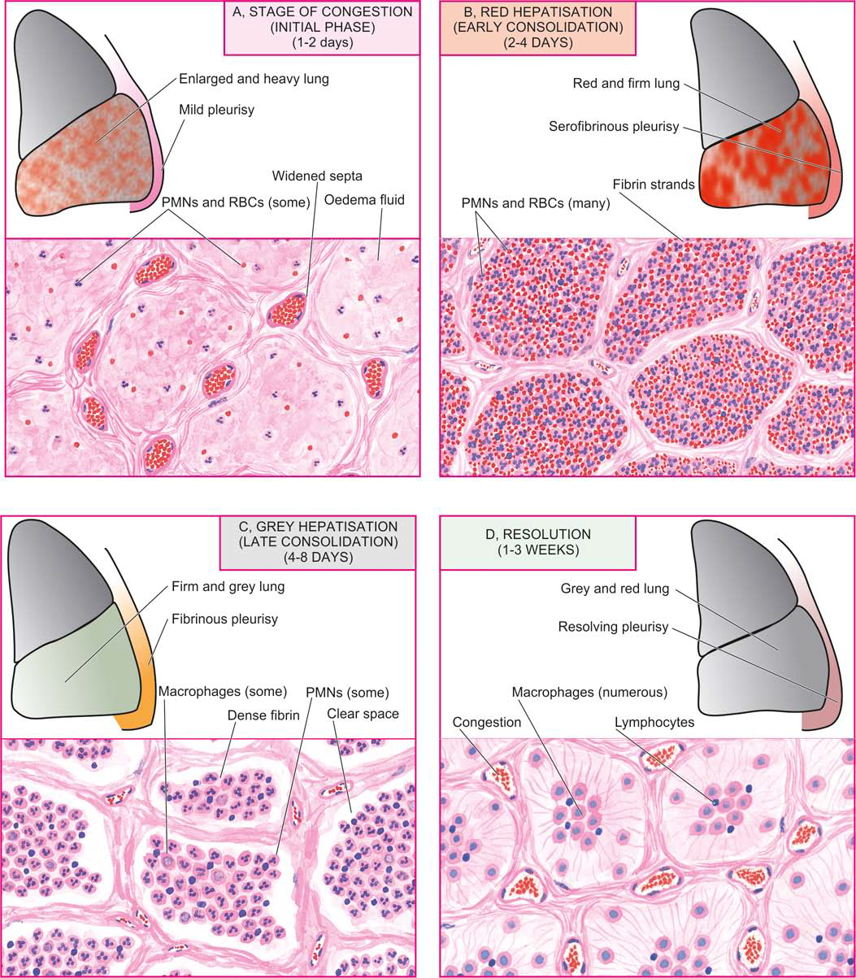

Slide 9
COMPLICATIONS
1. Organisation
2. Pleural effusion
3. Empyema
4. Lung abscess
5. Metastatic infection

Slide 10
CLINICAL FEATURES
Classically, the onset of lobar pneumonia is sudden.
The major symptoms are: shaking chills, fever, malaise with pleuritic chest pain, dyspnoea and cough with expectoration which may be mucoid, purulent or even bloody.
The common physical findings are fever, tachycardia, and tachypnoea, and sometimes cyanosis if the patient is severely hypoxaemic.
There is generally a marked neutrophilic leucocytosis. Blood cultures are positive in about 30% of cases.
Chest radiograph may reveal consolidation

Slide 11
Bronchopneumonia (Lobular Pneumonia)
Bronchopneumonia or lobular pneumonia is infection of the terminal bronchioles that extends into the surrounding alveoli resulting in patchy consolidation of the lung.

Slide 12
ETIOLOGY
The common organisms responsible for bronchopneumonia are staphylococci, streptococci, pneumococci, Klebsiella pneumoniae, Haemophilus infl uenzae, and gramnegative bacilli like Pseudomonas and coliform bacteria

Slide 13
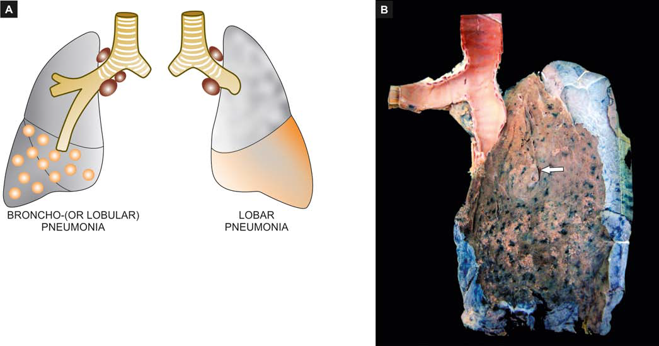
A, Gross appearance of bronchopneumonia contrasted with that of lobar pneumonia. B, The pleural surface of the specimen of the lung shows serofibrinous exudate. The sectioned surface shows multiple, small, grey-brown, firm, patchy areas of consolidation around bronchioles (arrow), while the intervening lung is spongy.

Slide 14
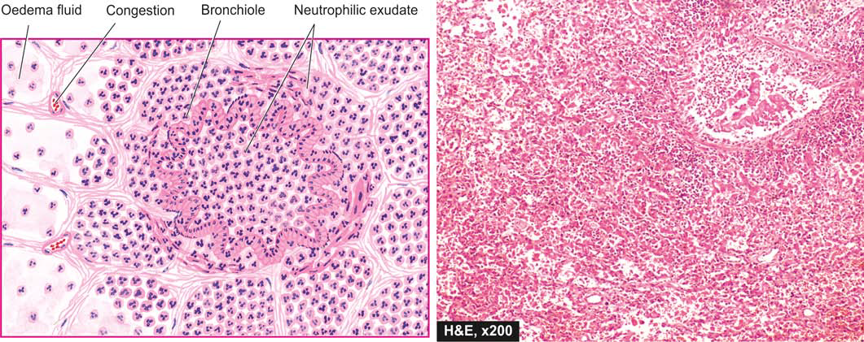
Microscopic appearance of bronchopneumonia. The bronchioles as well as the adjacent alveoli are filled with exudate consisting chiefly of neutrophils. The alveolar septa are thickened due to congested capillaries and neutrophilic infi ltrate.

Slide 15
THANK YOU

