Slide 1
Gastritis and acid peptic disease

Slide 2
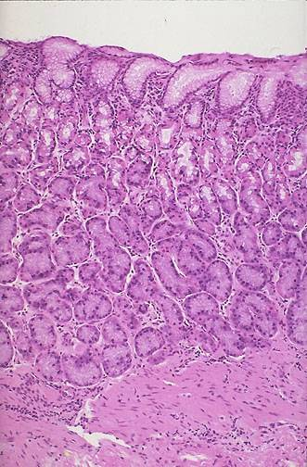
The normal gastric mucosa
Cardia – mainly mucus-secreting cells
Fundus (body) – acid producing parietal cells, pepsin producing chief cells
Pylorus – hormone (gastrin) production

Slide 3
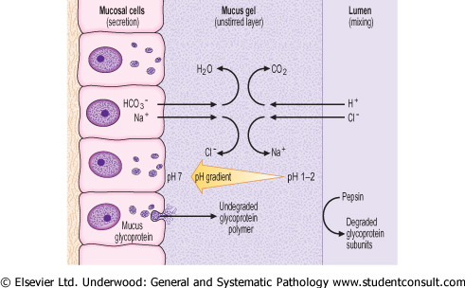
Function of stomach
Mixing of food with acid/pepsin
Unique acid environment requires functional gastric surface mucus barrier, bicarbonate buffering and epithelial integrity

Slide 4
Gastritis
Acute gastritis often due to chemical injury (alcohol drugs)
Chronic gastritis:
  Helicobacter pylori infection
  Chemical damage (bile reflux, drugs)
  Autoimmune (associated with vitamin B12 malabsorption (pernicious anaemia)

Slide 5
GASTRITIS
ACUTE
CHRONIC
AUTOIMMUNE
OTHER
  EOSINOPHILIC
  ALLERGIC
  LYMPHOCYTIC
  GRANULOMATOUS
  GVH
Notes:
The acute/chronic patterns of gastritis generally conform to the poly/mono principles we so often have referred to. The “other” category of gastritis are also histologically based.

Slide 6
GASTRITIS
ACUTE, HEMORRHAGIC
(NSAIDs), particularly aspirin
Excessive alcohol consumption
Heavy smoking
CHEMO
Uremia
Salmonella, CMV
Severe stress (e.g., trauma, burns, surgery)
Ischemia and shock
Suicidal attempts, as with acids and alkali
Gastric irradiation or freezing
Mechanical (e.g., nasogastric intubation)
Distal gastrectomy
Notes:
The concepts and histologic changes in acute and chronic follow of course the classic histologic principles:
Acute→ polys
Chronic→ monos
However, the main CLINICAL differentiation between acute and chronic gastritis would be the presence or absence of blood, respectively.

Slide 7
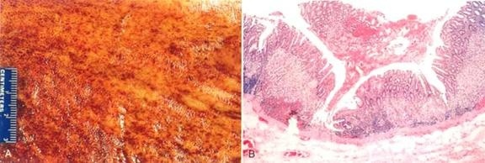
GASTRITIS
ACUTE, HEMORRHAGIC
HISTOLOGY: Erosion, Hemorrage, NEUTROPHILS
Notes:
The concepts and histologic changes in acute and chronic follow the classic histologic principles:
Acute→ polys
Chronic→ monos

Slide 8
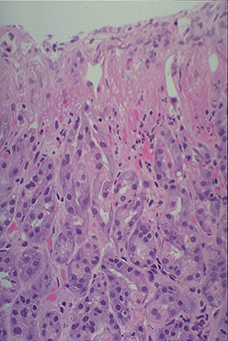
Acute gastritis
Drugs (non-steroidal anti-inflammatory drugs NSAID), alcohol cause acute erosion (loss of mucosa superficial to muscularis mucosae). Can result in severe haemorrhage
Acute Helicobacter infection has a prominent neutrophil infiltrate

Slide 9
Chronic gastritis ABC
A – autoimmune
B – bacterial (helicobacter)
C - chemical

Slide 10
GASTRITIS
CHRONIC, NO EROSIONS, NO HEMORRHAGE
Chronic infection by H. pylori
Immunologic (autoimmune), e.g., PA
Toxic, as with alcohol and cigarette smoking
Postsurgical, reflux of bile
Motor and mechanical, including obstruction, bezoars (luminal concretions), and gastric atony
Radiation
Granulomatous conditions (e.g., Crohn disease)
GVH, uremia
Notes:
ACUTE gastritis→ Hemorrhage, “erosions”, neutrophils (i.e., “POLYS”)
CHRONIC gastritis→ MONOS, NO hemorrhage, NO erosions
And do not forget: CHRONIC of the follows ACUTE

Slide 11
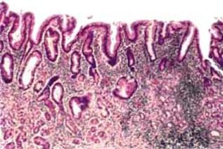
GASTRITIS
CHRONIC, NO EROSIONS, NO HEMORRHAGE
Perhaps some neutrophils
Lymphocytes, lymphoid follicles
REGENERATIVE CHANGES
  METAPLASIA, intestinal
  ATROPHY, mucosal hypoplasia, “thinning”
  DYS-PLASIA

Slide 12
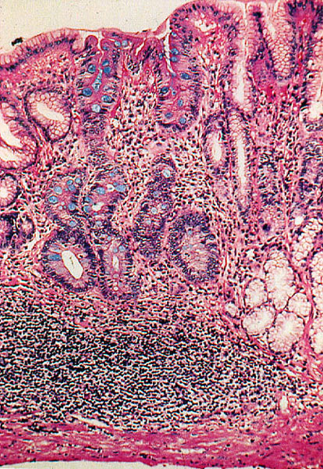
Morphology of chronic gastritis
Chronic inflammatory cell infiltration
Mucosal atrophy
Intestinal (goblet cell) metaplasia
Seen in Helicobacter and autoimmune gastritis (not chemical)

Slide 13
GASTRITIS
AUTOIMMUNE (10%)
ANTIBODIES AGAINST→
  acid producing enzyme H⁺
  K⁺ -ATPase
  gastrin receptor
  and intrinsic factor
Notes:
Would an autoimmune gastritis be associated with megaloblastic anemia? Why? Answer: DECREASED intrinsic factor
No doubt achlorhydria is the common factor of chronic gastritis and B12 megaloblastic anemias

Slide 14
Autoimmune chronic gastritis
Autoantibodies to gastric parietal cells
Hypochlorhydria/achlorhydria
Loss of gastric intrinsic factor leads to malabsorption of vitamin B12 with macrocytic,megaloblastic anaemia

Slide 15
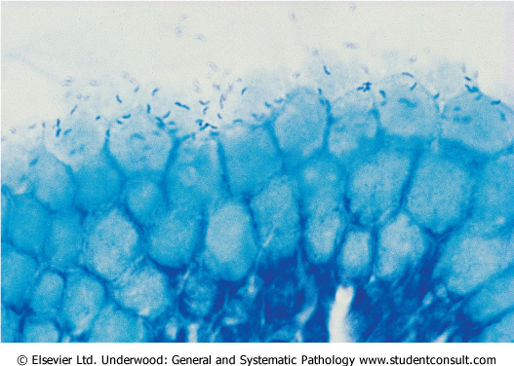
Helicobacter pylori
Adapted to live in association with surface epithelium beneath mucus barrier
Causes cell damage and inflammatory cell infiltration
In most countries the majority of adults are infected

Slide 16
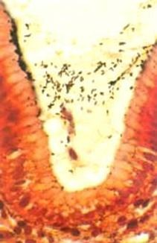
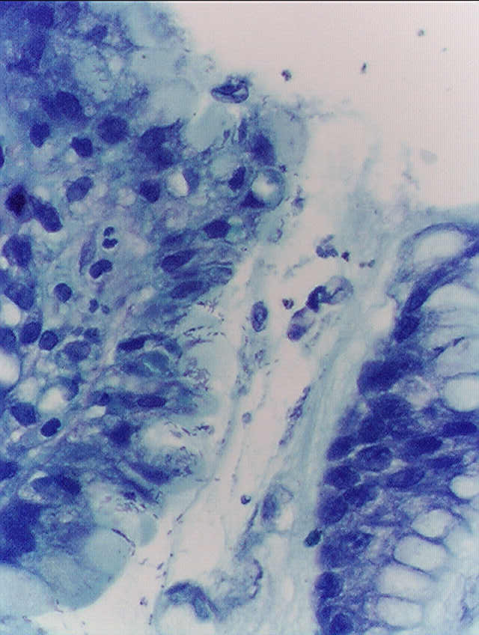
Helicobacter pylori, gastric biopsy, silver stain on left, Giemsa stain on right. As a rule, these bugs ADHERE closely to the gastric mucin rather than invade the epithelial cells.
Notes:
Helicobacter pylori, gastric biopsy, silver stain on left, Giemsa stain on right. As a rule, these bugs ADHERE closely to the gastric mucin rather than invade the epithelial cells.

Slide 17
Helicobacter gastritis
Acute inflammation mediated by complement and cytokines
Polymorphs infiltrate epithelium and may be partly responsible for its destruction
An immune response is also initiated (antibodies may be detected in serum)

Slide 18
Helicobacter gastritis
2 patterns of infection
  Diffuse involvement of body and antrum (“pan gastritis” associated with diminishing acid output)
  Infection confined to antrum (antral gastritis, associate with increased acid output)

Slide 19
Helicobacter pylori
Causes 80% of gastric peptic ulcers
Causes 100% of duodenal peptic ulcers
Causes chronic gastritis
Causes gastric carcinomas
Causes MALT lymphomas

Slide 20
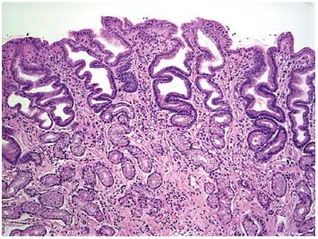
Chemical gastritis
Commonly seen with bile reflux (toxic to cells)
Prominent hyperplastic response (inflammatory cells scanty)
With time – intestinal metaplasia

Slide 21
Consequences of gastritis
Peptic ulcer disease (Helicobacter)
Adenocarcinoma (all types)

Slide 22
GASTRITIS
OTHER
  EOSINOPHILIC, middle aged women
  ALLERGIC, children (also eosinophils)
  LYMPHOCYTIC, T-Cells, body, DIFFUSE
  GRANULOMATOUS, Crohn’s, other granulomas
  GVH, in bone marrow transplants

Slide 23
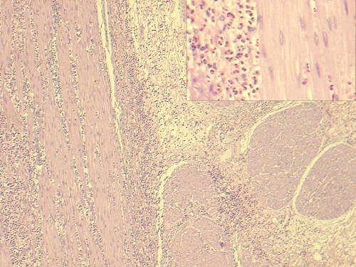
Eosinophilic gastritis.
Notes:
Eosinophilic gastritis.
If these were granulomas rather than eosinophils, what kind of gastritis would it be? (rhetorical question)

Slide 24
Peptic ulcer disease
A surface breach of mucosal lining of GI tract occurring as a result of acid and pepsin attack
Sites:
  Duodenum (DU)
  Stomach (GU)
  Oesophagus
  Gastro-enterostomy stoma
  Related to ectopic gastric mucosa (e.g. in Meckel’s diverticulum)

Slide 25
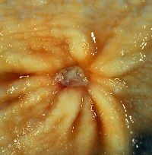
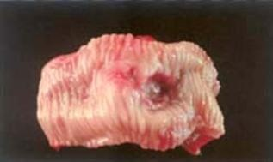
“PEPTIC” ULCERS
“PEPTIC” implies acid cause/aggravation
ULCER vs. EROSION (muscularis mucosa intact)
MUC→SUBMUC→MUSCULARIS→SEROSA
Chronic, solitary (usually), adults
80% caused by H. pylori
100% caused by H. pylori in
duodenum
NSAIDS
“STRESS”

Slide 26
“PEPTIC” ULCERS
Burning, aching pain, epigastric
Fe deficiency anemia
Acute hemorrhage
Penetration, perforation:
  Pain in BACK
  Pain in CHEST

Slide 27
Acute peptic ulcer
Like acute erosion but breaching muscularis mucosae
Specific examples
  Curling’s ulcer (following severe burns)
  Cushing’s ulcer (following head injury)

Slide 28
“ACUTE” ULCERS
NSAIDS
“STRESS” ULCERS
  ENDOGENOUS STEROIDS
    SHOCK
    BURNS
    MASSIVE TRAUMA
    Intracranial trauma, Intracranial surgery
    SEPSIS
  EXOGENOUS STEROIDS
    CUSHING ULCER
Notes:
Please remember acute “stress” ulcers are highly related to an EXCESS of endogenous or exogenous steroids.
Not surprisingly, acute “ulcers” are likened to acute “gastritis”. Does this list look familiar?

Slide 29
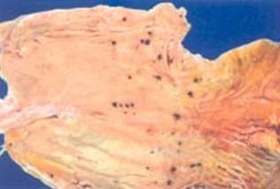
“ACUTE” ULCERS
Usually small (<1cm), superficial, MULTIPLE
Notes:
This type of acute “stress” ulcer is often confused with ulceration from gastric intubation, but intubation ulcers are usually more linear and less diffuse.
It is not at all unusual to see, at autopsy, stomachs that look like this in people whose death was preceded by extreme physiologic stress.

Slide 30
Chronic peptic ulcer
Complex epidemiology
  DU most common in Europe, GU in Japan
  Incidence of DU declining, GU stable

Slide 31
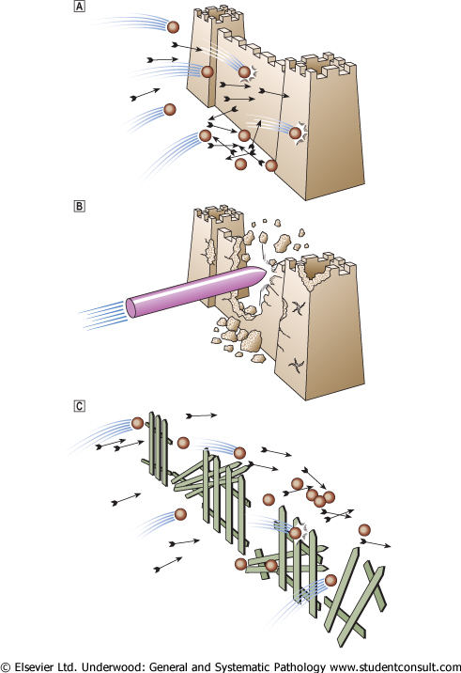
Pathogenesis
In normal acid/pepsin attack is balanced by mucosal defences
Increased attack by hyperacidity
Weakened mucosal defence – the major factor (H. pylori related)

Slide 32
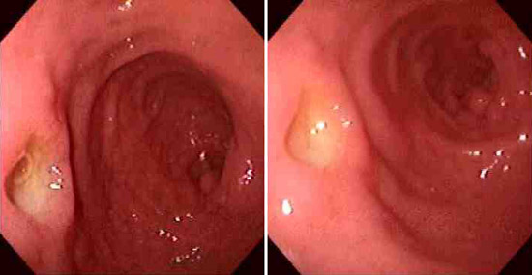
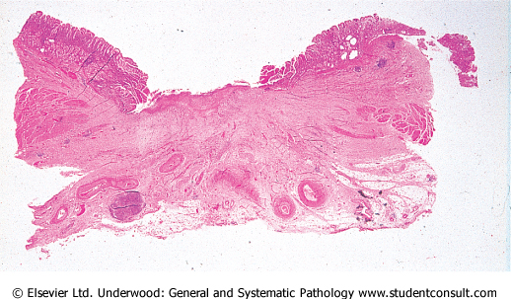
Morphology of peptic ulcers
Clean, non-elevated edge
Granulation tissue base (floor)
Underlying fibrosis

Slide 33
Acid production
Tends to be high in DU patients. Antral gastritis causes increased gastrin production and acid secretion
Acid stimulates development of gastric metaplasia in the duodenum
Helicobacter organisms colonise the metaplastic epithelium and cause inflammatory damage leading to ulceration

Slide 34
Acid in GU
Pan gastritis diminishes acid secretion
Ongoing gastritis and epithelial damage is the main causal factor for ulceration

Slide 35
Helicobacter factors in pathogenesis
Some strains are more pathogenic than others. The Cag A (cytotoxic) antigen is one important virulence factor
Human variability also plays a part (e.g. individuals who produce high levels of IL-1β in inflammation get pan gastritis and GU, lower levels associated with antral gastritis and DU)

Slide 36
Complications of peptic ulcer
Perforation leading to peritonitis
Haemorrhage by erosion of vessel in base
Penetration of surrounding organ (liver/pancreas)
Obstruction (by scarring) – pyloric stenosis
(Cancer – rare event in true peptic ulcer)

Slide 37
Bleeding
  Occurs in 15% to 20% of patients
  Most frequent complication
  May be life-threatening
  Accounts for 25% of ulcer deaths
  May be the first indication of an ulcer
Perforation
  Occurs in about 5% of patients
  Accounts for two thirds of ulcer deaths
  Rarely, is the first indication of an ulcer
Obstruction from edema or scarring
  Occurs in about 2% of patients
  Most often due to pyloric channel ulcers
  May also occur with duodenal ulcers
  Causes incapacitating, crampy abdominal pain
  Rarely, may lead to total obstruction with intractable vomiting
Notes:
Would this slide be seen in a REAL classroom to those sitting in the back row?

Slide 38
THANK YOU

