Slide 1
SEXUALLY TRANSMITTED INFECTIONS
Dr Vidya Date
Professor and Head
Microbiology

Slide 2
SEXUALLY TRANSMITTED INFECTIONS
The sexually transmitted infections (STIs) are a group of communicable diseases which are transmitted by sexual contact.

Slide 3
SEXUALLY TRANSMITTED INFECTIONS (Cont..)
1. Agents causing local manifestations—called genital tract infections
Lesions common to both sexes: Such as genital ulcers, urethritis, and anorectal lesions
Female genital tract infections: Such as vulvovaginitis, cervicitis and others
Male genital tract infections: Such as prostatitis, epididymitis, and orchitis.

Slide 4
SEXUALLY TRANSMITTED INFECTIONS (Cont..)
2. Agents causing systemic manifestations without producing local manifestations (e.g. HIV, hepatitis B and C).

Slide 5
Causative agents of sexually transmitted infections
Agents causing local manifestations (genital tract infections)
In both sexes:
Genito-ulcerative disease: Syphilis: Caused by Treponema pallidum Chancroid: Caused by Haemophilus ducreyi Genital herpes: Caused by herpes simplex viruses Lymphogranuloma venereum: Caused by Chlamydia trachomatis Donovanosis: Caused by Klebsiella granulomatis Urethritis: Gonococcal urethritis: Caused by Neisseria gonorrhoeae Non-gonococcal urethritis (NGU): Caused by Chlamydia trachomatis (D-K) Genital mycoplasmas: Ureaplasma urealyticum, Mycoplasma genitalium, M. hominis Herpes simplex virus Candida albicans Trichomonas vaginalis

Slide 6
Causative agents of sexually transmitted infections (Cont..)
Agents causing local manifestations (genital tract infections)
In both sexes:
Other genital tract infections common to both sexes Genital tuberculosis: Caused by M. tuberculosis Anorectal lesions: Proctitis: Caused by HSV, gonococcus, C. trachomatis Anogenital warts: Caused by human papilloma virus

Slide 7
Causative agents of sexually transmitted infections (Cont..)
Agents causing local manifestations (genital tract infections)
In females only:
Vulvovaginitis: Bacterial vaginosis, trichomoniasis and candidiasis Mucopurulent cervicitis caused by gonococcus, C. trachomatis Pelvic inflammatory disease: Presents as— Endometritis, salpingitis, oophoritis, tubo-ovarian abscess Extension to peritoneum can lead to peritonitis, pelvic abscess and perihepatitis Infections after gynecologic surgery Infections in pregnancy/postpartum
In males only:
Prostatitis, epididymitis, and orchitis
Agents causing systemic manifestations, no local lesions
HIV, Hepatitis B virus (HBV), Hepatitis C virus (HCV)

Slide 8
GENITO-ULCERATIVE DISEASE

Slide 9
GENITO-ULCERATIVE DISEASE
Genito-ulcerative disease comprises of five important STIs— syphilis, chancroid, genital herpes, lymphogranuloma venereum and donovanosis.

Slide 10
Comparison of manifestations of genito-ulcerative diseases
Features | Syphilis | Genital Herpes | Chancroid | LGV | Donovanosis
Incubation period | 9–90 days | 2–7 days | 1–14 days | 3 days–6 weeks | 1–4 weeks (up to 6 months)
Genital ulcer | Painless, single, indurated | Painful, multiple, bilateral, tiny vesicular ulcers | Painful, soft, usually multiple, purulent, bleeds easily | Painless, firm single lesion | Painless, single/multiple, beefy-red ulcer, bleeds readily
Lymphadenopathy | Painless, non- indurated (firm), bilateral | Painful, firm, often bilateral with initial episode | Painful, soft, marked swelling leads to bubo formation, unilateral | Painful and soft, unilateral | Absent (pseudobubo may be present due to subcutaneous swelling)
Treatment | Penicillin (single dose) | Acyclovir (7–14 days) | Azithromycin (single dose) | Doxycycline (21 days) | Azithromycin ( 7 days)

Slide 11
SYPHILIS (TREPONEMA PALLIDUM)

Slide 12
SYPHILIS (TREPONEMA PALLIDUM)
Treponema pallidum - causative agent of an ancient sexually transmitted infection (STI) ‘syphilis’.
The name pallidum refers to its pale-staining property.
Discovered by Schaudinn and Hoffmann in 1905.

Slide 13
Genus Description
Thin, flexible, elongated spirally coiled helical bacilli.
Include Treponema, Borrelia and Leptospira
Treponemes are slender spirochetes with fine spirals having pointed ends (trepos, meaning ‘turn’ and nema, meaning ‘thread’).
Most of them are commensals in mouth and genitalia

Slide 14
Genus Description (Cont..)
Only a few species are pathogenic to men, divided into two groups.
  1. Sexually-transmitted: Treponema pallidum—causes syphilis
  2. Nonvenereal treponematosis: T. pertenue, T. endemicum and T. carateum

Slide 15
Pathogenesis of Syphilis
Mode of transmission:
Venereal
Non-venereal - direct contact, blood transfusion or transplacental
Spread: T. pallidum penetrates through mucosa or abraded skin - Enter lymphatics and blood - systemic - primary lesion
Incubation period - Variable (10–90 days)
Inversely proportional to the number of organisms inoculated

Slide 16
Clinical Manifestations of Syphilis
Approximately, 30% of persons who have sexual exposure with an infected partner develop syphilis
Clinically, patients suffering from syphilis pass through four stages if left untreated: primary, secondary, latent and tertiary (or late) stages.
If transmitted vertically, the newborn babies develop a congenital form of syphilis.

Slide 17
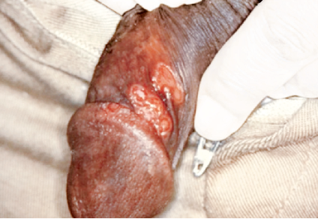
Primary Syphilis
Primary (or hard) chancre:
Single painless papule - ulcerated & indurated
Covered by thick exudate rich in spirochetes
Common sites – penis, cervix or labia
Heals within 4–6 weeks

Slide 18
Primary Syphilis (Cont..)
Regional (usually inguinal) lymphadenopathy
  Painless firm, non-suppurative, and often bilateral
  May persist for months
If acquired by non-venereal mode - primary syphilis is presented as:
  Direct contact → extragenital, usually on the fingers
  Blood transfusion → primary chancre does not occur

Slide 19
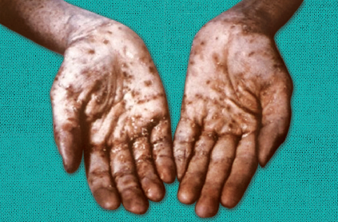
Secondary Syphilis
Develops 6-12 weeks after healing of primary lesion
Skin and mucous membranes - commonly affected and
  Skin rashes

Slide 20
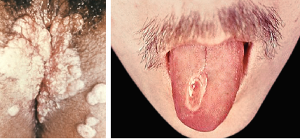
Secondary Syphilis (Cont..)
Condylomata lata - Mucocutaneous papules coalesce to form large pink to grey lesion in warm moist intertriginous areas (such as perianal region, vulva, and scrotum)
Mucous patches (superficial mucosal erosions)

Slide 21
Latent Syphilis
Absence of clinical manifestations, positive serological tests, normal CSF findings.
Patients still infectious – transmitting the infection - bloodstream or in utero
May have one of the following fates:
  Persistent lifelong infection (common)
  Development of late syphilis (rare)
  Spontaneous cure

Slide 22
Late or Tertiary Syphilis
Gumma (late benign syphilis): Locally destructive granulomatous lesions - bone and skin
Neurosyphilis: Chronic meningitis, vasculitis, general paresis of insane and tabes dorsalis
Cardiovascular syphilis: Aneurysm of ascending aorta and aortic regurgitation

Slide 23
Congenital Syphilis
Mother-to-fetus transmission can lead to development of various congenital manifestations

Slide 24
Laboratory diagnosis of Syphilis
Microscopy
Dark ground microscopy
Direct IF staining for T. pallidum (DFA-TP)
Silver impregnation method
  Levaditi stain (for tissue section)
  Fontana stain (smear)

Slide 25
Laboratory diagnosis of Syphilis (Cont..)
Direct microscopy of T. pallidum: A. Dark ground microscope; B. Direct fluorescent antibody staining for T. pallidum (DFA-TP); C. Silver impregnation method

Slide 26
Laboratory diagnosis of Syphilis (Cont..)
Culture: Not cultivable, maintained in rabbit testes
Serology (antibody detection):
  Non-treponemal or STS (standard tests for syphilis): (Reagin antibodies are detected by using cardiolipin antigen)
  Specific/Treponemal test: Specific antibodies are detected by using T. pallidum antigens

Slide 27
Laboratory diagnosis of Syphilis (Cont..)
Non-treponemal or STS (standard tests for syphilis): (Reagin antibodies are detected by using cardiolipin antigen)
  VDRL (Venereal disease research laboratory) test
  RPR (Rapid plasma reagin)
  TRUST (toluidine red unheated serum test)
  USR (Unheated serum reagin test).

Slide 28
Laboratory diagnosis of Syphilis (Cont..)
A. VDRL slide; B. VDRL test results

Slide 29
Laboratory diagnosis of Syphilis (Cont..)
Specific/Treponemal test: Specific antibodies are detected by using T. pallidum antigens:
  TPI (Treponema pallidum immobilization test)
  FTA-ABS (Fluorescent treponemal antibody absorption test)
  TPA (T. pallidum agglutination test)
  TPHA (T. pallidum hemagglutination test)
  TPPA (T. pallidum particle agglutination test).

Slide 30
Testing Algorithm
CDC recommends to use a testing algorithm comprising of non-treponemal test (as screening test), followed by treponemal test (for confirmation) for serodiagnosis of syphilis.
In area with high-prevalence for syphilis, reverse algorithm - cost-effective where a treponemal test is performed first, followed by non-treponemal test.

Slide 31
Testing Algorithm (Cont..)
Testing for syphilis in pregnancy:
Every pregnant woman - undergo a non-treponemal screening test at her first antenatal visit and, if there is high-risk of exposure, again retested at the third trimester and at delivery.

Slide 32
Syphilis and HIV
Both syphilis and HIV affect each other’s pathogenesis.
Genital syphilis facilitates transmission of HIV through the abraded mucosa
(2 to 5 fold increased risk)
Patient with HIV, if develops syphilis later → rapid progression to late stages of syphilis and neurological involvement

Slide 33
Syphilis and HIV (Cont..)
Problems in the diagnosis of syphilis in HIV infected people are:
  Confusing clinical picture, Lack of serologic response
  Unusually high titers in non-treponemal tests
  Failure of non-treponemal test titers to decline even after treatment
  Disappearance of treponemal test reactivity over time

Slide 34
Treatment of Syphilis
Penicillin - drug of choice for all the stages of syphilis:
  Primary, secondary, or early latent syphilis: single dose of Penicillin G
  Late latent CVS or benign tertiary stage: penicillin G is given single dose weekly for 3 weeks
  Neurosyphilis -aqueous crystalline or procaine penicillin G is given for 10–14 days.

Slide 35
Treatment of Syphilis (Cont..)
Alternative drug is used in patients with penicillin allergy:
  Primary, secondary, latent, CVS or benign tertiary syphilis - tetracycline
  Neurosyphilis or pregnancy or associated HIV - desensitization to penicillin

Slide 36
Evaluation after Treatment
Non-treponemal tests
For primary and secondary syphilis: At least fourfold decline in the titer by
the third or fourth month and an eightfold decline in the titer by sixth to
eighth month
Latent or late syphilis, or patients with multiple episodes of syphilis: Gradual decline in titer, low titers may persist for years

Slide 37
CHANCROID (HAEMOPHILUS DUCREYI)

Slide 38
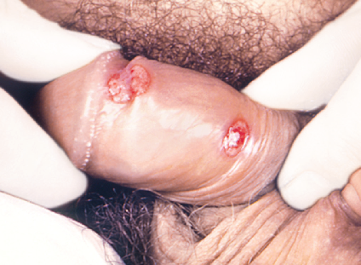
CHANCROID (HAEMOPHILUS DUCREYI)
Chancroid (or soft chancre) - sexually transmitted infection
  Painful genital ulceration that bleeds easily
  No inflammation of surrounding skin
  Enlarged, tender inguinal lymph nodes (bubo)

Slide 39
Epidemiology
Common cause of genital ulcers in developing countries.
Transmission predominantly heterosexual
Males to females ratio - 3:1 to 25:1
Chancroid and HIV: Chancroid increases both the efficiency of transmission and the degree of susceptibility to HIV infection.

Slide 40
Laboratory Diagnosis
Specimens: Exudate or swab from the edge of the ulcer and lymph node aspirate
Direct microscopy:
  Pleomorphic gram-negative coccobacillus; occurs in groups or in parallel chains
  Bipolar staining
  School of fish or rail road track appearance.

Slide 41
Laboratory Diagnosis (Cont..)
Culture:
  Requires factor X (hemin), but not factor V
  Rabbit blood agar/chocolate agar enriched with 1% isovitalex and made selective by adding vancomycin
  Chorioallantoic membrane of the chick embryo
Optimum conditions - 10% CO2, high humidity & incubation at 35°C for 2–8 days
Biochemical reactions: biochemically inert

Slide 42
Laboratory Diagnosis (Cont..)
Slide agglutination test: specific antiserum confirmative
Multiplex PCR assay

Slide 43
Treatment of Chancroid
Drug of choice: Azithromycin (1g oral; single dose)
Alternative drugs: Ceftriaxone, ciprofloxacin or erythromycin
Treatment of all the sexual partners is essential

Slide 44
HERPES GENITALIS

Slide 45
HERPES GENITALIS
Genital herpes is caused by herpes simplex viruses (HSV- 1 and 2).
Produce widespread disease - cutaneous, mucocutaneous and systemic diseases.
Genital ulcers: Characterized by multiple, painful, bilateral (widely spaced), tiny vesicular ulcers
Inguinal lymphadenopathy: Enlarged, tender, firm, often bilateral

Slide 46
HERPES GENITALIS (Cont..)
Recurrent episodes - milder and recover faster than primary genital herpes.
Associated symptoms - fever, headache, malaise, myalgia, itching, dysuria, vaginal and urethral discharge
Other genital infections : Urethritis, vulvovaginitis, cervicitis, endometritis and salpingitis, rectal (HSV proctitis) and perianal infections following rectal intercourse

Slide 47
HERPES GENITALIS (Cont..)
Laboratory diagnosis:
Staining of scrapings from the base of the lesions with Giemsa’s (Tzanck preparation), or Papanicolaou’s stain - giant cells or intranuclear inclusions of HSV infection
Viral antigen (by direct IF) or viral DNA (by PCR) - detected in scrapings from lesions

Slide 48
HERPES GENITALIS (Cont..)
Laboratory diagnosis (Cont..):
Multiplex platforms of PCR and real-time PCR
Isolation of the virus in scrapings from lesions.

Slide 49
Treatment of Genital herpes
Effective drugs in genital herpes - acyclovir, valacyclovir, or famciclovir.
First episode: Oral acyclovir is given for 7-14 days.
IV acyclovir - severe disease or associated neurologic complications
Recurrent genital herpes: Short-course (1 to 3 day) regimens.

Slide 50
LYMPHOGRANULOMA VENEREUM (LGV)

Slide 51
LYMPHOGRANULOMA VENEREUM (LGV)
Lymphogranuloma venereum (LGV) is an invasive systemic sexually transmitted infection, caused by Chlamydia trachomatis serovars L1, L2,
and L3

Slide 52
LYMPHOGRANULOMA VENEREUM (LGV)
(Cont..)
Clinical course passes in three stages:
First stage: Painless papule, ulcer or vesicle on penis or vulva
Second stage:
  Bubo - Enlarged, tender & soft Inguinal lymph nodes
  Fistulae - Buboes breakdown -discharge - spread - chronic fistulae
  Systemic symptoms - fever, headache and myalgia

Slide 53
LYMPHOGRANULOMA VENEREUM (LGV)
(Cont..)
Third stage: in untreated cases
  Rectal stricture or rectovaginal and rectal fistulae
  Esthiomene - edematous granulomatous hypertrophy of vulva, scrotum or penis
  Elephantiasis of the vulva or scrotum

Slide 54
LYMPHOGRANULOMA VENEREUM (LGV)
(Cont..)
Diagnosis - based on serology; biopsy is contraindicated - risk of sinus tract formation
  NAAT: C. trachomatis will be positive
  Antibody detection by ELISA or microimmunofluorescence (MIF)
  Direct detection of inclusion bodies by direct IF or for culture confirmation

Slide 55
LYMPHOGRANULOMA VENEREUM (LGV)
(Cont..)
Frei test: Skin test, used in the past - demonstrate type IV hypersensitivity
Treatment: Longer treatment course – necessary.
  Doxycycline for 21 days - drug of choice.
  Azithromycin (weekly once for 3 weeks) - alternatively

Slide 56
DONOVANOSIS

Slide 57
DONOVANOSIS
Also called granuloma inguinale, an STD
Klebsiella granulomatis (old name - Calymmatobacterium granulomatis)
1882 – McLeod - first described disease in Kolkata (Calcutta)
1905 - Charles Donovan in Chennai (Madras) demonstrated “Donovan bodies” in the genital lesion

Slide 58
DONOVANOSIS (Cont..)
Donovanosis is prevalent in India, Brazil, Papua New Guinea and parts of South Africa
Risk factors - poor hygiene, lower socioeconomic status and multiple sex partners

Slide 59
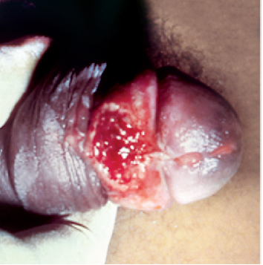
Clinical Features
Incubation period :1–4 weeks
Lesion: Starts as a painless papule - beefy red ulcer that bleeds readily when touched
Sites: Genitals (90%) - prepuce, frenum & glans in men and labia minora in women
Pseudobubos in inguinal region (10%) – due to subcutaneous abscess

Slide 60
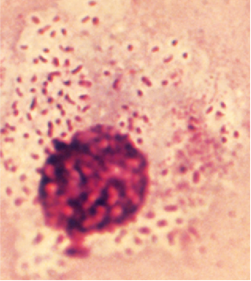
Laboratory Diagnosis
Specimen collection: Swab, piece of granulation tissue
Direct microscopy:
  Rapid Giemsa or Wright's stain
  Donovan bodies - Large cyst like macrophages filled with deeply stained capsulated bacilli - safety-pin (bipolar) appearance
  Non-motile, capsulated and gram-negative

Slide 61
Laboratory Diagnosis
Culture: egg yolk medium and on HEp-2 cell lines
Molecular Method: PCR -to differentiate Klebsiella granulomatis from other Klebsiella species - phoE gene

Slide 62
Treatment of Donovanosis
Azithromycin 1g orally once per week or 500 mg daily for at least 3 weeks, until all lesions have completely healed
Alternatively, doxycycline or co-trimoxazole - for 14 days.

Slide 63
URETHRITIS

Slide 64
GONOCOCCAL URETHRITIS

Slide 65
GONOCOCCAL URETHRITIS
Neisseria gonorrhoeae is noncapsulated, gram-negative kidney-shaped diplococcus.
Causes ‘gonorrhea’, a sexually transmitted infection (STI) - commonly manifests as cervicitis, urethritis and conjunctivitis.

Slide 66
Virulence Factors
Pili or fimbriae - Adhesion to host cells & prevent phagocytosis
Outer membrane proteins –
Porin (protein I) - >50% of OMP
  PorB.1A strains - local and disseminated gonococcal infections
  PorB.1B strains- local genital infections only

Slide 67
Virulence Factors (Cont..)
Opacity-associated protein (Protein II) - adhesion to neutrophils & other gonococci
Transferrin-binding and lactoferrin-binding proteins
IgA1 protease - protection from mucosal IgA
Lipo-oligosaccharide (LOS)

Slide 68
Clinical Manifestations
Gonorrhea: Produces various infections in males, females
Males:
  Acute urethritis – Most common manifestation
  Purulent urethral discharge ( ‘gonorrhea’- flow of seed)
  Incubation period is 2–7 days
  Complications - epididymitis, prostatitis, balanitis & water-can perineum

Slide 69
Clinical Manifestations (Cont..)
Females
  Infection is less severe – More asymptomatic carriage than males
  Mucopurulent cervicitis – Most common presentation
  Vulvovaginitis – in prepubertal girls & postmenopausal women- vagina mucosa thinned out & higher pH

Slide 70
Clinical Manifestations (Cont..)
Spread - Bartholin’s gland, endometrium and fallopian tube. Salpingitis and pelvic inflammatory disease - sterility
Fitz–Hugh–Curtis syndrome – Rare - peritonitis & perihepatic inflammation.
Both the sexes
  Anorectal gonorrhea
  Pharyngeal gonorrhea
  Ocular gonorrhea

Slide 71
Clinical Manifestations (Cont..)
Pregnant women
  Prolonged rupture of the membranes, premature delivery, chorioamnionitis, and sepsis in the infant
Neonates (Ophthalmia neonatorum)
  Purulent eye discharge within 2–5 days of birth

Slide 72
Clinical Manifestations (Cont..)
Disseminated gonococcal infection (DGI)
  Rarely following gonococcal bacteremia
  Polyarthritis and rarely dermatitis & endocarditis
In HIV-infected persons
  Nonulcerative gonorrhea

Slide 73
Epidemiology
Incidence decreased in developed countries
Under reporting due to stigma
Host - exclusively human disease
Source - asymptomatic female carriers or less often patient
Transmission : sexual contact (venereal) and mother to baby during birth.

Slide 74
Laboratory Diagnosis - Specimen Collection
Urethral swab in men and cervical swab in women
Dacron or rayon swabs
In chronic urethritis - secretion after prostatic massage or morning drop of secretion

Slide 75
Laboratory Diagnosis - Transport Media
Charcoal-coated swabs kept in Stuart’s transport medium ,
Amies medium,
JEMBEC or Gono-Pak system

Slide 76
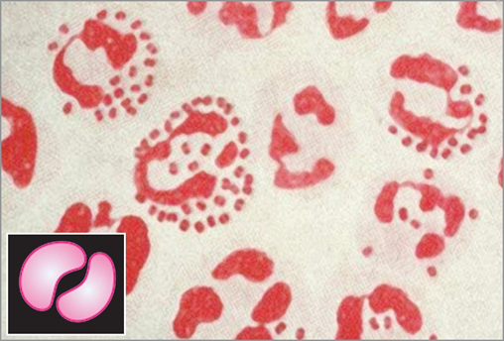
Laboratory Diagnosis - Microscopy
Gram-negative intracellular kidney-shaped diplococci

Slide 77
Laboratory Diagnosis - Culture
Endocervical culture has a sensitivity of 80–90%
Cervical swabs contain normal flora - selective media preferred
(Inhibit commensal Neisseria)
Thayer Martin medium - Chocolate agar with antibiotics

Slide 78
Laboratory Diagnosis - Identification
Gonococci - catalase and oxidase positive
Ferment only glucose, but not maltose and sucrose
Automated systems - MALDI-TOF can be used.

Slide 79
Laboratory Diagnosis - Molecular Method
Nucleic acid amplification tests (NAATs) - PCR - detection of N. gonorrhoeae from the clinical specimens targeting 16s or 23s rRNA gene.

Slide 80
Treatment of Gonorrhea
Third generation cephalosporins – DOC for uncomplicated gonococcal infection - both the sexual partners should be treated
  Ceftriaxone (250 mg given IM, single dose)
  Cefixime (400 mg given orally, single dose)
If coexisting chlamydial infection – azithromycin or doxycycline added.

Slide 81
Prophylaxis
No vaccination available for gonococci.
Early detection of cases
Treatment of both partners
Tracing of contacts
Health education about safe sex practices - use of condoms.

Slide 82
NON-GONOCOCCAL URETHRITIS

Slide 83
NON-GONOCOCCAL URETHRITIS
Chronic urethritis where gonococci cannot be demonstrated
NGU is more common than gonococcal urethritis.
Bacteria:
  Chlamydia trachomatis: Most common agent
  Urogenital Mycoplasma: Ureaplasma urealyticum and Mycoplasma hominis

Slide 84
NON-GONOCOCCAL URETHRITIS
Viruses: Herpes simplex virus
Fungi - Candida albicans
Parasites - Trichomonas vaginalis

Slide 85
Differences between gonococcal and non-gonococcal urethritis
Features | Gonococcal urethritis | Non-gonococcal urethritis
Onset | 48 hours | Longer (>1 week)
Urethral discharge | Purulent (flow of seed-resembling semen) | Mucous to mucopurulent
Complication | DGI (polyarthritis and endocarditis) Water-can perineum | Reiter's syndrome: Characterized by conjunctivitis, urethritis, arthritis and mucosal lesions
Diagnosis | Gram stain Culture on Thayer Martin media | For Chlamydia—culture on McCoy and HeLa cell lines For Trichomonas—detection of trophozoite For Candida—detection of budding yeast cells in discharge For PCR—can be done for HSV or Chlamydia
Treatment | Ceftriaxone | For Chlamydia—Doxycycline For Trichomonas—Metronidazole For Candida—Clotrimazole (as vaginal cream or tablet)

Slide 86
CHLAMYDIA TRACHOMATIS INFECTIONS

Slide 87
Genus Description
Chlamydiae are obligate intracellular bacteria
Cause a spectrum of diseases - trachoma, lymphogranuloma venereum (LGV), conjunctivitis, pneumonia and psittacosis

Slide 88
Classification
Based on genetic characteristics
  Chlamydia: C.trachomatis.
  Chlamydophila: C.psittaci and C.pneumoniae

Slide 89
Chlamydiae are Bacteria, Not Viruses
Chlamydiae resemble viruses
Obligate intracellular
Can not grow in artificial media, grow in cell lines, embryonated egg or animals
Filterable— pass through bacterial filters
Produce intracytoplasmic inclusions.

Slide 90
Chlamydiae are Bacteria, Not Viruses
(Cont..)
Chlamydiae are confirmed to be bacteria:
Possess both DNA and RNA
Cell wall similar to that of gram-negative bacteria
Multiply by binary fission
Susceptible to a wide range of antibacterial agents

Slide 91
Life Cycle

Slide 92
Chlamydia trachomatis Infections
Chlamydia trachomatis is primarily a human pathogen, causing ocular, urogenital and neonatal infections

Slide 93
Typing of Chlamydia
Biovars:
Historically, based on the disease produced, C. trachomatis was subdivided into two strains or biovars.
1. TRIC (Trachoma-inclusion conjunctivitis)
2. Lymphogranuloma venereum (LGV) biovar

Slide 94
Features of Chlamydia infections
Species | Character | Biovar | Serotype(s) | Disease
C. trachomatis | Forms compact inclusions mixed with glycogen matrix Sensitive to sulfonamide Natural human pathogen Leaves the host cell with a scar | TRIC | A, B, Ba, C | Trachoma
 |  |  | D-K (D, Da, E, F, G, H, I, Ia, J, Ja, K) | Genital chlamydiasis Inclusion conjunctivitis Infant pneumonia
 |  | LGV | L1, L2, L3 | Lymphogranuloma venereum

Slide 95
Features of Chlamydia infections (Cont..)
Species | Character | Biovar | Serotype(s) | Disease
C. psittaci | Forms diffuse vacuolated inclusions without glycogen matrix Resistant to sulfonamide Natural pathogen of birds Leaves the host cell by lysis | NIL | Many serotypes | Psittacosis (Atypical interstitial pneumonia) Transmission is by inhalation route—pet birds (parrots) and poultry (turkeys and ducks) No man-to-man transmission

Slide 96
Features of Chlamydia infections (Cont..)
Species | Character | Biovar | Serotype(s) | Disease
C. pneumoniae TWAR agent | Exclusive human pathogen Forms inclusions without glycogen matrix Resistant to sulfonamide | NIL | Only 1 serotype | Community-acquired atypical pneumonia Associated with: atherosclerosis and asthma

Slide 97
Genital Infections (C. trachomatis Serovars D–K)
Nongonococcal urethritis (NGU): Most common cause of nongonococcal urethritis (30–50%)
Differs from gonococcal urethritis (GU) by:
  Incubation period is 7–10 days, compared to 2–5 days for GU
  Symptoms: Mucopurulent discharge is followed by dysuria and urethral irritation (GU has purulent discharge).

Slide 98
Genital Infections (C. trachomatis Serovars D–K) (Cont..)
Postgonococcal urethritis (PGU)
Epididymitis and proctitis: Commonest cause of epididymitis in males
Reactive arthritis (Reiter’s syndrome): Conjunctivitis, urethritis, arthritis & characteristic mucocutaneous lesions
  Men : women =10:1

Slide 99
Genital Infections (C. trachomatis Serovars D–K) (Cont..)
In females:
  Mucopurulent cervicitis - endometritis, salpingitis, PID & pelvic peritonitis
  Perihepatitis (Fitz–Hugh–Curtis syndrome)

Slide 100
Laboratory diagnosis of Chlamydial infections
Specimen: Depends on the type of lesions
Microscopy: Detects chlamydial inclusion bodies
  Gram staining, Lugol’s iodine and other stains - Castaneda, Machiavello or Gimenez stains
  Direct IF: Used for direct detection of inclusion bodies.

Slide 101
Laboratory diagnosis of Chlamydial infections (Cont..)
Antigen detection (LPS antigens): By enzyme immunoassays
Culture: It was the gold standard method in the past
  Egg (yolk sac), mice inoculation and cell line culture
  Cell lines of choice - McCoy, HeLa (for C. trachomatis), HEp2 (for C. pneumoniae).

Slide 102
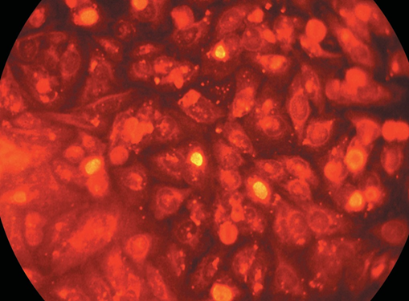
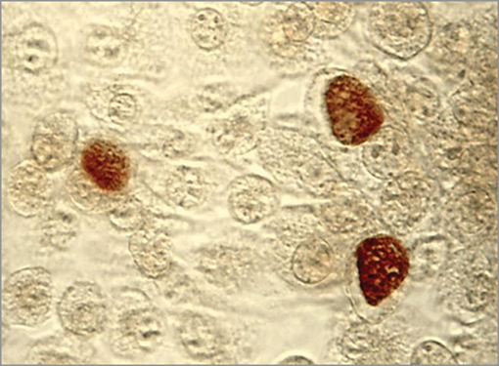
Laboratory diagnosis of Chlamydial infections (Cont..)
Chlamydia trachomatis inclusion bodies (brown) in a McCoy cell culture
HeLa cells infected with Chlamydia trachomatis

Slide 103
Laboratory diagnosis of Chlamydial infections (Cont..)
Nucleic acid amplification tests (NAAT), e.g. PCR
  The most sensitive and specific method
  Currently the diagnostic assay of choice.
Serology (antibody detection):
  CFT or ELISA using group specific LPS antigen
  Micro-IF test detects antibody against species and serovar specific MOMP antigen.

Slide 104
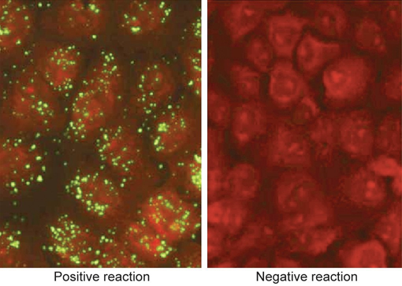
Anti-Chlamydia microimmunofluorescence test (MIF)

Slide 105
Treatment of C. trachomatis infections
For uncomplicated genital infection or trachoma or adult conjunctivitis:
Azithromycin - drug of choice - single dose of 1 gram tablet, per oral
Alternatively doxycycline, tetracycline, erythromycin or ofloxacin - 7 days
Ceftriaxone - added to the regimen as co-infection with gonococcus may be present in most of the cases.

Slide 106
Treatment of C. trachomatis infections (Cont..)
For complicated genital infection:
Doxycycline (100 mg twice daily), or erythromycin (500 mg four times daily) -given for:
  2 weeks for pelvic inflammatory disease and epididymitis
  3 weeks for LGV.

Slide 107
Prevention
Periodic screening of high-risk groups, such as young women having multiple sex partners
Treatment of both the sex partners
Use of barrier methods of contraception - condoms
Abstain from sex till 7 days after starting the treatment.

Slide 108
UROGENITAL MYCOPLASMA INFECTIONS

Slide 109
UROGENITAL MYCOPLASMA INFECTIONS
Mycoplasma (M. hominis, M. genitalium) and Ureaplasma (U. urealyticum and U. parvum) - associated with urogenital tract disease.
Frequently colonize female lower urogenital tract - vagina, periurethral area and cervix
Transmission: Sexual contact or mother to fetus during birth.

Slide 110
Clinical Manifestations
Non-gonococcal urethritis and epididymitis (mainly due to Ureaplasma and
M. genitalium)
Pyelonephritis (M. hominis), and urinary calculi (Ureaplasma)
Pelvic inflammatory disease (mainly due to M. hominis)
Postpartum and postabortal infection
Non-urogenital infections (rare, due to M. hominis): Brain abscess, wound infections or neonatal meningitis.

Slide 111
Laboratory Diagnosis
Culture and PCR - appropriate methods for diagnosis of urogenital mycoplasmas.
Ureaplasma forms very tiny colonies of 15–50 μm size - previously named as T-form Mycoplasma.

Slide 112
Treatment of Urogenital Mycoplasma infections
Macrolides (azithormycin) - drug of choice for Ureaplasma and M. genitalium infections
Doxycycline - drug of choice for M. hominis

Slide 113
OTHER GENITAL TRACT INFECTIONS
COMMON TO BOTH SEXES

Slide 114
GENITAL TUBERCULOSIS

Slide 115
GENITAL TUBERCULOSIS
In female patients - affects the fallopian tubes and the endometrium - cause infertility, pelvic pain, menstrual abnormalities and adnexal swelling.
In male patients, genital TB preferentially affects the epididymis, producing a slightly tender mass - drain externally through a fistulous tract. Other manifestations - orchitis and prostatitis.

Slide 116
ANORECTAL LESIONS

Slide 117
ANORECTAL LESIONS
Frequently seen in—
  (1) women and men who practice of anal-genital intercourse;
  (2) HIV-infected and other immunocompromised patients.
Common anorectal lesions - proctitis causing rectal ulcers, anal abscess and anogential warts

Slide 118
ANORECTAL LESIONS (Cont..)
Anogenital warts: Also called as condyloma acuminata - caused by human papilloma virus (HPV)
Site: Genital area - the penile shaft, scrotum, or labia majora of the vagina or in the anal area

Slide 119
ANORECTAL LESIONS (Cont..)
In HIV-infected patients, anorectal lesions tend to last longer, more severe, and are more difficult to treat compared with infections in the immunocompetent individuals

Slide 120
FEMALE GENITAL TRACT DISEASE

Slide 121
FEMALE GENITAL TRACT DISEASE
Common infections of female genital tract - vulvovaginitis, mucopurulent cervicitis, pelvic inflammatory disease, infections after gynecologic surgery and infections associated with pregnancy.

Slide 122
VULVOVAGINITIS

Slide 123
VULVOVAGINITIS
Vulvovaginitis refers to inflammation of the vaginal mucosa (called vaginitis) and the external genitalia vulva (called vulvitis).
Most common genital tract infection in females.
Women present with vaginal symptoms - abnormal discharge with/without offensive odor or itching

Slide 124
Differential diagnosis of vulvovaginitis
Feature | Vulvovaginal Candidiasis | Trichomonal Vaginitis | Bacterial Vaginosis
Etiology | Candida albicans | Trichomonas vaginalis | Gardnerella vaginalis, various anaerobic bacteria
Typical symptoms | Vulvar itching and/or irritation | Profuse purulent discharge; vulvar itching | Malodorous, slightly increased discharge
Discharge | Scanty, white, thick and cheesy | Profuse, white or yellow | Moderate, thin, white to gray
pH of vaginal fluid | Usually ≤ 4.5 | Usually ≥ 5 | Usually >4.5
Fishy odor with 10% KOH | None | May be present | Present
Vaginal inflammation (erythema) | May be present | Colpitis macularis (strawberry appearance) | None

Slide 125
Differential diagnosis of vulvovaginitis (Cont..)
Feature | Vulvovaginal Candidiasis | Trichomonal Vaginitis | Bacterial Vaginosis
Microscopy of vaginal discharge | ­ Leukocytes, epithelial cells; budding yeast cell with pseudohyphae | ­ Leukocytes; trophozoites seen in 80–90% of symptomatic patients | Clue cells, few leukocytes, no/few lactobacilli (Nugent’s score ≥7)
Other laboratory findings | Isolation of Candida spp. | Antigen detection or PCR | Culture, broad-range PCR
Treatment of the patient | Azole cream, tablet | Metronidazole or tinidazole | Metronidazole (tablet) and clindamycin cream
Treatment of sexual partner | None; topical treatment needed in case of Candida dermatitis of penis | Usually treatment needed | None

Slide 126
Trichomoniasis
Most common parasitic sexually transmitted infection (STI), caused by a flagellated parasite Trichomonas vaginalis.
Has only trophozoite stage; there is no cyst stage.

Slide 127
Trichomoniasis
Trophozoite has two forms:
  Flagellated trophozoite: Infective as well as the diagnostic form
  Amoeboid trophozoite: Actively replicating form, found in the tissue feeding stage of the life cycle.

Slide 128
Life Cycle
Asymptomatic females - reservoir of infection.
Humans acquire infection by sexual route.
Flagellated trophozoites after entry - amoeboid forms - multiply in the genital tract and cause infection - again transform back to flagellated trophozoites -discharged in vaginal/urethral secretions.

Slide 129
Clinical Feature
Asymptomatic infection: 25-30%
Acute infection (vulvovaginitis)
  Females - commonly affected and are presented as vulvovaginitis
  (thin profuse foul smelling purulent discharge)

Slide 130
Clinical Feature (Cont..)
  Strawberry appearance of vaginal mucosa (Colpitis macularis) -in 2% of patients. Characterized by small punctate hemorrhagic spots on vaginal and cervical mucosa
  Other features - dysuria and lower abdominal pain
  In males, the common features are nongonococcal urethritis and rarely epididymitis, prostatitis and penile ulcerations

Slide 131
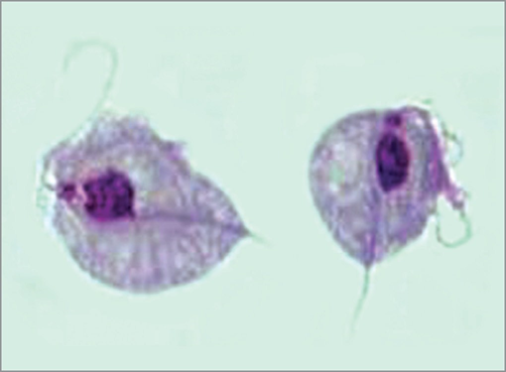
Laboratory Diagnosis
Vaginal, urethral discharge, urine sediment and prostatic secretions -examined.
Wet (saline) mount of fresh samples (within 10–20 minutes of collection) -jerky motile trophozoites and pus cells.

Slide 132
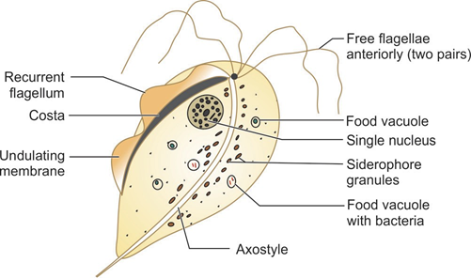
Laboratory Diagnosis (Cont..)
Other staining methods - permanent stains (e.g. Giemsa and Papanicolaou stain), acridine orange fluorescent stain and direct fluorescent antibody test (DFA).

Slide 133
Laboratory Diagnosis (Cont..)
Culture:
Culture is the gold standard method for diagnosis.
Specimen - processed immediately into media - Lash’s cysteine hydrolysate serum media.

Slide 134
Laboratory Diagnosis (Cont..)
Antigen Detection in Vaginal Secretion:
More sensitive than microscopy, easy to perform and indicates recent infection.
Both rapid ICT and ELISA are available using monoclonal antibodies.

Slide 135
Laboratory Diagnosis (Cont..)
Antibody Detection:
ELISA - whole cell antigen preparation and aqueous antigenic extract to detect anti-trichomonal antibodies in serum and vaginal secretion of the patients.

Slide 136
Laboratory Diagnosis (Cont..)
Molecular Methods:
Highly sensitive, replaced the culture techniques; target T. vaginalis specific genes - beta-tubulin gene.

Slide 137
Laboratory Diagnosis (Cont..)
Other Supportive Tests:
Raised vaginal pH (>4.5)
Positive whiff test
Increased pus cells

Slide 138
Treatment of Trichomoniasis
Metronidazole or tinidazole - drug of choice.
Standard therapy: 2 g, single dose is usually effective
Both the sexual partners - treated simultaneously to prevent reinfection, especially asymptomatic males .

Slide 139
Bacterial Vaginosis
Affects women of reproductive age
Associated with an alteration of the normal vaginal flora.

Slide 140
Bacterial Vaginosis (Cont..)
Increase in the concentrations of:
Gardnerella vaginalis,
Mobiluncus (motile, curved, gram-variable or gramnegative, anaerobic rods),
Several other anaerobes [Prevotella and some Peptostreptococcus],
Mycoplasma hominis

Slide 141
Bacterial Vaginosis (Cont..)
Decrease in the concentrations of lactobacilli (which maintain normal vaginal pH acidic, thereby inhibiting the growth of pathogenic organisms).

Slide 142
Risk Factors
Coexisting other infections - HIV, Chlamydia trachomatis & Neisseria gonorrhoeae
Recent unprotected vaginal intercourse
Vaginal douching
Premature rupture of membranes and preterm labor

Slide 143
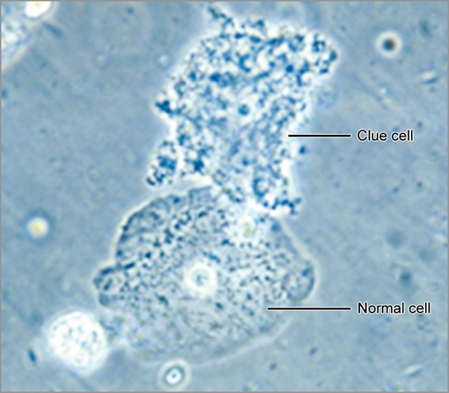
Amsel’s Criteria
Any 3 of the following 4 must be present:
1. Profuse thin white homogeneous vaginal discharge uniformly coated on vaginal wall
2. pH of vaginal discharge > 4.5
3. Accentuation of distinct fishy odor after vaginal secretions are mixed with 10% solution of KOH (Whiff test)
4. Clue cells

Slide 144
Laboratory Diagnosis
Nugent’s score :
Scoring system followed for the diagnosis of bacterial vaginosis
Done by counting the number of Gardnerella vaginalis, Mobiluncus and lactobacilli present in the Gram-stained smear of vaginaldischarge
A score of more than or equal to 7 is diagnostic

Slide 145
Laboratory Diagnosis (Cont..)
Culture:
G. vaginalis requires enriched media - chocolate agar, BHI broth with serum, etc.
Gram-negative (appears gram-variable in smears), non-motile, small pleomorphic rod, which shows metachromatic granules

Slide 146
Treatment of Bacterial vaginosis
Oral metronidazole, given twice daily for 7 days.

Slide 147
Vaginal Candidiasis
Candida albicans - most common species to cause vaginal candidiasis (80% to 90% of cases), followed by C. glabrata and C. tropicalis.
Classical presentation: Perivaginal pruritus (itching), erythema and vaginal discharge—typically thick and “cheesy” in appearance with pH <4.5

Slide 148
Vaginal Candidiasis (Cont..)
Risk factors - pregnancy, hormone replacement therapy, steroid, diabetes or immunocompromised state
Laboratory diagnosis - Culture of vaginal secretions on Sabouraud dextrose agar (pasty or dry white colonies), followed by identification by conventional (e.g. germ tube test) or automated methods (VITEK or MALDI-TOF)

Slide 149
Vaginal Candidiasis (Cont..)
Treatment:
Primary treatment - oral fluconazole or itraconazole (for 1 day).
Topical cream of clotrimazole may be given in milder cases

Slide 150
OTHER GENITAL TRACT INFECTIONS IN
FEMALES

Slide 151
Mucopurulent Cervicitis
Mucopurulent cervicitis (MPC) - inflammation of the columnar epithelium of the endocervix.
Agents: Caused by agents of urethritis - C. trachomatis, N. gonorrhoeae, Mycoplasma genitalium

Slide 152
Mucopurulent Cervicitis (Cont..)
Clinical diagnosis: The three cardinal signs of MPC are—
(1) yellow mucopurulent discharge from cervix,
(2) endocervical bleeding upon gentle swabbing, and
(3) edematous cervical ectopy

Slide 153
Mucopurulent Cervicitis (Cont..)
Diagnosis: Yellow cervical mucus on a white swab removed from the endocervix - pus cells
  Gram stain: Presence of ≥20 pus cells/oil immersion field
  Intracellular gram-negative diplococci
  PCR specific for N. gonorrhoeae

Slide 154
Mucopurulent Cervicitis (Cont..)
Treatment:
Ceftriaxone (single dose IM) followed by doxycycline (for 10 days).

Slide 155
Pelvic Inflammatory Disease (PID)
Infection that ascends from the cervix or vagina - endometrium and/or fallopian tubes - reproductive tract to involve peritoneum.
PID can be either primary or secondary.
  1. Primary PID, occurs spontaneously and usually sexually transmitted or
  2. Secondary PID, occurs following invasive intrauterine procedures

Slide 156
Etiology
N. gonorrhoeae and C. trachomatis.
Rare causes of PID include:
Genital mycoplasmas - M. genitalium
Anaerobic (peptostreptococci) and facultative organisms (Prevotella species)
E. coli, Haemophilus influenzae, and group B streptococci
Secondary to hematogenous dissemination (e.g. tuberculosis or staphylococcal bacteremia).

Slide 157
Clinical Manifestations
Endometritis
Salpingitis (inflammation of the fallopian tube)
Oophoritis (inflammation of ovary) and tubo-ovarian abscess
Extension to peritoneum can cause peritonitis, perihepatitis, perisplenitis, or pelvic abscess

Slide 158
Treatment of Pelvic inflammatory disease
Outpatient regimen: Ceftriaxone (IM once) plus doxycycline (for 14 days) plus metronidazole (for 14 days).
Parenteral regimen:
  Cefotetan or cefoxitin plus doxycycline
  Clindamycin plus gentamicin.

Slide 159
Bartholinitis
Infection of bartholin gland and blockade of its duct.
Mucus-producing gland present on each side of the vaginal orifice; opens through a duct on to the inner surface of the labia minora
Anaerobic and polymicrobial infections originating from normal genital flora -common cause.

Slide 160
Infections in Pregnancy/Postpartum
Prenatal infections may be acquired from:
Hematogenous route and then cross placenta to infect fetus or
Ascending genital tract route from the vagina through ruptured membranes resulting in chorioamnionitis.

Slide 161
Infections in Pregnancy/Postpartum (Cont..)
Natal (during birth) infections: Infections transmitted through the infected birth canal during delivery include—
Bacteria: Group B streptococci, E. coli, Listeria monocytogenes, N. gonorrhoeae, C. trachomatis
Viruses: CMV, HSV, enteroviruses, hepatitis B virus, HIV.

Slide 162
Infections in Pregnancy/Postpartum (Cont..)
Postpartum infections:
Puerperal sepsis - common in mother during postpartum period.
All the organisms listed under natal infection - cause postpartum infection.
These infections during birth or postpartum period - transmitted to the newborn to cause postnatal infections.

Slide 163
Group B Streptococcal Infection in Pregnancy
Streptococcus agalactiae - commensal in maternal genital tract.
Infection in pregnancy - peripartum fever, endometritis and puerperal sepsis
Transmission of organism to the neonate during birth - neonatal sepsis and meningitis

Slide 164
Group B Streptococcal Infection in Pregnancy (Cont..)
Prevention: Screening by rectal/vaginal swab culture is recommended at
35–37 weeks of pregnancy.
Chemoprophylaxis - penicillin - carrier mothers during delivery

Slide 165
OTHER GENITAL TRACT INFECTIONS IN
MALES

Slide 166
Prostatitis
Prostatitis (inflammation of prostate gland) - caused by both infectious (bacterial agents) and noninfectious means.
Bacterial prostatitis may present in acute or in chronic form.

Slide 167
Acute Bacterial Prostatitis
Caused by N. gonorrhoeae and C. trachomatis in males of age <35 years.
In males of >35 years - Enterobacteriaceae and Enterococcus.
Manifestations: Fever, chills, malaise, myalgia, dysuria, pelvic/perineal pain and cloudy urine

Slide 168
Acute Bacterial Prostatitis (Cont..)
Complications: Bacteremia, epididymitis, prostatic abscess, extension to joints, or rarely proceeds to chronic prostatitis
Treatment: Ceftriaxone (IM, single dose), followed by doxycycline
(for 10 days).

Slide 169
Chronic Prostatitis
Enterobacteriaceae (80%) and Enterococcus (15%), occasionally by Pseudomonas.
Manifestations: Low grade fever, urinary frequency, dysuria, urgency and perineal discomfort.
Treatment: Ciprofloxacin or levofloxacin is given for 4 weeks.

Slide 170
Epididymitis
Acute epididymitis - pain, swelling, and inflammation of the epididymis that lasts <6 weeks.
Young men: C. trachomatis and less commonly by N. gonorrhoeae
In older men - Seen following urinary tract instrumentation
In homosexual males: Epididymitis following insertive rectal intercourse - Enterobacteriaceae.

Slide 171
Treatment of Epididymitis
Ceftriaxone (single dose IM) followed by doxycycline (for 10 days) - epididymitis caused by N. gonorrhoeae or C. trachomatis.
Oral levofloxacin - Enterobacteriaceae is suspected.

Slide 172
Orchitis
Orchitis (inflammation of the testicles) is uncommon and generally acquired by the blood-borne dissemination of viruses.
Mumps - etiological agent in most cases.
Testicular pain and swelling following infection.
Infertility following mumps orchitis is very rare.

Slide 173
Questions:
Q1. Lugol’s iodine is used to stain the inclusion body of:
Chlamydia trachomatis
Chlamydophila psittaci
Chlamydophila pneumoniae
All of the above

Slide 174
Questions:
Q2. The most commonly used method for isolation of Chlamydia:
Culture on artificial media
Culture on Vero cell line
Inoculation into guinea pig
Culture on McCoy cell line

