Slide 1
HERPES VIRUS
Dr Himani Pandya
Assistant Professor
Department of Microbiology
SBKS MI&RC

Slide 2
Herpes derived from the word herpein=to creep, refer to the latent, reoccuring infections.
Herpes viridae comprises of a group of viruses that possess a unique property of:
  Establishing latent or persistent infections in their hosts
  Undergo periodic reactivation.

Slide 3
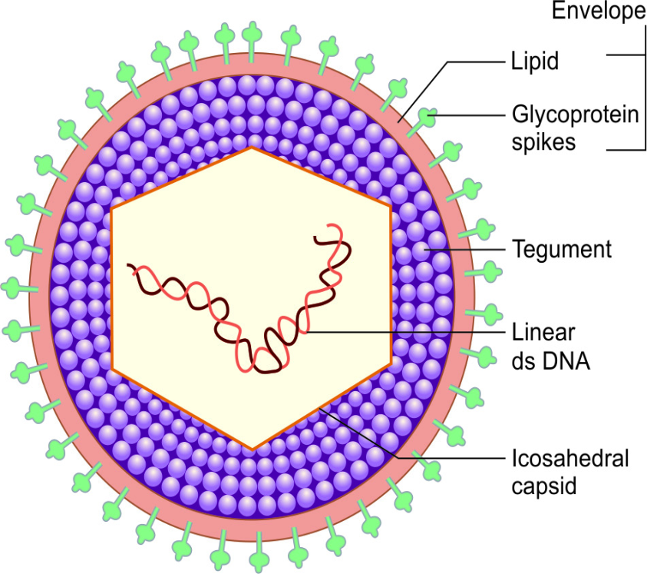
MORPHOLOGY
Size- Large (150–200 nm size).
Spherical in shape
Capsid is Icosahedral with 162 capsomere enclosing the core with Linear double-stranded DNA
Enveloped - lipoprotein in nature
  Lipid part is derived from the host cell nuclear membrane
  Protein part- Virus coded glycoprotein spikes, about 8 nm long are inserted into the lipid part.

Slide 4
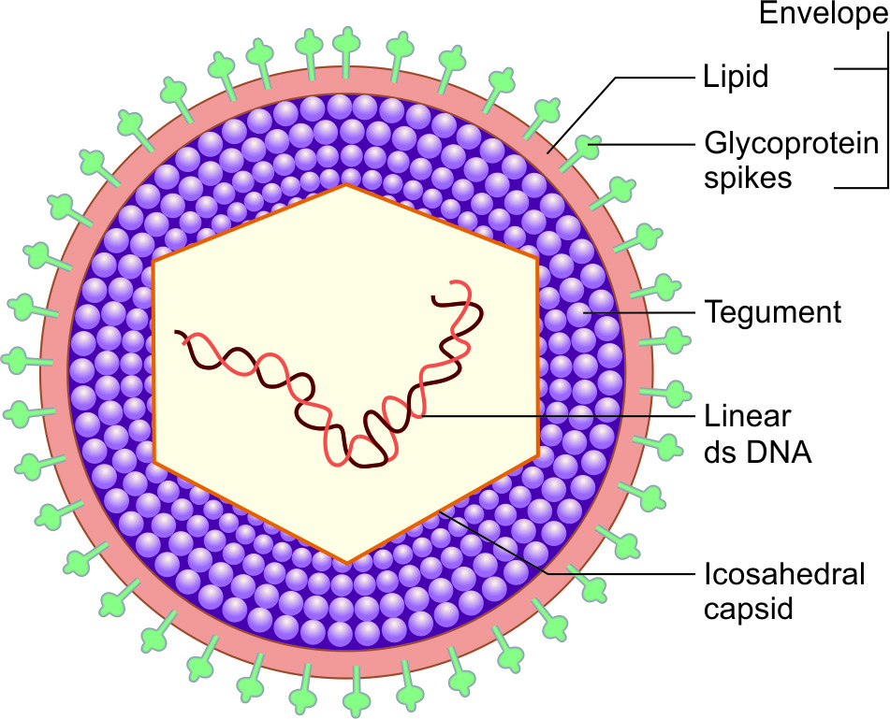
  Tegument- Amorphous, sometimes asymmetric structure present between the capsid and envelope. It contains several proteins.
Replication of herpes viruses takes place in the host cell nucleus. They form Cowdry Type A intranuclear inclusion body( Lipschutz)

Slide 5
Classification
Subfamily ("Herpesvirinae") | Duration of replication & Cytopathology | Site of Latency | Genus | Species
 |  |  |  | Official Name | Common Name
Alpha | Short (12-18 hours) Cytolytic | Neurons | Simplex virus | Human herpesvirus 1 | Herpes simplex virus type 1
 |  |  |  | Human herpesvirus 2 | Herpes simplex virus type 2
 |  |  | Varicello virus | Human herpesvirus 3 | Varicella zoster virus

Slide 6
Subfamily ("Herpesvirinae") | Duration of replication & Cytopathology | Site of Latency | Genus | Species
 |  |  |  | Official Name | Common Name
Beta | Long (>24 hours) Cytomegalic | Glands, Kidneys | Cytomegalovirus | Human herpesvirus 5 | Cytomegalovirus
 | Long(>24 hours) Lymphoproliferative | Lymphoid tissues (T cells) | Roseolovirus | Human herpesvirus 6 | Human herpesvirus 6
 |  |  |  | Human herpesvirus 7 | Human herpesvirus 7

Slide 7
Subfamily ("Herpesvirinae") | Duration of replication & Cytopathology | Site of Latency | Genus | Species
 |  |  |  | Official Name | Common Name
Gamma | Variable, lymphoproliferative | Lymphoid tissues (B Cells) | Lymphocryptovirus | Human herpesvirus 4 | Epstein-Barr virus
 |  |  | Rhadinovirus | Human herpesvirus 8 | Kaposi's sarcoma-associated herpesvirus

Slide 8
Herpes simplex
Occurs only in humans
Two types – HSV type 1 and HSV type 2
HSV type 1 – isolated from lesions in and around the mouth
Transmitted by direct contact or droplet spread from cases or carriers
HSV Type 2 – causes majority of genital herpes
Transmitted venerally

Slide 9
Properties | Herpes simplex virus-1 | Herpes simplex virus-2
Transmission | Direct contact with mucosa or abraded skin | Sexual mode or vertical mode
Latency | Trigeminal ganglia | Sacral ganglia
Age affected | Young children | Young adults
Common manifestations | 1.Oral-facial mucosal lesions 2.Encephalitis & meningitis 3.Ocular lesions 4.Skinlesions- above the waist | 1.Genital lesions 2.Skinlesions-below the waist 3.Neonatal Herpes

Slide 10
Properties | Herpes simplex virus-1 | Herpes simplex virus-2
Egg (CAM*) | Forms smaller pocks | Forms larger pocks
Chick embryo fibroblast | Doesn’t grow well | Replicates well
Neurovirulence | Less | More
Drug resistance | Less | More
Antigenic homology | HSV 1 and 2 show >80%antigenic homology
Genomic sequence homology | HSV 1 and 2 show >50% homology in the genomic sequence

Slide 11
PATHOGENICITY
Herpes simplex is one of the common viral infections in humans
Primary infections acquired in early childhood at 2 and 5 years
Humans are the only natural hosts
Source of infection – saliva, skin lesions or respiratory secretions
Asymptomatic carriers form the more important source of infection for genital lesions with Type 2 strains

Slide 12
ROUTE OF INFECTION
Transmission – close contact
Herpes simplex virus type 2 is transmitted through sexual route, venereally
Virus enters through defects in skin or mucous membranes, multiplies locally, with cell to cell spread

Slide 13
Pathogenesis
Transmission occurs through abraded skin or mucosa
Site of infection: HSV replicates at the local site of infection and produces lesions commonly-
  HSV-1 lesions are confined to areas above the waist (most common site-around mouth)
  HSV-2 produces lesions below the waist (most common site-genital area)

Slide 14
Spread via nerve- Virus then invades the local nerve endings → transported by retrograde axonal flow to the dorsal root ganglia → replicates further → undergoes latency.
Primary HSV infections are usually mild (most are asymptomatic).
In immunocompromised hosts–Viremia occurs that leads to widespread organ involvement and systemic manifestations.

Slide 15
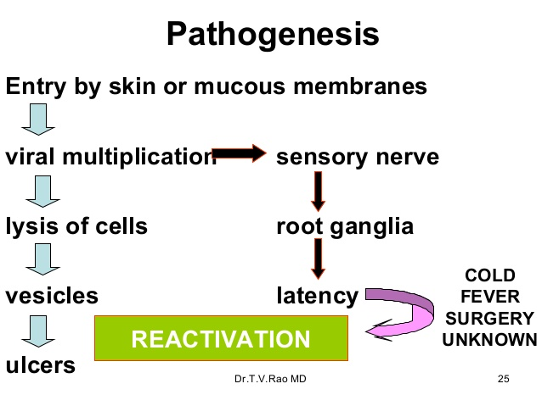
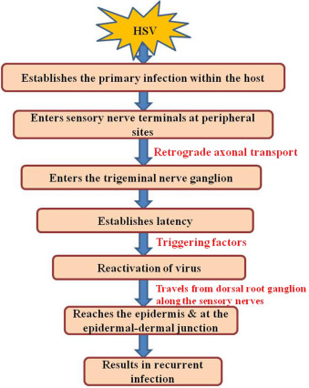

Slide 16
Reactivation of the latent virus: Following fever, axonal injury, physical or emotional stress, and exposure to ultraviolet light, infections and menstruation.
Via the axonal spread, virus goes back to the peripheral site and further replicates in skin or mucosa and produces secondary lesions.

Slide 17
HSV has a tendency to undergo latency in neurons
  HSV-1-trigeminal ganglia
  HSV-2-sacral ganglia
Non-replicating state- HSV does not replicate in latent stage except for a small RNA, called microRNA (encoded by a latency-associated viral gene) which maintains the latent infection and prevents cell death.
Viruses cannot be isolated during latency.

Slide 18
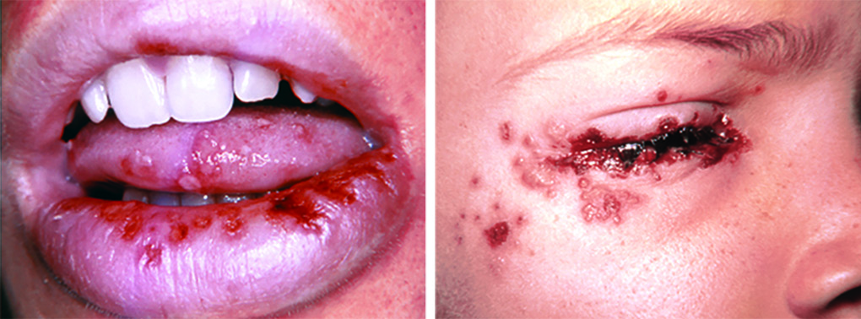
Clinical manifestations
Orofacialmucosal lesions:
Vesicles – thin-walled, umbilicated, roof of which breaks leaving tiny superficial ulcers; heal without scarring
Most common affected site - buccal mucosa
Most frequent primary lesions - gingivostomatitis and pharyngitis
Most frequent recurrent lesion is herpes labialis (painful vesicles near lips)
Other lesions - ulcerative stomatitis and tonsillitis.
Many cases are asymptomatic but can predispose to secondary infection by bacteria such as Streptococcus and Pneumococcus
Vesicular lesions on lips and tongue due to HSV-1

Slide 19
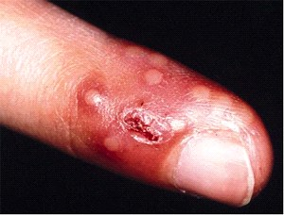
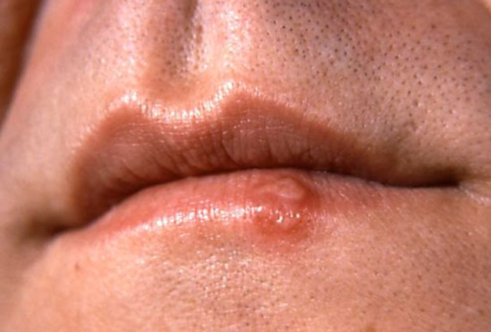
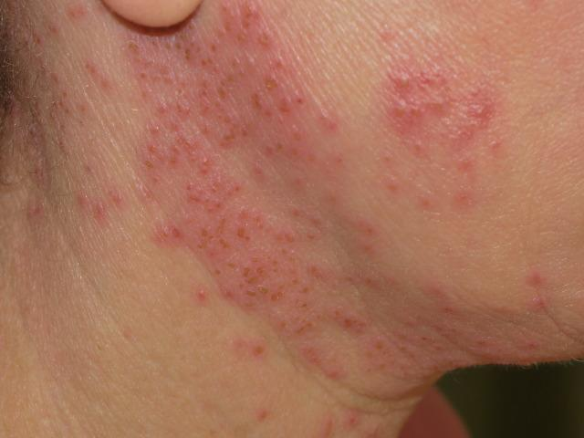
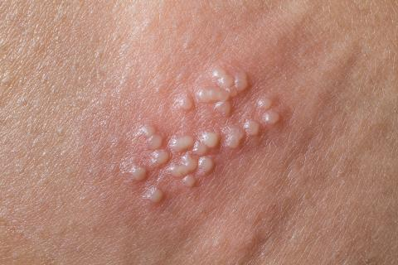
Cutaneous lesions:
  Herpetic whitlow-Doctors, nurses who are exposed to patients’ oral mucosa while not wearing gloves.
  Febrile blisters-COLD
  Herpes gladiatorum
  Eczema herpeticum affects children who have eczema.
Herpetic whitlow
Fever blister
Eczema herpeticum
  Herpes gladiatorum

Slide 20
Ocular lesions: (HSV-1 is more common than HSV-2)
Severe conjunctivitis - most common manifestations
HSV infection is a common cause of corneal blindness
Acute keratoconjunctivitis, follicular conjunctivitis
Periocular vesicular lesions due to HSV-1 infection
Nervous system:
Encephalitis
Meningitis

Slide 21
Genital lesions: (HSV-2 is more common than HSV-1)
Bilateral, painful multiple, tiny vesicular ulcers
Associated with fever and inguinal lymphadenopathy.
In men: lesions on penis and urethra
In women: cervix, vulva, vagina and perinuem are affected

Slide 22
Visceral and Disseminated Herpes:
Risk factors- Immunocompromised patients, underlying malnutrition or AIDS, pregnant women and transplant recipients are at a higher risk of developing viremia and disseminated infection.
HSV esophagitis may cause dysphagia, weight loss.
Common manifestations – pneumonitis, tracheo-bronchitis and hepatitis.

Slide 23
Neonatal Herpes:
Transmission- During birth from the maternal genital tract, in utero or after birth.
Risk of developing neonatal herpes is maximum (10 times more)if the mother recently acquires the virus (primary infection) than those who are presented with recurrent infection.
HSV-2 is more common to cause neonatal herpes (75% of total cases) than HSV-1.

Slide 24
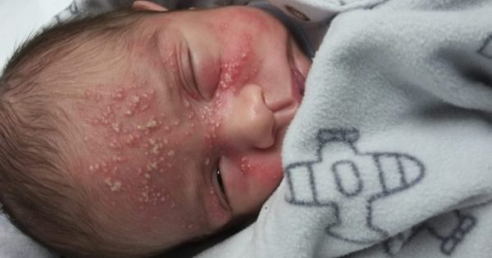
Neonatal Herpes:
Clinical features- Babies are almost always symptomatic and presenting one of the three forms -
  Local lesions involving skin, eye and mouth
  Encephalitis
  Disseminated disease involving multiple organs, including the CNS-Neonate has the highest frequency of visceral infections.

Slide 25
LABORATORY DIAGNOSIS
Specimen
Vesicle fluid, skin swabs, saliva, corneal scrapings, CSF
Microscopy
  Tzanck smear – scrapings from base of vesicles, stained with 1% aqueous toluidine blue –15 seconds.
  Multinucleated giant cells with faceted nuclei and homogenously stained ground glass chromatin Tzanck cells

Slide 26
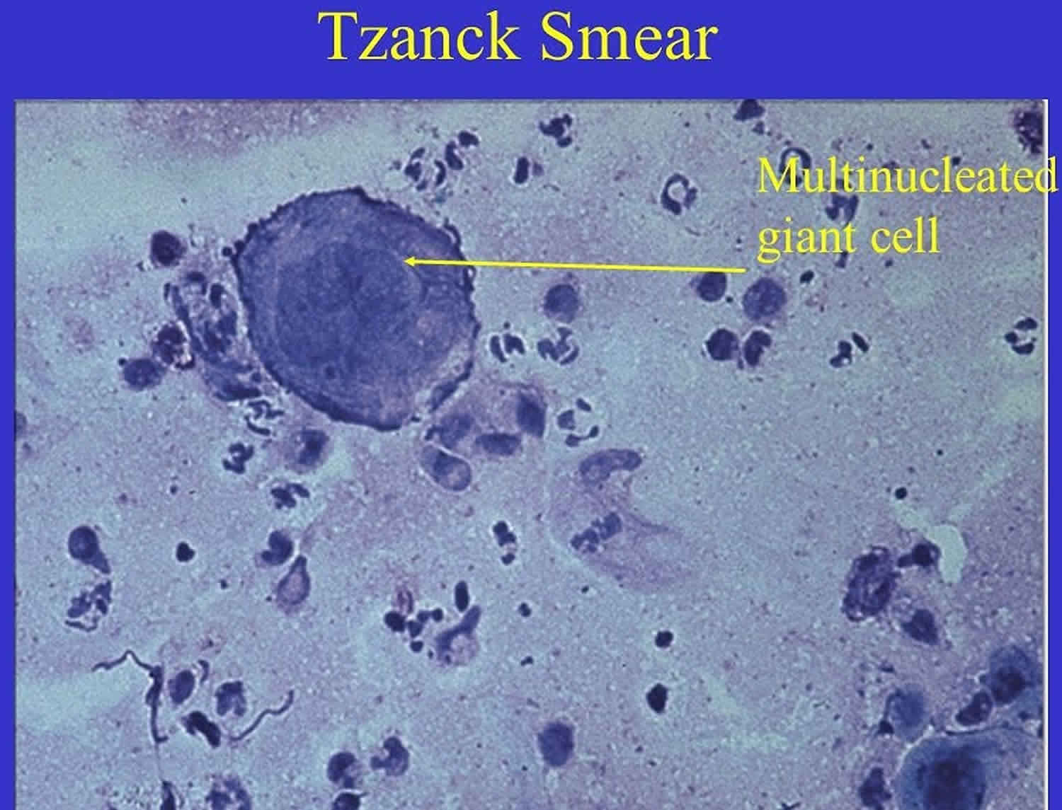
LABORATORY DIAGNOSIS
Herpesvirus in Tzanck smear

Slide 27
LABORATORY DIAGNOSIS
Giemsa stained smears – intranuclear type A inclusion bodies
Electron microscopy may also be used for virus demonstration
Herpes antigen demonstrated by immunofluorescence

Slide 28
LABORATORY DIAGNOSIS
Virus isolation
Mice, chick embryo CAM are not so sensitive
Tissue culture – primary human embryonic kidney, primary human amnion
Human diploid fibroblast is preferable
Growth detected by cytopathic effect
Drug susceptibility may be tested

Slide 29
LABORATORY DIAGNOSIS
Giemsa stained smears – intranuclear type A inclusion bodies
Electron microscopy may also be used for virus demonstration
Herpes antigen demonstrated by immunofluorescence

Slide 30
LABORATORY DIAGNOSIS
Virus isolation
Mice, chick embryo CAM are not so sensitive
Tissue culture – primary human embryonic kidney, primary human amnion
Human diploid fibroblast is preferable
Growth detected by cytopathic effect
Drug susceptibility may be tested

Slide 31
Serology
HSV1 and 2 differentiated by serological methods and by molecular studies
Antibody detection by ELISA, neutralisation and complement fixation test
PCR
More often used for diagnosis
CHEMOTHERAPY
Topical – idoxyuridine-eye and skin infcetions
Systemic – acyclovir, valaciclovir, famciclovir

