Slide 1
Enteric Fever
Dr Himani Pandya
Assistant Professor
Department of Microbiology
SBKS MI&RC

Slide 2
Learning objectives
At the end of the session, the students will be able to understand:
Classification and Nomenclature
Antigenic Structure
Typhoidal Salmonella
Non-Typhoidal Salmonella

Slide 3
INTRODUCTION
Enteric fever is a potentially fatal multisystemic illness caused by Salmonella Typhi (typhoid fever) and S. Paratyphi A, B and C (paratyphoid fever).

Slide 4
CLASSIFICATION AND NOMENCLATURE

Slide 5
CLASSIFICATION AND NOMENCLATURE
Salmonella – GNB (family Enterobacteriaceae)
Discovery - Salmon and Smith (1885).
S. Typhi, was first observed by Eberth (1880) and Gaffky (1884) - formerly called Eberth-Gaffky bacillus or Eberthella Typhi.

Slide 6
Clinical Classification
Oldest, user friendly classification widely used
1. Typhoidal Salmonella:
  Includes serotypes S. Typhi and S. Paratyphi
  Restricted to human hosts → enteric fever (typhoid/paratyphoid fever)
2. Non-typhoidal Salmonellae or NTS:
  Colonize intestine of animals
  Also infect humans → gastroenteritis & septicemia

Slide 7
Antigenic Classification (Kauffmann–White Scheme)
Serogroup |  | Serotype name | O Ag | V_{i} Ag | H Ag
New | Old |  |  |  | Phase 1 | Phase 2
2 | A | S.Paratyphi A | 1,2,12 | - | a | [1,5]
4 | B | S.Paratyphi B | 1,4,[5],12 | - | b | 1,2
 |  | S.Typhimurium | 1,4, [5],12 | - | i | 1,2
7 | C1 | S.Paratyphi C | 6,7 | + | c | 1,5
 |  | S.Choleraesuis | 6,7 | - | c | 1,5
9 | D1 | S.Typhi | 9,12 | + | d | -
 |  | S.Enteritidis | 1,9,12 | - | g,m | [1,7]

Slide 8
Molecular Classification
Genus Salmonella consists of 2 species—(1) Salmonella enterica, & (2) S. bongori.
Within the species S. enterica, there are six subspecies - enterica, salamae, arizonae, diarizonae, houtenae and indica.
Each subspecies is further differentiated into serotypes (based on O and H antigens as described in the Kauffmann–White scheme)

Slide 9
Nomenclature
Taxonomically, the correct nomenclature of the members of salmonellae is very much complicated,
E.g. Salmonella species enterica subspecies enterica serotype Typhi.

Slide 10
ANTIGENIC STRUCTURE

Slide 11
ANTIGENIC STRUCTURE
Three important antigens on their cell wall
1. Somatic antigen (O)
2. Flagellar antigen (H)
3. Surface envelope antigen (Vi)—found in some species

Slide 12
Difference between somatic (O) and flagellar (H) antigen
Somatic (O) antigen | Flagellar (H) antigen
It is a part of cell wall lipopolysaccharide (LPS) | Made up of protein flagellin , It confers motility to the bacteria
In Widal test, O antigen of S. Typhi is used | In Widal test, H antigens of S. Typhi, S. Paratyphi A and B are used
Less immunogenic | More immunogenic
O antibody appears early, disappears early: indicates recent infection | H antibody appears late, disappears late- Indicates convalescent stage
When O antigen reacts with O antibody forms compact, granular, chalky clumps Agglutination takes place slowly Optimum temperature for agglutination is 55°C | When H antigen reacts with H antibody- forms large, loose, fluffy clumps. Agglutination takes place rapidly Optimum temperature for agglutination is 37⁰C
Serogrouping of salmonellae is based on the O antigen | Serogroups are differentiated into serotypes based on H antigen

Slide 13
Vi Antigen
Surface polysaccharide envelope or capsular antigen covering the O antigen
Named with belief that Vi antigen is related to virulence
Expressed in only few serotypes - S. Typhi, S.Paratyphi C, S. dublin and some stains of Citrobacter freundii (Ballerup-Bethesda group)

Slide 14
Vi Antigen (Cont..)
Poorly immunogenic & antibody titers are low Not helpful in diagnosis of cases
Complete absence of Vi antibody poor prognosis
Disappears early in convalescence. If persists carrier state
Phage typing of S. Typhi - using Vi specific bacteriophages
Vi antigens - used for vaccination

Slide 15
TYPHOIDAL SALMONELLA

Slide 16
TYPHOIDAL SALMONELLA
S. Typhi and S. Paratyphi A, B and C which cause enteric fever

Slide 17
Pathogenesis
Transmission - oral route (contaminated food & water)
Infective dose- Minimum 10³–10⁶ bacilli
Risk factors that promote transmission: Conditions that decrease:
  Stomach acidity (<1 year age, antacid ingestion, or achlorhydria or prior Helicobacter pylori infection)
  Intestinal integrity (inflammatory bowel disease, prior GIT surgery or suppression of the intestinal flora by Antibiotics)

Slide 18
Pathogenesis (Cont..)
Entry through epithelial cells (M cells) lining the intestine
  Bacteria mediated endocytosis (BME) - mediated by type III secretion system
Entry into macrophages: Salmonellae containing vacuoles cross epithelial layer to reach submucosa phagocytosed by macrophages
Survival inside macrophages: induces certain alterations on its surface insusceptible to the lysosomal enzymes

Slide 19
Pathogenesis (Cont..)
Primary bacteremia: From inside macrophages spread via the lymphatics to enter the blood stream (transient primary bacteremia)
Spread: Disseminate throughout reticuloendothelial tissues (liver, spleen, lymph nodes and bone marrow further multiplication
Secondary bacteremia occurs from the seeded organs clinical disease

Slide 20
Clinical Manifestations of Enteric Fever
Incubation period is about 10 - 14 days.
Fever (step ladder pattern of remittent fever)
Other symptoms - Headache, chills, cough, sweating, myalgia and arthralgia
Rashes (called rose spots)
Early intestinal manifestations - abdominal pain, nausea, vomiting and anorexia

Slide 21
Clinical Manifestations of Enteric Fever (Cont..)
Important signs - hepatosplenomegaly, epistaxis and relative bradycardia
Complications - Gastrointestinal bleeding and intestinal perforation can occur mostly in the third and fourth weeks of illness
Neurologic manifestations occur rarely

Slide 22
Epidemiology
Host: Humans the only natural hosts
Transmission: Ingestion of contaminated water and food
Prevalence: Worldwide
Incidence is:
Highest (>100 cases per 100,000 population per year) in south central and southeast Asia
Medium (10–100 cases per 100,000) in the rest of Asia, Africa, Latin America
Low (<10 cases per 100,000) in other parts of the world

Slide 23
Epidemiology (Cont..)
Locality and age:
More common in urban than rural areas
More common among young children and adolescents than in adults
Factors that favour transmission:
Poor sanitation, contaminated water, food and drinks
Lack of hand washing and toilet access
Evidence of prior H.pylori infection.

Slide 24
Epidemiology (Cont..)
Typhi vs Paratyphi: S. Typhi infection is more common than S. Paratyphi A (ratio is 4:1).
Carriage: Untreated patients become carriers and excrete S. Typhi in feces or urine.
Carriers are of two types:
Fecal carriers
Urinary carriers

Slide 25
Epidemiology (Cont..)
Duration of shedding:
Temporary carriers - 3 months
Chronic carriers - more than 1 year

Slide 26
Epidemiology (Cont..)
Chronic carriers (1–4% of infected people) - more common in:
Women, infants and old age
Biliary tract abnormalities which leads to increased fecal excretion
Abnormalities of urinary tract and associated Schistosoma haematobium infection of bladder— leads to increased urinary excretion.
Food handlers or cooks who become chronic carriers – dangerous
Mary Mallon (‘Typhoid Mary’) - More than 1300 cases

Slide 27
Laboratory diagnosis (Cont..)
Type of specimen to be collected depends on the duration of illness.
First week of illness: Blood culture, bone marrow or duodenal aspirate culture
Second/third week of illness: Serum specimen for serology (e.g. Widal test)
Third/Fourth week of illness: Urine and stool culture.

Slide 28
Laboratory diagnosis (Cont..)
Culture isolation
Blood culture – positive in 90% of cases in 1st week of fever
Conventional: BHI broth/agar
Automated blood culture systems—BACTEC or BacT/ALERT

Slide 29
Laboratory diagnosis (Cont..)
Culture isolation (Cont..)
Stool culture (in 3–4 weeks of illness):
Enrichment broth such as Selenite F broth, tetrathionate broth and gram-negative broth
Low selective medium: MacConkey agar (translucent NLF colonies)
Highly selective media: DCA, XLD agar, and Wilson Blair’s Bismuth sulphite medium.
Urine culture (in 3–4 weeks of illness)—on MacConkey agar.

Slide 30
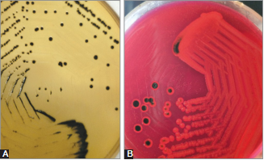
Laboratory diagnosis (Cont..)
Colonies of S. Typhi:
A. DCA (Deoxycholate citrate
agar) showing pale colonies with black center; and
B. XLD agar (Xylose lysine deoxycholate) showing red colonies with black center

Slide 31
Laboratory diagnosis (Cont..)
Other specimens-
Bone marrow culture – done in first week of illness (55–90% sensitive) when blood culture is negative, especially when patient is on antibiotics
Duodenal aspirate culture is recommended during first week of illness if both blood and bone marrow cultures turn negative

Slide 32
Laboratory diagnosis (Cont..)
Other specimens-
Combination of blood, bone marrow, and intestinal secretions culture is the best method in the first week (sensitivity >90%)
Rose spots, pus from suppurative lesions, CSF, sputum and autopsy specimens such as gallbladder, liver and spleen.

Slide 33
Laboratory diagnosis (Cont..)
Culture smear and motility: Motile, GNB
Biochemical identification
  Catalase positive and oxidase negative
  ICUT: Indole(–), Citrate(+/–), Urease(–) ,TSI:K/A, gas(+) except in S. Typhi, H2 S (S. Typhi- small speck, S. Paratyphi A-absent, S. Paratyphi B-abundant).
Slide agglutination test: To confirm the serotype
AST

Slide 34
Laboratory diagnosis (Cont..)
Serum antibody detection (Widal test): 2–3 weeks of illness
Antibodies are detected against TO, TH, AH, BH antigens
In S. Typhi infection: ↑TO and TH antibodies
In S. Paratyphi A infection: ↑TO and AH antibodies
In S. Paratyphi B infection: ↑TO and BH antibodies.
Result and interpretation
O antibodies: Produce granular chalky clumps when react with O Ag
H antibodies: Produce cottony woolly clumps when react with H Ag.

Slide 35
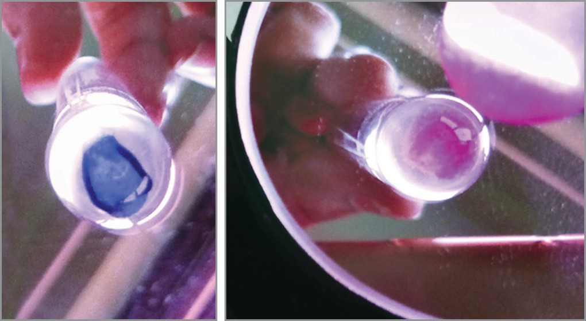
Laboratory diagnosis – Widal test (Cont..)
O and H agglutination in Widal test (reading taken in a mirror)

Slide 36
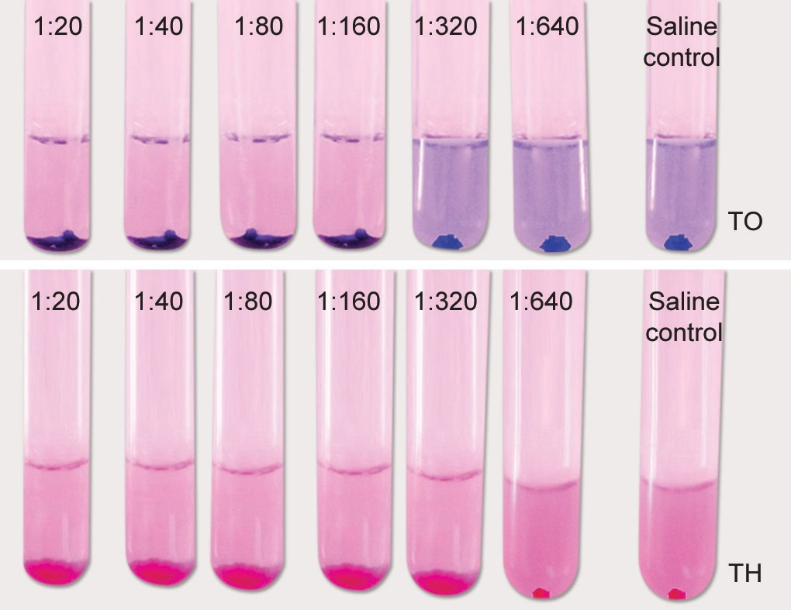
Laboratory diagnosis – Widal test (Cont..)
Widal test showing titre of TO 1:160 and TH 1:320.

Slide 37
Laboratory diagnosis - Interpretation of Widal test
Widal test result | Suggestive of
Rise of TO and TH antibody | Enteric fever due to S.Typhi
Rise of TO and AH antibody | Enteric fever due to S.Paratyphi A
Rise of TO and BH antibody | Enteric fever due to S.Paratyphi B
Rise of only TO antibody | Recent infection -Due to any serotype -S.Typhi or S.Paratyphi A or B
Rise of only TH antibody | ? Convalescent stage/ Anamnestic response
Rise of all three TH, AH, BH antibodies- | Post TAB vaccination

Slide 38
Laboratory diagnosis – Widal test (Cont..)
False-positive: Widal test may occur due to:
  Anamnestic response: It refers to a transient rise of titer due to unrelated infections (malaria, dengue) in persons who have had prior enteric fever
  If bacterial antigen suspensions are not free from fimbriae
  Persons with inapparent infection or
  Persons with prior immunization (with TAB vaccine).

Slide 39
Laboratory diagnosis – Widal test (Cont..)
False-negative: Widal test may occur in:
  Early - stage (1st week of illness)
  Late - stage (after fourth week)
  Carriers
  Patients on antibiotics
  Due to prozone phenomena (antibody excess) - this can be obviated by serial dilution of sera.

Slide 40
Laboratory diagnosis – Widal test (Cont..)
O agglutinins appear early and disappear early → Recent infection.
H agglutinins appear late and disappear late
O antibodies are serotype nonspecific (raised in all infections, i.e. S. Typhi, S. Paratyphi A and B)
H antibodies are specific. TH, AH and BH antibodies are raised in S. Typhi, S. Paratyphi A and B infections respectively.

Slide 41
Laboratory diagnosis – Widal test (Cont..)
Other Antibody Detection Tests - commercial methods
Tyhidot test: 50 kDa OMP antigen is used; it uses a dot ELISA format to detect both IgM and IgG separately after 2-3 days of infection
IDLTubex test: O9 antigen is used, detects only IgM antibodies against S. Typhi by a semiquantitative colorimetric method
IgM dip stick test and ELISA detect anti-LPS IgM antibodies
Dot blot assay: Flagellar antigen is used, detects only IgG antibodies.

Slide 42
Laboratory diagnosis (Cont..)
Demonstration of serum antigens – ELISA
Molecular methods- PCR (flagellin gene, Iro B and fliC gene)
Other non specific tests – neutropenia, LFT moderately deranged, muscle enzymes moderately elevated

Slide 43
Laboratory diagnosis (Cont..)
Detection of carriers
Culture: By stool and bile culture (fecal carriers) & urine culture (urinary carriers)
Detection of Vi antibodies: Tube agglutination test by using S. Typhi suspension carrying Vi antigen (Bhatnagar strains) → Titer of ≥1:10 considered as significant. (diagnosis should always be confirmed by culture)

Slide 44
Laboratory diagnosis (Cont..)
Detection of carriers
Isolation of salmonellae from sewage
  Sewer–swab technique: Gauze pads left in sewers are cultured on highly selective media, such as Wilson and Blair media
  Filtration: Sewage can be filtered through Millipore membranes and the membranes are cultured on highly selective media.

Slide 45
Treatment
Prompt administration of appropriate antibiotics prevents severe complications and reduces the mortality to <1%.
Treatment of cases depends on the susceptibility of the strains.

Slide 46
Treatment (Cont..)
The currently recommended drugs are as follows:
  Third generation cephalosporins: Ceftriaxone - drug of choice for empirical treatment - 1–2 g/day, IV, for 10–14 days
  Azithromycin: Alternative drug for empirical therapy.
  Fluoroquinolones : Because of increased drug resistance, it should not be given empirically.

Slide 47
Treatment (Cont..)
Drugs that were used in the past were: Chloramphenicol, amoxicillin and cotrimoxazole.
Treatment of carriers include: Ampicillin or amoxicillin plus probenecid; given for 6 weeks.

Slide 48
Drug Resistance in Typhoidal Salmonellae
Multidrug-resistant (MDR) S. Typhi - resistant to chloramphenicol, ampicillin and cotrimoxazole.
Fluoroquinolone (FQ) resistance - key mechanisms responsible - mutations in gyrA and parC genes.
Resistance to ceftriaxone - very rare (<1%), both ESBLs and AmpC β-lactamase producing S. Typhi have been detected

Slide 49
Prophylaxis
Control of Reservoir
Sanitation Measures
Vaccine

Slide 50
Control of Reservoir
Control of Cases:
By early diagnosis and prompt effective treatment
Disinfection of stool or urine soiled clothes with 5% cresol, 2% chlorine or by steam sterilizer
Follow-up examination of stool and urine culture to detect carriers (twice, at 3–4 months and at 12 months).

Slide 51
Control of Reservoir (Cont..)
Control of Carriers
Early detection of carriers by stool/urine culture or by detection of Vi antibodies
Effective treatment of carriers by:
  Ampicillin or amoxicillin (4–6 g/day) plus probenecid (2 g/day) - 6 weeks.
  Surgery: Cholecystectomy plus ampicillin

Slide 52
Control of Reservoir (Cont..)
Sanitation Measures:
Protection and purification of drinking water supplies
Hand washing and improvement of basic sanitation
Promotion of food hygiene
Health education.

Slide 53
Control of Reservoir (Cont..)
Vaccine:
Immunization provides short time protection. Indicated in following situations:
  Travelers going to endemic areas
  People attending melas and yatras
  Household contacts
  People at increased risk (school children)
  People living in endemic area (optional).

Slide 54
Vaccines for Typhoid Fever
1. Parenteral Vi polysaccharide vaccine:
Purified Vi capsular polysaccharide antigen derived from S. Typhi strain Ty2
Dosage: Single dose given IM or subcutaneously
Protection for 2 years booster every 2 years
Age: >2 years of age
Vi-rEPA: Vi antigen is conjugated with recombinant Pseudomonas aeruginosa Exotoxin A
Can be given to children less than two years

Slide 55
Vaccines for Typhoid Fever (Cont..)
2. Typhoral (oral live attenuated S. Typhi Ty2 1a vaccine):
Stable live attenuated mutant of S. Typhi strain Ty2 1a
Gal E mutant - lacks the enzyme UDP-galactose-4-epimerase
Multiplies for some time initiates the immune response but self-destructs after 4–5 divisions
Indicated only after 6 years of age

Slide 56
Vaccines for Typhoid Fever (Cont..)
2. Typhoral (oral live attenuated S. Typhi Ty2 1a vaccine) (Cont..):
Enteric coated capsules
Before food on alternate days - 1, 3, 5, 7 with booster every 5 years
Protective immunity starts after 7 days of the last dose and lasts for 4 years

Slide 57
Vaccines for Typhoid Fever (Cont..)
3. Parenteral TAB vaccine
It is a heat-killed whole cell S. Typhi/S. Paratyphi A and B vaccine
It is no longer in use because of significant side effects.

Slide 58
NON - TYPHOIDAL SALMONELLA

Slide 59
NON - TYPHOIDAL SALMONELLA
Non-typhoidal salmonellae cause mainly gastrointestinal manifestations.
However, upto 8% of patients with NTS gastroenteritis develop into bacteremia - lead to either endovascular infection or seedling to various organs leading to metastatic infections.

Slide 60
NON - TYPHOIDAL SALMONELLA
Risk factors for bacteremia include:
NTS serotype: Most common being S. Choleraesuis (source-pig) and S. Dublin (source—cattle)
Age: Infants and elderly people are at higher risk
Immunity: HIV and other conditions with low immunity
People with pre-existing valvular heart disease

Slide 61
Questions:
Q1. Infective does of S. Typhi:
One bacillus
10³ –10⁶ bacilli
10⁸ –10¹⁰ bacilli
1–10 bacilli

Slide 62
Questions:
Q2. In a patient with typhoid, diagnosis after 15 days of onset of fever is best done by:
Blood culture
Stool culture
Urine culture
Widal test

Slide 63
Questions:
Q3. Antibodies against which of the following antigen appear in typhoid carrier:
Vi antigen
O antigen
H antigen
Capsular antigen

