Slide 1
Coronavirus Infections
Including COVID-19
Dr Nidhi Bhalodia
Assistant professor
Microbiology
SBKS MI&RC

Slide 2
Learning objectives
At the end of the session, the students will be able to understand:
Morphology and classification of human coronaviruses.
Epidemiology, source, transmission, pathogenesis, clinical manifestations, lab diagnosis, treatment and infection control and prevention measures of SARS, MERS, COVID -19.

Slide 3
INTRODUCTION
Coronaviruses (CoV) cause respiratory tract infections in man; illness ranging from mild common cold to severe disease like pneumonia.

Slide 4
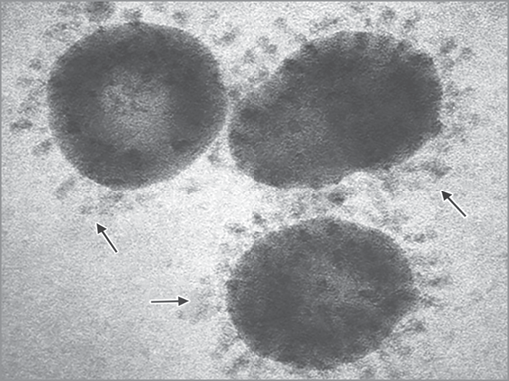
Morphology
Enveloped; petal or club-shaped or crown-like peplomer spikes giving appearance of solar corona.
Large (120–160 nm) spherical viruses, helical symmetry
Linear, positive-sense ssRNA of 26 to 32 kbp size, largest among the non-segmented RNA viruses.

Slide 5
Classification
Coronaviridae family contains two subfamilies: Coronavirinae and Torovirinae.
Former - grouped into four genera—α, β, γ and δ.
Most of them-infect animals except γ Coronavirus species - pathogens of birds.
Human infection - uncommon except few.

Slide 6
Human Coronaviruses
Coronaviruses that produce milder disease
Common coronaviruses that are widespread in distribution, affecting people of most part of the world and cause mild upper respiratory tract infections Human coronavirus 229E Human coronavirus NL63 Human coronavirus OC43 Human coronavirus HKU1
Coronaviruses that produce severe disease
Coronaviruses that caused explosive outbreaks of severe respiratory disease with higher mortality are: SarS-Cov (Severe acute respiratory syndrome coronavirus): It has caused an explosive epidemic called ‘SarS’ in China in 2003 MerS-Cov (Middle East respiratory syndrome coronavirus): It has caused an explosive epidemic ‘MerS’ in Middle East in 2012 SarS-Cov-2 (Severe acute respiratory syndrome coronavirus-2): It is the causative agent of an ongoing explosive pandemics affecting the whole world in 2019-20; called Covid-19 (Coronavirus disease, 2019)

Slide 7
Human Coronaviruses
Most of them belong to Betacoronavirus except the first two (229E and NL63) - belong to Alphacoronavirus.
Spread by droplet transmission (though coughing or sneezing) and also by close personal contact.

Slide 8
SEVERE ACUTE RESPIRATORY SYNDROME (SARS)

Slide 9
SEVERE ACUTE RESPIRATORY SYNDROME (SARS)
SARS-CoV - caused an explosive epidemic in China in 2003 - severe acute respiratory syndrome.
History: First recognized in China in 2003 by WHO physician Dr Carlo Urbani - diagnosed it in a businessman who travelled from China, through Hong Kong, to Hanoi, Vietnam.

Slide 10
SEVERE ACUTE RESPIRATORY SYNDROME (SARS) (Cont..)
Epidemiology: During 2003 outbreak, the SARS virus, spread from Asia to various regions of the world - nearly 8,098 cases in 29 countries, with over 774 deaths - India remained free from the infection.
Source: Contracted from animals, including monkeys, Himalayan palm civets, raccoon dogs, cats, dogs, and rodents

Slide 11
Origin of MERS-CoV, SARS-CoV and SARS-CoV-2

Slide 12
SEVERE ACUTE RESPIRATORY SYNDROME (SARS) (Cont..)
Transmission: Transmitted from person to person (droplet or contact) –
during the second week of illness -corresponds to the peak of virus excretion in respiratory secretions
Clinical manifestations - severe lower respiratory tract infection - muscle pain, headache, sore throat and fever, followed by the onset of respiratory symptoms mainly cough, dyspnea and pneumonia - may progress to ARDS.

Slide 13
SEVERE ACUTE RESPIRATORY SYNDROME (SARS) (Cont..)
Treatment: No effective vaccine or drug available - managed only symptomatically
Infection control: Implementation of appropriate infection control practices.

Slide 14
MIDDLE EAST RESPIRATORY SYNDROME (MERS)

Slide 15
Epidemiology
First reported in Saudi Arabia in 2012.
Origin: Might have originated in bats and was transmitted to camels sometime in the distant past.
Source: Dromedary camels - major reservoir host and an animal source of MERS infection in humans

Slide 16
Epidemiology (Cont..)
Transmission: Both zoonotic and human to human transmission.
Zoonotic: Direct or indirect contact with infected dromedary camels
Human-to-human: Close contact - providing unprotected care to an infected person by family members and healthcare workers.

Slide 17
Epidemiology (Cont..)
High-risk to acquire infection:
Recent history of travel from the Arabian Peninsula within 14 days
Close contacts of a confirmed case of MERS
Healthcare workers not following recommended infection control precautions
People with exposure to infected camels

Slide 18
Clinical Manifestations
Incubation period - 2–14 days
Fever, cough and shortness of breath
Pneumonia - common, but not always present
Gastrointestinal symptoms – diarrhea
Complications - acute respiratory distress syndrome and kidney failure.

Slide 19
Laboratory Diagnosis
Detection of antibodies in serum - past-exposure. ELISA - screening of antibodies; confirmed by immunofluorescence assay (IFA) and microneutralization assays.
Antigen detection: Capture ELISA detecting nucleocapsid protein in nasopharyngeal aspirate.

Slide 20
Laboratory Diagnosis (Cont..)
Molecular method: Detection of specific MERS-CoV RNA by real-time RT-PCR in respiratory specimens - active infection.
Laboratory confirmation requires detection of at least two MERS-CoV specific genes - upE and ORF1b present in the upstream of the E gene

Slide 21
Treatment and Prevention
Treatment is supportive and based on the patient’s clinical condition.
Regular hand washing before and after touching animals.
Avoid consumption of raw or undercooked camel products - milk and meat – consumed only after pasteurization, cooking or other heat treatment.

Slide 22
CORONAVIRUS DISEASE
(COVID)-2019

Slide 23
CORONAVIRUS DISEASE (COVID)-2019
Acute respiratory disease caused by severe acute respiratory syndrome coronavirus 2 (SARS-CoV-2).
Caused an explosive catastrophic pandemic - affected almost all part of the world - produced significant loss of lives and the worst financial crisis recorded ever, since World War II.

Slide 24
Epidemiology
SARS-CoV-2 originated from China - spread rapidly to affect rest the world over a period of 3-4 months.
First identified in December 2019 in Wuhan, China - produced a large cluster of pneumonia cases - initially called as the ‘Wuhan Virus’.
Subsequently - named as the 2019- novel coronavirus (2019-nCoV).

Slide 25
Epidemiology (Cont..)
Nomenclature: On 11th February 2020, WHO announced the official name ‘COVID-19’ for this new coronavirus disease - also renamed the virus as SARS-CoV-2.
Pandemic: On 11th March 2020, WHO declared it as a global pandemic

Slide 26
Situation in India (As of August 2020)
India was one among those countries where the COVID-19 pandemic had a slower growth curve to reach its peak.
First report - Kerala in January 2020 - three imported cases were reported.
Italian visitors: First cluster reported in India.
TJ cluster: Religious congregation that took place in Delhi’s Nizamuddin Markaz Mosque in early March 2020

Slide 27
Situation in India (As of August 2020) (Cont..)
Koyambedu cluster: Identified in Koyambedu market of Chennai in May 2020.
Maharashtra cluster: Maharashtra accounts for nearly one-third of the total cases in India as well as about 22% of all deaths.

Slide 28
MORPHOLOGY

Slide 29
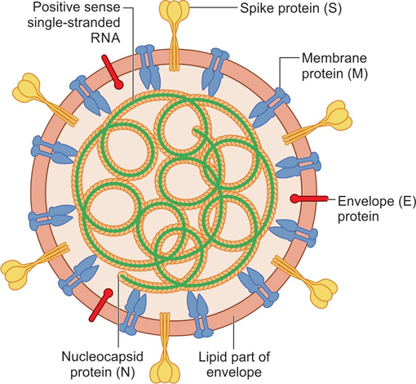
MORPHOLOGY
SARS-CoV-2 comprises of a nucleocapsid, surrounded by an envelope.
Measures 120 nm in size; has a helical symmetry.
Possesses 4 structural proteins (N, S, M and E),
16 nonstructural proteins and several other accessory proteins

Slide 30
MORPHOLOGY (Cont..)
Nucleocapsid consists of a positive-sense single stranded RNA
(~30 kb genome size), surrounded by nucleocapsid protein (N)
Envelope is lipoprotein in nature; lipid part - host-derived into which a number of proteins are embedded such as:
  Spike protein (S)
  Membrane glycoprotein (M)
  Envelope protein (E)

Slide 31
MORPHOLOGY (Cont..)
Nucleocapsid consists of a positive-sense single stranded RNA (~30 kb genome size), surrounded by nucleocapsid protein (N)
Envelope is lipoprotein in nature; lipid part - host-derived into which a number of proteins are embedded such as:
  Spike protein (S)
  Membrane glycoprotein (M)
  Envelope protein (E)

Slide 32
PATHOGENESIS

Slide 33
Transmission
Primarily transmitted via respiratory droplets and contact routes.

Slide 34
Droplet Transmission
Occurs when a person is in close contact (within 1 meter) with an infected person.
Occurs through coughing, sneezing or very close personal
Use of mask can prevent droplet transmission.

Slide 35
Contact Transmission
Transmission of the COVID-19 virus can occur directly by contact with infected people, or indirectly.
Following contact (direct or indirect), the virus can only be transmitted by touching the contaminated hand to a person’s mouth, nose or conjunctiva.
Frequent hand hygiene following potential contact exposure is crucial to prevent this type of transmission

Slide 36
Aerosol Transmission
Spread of the infected droplet nuclei beyond one meter - not documented yet.
Specific settings in which aerosol-generating procedures are performed (e.g. endotracheal intubation), aerosol transmission of the COVID-19 virus may be possible.
Use of N95 respirator - important to prevent this type of transmission.

Slide 37
Pre-symptomatic Transmission
Defined as the transmission of the COVID-19 virus from a person who is infected and shedding the virus but has not yet developed symptoms.
Observed in people 1-3 days before the onset of their symptom.

Slide 38
Host Cell Entry
SARS-CoV-2 enters into the target host cells by binding of its spike glycoprotein (S) antigen with the host cell receptor, i.e. angiotensin converting enzyme-2 (ACE-2).
Spike protein cleavage
Fusion
ACE-2 receptors

Slide 39
Development of ILI
ACE-2 receptors - highly expressed on the epithelial cells of oral mucosa.
At the initial stage, SARS-CoV-2 infects the pharyngeal epithelium, induces inflammation - influenza-like illness (ILI).

Slide 40
Development of ARDS
Leading cause of mortality in patients with COVID-19 is hypoxemic respiratory failure - result in acute respiratory distress syndrome (ARDS).

Slide 41
Reduced Surfactants
Damage to the type-II alveolar cells – reduced production of pulmonary surfactants - alveoli tend to collapse - air-liquid-interphase is perturbed - fluid retention in the interstitial space
To prevent collapse - muscular movement of inspiration becomes hyperactive - increased lung volume in the interstitial space – attracts liquid - edema in the lungs.

Slide 42
Cytokine Storm

Slide 43
CLINICAL MANIFESTATIONS

Slide 44
CLINICAL MANIFESTATIONS
Incubation period - 5-6 days, but can be as long as 14 days.
Common features: Fever, cough with expectoration, fatigue, shortness of breath, myalgia, rhinorrhea, sore throat, diarrhea. Loss of smell or taste sensation - occasionally occur preceding the onset of respiratory symptoms.

Slide 45
CLINICAL MANIFESTATIONS (Cont..)
Atypical symptoms: Seen in older people and immune-suppressed patients— fatigue, reduced alertness, reduced mobility, diarrhea, loss of appetite, delirium, and absence of fever.
Children might not develop fever or cough as frequently as adults.

Slide 46
Clinical severity of COVID-19 disease
Clinical stage | Clinical presentations
Mild disease
ILI ((influenza-like illness) | Patients with uncomplicated upper respiratory tract infection, may have mild symptoms such as fever, cough, sore throat, nasal congestion, malaise, headache Without evidence of breathlessness or hypoxia (normal saturation)
Moderate disease
Pneumonia with no signs of severe disease | Dyspnea, fever and cough Hypoxia, SpO2 <94%, respiratory rate ≥ 24 per minute

Slide 47
Clinical severity of COVID-19 disease (Cont..)
Clinical stage | Clinical presentations
Severe disease : Called as severe acute respiratory illness (SARI)
Severe pneumonia | Clinical signs of pneumonia plus one of the following sign of severe respiratory distress: (i) Respiratory rate >30 /min or (ii) SpO2 <90%
Acute respiratory distress syndrome (ARDS) | Symptoms: Onset of new or worsening respiratory symptoms within one week Chest imaging: Shows bilateral opacities, not fully explained by effusions, lobar or lung collapse, or nodules decreased pao2/Fio2 (normal value ≃ 500): ARDS can be classified into—mild (<300), moderate (<200), and severe (<100); (when PEEP or CPAP is maintained at ≥5 cm H2O)

Slide 48
Clinical severity of COVID-19 disease (Cont..)
Clinical stage | Clinical presentations
Severe disease : Called as severe acute respiratory illness (SARI)
Sepsis | Acute life-threatening multiorgan dysfunction: Clinically diagnosed by SOFA (sequential organ failure assessment) score
Septic shock | Persisting hypotension despite volume resuscitation, requiring vasopressors to maintain mean arterial pressure ≥65 mm Hg and serum lactate level >18 mg/dL

Slide 49
Strategy for COVID-19 testing in India, Indian Council of Medical Research (Version 5, 18/05/2020)
1. Patient with influenza-like illness (ILI) symptoms, plus fulfills one of the following criteria: History of international travel in the last 14 days or Contacts of laboratory confirmed cases or Health care workers/frontline workers or Hospitalized patient developing ILI or Living within hotspots/containment zones or Among returnees and migrants within 7 days of illness 2. All patients of Severe Acute Respiratory Infection (SARI) 3. Asymptomatic direct and high-risk contacts of a confirmed case to be tested once between day 5 and day 10 of contact. No emergency procedure (including deliveries) should be delayed for lack of test. However, samples can be sent for testing if indicated as above (1–3), simultaneously.

Slide 50
Strategy for COVID-19 testing in India, Indian Council of Medical Research (Version 5, 18/05/2020) (Cont..)
Note : ILI case is defined as one with acute respiratory infection with fever ≥ 38°C and cough SARI case is defined as one with acute respiratory infection with fever ≥ 38°C and cough and requiring hospitalization All testing in the above categories is recommended by real time RT-PCR test only. If antigen detection test is used, the negative result in symptomatic individuals has to be reconfirmed by real time RT-PCR.

Slide 51
Laboratory diagnosis of COVID-19
Specimens: Throat and nasal swabs
NAAT: Nucleic acid amplification testing
  Formats: Real time RT-PCR, automated formats (CBNAAT and Truenat)
  Gene targets: Screening (E, N, M genes), confirmatory (RdRp, N2 genes, etc.)

Slide 52
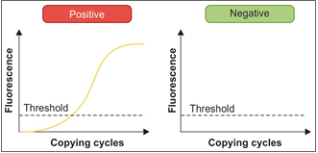
Interpretation of real-time RT-PCR result for COVID-19 diagnosis

Slide 53
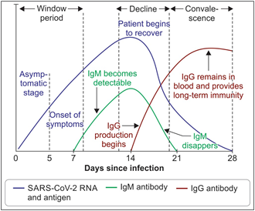
Course of the diagnostic markers in COVID-19

Slide 54
Laboratory diagnosis of COVID-19 (Cont..)
Antigen detection assay: Point-of-care test; detects nucleocapsid protein antigen in nasopharyngeal swab
Antibody (IgG) detection assay: Used for serosurveillance and survey in high-risk and vulnerable group; not for clinical diagnosis

Slide 55
Laboratory diagnosis of COVID-19 (Cont..)
Sequencing: To determine mutations in the viral genome
Viral culture: Used for research purpose
Nonspecific tests include:
  Radiology (chest CT scan): Ground-glass appearance
  Biomarkers: IL-6, D-dimer

Slide 56
Treatment under research for COVID-19
Drugs | Mechanism of action
Favipiravir | It is converted into an active form in cells which inhibits RNA polymerase activity
Remdesivir | It is converted into an active form (GS-441524), which inhibits viral RNA- dependent RNA polymerase
Lopinavir/Ritonavir | Protease inhibitors; block viral replication
Hydroxychloroquine | Used for prophylaxis against COVID-19

Slide 57
Treatment under research for COVID-19 (Cont..)
Drugs | Mechanism of action
Anti-cytokines | Useful for ARDS, by preventing cytokine storm
Tocilizumab or sarilumab | IL-6 receptor blocker
Tofacitinib | Jak3 inhibitor
Convalescent plasma therapy
The plasma of patients recovered from COVID-19 contains neutralizing antibodies against SARS-CoV-2 virus. These antibodies are believed to eliminate the virus completely.
Other drugs
Camostat mesylate | Inhibits TMPRSS2
Hesperidin | Inhibit binding of spike protein to ACE-2

Slide 58
Treatment of COVID-19
Symptomatic management
In patients with severe respiratory distress
Supplemental oxygen therapy is given immediately
High-flow nasal cannula oxygenation (HFNO)
Non-invasive mechanical ventilation

Slide 59
Treatment of COVID-19 (Cont..)
Mechanical ventilation: In patients with moderate or severe ARDS, higher PEEP (positive end-expiratory pressure) instead of lower PEEP is suggested.
Management of septic shock by—vasopressors, fluid replacement by crystalloids such as normal saline and Ringer’s lactate

Slide 60
Treatment of COVID-19 (Cont..)
Investigational therapy:
Remdesivir
Convalescent plasma therapy
Tocilizumab
Hydroxychloroquine (HCQ)

Slide 61
Treatment of COVID-19 (Cont..)
Remdesivir
It interferes with the action of viral RNA-dependent RNA polymerase
Indication: Considered in patients with moderate disease (those on oxygen)
Dosage: 200 mg IV on day 1 followed by 100 mg IV daily for 5 days
Contraindicated in: Children, pregnancy, lactation, liver or renal impairment.

Slide 62
Treatment of COVID-19 (Cont..)
Convalescent plasma therapy
Plasma of patients recovered from COVID-19 - neutralizing antibodies against SARS-CoV-2. These antibodies are believed to eliminate the virus completely.
Indication: Patients with the moderate disease not improving on steroids
Dose - variable ranging from 4 to 13 mL/kg (usually 200 mL, single dose).

Slide 63
Treatment of COVID-19 (Cont..)
Tocilizumab
Monoclonal antibody against IL-6 receptor.
Indication: Patients with moderate disease with progressively increasing oxygen requirements and in mechanically ventilated patients not improving ON steroids
Dose: 8 mg/kg (maximum 800 mg at one time) given slowly

Slide 64
Treatment of COVID-19 (Cont..)
Hydroxychloroquine (HCQ)
Effective in the early course of the disease and avoided in patients with severe disease.

Slide 65
Treatment of COVID-19 (Cont..)
Discharge policy
Upon clinical and/or microbiological recovery (negative result by real timer RT-PCR), the patient can be discharged and transmission-based precautions can be discontinued

Slide 66
PROPHYLAXIS

Slide 67
Chemoprophylaxis
Hydroxychloroquine (HCQ) - recommended by the Government of India for prophylaxis for SARS-CoV-2 infection.
Indication:
Asymptomatic household contacts of laboratory confirmed cases
All asymptomatic healthcare workers & asymptomatic frontline workers
Paramilitary/police personnel involved in COVID-19 related activities

Slide 68
Chemoprophylaxis (Cont..)
Dosage: 400 mg twice a day on day 1, followed by 400 mg once weekly for next 7 weeks (except for household contacts, given for 3 weeks)
Contraindication: Known case of retinopathy, hypersensitivity to HCQ, glucose-6-phosphate dehydrogenase (G6PD) deficiency, pre-existing cardiomyopathy and cardiac rhythm disorders, children <15 years age, in pregnancy and in lactation

Slide 69
Chemoprophylaxis (Cont..)
Precaution: ECG - done before prescribing HCQ prophylaxis and during the course to look for prolongation of QT interval

Slide 70
Vaccine
Currently - no vaccine against COVID-19 infection - intense research is on-going.
As per WHO (August 2020), there are 138 candidate vaccines in the preclinical evaluation and 29 candidate vaccines in clinical evaluation.

Slide 71
Vaccine (Cont..)
Some of the vaccine trials which are in advanced stage include:
Covaxin trial (India)
ChAdOx1-S (University of Oxford, USA)
Sputnik V trial (Russia)
Trial by Serum Institute of India.

Slide 72
INFECTION PREVENTION AND CONTROL

Slide 73
IPC Measures at Healthcare Facility
Hand Hygiene
Personal Protective Equipment
  HCWs giving care to the COVID-19 suspects
  HCWs working in non-COVID areas
  Anyone entering into a healthcare facility
Environmental Cleaning

Slide 74
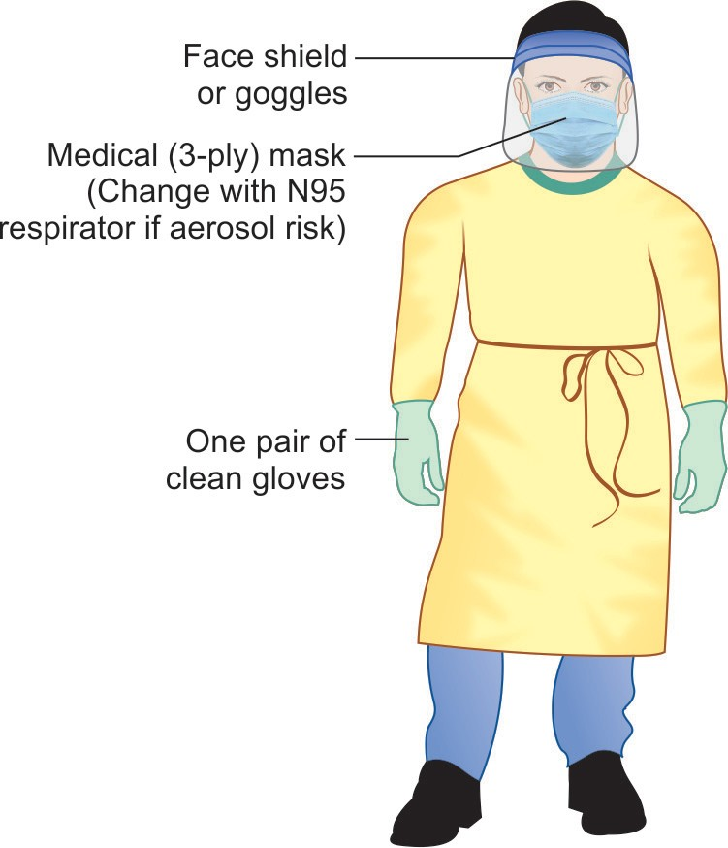
Personal protective equipment recommended for healthcare workers when giving care to COVID-19 patients

Slide 75
IPC Measures at Healthcare Facility (Cont..)
Respiratory hygiene and cough etiquette
Biomedical waste management
Laundry

Slide 76
IPC Measures for General Public
Hand Wash
Social Distancing
Environmental Cleaning
Cloth Mask (Non-medical Masks)

Slide 77
Measures taken by the Government - Quarantine
Quarantine refers to restriction on the movement of healthy people who are exposed to a confirmed case; aims at preventing the transmission if they develop disease subsequently.
Duration: Maximum incubation period (i.e. 14 days in case of COVID-19)

Slide 78
Measures taken by the Government - Quarantine (Cont..)
Quarantine centers: There are two types of centers—
(i) Facility quarantine: Provided by the government.
Various centers - converted to quarantine facilities - schools, marriage halls mandaps, hotels, etc. High-risk contacts - kept in facility quarantine.
(ii) Home quarantine: Low-risk contacts - usually sent for home quarantine.

Slide 79
Indications for Quarantine
WHO has recommended the following exposures occurring from -2 to + 14 days of onset of symptoms in a COVID-19 patient - considered as contacts and exposed persons - sent for quarantine
Face-to-face contact with a COVID-19 patient within 1 meter, for >15 minutes.
PPE breach: Providing direct care for COVID-19 patients without using PPEs or inappropriate use of PPE mounting to breach

Slide 80
Indications for Quarantine (Cont..)
Staying in the same close environment as a COVID-19 patient for any amount of time
Traveling in close proximity with a COVID-19 patient in any kind of conveyance
Other situations, as indicated by the local risk assessment

Slide 81
Lockdown
Lockdown refers to limiting the movement of the entire population as a preventive measure against the COVID-19 pandemic.
Adopted by several countries worldwide including India.
India adopted nationwide lockdown in four phases from 25th March to 31st May 2020.

Slide 82
Objective of lockdown during COVID-19 pandemic
Group | Definition | Benefit of lockdown
A | COVID -19 positive cases | They are admitted in the COVID care facility
B | Pass-by contacts Include anyone who is exposed to the case, but are beyond the memory re-call (e.g. all individuals of a movie theater) This is the most vulnerable group; nobody including themselves knows who is category B It is impossible to trace category B, except by performing passive surveillance of the whole community which is practically very difficult | Lockdown aims at immobilizing category B If anyone developed symptoms, will be referred to the hospital Others, who do not develop symptoms are either Un-exposed individuals, or Asymptomatic contacts: They get recovered during lockdown period and therefore will no longer transmit the infection

Slide 83
Objective of lockdown during COVID-19 pandemic (Cont..)
Group | Definition | Benefit of lockdown
C | Close contacts of COVID-19 positive cases (e.g. family members and office staff) | Traced easily by active surveillance as they are immobilized at home
D | Rest of the community, who are not exposed to a COVID-19 positive case | The most important objective of lockdown is immobilizing category D, so that they will no longer come in contact with others (especially category B)

Slide 84
Cluster Containment Strategy
Objective: To contain the disease within a defined geographic area by early detection of cases, breaking the chain of transmission and preventing its spread to new areas causing community transmission.
Components: Geographic quarantine, social distancing measures, enhanced active surveillance, testing all suspected cases, isolation of cases, quarantine of contacts.

Slide 85
Cluster Containment Strategy (Cont..)
Containment zone is determined by four factors—
(i) the index case/cluster, (called as epicenter),
(ii) the listing and mapping of contacts,
(iii) geographical distribution of cases and contacts around the epicenter, and
(iv) administrative boundaries within urban cities/towns/ rural areas.
A buffer zone of additional 5 km radius will be identified.

Slide 86
Questions:
Q1. While examining a stable patient with COVID -19, all the following PPE are required, except:
N 95 mask
Gown
Goggles
Gloves

Slide 87
Questions:
Q2. Gene targets for confirmation of COVID -19 include:
Spike protein (S)
Envelope protein (E)
Membrane protein (M)
RNA-dependent RNA polymerase (RdRp)

