Slide 1
Intestinal Protozoan Infections

Slide 2
Learning objectives
At the end of the session, the students will be able to understand:
Intestinal amoebiasis
Amoebae resembling E.histolytica
Opportunistic intestinal coccidian parasitic infections
Giardiasis, balantidiasis, Microsporidiosis

Slide 3
Intestinal Protozoan Infections
The protozoan parasites which cause intestinal infection include:
Intestinal amoebae: Entamoeba histolytica
Intestinal flagellate: Giardia lamblia
Opportunistic intestinal coccidian parasites: Cryptosporidium, Cyclospora, and Cystoisospora
Others: Balantidium coli, Blastocystis hominis, Sarcocystis and Microsporidia (now considered as fungi).

Slide 4
INTESTINAL AMOEBIASIS

Slide 5
INTESTINAL AMOEBIASIS
Amoebae (meaning “change”) - single-celled protozoan parasites that constantly change their shape - due to presence of an organ of locomotion called as “pseudopodium”.
Based on the habitat they are of two types -
  (i) intestinal amoebae, and
  (ii) free-living amoebae.

Slide 6
ENTAMOEBA HISTOLYTICA INFECTIONS

Slide 7
ENTAMOEBA HISTOLYTICA INFECTIONS
E. histolytica causes amoebic dysentery and a wide range of other invasive diseases, including amoebic liver abscess.
There are three other species of Entamoeba such as E. dispar, E. moshkovskii and E. bangladeshi which are morphologically similar to E. histolytica.

Slide 8
Epidemiology
E. histolytica is worldwide in distribution but more common in tropical and subtropical countries.
Largest burden of the disease - tropics of China, Central and South America, and Indian subcontinents affecting 10% of the world’s population (500 million)
Third most common parasitic cause of death in the world.

Slide 9
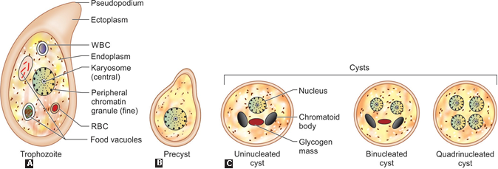
Morphology

Slide 10
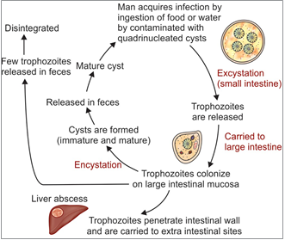
Life Cycle

Slide 11
Virulence Factors
Trophozoite of E. histolytica - invasive form and possesses many virulence factors that play an important role in the pathogenesis.
  Amoebic lectin antigen
  Amoebapore
  Cysteine proteases and hydrolytic enzymes
  Neuraminidase and metallocollagenase

Slide 12
Pathogenesis
Colonization: Trophozoites first colonize the intestinal mucosa.
Adhesion: Then the trophozites penetrate the mucus layer and adhere to the large intestinal mucosa by - Gal/GalNAc lectin molecules
Flask-shaped ulcers
Invasion: Amoebae then invade the large intestinal wall - migrate to extraintestinal sites.
Intestinal complications

Slide 13
Complications of intestinal amoebiasis

Slide 14
Clinical Manifestations
Incubation period - one to four weeks.
Males and females are affected equally.
Majority of infections (90%) result in asymptomatic cyst passers.
The remaining (10%), develop intestinal amoebiasis

Slide 15
Clinical Manifestations (Cont..)
Amoebic dysentery
Amoebic appendicitis
Amoeboma
Fulminant colitis

Slide 16
Differences in stool characters between amoebic dysentery and bacillary dysentery
Character | Amoebic dysentery | Bacillary dysentery
Pathology
Ulcer | Deep | Shallow
Margin | Ragged and undermined | Uniform
Intervening mucosa | Normal | Inflamed
Cellular response | Mononuclear | Polymorphonuclear

Slide 17
Differences in stool characters between amoebic dysentery and bacillary dysentery (Cont..)
Character | Amoebic dysentery | Bacillary dysentery
Stool macroscopic feature
Number of motion | 6–10/day | > 10/day
Amount | Copious amount | Small quantity
Color | Dark red | Bright red
Odor | Offensive | Odorless
Reaction | Acidic | Alkaline
Consistency | Not adherent to the container | Adherent to the container

Slide 18
Differences in stool characters between amoebic dysentery and bacillary dysentery (Cont..)
Character | Amoebic dysentery | Bacillary dysentery
Stool microscopic feature
Red blood cells (RBCs) | In clumps | Discrete or in rouleaux
Pus cells | Few | Numerous
Macrophages | Few | Numerous*
Eosinophils | Present | Absent or rare
Charcot-Leyden crystal | Present | Absent
Pyknotic body** | Present | Absent
Organism detected | E. histolytica cyst or trophozoite | Bacteria (e.g. Shigella)

Slide 19
Laboratory diagnosis of Intestinal amoebiasis
Stool microscopy by wet mount, permanent stains, etc.— detects cysts (round, 1–4 nuclei) and trophozoites (with finger like pseudopodia)
Histology—Intestinal biopsies stained with PAS or H&E stains reveal trophozoites
Stool culture—Polyxenic and axenic culture

Slide 20
Laboratory diagnosis of Intestinal amoebiasis (Cont..)
Stool antigen detection (copro-antigen)—ELISA (detecting 170-kDa of lectin Ag) and ICT (detecting 29-kDa surface Ag).
Serology
  Amoebic antigen—ELISA (170-kDa of lectin Ag)
  Amoebic antibody—ELISA
Isoenzyme (zymodeme) analysis

Slide 21
Laboratory diagnosis of Intestinal amoebiasis (Cont..)
Molecular diagnosis—Nested multiplex PCR and real time PCR (18S rRNA) and Biofire FilmArray

Slide 22
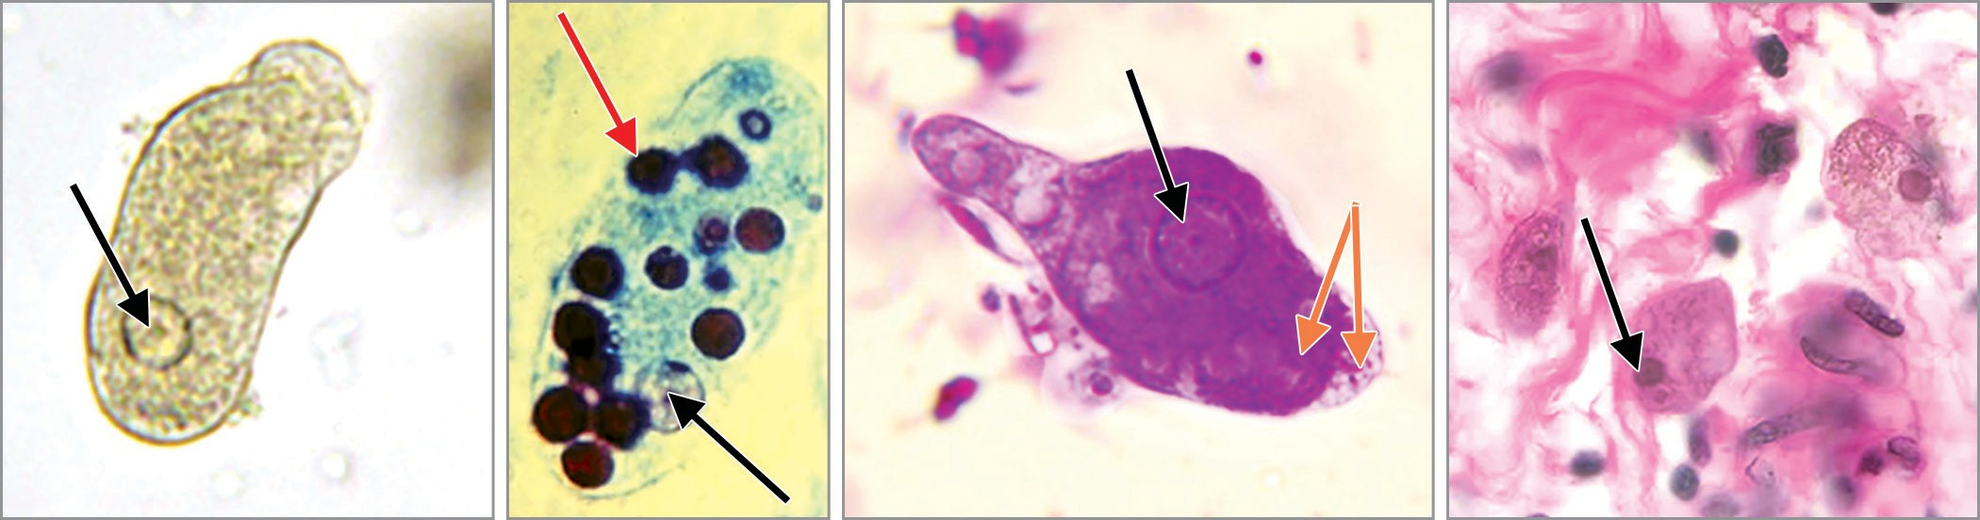
Laboratory diagnosis of Intestinal amoebiasis (Cont..)
A
B
C
D
Entamoeba histolytica trophozoites: A. Saline mount; B and C. Trichrome stain, note the single nucleus (black arrow) RBCs (red arrow) and ectoplasm and endoplasm (orange arrows);
D. Trophozoites in colon tissue stained with H&E.

Slide 23
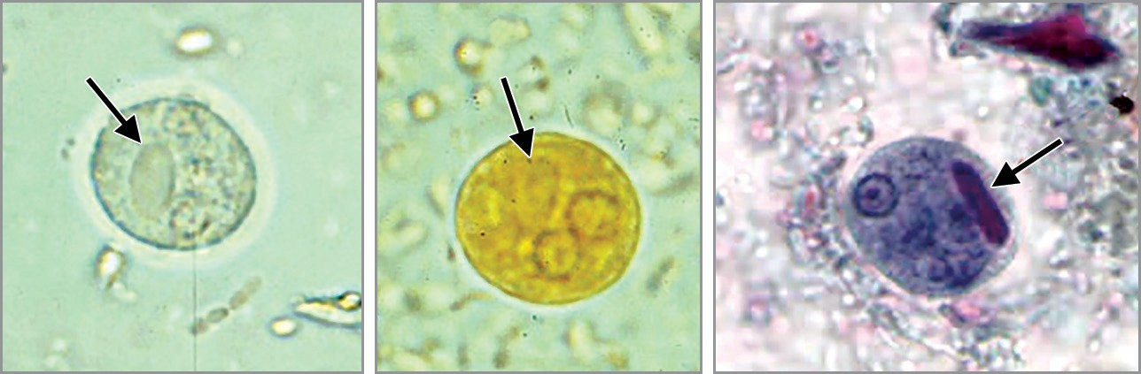
Laboratory diagnosis of Intestinal amoebiasis (Cont..)
A
B
C
Cyst of E. histolytica: A. Saline mount; B. Iodine mount;
C. Trichrome stained smear. Note the chromatoid body with blunt ends (arrow).

Slide 24
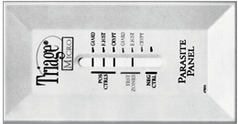
Laboratory diagnosis of Intestinal amoebiasis (Cont..)
Triage parasite panel, positive for E. histolytica/E. dispar antigen

Slide 25
Treatment of Intestinal amoebiasis
Asymptomatic carriage: Treatment helps in reducing passage of cysts in stool and thereby preventing the disease transmission.
Luminal agents are used for treatment.
  Iodoquinol (for 20 days) or
  Paromomycin (for 10 days)

Slide 26
Treatment of Intestinal amoebiasis (Cont..)
Amoebic dysentery: Treatment consists of:
  Tissue agents: Metronidazole (for 5–10 days) or tinidazole (for 3 days) plus
  Luminal agents as above
Other measures include fluid and electrolyte replacement and symptomatic treatment.

Slide 27
Prevention
Preventive measures are as follows:
Avoiding ingestion of food and water contaminated with human feces
Treatment of asymptomatic carriers.

