Slide 1
Intestinal Nematodes
Mrs Sangita Vasava
Assistant Professor
Department of Microbiology
SBKS MI&RC

Slide 2
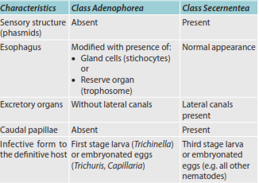
SYSTEMIC CLASSIFICATION

Slide 3
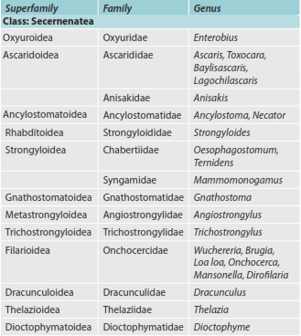
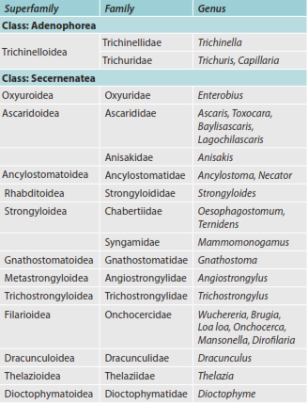
SYSTEMIC CLASSIFICATION (cont..)

Slide 4
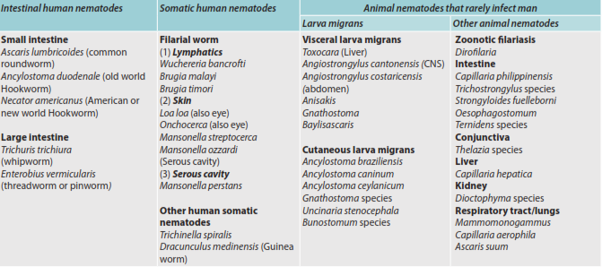
Classification based on habitat

Slide 5
Classification based on they lay egg or larva
Oviparous: Most of the intestinal nematodes are oviparous except Strongyloides. Examples include hookworm,Ascaris, Trichuris, Enterobius, etc.
Viviparous: Most of the somatic nematodes are viviparous. Examples include filarial worm, Trichinella and Dracunculus
Ovoviviparous: Example includes Strongyloides species

Slide 6
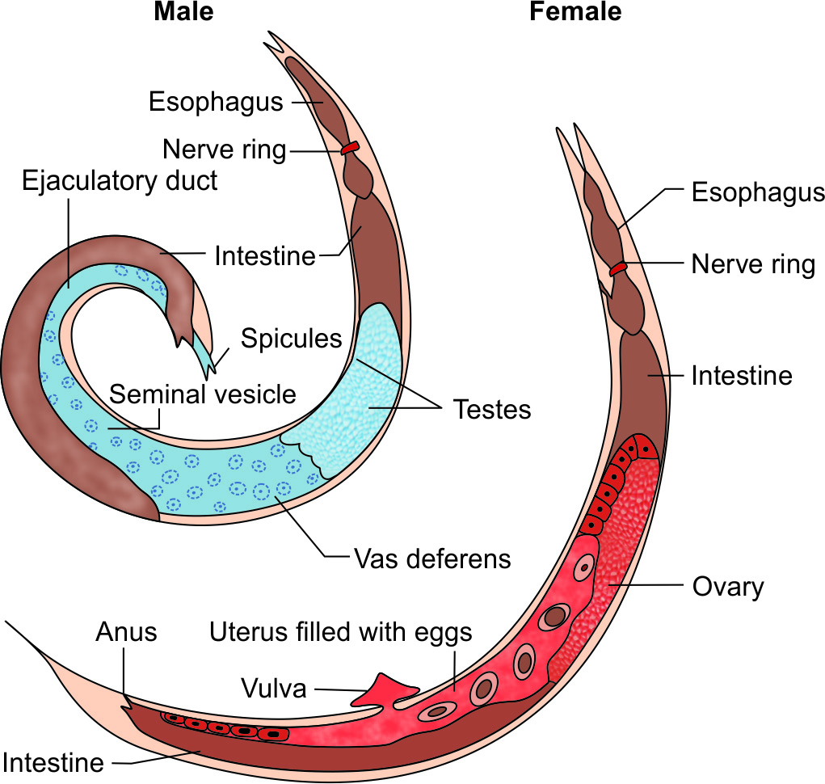
MORPHOLOGY
Adult male and female nematode

Slide 7
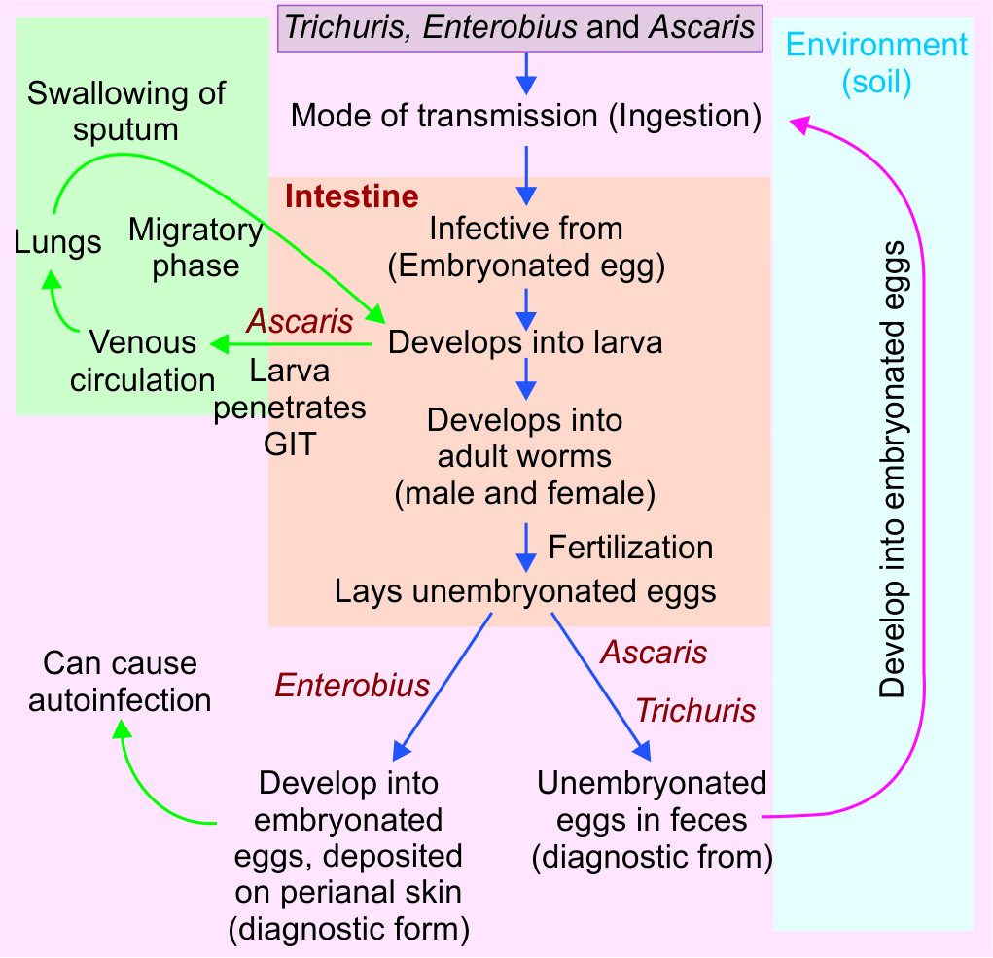
Life cycles of Trichuris, Enterobius and Ascaris

Slide 8
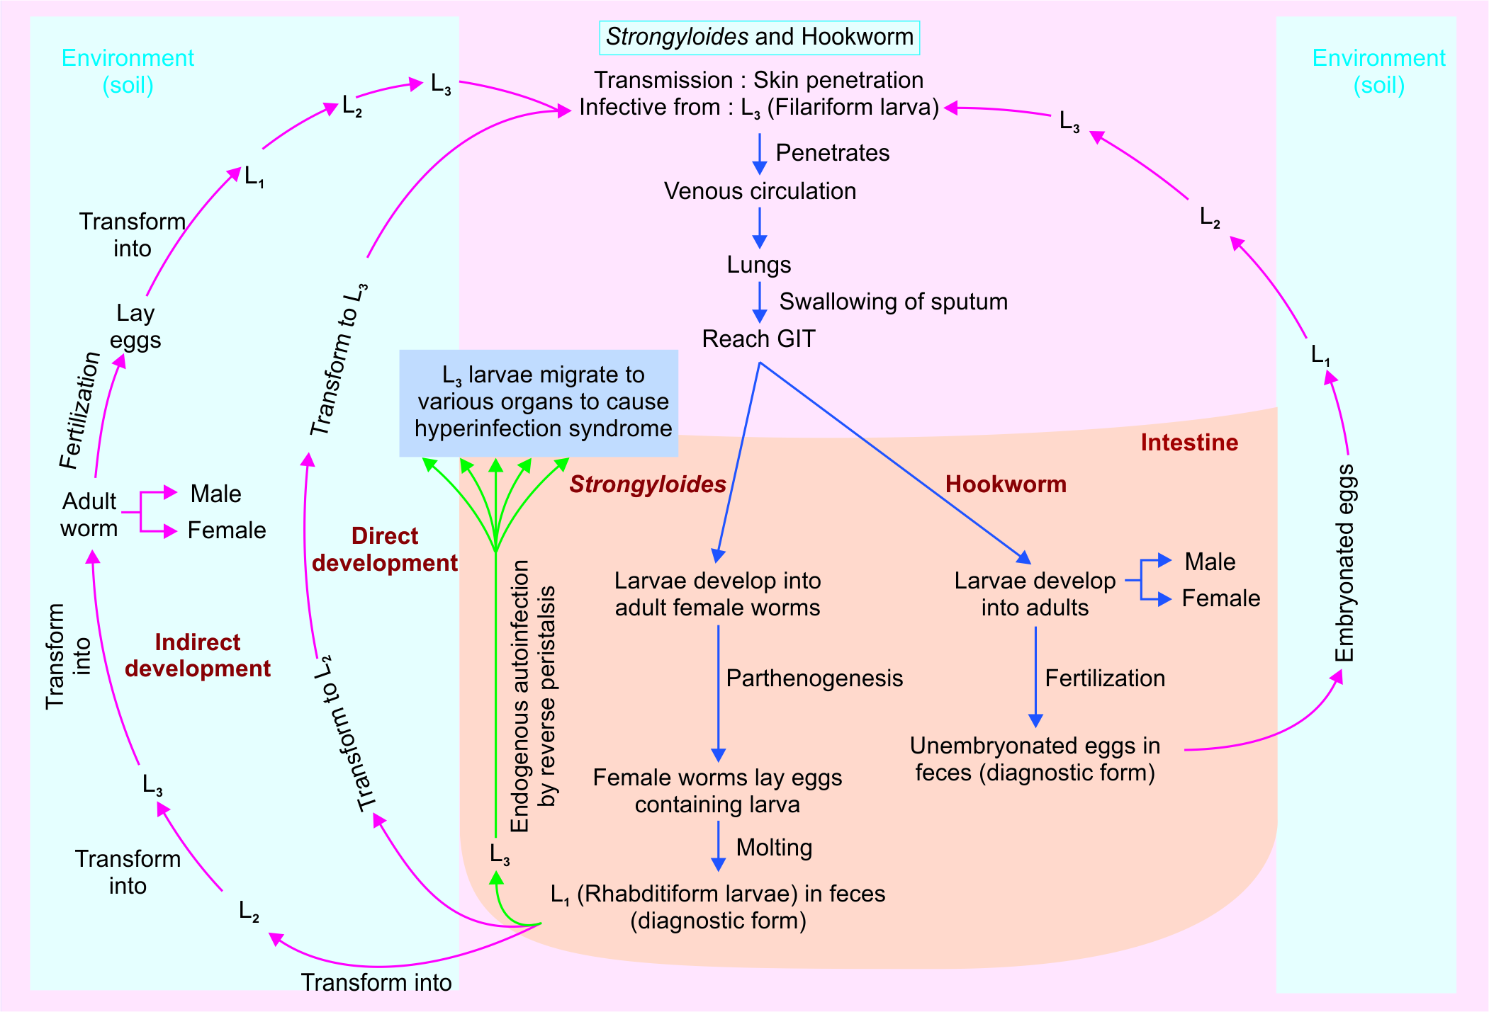
Life cycles of Hook worm and Strongyloides

Slide 9
LARGE INTESTINAL NEMATODES
TRICHURIS TRICHIURA
Whipworm
One of the soil-transmitted helminth

Slide 10
TRICHURIS TRICHIURA
Habitat:
T. trichiura resides in the large intestine of man (mainly cecum and appendix).
Epidemiology
Trichuriasis is worldwide in distribution, mainly in warm and moist climate similar to ascariasis.
Children are commonly affected
Global prevalence in humans is approximately 604 million.

Slide 11
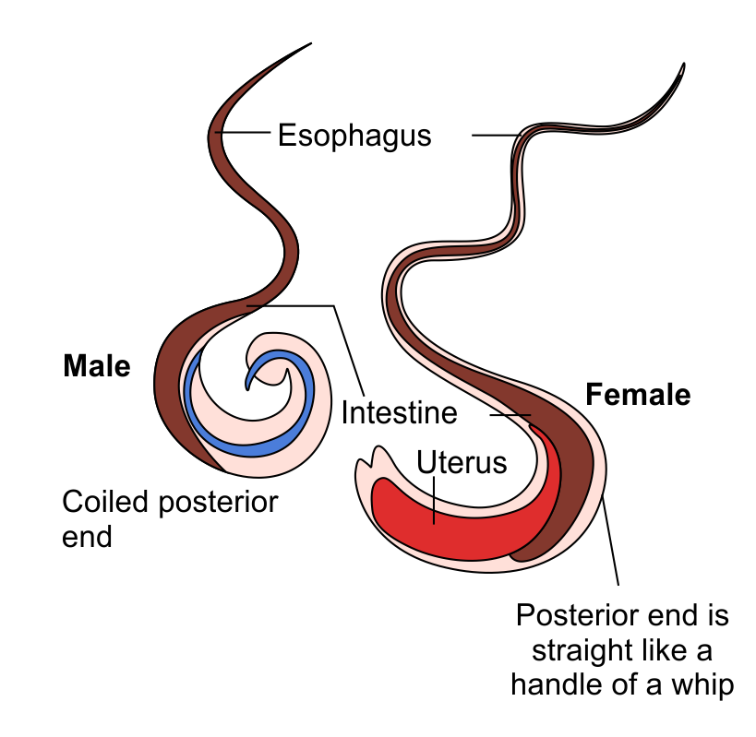
Morphology
Adult worm

Slide 12
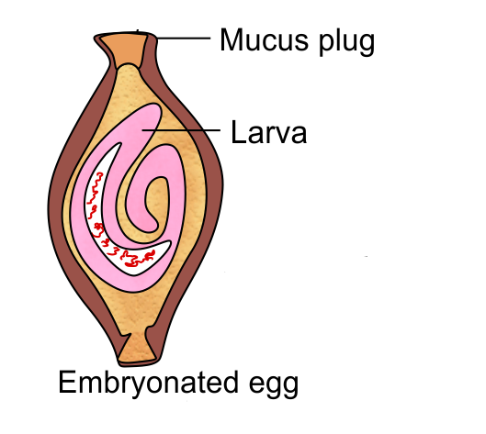
Morphology
EGG
Barrel-shaped; surrounded by a shell, bear mucus plug at both the poles.
50–54 µm long and 22–23 µm wide
Bile stained
Float in saturated salt solution.

Slide 13
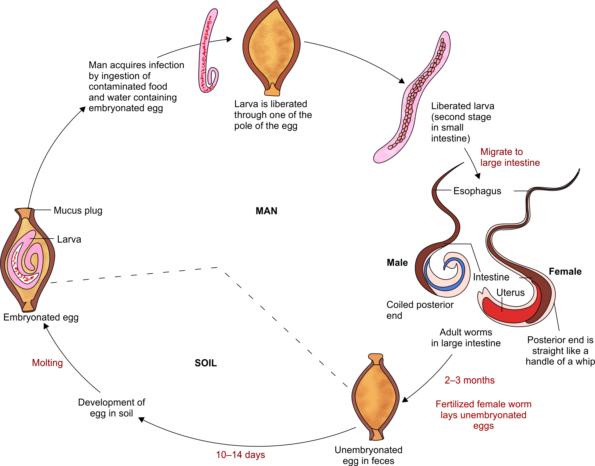
Life cycle of Trichuris trichiura

Slide 14
Pathogenicity and Clinical feature
Incubation period varies from 70 to 90 days.
Most infected individuals are asymptomatic, with or without having eosinophilia.
In people with heavy infections: Mechanical distortion: leading to inflamed, edematous, and friable mucosa
Allergic response by the host

Slide 15
Pathogenicity and Clinical feature
Common manifestations include:
Abdominal pain, anorexia, etc.
Trichuris dysentery syndrome
Iron deficiency anemia
Recurrent rectal prolapse
Growth retardation and impaired cognitive function

Slide 16
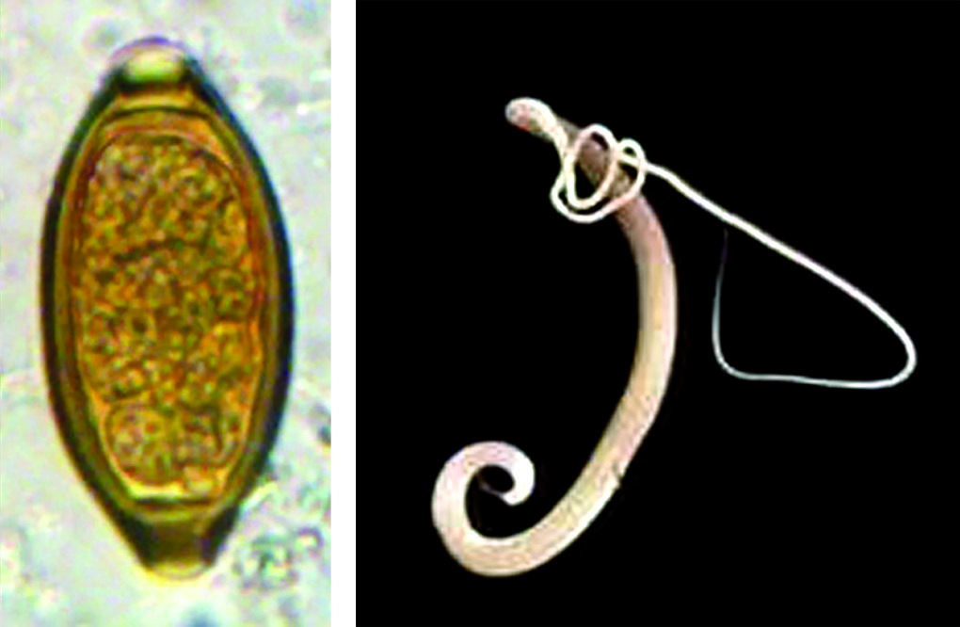
Laboratory diagnosis
Stool Examination - Because the level of egg output is high (approximately 200 eggs/g of feces per worm pair), microscopic examination of a single fecal smear is sufficient for diagnosis of symptomatic cases
Trichuris trichiura (A) Egg in saline mount;
(B) Adult female

Slide 17
Laboratory diagnosis
Other Findings:
Peripheral blood eosinophilia (<15%)
Increased serum IgE level.

Slide 18
Treatment
Mebendazole (500 mg once) or albendazole (400 mg daily for three doses) is safe and moderately effective for treatment, with cure rates of 70%
Ivermectin (200 mg/kg daily for three doses) is also safe but is less effective.

Slide 19
ENTEROBIUS VERMICULARIS
Enterobius vermicularis is also called as pinworm or threadworm.
Habitat - Adult worm remains attached to the large intestine (cecum, appendix and adjacent portion of colon) by their mouth end.

Slide 20
Epidemiology
The prevalence is maximum in school children between
the age of 5 and 14 years
People carry the infection for years together due to auto infective cycles
Factors promoting infection: Overcrowding and impaired hygiene, poor personal care

Slide 21
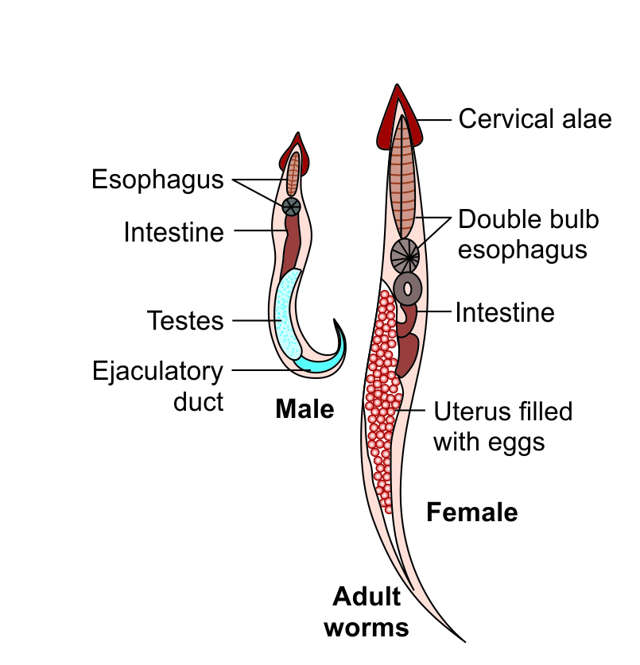
Morphology-
Adult worm

Slide 22
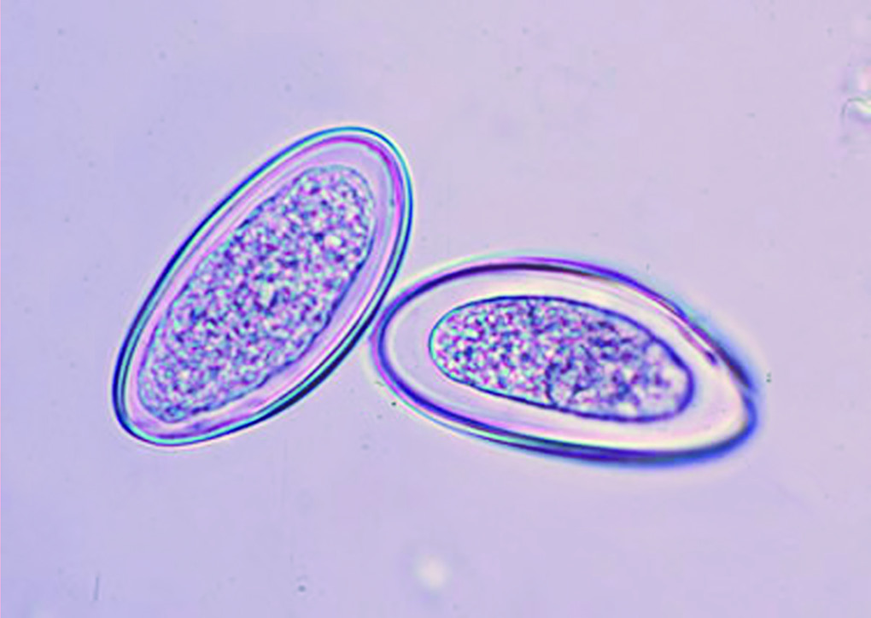
Morphology-
Eggs
Oval or planoconvex
50–60 µm long × 20–30 µm wide
Double layered egg shell
Non bile-stained, colorless in saline mount
Embryonated egg - tadpole shaped larva inside
Floats in saturated salt solution.

Slide 23
Life Cycle
Host: Humans are the only host.
Infective form: Embryonated eggs are infec tive to man.
Mode of transmission: Man (usually children) acquires infection by:
  Ingestion of eggs contaminated with fingers due to
  inadequate hand washing or nail biting habit
  Autoinfection: Endogenous autoinfection or Exogenous autoinfection

Slide 24
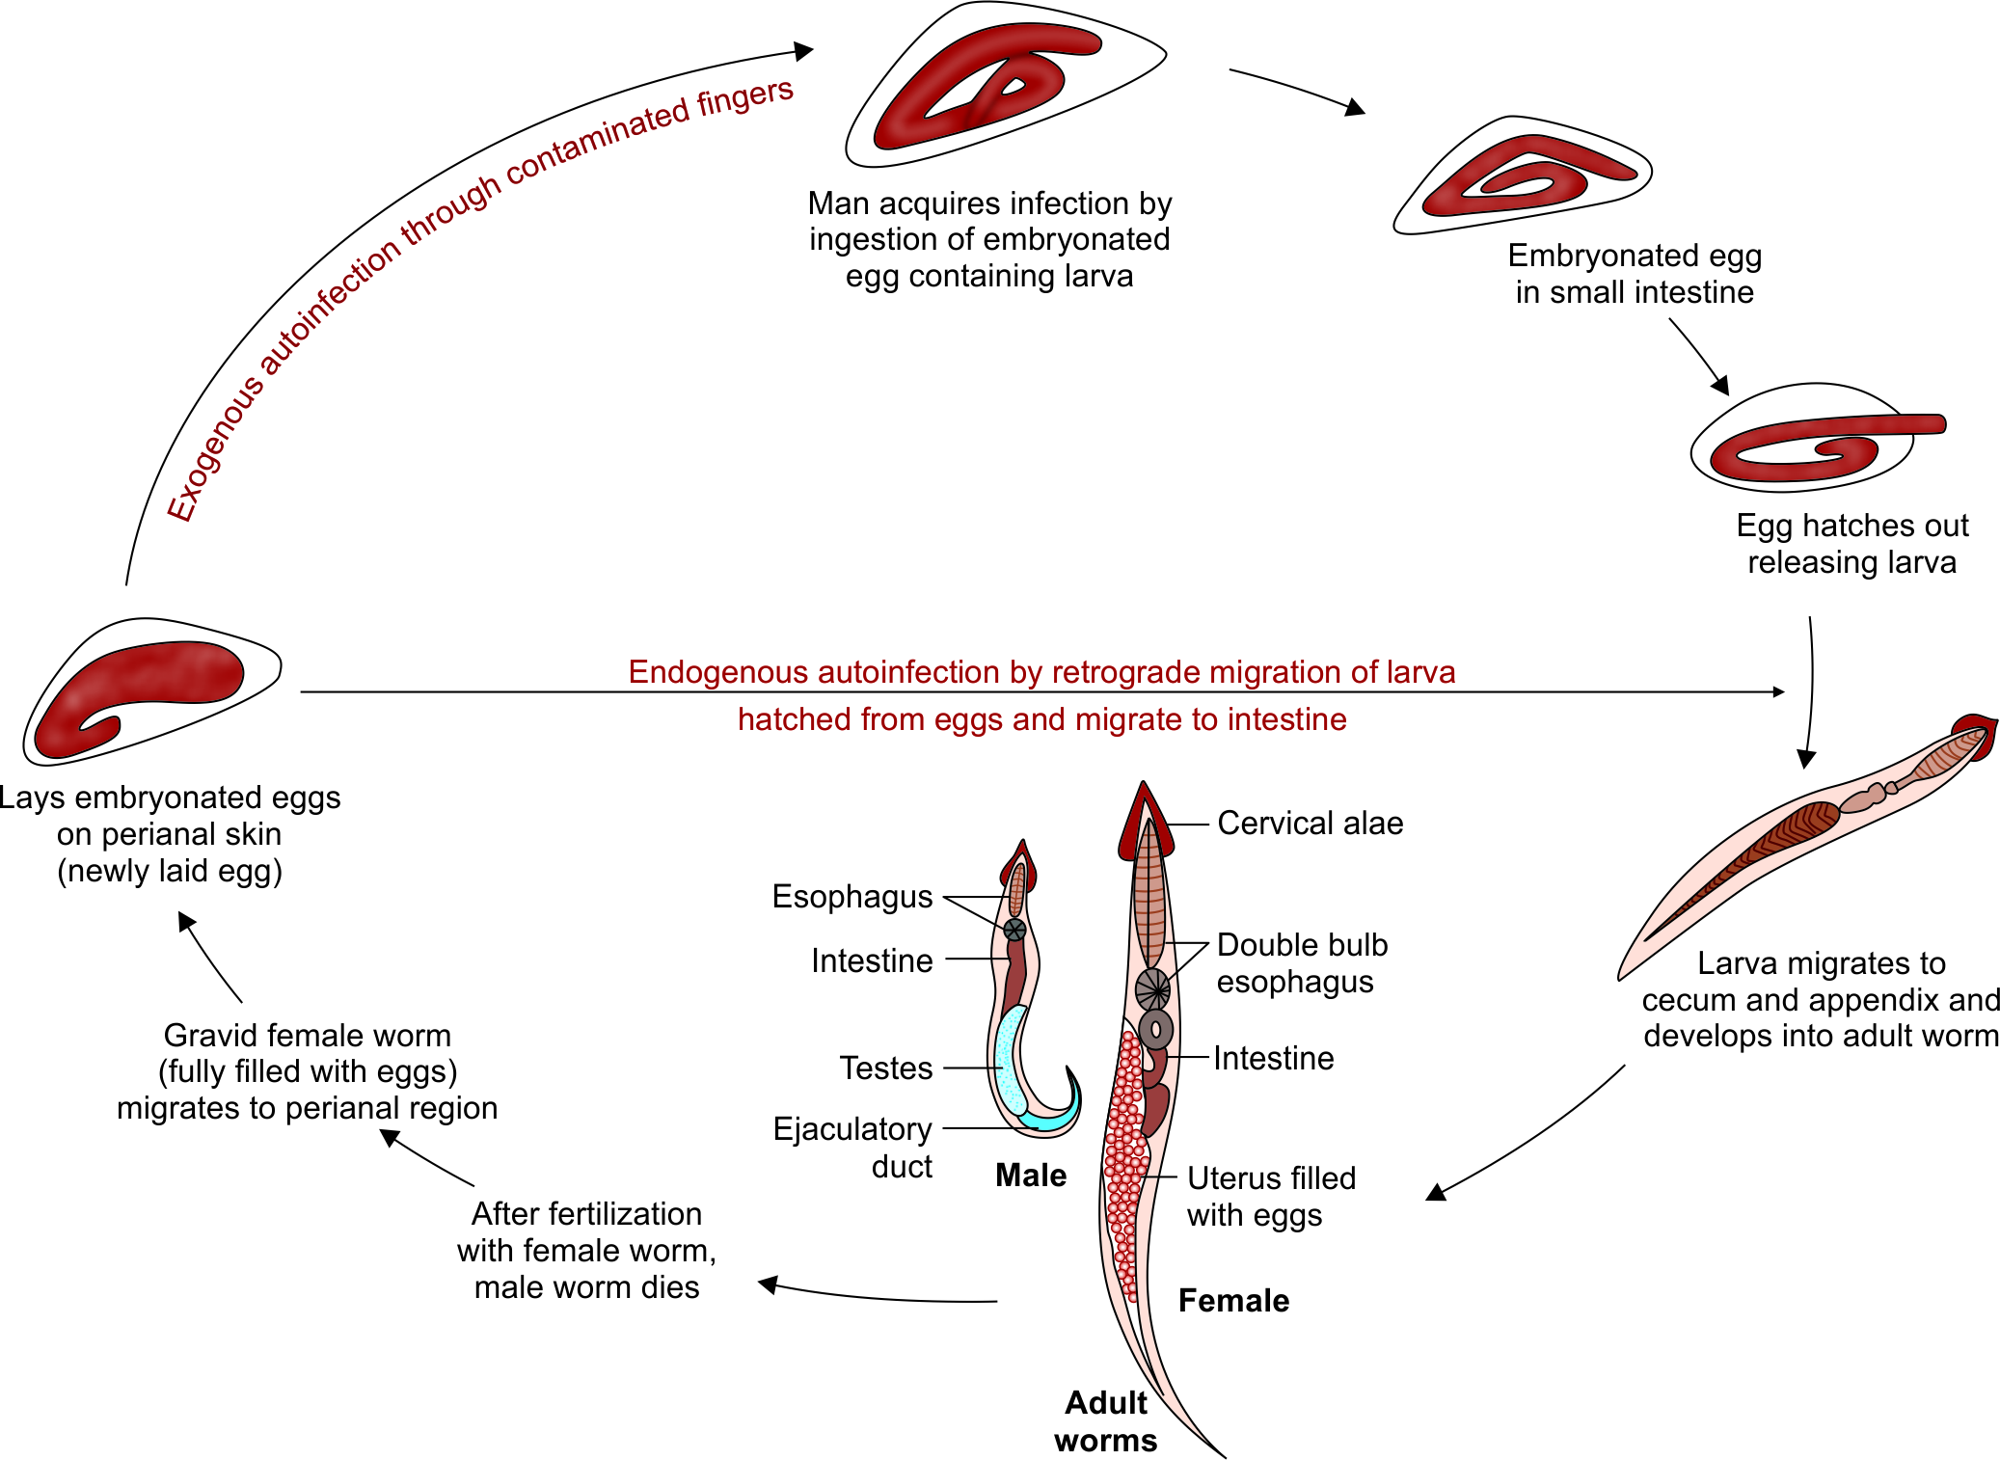
Life Cycle

Slide 25
Pathogenicity and Clinical features
Asymptomatic: Most of the infections are asymptomatic
Symptomatic patients: Perianal pruritus often worse at night; Repeated scratching is the main reason of
contaminated finger; which causes autoinfection.
Excoriation of the perianal skin and bacterial superinfection
Abdominal pain and weight loss

Slide 26
Laboratory diagnosis
Eggs are rarely detected by stool examination; around 5% of cases.
The eggs deposited in the perianal skin are collected by applying cellophane tape or its modification called, NIH swab.
Eggs are non bile-stained, plancoconvex
Number of specimens: A series of 4–6 consecutive tapes
Timing: Samples should be collected when the chance of egg deposition is more such as late in the evening,

Slide 27
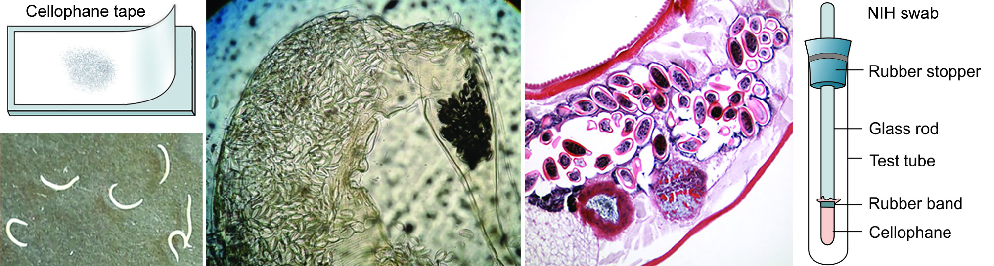
Laboratory diagnosis
A
B
D
E
C
(A) Cellophane tape; (B) Adult worms (actual size); (C) Adult female worm containing numerous eggs; (D) Longitudinal section of an adult female worm shows many planoconvex eggs; (E) NIH swab method (schematic)

Slide 28
Treatment
Mebendazole (100 mg once)
Albendazole (400 mg once) or
Pyrantel pamoate (11 mg/kg once; maximum, 1 g)
The same treatment should be repeated after 2 weeks
Treatment of household members is advocated to eliminate asymptomatic reservoirs of potential reinfection.

Slide 29
SMALL INTESTINAL NEMATODES
HOOKWORM
Classification:
Human parasite:
  A. duodenale or old world hookworm
  N. americanus or new world hookworm or American hookworm.
Animal parasites that rarely infect man, causing cutaneous larva migrans:
  Ancylostoma braziliensis
  Ancylostoma caninum
  Ancylostoma ceylanicum
  Uncinaria stenocephala.

Slide 30
Epidemiology
India
Hookworm infection is widely prevalent in India.
More than 200 million people are estimated to be infected in India.
N. americanus is predominant in South India and A.duodenale in North India
Necator is seen in all the states except in Punjab and Uttar Pradesh

Slide 31
Endemic Index
Chandler’s index is used in the epidemiological studies of hookworm disease
To estimate the morbidity and mortality in the community due to hookworm infection (whichdepends much upon the worm load).

Slide 32
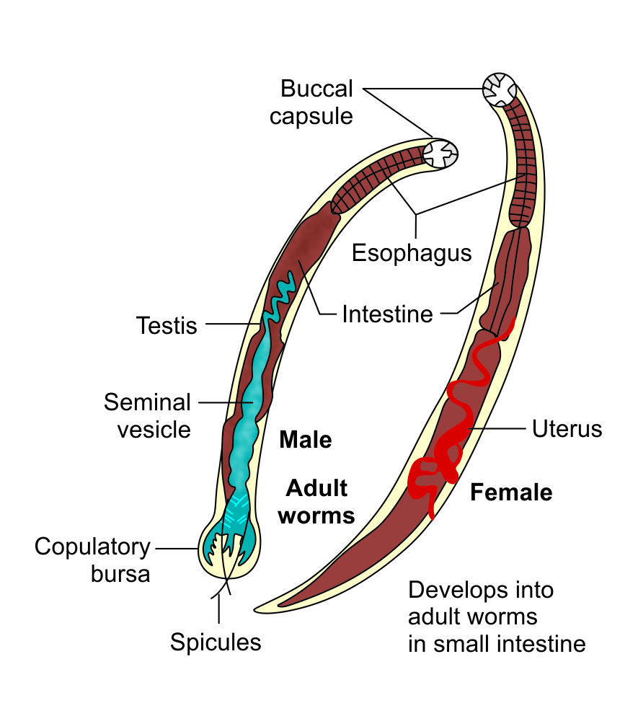
Morphology
Adult worm (A. duodenale)

Slide 33
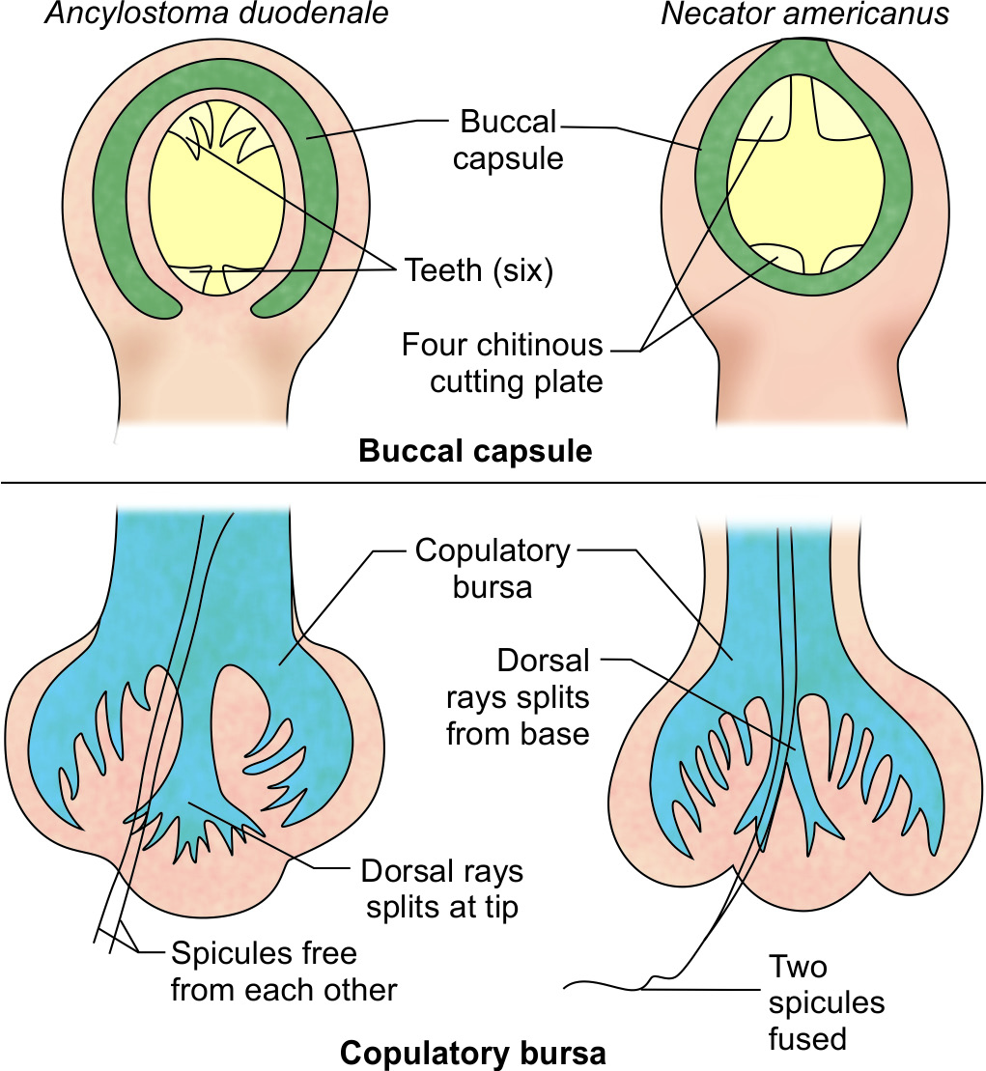
Buccal capsule and Copulatory bursa of
Ancylostoma duodenale and Necator americanus

Slide 34
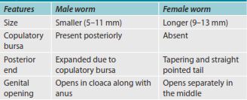
Differences between male and female worms of
Ancylostoma duodenale

Slide 35
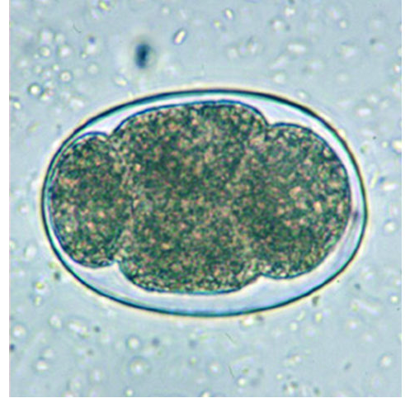
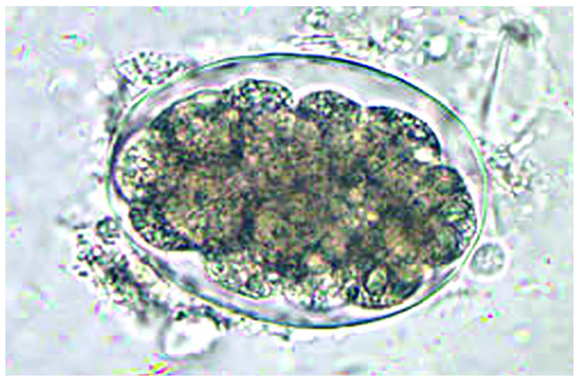
MORPHOLOGY
EGG
Oval-shaped
Measures 60 × 40 µm
Not bile stained, appear colorless in saline mount
Egg shell
Ovum (embryo) is segmented; comprises of 4 to 32 blastomeres
Floats on saturated salt solution
Eggs of both A. duodenale and N. americanus are morphologically indistinguishable.

Slide 36
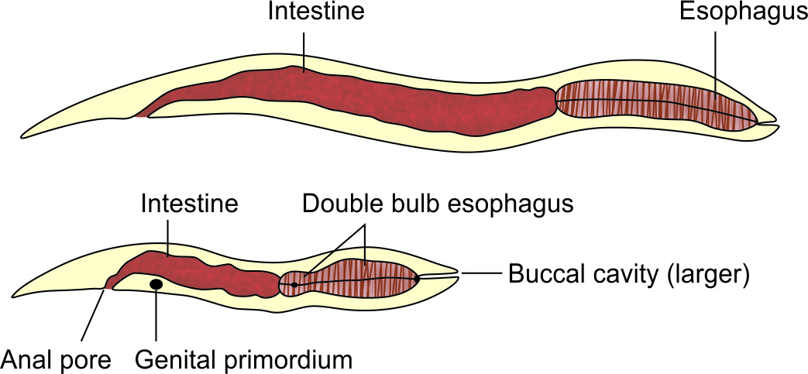
MORPHOLOGY-
LARVA
First stage larva is called as rhabditiform larva
L3 larva is called as filariform larva and is the infective form to man
A
Hookworm (Acylostoma duodenale)
(A) Filariform larva;
(B) Rhabditiform larva
B

Slide 37
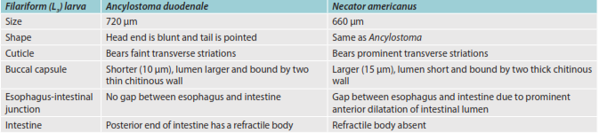
Differences between filariform (L3) larva of Ancylostoma duodenale and Necator americanus

Slide 38
LIFE CYCLE
Host: Hookworm involves only one host (man).
Infective stage: Third stage filariform larva acts as the infective form.
Mode of transmission: Through penetration of skin by the third stage larva (by walking bare foot in dampen soil).
Other routes of transmission of the larva has been reported through oral, in utero and transmammary routes.

Slide 39
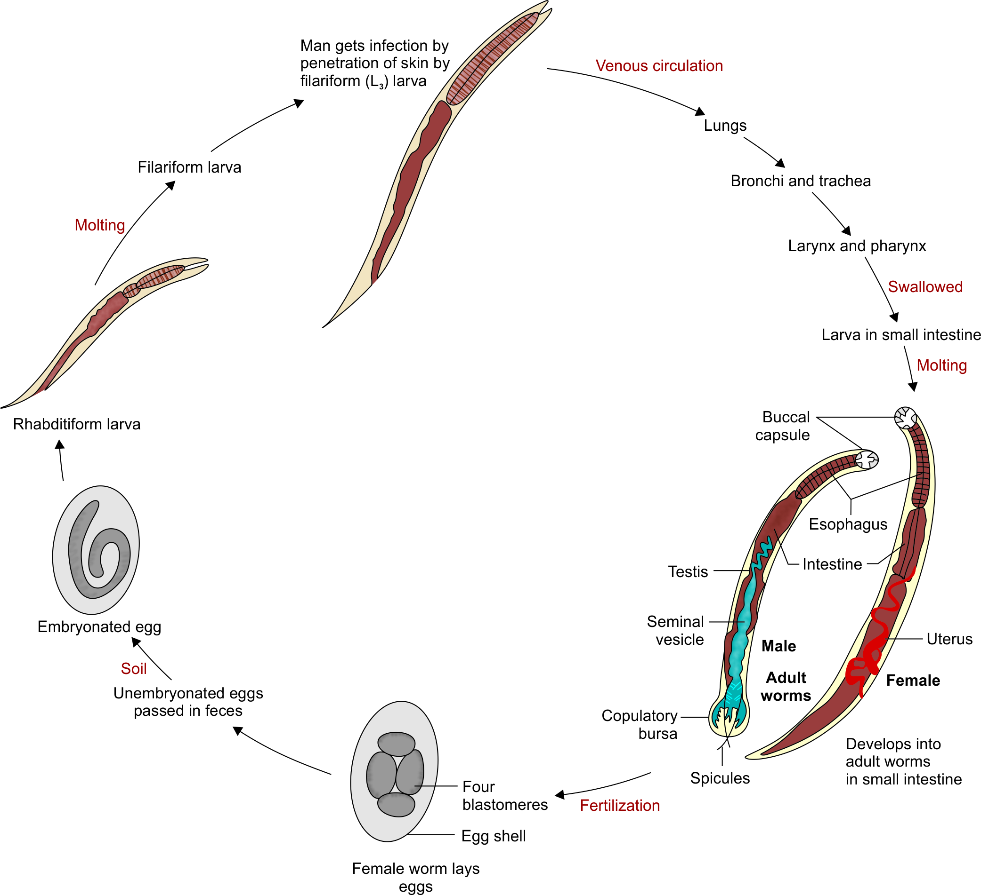
LIFE CYCLE (cont..)

Slide 40
Pathogenicity
Hookworm has ability to suck blood from the intestinal vessels by:
Attaching and making cuts in the intestinal wall
Secreting hydrolytic enzymes
Releasing anticoagulants like factor Xa or VIIa/tissue factor inhibitor,
Habitual blood-sucker; produces active suction impulses 120–200 times/min.
Can also penetrate the skin which is facilitated

Slide 41
Clinical features
Affect due to Migrating Larva - (“ground itch”) at the site of skin penetration and serpiginous tracks may be formed due to subcutaneous migration of the larva
Mild transient pneumonitis

Slide 42
Clinical features (cont..)
Clinical spectrum produced by adult hookworm depends upon the worm load.
Asymptomatic : Most hookworm infections are asymptomatic
Early intestinal phase (less worm load): epigastric pain, inflammatory diarrhea, or other abdominal symptoms, accompanied by eosinophilia
Late intestinal phase (chronic hookworm infection with heavy worm load): Patients develop iron deficiency anemia and protein energy
Wakana disease

Slide 43
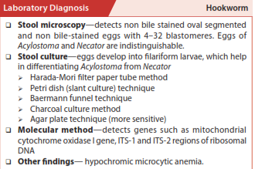
Laboratory diagnosis

Slide 44
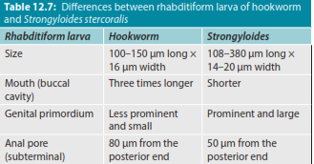
Differences between rhabditiform larva of hookworm and Strongyloides stercoralis

Slide 45

Classification of intensity of infection based on WHO guidelines (eggs per gram of stool)

Slide 46
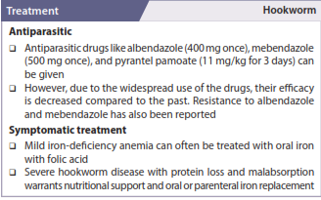
Treatment

Slide 47
Prevention
General preventive measures include:
Improved personal hygiene
Proper disposal of feces
Improved nutrition with dietary iron
Treatment of infected persons.

Slide 48
Vaccine
No vaccine has been licensed yet for hookworm infection;
Vaccine trials:
  N. americanus 24 kDa glutathione-S-transferase (Na-GST-1)
  N.americanus aspartic protease recombinant (Na-APR)-1
  Alhydrogel combined with an glucopyranosyl lipid A (GLA).

Slide 49
STRONGYLOIDES STERCORALIS
Classification - Strongyloides belongs to superfamily Rhab ditoidea and family Strongyloididae.

Slide 50
Epidemiology
S. stercoralis is distributed in hot, humid tropical areas.
Particularly common in South-east Asia (including India), Sub-Saharan Africa, and South America (Brazil)

Slide 51
Habitat
Parasitic female worms reside in the human intestine (duodenum and upper jejunum)
Free-living female worms multiply in the environment.

Slide 52
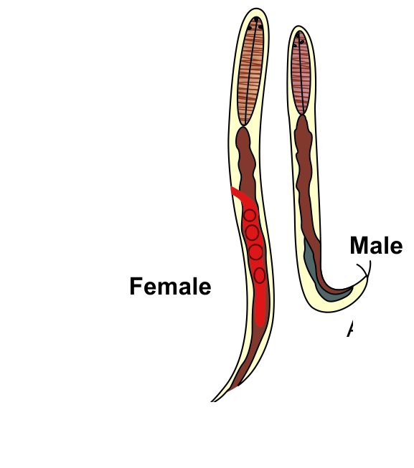
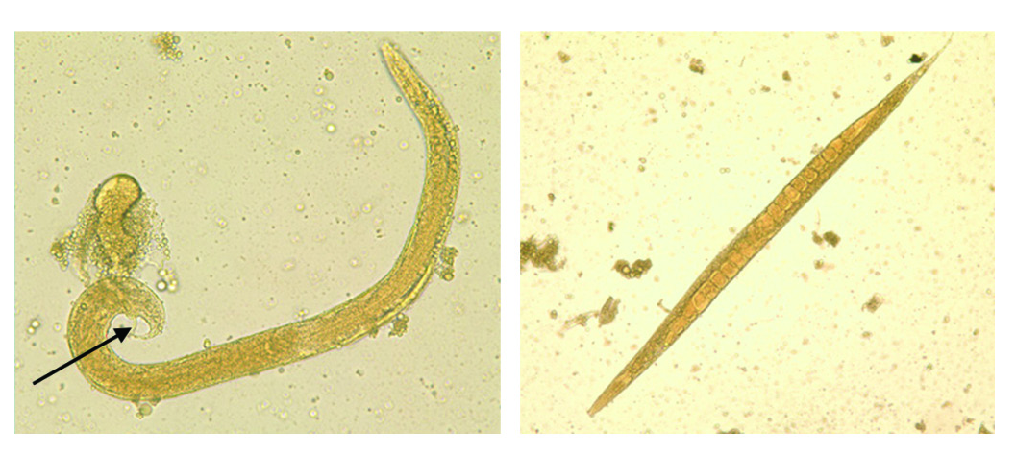
Morphology-
Adult worm
Adult male (arrow
shows spicules)
Adult female (containing single row of eggs);

Slide 53
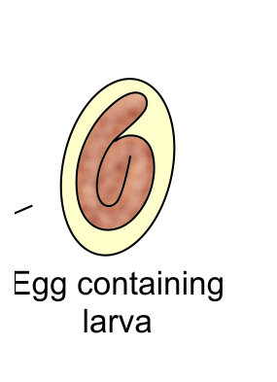
Morphology-
Eggs
Oval and measure 50–58 × 30-34 µm in size

Slide 54
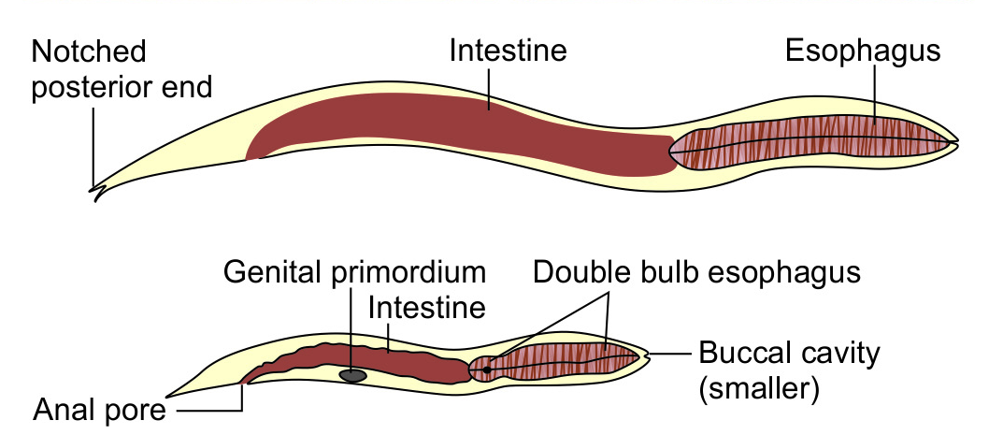
Morphology-
Larva
There are four stages of Strongyloides larva (L1 – L4)
Filariform larva
Rhabditiform larva

Slide 55
Life Cycle
Host: S. stercoralis involves only one host (man). Rarely, domestic pets are recognized as reservoir of infection.
Infective stage: L3 larva (filariform).
Mode of transmission: Penetration of skin by the L3 larva and Autoinfection (internal autoinfection)

Slide 56
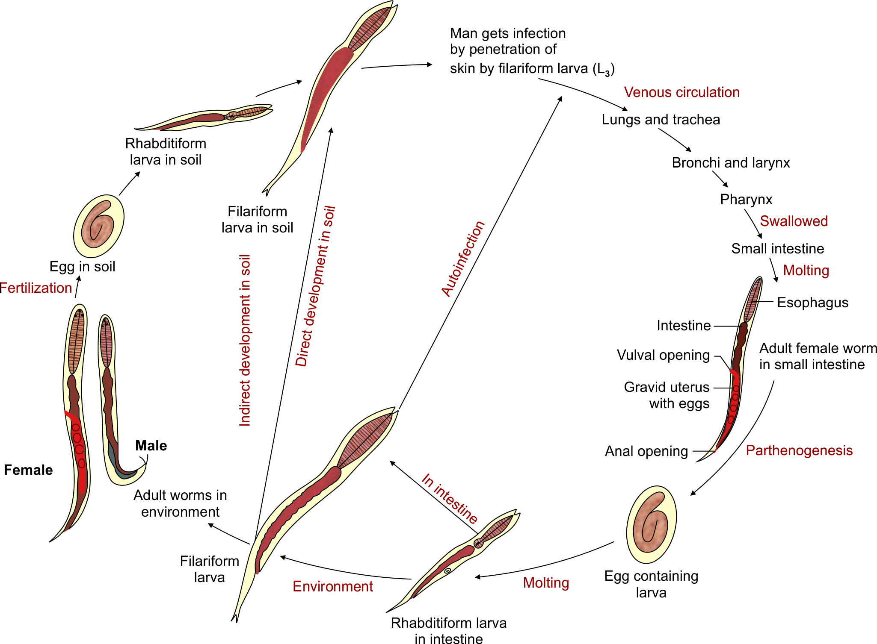
LIFE CYCLE

Slide 57
Pathogenesis and Clinical feature
Effect due to Migrating Larva
Asymptomatic infection
Rashes
Cutaneous larva migrans
Pulmonary symptoms

Slide 58
Pathogenesis and Clinical feature (cont..)
Effect due to Adult worm and Filariform Larva
Mild to moderate worm load: Epigastric pain (resembling peptic ulcer), nausea, diarrhea, constipation, and blood loss
Heavy larva load: Hyperinfection syndrome and disseminated strongyloidiasis

Slide 59
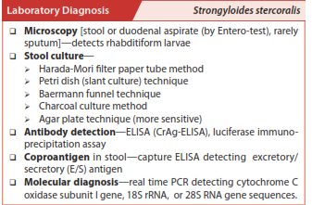
LABORATORY DIAGNOSIS

Slide 60
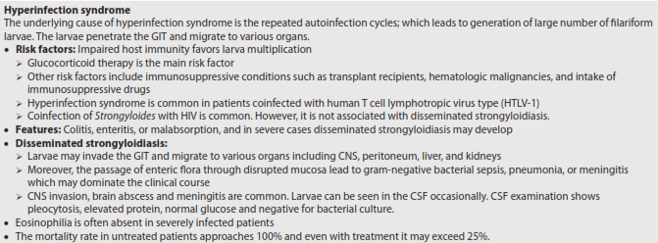
Complications of strongyloidiasis

Slide 61


Slide 62
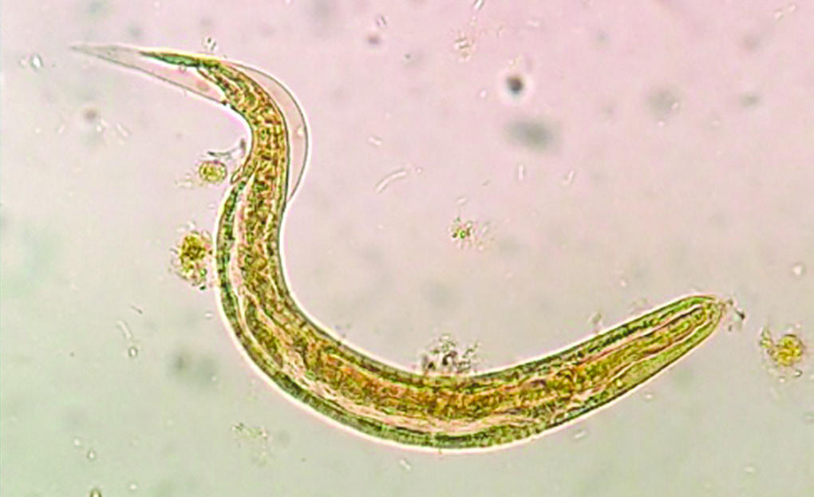
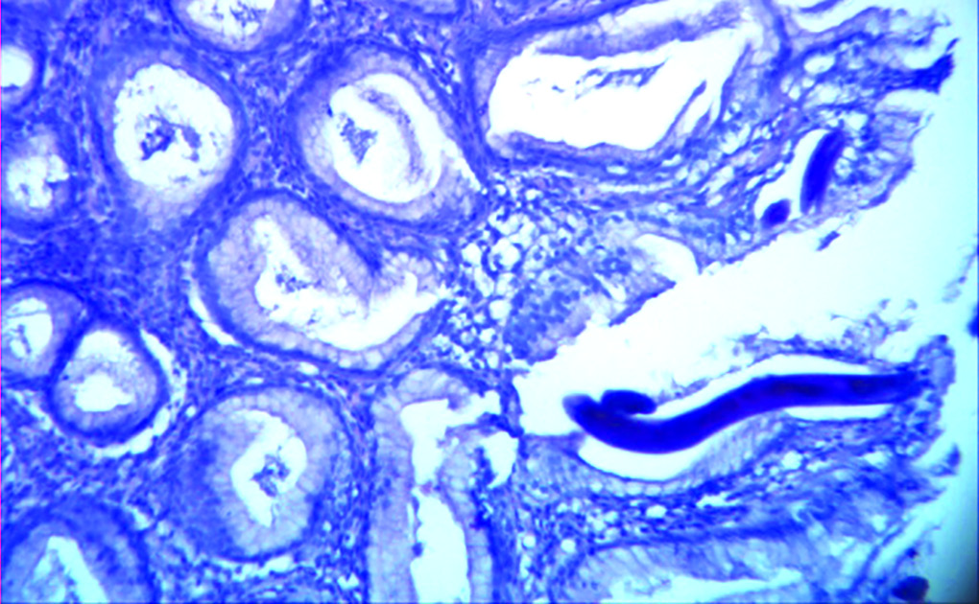
Rhabditiform larva
Rhabditiform larva of Strongyloides stercoralis (A) Iodine mount
Histopathology from Intestinal biopsy (hematoxylin and eosin stain)

Slide 63
Treatment
Even in the asymptomatic stage, strongyloidiasis must be treated because of the potential for subsequent fatal hyper infection
  Ivermectin (200 mg/kg daily for 2 days) is more effective than albendazole (400 mg daily for 3 days)
  For disseminated strongyloidiasis: Prolon ged course of Ivermectin should be given at least 5 days or until the parasites are eradicated.

Slide 64
ASCARIS LUMBRICOIDES
Commonly called as round- worm.
Soil-transmitted helminth
Epidemiology - A. lumbricoides is cosmopolitan in distribution, mainly affecting tropical countries including India.

Slide 65
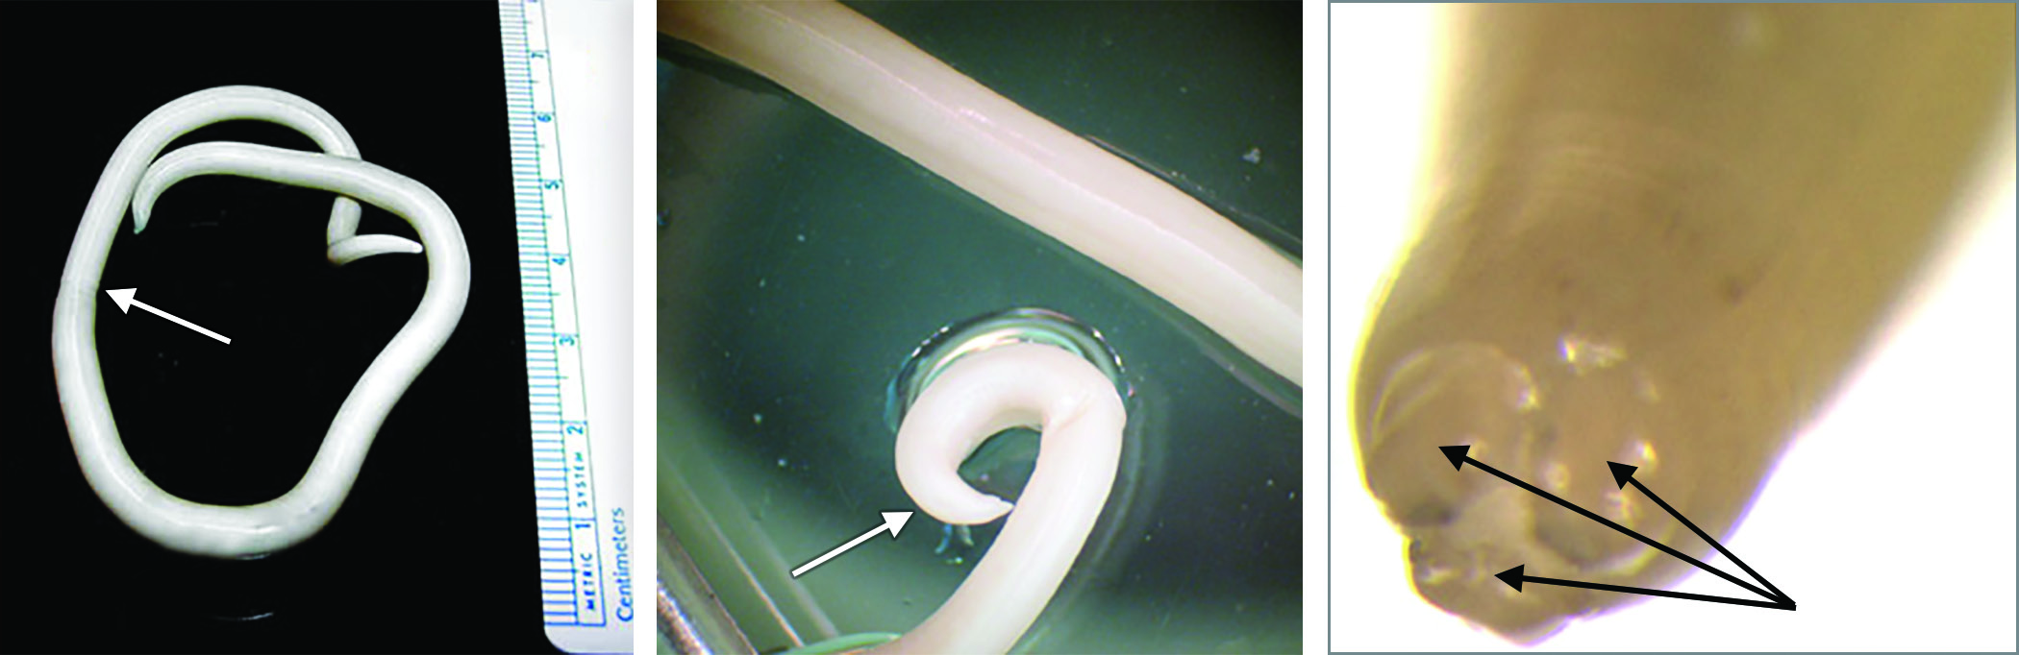
MORPHOLOGY –
ADULT WORM
Adult female with vulvar waist
Posterior end of adult male showing
the curled tail
Close-up of the anterior end of an adult showing the characteristic three lips

Slide 66
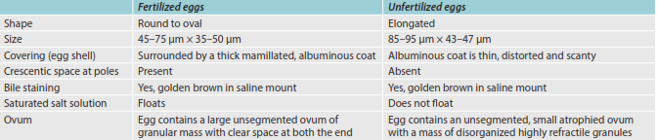
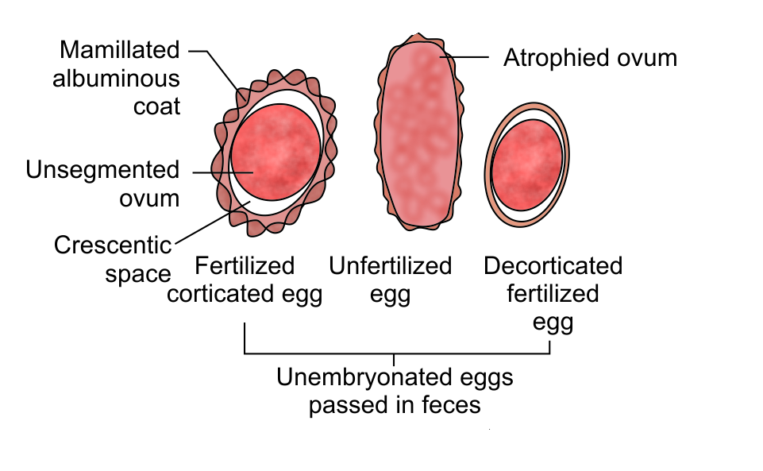
MORPHOLOGY –
EGGS

Slide 67
MORPHOLOGY –
LARVA
Four stages of Ascaris larvae (L1 - L4).

Slide 68
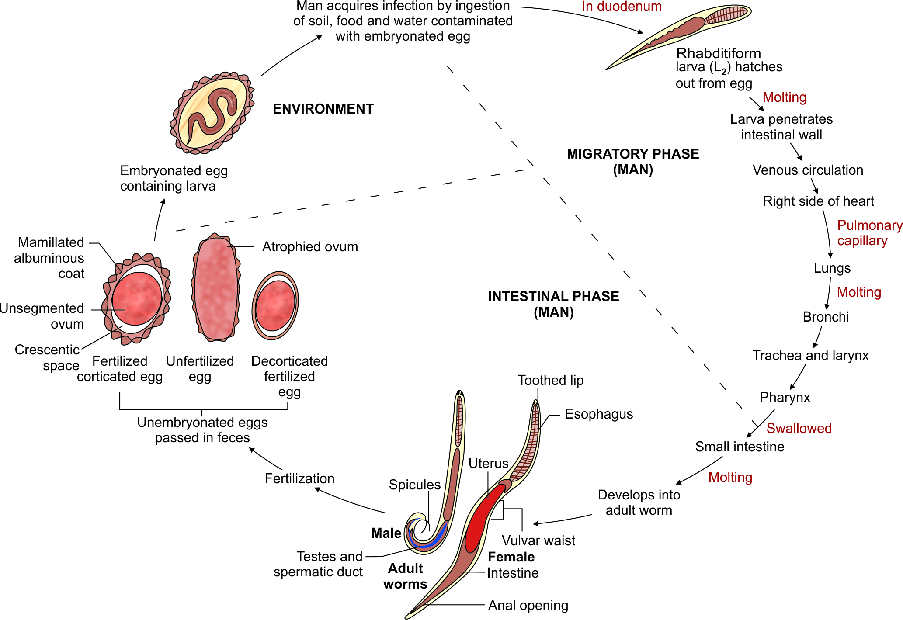
LIFE CYCLE

Slide 69
Pathogenesis and Clinical feature
Effect due to Migrating Larva
Pulmonary symptoms
Eosinophilic pneumonia (Loeffler’s syndrome)
Effect due to Adult worm
Asymptomatic
Malnutrition and growth retardation
Intestinal complications - acute pain abdomen due to small- bowel obstruction, rarely perforation, intussusception
Extraintestinal complications: Larger worms can enter and occlude the biliary tree, causing biliary colic, cholecystitis, pancreatitis, or (rarely) intrahepatic abscesses.

Slide 70
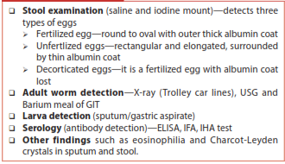
Laboratory diagnosis

Slide 71
Treatment
Antiparasitic drugs - Ascariasis should always be treated early to prevent potentially serious complications.
Albendazole (400 mg once), meben dazole (100 g twice daily for 3 days or 500 mg once) is recommended.
Alternate drugs like ivermectin (150・00 mg/kg once) and nitazoxanide are also effective
In pregnancy, pyrantel pamoate is safe

Slide 72
Soil-transmitted helminths
Soil-transmitted helminths (STH) refer to the intestinal worms infecting humans that are transmitted through contaminated soil such as Ascaris, Trichuris and hookworm.

