Slide 1
SARS Covid 19
Dr Maharshi Vinod Patel
Associate Professor
Department of Community Medicine
SBKS MI RC
Sumandeep Vidyapeeth Piparia

Slide 2
The new coronavirus that jumped from some animal to a person in the city of Wuhan at the end of last year has managed, in only a few weeks, to draw huge attention from the media, scientists and the international community.
On January 30, the WHO declared the epidemic a Public health emergency of international concern (PHEIC).
At present around 12 064 828+ cases of coronavirus disease 2019 (COVID-19) and 550 384 deaths have been reported around the world.
India has reported 794K+ cases and 21,604 deaths till date.

Slide 3
The new coronavirus, first called 2019–nCoV and officially renamed as SARS- CoV2 (the virus) and COVID-19 (the disease), belongs to the family of coronavirus, the name to crown-like spikes on their surface. Most described coronavirus are found in birds or mammals, particularly bats.
The new coronavirus is called SARS-CoV2 because its genetic sequence is very similar to that of SARS, another coronavirus that appeared for first (and only) time in 2002 and caused a pandemic with more than 8,000 infected people and 800 deaths.
Another coronavirus that causes severe disease in humans is MERS-CoV, identified for the first time in 2012 in the Middle East and associated with camels.

Slide 4
High Risk Groups
COVID-19 is peculiar in its disproportionate case fatality rate among patients >60 years as opposed to young adults or pediatric population.
The highest mortality rates were seen among individuals above 80 yr of age at 14.8 per cent.
While further research is going on, the data suggests that tobacco smoking is also a risk factor for COVID-19.
Smokers (both former and current) are more likely to have severe symptoms, are admitted to intensive care unit (ICU), need mechanical ventilation or die compared to non-smokers.

Slide 5

Comorbid illness and case fatality rates in high-risk groups
Age, year (case fatality rate, %) Comorbid illness (case fatality rate, %)
60-70 (4)
>70-80 (8)
>80 (15)
Cardiovascular disease (10.5)
Diabetes mellitus (7.3)
Chronic respiratory disease (6.3)
Systemic hypertension (6.0)
Cancer (5.6)
The high-risk groups and age-wise case fatality rates are depicted in above table
NOTE: case fatality rate is the proportion of deaths from a certain disease compared to the total number of people diagnosed with the disease for a certain period of time.

Slide 6
HOW do YOU get COVID-19?
A person can contract COVID-19 if:
They come in contact with another person infected with the virus
Someone infected coughs or sneezes directly to them
They touch any surface with little droplets from infected people’s cough or sneezes and then touch their eyes, nose or mouth

Slide 7


C l i n i c a l
The most common presenting features of COVID-19 infection are listed below:
f e a t u r e s
Symptoms (frequency in %)
Fever (80-90)
Cough (60-80)
Breathlessness (18-46)
Fatigue (38)
Body ache/joint pain (15)
Sore throat (11-14)
Headache (6-14)
Chills (12)
Running nose (5)
Nausea/vomiting (5)
Diarrhea (2-10)
f e a t u r e s
C l i n i c a l
The incubation period of COVID-19 is 1-14 days (mean duration of 5-7 days), with peak viraemia occurring before the onset of symptoms.

Slide 8
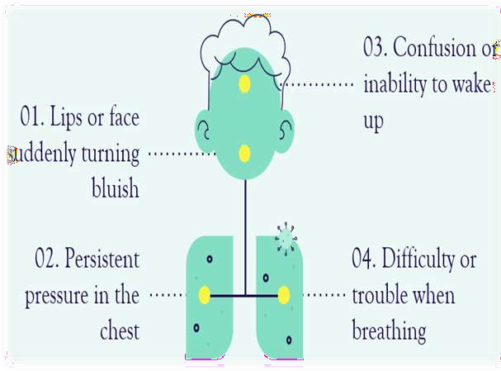
Wa r n i n g s i g n s
E M E R G E N C Y
Warning signs or red flag signs that can assist in triage, indicating the need for urgent care/hospitalization, are listed below:
Fever and upper respiratory symptoms lasting
for >5 days and any of the following:
Breathlessness/respiratory rate >24/min
Oxygen saturation (SpO2 )
110/bpm Systolic blood pressure

Slide 9
Mild
Categorization of probable coronavirus disease 2019 (COVID-19) severity, testing and admission strategy
Clinical category of COVID-19 | Features | Testing strategy | Level of care
Fever with upper respiratory symptoms Mild sore throat and GI symptoms
Testing may be considered in select individuals
individuals in the high-risk group
Low priority
Home care
Moderate
Breathlessness/respiratory rate >24/min Oxygen saturation (SpO2) <95% in room air Fatigue with heart rate of >110/bpm
Systolic blood pressure <90 mmHg
High priority
Inpatient care
Severe
SpO2 <90% in room air
Hypotension requiring ionotropic support ARDS/myocarditis
High priority
Intensive care

Slide 10
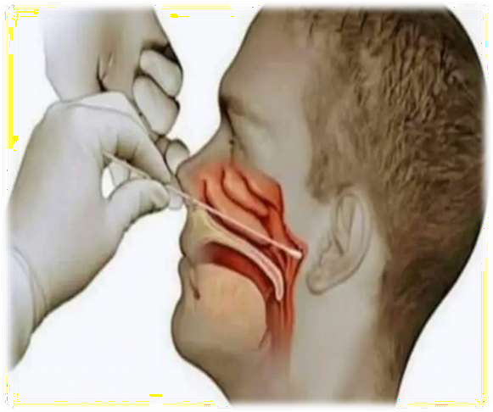
Diagnosis
Travel history to endemic countries
CBC (leukopenia, seen in 30% to 45% of patients, and lymphocytopenia, seen in 85% of the patients)
Chest X-Ray (cheaper & easier with 60% sensitivity)
RT- PCR (30%-70% sensitivity)
Chest CT Scan (95% sensitivity, low specificity)
IgM/IgG combo test for COVID-19

Slide 11

clinical management

Slide 12

At present, the role of specific antiviral medication is at best adjunctive in nature. The following drugs have shown some promise for the management of COVID-19
1. Hydroxychloroquine:
The 4-aminoquinolone, commonly used as an antimalarial and anti-inflammatory agent, possesses broad antiviral activity. While the exact mechanisms are unknown, it is considered to gain its antiviral effects through alkalinization of the phagolysosome as well as inhibition of viral entry by blocking receptor binding and membrane fusion. With a similar mechanism of action, hydroxychloroquine (HCQ) has demonstrated more potent in vitro inhibition of SARS-CoV-2 virus compared to chloroquine.
Its fewer side effects, safety in pregnancy and inexpensive nature makes it more preferable to chloroquine
If chosen for the treatment of confirmed COVID-19, the dose of HCQ suggested is 400 mg twice a day (bd) for one day followed by 200 mg (bd) for 5-10 days.
ADRS: Nausea, vomiting, loss of appetite, diarrhea, dizziness, or headache

Slide 13

2. Lopinavir/ritonavir:
A boosted protease inhibitor combination, while commonly used in the treatment of HIV-1 infection, came into spotlight during the SARS outbreak in 2003
the lopinavir arm had numerically lesser deaths and ventilator days. However, the drug did not reduce the viral loads when compared to the control arm.
The dose used was lopinavir 400 mg-ritonavir 100 mg twice a day for 14 days
3. Oseltamivir:
A neuroaminidase inhibitor, is a pivotal drug in influenza management. It has not been shown
to have activity for CoVs due to lack of neuraminidase and is hence unlikely to be of benefit.
Though it was used in the earlier part of the epidemic in China, it is no longer recommended by most guidelines

Slide 14
4. Remdesivir:
It is an adenosine analogue and RNA polymerase blocker, is a novel drug developed for the treatment of Ebola virus infection. A randomized control trial on remdesivir in severe COVID-19 patients did not show any significant benefit.
However, there was a trend towards shortened illness in patients who received the drug early. While the drug is available in different countries through multiple clinical trials, it is also being provided by the manufacturers on a compassionate use basis. In view of its broad antiviral properties, safety profile from Ebola studies and in vitro activity against SARS-CoV-2, remdesivir is considered as a promising agent.
A recent case series of the drug in a compassionate use programme in COVID-19 patients with hypoxemia showed clinical improvement in two-thirds of the patients.
5. Favipiravir:
It is an a RNA polymerase inhibitor, has shown modest activity against SARS-CoV-2 virus with pronounced cytopathy in Vero cell studies
The drug has been used in China for the treatment of COVID-19 and is being studied in a clinical trial for
mild SARS-CoV-2 disease and also as an adjunct agent in moderate and severe diseases

Slide 15
6. Interleukin-6 (IL-6) inhibitors
A subgroup of patients with COVID-19 develop severe cytokine activation and secondary haemophagocytic lymphohistiocytosis (HLH), leading to rapid-onset hypoxemia, shock and multiorgan dysfunction. A higher neutrophil count and elevated C-reactive protein may predict this subgroup of patients.
Interleukin-6 (IL-6) is a key cytokine in the cytokine storm, and tocilizumb, a humanized anti- IL-6 receptor antibody, is proposed as a therapeutic agent in severe SARS-CoV-2 disease.
In a small series of 21 patients with severe or critical COVID-19 from China, tocilizumab showed marked improvement in hypoxia, chest imaging, fever, lymphocyte counts and C-reactive protein.
7. Corticosteroids:
These are generally not useful against similar severe respiratory viral illnesses such as SARS or
Middle East respiratory syndrome (MERS)-CoV disease.
A recent retrospective review showed decreased likelihood of death among patients with SARS-
CoV-2-related acute respiratory distress syndrome (ARDS) who received methylprednisolone

Slide 16
8. Convalescent plasma from COVID-19 survivors
Uncontrolled studies during the SARS epidemic showed that convalescent plasma therapy decreased hospital stay and mortality when used in the critically ill48. Convalescent plasma plasma therapy was attempted with some benefit in MERS, Ebola and H1N1 pandemic influenza. A small case series of five patients with critically ill COVID-19 on mechanical mechanical ventilation improving after receiving therapy on the third week of illness is encouraging.

Slide 17


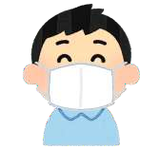



PROTECTING YOURSELF AND PREVENTING THE SPREAD OF
THE DISEASE
Wash your hands with an alcohol-based sanitizer or with soap and water
Keep a distance of at least 1 meter between yourself and anyone who coughs or sneezes
Try your best not to touch your eyes, your nose and your mouth
Cover your mouth and your nose with your bent elbow or a tissue when coughing
Seek medical attention if you have difficulty breathing and a high fever
Follow the directions of your national or local health authorities

Slide 18

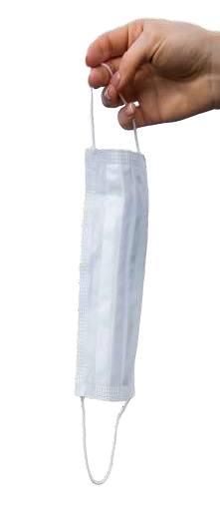
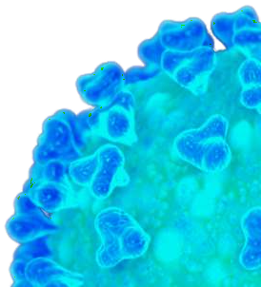
HOW TO USE A MASK
Before wearing a mask, wash your hands with an alcohol-based disinfectant or with soap and water.
Cover your mouth and nose with the mask and make sure the mask is firmly pressed against your face.
Do not touch the mask while you are wearing it; if you do, wash your hands with an alcohol-based disinfectant or with soap and water afterward.
Replace the mask as soon as it gets wet and do not reuse disposable masks.
Remove the mask from behind (do not touch its front side); throw it away in a closed container and then wash your hands with an alcohol-based disinfectant or with soap and water.

Slide 19
Stockman L J, Bellamy R, Garner P. SARS: Systematic Review of Treatment Effects. PLoS Medicine September 2006; 3(9). | Systematic Review(High Level) | In response to the WHO request a systematic review was conducted of the published literature on ribavirin, corticosteroids, lopinavir and ritonavir (LPV/r), type I interferon (IFN), intravenous immunoglobulin (IVIG), and SARS convalescent plasma from both in vitro studies and in SARS patients. We also searched for clinical trial evidence of treatment for acute respiratory distress syndrome. Sources of data were the literature databases MEDLINE, EMBASE, BIOSIS, and the Cochrane Central Register of Controlled Trials (CENTRAL) up to February 2005. Data from publications were extracted and evidence within studies was classified using predefined criteria. | In total, 54 SARS treatment studies, 15 in vitro studies, and three acute respiratory distress syndrome studies met our inclusion criteria. Within in vitro studies, ribavirin, lopinavir, and type I IFN showed inhibition of SARS-CoV in tissue culture. In SARS-infected patient reports on ribavirin, 26 studies were classified as inconclusive, and four showed possible harm. Seven studies of convalescent plasma or IVIG, three of IFN type I, and two of LPV/r were inconclusive. In 29 studies of steroid use, 25 were inconclusive and four were classified as causing possible harm. | Despite an extensive literature reporting on SARS treatments, it was not possible to determine whether treatments benefited patients during the SARS outbreak. Some may have been harmful. Clinical trials should be designed to validate a standard protocol for dosage and timing, and to accrue data in real time during future outbreaks to monitor specific adverse effects and help inform treatment.

Slide 20
When did WHO declared COVID 19 the epidemic a Public health emergency of international concern (PHEIC)
30 January 2020
29 January 2020
31 January 2020
28 January 2020

Slide 21
2. COVID 19 is
Bacterial Disease
Viral Disease
Fungal Disease
Parasitic Disease

Slide 22
3. Most common symptom of COVID 19 is
Cough
Breathlessness
Fever
Anosmia

Slide 23
4. Following category of COVID 19 requires intensive care
Mild
Moderate
Mild to moderate
Severe

Slide 24
5. RT PCR uses following for testing COVID 19
Naso and oropharyngeal swab
Blood
Serum
Sputum

