Slide 1
IDENTIFICATION
- Dr. Anu Singh

Slide 2
In this session
Introduction to identity of a person
Identification parameters
Corpus delicti
Race
Sex

Slide 3
Identification – determination of the individuality of a person based on certain physical & biological characteristics.

Slide 4
Parameters for identification of a person
Age
Sex
Race
Religion, religious rituals/wearings
Stature
Anthropometric measurements
Odontology (Dental status)
Hair, nails
External features – moles, birthmarks, scars, tattoo, occupation marks, physical deformities/disability

Slide 5
Face, Eye, Nose, Ears, Lips
Dactylography (Fingerprints & footprints)
DNA, Blood group
Personal belongings – cloths, ornaments, pocket contents, spectacles, hearing aids, walking stick
Voice, Speech
Hand writings
Gait, tricks, manner & habits
Memory, education, occupation

Slide 6
Medicolegal importance
In living persons | In dead persons
‘Baby swap’ cases in hospitals Unconscious pt Lost & found cases Impersonation (Identity theft) Inheritance of property Marriage Paternity & maternity disputes In sports competitions Disputed sex Disputed age | Unknown deadbody Mass disaster – earthquack, fire, flood, rail accidents etc. Decomposed, skeletonised deadbodies Burnt, mutilated deadbodies Insurance claims

Slide 7
Corpus delicti
‘Body of offence’, ‘essence of crime’
The facts of any crime or offence.
e.g. in c/o murder
  Deadbody of a person
  injuries on victim’s deadbody
  Weapon (knife, gun…)
  cloths with blood of victim on it
  photographs, videos, evidences
  statements of witness
Importance – essential part of any crime based upon which a offence case is registered, investigated & charged.

Slide 8
RACE
TRAIT | CAUCASIAN | NEGRO | MONGOLIAN
Skin Complexion | European – White Indian - Brown | Black | White/ pale yellow
Eyes | European – Blue/Gray Indian – dark brown/ black | Black Black | Brown
Hairs | Europeans – fair brown/ red, thin, straight/wavy Indian – black, thin, straight/wavy | Black, thick, wooly | Brown, thin, straight

Slide 9
TRAIT | CAUCASIAN | NEGRO | MONGOLIAN
Skull | Mesaticephalic (medium) | Dolico-cephalic (long-headed) | Brachy-cephalic (Short- headed)
Skull features Whole Skull Orbits Nasal aperture Hard palate Lower face/jaw Cephalic Index [MB/ML x 100] | Rounded Triangular Elongated Triangular Straight (orthognathism) 75-80 | Narrow, elongated Square Broad Rectangular/’U’ shape Projected forward (Fascial prognathism) 70-75 | Square Round Rounded Rounded Straight 80-85

Slide 10
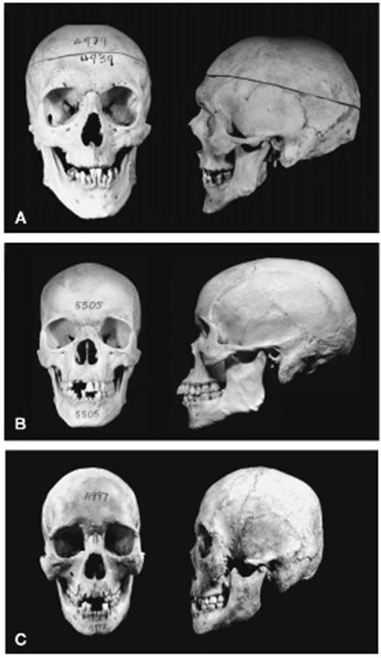
Caucasian skull
Mongolian
Negroid

Slide 11
SEX
Medicolegal Importance
  Identity
  Marriage & Divorce
  Rape & sexual offences
  Decomposed, burnt, mutilated, skeletonised deadbody in PM
  Intersex
  Gender based Sport competitions
  Gender based government schemes
  Concealed sex
  Heirship

Slide 12
Methods to determine
External examination – hair, face, external genitalia, secondary sexual characteristics
Bone examination
CT scan, MRI for internal genital organs
Chromosomal karyotyping – XX, XY
  Dyes : quinacrine dihydrochloride – Y, acriflavin schiff reagent - X
Sex chromatins – Barr body, Davidson body
Sex Hormone analysis – estrogen, progesterone, testosterone etc.

Slide 13
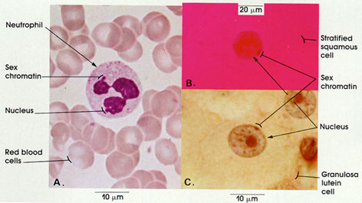
Sex Chromatin

Slide 14
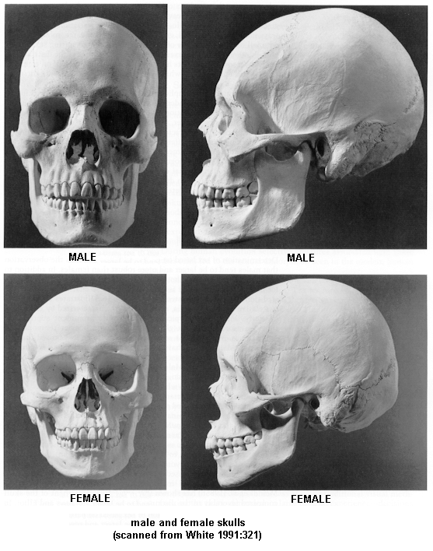

Slide 15
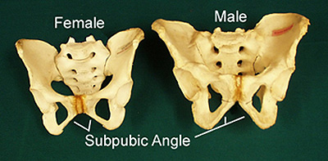
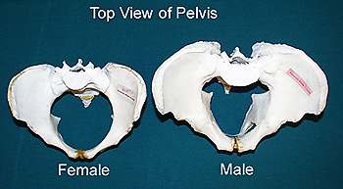

Slide 16
Intersex
Persons having mixed characteristics of both male & female sex
Causes :
  Gonadal agenesis
  Gonadal dysgenesis
  Klinefelter’s Sn – XXY, phenotype – male
  Turner’s Sn – XO, phenotype – female
  True hermaphroditism
  Pseudo HermaPhroditism
    Male PHP – XY, phenotype – F, testicular feminization Sn
    Female PHP – XX, phenotype – M, adrenal hyperplasia

Slide 17
MCQs
Questions ?

Slide 18
MCQ 1
Which of the following parameters is not for identification of an individual?
Age
Stature
Religion
Stomach content

Slide 19
MCQ 2
The facts of any crime or offence(essence of crime) is called as which of following term?
Corpus callosum
Corpus delicti
Cognisable offence
Perjury

Slide 20
MCQ 3
A skeletonised dead body brought to mortuary for PM examination. Which of the following features does not indicate male sex ?
Slopping steeper frontal bone in skull
Narrow subpubic angle in pelvis
Presence of Bar body
Body of S1 vertebra larger than ala bredth

Slide 21
MCQ 4
In a case of Klinefelter's syndrome, sex chromosomal pattern would be seen as which of following genotype?
XY
XX
XXX
XXY

Slide 22
MCQ 5
A skull of an unknown male found in a box in Arabian sea. On examination, the orbits and nasal aperture were round shape, hard palate was round, lower face was straight, cephalic index was 82(brachy-cephalic). The person belongs most probably which race?
Caucasian
Negro
Mongolian
Arabian

