Slide 1
FORENSIC SCIENCE LABORATORY
Dr. Kalpesh Zanzrukiya

Slide 2
In this session
No. | COMPETENCY | Domain (K/S/A/C) | Level (K/KH/S/SH/P) | Core (Y/N)
FM8.5 | Describe Medico-legal autopsy in cases of poisoning including preservation and dispatch of viscera for chemical analysis | K | KH | N
FM8.10 | Describe the general principles of Analytical Toxicology and give a brief description of analytical methods available for toxicological analysis: Chromatography – Thin Layer Chromatography, Gas Chromatography, Liquid Chromatography and Atomic Absorption Spectroscopy | K | KH | Y

Slide 3
SPECIFIC LEARNING OBJECTIVES At the end of this session, the 2nd MBBS student.... | Integration
1. should able to describe general external and internal autopsy findings in death due to poisoning case 2. Should able to describe preservation of viscera for chemical analysis in autopsy of poisoning case 3. Should able to demonstrate methods of collection, preservation and dispatch of viscera for chemical analysis | N
1. should able to describe general principles of analytical toxicology 2. Should able to describe in brief about methods for toxicological analysis: Chromatography – Thin Layer Chromatography, Gas Chromatography, Liquid Chromatography and Atomic Absorption Spectroscopy | N

Slide 4
In this session
FSL - introduction
Methods for toxicological/biochemical analysis
Locard’s exchange principle
Lie detection tests
  Polygraphy
  Narco analysis
  Brain mapping

Slide 5
Forensic science laboratory (FSL)s
Central FSLs – New Delhi, Chandigarh, Bhopal, Pune, Hyderabad, Kolkata, Guwahati
State FSLs – 32
FSLs in Gujarat
  Directorate of FSL Gandhinagar
  FSL Ahmedabad
  Regional FSL Junagadh
  Regional FSL Vadodara
  Regional FSL Surat
  Regional FSL Valsad
  Regional FSL Rajkot
National Forensic Science University, Gandhinagar
Mobile FSL Units

Slide 6
Various sections in FSL
Toxicology section
Chemistry section
Biology, Serology and Immunology section
Molecular biology section
Ballistics and explosive section
Fingerprint section
Documents examination section
Photography-Videography section
Physics section
Lie detection section (Forensic Psychology section)
Cyber security & Digital Forensics section

Slide 7
methods for detection for toxicology and chemical/ biological substances
Chromatography
Electrophoresis
Spectrophotometry
Neutron activation analysis

Slide 8
chromatography
Method of qualitative and quantitative assessment of various poisons, drugs or chemicals in any physical form(solid, liquid or gas) from their characteristics of dispersion or spreading in different suitable media or environment.
“Fingerprint of the substance”

Slide 9
Different techniques of chromatography
Column chromatography
Paper chromatography
Thin layer chromatography
Gas chromatography

Slide 10
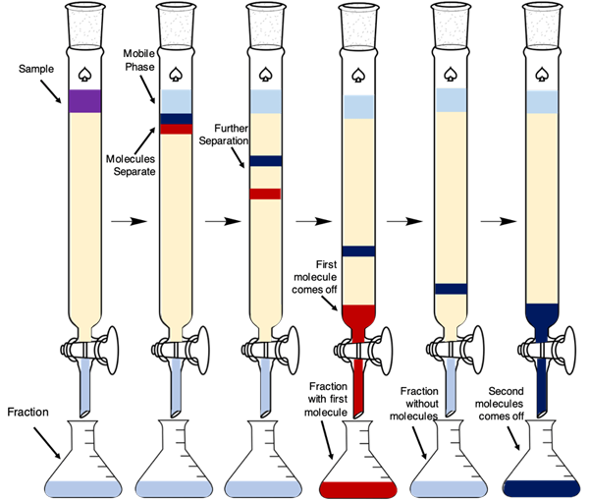
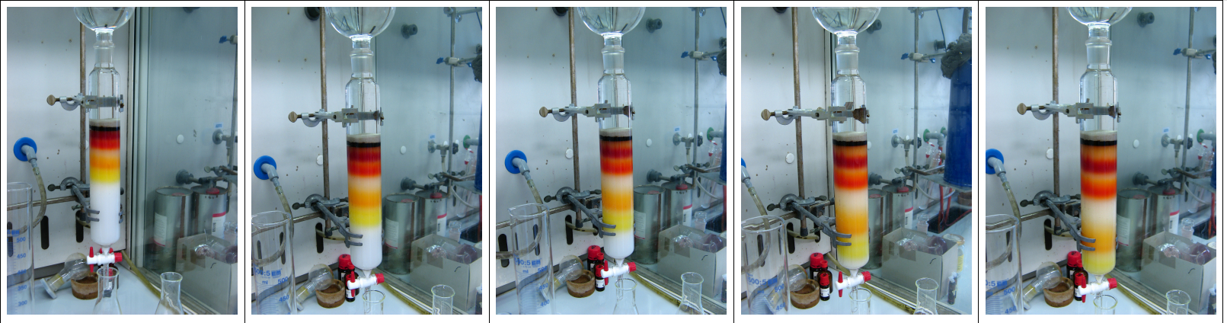

Slide 11
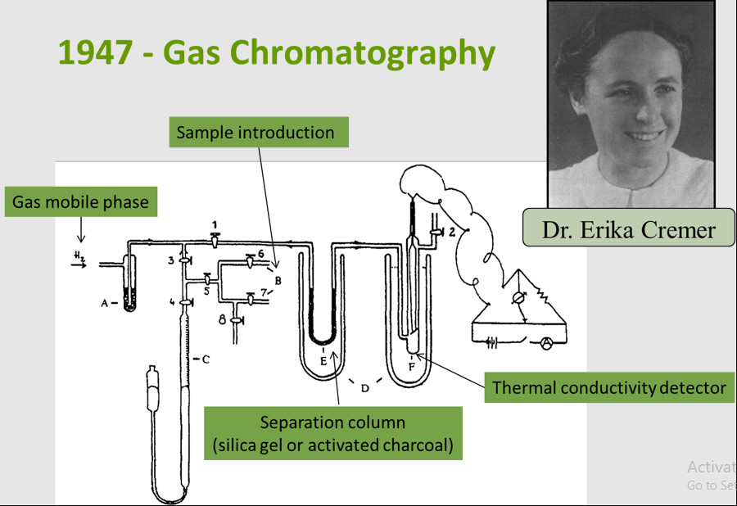

Slide 12
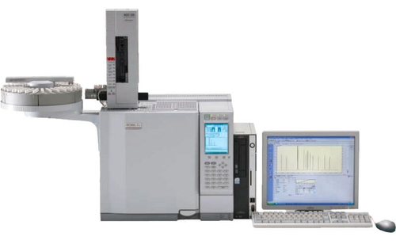

Slide 13
electrophoresis
It is the process of identification of protein constituents in different body fluids by studying the distance of their movement, by passing them trough a stationary phase made up of starch or agar gel on a glass slide on application of electric charge.
The separated proteins in stationary phase if stained with colouring agent will show characteristic bands which is specific for a particular protein.
Types of electrophoresis
  1) gel electrophoresis
  2) paper electrophoresis

Slide 14
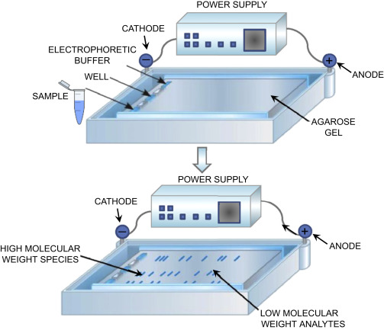

Slide 15
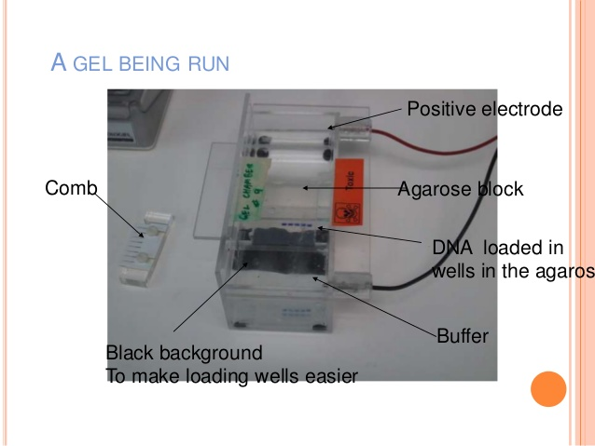

Slide 16
Spectroscopy/ spectrophotometry
Every substance has the capacity of absorbing light rays of various wave length, both visible as well as invisible range.
Spectrophotometry is the study of the range of wave length of the light rays absorbed by the testing material for its qualitative and quantitative detection.

Slide 17
Different types of spectrophotometry
Calorimeter spectroscopy
Ultraviolet and infrared spectroscopy
Mass spectrophotometry
Chemical ionization mass spectrophotometry
Emission spectrophotometry
Atomic absorption spectrophotometry

Slide 18
Neutron activation analysis
Very sensitive method, Even the one billionth of 1 gm of an element can be identified. (1/1,000,000,000)
Can identify minute traces of an element present in hair, nails, paints, gun powder residue around firearm entry wound or on hands of gun user, soil etc.
Principle : the elements present in the testing material is bombarded with neutrons inside a nuclear reactor. Neutrons are captured by some nuclei of atoms and they become radioactive. During disintegration, gamma radiation liberated which is measured by a detector and then analyzed to identify the element and its concentration.

Slide 19
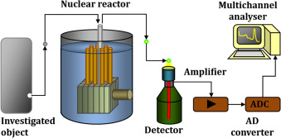

Slide 20
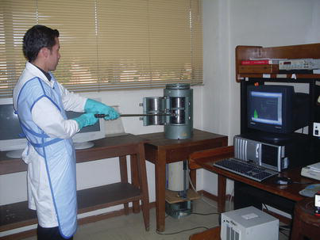

Slide 21
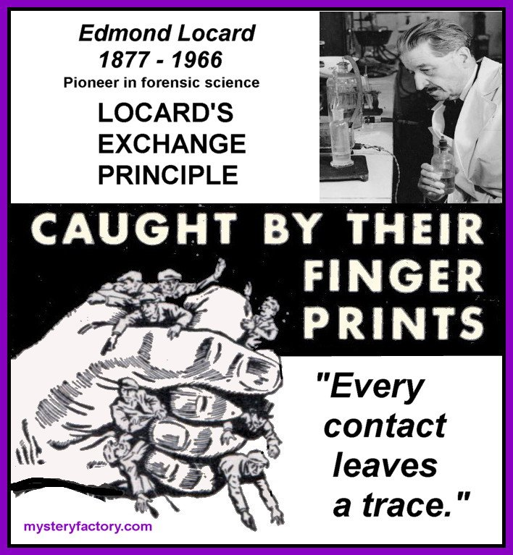
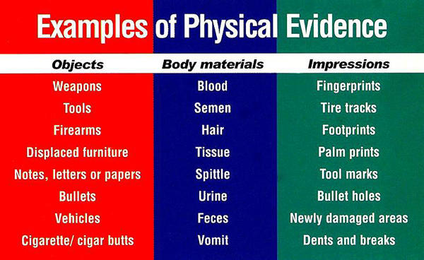
LOCARD’s PRINCIPLE of EXCHANGE
When two objects or person comes into contact with each other, there is always exchange of material- gross or trace (now also digital).

Slide 22
FORENSIC PSYCHIATRY & PSYCHOLOGY
LIE DETECTION TESTS:
Polygraph test
Narco-analysis
Brain mapping/brain fingerprinting

Slide 23
Polygraph or mechanical lie detector
Instrument used for comprehensive study of the body reactions of different body systems (circulation, respiration, peripheral nervous system etc.) while giving false statements or telling lie in answers to a question.
Polygraphs commonly used
  1) Keeler polygraph
  2) steolling deceptograph

Slide 24
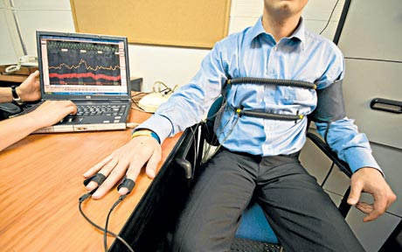
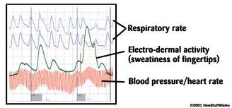
POLYGRAPHY

Slide 25
Process of polygraphy
Sit in a chair
An pneumograph belt - respiration.
A sphygmomanometer cuff - blood pressure.
galvanic electrodes - electrodermal response(sweating).
A pulse-oxymeter - pulse rate(HR), pulse volume and Sp O2.

Slide 26
All these responses collectively analyzed.
Respiratory and electrodermal reactions are more important than circulatory.
Before examination, the subject is prepared by physical and mental relaxation.
Persons with psychotic, neurotic personality; drug addicted, gross abnormality of body systems, restless, non cooperative nature are to be specially prepared before the test.

Slide 27
After preparation, ‘pre test interview’:
Subject is made aware about aims and objects, procedure and that he would be asked subjective questions whose answers in form of ‘yes’ or ‘no’.

Slide 28
test proper
Relevant, irrelevant and control questions mixed up, each question asked in every 20 to 25 seconds and polygraph recorded continuously for 3 to 4 minutes.
Same test repeated twice or thrice.
Alternatively different sets of tests like a) first test b) card test c) third test d) mixed question test e) yes test f) guilt complex test g) re-examination test h) peak of tension test may done to avoid errors or prevent attempts to fool the operator by habitual criminals.

Slide 29
Medicolegal importance
Its accuracy is 80 to 90%.
For civil cases – disputed paternity, insurance claims, pre employment screening in responsible jobs and services.
For criminal cases – to testify the statements made by offenders, suspects, victims, informants, witnesses.
None of methods – mechanical lie detection, narco analysis, brain mapping fingerprinting – accepted as an evidence in Indian court of laws till date.
They are mainly used as an investigating tool.
Brain mapping/fingerprinting is accepted in court of laws in USA as an evidence since 2003.

Slide 30
Narco analysis
It is based on fact that when a suspect is brought to a point close to unconsciousness, the person will not be able to resist questioning or unable to manufacture falsehood to conceal guilt and answers properly or truthfully to the questions.
Drugs known as ‘truth serum drugs’ used for this test.

Slide 31
Truth drugs for narco analysis
Scopolamine hydrobromide 0.5mg s/c followed by 0.25mg every 20 min. usually 3 to 6 injections required .
Sodium amytal or Sodium pentothal 0.25 to 0.5 gm in 2.5 to 5 % solution slow i.v.
S/c sodium seconal 0.5mg followed by morphine sulphate 15mg and scopolamine hydrobromide 0.5mg after 45 min.

Slide 32
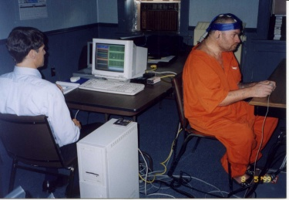
Brain mapping/brain fingerprinting
In this method, an equipment called ‘electro cap’ is fixed on the suspect’s head for recording EEG.
Study of P300 wave in the EEG of a suspected criminal for scientific detection of certain information whether stored in the brain or not.
Emission of such signals are dependent on cognitive brain responses and not on anxiety or fear.

Slide 33
Than the suspect is questioned about the crime and also shown some photographs or visuals related to crime(weapons, scene of offence, photo of victim) along with some other irrelevant visuals for control.
P300 wave will be generated when ever a question or visual stimulus matches the information stored in the brain if the suspect is the real offender.
The question and the EEG response are printed for scientific evidence.
This method of lie detection is claimed to be 100% effective by FBI. It is only method accepted in court of laws in USA as an evidence since 2003.

Slide 34
Any QUESTIONS?
Reference books
The Essentials of FMT by Dr KSN Reddy
Essentials of FMT by Dr A Aggrawal
Review of FMT by Dr G Biswas
Textbook of FMT by Dr PC Dikshit
Textbook of MJFMT by Dr CK Parikh
Forensic Medicine by Dr BK Bastiya
Textbook of FMT by Dr VV Pillay
Forensic Medicine by Dr BK Bastiya

