Slide 1
THERMAL INJURIES
Dr. anu singh

Slide 2
Classification
Thermal
Injuries
Cold
- Frost bite
- Immersion foot
Heat
Dry Heat
- Flame burns,- Hot metal
Chemical
- Corrosive acid, alkali, salts
Electricity
- Joule burn, Flash burn, Lightening
Moist Heat
- Hot liquid, steam
Radiation
X-rays, UV rays

Slide 3
Dry heat
Flame
Heated solid substance
Min temp : 44⁰C for 5-6 hrs
65⁰C for 2 sec
>70 ⁰C for few sec – full thickness burns

Slide 4
Degree of burns
Characteristics | Duputren | Wilson | Hebra
Erythema | 1st degree | Epidermal | 1st degree
Vesicals, bulla | 2nd degree
Superficial skin | 3rd degree | Dermo-epidermal | 2nd degree
Whole skin | 4th degree
Muscles & tendons | 5th degree | Deep | 3rd degree
Bones & organs | 6th degree

Slide 5
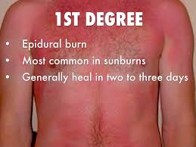
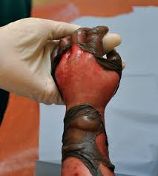
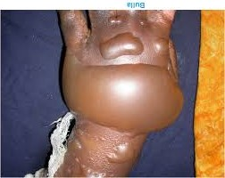
Epidermal :
  Erythema, capillary dilatation
  transudation of fluid, Swelling
  Vesicles, Blister, bulla
  -> base bright red
  Singeing of hair
  Very painful
  Heals completely without scar

Slide 6
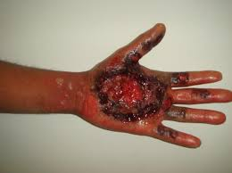
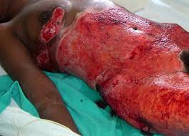
Dermo-epidermal :
  Whole thickness of skin destroyed with dermal appendages
  Central zone of necrotic tissue with surrounding rim of 1st degree burn with hyperemia
  Shrivelled, depressed areas of coagulated tissues
  Brown or black due to charring and eschar
  Pain & fluid loss – more severe
  Heals in 1wk to 1mth with scar formation, disfigurement, impairment of function

Slide 7
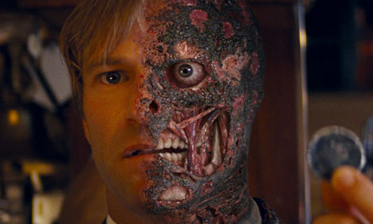
Deep :
  Gross destruction of skin & subcutaneous tissue, muscles even up to bone
  No/less pain due to Nerve endings also destroyed
  Appearance same as dermo-epidermal burn but up to deeper tissues.

Slide 8
Distribution
Rule of nine [Wallace]
Palmer surface of person’s hand is about 1% of BSA.
Involvement of >50% of BSA proves fatal even 1st degree burns.

Slide 9
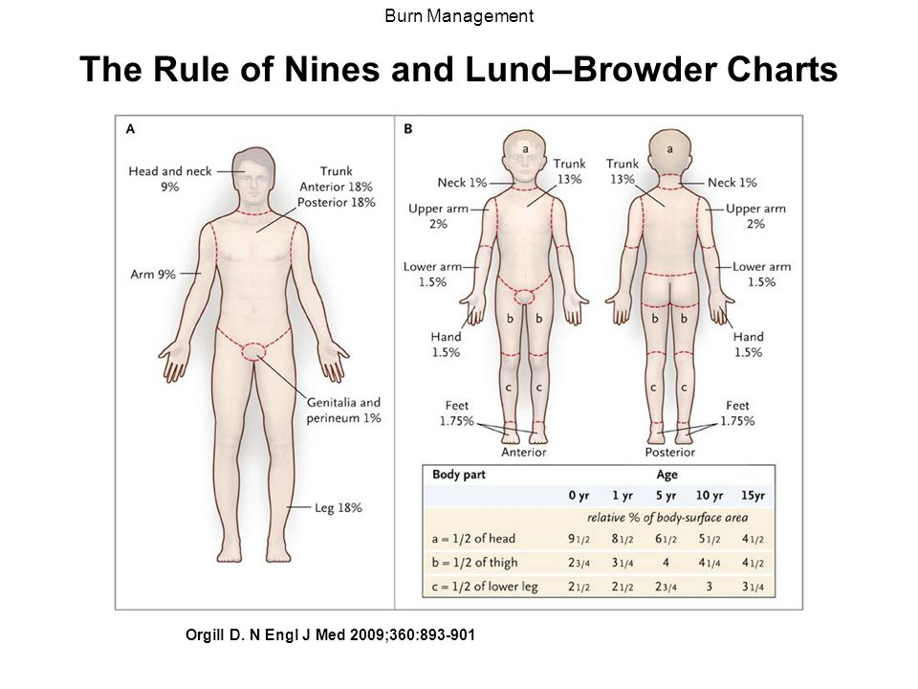

Slide 10
Clinical features
TRAIT | DRY HEAT | MOIST HEAT | CHEMICAL BURN
CAUSE | Flame, solid body, radiation | Steam or liquid >60⁰C | Corrosive chemicals
SITE | At and above site of contact | Fluid - At and below, steam – at & above | At and below site of contact
SPLASHING PATTERN | Absent, present in keroscene/petrol | Present | Present
SKIN | Dry, wrinkled, charred | Sodden, bleached | Destroyed
VESICLES | At the circumference of burnt area | Over the burnt area | Very rare
RED LINE | present | Present | Absent
COLOUR | Black/ red | Bleached | Distinctive

Slide 11
TRAIT | DRY HEAT | MOIST HEAT | CHEMICAL BURN
CHARRING | Present | Absent | May be present
SINGEINING | Present | Absent | Absent
ULCERATION | Absent/ present | Absent initially | Present
SCAR | Thick, contracted | Thin, less contracted | Thick, contracted
CLOTHES | burnt | Wet, not burnt | May be burnt, Show characteristic stains
CHEMICAL ANALYSIS | Inflammable material may be detected | Scaldable material | Corrosive material

Slide 12
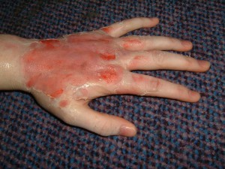
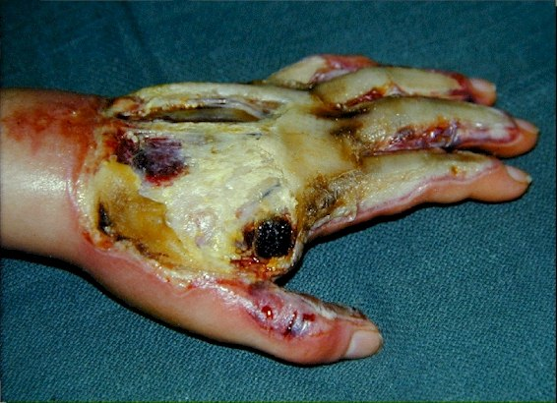
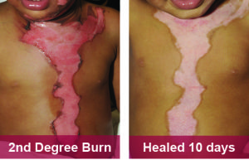

Slide 13
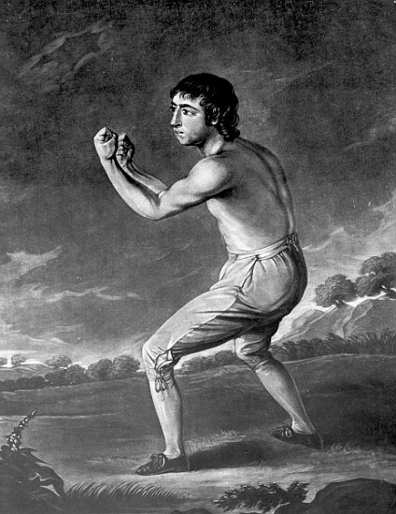
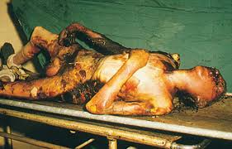
PM APPEARANCE
External appearance:
  Cloths – burnt, inflammable material
  Burns over body
  Smell of inflammable material
  Hairs singed
  Pugilistic attitude – boxer attitude
  Heat rigor, heat contracture, heat rupture

Slide 14
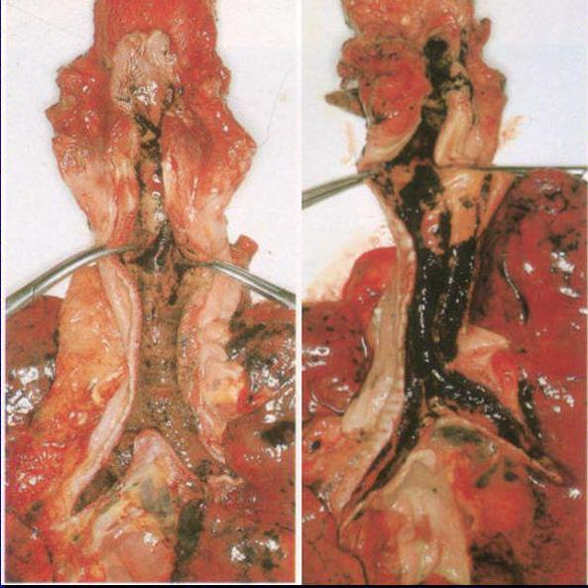
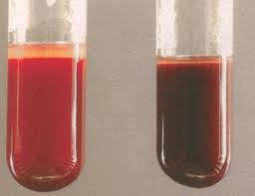
Internal appearance
  Heat hematoma
  Heat fracture
  Blackish soot particles in nose, mouth, pharynx, larynx, trachea, esophagus
  Pulmonary edema, blackish carbon particles in bronchioles
  All internal organs congested, edematous/ cooked
  Blood is cherry red due to HbCO
  presence of HbCO in chemical analysis

Slide 15
TRAIT | ANTEMORTEM BURNS | POSTMORTEM BURNS
LINE OF REDNESS | Present | Absent
BLISTER | Serous fluid with proteins & chlorides. Base red, inflamed | Air & thin clear fluid. Base dry, hard, yellow.
VITAL REACTIONS | Marked cellular exudation Reactive changes in tissue cells, healing changes | Absent
Soot in respi tract | Present | Absent
HbCO in blood | Present | Absent
ENZYMES | Peripheral zone - increase enzyme activity | No increase in enzyme activity
TEETH | Loosen in sockets | Firmly attached

Slide 16
Cause of death
Primary (neurogenic) shock
Hypovolemic shock
Septicemia
Asphyxia due to smoke
Electrolyte imbalance
Renal failure
Fat embolism, pulmonary embolism

Slide 17
manner of death
Accidental : front of thighs, abdomen, chest & face
Suicidal : extensive 2nd & 3rd degree burn on front & upper part of body. Skin folds & soles spared.
Homicidal : part of body with contact of ground is spared, marks of violence, struggle.

Slide 18
Moist Heat
Scald
Injury result from application of liquid above 60⁰C or steam.
Degrees of scald:
Erythema
Blister formation
Necrosis

Slide 19
HEAT SYNDROMES
Exposure to excessive environmental heat/temp.
Heat cramps
Heat stroke
Heat prostration
Hyperthermic anhydrosis syndrome
Sun burn

Slide 20
Chawla Rahul, Chanana Ashok, Rai Hukumat, Aggarwal AD, Singh Harnam. Clinico-pathological profile in deaths due to burns. Journal of Indian Academy of Forensic Medicine. 2011 Jan; 33(1): 14-17.
Chawla R, Chanana A, Rai H, Aggarwal AD, Singh H | Clinico-pathological profile in deaths due to burns. | Burns represent an extremely stressful experience for both the burn victims as well as their families. Burns constitute, a medical and psychological problem. | 40% cases died within 24 hours of sustaining burns. 66% cases had given dying declaration. 84% cases of total cases were alleged cases of accident. The major cause of death was Septicemic shock in 56% cases..

Slide 21
Questions ?

