Slide 1
GENERAL TOXICOLOGY
- Dr. Dushyantkumar

Slide 2
In this session
No. | COMPETENCY | Domain (K/S/A/C) | Level (K/KH/S/SH/P) | Core (Y/N)
FM8.1 | Describe the history of Toxicology | K | K/KH | Y
FM8.2 | Define the terms Toxicology, Forensic Toxicology, ClinicalToxicology and Poison | K | K/KH | Y
FM8.3 | Describe the various types of poisons, Toxicokinetics & Toxicodynamics and diagnosis of poisoning in living and dead | K | K/KH | Y
FM8.4 | Describe the Laws in relations to poisons including NDPS Act, Medico-legal aspects of poisons | K | K/KH | Y

Slide 3
Specific Learning Objectives At the end of this session, the 2nd MBBS student.... | Integration
1. should able to describe the history of Toxicology | N
1. should able to Define the terms Toxicology, Forensic Toxicology, Clinical Toxicology, Occupational Toxicology, Toxidrome, Toxinology, Poison | N
should able to describe Classification of Poisons. should able to describe about Toxicokinetics & Toxicodynamics. should able to describe the approach for diagnosis of poisoning in living and dead | N
should able to describe the Laws in relations to poisons including NDPS Act, Medico-legal aspects of poisons Should able to describe duties of a doctor in poisoning case – Medico-Legal and Medical | N

Slide 4
Definitions
Toxicology : Branch of science that deals with properties, actions, toxicity, detection of various poisons and treatment of poisoning cases.
Forensic Toxicology : branch of medicine deals with application of knowledge of toxicology to aid in administration of justice.
Clinical Toxicology : Branch of medicine deals with study of poisoning and diseases caused by various poisons and their treatment.
Toxidrome: syndrome caused by a dangerous level of toxins in the body. E.g. Plumbism, Hydragyriam, Wilson’s disease

Slide 5
Definitions
Poison : a substance (solid, liquid or gas), which if introduced in the living body or brought into contact with any part thereof, will produce ill-health or death, by its constitutional or local effects or both. Ex. pesticides, corrosives etc.
Hazardous materials : substances that can produce adverse health effects to any person or potential for it. E.g. poisons, biological agents, chemicals, radio-active substances.

Slide 6
Definitions
Occupational Toxicology:
Environmental Toxicology:
Toxinology : study of toxins produced by living organisms which are dangerous to man. e.g. poisonous plants, venom of snakes, spiders, bees, etc including bacterial & fugal toxins.

Slide 7
History
Maharshee Charak – ‘Charak Samhita’ (7th cent BC)
  Various poisons & their treatment
Shree Manu – ‘Manusmriti’ (4th cen BC)
  Intoxication state of mind & mental incapacity
Shree Kautilya (Chanakya) – ‘Arthshashtra’ (3-4th cen BC)
  Poisons, medicines & medical negligence
Maharshee Shushruta – ‘Shushrut samhita’ (200-300 AD), ‘Shushruta the Surgeon’
  Classification of Poisons & snakes
  Treatment & management

Slide 8
History
Paracelsus – ‘Father of toxicology’
Orfila (Paris) – ‘founder of modern toxicology’
  Chemical methods of toxicological analysis for detection of various poisons

Slide 9
Classification of poisons
Corrosives :
  Acids –
  (i)Inorganic – H2SO4, HNO3, HCl
  (ii)Organic – carbolic, oxalic, salicylic, acetic
  Alkalis – hydrates/carbonates of Na, K, NH4
  Metallic salts – ZnCl2, FeCl3, CuSO4, AgNO3, KCN

Slide 10
Irritants :
  Agricultural poisons –(i)OP (ii)OCl (iii)Phosphides AlP, ZnP
  Inorganic – (i)Metallic – As, Pb, Hg, Cu, Zn, Sb, Ag (ii)Non metallic – P, I, Cl, Br
  Organic – (i) Plant – Abrus precatorius, Croton, Ricinus communis, Calotropis, Semicarpus anacardium (ii) Animals – Snakes, Scorpion, Spider, Bees, Cantherides

Slide 11
Systemic :
  Brain – (i) CNS depressants – alcohol, GA, Opium, Heroin, Sedatives, Hipnotics (ii) CNS stimulants – amphetamines, caffeine, MDMA, designer drugs (iii)Deliriant poisons – Dhatura, Cannabis, Cocaine
  Spinal – Nux Vomica, Gelsemium
  PNS – Curare, Conium
  CVS – Aconite, Quinine, Oleander, Nicotin
  RS/Asphyxiants – CO, CO2, H2S, CH4, HCN, War gases
Miscellaneous : Food poisons, botulism…

Slide 12
Circumstances of poisoning
Accidental – children, old age, look a like, food poisoning, poisonous animal bite
Occupational hazard
Suicidal
Homicidal, Assault
For criminal intent – robbery, rape, to disfigure/injure
Overdose in addicted persons

Slide 13
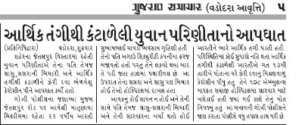
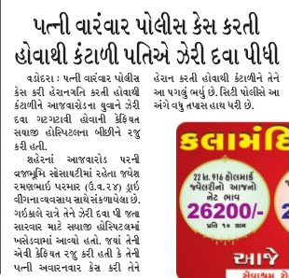
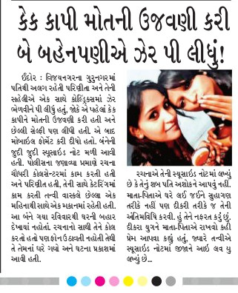
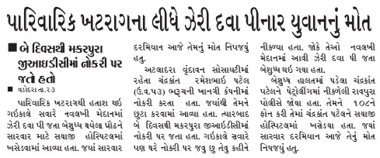

Slide 14
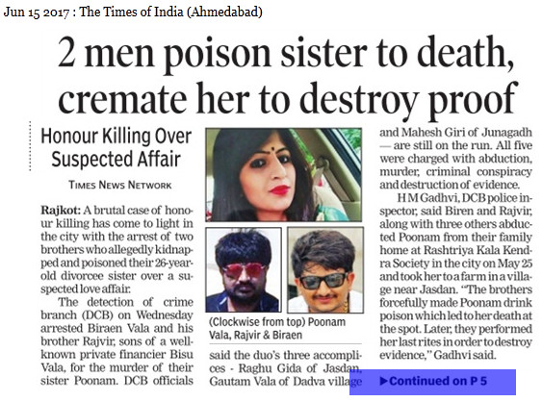
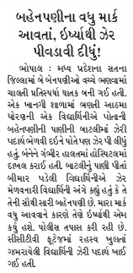

Slide 15
Ideal suicidal poison
Easily available
Cheap
Highly toxic
Taste – pleasant/tasteless
Easy administration – mixable with food/drink
Painless death
Examples - Opium, barbiturates
MC used – Organophosphates and household poisons

Slide 16
Ideal homicidal poison
Easily available, Cheap
Tasteless, colorless, odorless
Easy administration
Highly toxic
No antidote available
Signs-symptoms resemble natural disease
Time lag for ill effects to escape suspicion
No suspicious Postmortem changes in body
Rapidly destroyed in body after death
Not detectable by chemical tests
Examples – fluorides, Thallium
MC used – As, Aconite, Cn

Slide 17
House hold poisons
Substances used for household purposes
  Rodenticides, insecticides, moth balls
  Kitchen – backing powder, dish washers, grain/pulse preservatives, inflammable materials(gas, kerosene)
  Sanitary – floor cleaners, toilet cleaners, disinfectants, soaps & toilet materials
  Cosmetics – nail polish remover, lotions, creams
  Shoe polish, toys, crayons, fire crackers
  Overdose of common medicines
  Gardening solutions, car-vehicle solutions

Slide 18
Prajapati T, Prajapati K, Tandon R, Merchant S. Acute chemical and pharmaceutical poisoning cases treated in civil hospital, Ahmedabad: one year study. Asia Pacific Journal of Medical Toxicology. 2013 Jun 20;2(2):63-7.
Tejas Prajapati ¹ ; Kartik Prajapati¹ ; Rakesh Tandon² ; Saumil Merchant¹ | Acute Chemical and Pharmaceutical Poisoning Cases Treated in Civil Hospital, Ahmedabad: One year study | This was a prospective study of patients with chemical and pharmaceutical poisoning who were admitted to the emergency department of Civil Hospital Ahmadabad. | The most common type of poison was pesticides in 33.9% of cases, followed by household chemicals in 26.8% of cases. The prevention and treatment of poisoning with pesticides and household chemicals should merit high priority in the health care of Gujarat population.

Slide 19
Reference books
The Essentials of FMT by Dr KSN Reddy
Forensic Medicine by Dr BK Bastiya
Essentials of FMT by Dr A Aggrawal
MedicoLegal Manual by Dr S Agrawal, Dr L Kumar, Dr KD Chavali
Review of FMT by Dr G Biswas
Textbook of MJFMT by Dr CK Parikh

Slide 20
MCQ 1
Garlic like odour perceived in breath & excreta in a patient of unknown substance poisoning. Which of following poison is least possible for this case?
Arsenic trioxide
Parathion
Opium
Phenol(Carbolic acid)

Slide 21
MCQ 2
Which of the following substance toxicities does NOT produce ‘pin point pupils’ ?
Carbolic acid(Phenol)
Hyosciamine(Dhatura)
Organophosphates
Morphine

Slide 22
MCQ 3
Which of following poisoning causes hypothermia?
Cocaine
Aspirin
Anticholenergics
Ethanol

Slide 23
MCQ 4
Alcohol consumption is illegal and punishable in Gujarat state under which of following act?
The Poison Act
Drugs & Magic Remedies act
Gujarat Prohibition Act
Narcotic Drugs and Psychotropic Substances Act

Slide 24
MCQ 5
All of following substances are controlled under NDPS Act EXCEPT?
Ethenol
Opium
Marijauna
Cocaine

