Slide 1
PM Reports
Natural Deaths
1) Myocardial Ischemia
2) Pulmonary Tuberculosis
- Dr Kalpesh Zanzrukiya

Slide 2
In this session
No. | COMPETENCY | Domain (K/S/A/C) | Level (K/KH/S/SH/P) | Core (Y/N)
FM14.5 | Conduct & prepare post-mortem examination report Natural Deaths – MI, Pulmonary Tuberculosis | S | SH | Y
FM6.1 | Describe different types of specimens and tissues to be collected both in the living and dead: body fluids (blood, urine, semen, faeces, saliva), skin, nails, tooth pulp, vaginal smear, viscera, skull, specimen for histo-pathological examination, blood grouping, HLA Typing and DNA Fingerprinting. Describe Locard’s Exchange Principle | K | KH | Y
FM6.2 | Describe the methods of sample collection, preservation, labelling, dispatch, and interpretation of reports | K | KH | Y
FM6.3 | Demonstrate professionalism while sending the biological or trace evidences to Forensic Science laboratory, specifying the required tests to be carried out, objectives of preservation of evidences sent for examination, personal discussions on interpretation of findings. | A & C | SH | Y

Slide 3
SPECIFIC LEARNING OBJECTIVES At the end of this session, the 2nd MBBS student.... | Integration
1. should able to describe medicolegal autopsy procedures in detail 2. should able to observe & assist medicolegal autopsy – external and internal examination in a natural death cases 3. should able to describe and demonstrate external and internal autopsy findings in natural death case – MI , Pulmonary TB 4. should able to prepare PM reports for observed autopsies. | Y Pathology
1. should able to describe different types of specimens and tissues to be collected both in the living and dead. Specimens to be preserved for histo-pathological examination, microbiological examination, chemical examination, blood grouping, HLA Typing and DNA Fingerprinting. 2. should able to describe Locard’s Exchange Principle and application of it in FMT | Y Pathology
1.should able to describe the methods of sample collection, preservation, labelling, dispatch and interpretation of reports | Y Pathology
1.should able to demonstrate professionalism while sending the biological or trace evidences to Forensic Science laboratory, Histo-patho lab, Microbiology lab, Serology/Biochemistry lab | Y Pathology

Slide 4
Postmortem examination –
CASE
A deadbody of 65 yrs old male brought to mortuary with alleged H/o found unconscious in bathroom today morning 7am and rushed to emergency of nearby hospital. Emergency medical officer examined and declared him brought dead and sent the deadbody for PM. Patient was K/c/o MI x 10years (2 episodes of angina pectoris).

Slide 5
PM no. _______ Date: ________
Name of diseased : Mr. ABC
Address : Hari Nivas faliyu, Pipariya, Vadodara
Autopsy by Dr. XYZ
a) Deadbody sent by - PI, Piparia PS
b) Name & place - as per
inquest
c) Distance of place - as per inquest
Deadbody brought by - HC Mrs. DEF sign___
Deadbody identified by- Mrs. MNO sign___
relationship – wife of deceased

Slide 6
4. Date & Time of
receipt of deadbody - ______ on ______
begin of autopsy - ______ on ______ end of autopsy - ______ on ______
5. Substance of acc…….
………supposed COD - as per inquest
6. If autopsy not conducted at hospital
    - Not Applicable

Slide 7
External examination
7. Cloths & ornaments:
  A white kurta
  A white pants
  A brown underwear
  A yellow metallic chain around neck
8. Condition of cloths
  - No stains/ unusual smell

Slide 8
9. If deadbody unidentified : body identified by police & relative.
If deadbody of newborn : NA
10. Condition of body : body well built, well nourished. Body is cold.
11. Rigor mortis : rigor mortis present over eyelids, jaw, neck, proximal parts of upper & lower limbs. It is in developing stage.
12. PM lividity, decomposition : Bluish purple coloured PM lividity present over back of whole body. It is fixed.

Slide 9
13. External features of body:
  both eyes closed, conjunctiva congested, cornea hazy.
  Mouth closed, tongue inside mouth, oral mucosa congested.
  No bleeding from mouth, ears or nose.
14. Condition of skin : NA
15. Injuries over external genitalia : no injury
16. Hands & fingers (in case of drowning) : NA

Slide 10
17. External injuries : no injuries.
18. Palpable fracture? : No palpable fracture present.
18(a) injuries in 17 & 18 antemortem? : NA

Slide 11
Internal examination
19. Head :
  Injuries of scalp – no injury present
  Skull – no injury present
  Meninges & Brain –
    all meninges intact, congested.
    Brain intact, edematous, congested.

Slide 12
20. Thorax :
  Wall, ribs : intact, no fresh injury.
  Pleura : both pleura intact & congested.
  Trachea & bronchi : intact, mucosa congested.
  Right lung : congested.
  Left lung :congested.
  Pericardium : intact. No abnormal fluid collection.
  Heart : intact, coronary arteries thickened. Whitish patch (1x1cms over anterior wall). Walls of left ventricle hypertrophied (max thickness 2.5 cms).
  Major vessels : intact. Walls of proximal aorta thickened with yellowish white patches and changes of atherosclerosis.

Slide 13
21. Abdomen :
  Wall : intact, no injuries present.
  Peritoneum : intact.
  Cavity : no abnormal fluid collection
  Esophagus : intact, mucosa congested
  Stomach : intact, mucosa congested, cavity empty, no unusual smell
  Small Intestine : intact, congested
  Large intestine : intact, congested

Slide 14
  Liver : intact, congested.
  Gall Bladder : intact, congested.
  Spleen : intact, congested.
  Pancreas, adrenals : intact, congested.
  Kidneys : intact, congested.
  Gonads : intact, congested.
  Urinary bladder : intact, congested, cavity empty.

Slide 15
Additional remarks & Viscera samples :
  Following samples preserved for histo-pathological analysis
  Brain – half
  Heart – whole with proximal aorta
  Right lung – piece
  left lung – piece
  Liver – piece
  Right Kidney - half
  left Kidney - half
22. Vertebra & Spine : NA

Slide 16
Opinion as to Cause of Death
All external & internal injuries : NA.
Time of death : Between 6hrs to 12hrs before PM examination start
Pending reports : report for histological analysis of samples
Cause of Death : pending for reports as above
Date _________ Sign of Doctor

Slide 17
Final Opinion as to Cause of Death
Final Cause of Death based on lab reports:
“Myocardial Ischemia due to atherosclerosis of coronary arteries”
Date _________ Sign of Doctor

Slide 18
Postmortem examination –
CASE
A deadbody of 70 yrs old female brought to mortuary with alleged H/o found unconscious in her bed today morning 7am and rushed to emergency of nearby hospital. Emergency medical officer examined and declared her brought dead and sent the deadbody for PM. Patient was K/c/o pulmonary TB x 2years (under treatment).

Slide 19
PM no. _______ Date: ________
Name of diseased : Mrs. ABC
Address : Hussain gali, Pipariya, Vadodara
Autopsy by Dr. XYZ
a) Deadbody sent by - PI, Piparia PS
b) Name & place - as per
inquest
c) Distance of place - as per inquest
Deadbody brought by - HC Mrs. DEF sign___
Deadbody identified by- Mr. MNO sign___
relationship – husband of deceased

Slide 20
4. Date & Time of
receipt of deadbody - ______ on ______
begin of autopsy - ______ on ______ end of autopsy - ______ on ______
5. Substance of acc…….
………supposed COD - as per inquest
6. If autopsy not conducted at hospital
    - Not Applicable

Slide 21
External examination
7. Cloths & ornaments:
  A white kurta
  A white salwar
  A white bra
  A white underwear
  Yellow metallic bangles around wrist
  White metallic ring in 2nd toes of both feet
8. Condition of cloths
  - No stains/ unusual smell

Slide 22
9. If deadbody unidentified : body identified by police & relative.
If deadbody of newborn : NA
10. Condition of body : body poorly built, poorly nourished. Body is cold.
11. Rigor mortis : rigor mortis present over eyelids, jaw, neck, proximal parts of upper & lower limbs. It is in developing stage.
12. PM lividity, decomposition : Bluish purple coloured PM lividity present over back of whole body. It is fixed.

Slide 23
13. External features of body:
  both eyes closed, conjunctiva congested, cornea hazy.
  Mouth closed, tongue inside mouth, oral mucosa congested.
  Cyanosis over nails of both hands, feet, oral mucosa.
  No bleeding from mouth, ears or nose.
14. Condition of skin : NA
15. Injuries over external genitalia : no injury
16. Hands & fingers (in case of drowning) : NA

Slide 24
17. External injuries : no injuries.
18. Palpable fracture? : No palpable fracture present.
18(a) injuries in 17 & 18 antemortem? : NA

Slide 25
Internal examination
19. Head :
  Injuries of scalp – no injury present
  Skull – no injury present
  Meninges & Brain –
    all meninges intact, congested.
    Brain intact, edematous, congested.

Slide 26
20. Thorax :
  Wall, ribs : intact, no fresh injury.
  Pleura : both pleura intact & congested, 900ml sero-purulant fluid in right pleural cavity
  Trachea & bronchi : intact, mucosa congested, yellow pus over mucosa at places.
  Right lung : congested, an abscess size 5x12x10cms with yellow seropurulant pus and granulation in surrounding tissues noted in upper lobe. Another abscess size 4x8x6cms with yellow seropurulant pus in lower lobe. Multiple cheeseous granuloma nodules in whole lung.
  Left lung :congested. Multiple cheeseous granuloma nodules in whole lung.
  Pericardium : intact. No abnormal fluid collection.
  Heart : intact.
  Major vessels : intact.

Slide 27
21. Abdomen :
  Wall : intact, no injuries present.
  Peritoneum : intact.
  Cavity : no abnormal fluid collection
  Esophagus : intact, mucosa congested
  Stomach : intact, mucosa congested, cavity empty, no unusual smell
  Small Intestine : intact, congested
  Large intestine : intact, congested

Slide 28
  Liver : intact, congested.
  Gall Bladder : intact, congested.
  Spleen : intact, congested.
  Pancreas, adrenals : intact, congested.
  Kidneys : intact, congested.
  Gonads : intact, congested.
  Urinary bladder : intact, congested, cavity empty.

Slide 29
Additional remarks & Viscera samples :
  Following samples preserved for histo-pathological analysis
  Brain – half
  Heart – whole with proximal aorta
  Right lung – piece (lobes containing abscess)
  left lung – piece
  Liver – piece
  Right Kidney - half
  left Kidney – half
  Following samples preserved for microbiogical analysis
  Swab from trachea and bronchus
  Swab from pus in abscess in right lung
22. Vertebra & Spine : NA

Slide 30
Opinion as to Cause of Death
All external & internal injuries : NA.
Time of death : Between 6hrs to 12hrs before PM examination start
Pending reports : report for histological & microbiological analysis of samples
Cause of Death : pending for reports as above
Date _________ Sign of Doctor

Slide 31
Final Opinion as to Cause of Death
Final Cause of Death based on lab reports:
“Pulmonary Tuberculosis – Mycobacterium TB”
Date _________ Sign of Doctor

Slide 32
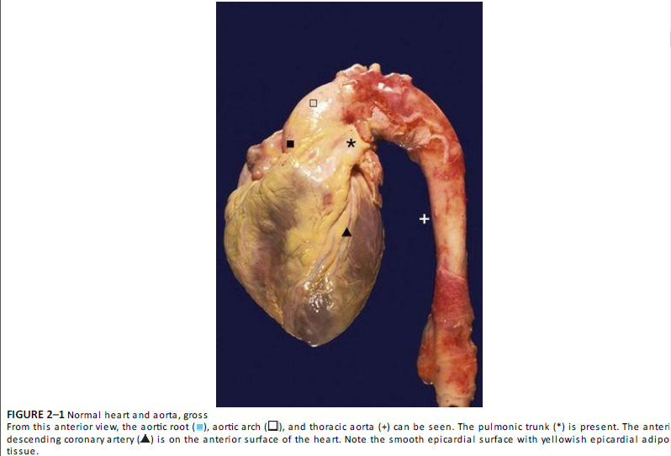

Slide 33
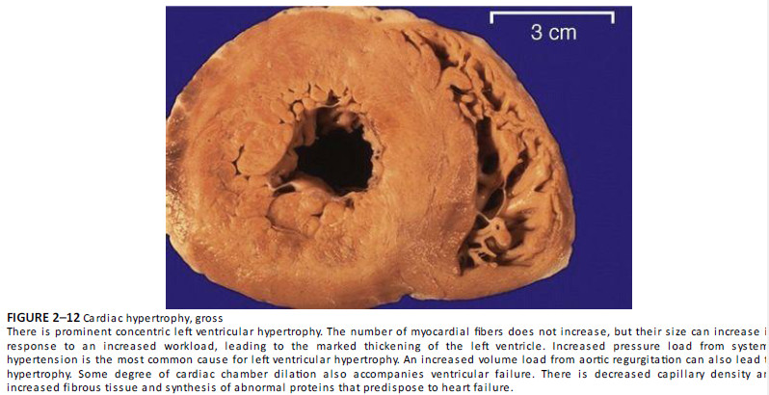

Slide 34
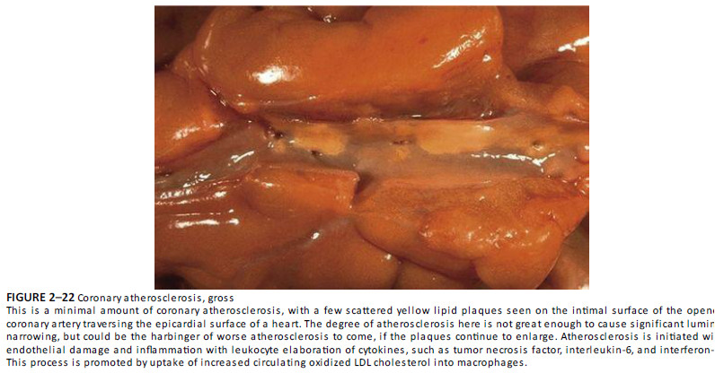

Slide 35
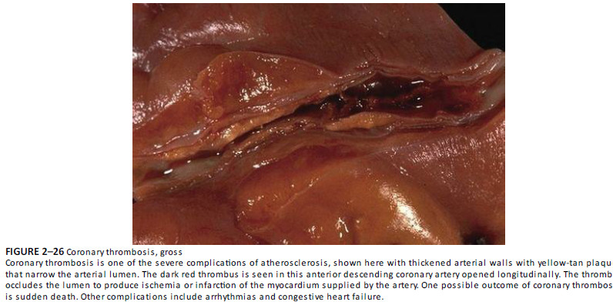

Slide 36
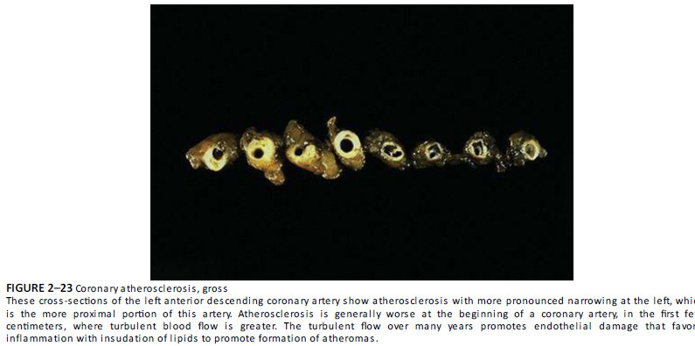

Slide 37
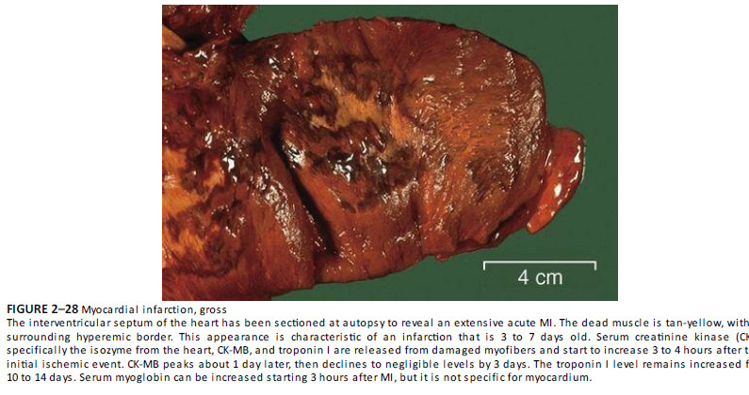

Slide 38
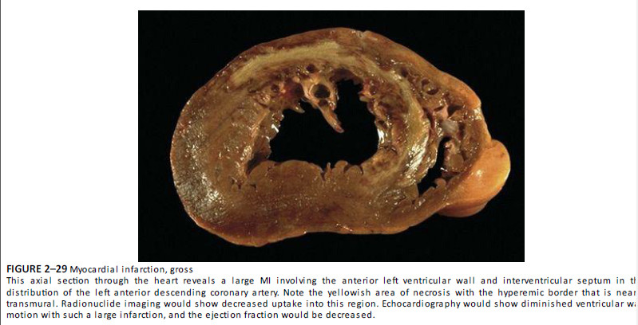

Slide 39
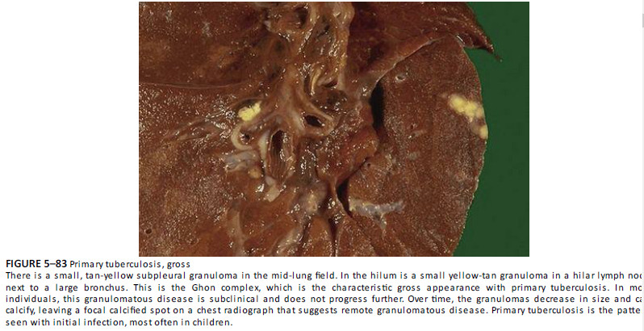

Slide 40
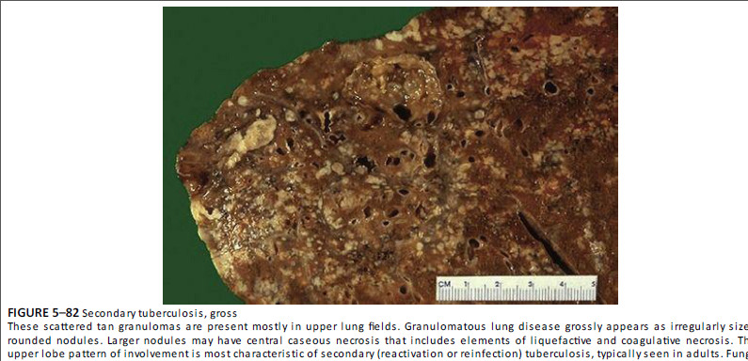

Slide 41
Pneumonia
Malaria
Typhoid
Cholera
Carcinoma breast
Carcinoma prostate
Blood cancer – Lymphoma, Leukemia
Thrombo-embolism in cerebral artery
Septicemia due to gangrene of foot
Cardiac arrythmia
COVID19

