Slide 1
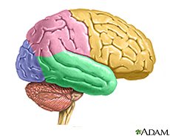
Cerebellar Disorders
Dr. J. D. Lakhani.

Slide 2
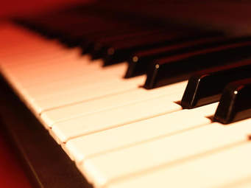
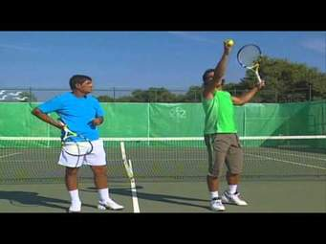
When you play the piano or hit a tennis ball you are activating the cerebellum. The cerebellum is the area of the brain that controls coordination and balance.
*****cerebellum*****

Slide 3
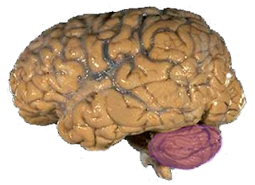
CEREBELLUM
Anatomy: Largest part of Hindbrain
Post Fossa :- 150 gm.
It Lies behind Pons & M.OB.
Median portion separated by IV ventricle.
Cerebrum: Cerebellum in Adult 8:1 & in Infant 20: 1,

Slide 4
Functions:-
a. Control of the movement,
b. Maintenance of equilibrium and posture,
c. Tone maintenance.

Slide 5
Anatomical and Functional Division Larsell’s Classification:-
Corpus cerebelli
Ant Post
Flocculonodular Lobe
Floculi Nodule
Peduncles
It is separated by post lateral fissure.

Slide 6
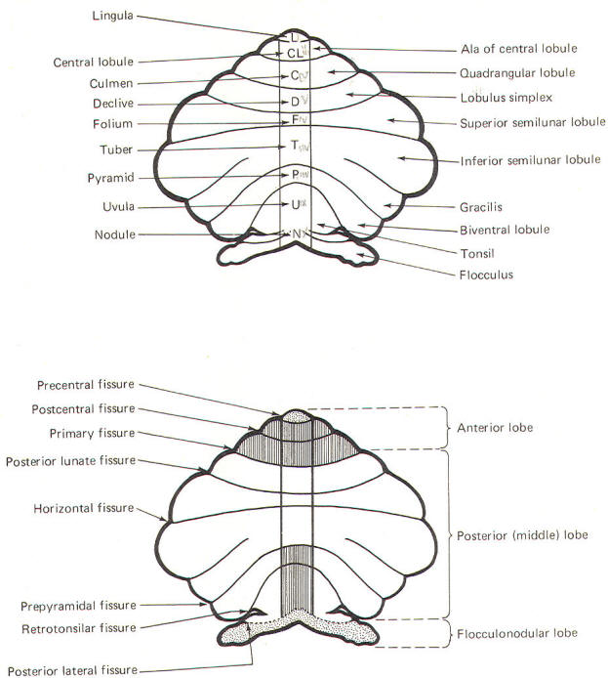

Slide 7
Phylogenetic Subdivision :-
1. Archi, 3. Neo
2. Palaeo,

Slide 8
3 Functional Divisions:-
1. Archi cerebellum (Floculo nodular)-Vestibular
2. Palaeocerebellum (Anteriosup.)-Spinocerebellar
3. Neocerebellum (Post.)- Cortical

Slide 9
MCQ1
Following statement regarding functional divisions of cerebellum is not correct:
A. Floculonodular lobe is related with Archi cerebellum
B. Archicerebellum is vestibular in origin.
C. Neocerebellum has cortical connection and is through denatothalmocortical tract. connection.
D.Paleocerebellum is the largest part of the brain.

Slide 10
Functions :-
1. Archi:- Vestibular, Lingula- Some Spino Cerebellar
connection,
2. Palaeo :-Spino Cerebellar ,
3. Neo:- Corticopontocerebellar connection

Slide 11
1. Archi
Nodule Lingula
Floculi Peduncle

Slide 12
2. Palaeo
1.Central lobules 4.Quadrangular
2. Alae 5. Pyramid
3. Culmen 6. Uvula

Slide 13
3. Neo
Declive,
Folium,
Tuber,
Lobulus Simplex,
Sup.Semilunar lobule,
Inferior Semi lunar lobule,
Biventricular lobule,
Tonsil.

Slide 14
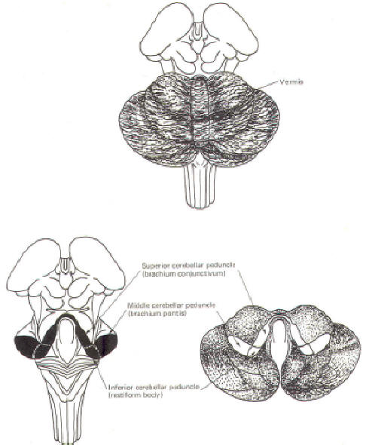
vermis
1.SCP
2.MSP
3.ISP

Slide 15
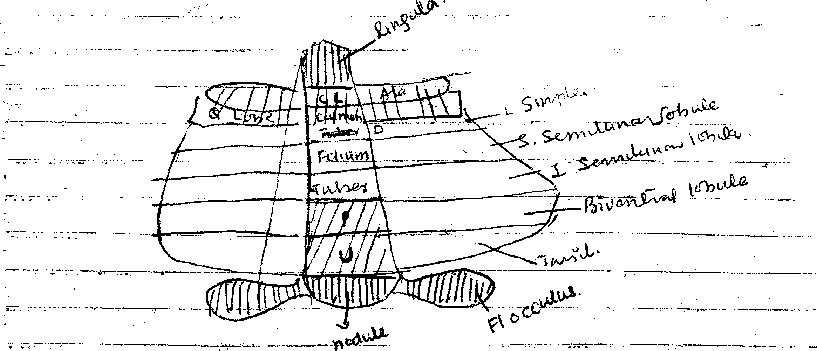
1.Central lobules 4.Quadrangular
2. Alae 5. Pyramid
3. Culmen 6. Uvula
Archi:- Vestibular, Lingula- Some Spino Cerebellar
connection,
2. Palaeo :-Spino Cerebellar ,
3. Neo:- Corticopontocerebellar connection
4
4
4

Slide 16
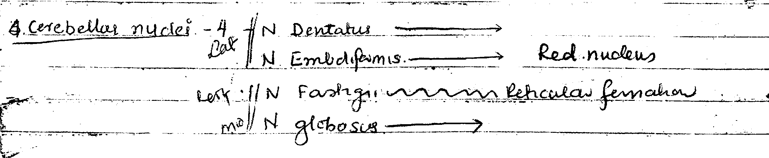
4

Slide 17
 | Lingula
alae | Central lobule
Quadrangular lobe | culmen
Lobule simplex | Declive
Sup. Semilunar lobule | folium
Inf. Semilunar lobule | tuber
Biventricular lobule | Pyramid
tonsil | Uvula
NEO -cortico-ponto
Archi-vestibular
Paleo-spinocerebellar
flocculus | nodule

Slide 20
Cerebellar nuclei
N. dentatus
N. Embiloformis-------Red nucleus
N. fastigii ----------------Reticular formation
N. globosus

Slide 21
Fibers
Efferent:-
From center to deep nuclei.
From deep nuclei to extra Cerebellar region.
White matter forms the white cover –
Projection fibers,
Association fibers,

Slide 22
Connections :-
1. Inf.C.P :-
Afferent:- a. Dorsal Spinocerebellar tract
b. External Aracuate fibers.
c. Vestibulo Cerebellar tract,
d. Olivo cerebellar tract,
e. Fibers & 5th,9th & 10th Cranial nerves,
f. Tecto cerebellar.

Slide 23
Connections :-
Efferent:- a. Fastigo Vestibular,
b. Fastigo bulbar,
c. Cerebello olivary,
2. Middle Cerebellar Pedunde:-
Afferent:- a. PontoCerebellar Fronto PontoCerebellar
b. Cerebellum Cerebrum

Slide 24
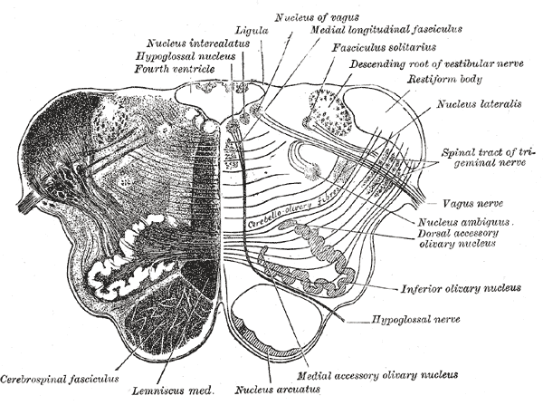

Slide 25
Connections :-
3. Sup. Cerebellar Pedunde:-
Afferent:- a. Ventral Spinocerebellar
b. Tecto cerebellar,
Efferent:- a. Dentetothalamo cortical tract,
b. Dentetorubrothalamic tract

Slide 26
MCQ-2
All statements regarding cerebellar connection are true except :
A.Ventral spinocerebellar tract passes through SCP
B. External arcuate fibers passes through ICP
C. Association fibers from one cerebellum to another passes through MCP
D. Vestibulocerebellar tract fibers passes in SCP

Slide 27
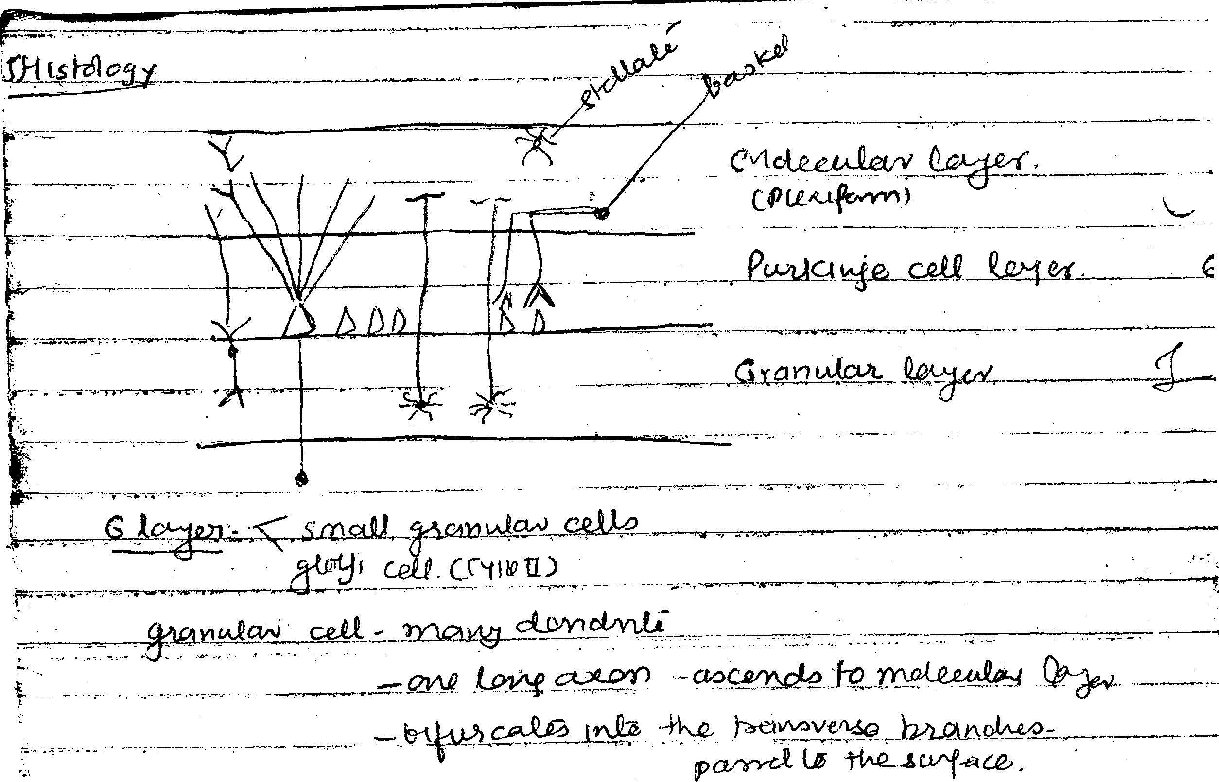

Slide 28
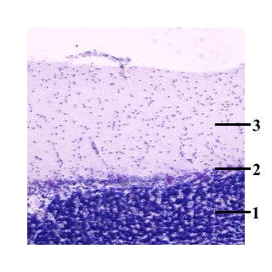
1.Stratum granulosum der Kleinhirnrinde
2. Purkinje-Zellen des Stratum ganglionare
3. Stratum moleculare

Slide 29
6 layers
Small granular cells-many dendrite,one long axon ascends to molecular layer,bifurcates into transverse branches parrel to the surface.
Golgi cells (type II)

Slide 30
Layers
2. Intermediate layer of purkinje cell. (Middle layer)Large flask shaped purkinje cell
3. Molecular- outer layer-
a. Small Stellate cells.
b. Basket cells :- Sends transverse fibers ending round
the bodies of purkinje cells.

Slide 31
2
Intermediate layer of purkinje cells(middle layer), large flask shaped purkinjee cells
Molecular-outer layer A. small stellate cells
B.basket cells-sends transverse fibers ending round the bodies of purkinjee cells.

Slide 32
Fibers
Afferent Fibers:-
a. Mossy (Spino Cerebellar – Olivo Cerebellar)- It ends in Granular layer.
b. Tenderil- Communicate with dendrite and of Purkinje cell
(Climbing)
Positive and vestibular.,

Slide 33
Functions :-
1. Archi:- Vestibular, Lingula- Some Spino Cerebellar
connection,
2. Palaeo :-Spino Cerebellar ,
3. Neo:- Corticopontocerebellar connection

Slide 34
Functions:-
a. Control of the movement,
b. Maintenance of equilibrium and posture,
c. Tone maintenance.

Slide 35
Abnormal Functions:-
1. Cerebellar ataxia,
2. Asthenia
3. Atonia- Hypotonia,
4. Adiadokokinesis,
5. Dysmetria- pas pointing,
6. Incoordnation,
7. Nystagmus- Horizontal rapid phase more prominent
8. Intentional tremors – Astasia

Slide 36
Abnormal Functions:-
9.Pendular knee jerk,
10. Rebound phenomenon
11. Titubation,
12. Trunkal ataxia,
13. Neck turned to the opp. side,
14. Scanning & Scatto speech,
15. Decomposition & Movement of affected side,
16. Skew deviation of eyeball.

Slide 37
Disease of Cerebellum:-
1. Congenital : C V Anatomy (Arnold chiarii)
2. Familial :- Von- Hippel-Lindau,
3. Vascular :- Cerebellar Infract
Cerebellar hemorrhage,
4. Tumors:-
a. Astrocytoma (Glioblastoma),
b. Cystic Astrocytoma (Plioytic),
c. Medulloblastoma (Medline portion affected) (Vermis).
d. Hemmangioblastoma,
e. Metastasis,
f. Tuberoculoma,
g. Gumma

Slide 38
Disease of Cerebellum:-
5. Secondary :- Acoustic Neuroma and other post fossa
tumors
6. Demylinative:- M.S.
7. Infective: a. Cerebellar abscess:-
b. Encephalitis,
c. Malaria
d. Hyperpyrexia

Slide 39
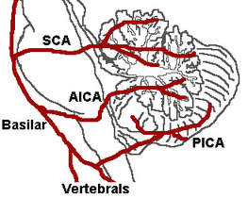

Slide 40
MCQ3 Following is true
A.Most of the time PICA is branch of Basilar artery.
B.Superior cerebellar artery has superior and inferior division.
C.PICA supplies lateral medulla.
D. Cerebellum is supplied by posteior cerebral artery.

Slide 41
Disease of Cerebellum:-
5. Secondary :- Acoustic Neuroma and other post fossa
tumors
6. Demylinative:- M.S.
7. Infective: a. Cerebellar abscess:-
b. Encephalitis,
c. Malaria
d. Hyperpyrexia

Slide 42
4.MCQ
Following is true for CV anomaly;
A.There is basilar Invagination
B, may have tentorial herniation
C.May have KlippelFeild anomaly
D.All of the above

Slide 43
Cancer and Cerebellum
Treatment of cerebellar disorders depends on the cause of which one of the important cause could be paraneoplastic syndrome because of cancer.

Slide 44
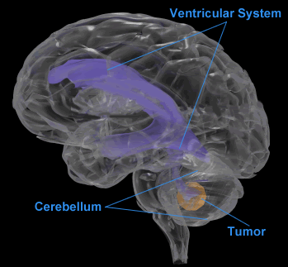

Slide 45
Medulloblastoma
Medulloblastoma, is a highly malignant primary brain tumor that originates in the cerebellum or posterior fossa( infratentorial).
Medulloblastoma is infratentorial primitive neuroectodermal tumor (PNET), which is the most common PNET originating in the brain*.
*Hinz, Chris; Hesser, Deneen. Focusing On Brain Tumors: Medulloblastoma. American Brain Tumor Association.ISBN 0-944093-67-1.

Slide 46
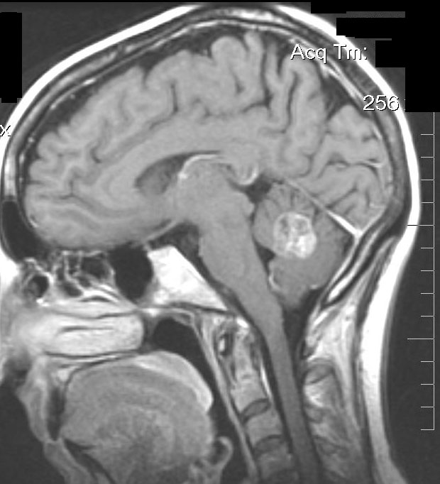

Slide 47
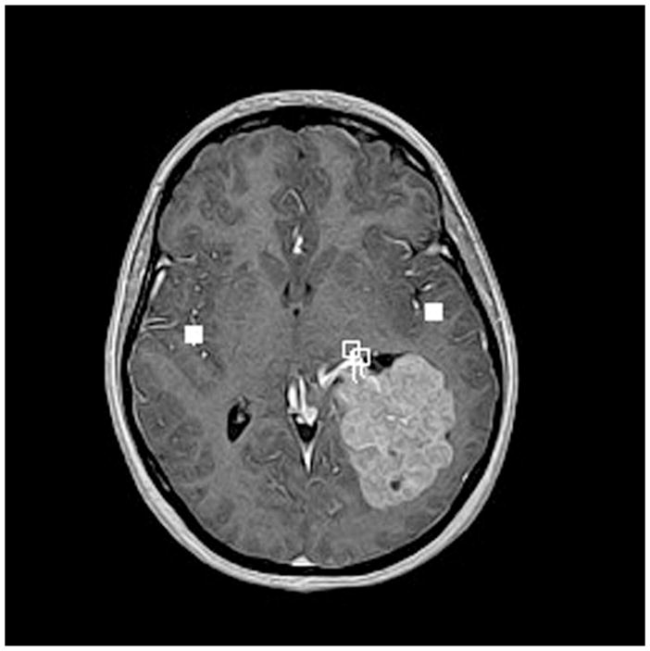

Slide 48
5.Medulloblastoma is
A. CP angle tumor
B. cerebellar Hemisphere tumor on lateral side
C. Midline vermicular
D. Cerebral tumour

Slide 49
Treatment of Medulloblastoma
Majority of patients requiring surgery, radiation, and chemotherapy. Over the past 20 years, surgery for children with medulloblastoma has become safer, yet two of every ten children will develop severe, sometimes irreversible, neurologic problems afterwards, including loss of speech and severe balance difficulties.

Slide 50
Management of cerebeller tumors/Medulloblostomas
Several technological advancements have increased our knowledge of the cell biology of pediatric brain tumors, facilitated earlier diagnosis, and improved neurosurgical resections while minimizing neurological deficits.
These in turn have not only improved the survival of children with brain tumors but also their quality of life.

Slide 51
Type Of study | Referencee | Aims | Result/ Conclusions | Grade
Systematic review | Treatment developments and the unfolding of the quality of life discussion in childhood medulloblastoma: a review. Gudrunardottir T^{1et al} Childs Nerv Syst. 2014 Feb 26. | To describe how the quality of life (QOL) discussion in childhood medulloblastoma (MB) relates to treatment developments, survival and sequelae from 1920 to 2014. | Therapeutic improvements raise the question of QOL versus cure. | Grade A

Slide 52
Management of cerebeller tumors/Medulloblostomas-2
Current management strategies in most cases rely on surgery coupled with adjuvant therapies, including radiation therapy and chemotherapy. The vulnerability of the immature brain to adjuvant therapies creates many challenges for the treating physician.

Slide 53
Complete Resection improves survival/QOL.
There is strong evidence that medulloblastomas which are only biopsied at the time of surgery are very difficult to control, despite the use of radiation and chemotherapy. Children whose tumors are resected (totally when possible) have a better overall rate of survival.

Slide 54
Genetic disorder in relation to cerebellum
Very important etiology is genetic disorder. The function of some of the genes like SYNE1 is important in the maintenance of cerebellar structure and functions in humans.

Slide 55
Cerebellar Ataxias, evidence based classification , (National AtaxiaFoundation,NAF, www.ataxia.org )
Ataxia was classified earlier by the symptoms if developed at an early age, was diagnosed as Friedreich's ataxia.
If ataxic symptoms developed after age 20, it was often given the name Marie’s ataxia. Dominantly inherited ataxias were all called Marie’s.
With the availability of better brain imaging and molecular genetic testing, classification of ataxia is becoming more defined.
2009 ATAXIA Classification is an evidence-based classification and has replaced older terms and classifications

Slide 56
Dominant Spinocerebellar ataxias
Recently, many of the dominantly inherited ataxias have been renamed Spinocerebellar Ataxia or SCA.This is usually followed by a number which indicates the ataxia is caused by a specific genetic defect. The numbers are usually assigned in the order in which the gene was identified.
The SCA1 gene was found in1993 while SCA30 gene was reported in 2008. As of 2008, genetic testing is available for twelve of the dominantly inherited ataxias: SCA1, SCA2, SCA3,SCA5, SCA6, SCA7, SCA8, SCA10, SCA12, SCA13,SCA14 and SCA17.
Genetic testing is also available for DRPLA and FXTAS. Through research, one or two new genetic tests for dominant ataxia become available each year.

Slide 57
recessively inherited ataxias
This includeFriedreich's ataxia, Ataxia-telangiectasia, Ataxia with vitamin E deficiency, ataxia with oculomotor apraxia types 1 and 2 and others.
Often recessive ataxias have an earlier onset than the dominantly inherited ataxias.
Genetic testing is available for many of the recessive ataxias to identify the specific type.

Slide 58
Type of study | reference | Aims | Result
Molecular study, French Canadian cohort | Nat Genet. 2007Jan;39(1):80-5. Epub 2006 Dec 10. Mutations in SYNE1 lead to a newly discovered form of autosomal recessive cerebellar ataxia. Gros-Louis F¹ etal. | Causative genes have been identified for a few autosomal recessive ataxias like Friedreich's ataxia, ataxia with vitamin E deficiency, ataxia telangiectasia etc , genes remain unidentified for most recessive ataxias. | SYNE1 mutations the first identified gene responsible for a recessively inherited pure cerebellar ataxia.

Slide 59
Genetic mutation leads to familial spinocerebellar ataxia-
Type of study | reference | Aims | Result | Grade of evidence
Clinical and genetic study(64 probands and affected members of 30 French-Canadian families-cohort ) | Ann Neurol. 2007 Jul;62(1):93-8 Clinical and genetic study of autosomal recessive cerebellar ataxia type 1 Dupré N etal | Define the phenotype and genotype of a cluster of families with a relatively pure cerebellar ataxia referred to as autosomal recessive cerebellar ataxia type 1 (ARCA-1). | a cluster of French-Canadian families with a new recessive ataxia of relatively pure cerebellar type caused by mutations in SYNE1. | Grade A

