Slide 1
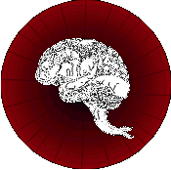
Approach to Coma
DR.J.D.LAKHANI
Notes:
Etiology
Coma results from a disturbance in the function of either the brain stem reticular activating system above the mid pons or both cerebral hemispheres.
This disturbance can be caused by lesions in the reticular activating system or both hemispheres or by lesions outside this structures but capable of affect their normal function. The many causes of coma are shown in table 1.
Table 1. Causes of Coma
Category
Possible Etiologic Factors
Supratentorial LesionsEpidural or Subdural Hematoma
Large Isquemic Infarction
Tumor
Intraparenchymal hemorrhage
Trauma
Abscess
Infratentorial LesionsBasilar artery thrombosis
Pontine or Cerebellar Hematoma
Ischemic Cerebellar Infarction
Tumor
Abscess
Diffuse EncephalopathiesHypoglycemia
Drug Intoxication
Hepatic Encephalopathy
Hyperosmolar States
Hyponatremia
Global Cerebral Ischemia
Hyperthermia
Meningitis and Encephalitis
Subarachnoid Hemorrhage
Myxedema
Renal Failure
Hypercarbia
Thiamine Deficiency
Hydrocephalus
PsychogenicCatatonic States
Acute Psychotic Deliria
Hysteria-malingering
Emergency Management
The approach to diagnosis of the comatose patient consists of two steps. First you need to stabilize the patient and treat presumptively life-threatening disorders. After that, efforts are directed to establish an etiologic diagnosis
Secure airway
Establish Adequacy of Ventilation
Establish Adequacy of Circulation
Insert Intravenous cannula
Draw blood for laboratory studies
Treat Immediately Reversible causes of coma
a) Hypoglycemia - 25g of glucose I.V
b) Opiate overdose - Naloxe 2 mg I.V
c) Wernicke's Encephalopathy - Thiamine 100 mg I.V
Treat seizures
Draw blood for arterial blood gas determinations
History
After the emergency measures have been taken with successful, you will need to obtain a description of the onset of coma and a history of any chronic illness, eg, diabetes, hypertension or drug abuse.
It is very important because some aspects like the time over which coma develops is crucial to guide your clinical investigation. For example: a sudden onset of coma suggest a vascular origin and in contrast a more protracted course is seen with tumor, Abscess or chronic subdural hematoma
General Physical Examination
Posture - Look for muscle jerks or tremors. Inspect the respiratory movements for tachypnea, bradypneia, Cheyne-Stokes breathing and Kussmaul breathing.
Color - Look for pallor, icterus, the cherry-red color of carbon monoxide hemoglobin and the cyanosis of methemoglobinemia.
Facial muscles - Look for asymmetry of the face which may indicate hemiplegia
Oral Cavity - Look for lacerations in the tongue which may indicate biting during a convulsive seizure. Smell the breath for alcohol or ammonia.
Ears - Look for pus
Neck - Test for nuchal rigidity, Brudzinski sign, Kernig sign, for evidence of meningeal irritation.
Vital signs
Blood Pressure - Elevation of blood pressure can indicate
1. Long-standing hypertension, which predisposes to intracerebral hemorrhage or stroke).
2. Hypertensive Encephalopathy
3. May be a consequence of the process causing the coma ( intracerebral or subarachnoid hemorrhage
Temperature
1. Hypothermia - can occur in ethanol or sedative drug intoxication, Wernicke's encephalopathy, hepatic encephalopathy, and Myxedema.
2. Hyperthermia - can occur in status epilepticus, pontine hemorrhage, heat stroke, malignant hyperthermia and anticholinergic intoxication.
Optic Fundi - Look for Papilledema or retinal hemorrhage which may indicate chronic or acute hypertension or an elevation in intracranial pressure.
subhyaloid hemorrhages in an adult suggest subarachnoid hemorrhage.
Signs of trauma:
Battle's sign ( swelling and discoloration overlying the mastoid bone behind the ear)
Raccoon eyes (Periorbital ecchymosis)
Cerebrospinal fluid rhinorrhea or otorrhea
Skull fractures
Neurologic Examination
The neurologic examination is very important to etiological diagnosis and have to be done with special attention.The results have to be recorded because they will help later in evaluating the treatment. Some aspects of the neurologic examination were explained above and will not be discussed here.
Pupils - Pupillary size(normal 3-4 mm in diameter) and reactivity is dependent on sympathetic parasympathetic innervation. Brain stem reflexes, such as the pupillary reaction to light, offer clues to the location of the lesion responsible for the coma.
Bilateral dilated pupils - Are greater than 7 mm in diameter and do not react to light stimulation. Are seen in:
a. Transtentorial herniation of both medial temporal lobes
b. Anticholinergic or Sympathomimetic drug intoxication
Bilateral pinpoint pupils - Have 1-1,5 mm in diameter and are seen in:
a. Morphine poisoning
b. Pontine hemorrhage
c. neurosyphilis
d. Organophosphates poisoning
e. Miotic eyes drops
Asymmetric pupils(anisocoria) - With a difference of 1 mm or less in diameter and a normal constriction response to light is a normal finding in 20% of the population. If the dilated pupil do not react to light or do it slowly, it usually indicates a rapidly expanding lesion on the ipsilateral side as in subdural or middle meningeal hemorrhage or brian tumor, that is compressing the midbrain or oculomotor nerve directly or by mass effect.
Fixed midsized pupils - Are about 5 mm in diameter, do not react to light and are the result of midbrain lesion.
Extraocular Movements - In the comatose patient eye movements are tested by stimulating the vestibular system by the oculocephalic reflex(doll's head maneuver) which consists of passive head rotation or by the oculovestibular reflex(cold-water calorics test) which uses ice-water irrigation against the tympanic membrane.
Normal - The presence of full reflex eye movements( full conjugate horizontal eye movement during the doll's head maneuver and tonic conjugate movement of both eyes to the side of the ice-water irrigation during caloric test) attests to the integrity of the brain stem from the pontine to the midbrain level.
Abnormal
a. Impaired unilateral adduction - Indicates lesions of the oculomotor nerve or midbrain lesions involving the oculomotor nucleus.
b. Downward deviation of one or both eyes - is suggestive of sedative drug intoxication.
c. No response - Complete absence of response on oculovestibular testing implies either a structural lesion of the brain stem at the level of the pons or a metabolic disorder with a particular predilection for brain stem involvement(sedative drug intoxication).
Classify the seriousness of cerebral dysfunction using the Glasgow Coma Scale
Treatment
The emergency management of comatose patient is the first part of the treatment. It is necessary to stabilize the patient and to permit further evaluation. The continuation of treatment depends on the etiology of the coma and can vary from medical therapy to neurosurgical intervention.
Prognosis
The most important aspect of evaluation of the comatose patient is to decide whether unconsciousness is the result of a structural brain lesion or a diffuse encephalopathy caused by metabolic disturbance, meningitis or seizures, because they need different therapies. Structural brain lesions may need neurosurgical intervention while diffuse encephalopathy may require only medical treatment. Another important part of medical evaluating includes forecasting the outcome of illness, since vigorous treatment may be followed by an unwanted outcome.

Slide 2
OBJECTIVES
Primary Objective: Able to stabilize, evaluate, and treat the comatose patient in the emergent setting.
To understand this involves an organized, sequential, prioritized approach.

Slide 3
The Comatose Patient
Primary Objectives
Airway
Breathing
Circulation
Treatment of rapidly progressive, dangerous metabolic causes of coma (hypoglycemia)
Evaluation as to whether there is significant increased ICP or mass lesions.
Treatment of ICP to temporize until surgical intervention is possible.

Slide 4
The Comatose Patient
Secondary Objectives
Understand and recognize:
    Coma
    Signs of supratentorial mass lesions
    Signs of subtentorial mass lesions
    Herniation syndromes
Able to develop the differential diagnosis of metabolic coma.

Slide 5
Why Coma management
Common medical emergency 3-5%
Large proportion of comatose patient recover
Untreated coma may lead to further brain damage

Slide 6
Is it Coma ?
Coma is prolonged Unconsciousness
Notes:
Coma
Coma is a state in which the patient is unresponsive to environmental stimuli, unable to communicate in any manner and from which he or she cannot be aroused. The examination requires a special approach because the patient cannot give a history and cooperation is absent.
Coma is a prolonged period of unconsciousness. Unconsciousness is the lack of appreciation of (or reaction to) a stimulus. Coma differs from sleep in that one cannot be aroused from a coma.
Coma involves two different concepts:
1.) Reactivity: Reactivity refers to the innate (or inborn) functions of the brain, i.e., the telereceptors (eyes and ears), the nociceptors (responses to pain), the arousal reaction (wakefulness) and the orienting response (turning one's head toward the source of sound or movement). We could also refer to these as reflexive movements.
2.) Perceptivity: Perceptivity refers to the responses of the nervous system to stimuli, which have been learned or acquired, i.e., language, communication skills, individual methods of movement such as gestures, etc. Perceptivity also refers to less complex learned or acquired reactions such as flinching when threatened. We can also think of these as conscious movements.
A person in a coma does not exhibit reactivity or perceptivity. He/she can not be aroused by calling his/her name or in response to pain.
As a person begins to emerge from a coma, they may begin to react to certain stimuli. To regain "consciousness" however, reactivity and perceptivity must both be present. These two elements are necessary for a state of awareness. Often, many of the elements of perceptivity must be relearned, such as speech, self-care, etc.
Many people are surprised that all stages of coma do not resemble what we have been taught to expect; a deep sleep. The person in the coma may exhibit movement, make sounds, and experience agitation. It is important to keep in mind that the coma patient may exhibit reflex activities which mimic conscious activities. Coma patients may be restrained to keep them from removing tubes or dislodging IVs. The progress of coma is measured by the patient's increasing awareness of external stimuli. There are many levels of coma which the patient will pass through as functionality increases.
Sometimes a coma is induced by chemical means to aid in medical treatment and recovery.
It is very important to remember to speak positively to and in the presence of the person in a coma. Some patients claim to remember very distinctly events while they were in a coma. And although we cannot be positive about the level of awareness in any particular case, studies show that a positive attitude may be beneficial to the recovery of the patient. Conversations about the possible negative outcomes with doctors, nurses, and family should be conducted with discretion.
It is also important to keep in mind that different injuries produce different outcomes. While we can expect that a patient may slowly emerge over time, some patients can suffer from "locked in" syndrome in which they are awake but unable to react or act upon their environment, or recover to a point where they have limited capacities, or have a limited recovery which will require long term care.
Consciousness
Awareness of self and environment
Meaningful responsiveness
Component of consciousness
Content
Arousal
Spectrum of alteration of consciousness
Confusion -> stupor -> coma -> brain death
Brain failure:- prolonged suspension of cerebral function
Sleep like state of unresponsiveness to external stimuli
Unawareness of self and environment
Coma
Coma is a state in which the patient is unresponsive to environmental stimuli, unable to communicate in any manner and from which he or she cannot be aroused. The examination requires a special approach because the patient cannot give a history and cooperation is absent.
Normal Physiology of Consciousness
Consciousness is maintained by the normal functioning of the brain stem reticular activating system and it's bilateral projections to the thalamus and cerebral hemispheres.

Slide 7
Consciousness
Perception -Awareness of self and environment ( Sensory System)
Reaction – Meaningful responsiveness (Motor system)
Wakefulness – (Sleep wave cycle)

Slide 8
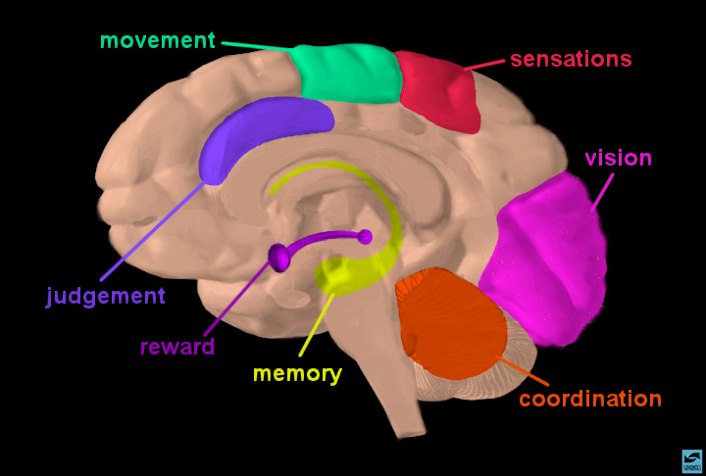
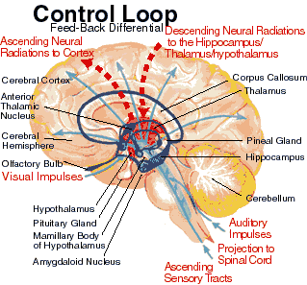
Component of consciousness
  Arousal - appearance of wakefulness
  Content - the sum of cognitive and affective function
Notes:
Arousal: where is it localized?
Ascending Reticular Activating System (ARAS) ‘core of the brainstem’
ARAS acts as a gating system, increasing or decreasing thalamic inhibitory influence on the cortex
alters effect of sensory stimuli ascending
alters descending cortical stimulation
receives input from numerous somatic afferents
projects to midline thalamic nuclei (which are in a circuit with cortical structures) and the limbic system

Slide 9
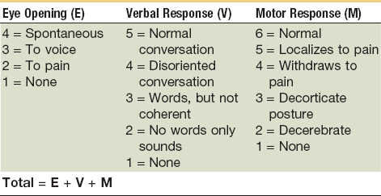

Slide 11
Level of consciousness
GCS
Eyes Open
Spontaneous | 4
To Speech | 3
To Pain | 2
Absent | 1
Converses/Oriented | 5
Converses/Desoriented | 4
Inapropriate | 3
Incomprehensible | 2
Absent | 1
Obeys | 6
Localizes Pain | 5
Withdraws(flexion) | 4
Decorticate(flexion) Rigidity | 3
Decerebrate(extension) Rigidity | 2
Absent | 1
Verbal
Motor
The sum obtained in this scale is used to the assess Coma and Impaired consciousness
Mild is 13 through 15 points
Moderate is 9 to 12 points
Severe 3 through 8 points
Patients with score less than 8 are in Coma

Slide 12
Coma scales: a historical review.
OBJECTIVE: To describe the most important coma scales developed in the last fifty years.
METHOD: A review of the literature between 1969 and 2009 in the Medline and Scielo databases
RESULTS:
Five main scales were found in chronological order: the Jouvet coma scale, the Moscow coma scale, the Glasgowcoma scale (GCS), the Bozza-Marrubini scale and the FOUR score (Full Outline of UnResponsiveness),
DISCUSSION:
Of the five main scales, the GCS is by far the most widely used. It is easy to apply and very suitable for cases of traumatic brain injury (TBI).. The FOUR score is easy to apply and provides more neurological details than the Glasgow scale.

Slide 13
EVIDENCE | AIM | METHOD | RESULT | CONCLUSION
Arq Neuropsiquiatr. 2010 Dec;68(6):930-7 Bordini AL LEVEL 5 | To describe the most important coma scales developed in the last fifty years | A review of the literature between 1969 and 2009 in the Medline and Scielo databases was carried out using the following keywords: coma scales, coma, disorders of consciousness, coma score and levels of coma | Five main scales were found in chronological order: the Jouvet coma scale, the Moscow coma scale, the Glasgow coma scale (GCS), the Bozza-Marrubini scale and the FOUR score (Full Outline of UnResponsiveness), as well as other scales that have had less impact and are rarely used outside their country of origin | Of the five main scales, the GCS is by far the most widely used. It is easy to apply and very suitable for cases of traumatic brain injury

Slide 14
Coma mimics
Psychogenic unresponsiveness
Locked in syndrome
Akinetic mutism
Catatonia
Persistent vegetative state
Notes:
Conditions that resemble coma
The Locked-in Syndrome Patients who have bulbar and limb paralysis may look comatose, because they cannot speak or move in response to commands, but may actually be fully awake. Lesions that interrupt the corticobulbar and corticospinal pathways in the base of the pons, but spare the peri-acqueductal reticular formation in the tegmentum of the pons and midbrain, can produce this clinical picture, that has been aptly named the locked-in syndrome. Brain stem stroke from basilar artery thrombosis is the most common cause. In these patients, vertical eye movements, mediated by pathways in the midbrain tegmentum, are usually spared. Therefore, consciousness may be ascertained by asking the patient to look up or down. If the patient obeys, you may develop a code of eye movements (e.g., "look up for yes,' down for no'") to test mental status. The EEG in these patients shows a normal awake pattern when they are aroused, and the normal EEG phases of sleep. Less commonly, polyradiculoneuropathy (Guillain-Barr‚ syndrome) may produce a similar picture. If eye movements are not spared, the EEG may be the only means of distinguishing this state from coma.
Persistent Vegetative State These patients may appear to be awake, because their eyes are open, but they are functionally comatose. They show no evidence of comprehending what is happening around them, and they make no meaningful response to commands. They may withdraw their limbs appropriately from painful stimuli, or they may demonstrate decorticate posturing. They may regain sleep-wake cycles, but their awake EEG is slow. Several different mechanisms may account for similar syndromes:
The Apallic State:
following severe hypoxic-ischemic damage, as from prolonged cardiac arrest, cortical damage may be so profound that cortical processing is essentially nil. Retained brain stem and partial diencephalic function allows for the patient to appear awake, but high-level processing of stimuli or formulation of meaningful responses is not possible.
Akinetic mutism:
Patients with damage to thalamic reticular structures may open their eyes to stimuli, but fail to make any meaningful response to stimuli. Selective failure of brain stem and thalamic arousal mechanisms allows for the appearance of wakefulness (eye opening) without actual consciousness. The EEG remains slow, as in deep sleep or coma.
Severe Abulia:
Patients with medial frontal lesions may also be profoundly akinetic. They presumably process sensory stimuli, but they fail to respond. Often, such patients will occasionally demonstrate appropriate responses, only to lapse again into total akinesia.

Slide 15
Psychogenic coma
Holds eye tight, resist opening
Fixed stare, quick blink
Normal pupil
Normal oculocephalic
Normal oculovestibular
Normal posture, breathing, bp,pulse

Slide 16
Coma Pathophysiology
Coma implies dysfunction of:
  Ascending Reticular Activating System or
  Both hemi-cortices
Anatomically, this means
  central brainstem structures (bilaterally) from caudal medulla to rostral midbrain
  both hemispheres
Notes:
Physiological Basis of Coma (introductory remarks)
The physiopathology of coma poses three main problems :
(1) Which structures are required for the conscious appreciation of a stimulus? In terms of neuro physiology, we may say that conscious appreciation depends on the integrity of cortical structures, provided that the waking system of the brainstem is itself functionally intact.
(2) Conscious appreciation is not a stable and permanent phenomenon. It is subject to a physiological dissolution by reason of the presence of sleep "systems" which periodically counteract the waking system. Now, do the sleep systems play a part in the production of a comatose state ? The answer would appear to be "no" as organic lesions of the sleep systems in animals cause no apparent disturbance of consciousness.
(3) The last problem is histopathological: what are the exact mechanisms by which neurological lesions lead to a comatose state ?
Reactivity and perceptivity : it is important to make a distinction between the two basic concepts lead of reactivity and perceptivity (Alajouanine 1957) as we shall later rely on these notions to assess the depth of coma in man and animals.
Reactivity brings into play mechanisms which are present since birth, the seat of which is subcortical; these are activated via the telereceptors (the eyes and ears) or via the nociceptive stimuli.The arousal reaction, the orienting response (rotation of the head towards the source of an auditory stimulus) and the facio-vocal reactions to pain are all part of the reactivity complex.
Perceptivity on the other hand implies the response of nervous mechanisms acquired by learning. It is a response to stimuli of a more complex nature (words, gestures, writing) or to simpler ones (elementary conditioning in the case of blinking response to a threat). We now know that these responses, which depend upon recent and long-term memory, require a certain degree of cortical integration . The integrity of the cerebral cortex, however, is a necessary but not a sufficient condition to ensure normal perceptivity. We must go further, therefore, in our neurophysiological analysis of the nervous mechanisms which are essential for the awareness of an external event.
Nervous structures necessary for consciousness
A priori, failure to "perceive" a signal may result theoretically from the following lesions (Fig. 1):
a lesion of the ascending pathways specifically responsible for the conduction of stimuli from the external environment to the "integrating central structures";
a lesion of the efferent pathways responsible for providing external evidence that the signal has been integrated (i.e. via muscular or vegetative effectors);
finally, a lesion affecting the integrating central structures.
Neurophysiology has shown that the first two hypotheses do not apply in the great majority of cases. Indeed, lesions simultaneously affecting the afferent pathways on both sides are rare; besides, in animals, experimental de-afferentation of the various receptors, or even transection of the specific lateral afferent pathways in the brainstem (without damaging the central paft of the tegmentum) do not lead to a comatose state. The animal is still capable of reacting correctly to a number of conditioned reflexes (Sprague et al. 1963). Also, if a general de-efferentation may sometimes result in a clinical picture of coma, a closer examination would usually show that normal perception is preserved. This is the case in patients suffering from advanced tetanus, and are kept under artificial respiration after intense and prolonged curarization. These patients may at first sight appear comatose as they are unable to show objectively by means of movements their perception of external stimuli, and yet they are fully aware of their surroundings. We tested this by showing our curarized patients various cards (ace of hearts, king of spades) and asking them to identify the cards later in a shuffled pack of cards. When they recovered and curarization was stopped, they were perfectly capable of recognizing the cards which had previously been shown to them. These cases are exceptional as there is no clinical test that enables us to assess the state of consciousness of a curarized patient. It is possible that an electroencephalogram by showing an arousal reaction, might provide important, if not decisive information.
Even though it may appear to be of purely theoretical interest, this question is of prime importance. Some lesions of the brainstem, in particular lesions of the ventral part of the mesencephalic or pontine tegmentum, can in fact involve the extrapyramidal system, and prevent certain voluntary movements, as well as cause a motor de-efferentation. At this point, we would like to mention an observation by Lhermitte et al. (1963). A patient with a lesion of the mesencephalic reticular formation presented the clinical picture of deep coma. She had bilateral ptosis, which gave the impression that she was in a state of permanent sleep, and failed to respond even to strong stimuli. It was noticed, however, that she was still able to move her wrists slightly. Due to these movements of the wrist, it was possible to establish a code by means of which she was able to answer complicated questions in a simple manner. This fact leads to two practical points worth remembering when one is faced with patients presenting a state of "akinetic mutism". First, one should always have recourse to all possible paraclinical examinations (including polygraphy) before deciding that a patient has lost all perception. Secondly, one should always remember that a patient who is akinetic and speechless, may still understand all that is being said around him.
It would appear therefore that neither a subtotal nor a total de-efferentation can (alone) result in complete loss of perception. This is why disturbances of consciousness seem to be connected with an organic or functional lesion of the integrating central structures. These structures belong to two main groups. The first group includes the ascend ing activating reticular system, the normal functioning of which is essential for waking, but is not sufficient to insure normal perceptivity. The second group includes the thalamocortical integration system, the integrity of which is necessary for normal perceptivity.
The ascending reticular activating system (ARAS) and the arousal reaction.
The brainstem reticular formation includes the areas of grey matter in the bulbar tegmentum, the pons and the mesencephalon, but excluding the cranial nerve nuclei, and the relay centres of the cerebellar system. It is continuous at the bulbospinal junction with the spinal reticular formation. Anteriorly, its limits are not clearly defined, and in the sub thalamic area it is continuous with the diffuse thalamic system. Thus the reticular formation appears as a complex collection of neurones which serves as a converging point for signals from the external and the internal environments, and is capable of exercising a dynamogenic effect on the electrical activity of the cortex, and on the motor and vegetative efferent system.
Since 1949, thanks largely to the work of Moruzzi, Magoun and their school (Lindsley et al . 1950; French and Magoun 1952) it has been shown that after destruction of the mesencephalic reticular formation, an animal remains immobile and "comatose". Sensory stimuli, auditory or painful, fail to clinically elicit the arousal reaction. The electrical activity recorded from the cortex is similar to a sleep-recording, and with the exception of olfactory stimuli, all forms of sensory stimulation fail to elicit a reaction. Excitation of the reticular formation in sleeping animals confirms its activating influence: when high frequency excitation is applied, the animal wakes up, opens its eyes, and there is mydriasis and increase in muscle tone, etc.; in some cases, the animal will give an impression of attention. At the same time, there is a rapid, low voltage EEG cortical activity which is characteristic of the "arousal reaction".
This work led to the discovery in the brainstem of a system of neurones which is now regarded as the basis of the waking mechanism. Further work has shown that the structures responsible for the maintenance of the waking state are situated in the posterior diencephalon and at the mesodiencephalic junction, while the cell groups responsible for cortical activation are localized in the posterior mesencephalon and the anterior part of the nucleus reticularis pontis oralis (Rossi and Zanchetti 1956).
Cortex, perceptivity and learning.
It is now established that the cortical centres are responsible for the nerve connections acquired during the history of the organism. Thus, after decortication, either widespread or limited to a specific area, all the possibilities of conditioning, achieved in animals by means of complex stimuli, are lost. This state is comparable in man to visual, auditory, somesthetic agnosia resulting from lesions either of a specific cortical area or of the nonspecific adjacent areas of integration (Ajuriaguerra and Hécaen 1960).
It is necessary at this point to sum up briefly the present data concerning the structures responsible for the facio-vocal reactions to pain. Indeed, investigation of reactions to painful stimuli should be an integral part of the examination of a comatose patient, as it serves to test some of the essential mechanisms of reactivity.
Structures responsible for responses to painful stimuli.
We know that a painful stimulus activates a complex afferent system, the organisation and integration centres of which are only now being partly elucidated. We can accept the view of Bard and Mountcastle (1948) according to which the neocortex, the cingulate cortex, the amygdaloid nucleus and the pyriform lobe correspond to zones of the inhibition of pain and anger reactions. Their influence would be transmitted as far down as the brainstem by way of a circuit similar to the amygdaloid pathway. They suggest the presence, in addition, of a direct extra-amygdaloid pathway via which the neocortex might exert a facilitatory influence on the mesencephalic centres.
The mesencephalic structures where the facial and vocal components of the pain reaction are integrated are situated in the central part of the brainstem, within the peri-aqueductal grey matter. Destruction of this area in animals results in complete loss of vocal or expressive reactions following a painful stimulus (Adametz and O'Leary 1959; Kelly et al. 1946), while excitation of this same area provokes intense vocal and facial reactions. The vegetative responses to pain (pupillary, respiratory, cardiac vasomotor) are elaborated in the inferior part of the brain stem; they result from mechanisms originating in the mesencephalic, rhombencephalic and bulbar areas. The spinal component may suffice when a limb is withdrawn from a painful stimulus applied to the skin; this is the classical flexor reflex.
And finally, although no absolute correlation exists between the disturbances of perceptivity and reactivity on the one hand, and of muscle tone on the other, in most cases a clinical correlation is found between lesions of the integrative structures and those affecting the centres controlling muscle tone.

Slide 17
Coma - Aetiology
Metabolic:-
  Ischemic hypoxic
  Hypoglycaemic
  Organ failure
  Electrolyte disturbance
  Toxic
Structural:-
  Supratentorial bilateral
  Unilateral large lesion with transtentorial herniation
  Infratentorial

Slide 18
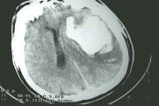
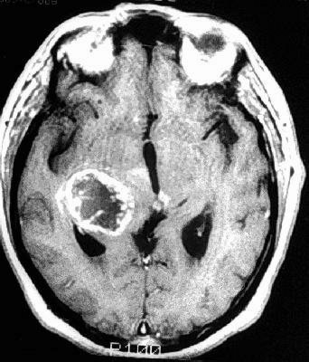
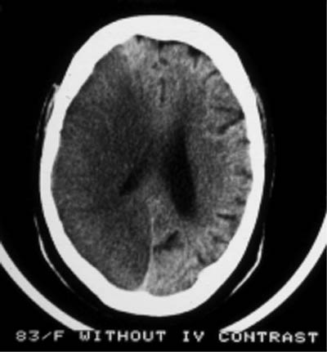
Supratentorial Lesions
Epidural or Subdural Hematoma
Intraparenchymal haemorrhage
Large Ischemic Infarction
Tumour
Trauma
Abscess

Slide 19
Supratentorial Mass Lesions
Differential Characteristics
    Initiating signs usually of focal cerebral dysfunction
    Signs of dysfunction progress rostral to caudal
    Neurologic signs at any given time point to one anatomic area - diencephalon, midbrain, brainstem
    Motor signs are often asymmetrical
Plum and Posner, 1982

Slide 20
Rostral Caudal Progression

Slide 21
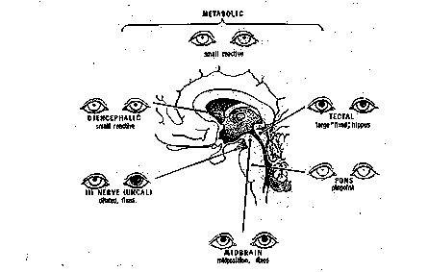
Rostral Caudal Progression

Slide 22
Rostral Caudal Progression

Slide 23
Infratentorial Lesions
Cause coma by affecting reticular activating system in pons
Brainstem nuclei and tracts usually involved with resultant focal brainstem findings

Slide 24
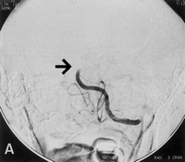
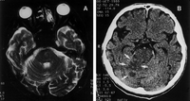
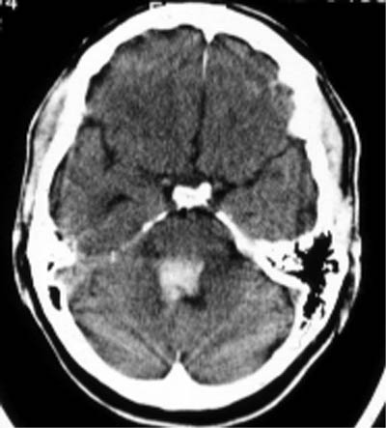


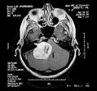
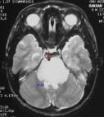
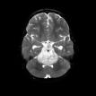
Infratentorial Lesions
Basilar artery thrombosis
Pontine or Cerebellar Hematoma
Ischemic Cerebellar Infarction
Tumour
Abscess

Slide 25
Infratentorial Mass Lesions
Differential Characteristics
History of preceding brainstem dysfunction or sudden onset of coma
Localizing brainstem signs precede or accompany onset of coma and always include oculovestibular abnormality
Cranial nerve palsies usually present
“Bizarre” respiratory patterns common, usually present at onset of coma
Contemp Neurol Ser.
The diagnosis of stupor and coma.
Plum F, Posner JB.

Slide 26
Metabolic encephalopathy
Confusional state -> coma , fluctuation
No focal neurological sign
No neck stiffness
Normal brainstem reflexes
Coarse tremor 8-10hz
Multifocal myoclonus
Asterixis
Generalized/periodic myoclonus

Slide 27
History
Circumstances and temporal profile
Of the onset of coma
Details of preceding neurological
Symptoms headache, weakness seizure
Any fall
Use of drug and alcohol
Previous medical illness liver,kidney
Previous psychiatric illness

Slide 28
Other symptoms of coma
Yawning
  Poor localizing value
  Posterior fossa expanding lesion
  Medial temporal, third ventricular
Hiccup
  Medullary lesion in the region of Third ventricle
Vomiting
  Lateral reticular formation of the medulla
  Projectile ( usually nausea)
  Medulloblastoma ependymoma
  Raised icp -> compression of medulla
  Basal meningitis
  Ivh -> irritating fourth ventricle
  Lateral medullary infarct (vestibular

Slide 29
Examination
General physical examination
Evidence of external injury
Colour of skin and mucosa
Odour of breath
Evidence of systemic illness
Heart lung

Slide 30
Neurological examination
Funduscopy
Pupil size and response to light
Ocular movements
Posture and limb movement
Reflexes

Slide 31
Circulation
Kocher-Cushing response - rise in BP->bradycardia due to rise in ICP -> compression of floor of the iv ventricle fall in BP and tachycardia usually terminal event due to medullary failure

Slide 32
Breathing
Forebrain
  Post hyperventilation apnea
  Cheyne stoke respiration
Hypothalamus midbrain
  Central neurogenic hyperventilation
Basis pontis
  Pseudobulbar paralysis of voluntary center

Slide 33
Breathing in coma
Lower pontine tegmentum
  Apneustic breathing
  Cluster breathing
  Short cycle periodic breathing
  Ataxic breathing
Medulla
  Ataxic breathing
  Slow regular respiration
  Gasping

Slide 34
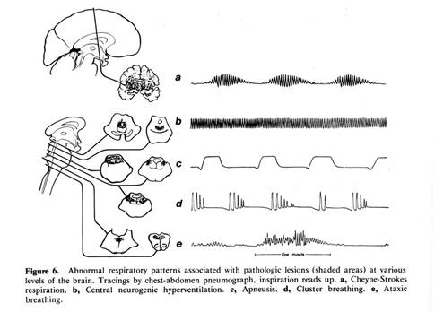
Breathing: Key points
Breathing patterns
  Supratentorial - Cheyne-Stokes
  High brain stem - Central hyperventilation
  Low brain stem - Ataxic (irregular)
Least useful sign because:
  Acid-base derangements
  Hypoxia
  Cardiac influences

Slide 35
Cranial Nerve Exam
Systematic assessment of brainstem function via reflexes
Cranial Nerve Exam
  Pupillary light response (CN 2-3)
  Occulocephalic/calorics (CN 3,4,6,8)
  Corneal reflex (CN 5,7)
  Gag refelx (CN 9,10)

Slide 36
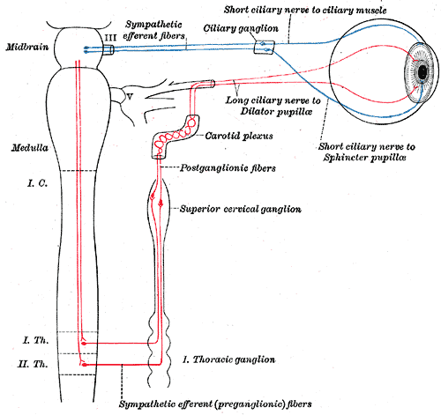
Pupils: Anatomy
Afferent Limb: Optic Nerve
Efferent Limb: Parasympathetics via occulomotor
Midbrain integrity/ tectum
Uncal Herniation (3rd nerve dysfunction)
Pupillary resistance to insult
Hypothalamus
Parasympathetic

Slide 37
Pupils: Key points
Size dependent on sympathetic and parasympathetic input
Anatomically near the RAS
Resistant to metabolic influences
Small and reactive with metabolic causes
Unilateral dilation indicates uncal herniation

Slide 38
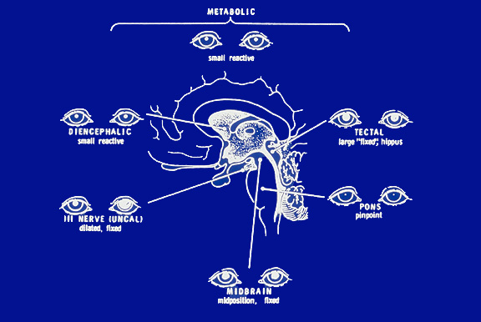
Pupil
Atropine
Opiate
Organophosphorus

Slide 39
Pupil
Diencephalic (metabolic) Small reactive
Midbrain tectal Midsize,fixed
Midbrain nuclear Irregular pear shaped
3rd nerve Fixed widely dilated
Pontine Pinpoint reactive
Opiate Pinpoint
Organophosphorus Small
Atropine Wide dilated

Slide 40
Eye movements: Exam
Position at rest
  Straight ahead
  Dysconjugate
  Conjugate deviation
Oculocephalic reflex
  Positive “Doll’s eyes”
  Negative “Doll’s eyes”
Oculovestibular reflex
  Cold calorics
Resting position
  Midline
    Deviation suggests frontal/pontine damage
  Conjugate
    Dysconjugance suggests CN abn.
  Moving
    Roving, dipping, bobbing

Slide 41
Eye movement
Metabolic
  Roving eye movement,
  Oculocephalic,
  Vestibuloocular
Supratentorial
  Contralateral conjugate palsy
Thalamus
  Upper turn down

Slide 42
Eye movements in Coma
Midbrain
  Ipsilateral 3rd
Pontine
  Ipsilateral 6th
  Ipsilateral gaze palsy
  One and half syndrome
  Bilateral gaze palsy
  Ocular bobbing
  Mlf syndrome

Slide 43
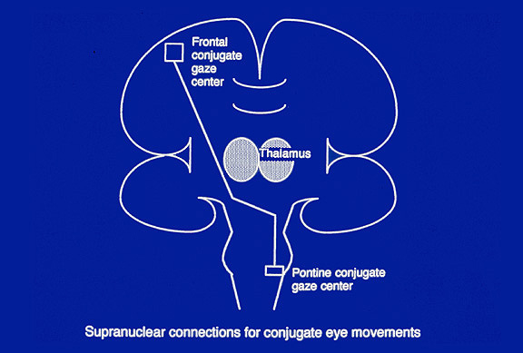
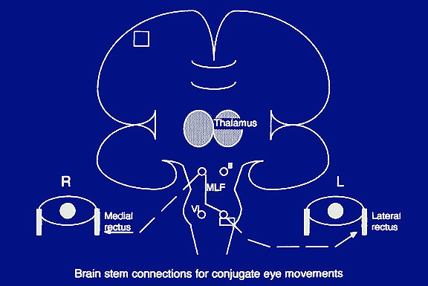
Eye movements: Anatomy
R
L

Slide 44
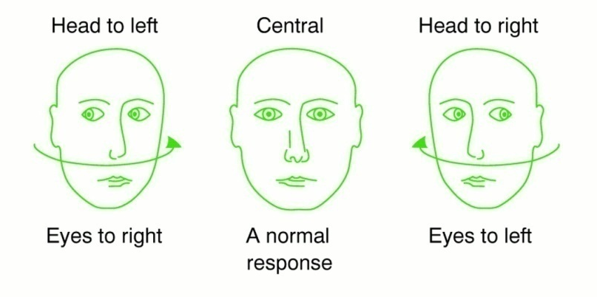
Eye movements: Exam
Oculocephalic reflex
  Eye response to head turning
  Proprioception from the neck triggers the pontine conjugate eye center
  Doll’s + or -?
  Smart brain
  Dumb brain
Notes:
Oculocephalic and caloric response. Oculocephalic (doll's eyes) response: move head passively and observe motion of the eyes. The eyes should move conjugately in the direction opposite to the movement. An abnormal response (absent or asymmetric) implies brain stem disease. Do not perform when neck instability is suspected. Caloric response: if doll's eye movements are absent proceed to calorics. Ice cold water applied to the tympanic membrane normally elicits a slow conjugate deviation to the irrigated side. Absence indicates brain stem disease. Caloric testing is more sensitive than the oculocephalic response. Check the tympanic membrane is intact before testing.
Brisk rotation of head with eyes held open
Watch for contraversive movements
Next:
Flexion: eyes deviate up and eyelids open (doll’s head phenomenon)
Extension:eyes deviate downward

Slide 45
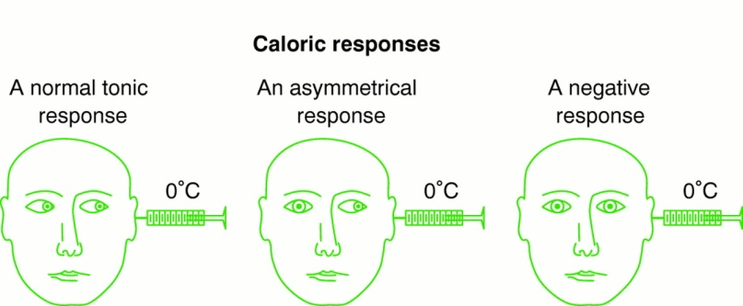
Eye movements: Exam
Oculovestibular reflex
  Eye response to cold water on the tympanic membrane
  Horizontal semicircular canal stimulation triggers the pontine conjugate eye center
  Nystagmus
  COWS
  Smart brain
  Dumb brain

Slide 46
Caloric reflex
Ensure TM integrity
Elevation of head to 30 degrees (so that lateral semicircular canal is vertical)
Instillation of up to 120 ml of ice water
  Awake: deviation toward,nystagmus away
  Comatose: deviation toward
Wait 5 minutes, do other ear
Watch for conjugance of deviation
To test vertical eye movements
  Both ears, cold water-downward gaze
  Both ears, warm water-upward gaze

Slide 47
Eye movements: Key points
Symmetric responses seen with metabolic or structural causes
Asymmetric responses seen with structural causes
The hemispheres (smart) are responsible for:
  Inhibiting Doll’s eyes
  Fast component of nystagmus
The brain stem (dumb) is responsible for:
  Allowing Doll’s eyes
  Slow component of nystagmus

Slide 48
Motor Exam Key Points:
Assess tone, presence of asterixis
Response to painful stimuli
  none
  abnormal flexor
  abnormal extensor
  normal localization/withdrawal
Symmetric responses seen with metabolic or structural causes
Asymmetric responses seen with structural causes

Slide 49
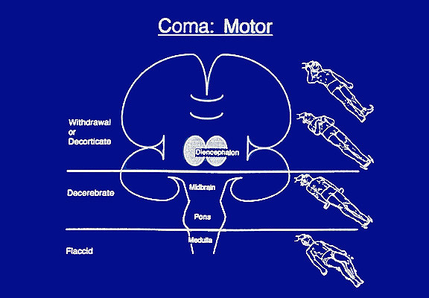
Posture
Cerebral hemisphere
  Decorticate posture
Diencephalon supratentorial
  Diagonal posture
Upper brain stem
  Decerebrate posture
Pontine
  Abnormal ext arm
  Weak flexion leg
Medullary
  Flaccidity
Notes:
Neurophysiological basis of abnormalities of posture.
In man, disturbances of posture, which are char acterised by the rigidity of decortication and de cerebration, depend largely on the multisynaptic systems of the brainstem. And, as we know, the systems responsible for the waking reaction are closely associated with the supraspinal centres controlling muscle tone. For that reason, we would like to summarize some of the neurophysiological experimental data concerning the regulation of muscle tone (Granit 1957; Jung and Hassler 1960; Rushworth 1960). Muscle tone depends on the simultaneous control of the facilitatory and inhibitory supraspinal systems, which act on the stretch reflex.
The inhibitory influences, independent of the pyramidal system, follow a corticobulboreticular system which originates in the suppressive areas of the cortex, or a multi-relay system at the level of the striate nuclei, or again they may depend on the anterior lobe of the cerebellum. Of the supra spinal control systems, the bulbar inhibitory reticular system is one of the most dominant. Its influence reaches down to the spinal motoneurones by way of the reticulospinal tract.
The facilitatory influences, which act on the spinal level, come from the vestibulospinal tracts (probably unimportant in man), the middle lobe of the cerebellum, the pyramidal tract, and especially from the facilitatory reticular formation which is situated in the mesencephalic tegmentum, and lies very close to the inhibitory reticular formation at tne pons.
Spasticity appears whenever a lesion affects the inhibitory centres and leaves the facilitatory system to act unopposed on the spinal stretch reflexes. According to this classical conception, in the presence of a cortical lesion, the inhibitory reticular formation, though not organically damaged, undergoes a sort of "isolation dystrophy" which prevents its inhibitory action on muscle tone, and this results in spasticity. It has been shown in fact (Jouvet et al. 1961) that in the cat and in man, the reticular formation continues to have a periodic inhibitory influence in certain stages of sleep (paradoxical sleep). Thus rigidity resulting from suprapontine lesions may still be under a periodic inhibitory influence during sleep.
Thus, according to the various types of experimental lesions studied in animals, we may consider the following schematic pictures:
Total decortication in the cat (in direct opposition to what happens in man) is accompanied by minimal changes in muscle tone. On the other hand, perceptivity is completely absent: the "blinking" reflex is lost, although the light reflex persists, and the animal is unable to move to wards his food. One orientation reaction remains: startling, turning the ears and rotating the head towards a noise. Finally, the ability to learn is lost, and no conditioned reflex can be demon strated. Reactivity however remains normal: the arousal reaction is present, and the animal can be aroused from its sleep by an acoustic stimulus. Finally, the facio-vocal reactions to pain are exaggerated and result in an expression akin to that of "sham rage".
Destruction of the ascending reticular actitvating system. Here, even though the cortex is intact, perception is completely abolished, while reactivity is severely impaired. The animals also show signs of severe muscle tone disturbances (resulting in more typical cases, in a clinical picture of decerebrate rigidity in extension). The eyes are closed; the pupils are constricted; auditory and painful stimuli fail to provoke an arousal or an orientation reaction. Finally, cortical activity consists entirely of slow waves and remains unchanged by all sensory stimuli with the exception of olfactory stimuli.
In addition to these two generalized syndromes, there are those due to more localized lesions. One of these is experimental akinetic mutism resulting from lesions of the median structures situated in the peri-ependymal grey matter and the medial thalamic nuclei. The disturbances of perceptivity are more apparent than real, and appear to be due to damage to the motor effector mechanisms. The animal is still able to blink when threatened, but its immobility makes motor conditioning difficult to achieve. The waking reaction is normal, but facio-vocal reactions to pain are completely absent. There is also a generalized disturbance of muscle tone which in the more typical cases may result in catatonia.
Finally, a more generalized lesion (most com monly seen after prolonged anoxia) affecting the cortex, the mesencephalic reticular formation, the pontine reticular formation and other more caudal structures will lead to a state of brain death or even to the picture of "isolated heart-lung preparation", on condition that artificial respiration is applied. This clinical state is the ultimate stage of coma: it is characterized by complete absence of perceptivity and of reactivity, and by total cerebral electrical silence.

Slide 50
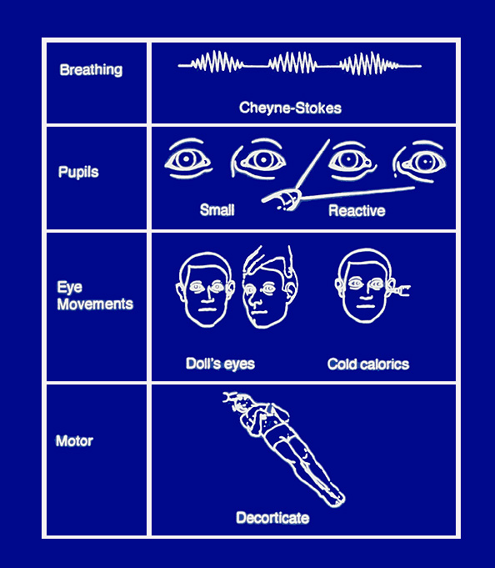

Slide 51
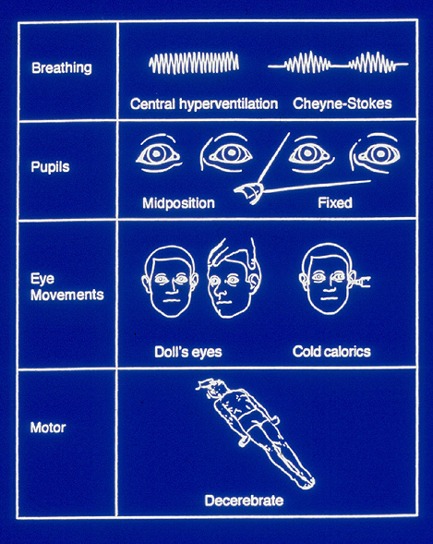

Slide 52
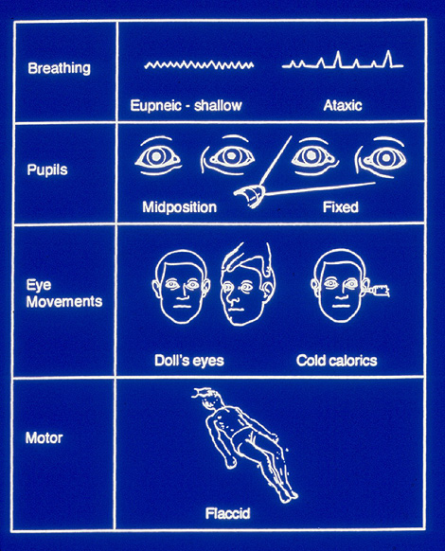

Slide 53
Investigation
Complete blood count, MP, B.sugar
Blood urea, s. creatinine, s.electrolyte
Blood gases, ALT, AST
CSF examination
CT scan/ MRI
X-ray chest, ECG

Slide 54
ECG changes in coma
(SAH, ICH, INFARCT)
  Tall T, prolonged QT
  Q wave with st depression
  SVT, AF, AFL
  Sinus bradycardia,arrest, nodal rhythm
  A-V block or dissociation
  PVc's, VFL, VF

Slide 55
Agitated
Reassurance
Narcotics
  Small doses administered
  Intravenously
Sedation
  Should follow analgesia
  Sedation in presence of pain causes agitation,
  Titrate intravenously so that agitation is blunted,
  Do not induce excessive drowsiness

Slide 56
Agitated patient
General management
  Face a window for day/night orientation
  Clock, calendar
  Have friend or family member stay with patient
  Light the room if illusions, paranoia occur at night
  Provide eyeglasses, hearing aids
  Have staff identify themselves to patient
  Explain all procedures
  Provide radio, reading, TV

Slide 57
Coma Subsequent management
Eye, mouth, skin
Fluid electrolyte, feeding
Respiration, circulation
Urine, bowel
Stimulation
Infection

Slide 58
1) Roth is a 28-year-old Caucasian All American Super Bowl quarter back star who on arrival at the emergency room after a motorbike accident with no helmet on, was jovial, ebullient and fully aware. He urged to be discharged home as he had no obvious physical injuries. About 30 minutes after his arrival, Roth lapsed into coma with no evident motor deficit. The most likely cause of coma in this patient is:
Acute Subarachnoid hemorrhage
Acute Subdural hemorrhage
Acute Parenchymatous hemorrhage
Acute Epidural hemorrhage
Acute Lateral ventricle hemorrhage

Slide 59
Lucid Interval
20 to 50% patients of epidural hematoma may experience Lucid interval.
Concussion Injury: MTBI mild truamatic Brain Injury. A brain injury caused by blow to head or a violent shaking of head and body
Post concussion Syndrome

Slide 60
2) A young female patient is brought to ER. She is unconscious and unarousable. A CT scan is done and the neuroradiologist reports that she has herniation syndrome. What is the most likely cause of her loss of consciousness?
she is in coma due to primary lesions of her cerebral cortex
she is in coma due to primary lesions of her thalamus
she is in coma due to primary lesions of her reticular formation
she is in coma due to secondary lesions of her reticular formation
she is not in coma, it’s only that her reticular activating system has been inactivated

Slide 61
3)The MRI of a 49-year-old woman with brain tumor and ataxic breathing shows tonsillar herniation. Which of the following portions of the brain stem would be most adversely affected by tonsillar herniation?
Caudal midbrain
Rostral midbrain
Rostral Pons
Medulla

Slide 62
4)Placing a small amount of cold water in a patient’s right external auditory meatus will under normal circumstances result in:
Nystagmus with a quick component to the left
Both eyes drifting slowly to the left
The right eye looking to the left
Nystagmus with a quick component to the right
Both eyes looking upwards

Slide 63
5) At about 7.30 a.m. the day after Christmas, the son of a 71 year old extremely obese African American male called 108 for an ambulance saying that he is unable to wake up his father. At ER, the attending physician suspecting a metabolic disorder obtained blood samples from the patient for lab work up. Which of the following metabolic disorders is the most likely cause of coma in this patient?
Hyperchloremic alkalosis
Respiratory acidosis
Diabetes Mellitus
Metabolic alkalosis
Acute aspirin overdose

Slide 64
Answers
1 | D
2 | D
3 | D
4 | A
5 | C

Slide 65
Thank You

