Slide 1

DR.J.D.LAKHANI

Slide 2
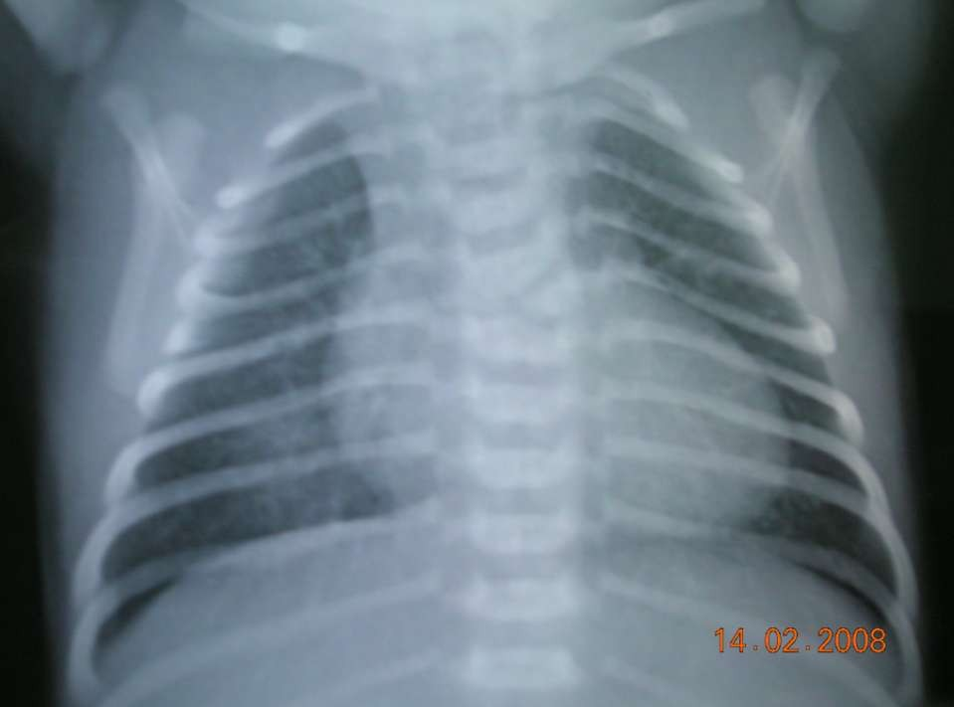

Slide 3
Immunological disorder initiated by group A beta hemolytic Streptococus.

Slide 4
It is characterized by an exudative and proliferative inflammatory lesion of the connective tissue, especially that of the
heart,
joints,
blood vessels,
and subcutaneous tissue.

Slide 5
Acute ARF is an immuno-inflammatory condition that presents as a connective tissue disease, clinically manifesting as
carditis
Arthritis,
sometimes with chorea,
subcutaneous nodules
& erythema marginatum.

Slide 6

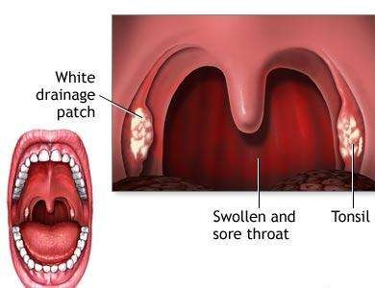
An untreated Group- A beta hemolytic streptococcal infection is the commonest antecedent event that precipitates an attack of Acute Rheumatic Fever.
It is a delayed non-suppurative sequelae to URTI with GABH streptococci.

Slide 7
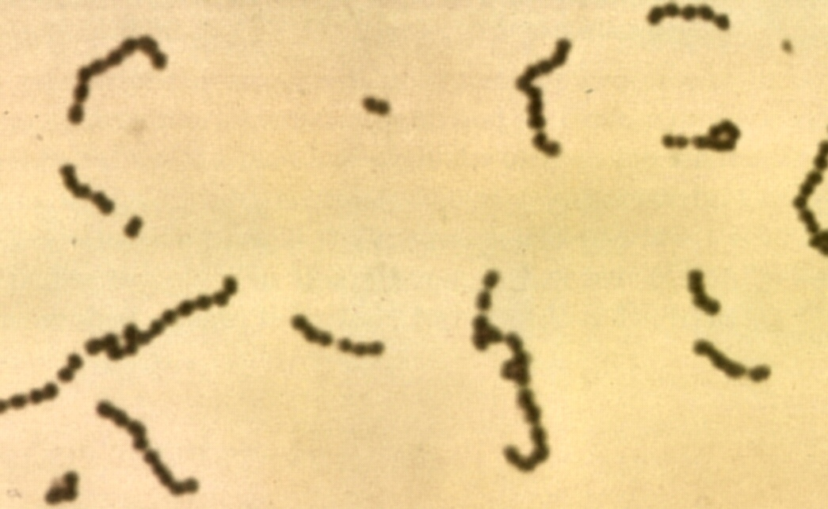

Slide 8
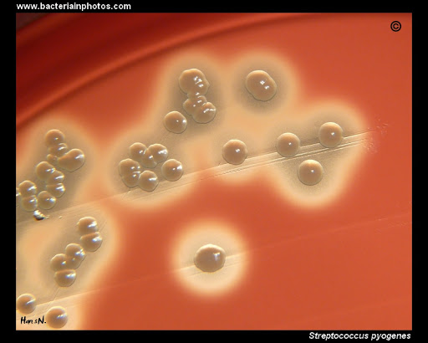

Slide 9
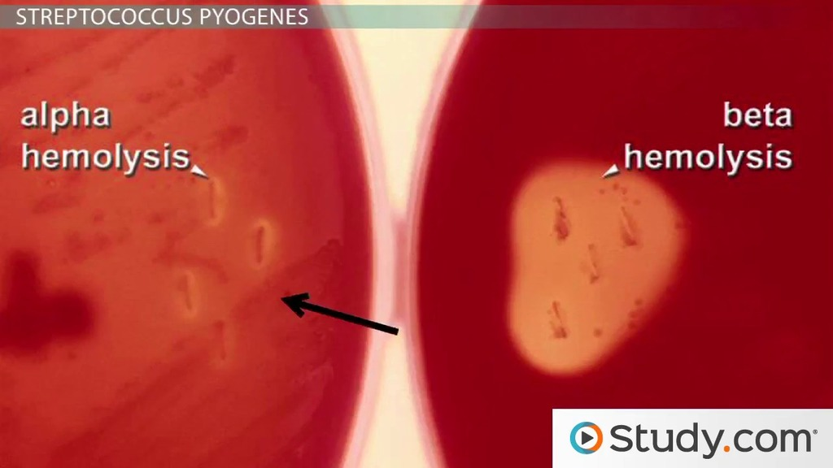

Slide 10
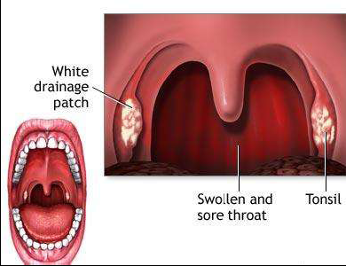

Slide 11
The portal of entry is usually the Upper Respiratory tract .
Sore throat
Frank scarlet fever
Otitis media
Other streptococcal infection precede the onset of the disease by two to three weeks
The interval between infection and symptoms suggest a hyper-sensitivity state

Slide 12
Group A streptococcus (e.g., M types 1, 3, 5, 6, 18, 24) are more frequently
isolated from patients with acute rheumatic fever.
The attack rate of acute rheumatic fever - Ranges from 0.3 to 3 percent.

Slide 13
The incidence of both initial attacks and recurrences of acute rheumatic fever peaks in children aged 5-15 yr.
Patients who have had one attack of acute rheumatic fever tend to have recurrences
There is association between the presence of specific HLA markers and susceptibility to acute rheumatic fever.

Slide 14
Predisposing factors -
low socioeconomic status
overcrowding
poor nutrition
poor hygiene
- genetic predisposition.

Slide 15
Incidence of rheumatic fever is on decline for following reasons-
Improvements in living conditions
Large measure to the greater availability of medical care.
The widespread use of antibiotics.
Antibiotic therapy of group A streptococcal pharyngitis has been important in preventing initial attacks.

Slide 16

A- antibiotic coverage has increased B- Better housing
C- Conditions ( economic & health) have improved
D- Decreased bacterial virulence E- Easy access to medical care

Slide 17
 The joints- Rheumatic fever
( Rheumatic Polyarthritis)
A triad of syndromes may result
Heart-Rheumatic pancarditis
Brain - Chorea

Slide 18
The cytotoxicity theory -
Pathogenesis
streptolysin 0 has a direct cytotoxic effect on mammalian cells in tissue culture.
Its inability to explain the latent period between an episode of group A streptococcal pharyngitis and the onset of acute rheumatic fever.

Slide 19
The immunologic theory-
The latent period between the group A streptococcal infection and the acute rheumatic fever.
The antigenicity of a large variety of group A streptococcal products and constituents, as well as the immunologic cross-reactivity between group A
streptococcal components and mammalian tissues.

Slide 20
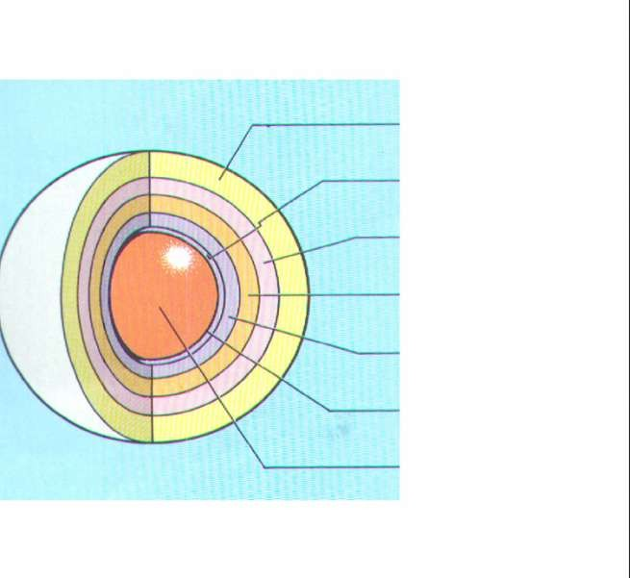
Diagrammatic structure of the group A beta hemolytic streptococcus
Capsule Cell wall Protein antigens Group carbohydrate Peptidoglycan Cyto.membrane Cytoplasm
Antigen of outer protein cell wall of GABHS
induces antibody response in victim which result in autoimmune damage to heart valves,sub cutaneous tissue, tendons,
joints & basal ganglia of brain

Slide 21

 Inflammatory Lesions in
Heart
Brain
Joints
Skin
Aschoff bodies in the atrial myocardium-
 Swelling, fragmentation of collagen fibers

Alterations in the staining characteristics of
connective tissues.

Slide 22
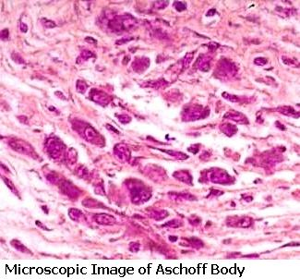

Slide 23
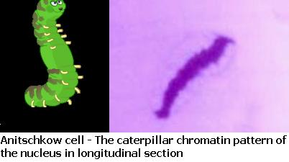

Slide 24
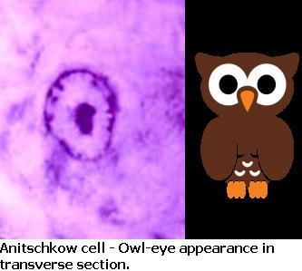

Slide 25
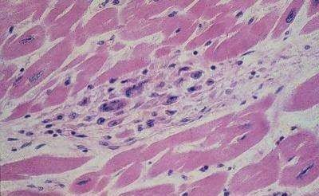
Myocardial Aschoff body – the cells are large, elongated, with large nuclei; some are multinucleate

Slide 26
Intended only for the diagnosis of the initial attack of acute rheumatic fever and not for recurrences.
Five major and four minor criteria
When a patient fulfills two major criteria or one major and two minor criteria and meets the absolute requirement for evidence of recent GAS infection.

Slide 27
Major Manifestations | Minor Manifestations
Carditis | Clinical findings- Arthralgia Fever Lab Findings- Elevated acute phase reactants- ESR ,CRP Prolonged PR interval
Polyarthritis
Chorea
Erythema marginatum
Subcutaneous nodules

Slide 28




Carditis
Polyarthritis
Erythema marginatum
Subcutaneous nodules
Chorea
Pnemonic
C²ASE
C – Carditis
C – Chorea
A – Arthritis
S – Subcutaneous nodules
E – Erythema marginatum

Slide 29
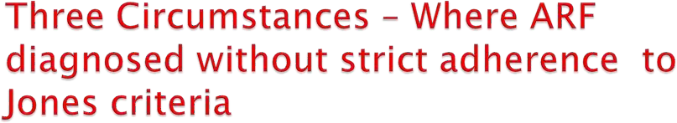
Indolent carditis may be sole manifestation
Chorea may be the sole manifestation
ARF recurrence may not fulfill the Jones criteria

Slide 30

Arthritis
  Flitting & fleeting , Migratory: Polyarthritis involving major major joints
Commonly involved joints-knee, ankle, elbow & wrist
Occur in 80%,involved joints are exquisitely tender
In children below 5 yrs arthritis usually mild but carditis more prominent
Arthritis do not progress to chronic disease
Dr.Said Alavi
05/05/1999
23

Slide 31

Involves larger joints, particularly the knees, ankles, wrists, and elbows.
Rheumatic joints are generally hot, red, swollen, and exquisitely tender.
the pain can precede and can appear to be disproportionate to the other findings.
The joint involvement is
characteristically migratory in nature

Slide 32
A dramatic response to even small doses of salicylates .
The absence of such a response should suggest an alternative diagnosis.
Rheumatic arthritis is typically not deforming.
Arthritis is the earliest manifestation of acute rheumatic fever.

Slide 33

Tachycardia
A heart murmur of valvulitis
Pericarditis
Cardiomegaly on X-ray chest
Signs of CHF

Slide 34
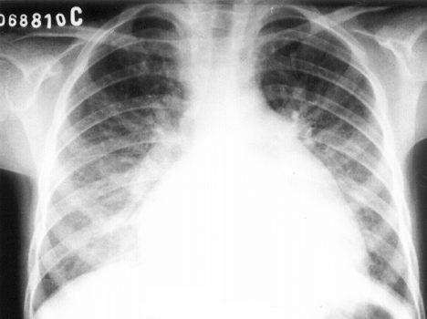
Chest radiograph of an 8 year old patient with acute carditis .

Slide 35

Tachycardia out of proportion to fever sleeping pulse rate raised
Pericardial rub
}
 CCF, gallop rhythm and so on
 Cardiac enlargement
Reversible
Irreversible
 Pulmonary hypertension
 Cardiac murmur

Slide 36

High pitched apical holosystolic murmur radiating to axilla – Mitral regurgitation
An apical mid diastolic murmur
A high pitched decrescendo diastolic murmur- upper sternal border- Aortic regurgitation

Slide 37
Mitral insufficiency
Some loss of valvular substance
Shortening & thickening of Chordae tendinae
Mitral stenosis
Takes longer duration to develop after an attack of ARF
Fibrosis of mitral ring, commissural adhesions
Contracture of the valve leaflets, chordae & papillary muscles
Opening snap, low pitched, rumbling mitral diastolic murmur with pre systolic accentuation ending in loud first sound

Slide 38
Aortic insufficiency
Sclerosis of aortic valve- distortion & retraction of the cup
Characteristic cardiac murmur, early diastolic
An apical pre systolic murmur ( Austin flint)

Slide 39
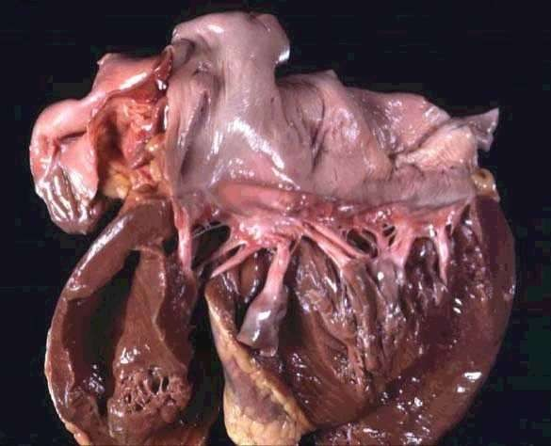
Rheumatic heart disease. Abnormal mitral valve.
Thick, fused chordae

Slide 40
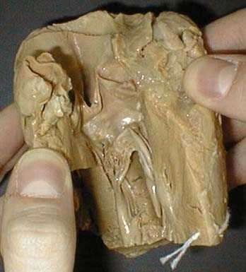
Another view of thick and fused mitral valves in Rheumatic heart disease

Slide 41

Nonpruritic serpiginous or annular erythematous rash more prominent on the trunk & inner proximal portions of the extremities.
Rash disappears on exposure to cold & reappears after hot shower.

Slide 42
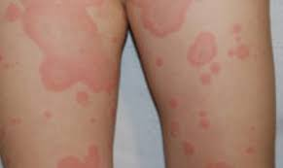

Slide 43
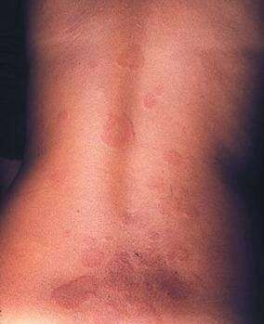
Erythema marginatum on the trunk, showing erythematous lesions with pale centers and rounded or serpiginous margins

Slide 44
Hard, painless, nonpruritic, freely mobile, 2 to 2.5 cm in diameter.
Found symmetrically, singly or in clusters, on extensor surfaces of both large & small joints, over the scalp or along the spine.
Lasts for weeks.
Always associated with severe carditis

Slide 45

Neuropsychiatric disorder
More often in prepubertal girls (8to 12 yrs) than in boys.
Neurologic signs – choric movement & hypotonia
Psychiatric signs- emotional liability, hyperactivity, separation anxiety, obsessions & compulsions

Slide 46

10 – 15 % of patients
Usually a delayed and often the sole manifestation of acute rheumatic fever
Characterized by involuntary movements, specially of the face and limbs, muscle weakness, disturbances of speech and gait, poor scholastic performance
Milk maid grip, spooning and pronation of extended hands, wormian movements of tongue

Slide 47

Long latent period
Uncontrollable movements
Facial grimacing
In coordination
Poor school performance
Emotional liability
Exacerbated by stress
Disappearing sleep
Rarely leads to permanent neurological sequeale

Slide 48
Arthralgia without objective changes of arthritis
Fever at least 102 degree F
Elevated ESR & CRP
Prolonged PR interval

Slide 49
H/O Sore throat or scarlet fever
Positive throat culture or rapid streptococcal antigen test
Streptococcal antibody tests more reliable ASO titer of at least 333 Todd units in children & 250 Todds unit in adult
single low ASO titer dose not exclude rheumatic fever

Slide 50
Abdominal pain
Rapid sleeping heart rate
Tachycardia out of proportion to fever
Epistaxis
Precordial pain
Positive family history of rheumatic fever

Slide 51

 Evidence of recent streptococcal infection can include:
Increased antistreptolysin O or other streptococcal antibodies (anti-DNAse B)
Positive throat culture for Group A beta-hemolytic streptococci
Positive rapid direct Group A strep test
Recent scarlet fever

Slide 52
Chorea
Indolent carditis
Patient with rheumatic fever recurrence

Slide 53

 Arthritis
Rheumtoid arthritis (JRA)
SLE
Reactive arthritis – shigella, Salmenolosis, Yersenia
Lyme’s disease
viral myocarditis,& Pericarditis Infective endocarditis Congenital heart lesions Huntington chorea
Wilson disease Tics
 Carditis-
 Chorea -

Slide 54

 Arthritis
1) Rheumatoid arthritis-
Involvement of peripheral small joints
Symmetrical involvement of large joints without migratory arthritis
Spiking fevers,
Lymphadenopathy,
Splenomegaly
The response to salicylate therapy is also much less dramatic.

Slide 55

Systemic lupus erythematosus - presence of antinuolear antibodies.
Gonococcal arthritis
leukemia
Serum sickness
Sickle cell disease
reactive arthritis related to gastrointestinal infections (e.g., Shigella, Salmonella )

Slide 56

Only carditis cause permanent cardiac damage.
S/O mild carditis disappear in weeks.
Sever carditis may last for 2 to 6 months.
Arthritis subside within few days to wks & dose not cause permanent damage .
Chorea subsides in 6 to 7 months & dose not cause permanent neurologic damage.

Slide 57

Bed rest
Monitor closely for evidence of carditis
Ambulation as soon as the signs of acute inflammation have subside.
Patients with carditis require longer periods of bed rest.

Slide 58

ANTIBIOTIC THERAPY
10 days of orally administered penicillin or erythromycin.
Single intramuscular injection of benzathine penicillin .
After this initial course of antibiotic therapy, the patient should be started on long-term antibiotic prophylaxis.

Slide 59
Oral salicylates –
Patients with typical migratory polyarthritis and those with carditis without cardiomegaly or CCF.
Aspirin -100 mg/kg/24 hr divided qid PO for
3-5 days.
followed by 75 mg/kg/24 hr divided qid PO for 4 wk.
Salicylate toxicity -tinnitus, hyperventilation.

Slide 60
Corticosteroids-
Patients with carditis & cardiomegaly or CCF
Prednisone - 2 mg/kg/24 hr in 4 divided doses for 2-3 wk.
Followed by a tapering of the dose.
At the beginning of the tapering of the prednisone dose, aspirin should be started at 75 mg/kg/24 hr in 4 divided doses for 6 wk.
During the full course of anti-inflammatory therapy, antacids are added to overcome irritation to gastric mucosa.

Slide 61

Digoxin
Fluid and salt restriction
Diuretics
Oxygen.

Slide 62
Physical and emotional stress should be reduced.
Injection of benzathine penicillin for prophylaxis indicated as in other rheumatic patients.
Anti-infalmatory drugs not needed in isolated chorea.
For severe cases-
Phenobarbitone 15 to 30 mg every 6 to 8 hours.
Haloperidol (0.01-0.03 mg/kg/ 24 hr divided bid PO)
Chlorpromazine(0.5 mg/kg q 4-6 hr PO)

Slide 63

The more sever the cardiac involvement at the time the patient first seen, greater the incidence of residual heart disease.
The severity of valvular involvement increases with each recurrence.
Valvular disease resolve more frequently when prophylaxis is followed.

Slide 64

Prophylaxis –
Duration Ideally indefinitely.
Up to 21to 25 yrs if no evidence of valvular involvement.
Chance of recurrence is highest in the first 5 years after the acute rheumatic fever.

Slide 65
Rheumatic Fever without carditis | 5yrs or until 21yrs – whichever is longer
Rheumatic Fever with carditis but no valvular disease | 10yrs or “well into adulthood” – whichever is longer
Rheumatic Fever with carditis and persistent valvular disease | At least 10yrs since last episode and at least until 40yrs; sometimes lifelong

Slide 66

Primary prevention –
Possible with a 10 days course of penicilline therapy for streptococcal pharyngitis.
Secondary prevention-
Benzathine penicilline 1.2 million units I.M. every 28 days.
Alternative-
Oral penicilline V 250 mg twice daily
Oral sulfadiazine, 1 gm once daily.
Oral erythromycin 250 mg twice a day.

Slide 67
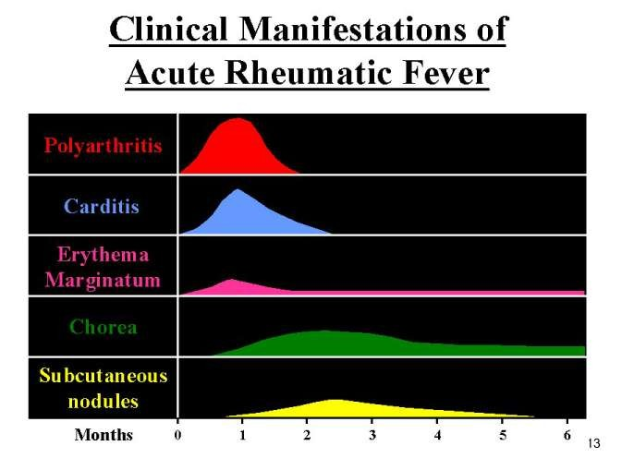

Slide 68
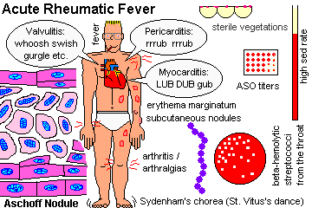

Slide 69
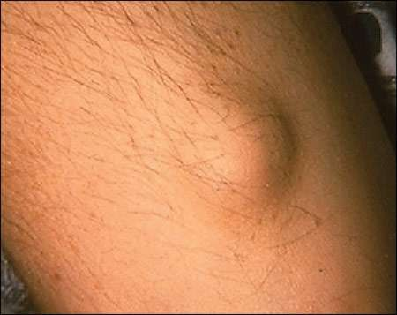
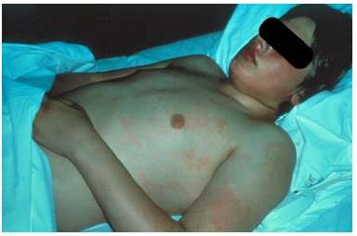
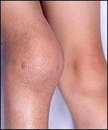
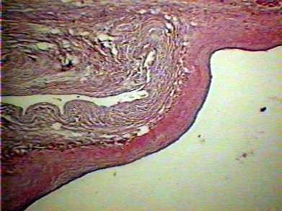
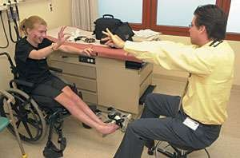

Slide 70
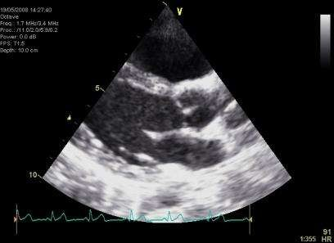
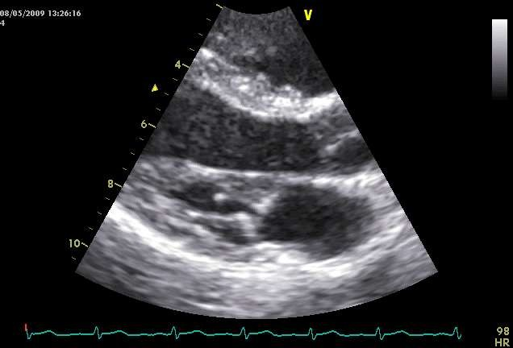
During an episode of ARF, valve changes can be minor and are still able to regress.
After recurrent episodes of ARF, thickening of subvalvar
apparatus, chordal thickening and shortening and progression to permanent valve damage is evident.

Slide 71
Transthoracic echocardiographic images of a
9-year-old girl with first episode of acute rheumatic fever. Images
demonstrate the typical echocardiographic findings of acute rheumatic
carditis. The valve leaflets are relatively thin and highly mobile.
The failure of coaptation of the mitral valve leaflets is the result of
chordal elongation and annular dilatation. The mitral valve regurgitation is moderate with a typical posterolaterally directed regurgitant jet of rheumatic carditis. A. Acute rheumatic carditis (apical four-chamber view echocardiogram).

Slide 72
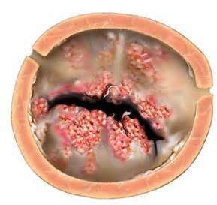

Slide 73

Awareness raising: public, healthcare workers
Surveillance: incidence, prevalence, temporal trends
Advocacy: appropriate funding of the treatment and prevention programmes
Prevention: application of existing knowledge in primary & secondary prevention

Slide 74



Slide 75
EVIDENCE : Juliet Manyemba, Bongani M Mayosi Editorial Group: Cochrane Heart Group Published Online: 22 JUL 2002 Assessed as up-to-date: 29 JUN 2009 DOI: 10.1002/14651858.CD002227 Study on Penicillin for secondary prevention of rheumatic fever LEVEL 1 | METHODOLOGY : Randomised controlled trials .(2) of at least 6 months duration. Non-randomised or poorly randomised studies were included if a control or comparison group was specified. Types of participants Children and adults with a history of rheumatic fever with or without current evidence of rheumatic heart disease, with the initial diagnosis of rheumatic fever based on the Jones criteria (Jones 1944), and revised Jones criteria Types of interventions Selected studies were those in which the following interventions were compared: (1) penicillin (oral or intramuscular) versus control; (2) daily oral penicillin versus intramuscular penicillin; (3) 2-weekly or 3-weekly versus 4-weekly intramuscular penicillin. Types of outcome measures Primary outcomes: rheumatic fever recurrence, mortality related to rheumatic fever and rheumatic heart disease and development of chronic rheumatic heart disease. Secondary outcomes: streptococcal throat infections, compliance and adverse events | RESULTS : Nine studies were included (n=3008). Data were not pooled because of heterogeneity. Overall, the methodological quality of included studies was poor. Three trials (n= 1301) compared penicillin with control. Only one of three studies showed that penicillin reduced rheumatic fever recurrence (RR 0.45, 95% CI 0.22 to 0.92) and streptococcal throat infection (RR 0.84, 95% CI 0.72 to 0.97). Four trials (n=1098) compared intramuscular with oral penicillin and all showed that intramuscular penicillin reduced rheumatic fever recurrence and streptococcal throat infections compared to oral penicillin. One trial (n= 360) compared 2-weekly with 4-weekly intramuscular penicillin. Penicillin given every two-weeks was better at reducing rheumatic fever recurrence (RR 0.52, 95% CI 0.33 to 0.83) and streptococcal throat infections (RR 0.60, 95% CI 0.42 to 0.85). One trial (n= 249) showed 3-weekly intramuscular penicillin injections reduced streptococcal throat infections (RR 0.67, 95% CI 0.48 to 0.92) compared to 4-weekly intramuscular penicillin. | CONCLUSION : The study showed significant benefit with treatment with penicillin and complications of rheumatic fever.

Slide 76
MCQs
1. WHICH MICROORGANISM IS RESPONSIBLE FOR RHEUMATIC FEVER-
A. STAPHYLOCOCCI
B. ENTEROCOCCI
C. PSEUDOMONAS
D. GROUP A BETA HEMOLYTIC STREPTOCOCCI

Slide 77
2. DRUG OF CHOICE FOR SECONDARY PROPHYLAXIS IN A PENICILLIN ALLERGIC PATIENT IS –
A. MEROPENAM
B. ERYTHROMYCIN
C. CLINDAMYCIN
D. SECOND GENERATION CEPHALOSPORINS

Slide 78
3. WHICH OF THE FOLLOWING IS NOT A MAJOR JONES CRITERIA -
A. POLYARTHRALGIA
B. CARDITIS
C. SUBCUTANEOUS NODULES
D. CHOREA

Slide 79
4. MOST COMMON AGE GROUP AFFECTED BY RHEUMATIC FEVER –
A. INFANCY
B. 0-5 YRS
C. 5-15 YRS
D. 15-25 YRS

Slide 80
5. ASCHOFF BODIES ARE SEEN IN –
A. RHEUMATIOD ARTHRITIS
B. MI
C. PULMONARY EMBOLISM
D. ACUTE RHEUMATIC FEVER

Slide 81
ANSWERS
1.D
2.B
3.A
4.C
5.D

Slide 82
MCQ1.Following is not true for rash of Acute Rheumatic fever:
There is maculopapular eruptions.
Erythema marginatum, distinctive pattern of enlarging and shifting transient annular lesions is present in Acute rheumatic fever.
Typical Rash is John’s minor criteria in ARF.
centrally distributed.

Slide 83
MCQ2.Following is not true for Acute Rheumatic fever in relation to ACUTE PHARYNGITIS
Acute pharyngitis related to Acute rheumatic fever occur due to group A β-hemolytic Streptococcus (S. pyogenes)
Timely treatment of ACUTE PHARYNGITIS by penicillin therapy can reduce risk of rheumatic fever.
Acute rheumatic fever and ACUTE PHARYNGITIS occurs simultaneously
Throat swab examination may be needed.

Slide 84
MCQ3.Following is not true for Carey-Coombs murmur
It is mid-diastolic murmur.
It is heard at apex.
It suggest Rheumatic carditis
Murmur is due to chronic mitral stenosis.

Slide 85
MCQ4.Following is not true for Rheumatic arthritis:
It is Migratory polyarthritis
Responds to aspirin.
It is small joint arthropathy
It is one

Slide 86
MCQ5 Following is not true for Lancefield’s Group B Streptococcus (GBS)
Streptococcus agalactiae is Group B Streptococcus
It is leading cause of bacterial sepsis and meningitis in newborns
It is major cause of endometritis and fever in parturient women.
It may cause Acute Rheumatic fever.

