Slide 1
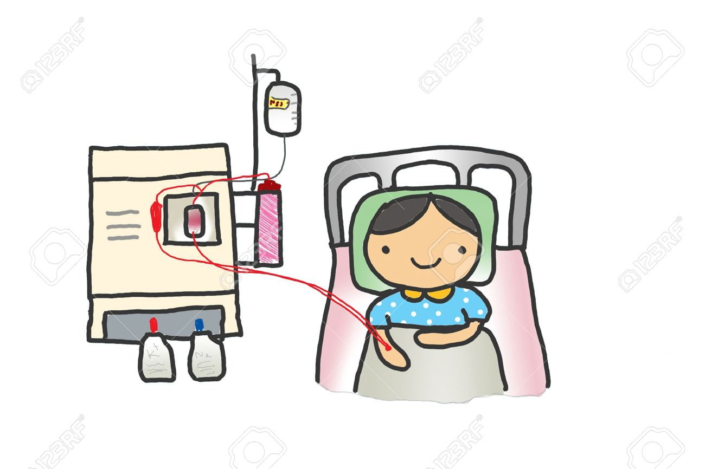
Haemodialysis
and Its Recent Advances
DR.P.R.JHA

Slide 2
Its is also known as Extra corporeal therapy
Definition
It is the process by which fluid & solutes are removed
from or added to the patient’s blood outside the body.
It involves hemodialyzer and hemofilter containing
semipermeable membrane.

Slide 3
Types of Extracorporeal therapy:
Hemodialysis
2. Hemofiltration
3. Hemodiafiltration
4. Hemoperfusion

Slide 4
Hemodialysis
Remove solute by diffusion method
It is based on concentration gradient of solute between the blood and the dialysate across the semi permeable membrane
For example
Urea will diffuse out of blood to dialysate through
semipermeable membrane
There will be loss of urea concentration in plasma
No need of fluid replacement

Slide 5
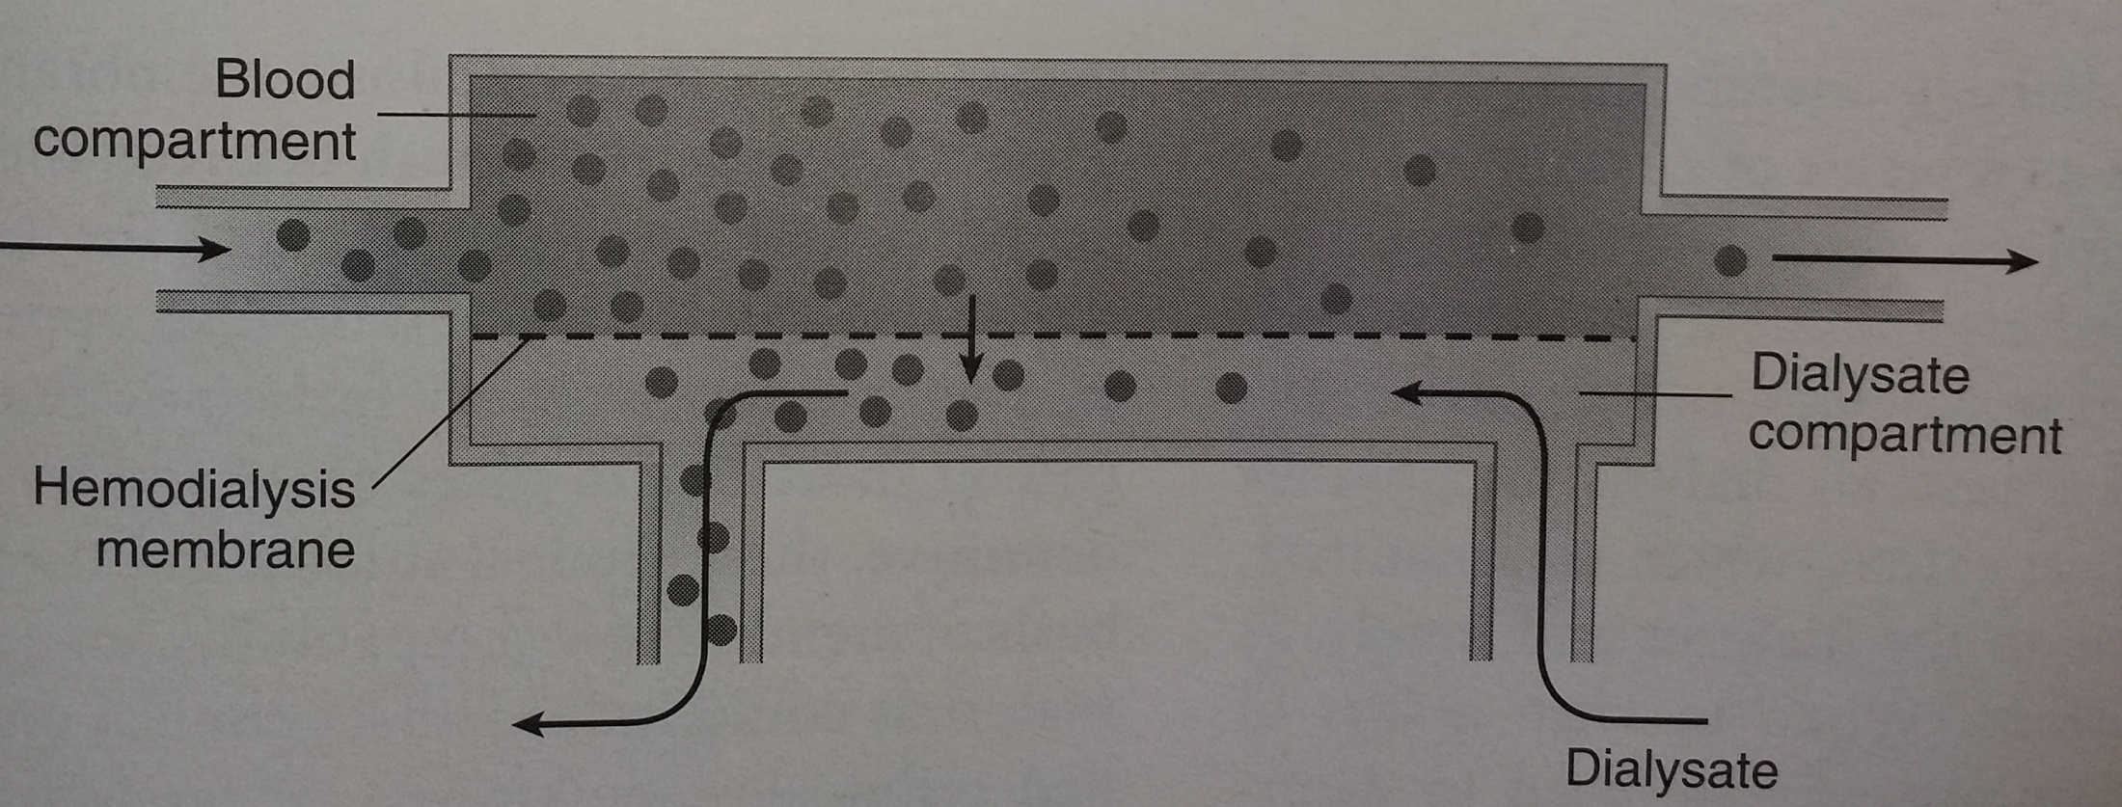

Slide 6
Hemofiltration
Removes fluid by convection method
Removal of solute that are dissolved in water through large pore
semipermeable membrane
For eg there will be loss of solute with large amount of water.
There will be no loss of plasma concentration of solute
Fluid replacement needed

Slide 7
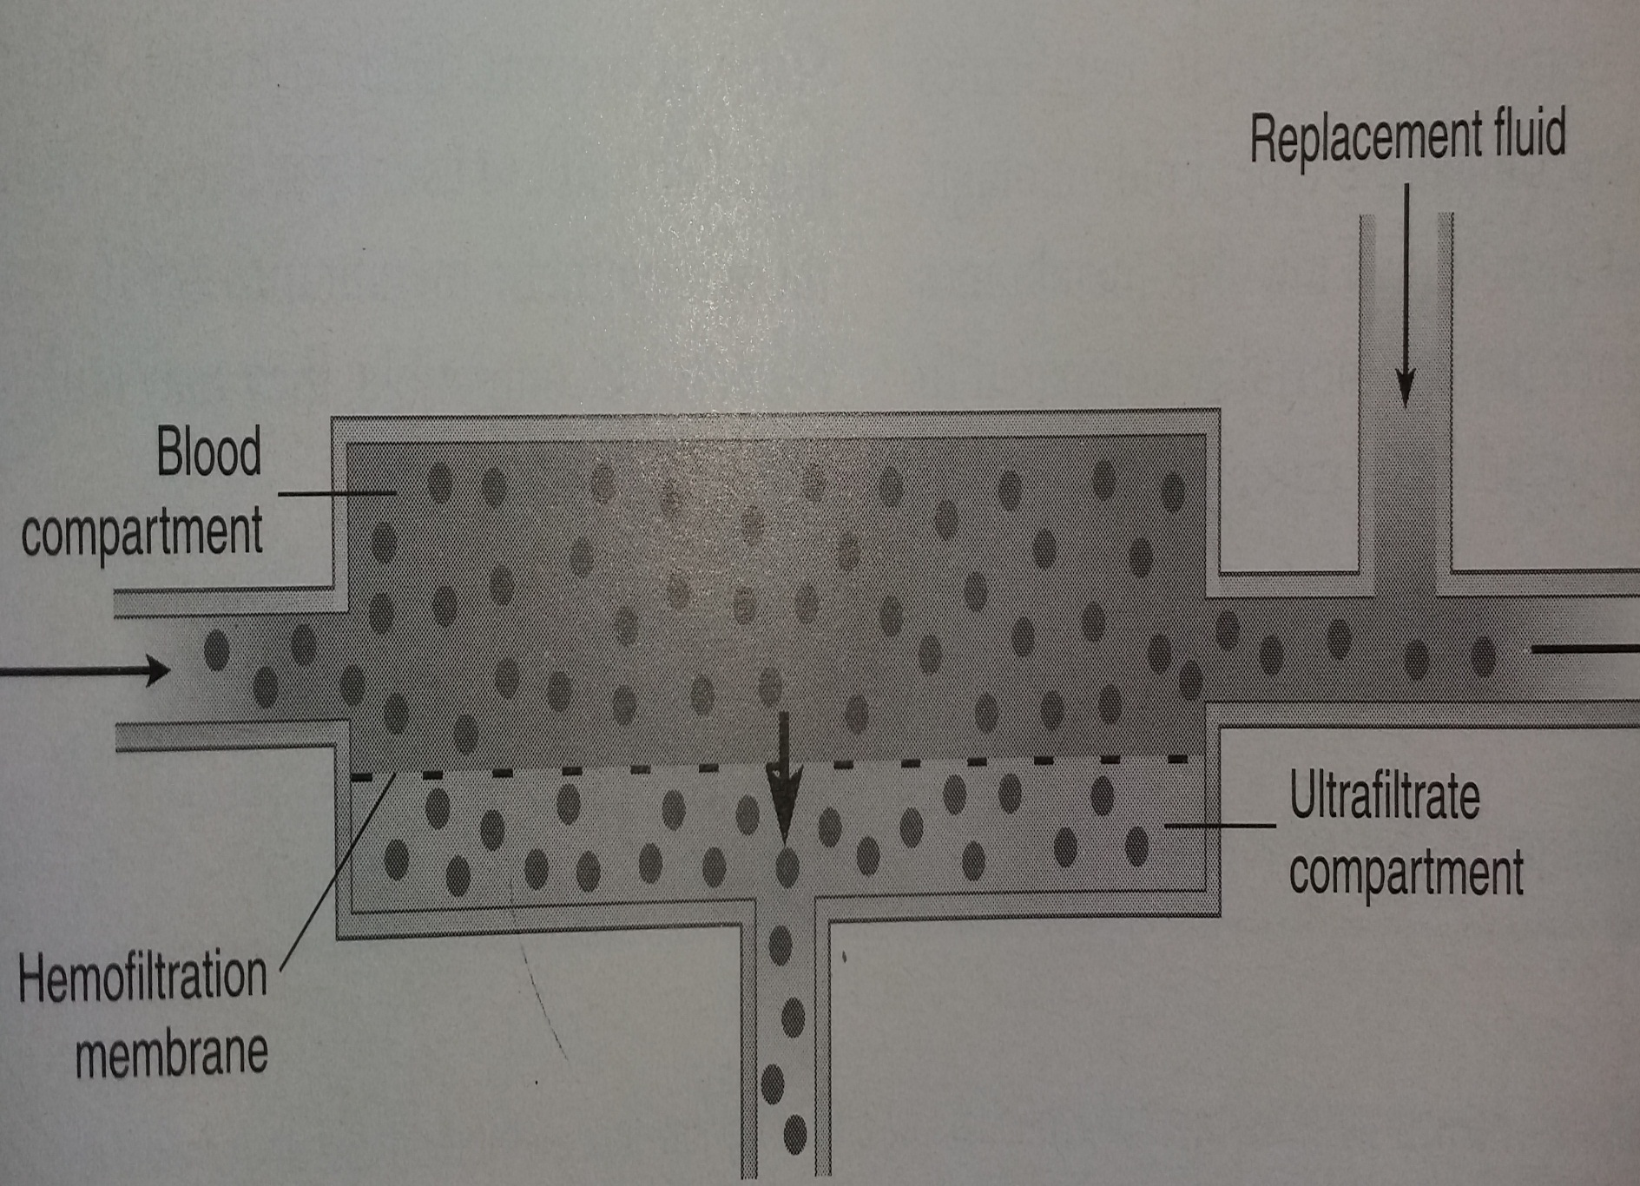

Slide 8
Hemodiafiltration
It is a combination of hemodialysis & hemofiltration that is removal of fluid by diffusion & convection method
Hemoperfusion
In this there is only removal of solute (toxins) by using material
such as charcoal or resins mainly use this process in treatment of
acute poisoning.

Slide 9
If the patient is hemodynamically unstable then the renal replacement therapy advocated is continuous renal replacement therapy in which very low blood and dialysis flows are accepted for continuous and prolonged periods, Usually for days together
They are divided into two part:
1. CAVHF - Continous Arteriovenous Hemofiltration
2. CVVHDF - Continous Venovenous Hemodiafiltration

Slide 10
Membranes of dialyzer
Membranes are made up off two type:
Cellulose polymer
Synthetic polymer
Membrane | Hydr. Permeability | Biocompatibility
Non modified cellulose | Low flux | Poor
Modified cellulose | Low / high flux | Intermediate
Synthetic | High / low flux | good

Slide 11
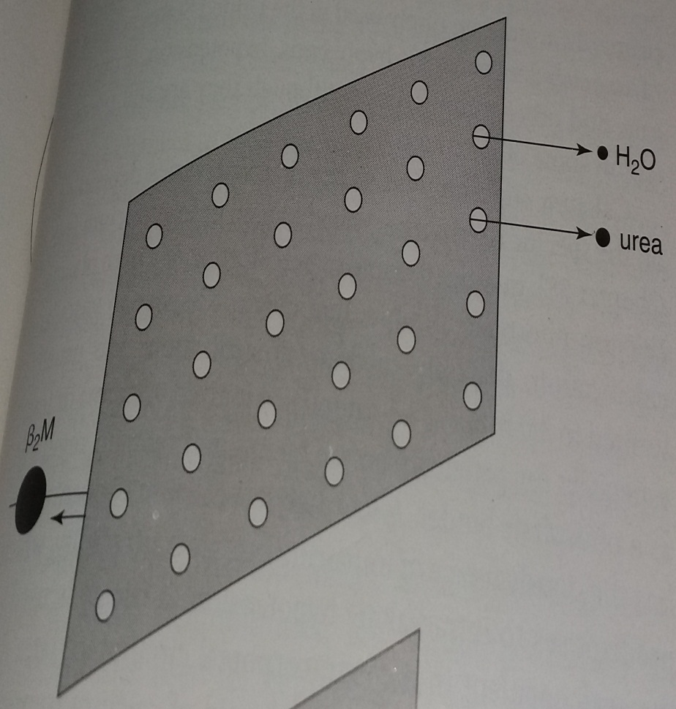
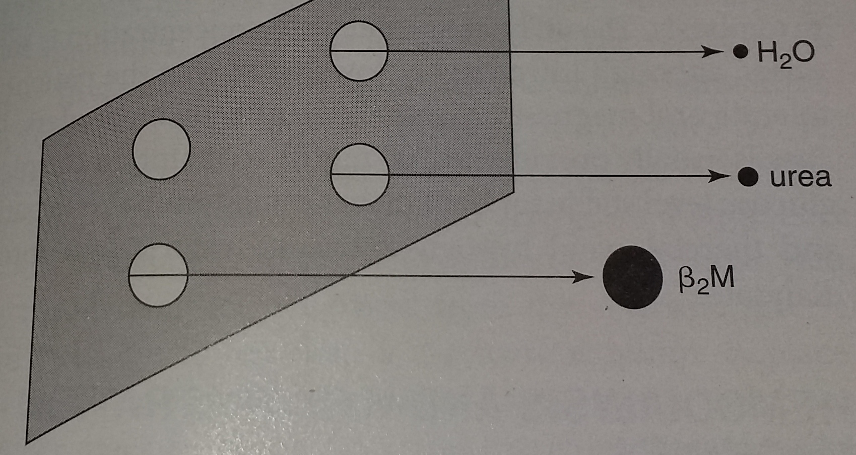
Membranes are classified into two type:
Flux: low or high
Efficiency: low or high
Low Flux
High flux

Slide 12
Role of Membranes
In hemodialysis
  Conventional hemodialysis - low efficiency and low flux is used
  High efficiency hemodialysis used in removal of small size uremic toxins
  (eg. Urea)
  High flux hemodialysis used to remove middle molecules like beta
  2 microglobulin
2. In hemofiltration
a. Continous Arteriovenous or Venovenous hemofiltration is done by high flux membrane & convection. Used for removal small size solute with middle molecules & large amount of water.
b. Intermittent Arteriovenous or Venovenous hemofiltration used for
end stage renal disease

Slide 13
Water transport in dialysis
Ultrafiltration coefficient is defined as volume of water transported per unit time
Ultrafiltration coefficient of :
  1. Low flux is 2 to 5ml/hr/mmHg
2. High flux is around 12 to 60 ml/hr/mmHg
Transmembranes pressure is 200mmHg
Water transport in dialysis is defined in ultrafiltration coefficient
For example
if a dialyzer has coefficient of 2.5 ml/hr/mmHg then it will be
able to remove 0.5L in one hour

Slide 14
Solute Clearance Profile
Ability of dialysis membrane to transport solute is expressed as mass transfer coefficient – area product
That is K0A
Where:
K0 is mass transfer coefficient
A is membrane surface area

Slide 15
 | Urea K0A | Urea clearance | Ultrafiltration coefficient | Beta 2 M Clearance
Dailyzer
Conventional | <450 | <150 | <12 | <10
High efficiency | >600 | >200 | Variable | Variable
High flux | Variable | Variable | >12 | >20
Hemofilters | Variable | Variable | >12 | >20

Slide 16
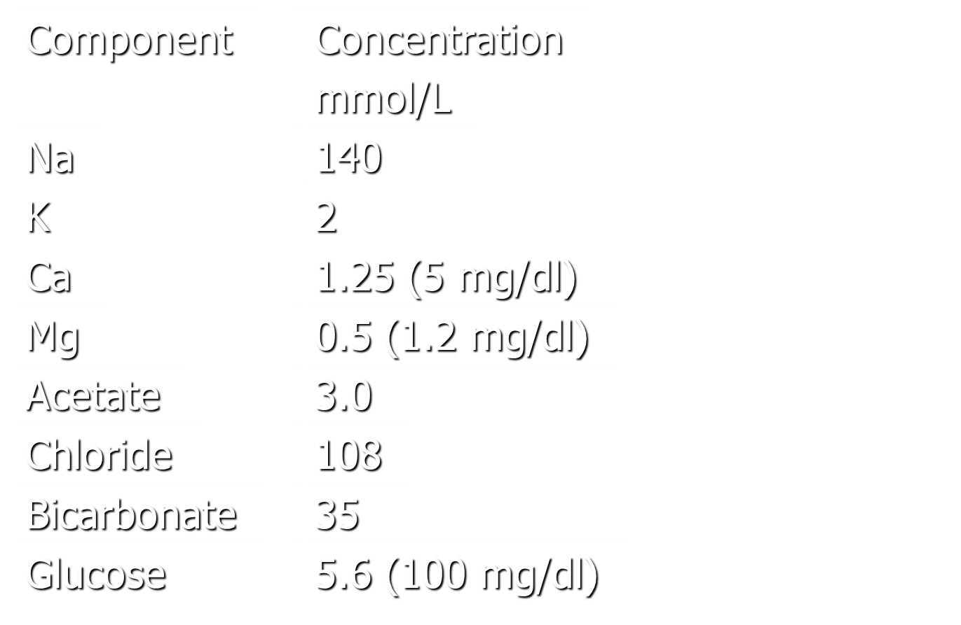
Dialyser Compostion

Slide 17
Vascular Access
Large diameter catheter is necessary required to perform
acute dialysis
Adequate vascular access should permits blood flow to the
dialyzer of 200 to 500mL/min

Slide 18
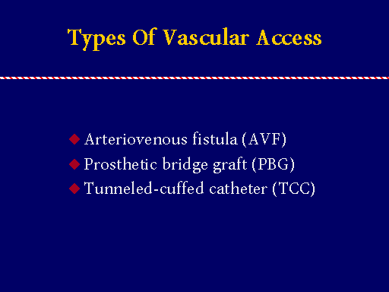

Slide 19
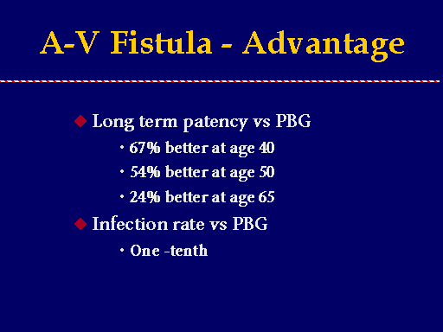

Slide 20
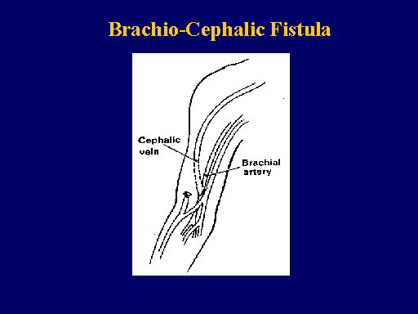

Slide 21
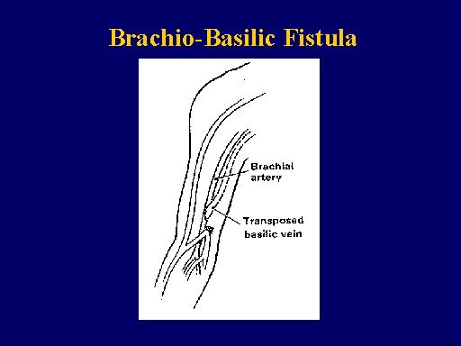

Slide 22
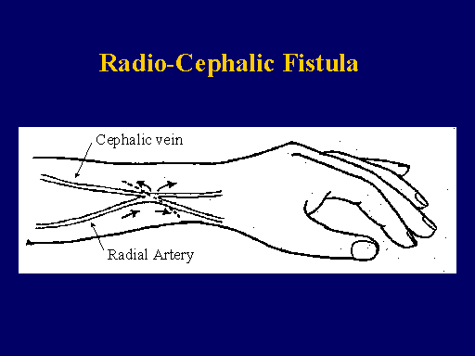

Slide 23
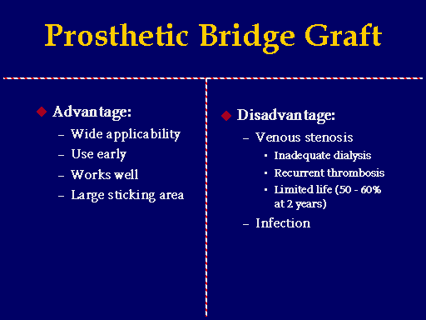

Slide 24
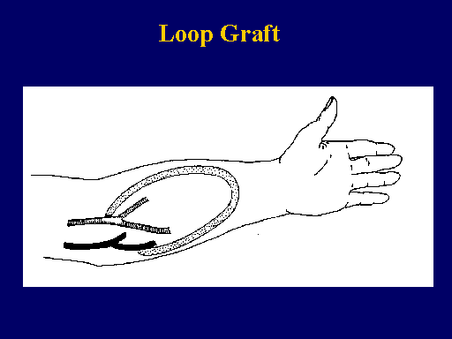

Slide 25
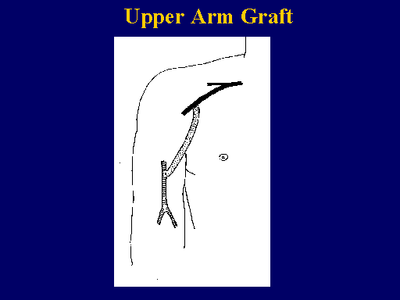

Slide 26
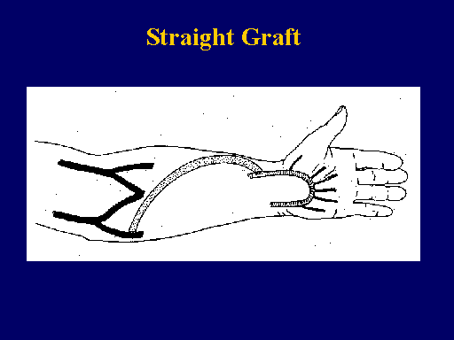

Slide 27
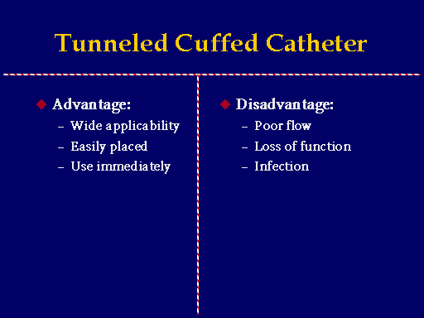

Slide 28
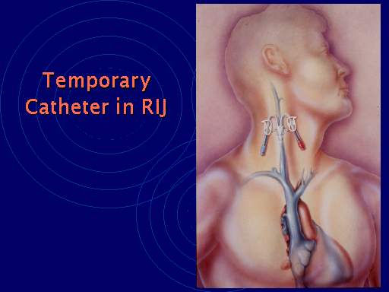

Slide 29
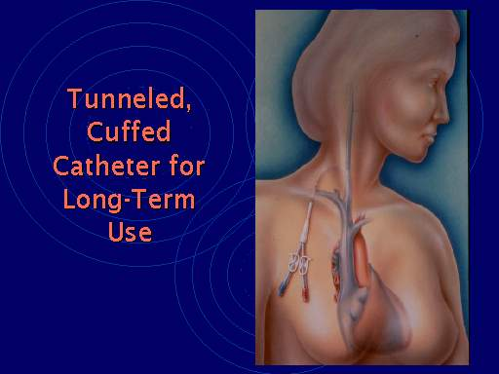

Slide 30
Indication for Initiating of Hemodialysis
In patients with calculated Creatinine clearance
<20 ml/min/1.73 m2 the onset of:
Uremic symptoms:
Nausea/emesis
Altered sleep pattern
2. Altered mental status:
Coma
Stupor
Tremor
Clonus
Seizures

Slide 31
More Indication
1. Pericarditis or Tamponade (urgent indication)
2. Uremic platelet dysfunction (urgent indication)
3. Volume overload
4. Hyperkalemia
5. Metabolic acidosis with anuria

Slide 32
Equations for estimation of renal function
Cockcroft and Gault equation
MDRD Formula
(Modification of Diet in Renal Disease)

Slide 33
The Cockcroft-Gault equation
Cr Cl =(140-age) x wt/72(serum Cr)
Decrease 15% for women
Decrease 20% for paraplegia, 40% for quadriplegia
Increase 12% for Afro-American males

Slide 34
The MDRD formula
Modification of Diet in Renal Disease Study
GFR (ml/min/1.73m2)=
186 x {S.cr } -1.154 x {age}-0.203
multiply by 1.212 if black
multiply by 0.742 if female
The MDRD equation calculates GFR, hence values are lower than those of creatinine clearance by Cockcroft Gault equation.

Slide 35
Complications of Hemodialysis
Dialysis Reactions
Intradialytic Hypotension
Neuromuscular complications
Dialysis dysequilibrium
Hemolysis
Intradialytic hypoxemia
Metabolic derangements
Cardiac arrhythmia and sudden death

Slide 36
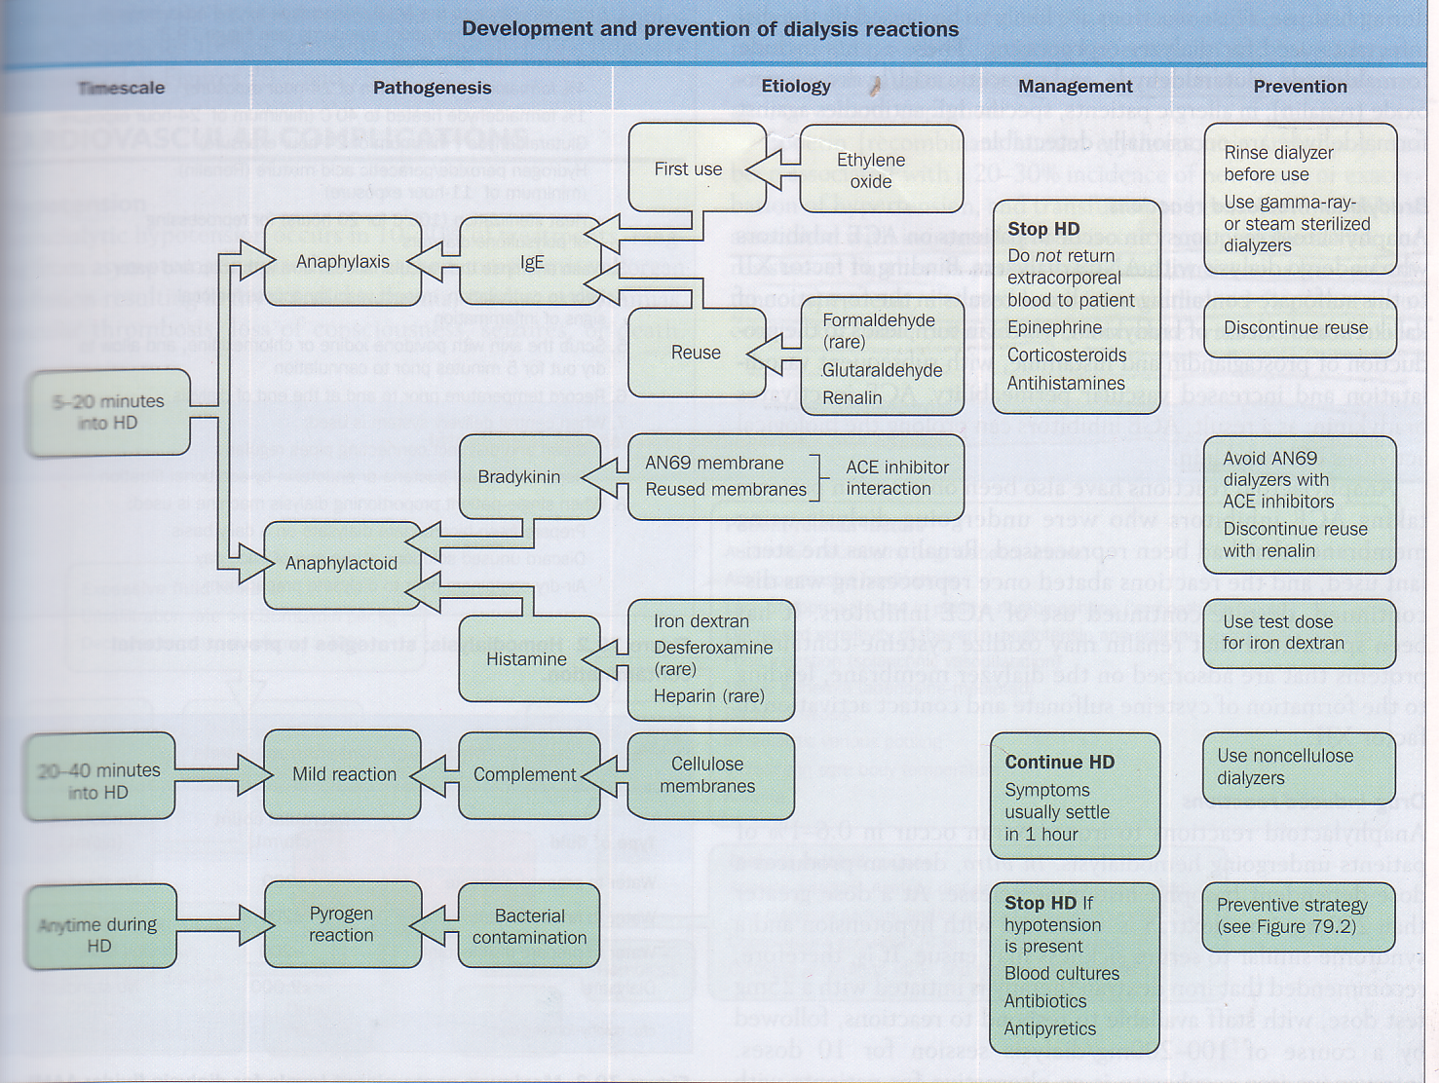
Dialysis Reactions

Slide 37
Intradialytic Hypotension
(IDH) is defined as a decrease in systolic blood pressure by ≥20 mm Hg or a decrease in MAP by 10 mm Hg.
Symptoms that include:
Abdominal discomfort,
Yawning,
Sighing,
Nausea,
Vomiting,
Muscle cramps,
Restlessness,
Dizziness or fainting,
Anxiety.

Slide 38
Pathway
Recognition of low BP
Is MAP is more than >30 mmHg
Yes
No
Pause ultrafiltration for 10 mins
and then recheck BP
Yes
Is MAP less than 70 mmHg
No
Has BP improved??
MAP >70mmHg
Patient BP monitoring
Yes
No
Consider for extra 10 mins or alter UF goal
Consider UF resumption and monitor patient BP

Slide 39
Management of Intradialytic Hypotension
Assess dry weight frequently
Avoid BP meds before HD
Avoid rapid UF
Use sequential UF and HD
Avoid feeding patients on HD
Use Sodium modeling
Use HCO3 based dialysate
Use non Cellulosic membranes
Keep Dialysate temperature<37 degrees Celsius
Assess cardiac function, r/o pericardial effusion/tamponade

Slide 40
Neuromuscular complications
Muscle cramps
Headache
Seizures
Restless legs syndrome

Slide 41
Dialysis Disequilibrium Syndrome (DDS)
Is the occurrence of neurologic signs and symptoms, attributed to cerebral edema, during or following shortly after intermittent hemodialysis.
Pathogenesis:
Reverse urea effect (rapid reduction of serum urea while CSF urea concentration remains high)
Paradoxical CSF acidosis
Intracerebral accumulation of idiogenic osmols in uremia

Slide 42
Risk factors:
Young age,
Severe and chronic azotemia, Initial dialysis treatment,
High flux/ large surface area dialyzer
Symptoms:
  Headache, nausea, emesis, blurred vision, hypertension, disorientation, muscle twitching

Slide 43
Treatment
Early detection of uremia, early intervention with dialysis
First few treatments should aim to achieve modest reduction in serum urea concentration (30% or less)
Sodium modeling, use of Bicarbonate dialysis, slow QB
Osmotically active agents in dialysate can be used like albumin, glycerol, mannitol

Slide 44
Intradialytic Hemolysis
Uncommon
Loss of blood during dialysis
Causes are:
  High blood pump flow
Contamination with Formaldehyde
  Overheated dialysate
High negative arterial pressure

Slide 45
Symptoms
Nausea
Abdominal pain
Chest pain
Shortness of breath
Cyanosis
Back pain
Headache
Treatment
Stop blood pump, clamp venous bloodline
Provide oxygen to the patient
Type and cross of blood transfusion if needed
Resume HD as soon as patient is stabilized

Slide 46
Intradialytic Hypoxemia
Arterial p O2 drops by 5 to 30 mm Hg during Hemodialysis due to central Hypoxemia.
This is a result of a drop in CO2 that accompanies correction of acidosis on dialysis
Acetate can induce respiratory muscle fatigue
Treatment : Supplemental oxygen during hemodialysis in susceptible patients

Slide 47
Dialyzer reuse
Can be reused
Substance used for clean are formaldehyde, sodium
hypochlorite with combination solution of hydrogen
peroxide & Peroxyacetic acid.
Choice of hemodialyzer
As per capacity of membrane to clear urea
Biocompatibility

Slide 48
Drugs
Analgesic
Anti depressants
Antimicrobials – Acyclovir, Rifampin, Vancomycin
Benzodiazepine
Ace inhibitors
Diuretics
Proton pump inhibitors

Slide 49
Care
In pre-dialysis patients, patients should have to be on a low-protein diet around 0.8g/kg/day
During dialysis, patients should be given diet with more protein.
Patient on hemodialysis, should avoid foods containing high amounts of phosphorus, sodium and potassium.
Diabetic patients should have controlled blood glucose levels.
Patient should avoid salt substitutes, or add salt at the table.

Slide 50
THANK YOU

