Slide 1
Hypertension And Pregnancy(HDP)
DR.P.R.JHA

Slide 2
Objectives
Define hypertension in pregnancy.
Give recent classification of the hypertensive
disorders of pregnancy.
Diagnose pre-eclampsia and chronic hypertension.
List which patients are at risk of developing preeclampsia..
Differentiate pre-eclampsia from severe pre-eclampsia.
Give a practical guide to the management of preeclampsia.
eclampsia. gestational hypertension and
chronic hypertension during pregnancy.

Slide 3
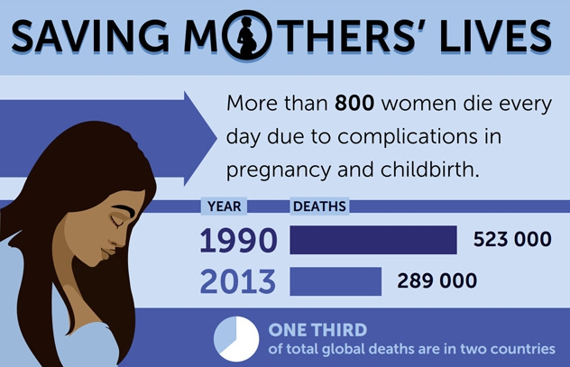

Slide 4
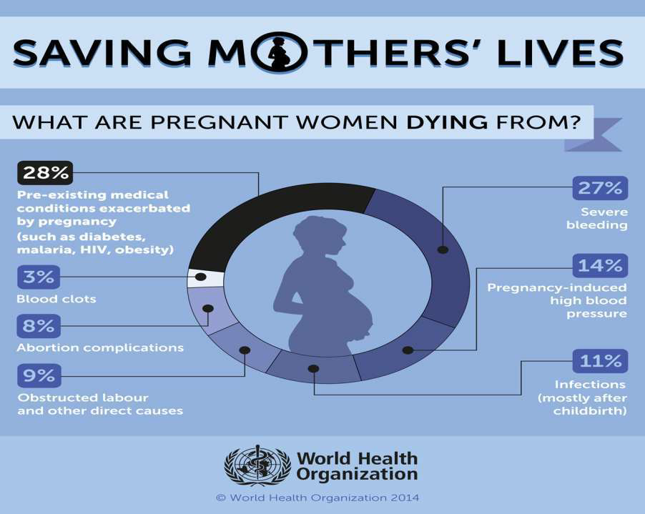

Slide 5
Introduction
Hypertensive disorders of pregnancy (HDP) remain among the most significant and intriguing unsolved problems in obstetrics.
In India, the prevalence of HDP was 7.8% with pre‑eclampsia in 5.4% of the study population.
The problems in HDP may be due to the effects on the cardiovascular, respiratory, neurologic, renal, haematologic, hepatic and uteroplacental systems.

Slide 6
Introduction
Approximately 1/3 of hypertensive disorders in pregnancy (HDP) are due to chronic hypertension and 2/3 are due to gestational hypertension–preeclampsia.
The spectrum of the disease ranges from mildly elevated blood pressures with minimal clinical significance to severe hypertension and multi organ dysfunction.

Slide 7
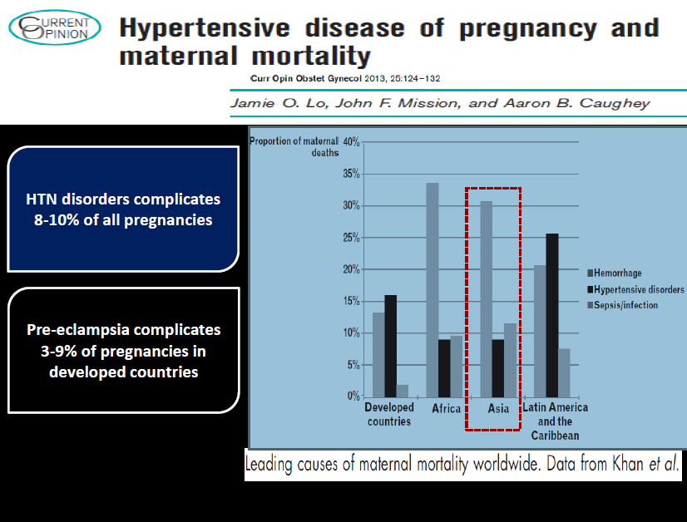

Slide 8
Introduction
Nothing has changed…
The first description of Preeclampsia was given by Hippocrates, a father of modern medicine (460-377 BC), a son of Heraclides from the island of Kos .
Even after more than two millennia since the first descriptions, the syndrome of preeclampsia/ eclampsia (PE/E) has remained a multi-system disorder of unknown etiology.

Slide 9
Introduction
The diagnosis is based on a clinical picture and laboratory analysis;
BUT, an efficient prevention and screening are still missing,
The therapy is ONLY symptomatic,
While giving birth STILL REMAINS the only causal therapy.

Slide 10
Updated Classification

Slide 11
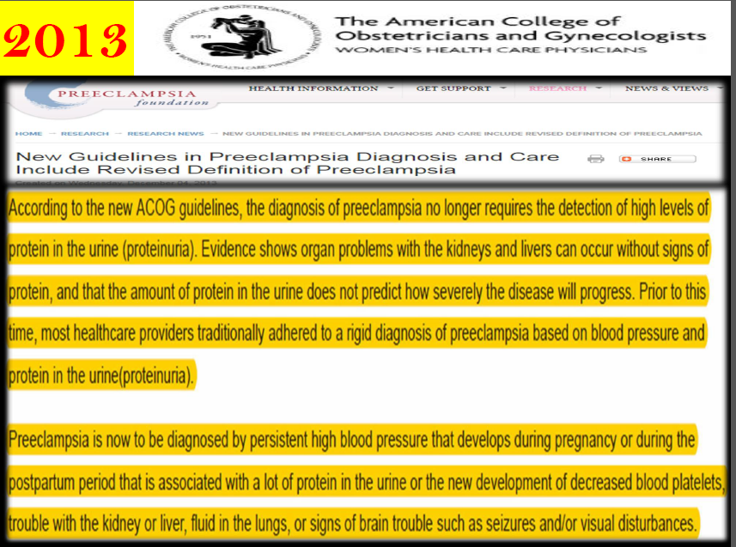

Slide 12
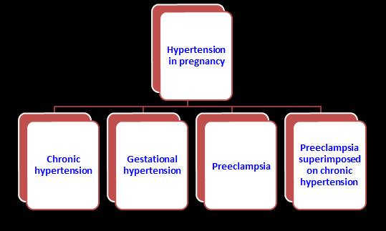
Updated Classification of Hypertensive disorders of pregnancy ( ACOG,2013)

Slide 13

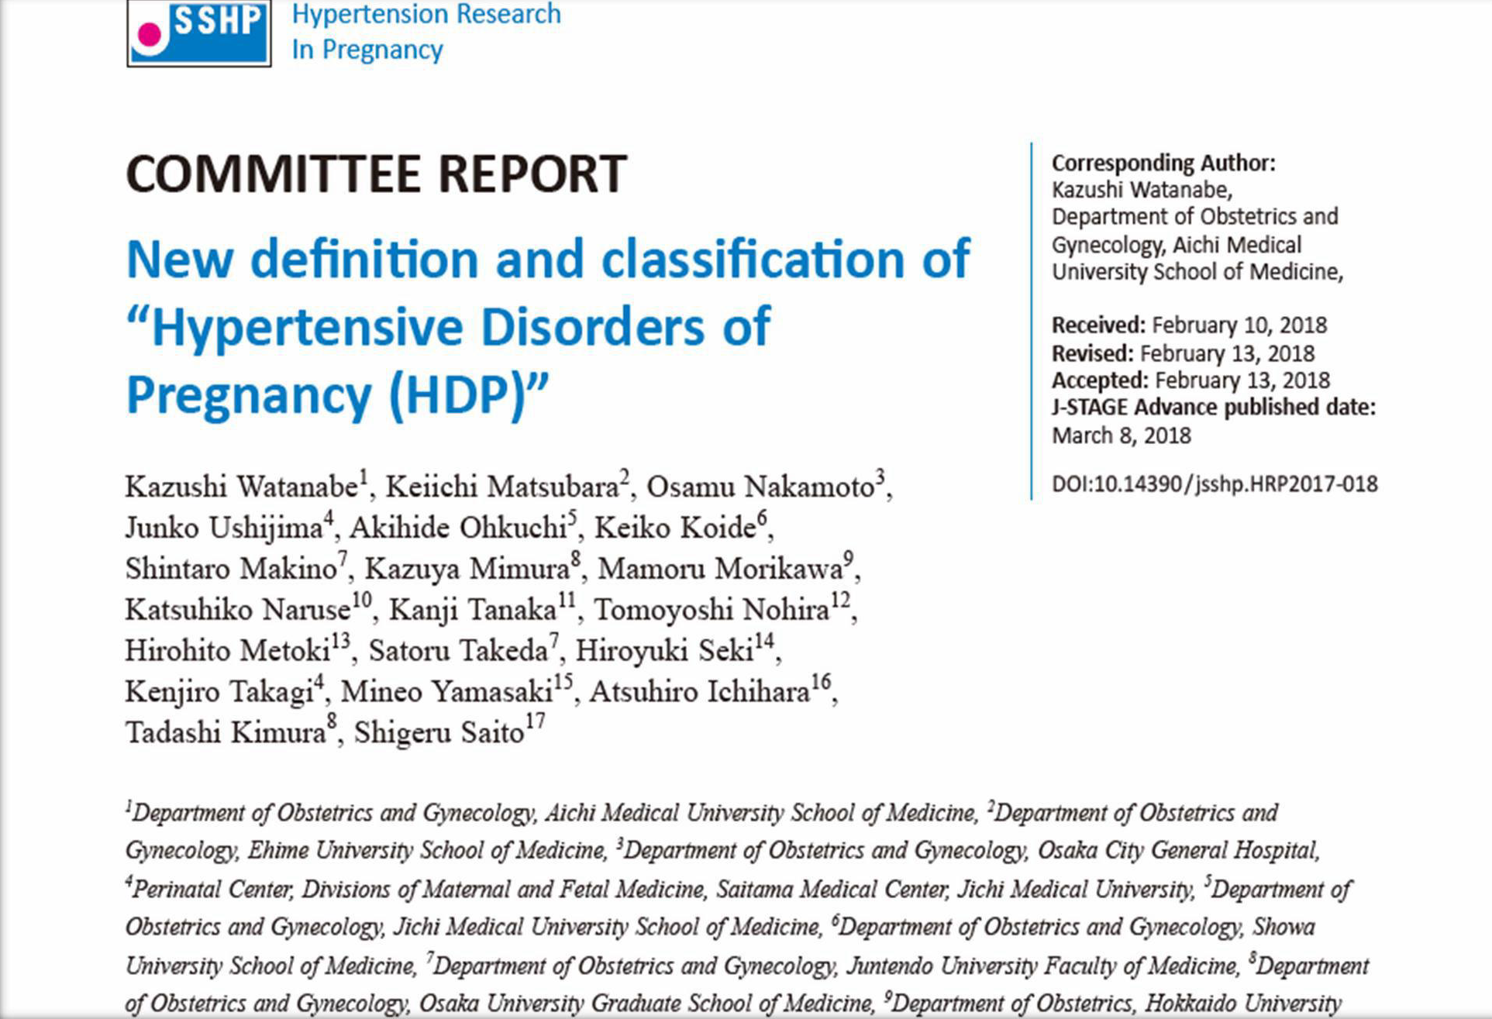
2018

Slide 14
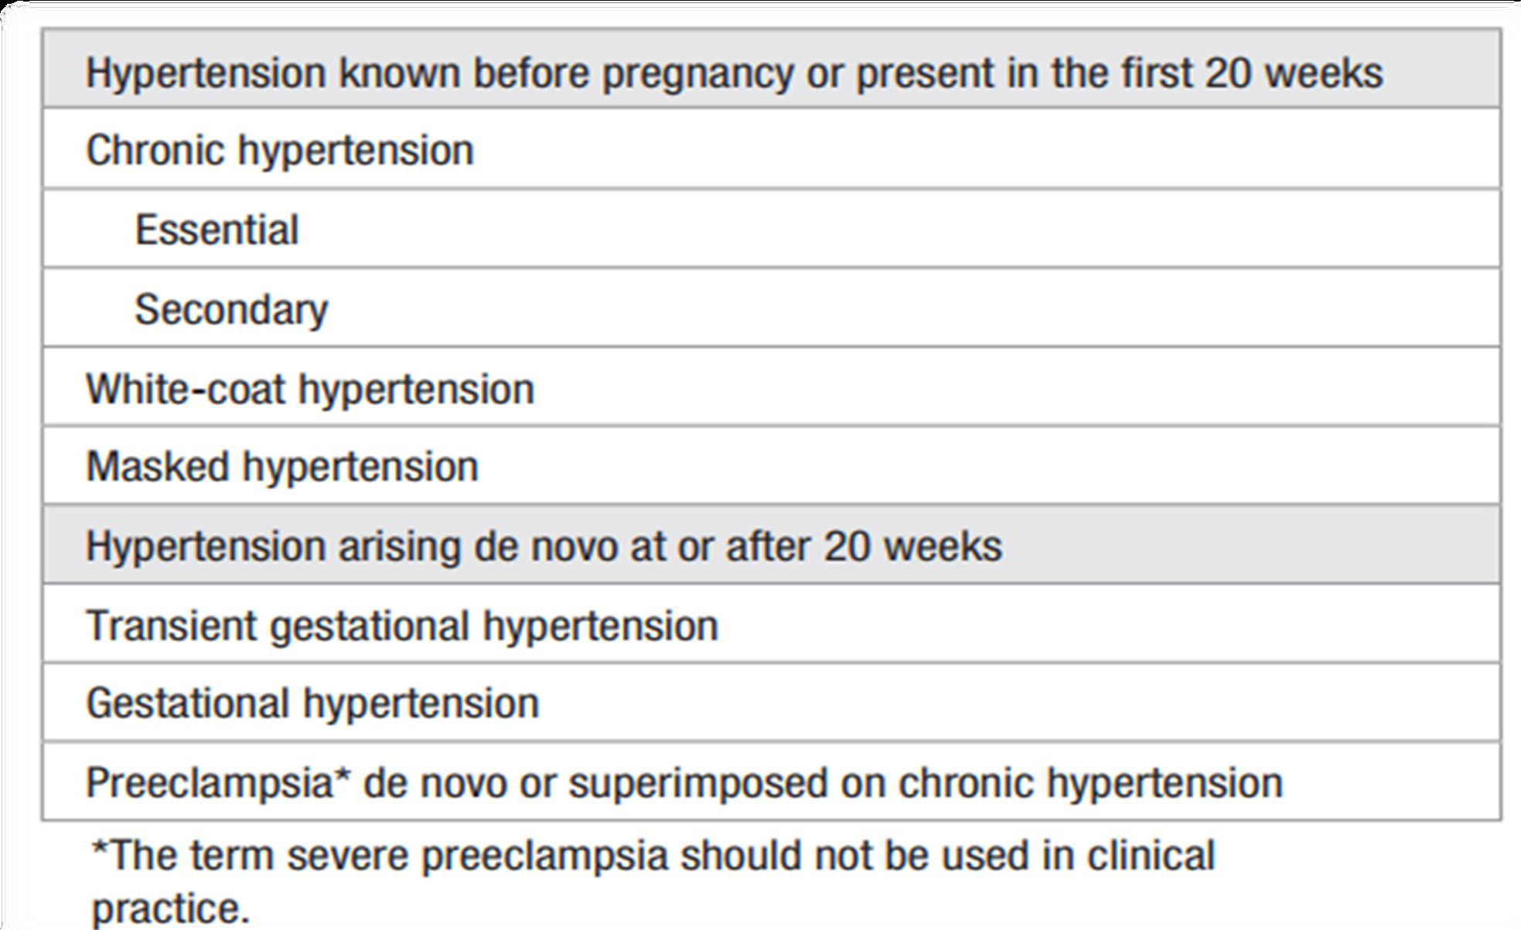

Slide 15

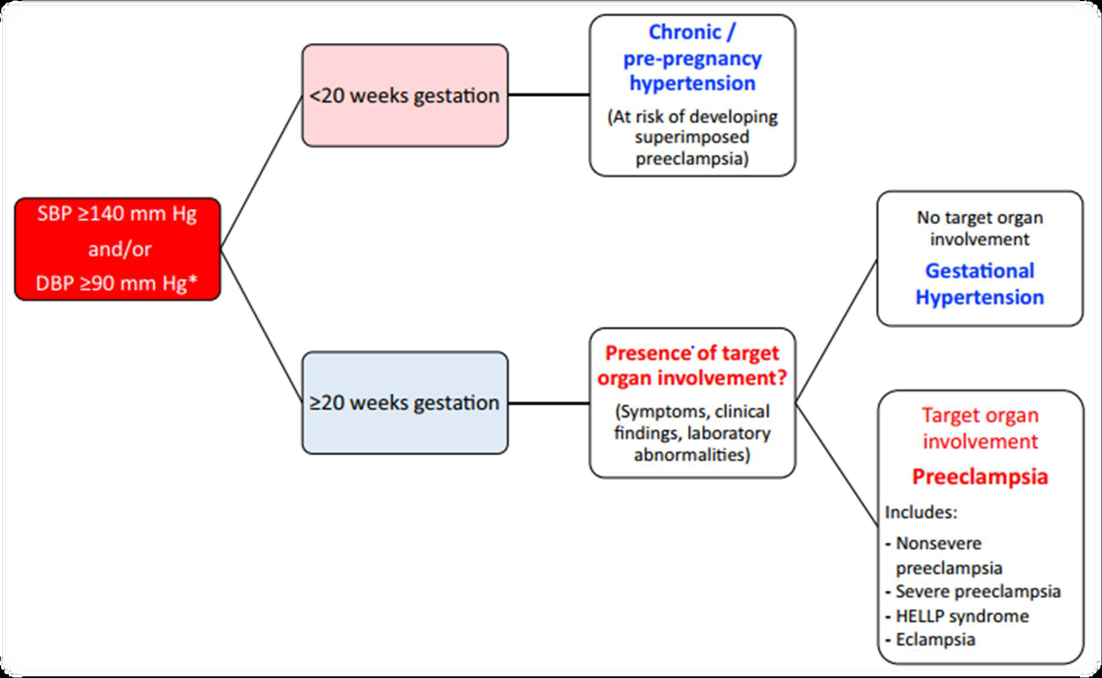
2018
2018

Slide 16

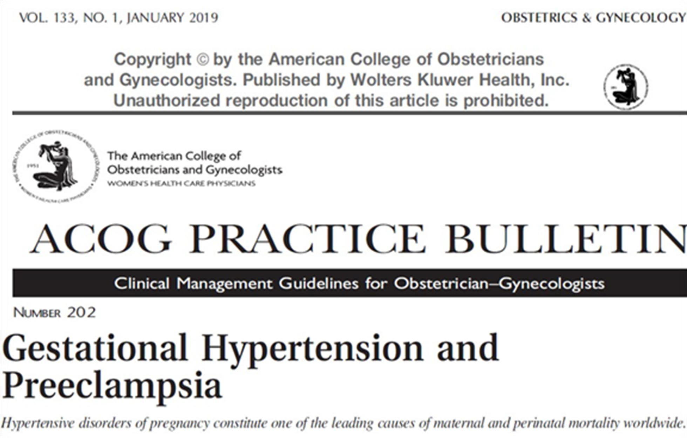
2019

Slide 17
Major changes of the new classification are as follows:
(1) HDP is defined as hypertension in pregnancy.
(2) Eclampsia was removed from the major classification.
(3) Chronic hypertension was added to the major classification.
(4) If pregnant women with new onset of hypertension have either maternal organ dysfunction or uteroplacental dysfunction, they should be diagnosed with preeclampsia, even in the absence of proteinuria.

Slide 18
Major changes of the new classification are as follows:
(5) The severity classification should be ‘severe’ when hypertension is severe, or when hypertension is mild but there is maternal organ dysfunction or uterine placental dysfunction. The term ‘mild’ was excluded from the criteria of HDP because it can be misinterpreted to mean ‘not at high risk’.
(6) The definition of ‘early onset type’ is that which appears earlier than 34 weeks gestation, in accordance with international standards.

Slide 19
Major changes of the new classification are as follows:
Pre-eclampsia does not require the presence of proteinuria for Dx.
Pre-eclampsia may be diagnosed if HTN+
–Thrombocytopenia (PLTs<100k)
  –Liver injury (ALT/AST > x2 UNL)
–Renal dysfunction (SCr>1.1 or x2 from baseline)
–Pulmonary edema
–New onset cerebral or visual disturbances

Slide 20
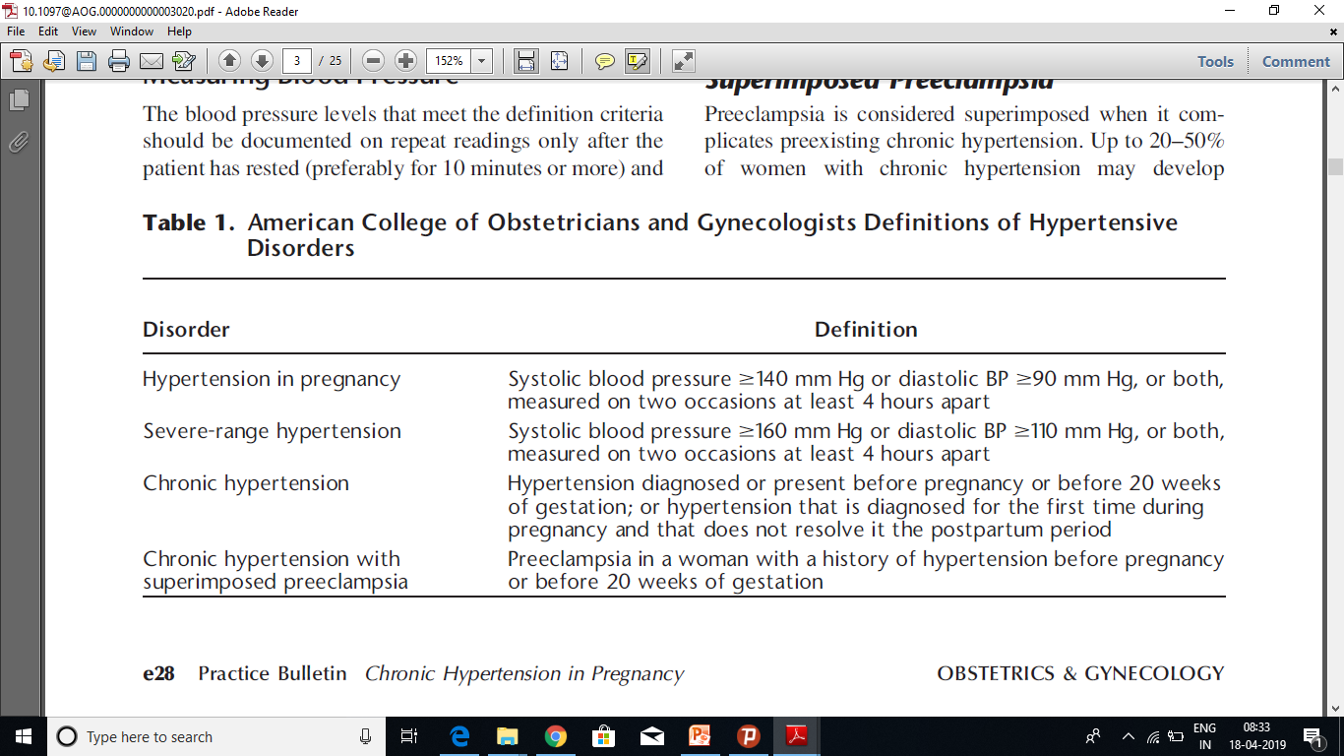
Updated Classification of Hypertensive disorders of pregnancy

Slide 21
DIAGNOSIS

Slide 22
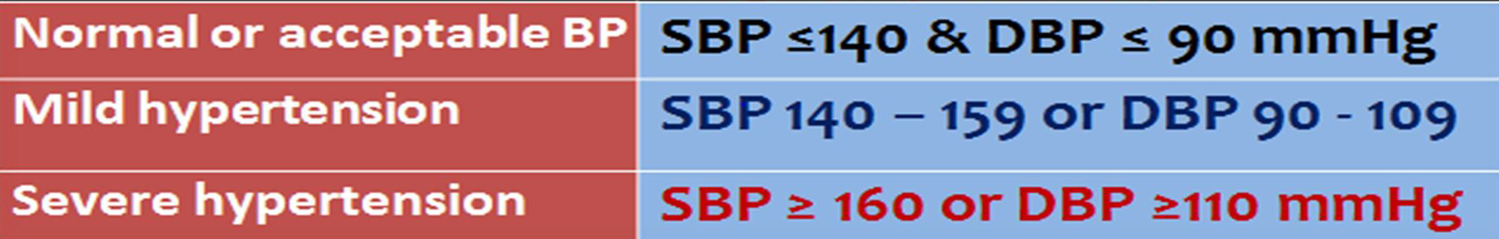
As per National High Blood Pressure Education Program (NHBPEP)

Slide 23
Chronic Hypertension
Defined as hypertension diagnosed or present before pregnancy or before 20 weeks of gestation. Hypertension that is diagnosed for the first time during pregnancy and that does not resolve in the typical postpartum period also is classified as chronic hypertension.
Often diagnosed at the first or early booking visits.
Should be confirmed by 24-hour ABPM or home BP monitoring, or at minimum, after repeated measurements over hours at the same visit
The majority because of essential hypertension
White-coat hypertension not an entirely benign condition..
Masked hypertension more difficult to diagnose

Slide 24
Gestational Hypertension
Defined as a systolic blood pressure 140 mm Hg or more or a diastolic blood pressure of 90 mm Hg or more, or both, on two occasions at least 4 hours apart after 20 weeks of gestation, in a woman with a previously normal blood pressure without proteinuria or severe features, blood pressure levels return to normal in the postpartum period
considered severe when the systolic level reaches 160 mm Hg or the diastolic level reaches 110 mm Hg, or both.
Of women with apparent gestational hypertension, about ⅓ develop preeclampsia
maternal and fetal outcomes are usually normal
High risk of chronic hypertension later in life

Slide 25
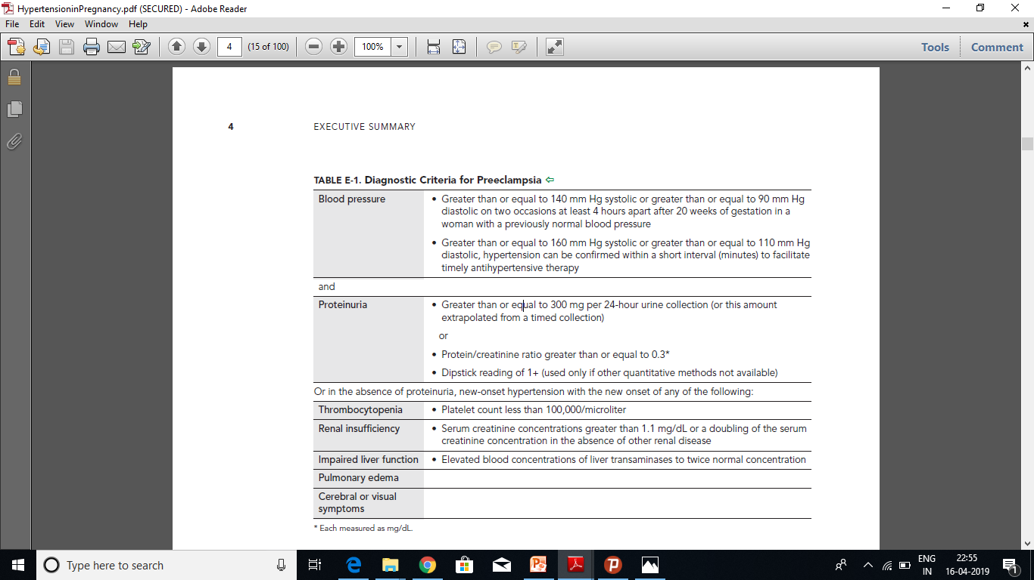
Pre-eclampsia

Slide 26
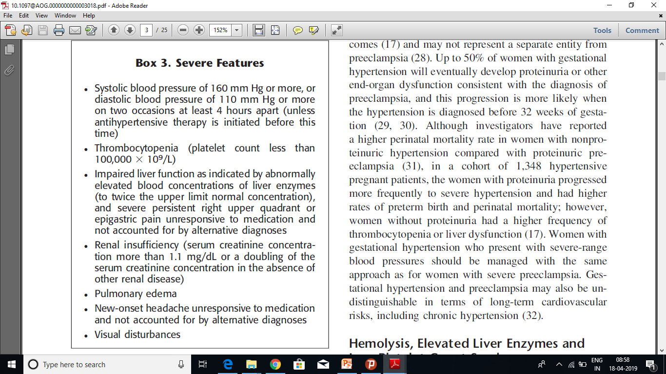

Slide 27
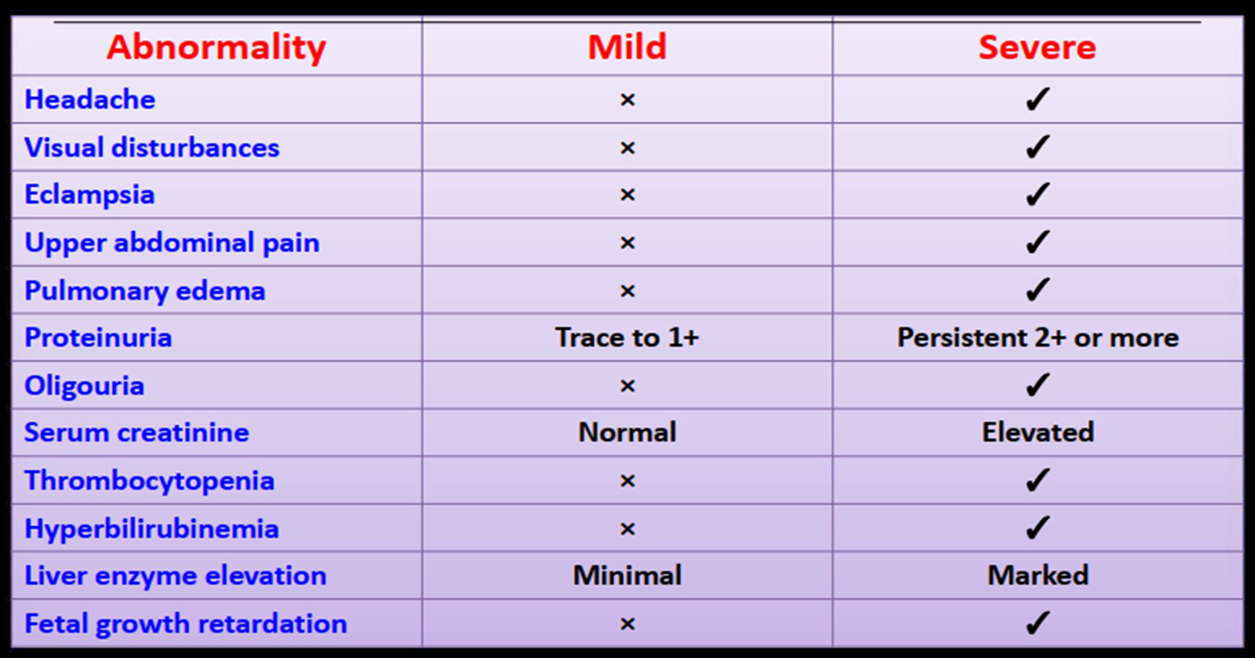
Severe Preeclampsia
BP is not always a dependable indicator of severity

Slide 28
Chronic Hypertension with Superimposed Preeclampsia ( CHSP)
Develop in 25 % of women with chronic hypertension
higher in women with underlying renal disease.
DIAGNOSIS
Experience a sudden exacerbation of hypertension (not sufficient alone)
Develop maternal organ dysfunction
New-onset proteinuria
Increase in proteinuria in proteinuric renal disease

Slide 29
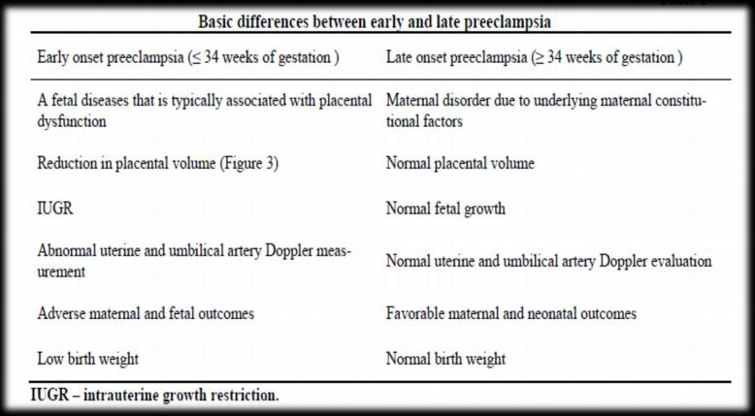
Early Vs. Late Preeclampsia

Slide 30
HELLP Syndrome
Clinical presentation is one of the more severe forms of preeclampsia because it has been associated with increased rates of maternal morbidity and mortality.
Presenting symptoms
  right upper quadrant pain and generalized malaise-90%
  nausea and vomiting - 50%
Routinely used criteria for diagnosis:
  lactate dehydrogenase (LDH) elevated to 600 IU/L or more,
  aspartate aminotransferase (AST) and alanine aminotransferase (ALT) elevated more than
  twice the upper limit of normal
  the platelets count less than 100,000 x 109 /L.

Slide 31
Eclampsia
Eclampsia is defined by new-onset tonic-clonic, focal, or multifocal seizures in the absence of other causative conditions such as epilepsy, cerebral arterial ischemia and infarction, intracranial hemorrhage, or drug use.
often (78–83% of cases) preceded by premonitory signs of cerebral irritation such as severe and persistent occipital or frontal headaches, blurred vision, photophobia, and altered mental status.
can occur in the absence of warning signs or symptoms
Eclampsia can occur before, during, or after labor.

Slide 32
Nervous system manifestations in preeclampsia are:
headache,
blurred vision,
scotomata, and
hyperreflexia.
uncommon, temporary blindness
Nervous system manifestations frequently encountered in preeclampsia are headache, blurred vision, scotomata, and hyperreflexia. Although uncommon, temporary blindness.

Slide 33
Etiopathogenesis
Etiopathogenesis
Still not clear…
chronic uteroplacental ischemia
immune maladaptation
very low-density lipoprotein toxicity
genetic imprinting
increased trophoblast apoptosis or necrosis
exaggerated maternal inflammatory response to deported trophoblasts
possible role for imbalances of angiogenic factors

Slide 34
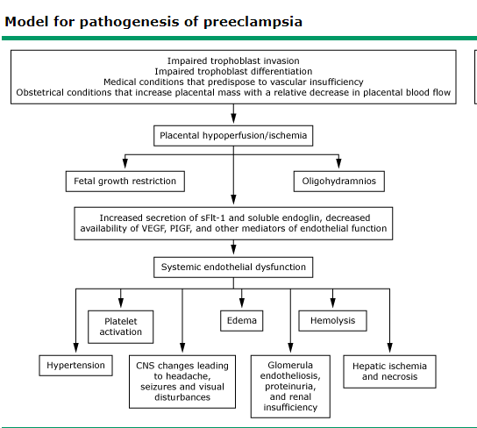
Etiopathogenesis

Slide 35
Prediction
No single test or set of tests can reliably predict the development of preeclampsia
the routine clinical use of rule-in or rule-out tests not recommended
PlGF or sFlt-1 [soluble fms-like tyrosine kinase-1]/PlGF ratio for preeclampsia continue to be evaluated

Slide 36
Prediction Of PE
Why prediction is important?
The ideal screening test
Methods
I. Preconception factors
II. Pregnancy-Related Factors
1. Risk factors
2. Markers

Slide 37
1.Preconception factors
1st step in the management of a woman with a history of PE is to conduct a detailed evaluation of potential risk factors (Barton& Sibai, 2008).

Slide 38
Risk Factors ( ACOG, 2019) (PREconceptional)
High | Moderate
-History of preeclampsia, especially when accompanied by an adverse outcome -Multifetal gestation -Chronic hypertension -Type 1 or 2 diabetes -Renal disease -Autoimmune disease ( SLE, antiphospholipid syndrome) | -Nulliparity -Obesity (BMI > 30) -Family history of preeclampsia (mother or sister) -Sociodemographic characteristics (African American race, low socioeconomic status) -Age 35 years or older -Personal history factors (LBW, SGA, Previous adverse pregnancy outcome, > 10-year pregnancy interval)

Slide 39
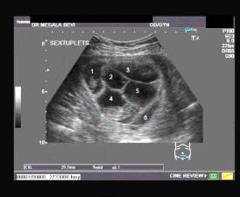
II. Pregnancy-Related Factors
Risk factors: Magnitude of risk depends on the number of factors
-Hydrops/hydropic degeneration of the placenta
-Multifetal gestation
-Unexplained FGR
  -Gestational hypertension
-UTI
-Periodontal infection
Markers
  Biophysical
  Biochemical

Slide 40
Markers
Many
Based on: pathophysiological abnormalities

Slide 41
Biochemical Markers
The most widely studied and promising markers being developed are VEGF(Vascular Endothelial Growth Factor) and PlGF (pacental growth factor) and their antagonist sFlt-1(soluble FNS like Tyrosine Kinase) and sEng(Soluble Endoglin).
During pregnancy, sFlt-1 levels remain stable until 29–33 weeks, and then rise steadily until delivery
.While levels of PlGF rise progressively starting from the first trimester, reaching its peak around 29–33 weeks, and decline there after.

Slide 42
In preeclampsia, maternal circulating sFlt-1 levels are significantly increased more than one month before the onset of the early detectable clinical symptoms . In the case of PlGF, significant lower concentrations in women who later develop preeclampsia are seen from the beginning of the second trimester.
Individually sFlt-1 and PlGF failed to be good predictors of preeclampsia, but sFlt-1/PlGF ratio lower than 38 has been reported to be negative predictor of preeclampsia with 100% accuracy .
The sFlt-1/PlGF ratio greater than 85 (for early onset preeclampsia, EOPE) or 110 (for late onset preeclampsia, LOPE) are indicative of high risk of developing preeclampsia or placenta-related disorders, and these women should be closely monitored . However, the positive predictive value of the sFlt-1/PlGF ratio is only 18–20% .

Slide 43
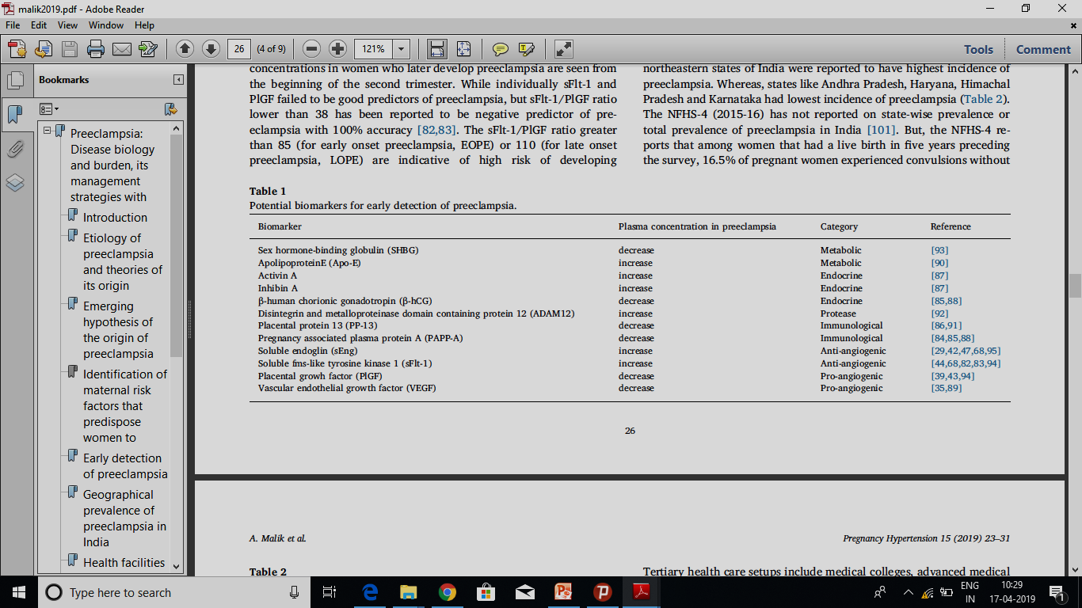

Slide 44
Biophysical Markers
Mean arterial pressure
(2D BP+S BP)/3
Better predictor of PE than S & D BP (BMJ 200817;336:111; Meta-analysis of 34 RCT)
BP remains the cornerstone of early diagnosis although it has limitations:
Measurement errors associated with sphygmomanometer
Effect of maternal posture on BP in pregnant women.

Slide 45
Repeated routine urinalysis:
Throughout pregnancy NOT useful for predicting PE (JAMA 2003: 12;289(10):1220)

Slide 46
Uterine artery Doppler ultrasound
(impaired trophoblastic invasion of the spiral arteries: reduction in uteroplacental blood flow}
High pulsatility index and/or Notch in 1st & 2nd trimesters: poor predictor of PE(Papgeorghiou & Leslie, 2007)
Uterine artery Doppler plus biochemical markers
Promising results
BUT , Current data do not support this combination for routine screening for PE (Barton& Sibai, 2008).

Slide 47
Assessment of proteinuria in hypertensive disorders of pregnancy
1. Interpret proteinuria measurements for pregnant women in the context of a full clinical review of symptoms, signs and other investigations for pre eclampsia. [2019]
2. Use an automated reagent-strip reading device for dipstick screening for proteinuria in pregnant women in secondary care settings. [2019]
3. If dipstick screening is positive (1+ or more) use albumin:creatinine ratio or protein:creatinine ratio to quantify proteinuria in pregnant women. [2019]

Slide 48
Assessment of proteinuria in hypertensive disorders of pregnancy
4. Do not use first morning urine void to quantify proteinuria in pregnant 20 women. [2019]
5. Do not routinely use 24-hour urine collection to quantify proteinuria in 22 pregnant women. [2019]
6. If using protein:creatinine ratio to quantify proteinuria in pregnant women:
  use 30 mg/mmol as a threshold for significant proteiunuria
  if the result is 30 mg/mmol or above and there is still uncertainty about the diagnosis of pre-eclampsia, consider re-testing on a new sample, alongside clinical review. [2019]

Slide 49
Assessment of proteinuria in hypertensive disorders of pregnancy
  7. If using albumin:creatinine ratio as an alternative to protein:creatinine ratio to diagnose pre-eclampsia in pregnant women with hypertension:
  -use 8 mg/mmol as a diagnostic threshold
  -if the result is 8 mg/mmol or above and there is still uncertainty about the diagnosis of pre-eclampsia, consider re-testing on a new sample, alongside clinical review. [2019]

Slide 50
Remember…
BP remains the cornerstone of early diagnosis
Markers Reliability is inconsistent Many suffer from poor specificity & predictive values. None provided a cutoff value that could be clinically useful for the prediction of PE (Widmer et al, 2007)

Slide 51
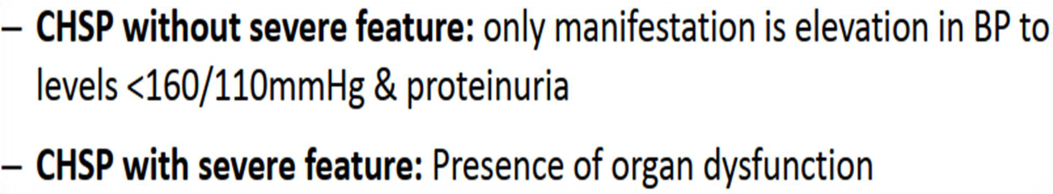
Chronic Hypertension with Superimposed Preeclampsia ( CHSP)
Develop in 25 % of women with chronic hypertension
higher in women with underlying renal disease.
DIAGNOSIS
Experience a sudden exacerbation of hypertension (not sufficient alone)
Develop maternal organ dysfunction
New-onset proteinuria
Increase in proteinuria in proteinuric renal disease

Slide 52
Management

Slide 53
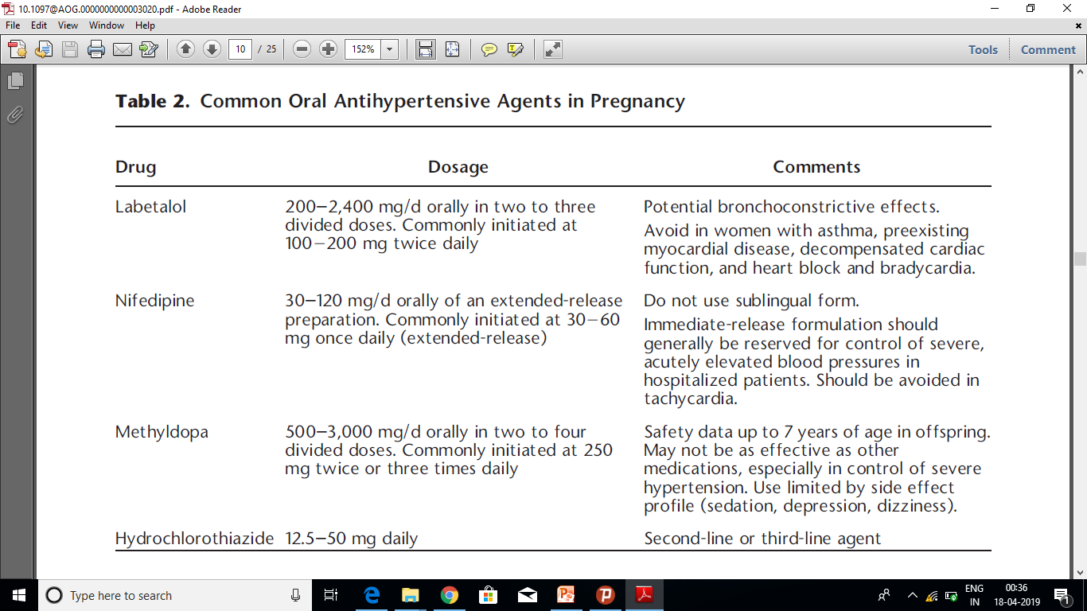
Drugs For Management of Hypertension In Pregnanacy

Slide 54
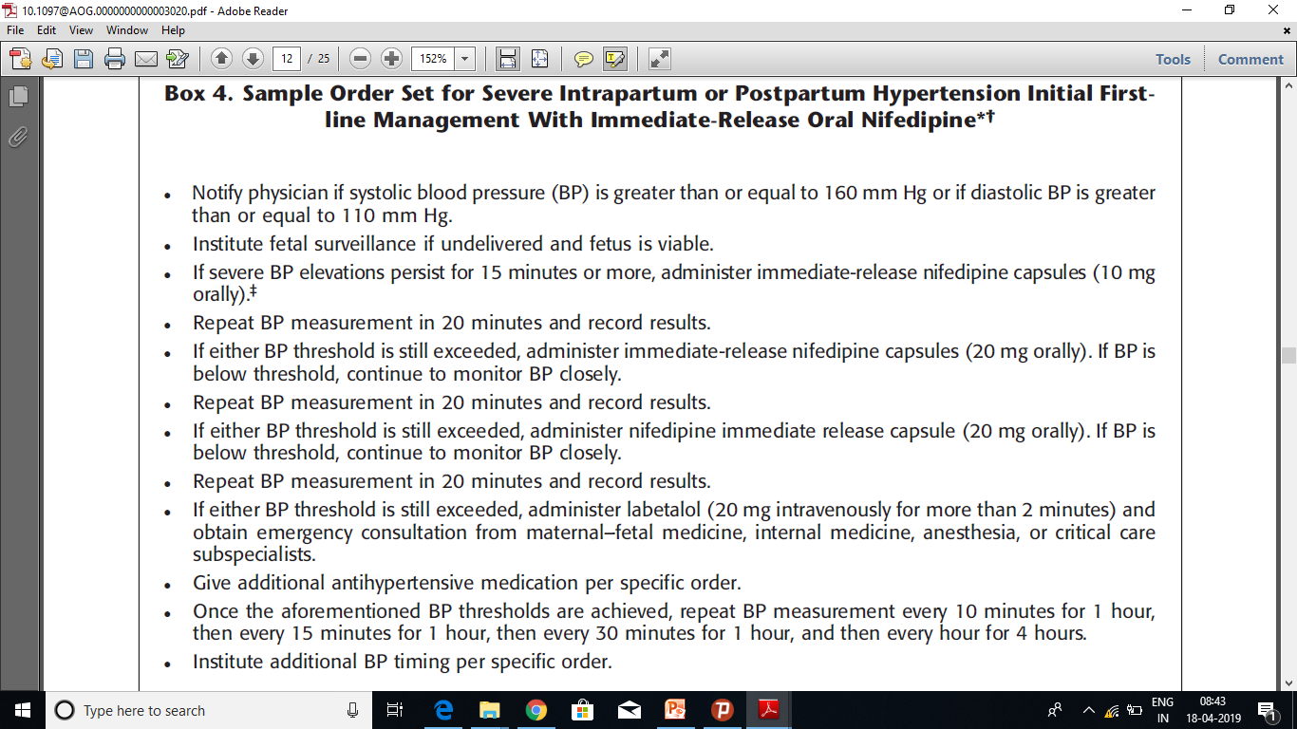
Management of Severe Hypertension

Slide 55
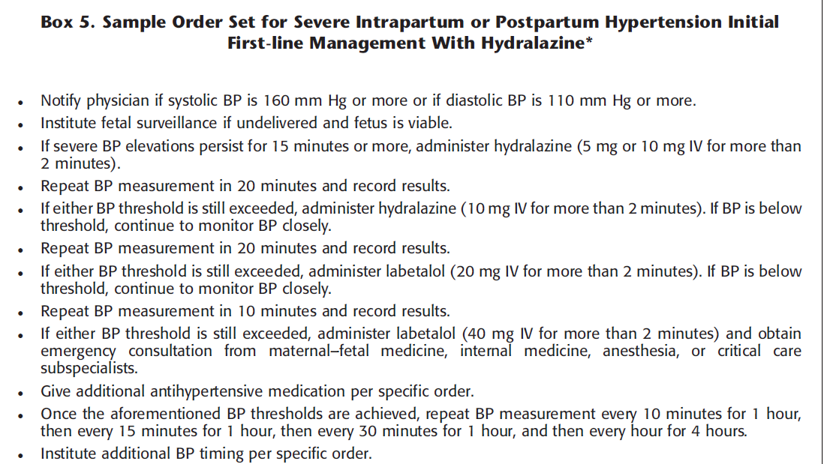
Management of Severe Hypertension

Slide 56
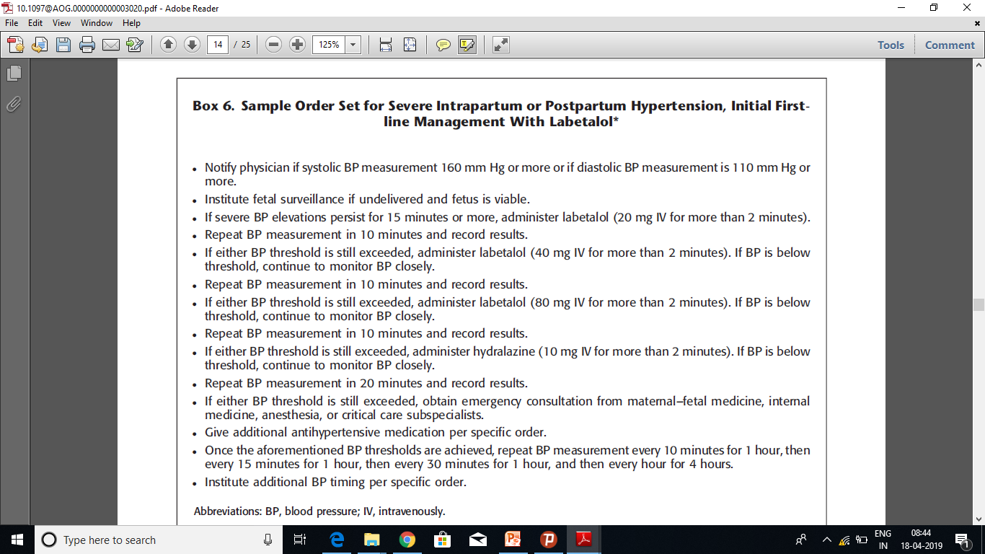
Management of Severe Hypertension

Slide 57
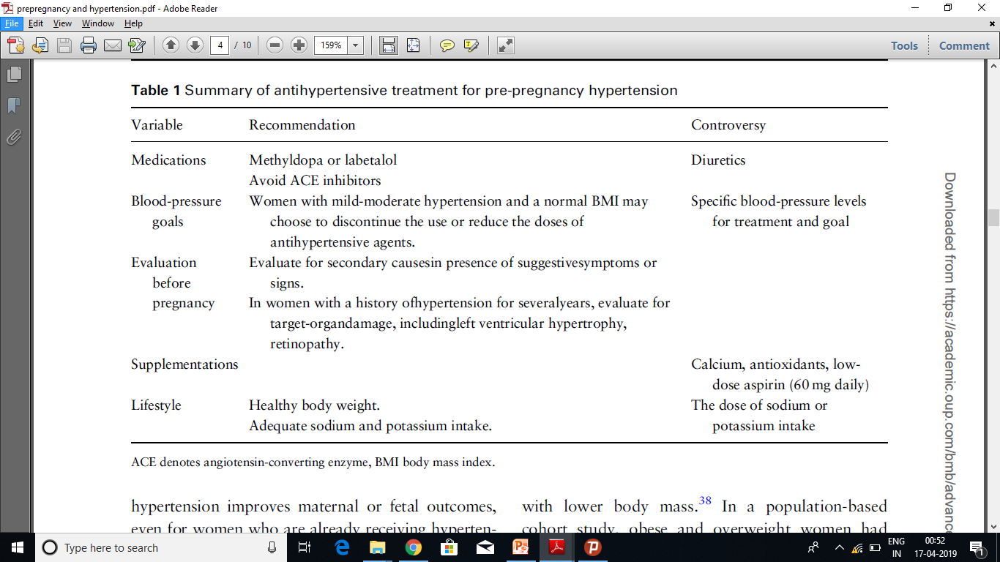
The management of hypertension in women planning for pregnancy

Slide 58
Chronic Hypertension
Initial low dose aspirin(81mg) between 12 weeks to 28 weeks(preferably before 16 weeks) till Delivery (level A)
ACE/ARB/Renin Inhibitors/Minerocorticoid receptor antagonist – NOT RECOMMENDED
Acute onset Severe HTN-(SBP<160/DBP>110) after confirming persistance start Anti HTNsive within 15 to 30 mins. (level B)

Slide 59
Expert suggest that: In Chronic HTNsive Patients
Prepregnancy evaluation for end organ damage.
Third Trimester USG- To R/o Fetal Growth Restriction.
Maintain BP- (on Anti HTN Medication)
    SBP- 110mmhg to 140mmhg
    DBP- 80mmhg to 85mmhg

Slide 60
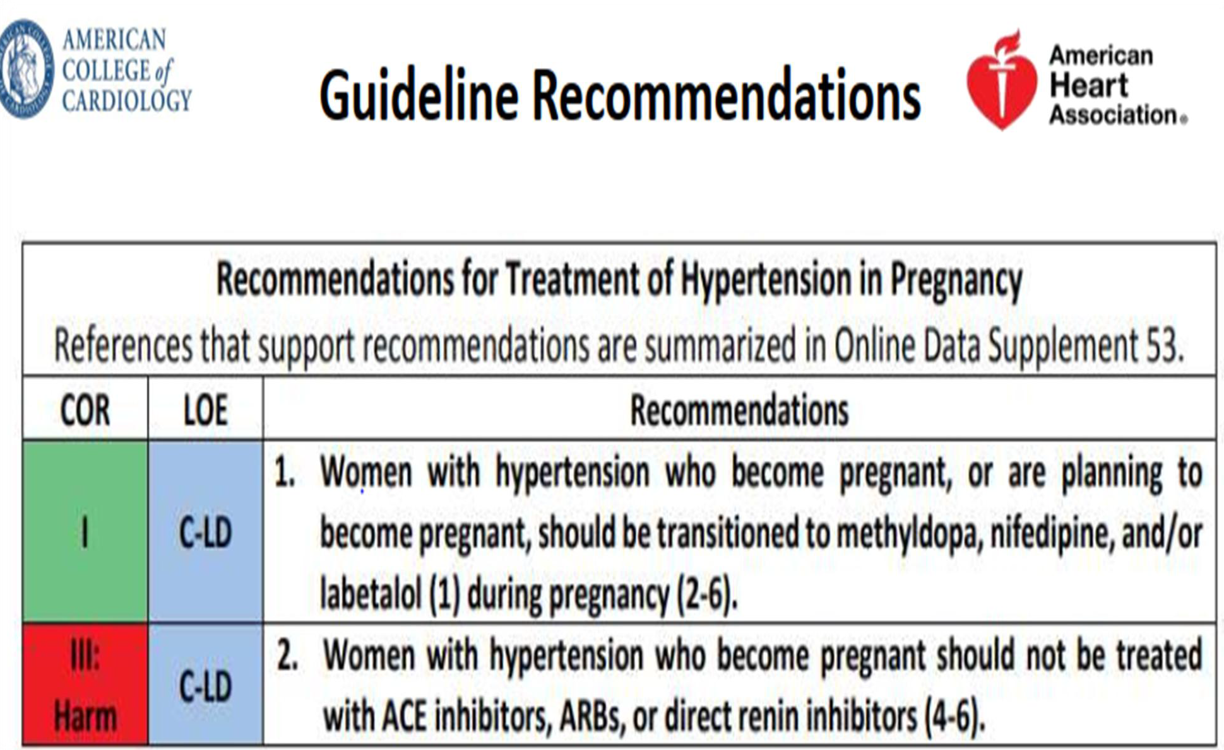
Chronic Hypertension

Slide 61
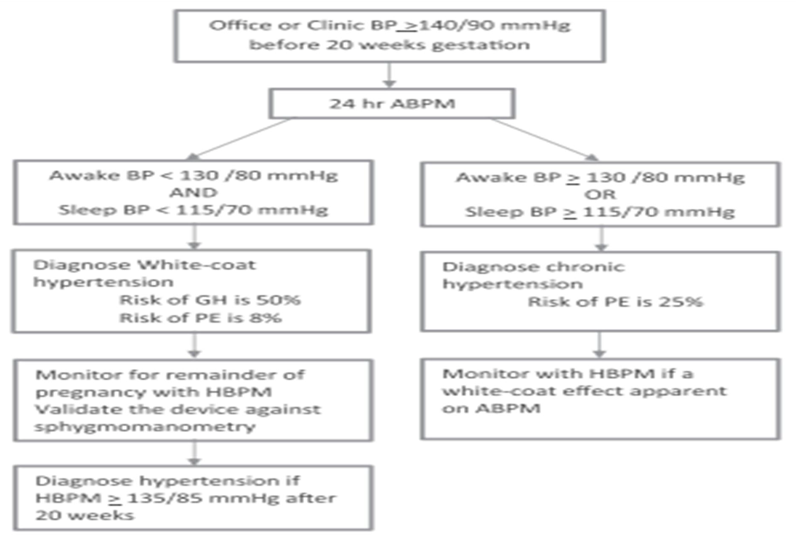
White-Coat Hypertension

Slide 62
Gestational hypertension Preeclampsia without severe features
>37 Weeks of Gestation-DELIVER
<37 Weeks of Gestation- Expectant Management till term or maternal/fetal indication for Delivery.
ACOG,2019 Level A Recommendation

Slide 63

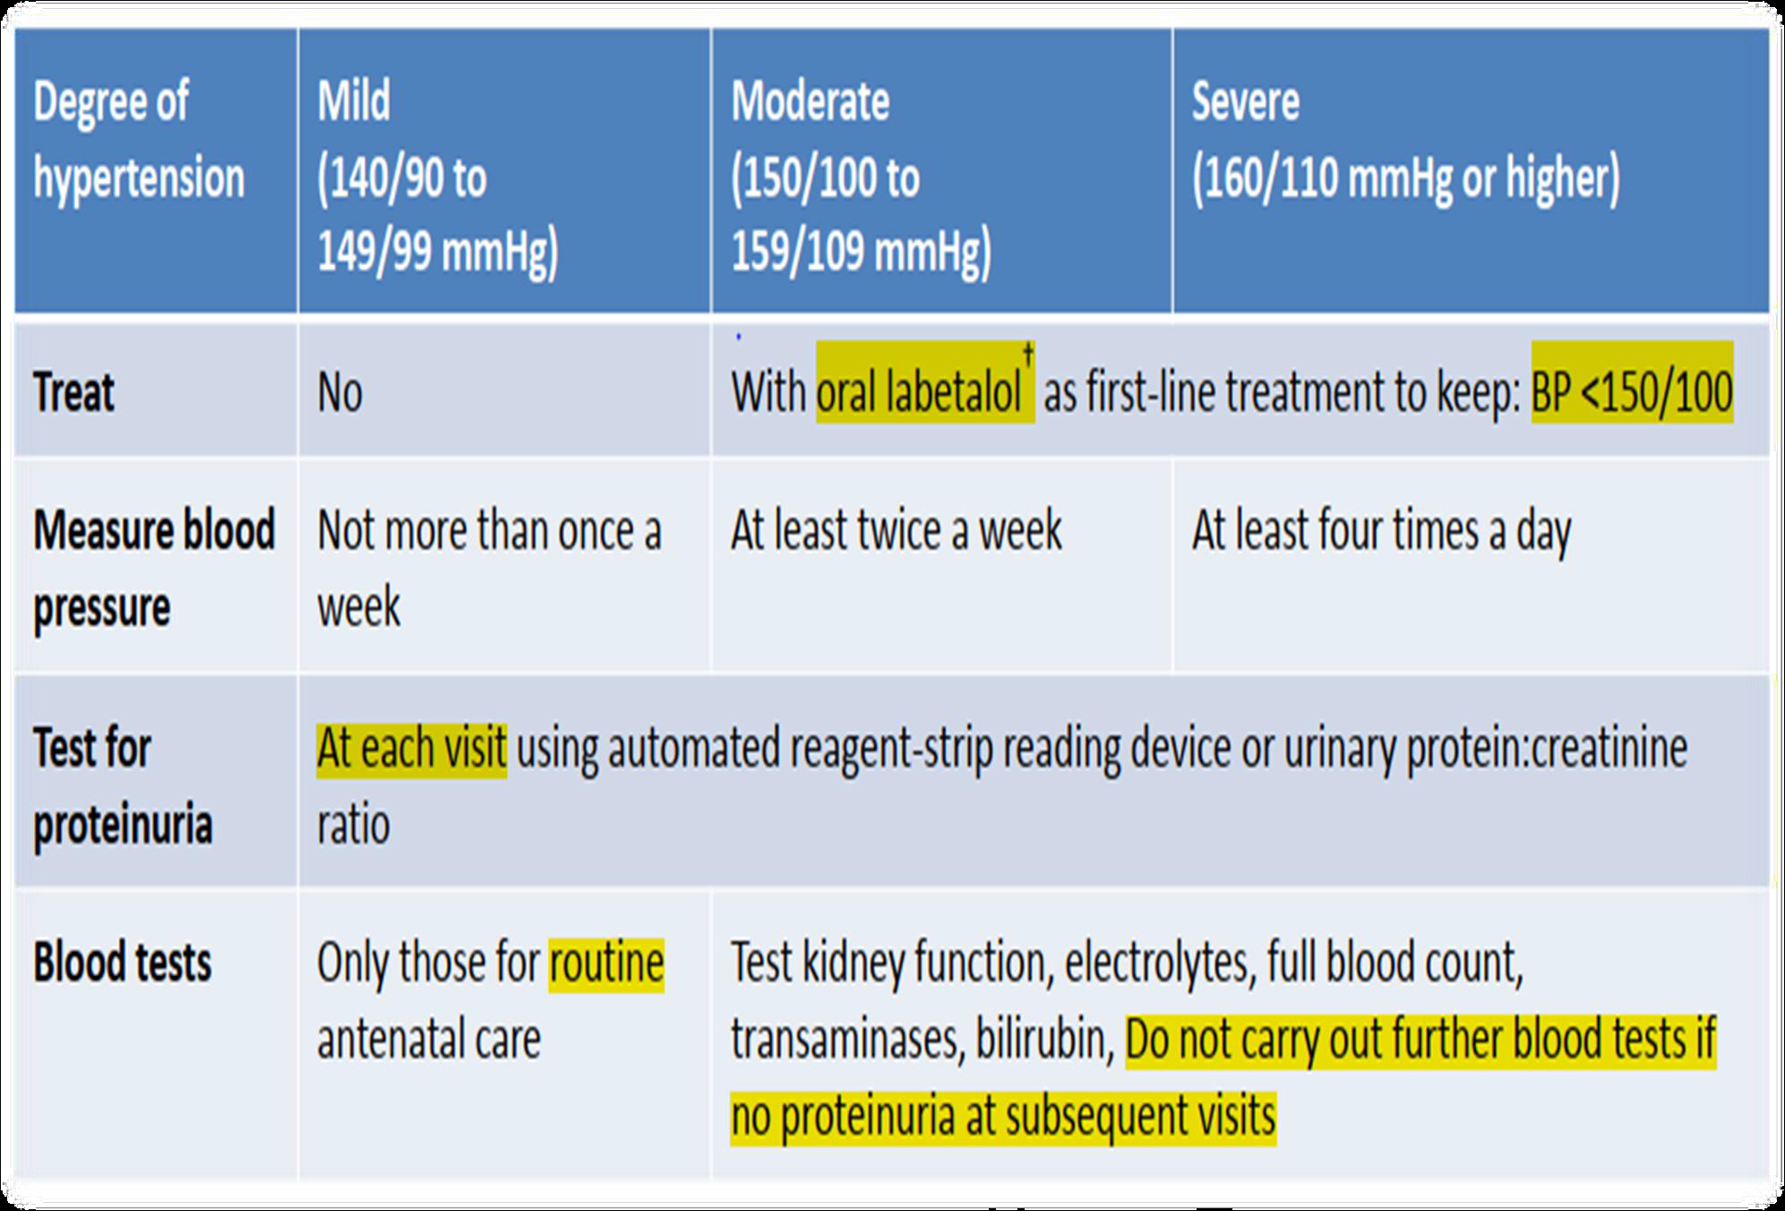
Gestational Hypertension

Slide 64
Are there prevention strategies for reducing the risk of hypertensive disorders of pregnancy?
To date, no intervention has been proved unequivocally effective at eliminating the risk of preeclampsia.
a significant reduction in preeclampsia with calcium supplementation, with the greatest effect among women with low-baseline calcium intake(1.2–2.5g/d)
Women with any of the high-risk factors for preeclampsia should receive low-dose (81 mg/ day) aspirin for preeclampsia prophylaxis initiated between 12 weeks and 28 weeks of gestation (optimally before 16 weeks of gestation) and continuing until delivery

Slide 65
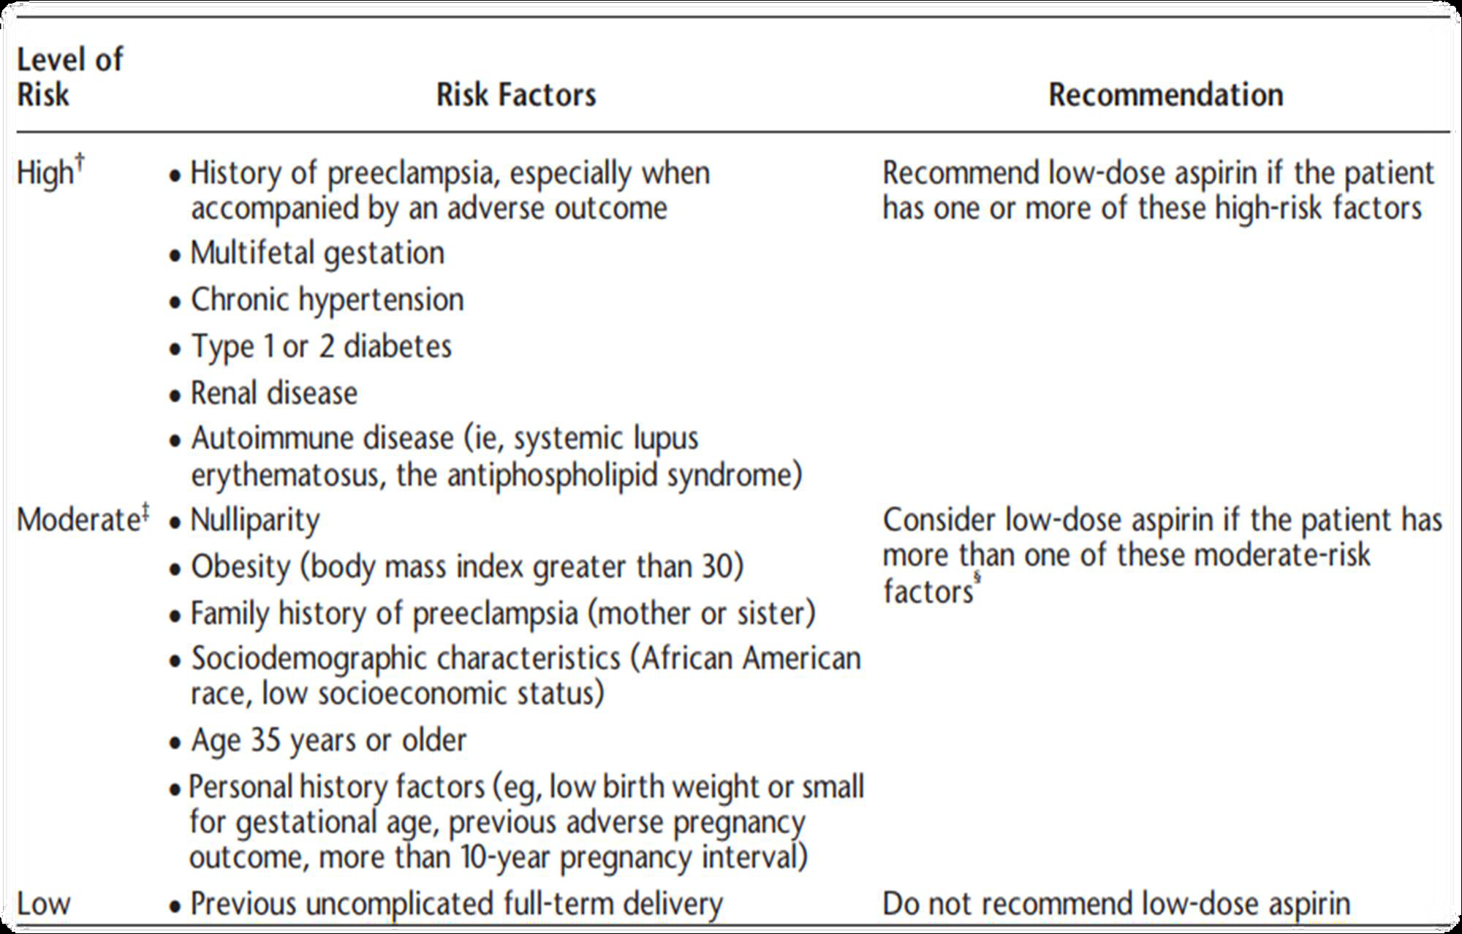
Prevention ( ACOG , 2019)
Clinical risk factors and aspirin use

Slide 66
What is the optimal treatment for women with gestational hypertension or preeclampsia?
Delivery Versus Expectant Management
Initial evaluation,
  a complete blood count with platelet estimate,
  serum creatinine,
  LDH,
  AST, ALT, and
  testing for proteinuria
  a uric acid
  a comprehensive clinical maternal and fetal evaluation

Slide 67
Fetal Monitoring and Management
At 1st Dx of PE Fetal biometry , EFW, AFI assessment, and fetal Doppler waveform performed
In confirmed preeclampsia serial evaluation of fetal growth, AFI and UA Doppler 24 weeks’ gestation
Fetal growth no more than at 2 WK intervals.
More frequent ultrasound measurements if there is high UA RI or absent or reversed end-diastolic flow.
Prenatal corticosteroids for fetal lung maturation given between 24+0 and 34+0 weeks
Multiple steroid courses not recommended.
MgSO4 for fetal neuroprotection should be administered in gestations before 32 weeks.

Slide 68
Gestational hypertension or preeclampsia without severe features
Continued monitoring until delivery at 37 0/7 weeks of gestation.
In women with gestational hypertension or preeclampsia without severe features at or beyond 37 0/7 weeks of gestation, delivery rather than expectant management upon diagnosis is recommended.
Women should be advised to immediately report any persistent, concerning, or unusual symptoms.
Continued monitoring of women includes:
    serial ultrasonography to determine fetal growth,
    weekly antepartum testing,
    close monitoring of blood pressure, and
    weekly laboratory tests for preeclampsia

Slide 69
Gestational hypertension or preeclampsia with Severe Feature.
Diagnosed at or beyond 34 0/7 weeks: - Delivery is recommended.
-Delivery should not be delayed for the administration of steroids in the late preterm period.
At less than 34 0/7 weeks of gestation –
with stable maternal and fetal condition expectant management may be considered.

Slide 70
NO Expectant Management (ACOG,2019)
Maternal | Fetal
Uncontrolled severe BP ( not responsive to antihypertensive ) Persistent refractory headaches Epigastric pain or right upper pain Persistent Visual disturbances, motor deficit or altered sensorium Stroke Myocardial infarction HELLP syndrome New or worsening renal dysfunction Pulmonary edema Eclampsia Suspected acute placental abruption or vaginal bleeding in the absence of placenta previa | Abnormal fetal testing Fetal death Fetus without expectation for survival at the time of maternal diagnosis ( lethal anomaly, extreme prematurity) Persistent reversed end-diastolic flow in the umbilical artery

Slide 71
Tight or Relaxed Control of BP?
NEJM January 2015
● A multi-centre RCT of 987 women 15-34 weeks
with chronic hypertension (75%) or gestational
hypertension
● Tight = BP below 85mm diastolic BP vs
● Relaxed control BP up to 100mm
● No difference in terms of perinatal death, severe
neonatal morbidity or serious maternal sequelae
up to 6 weeks postnatal
● Significantly more women with Relaxed control had
severe hypertension CF those under tight control
(40.6% vs 27.5%, P<0.001)

Slide 72
Inpatient Versus
Outpatient Management
Ambulatory management at home -women with gestational hypertension or preeclampsia without severe features (expectant management up to 37 0/7 weeks)
  frequent fetal and maternal evaluation
  Maternal evaluation
    weekly evaluation of platelet count, serum creatinine, and liver enzyme levels
    once weekly assessment of proteinuria is recommended.
  Fetal Evaluation ultrasonography
    fetal growth every 3–4 weeks of gestation
    amniotic fluid volume assessment at least once weekly.
Hospitalization is appropriate for women with severe features.

Slide 73
Magnesium sulphate protocol
Magnesium sulphate is the drug of choice to prevent further seizures in women with eclampsia and to reduce the risk of seizures in
women with severe pre-eclampsia.
• Magnesium sulphate is also used for neuroprotection of the fetus at gestation <30 weeks.

Slide 74
Precautions
- Using this drug can be hazardous in
association with:
• myasthenia gravis
• renal failure or severe renal compromise
• hypocalcaemic states
• other drugs, especially vasoactive drugs
• acute haemolytic states
• cardiac ischemia, heart block, or myocarditis

Slide 75
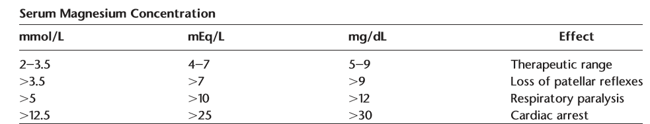
Serum Magnesium Concentration and Toxicities

Slide 76
Magnesium sulphate IV regimen
• The total adult daily dose should be no more than 40 g of magnesium sulphate.
• Do not administer more than 8 g of magnesium sulphate over 1 hour.
• Continue for 24 hours following birth or 24 hours after the last seizure, whichever is the later.

Slide 77
Magnesium sulphate IV regimen
• To prevent eclampsia (prophylaxis)
• For the loading dose, administer 4 g over 10 minutes. ( Concentration should be no higher than 20%.)
• After 10 minutes, use maintenance dose infusion to begin maintenance at 1 g/hour.
• Conduct (ECG) monitoring .

Slide 78
Magnesium sulphate IV regimen
For eclamptic seizures
• For the loading dose, administer 4 g over 5–10 minutes.
• After 10 minutes, use maintenance dose infusion to begin maintenance at 1 g/hour.
• Conduct ECG monitoring and have anesthetist on site.
• If seizures have not stopped, an alternative medication may be required.

Slide 79
Magnesium sulphate IV regimen
When seizure recurs during maintenance treatment:
Administer 2 g IV over 10 minutes.
Once the condition is stable, either: – reset infusion pump to maintenance dose of 1 g/hour – increase the maintenance infusion rate to 2 g/hour.
Check for hyporeflexia and reduced respiration rate.
Ensure calcium gluconate is available.

Slide 80
Intramuscular dose (suitable for retrieval and transfer)
• Administer two deep intramuscular injections of 4 g magnesium sulphate 50% solution into each buttock (the total dose of up to 10 g injected into one site is highly irritating)
• Provide maintenance treatment of 5 g magnesium sulphate 50%, given by deep intramuscular injection, every 4 hours.

Slide 81
Monitoring
• – Blood pressure – every 5 minutes during loading dose and then hourly during maintenance dose
• – Respiratory rate/SpO2 – hourly
• – Patellar/brachial reflexes – hourly –
• - Urine output – review hourly . Should be
>100 mL/4 hours
• – Pre-eclampsia bloods = full blood count ,
creatinine, electrolytes, liver function tests
(albumin, ALT and AST).

Slide 82
Monitoring
• Stop the infusion if:
– reflexes are absent
– the respiratory rate is less than 12 per minute,
or – the urine output drops below 100 mL in 4 hours.
• Toxicity If signs of toxicity occur (hypoventilation,
arrhythmia, hypotonia):
• • Administer oxygen at 8–12 liters/minute
• • Stop infusion • monitor vital signs
• • Administer calcium gluconate (10% solution), 10
mL, slowly intravenously
• • Check electrolytes, creatinine and magnesium
sulphate levels.

