Slide 1
INFLAMMATORY BOWEL DISEASE
DR.SUNIL KUMAR

Slide 2
ETIOPATHOGENESIS
Exact cause is unknown.
Genetic factors
Immunological factors
Microbial factors
Psychosocial factors

Slide 3
INFLAMMATORY BOWEL DISEASE
INFLAMMATORY BOWEL DISEASE IS AN IMMUNE MEDICATED , CHRONIC INFLAMMATORY CONDITION.
It includes a group of chronic disorders that cause inflammation or ulceration in THE INSTESTINAL TRACT.
ULCERATIVE COLLITIS AND CROHN’S DISEASE ARE THE TWO MAJOR TYPES OF IBD.

Slide 4
EPIDEMOLOGY
 | ULCERATIVE COLITIS | CROHN’S DISEASE
INCIDENCE (PER 100,000) | 0-19.2 | 0-20.2
AGE OF ONSET | 2ND TO 4TH AND 7TH TO | 9TH DECEDE
ETHNICITY | JEWISH >WHITE> AFRICAN >HISPANIC >ASIAN | AMERICAN
FEMALE/MALE RATIO | .51-1.58 | .34-1.65
SMOKING | MAY PREVENT DISEASE | MAY CAUSE DISEASE
ORAL CONTRACEPTIVES | DONOT INCREASE RISK | MAY CAUSE DISEASE
APPENDECTOMY | POTECTIVE | NOT PROTECTIVE
MONOZYGOTIV TWINS | 6-18 % CONCORFANCE | 38-15%
DIZYGOTIC TWINS | 0-20 % CONCORDANCE | 4 %

Slide 5
GENETIC FACTORS
THE DISEASE AND GENETIC RISK FACTORS THAT ARE SHARED WITH ibd are ; rheumatoid arthritis (tnfaip3) , psoriasis (il23r, il12b) ankylosing spoNdyltis (il23r) , type 1 diabetes melltus (il10) ,sle (tnfaip3 , il10)
ibd has 3-20 times higher incidence in first degree relatives

Slide 6
IMMUNOLOGIC FACTORS
Defective regulation of immunosuppresion.
Activated CD+4 cells activate other inflammatory cells like
macrophages & B-cells or recruit more inflammatory cells by stimulation of homing receptor on leucocytes & vascular epithelium.

Slide 8
PATHOLOGY
MACROSCOPIC FEATURES .
ULCERATIVE COLLITIS
Usually involves rectum & extends proximally to involve all or part of colon.
Spread is in continuity.
May be limited colitis( proctitis & proctosigmoiditis)
In total colitis there is back wash ileitis (lumpy-bumpy appearance)

Slide 10
Mild disease- erythema & sand paper appearance(fine granularity)
Moderate- marked erythema, coarse granularity, contact bleeding & no ulceration
Severe- spontaneous bleeding, edematous & ulcerated(collar button ulcer).
Long standing- epithelial regeneration s/o pseudopolyps , mucosal atrophy & disorientation leads to a precancerous condition. Eventually can lead to shortening and narrowing of colon.
Fulminant disease-Toxic colitis/megacolon

Slide 12
MICROSCOPIC FEATURES
Crypts atrophy & irregularity
Superficial erosion
Diffuse mixed inflammation
Basal lymphoplasmacytosis

Slide 13
DIFFUSE INFLAMMATION
CRYPT DISTORTION

Slide 14
MACROSCOPIC FEATURES
CROHN’S DISEASE
Can affect any part of GIT.
Transmural
Segmental with skip lesions
Cobblestone appearance
Creeping fat- adhesions & fistula

Slide 17
MICROSCOPIC FINDINGS
Aphthous ulcerations
Focal crypt abscesses
Granuloma-pathognomic
Submucosal or subserosal lymphoid aggregates
Transmural with fissure formation

Slide 18
APHTHOUS ULCERS
GRANULOM

Slide 19
CLINICAL FEATURES
ULCERATIVE COLITIS
Diarrhoea
Rectal bleeding
Tenesmus
Passage of mucus
Crampy abdominal pain

Slide 20
Diarrhoea & bleeding blood-intermittent &mild. do not seek medical attention.
Patient with proctItis- pass fresh or blood stained mucus with formed or semi formed stool.
They also have tenesmus , urgency with feeling of incomplete evacuation.
With proctosigmoiditis-constipation
Severe disease-liquid stools with blood , pus & fecal matter.

Slide 21
CLINICAL SEVERITY OF UC
 | MILD | MODERATE | SEVERE
BOWEL MOVEMENTS | < 4 /DAY | 4-6 / DAY | > 6 /DAY
BLOOD IN STOOL | LITTLE | MODERATE | SEVERE
FEVER | NONE | <99.5 F | >99.5
HEART RATE | NORMAL | <90/MIN | >90/MIN
ANEMIA | MILD | <75 OR NORMAL | PERFUSSION REQUIED
ESR | <30 |  | >30

Slide 22
DIAGNOSIS
• Laboratory tests
• Endoscopy
• Radiography
• Biopsy
• CT enterography
• wireless capsule endoscopy

Slide 23
LAB TESTS
Hemogram
C-reactive protein is increased
ESR is increased
Platelet count- increased
Heamoglobin- decreased
Leukocytosis
hypoalbuminemia
Feacal Calprotectin levels correlate with histological inflammation , predict relapses & detect pouchitis

Slide 24
BARIUM ENEMA
Fine mucosal granularity
Superficial ulcers seen
Collar button ulcers
Pipe stem appearance loss
of haustrations
Narrow & short colon
ribbon contour colon

Slide 25
SIGMOIDOSCOPY
• Always abnormal
• Loss of vascular patterns
• Granularity
• Friability
• ulceration

Slide 27
String sign

Slide 28
CT enterography
• Mural hyperenhancement
• Stratification
• Engorged vasa recta
• Peri-enteric inflammatory
changes

Slide 29
Wireless capsule endoscopy
(WCE)
It is a noninvasive technology designed primarily to provide diagnostic imaging of the small intestine, an anatomic site that has proven peculiarly difficult to visualize.
Limited views of the esophagus, stomach, and cecum may also be acquired.
Images acquired are of excellent resolution and have a 1:8 magnification, which is higher than that of conventional endoscopes.

Slide 30
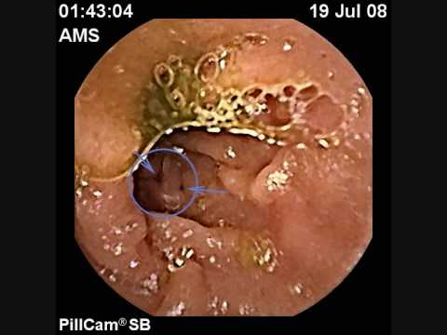
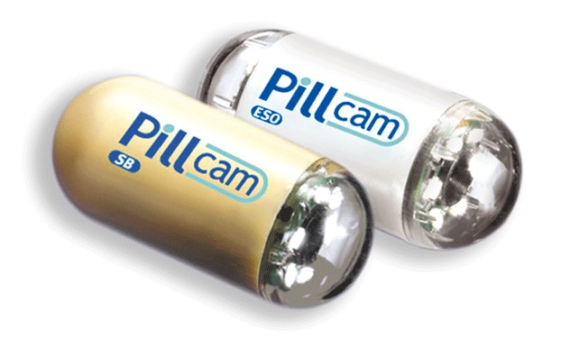

Slide 31
TREATMENT
DRUGS
SURGICAL THERAPY
NUTRITIONAL THERAPY
LIFESTYE CHANGES

Slide 32
DRUGS
• 5-ASA agents
• Glucocorticoids
• Antibiotics
• Immunosuppresants
• Biological therapy

Slide 33
5–ASA agents
Sulfasalazine (5-aminosalicylic acid and sulfapyridine as carrier substance) ~ 3-6 g/day
Mesalazine (5-ASA), e.g. Asacol, Pentasa ~ 2.4-4.8 g/day
Balsalazide (prodrug of 5-ASA) ~ 6.75-9 h/day
Olsalazine (5-ASA dimer cleaves in colon) ~ 1-3 g/day

Slide 34
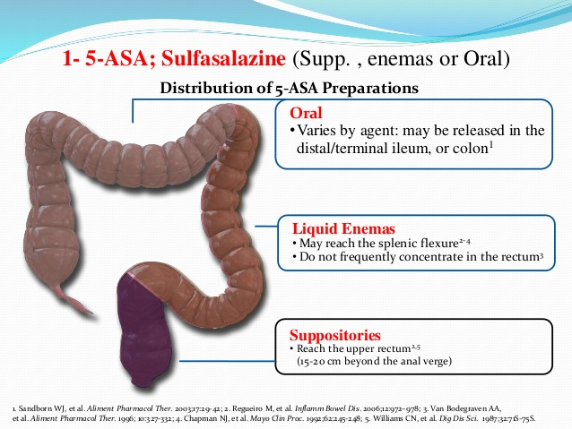
Topical Action of 5-ASA: Extent of Disease
Impacts Formulation Choice

Slide 35
use
In mild to moderate UC & crohn’s colitis
Maintaining remission
May reduce risk of colorectal cancer
Adverse effects
Nausea, headache, epigastric pain, diarrhoea, hypersensitivity, pancreatitis
Caution in renal impairment, pregnancy, breast feeding

Slide 36
glucocorticoids
• Anti inflammatory agents for moderate to
severe relapses.
• Inhibition of inflammatory pathways
• Budesonide- 9mg/dl used for 2-3 months &
then tapered.
• Prednisone-40-60mg/day
• No role in maintainence therapy

Slide 37
amtibiotics
No role in active UC
Metronidazole is effective in active inflammatory, fistulous & perianal CD.
Dose-15-20mg/kg/day in 3 divided doses.
Ciprofloxacin 500 mg bd

Slide 38
Immunosupressants
• purine analogues
Azathioprine ~ 2-3 mg/kg/day
6-mercaptopurine ~ 1-1.5 mg/kg/day
• Methotrexate ~ 25 mg/week

Slide 39
cyclosporines
Preventing clonal expansion of T cell subsets
• Use
Steroid sparing
Active and chronic disease
• Side effects
Tremor, paraesthesiae, malaise, headache, gingival
hyperplasia, hirsutism Major: renal impairment,
infections, neurotoxicity

Slide 40
Biological therapy
• Infliximab
Anti TNF monoclonal antibody
Infliximab binds to TNF trimers with high affinity, preventing cytokine
from binding to its receptors
It also binds to membrane-bound TNF- a and neutralizes its activity &
also reduces serum TNF levels.
• Use
Fistulizing CD
Severe active CD
Refractory/intolerant of steroids or immunosuppression
• Side effects
Infusion reactions, Sepsis, Reactivation of Tb, Increased risk of Tb

Slide 41
Other medications
Anti- diarrheal - Loperamide (Imodium)
Laxatives - senna, bisacodyl
Pain relievers. acetaminophen (Tylenol).
Iron supplements
Nutrition

Slide 42
surgery
Ulcerative colitis
Indications:
• Fulminating disease
• Chronic disease with anemia, frequent stools, urgency & tenesmus
• Steroid dependant disease
• Risk of neoplastic change
• Extra-intestinal manifestations
• Severe haemorrhage or stenosis

Slide 43
Crohn’s disease
• Ileo-ceaecal resection
• Segmental resection
• Colectomy & ileorectal anastomosis
• Temporary loop ileostomy
• Proctocolectomy
• Stricturoplasty

Slide 44
Others
• Proctocolectomy & ileostomy
• Rectal &anal dissection
• Colectomy with ileorectal anastomosis
• Ileostomy with intraabdominal pouch

