Slide 1
CONTINUOUS GLUCOSE MONITORING
AND
INSULIN PUMP
DR.SUNIL KUMAR

Slide 2
INTRODUCTION
Diabetes is rapidly becoming a major health epidemic in most regions of the world . All patients with type 1 diabetes and a signiﬁcant number with type 2 diabetes require the use of insulin for controlling blood glucose.
In the last 20 years, technological innovation and bioengineering has transformed the diabetes therapeutic landscape.
There are several varieties of insulin and many different injection regimens that can be used. However, in spite of the availability of insulin vials and pens, the acceptability for patients and the glucose readings that are obtained with the use of single or multiple-dose injection regimens is not to the desired level.

Slide 3
Insulin delivery with pumps
Insulin delivery with pumps, also known as continuous subcutaneous insulin infusion (CSII), was introduced almost a half century ago.
It utilizes short- or rapid-acting insulin types only, thus minimizing variability of administration and reducing the chances of glucose ﬂuctuations. Pump technology has progressed to the level of precisely mimicking physiological demands.
Programmable insulin administration in basal and bolus fashion is integrated and augmented with glucose biosensors to provide real-time, data-driven glycemic control and early detection of hypoglycemia.

Slide 4
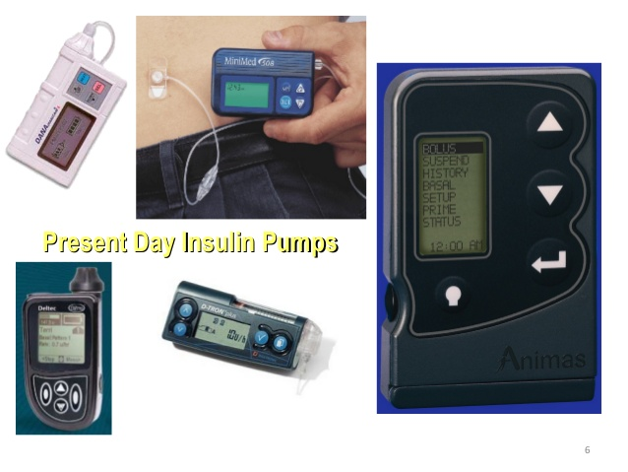
INSULIN PUMP- PRESENT DAY

Slide 5
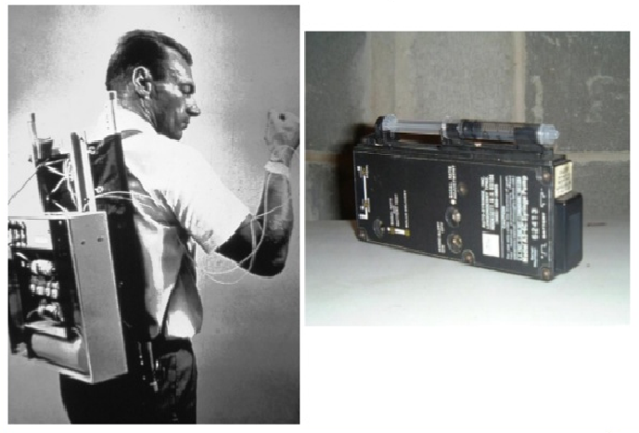
INSULIN PUMP- IN EARLY 1970

Slide 6
How Do Insulin Pumps Work?
Insulin pumps deliver insulin by continuous infusion through a single subcutaneous site which is replaced, on average, every three days.
Only rapid-acting insulin is used and the analogue insulins have gained popularity over regular insulin for this purpose.
A pump delivers programmable basal insulin around the clock which is tailored to the patient’s 24-h glucose proﬁle. The insulin requirements may be affected by the individual’s physiology, the type and duration of daily activity, work schedule, exercise, illness, concomitant medications, etc.
Almost all pumps have the capability of programming basal rates that are modiﬁable every hour and also have a temporary basal rate feature for special situations.

Slide 7
Patients can also deliver bolus insulin which infuses over a few minutes to a few hours. Insulin boluses cover meals and correct for high blood glucose levels.
For the pump to accurately calculate bolus insulin amounts, the carbohydrate content of food and the blood glucose level are required.
Insulin delivery via the pump can be suspended by the patient if necessary

Slide 8
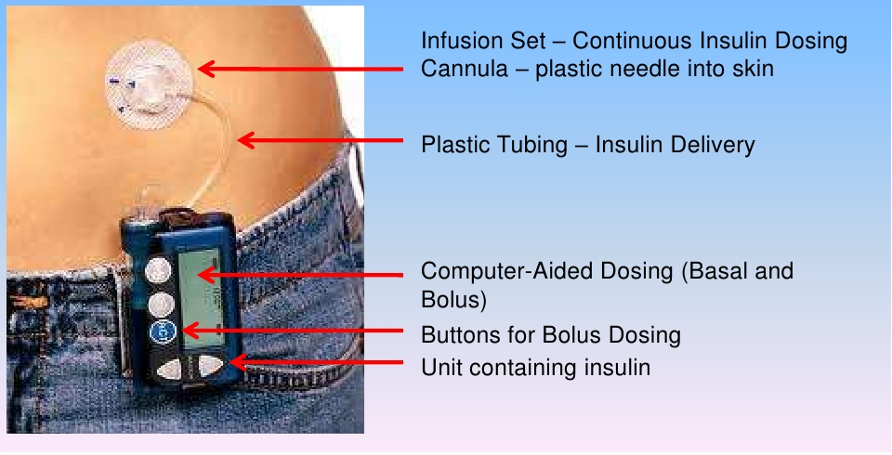
HOW INSULIN PUMP WORKS?

Slide 9
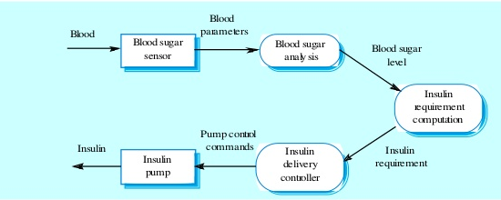
Flow model of insulin delivery system

Slide 10
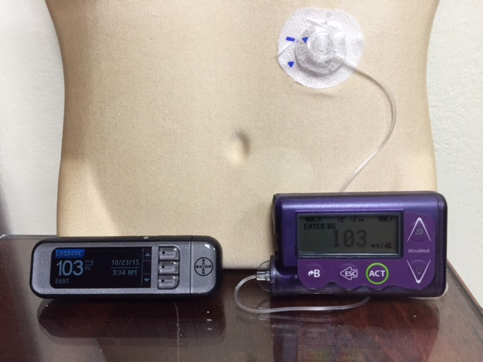
A Medtronic Minimed Insulin Pump
Insulin Pump and a blood glucose meter
that communicates
blood glucose readingwirelessly with it.

Slide 11
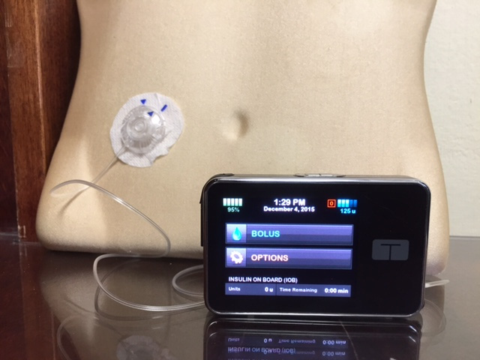
The T-slim Insulin Pump
Popular with young patients due to its new touch-screen design

Slide 12
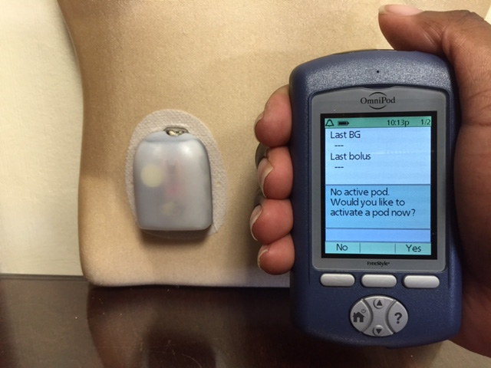
The OmniPod Tubeless Insulin Pump
The OmniPod Tubeless Insulin Pump with a pod (right) and a handheld device that functions as a blood glucose meter and communicates wirelessly with the pod to deliver insulin based on the patient’s personal settings.

Slide 13
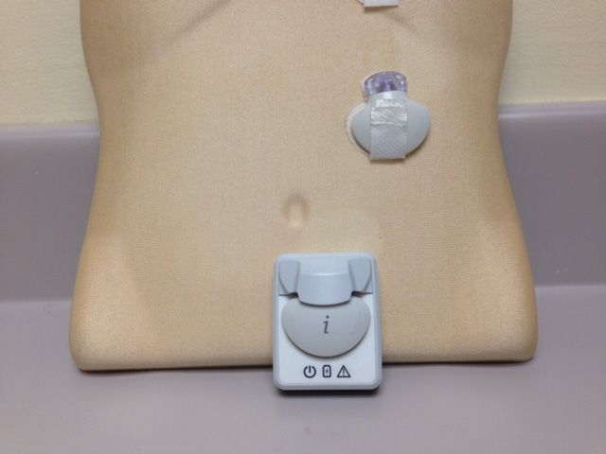
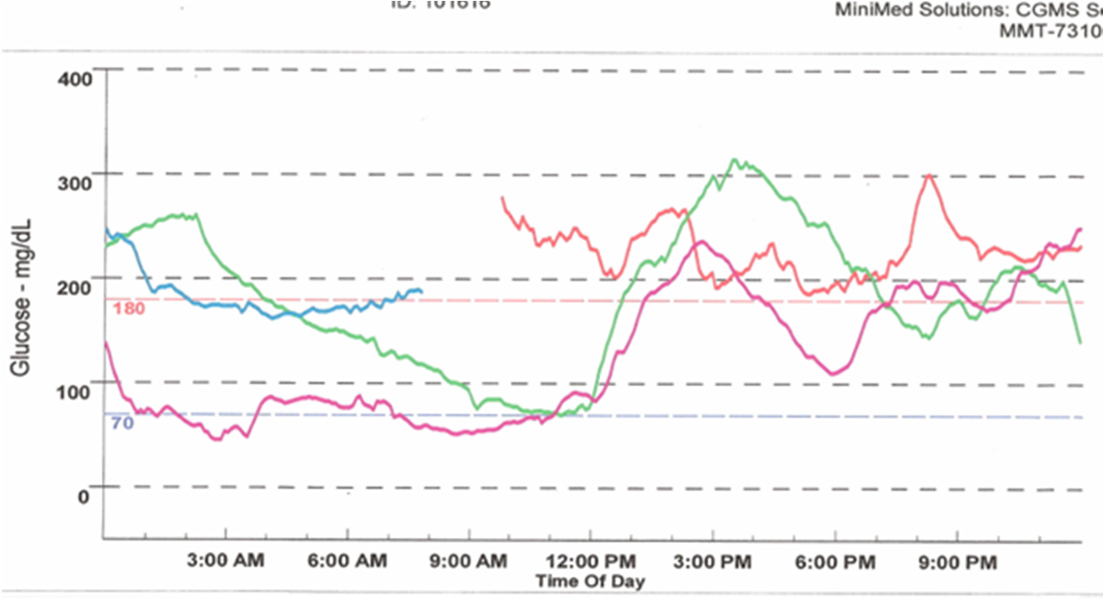
The Medtronic iPro2 Professional Continuous Glucose Monitor (a) with its charger, and a Downloaded Tracing showing daily color-coded readings (b)

Slide 14
Potential Advantages of Insulin Pump Therapy
Programmable insulin delivery allows closer match with physiologic needs
Uses only short- or rapid-acting insulin, minimizing peaks and absorption-related variability
Uses one injection site for up to 72 h, thus reducing variations in absorption and treatment-related burden from multiple injections.
Reduction in glycemic variability and improved glycemic control
Decreased risk of severe hypoglycemia and need for emergent medical attention
Reduction in need for hospitalization and cost of care
Improved quality of life and treatment satisfaction

Slide 15
ISSUES WITH INSULIN PUMP THERAPY
Mechanical malfunction of the pump
Insertion site issues(inﬂammation or skin infections).
Interruption of insulin supply due to kinking or blockage of the infusion set can lead to the rapid development of extreme hyperglycemia, especially in type 1 diabetes.

Slide 16
Indications for Insulin Pump Treatment.
Suboptimal glycemic control in spite of efforts multiple daily insulin injections
Frequent or unpredictable hypoglycemia and hypoglycemia unawareness
“Dawn” phenomenon with persistent early-morning hyperglycemia
An active lifestyle (exercise, strenuous physical activity, athletic pursuits)
Children and young adults who typically desire fewer restrictions and more ﬂexibility

Slide 17
Growth spurt of adolescence
Preconception planning and pregnancy
Presence of gastroparesis
Hectic lifestyle and frequent travel
Shift work and erratic daily schedules
Type 2 diabetes with increased insulin requirements

Slide 18
Continuous Glucose Monitoring (CGM)
A landmark change in diabetes care came with the development of continuous glucose monitoring (CGM) via an indwelling subcutaneous sensor that could check interstitial ﬂuid glucose readings every 3–5 min.
CGM provides more frequent information on blood glucose less invasively than with the use of a traditional meter. It also gives hourly, daily, and weekly glucose trends and patterns, and knowledge of glucose values in real time.

Slide 19
Two types of continuous glucose monitoring systems are available.
The Professional CGM works in a similar fashion to a cardiac Holter monitor. It can be used by physicians’ ofﬁces to record the patient’s ambulatory glucose values for up to six days, followed by downloading and retrospective review and analysis
The Personal CGM is a patient-owned device that allows a small sensor placed subcutaneously to send glucose readings wirelessly and viewed on a separate receiver. An individual sensor can stay in place for up to seven days at a time.

Slide 20
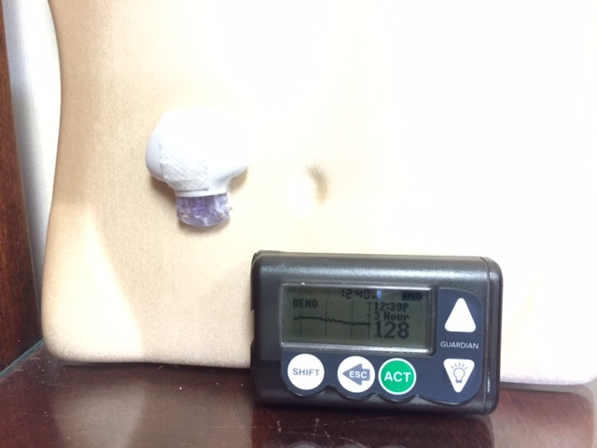
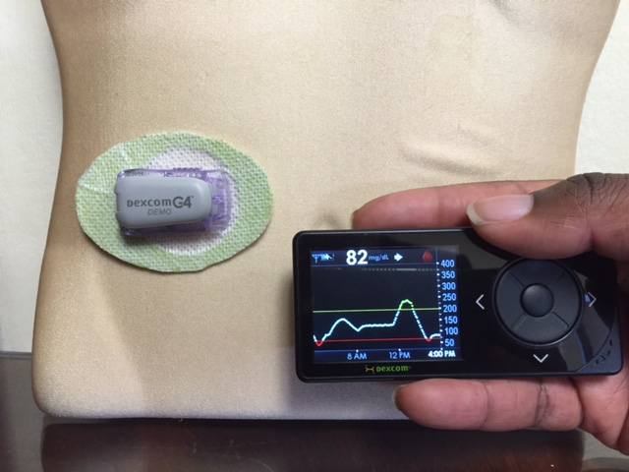
PERSONAL CONTINUOUS GLUCOSE MONITORS
THE Medtronic guardian
DEXCOM 7

Slide 21
SAP (Sensor augmented pump) therapy
Insulin pump therapy combined with real-time continuous glucose monitoring, is known as sensor-augmented pump (SAP) therapy
SAP Therapy has been shown to improve metabolic control and to reduce the rate of hypoglycemia in adults with type 1 diabetes compared to multiple daily injections or standard continuous subcutaneous insulin infusion.
Superior to traditional dialy multi dose insulin injections
Equipped with alarms of high and low readings as well as “Up” and “Down” trend arrows for rapidly changing values.
Eg:- Medtronic 530G , Animas Vibe pump

Slide 22
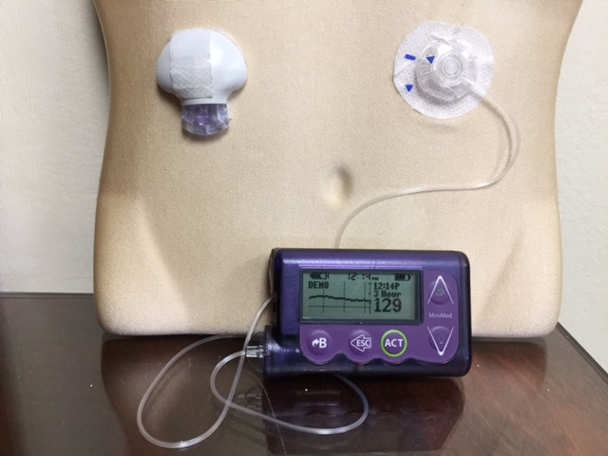
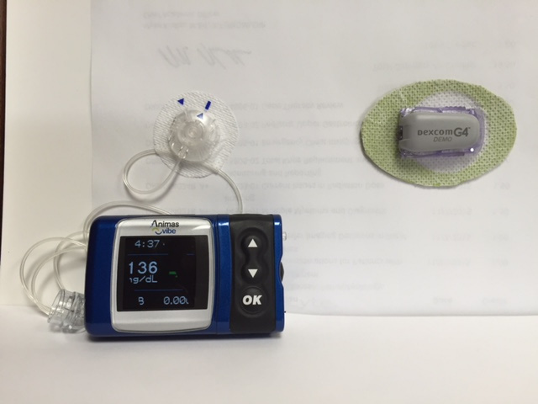
Sensor augmented pump
Medtronic 530G
Animas Vibe pump

Slide 23
ADVANTAGES OF SAP
Glycemic variability is reduced in patients on SAP therapy.
This approach allows patients to monitor their glucose levels being informed of glycemic concentration and trend.
Trained diabetic patients, therefore, can appropriately modify insulin infusion and/or carbohydrate intake in order to prevent hypo- or hyperglycemia.
For these reasons, SAP therapy is now considered the gold standard for type 1 diabetes treatment.

Slide 24
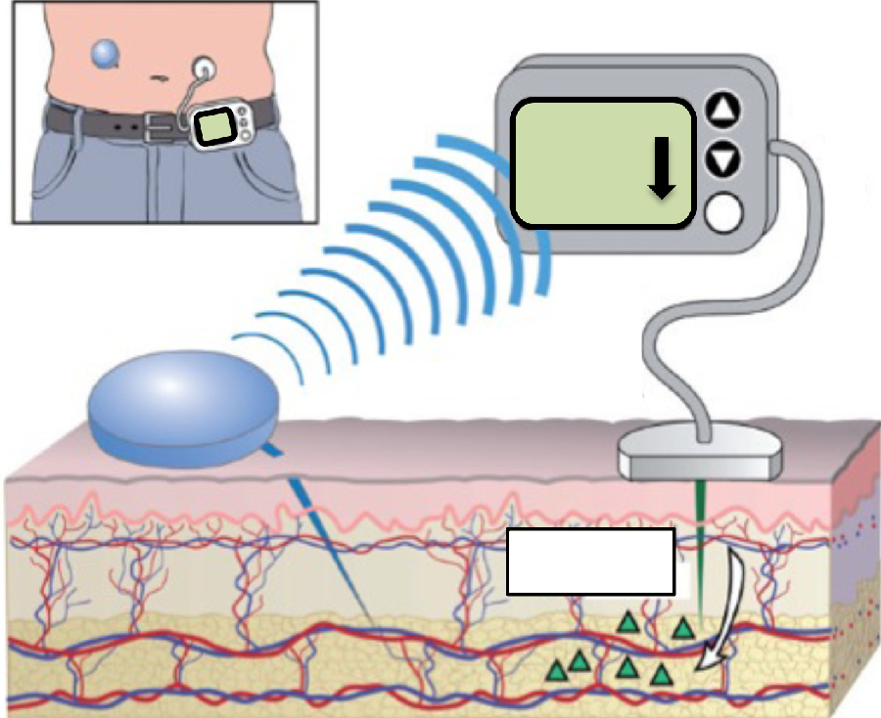
SAP:
Real-time glucose sensor, sitting on the skin surface with its tip inserted in the tissue interstitial fluid, measures glucose levels.
The glucose value is transmitted to the insulin pump by radio frequency.

Slide 25
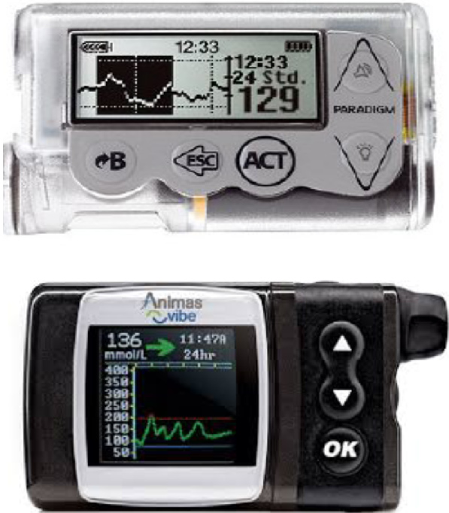
Current available devices for sensor-augmented insulin pump therapy:
1) Medtronic Paradigm veO (Northridge, CA, USA) (top);
2)Animas viBe (west Chester, PA, USA) (bottom)

Slide 26
SENSOR DRIVEN INSULIN PUMP (AUTO SHUTOFF)
The most recent advancement in insulin pump technology has been the ﬁrst, albeit tiny, step towards the development of a genuine sensor-driven insulin pump.
The Medtronic Veo and 530G pump brands represent the latest versions where an actual or predicted hypoglycemic value detected by a sensor that integrally communicates with the pump would cause the insulin delivery to be stopped—a form of threshold-based insulin-pump interruption—the so-called “Auto Shut-Off” feature
This mechanism does not require the patient’s intervention in order to interrupt the insulin delivery.

Slide 27
It has been promoted as being a safety feature against hypoglycemia, especially during sleep or in patients who have hypoglycemia unawareness, as less time is spent in the hypoglycemic glucose range.
More importantly, it demonstrates how a sensor-pump unit can be advanced from merely being data-providing gadgetry with alarms and cues, to actual modiﬁcation and adjustment of insulin administration without patient input—an example of a partial closed-loop system or a “true artiﬁcial pancreas” .

Slide 28
Implantable Pumps
Efforts are also under way to implant longer-lasting pumps internally, such as in the intra-peritoneal cavity.
An implantable insulin pump, possibly with a sensor and a digital handheld control device for receiving glucose readings and knowledge or manipulation of insulin delivery, would be discrete with ostensibly good patient acceptability

Slide 29
A subcutaneous sideportcould be used for refilling concentrated insulin.
It has thus far met with problems with infection and malfunction in initial trials, resulting in the need for frequent explanting .
Nevertheless, the more physiologic insulin delivery via the portal system (hepatic “firstpass”) and full automation based on accurate glucose sensing could be the equivalent of pancreas replacement technology of the future

Slide 30
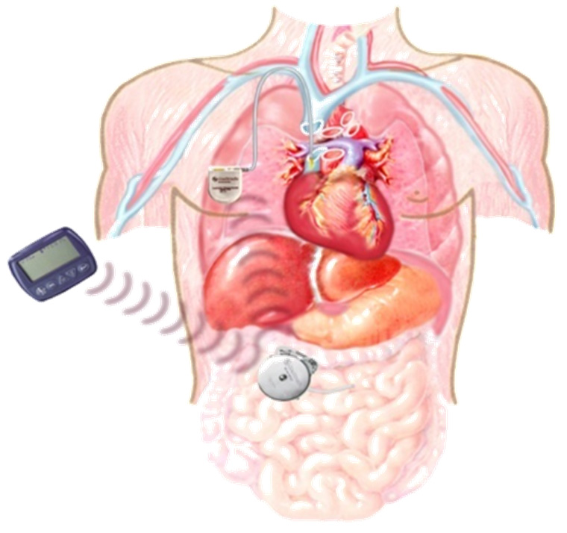
diagrammatic representation of an implantable insulin pump

Slide 31
Thank you

