Slide 1
TROPICAL FEVER
DR.PRADEEP REDDY

Slide 2
Tropical Infection
Infectious diseases that either occur uniquely or more commonly in tropical and subtropical regions, are either more widespread in the tropics or more difficult to prevent or control.

Slide 3
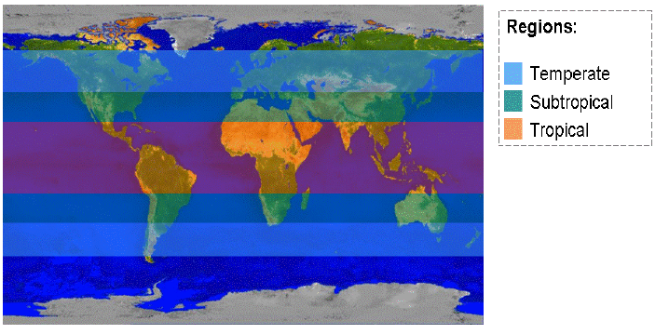
Tropical and Sub-tropical regions

Slide 4
Common Tropical Fever
Leptospirosis
Rickettsioses:
  Scrub typhus
  Murine typhus
Japanese encephalitis
Enteric fever
  Typhoid fever
  Paratyphoid fever
Non typhoidal salmonellosis
Tuberculosis
Malaria
Dengue infection
Helminthic infection
Infective diarrhea

Slide 5
Malaria
5 human Plasmodium sp. pathogens
  P. falciparum P. vivax
  P. ovale P. malariae
  P. knowlesi
Vector: Anopheles sp.

Slide 6
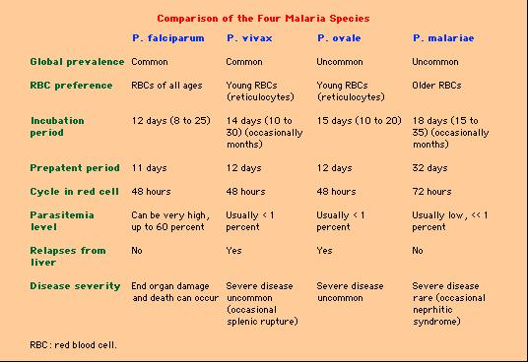

Slide 7
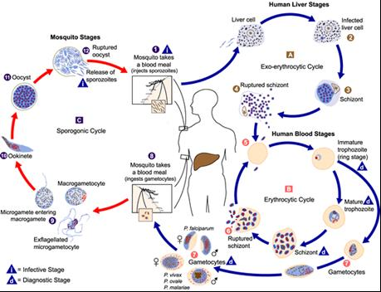
Malaria: Life Cycle
http://www.cdc.gov

Slide 8
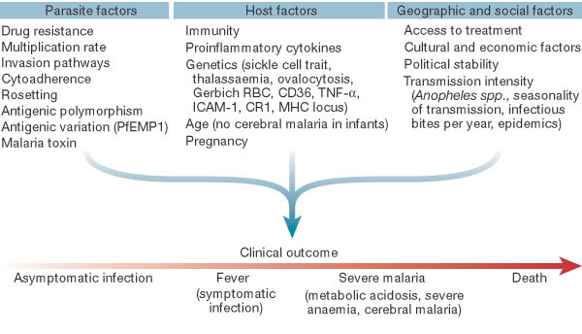
Clinical outcomes

Slide 9
Uncomplicated malaria
Signs and symptoms of malaria: non-specific
    Fever
    Chills
    Headache
    Myalgia
    Sore throat
    Anorexia
    Anemia
    Hepatosplenomegaly

Slide 10
WHO criteria for severe malaria
Cerebral malaria
Impaired of consciousness (GCS <11)
Severe anemia (Hct <20% or Hb <7 g/dl)
Hypoglycemia (BS <40 mg/dl)
Metabolic acidosis (HCO₃ <15 mmol/L)
Acute renal failure (Cr >3 mg/dl and urine output <400 ml/day)
Acute pulmonary edema and ARDS
Shock
Abnormal bleeding
Jaundice (TB >2.5 mg/dl)
Hemoglobinuria
Hyperparasitemia ( infection rate >5%)

Slide 11
Lab Diagnosis
Thick and thin film blood smear – Gold standard
Antigen detection by rapid dipstick immunochromatographic assays
  Histidine-rich protein-2: P. falciparum
  Parasite-specific LDH: All Plasmodium spp.
PCR technique

Slide 12
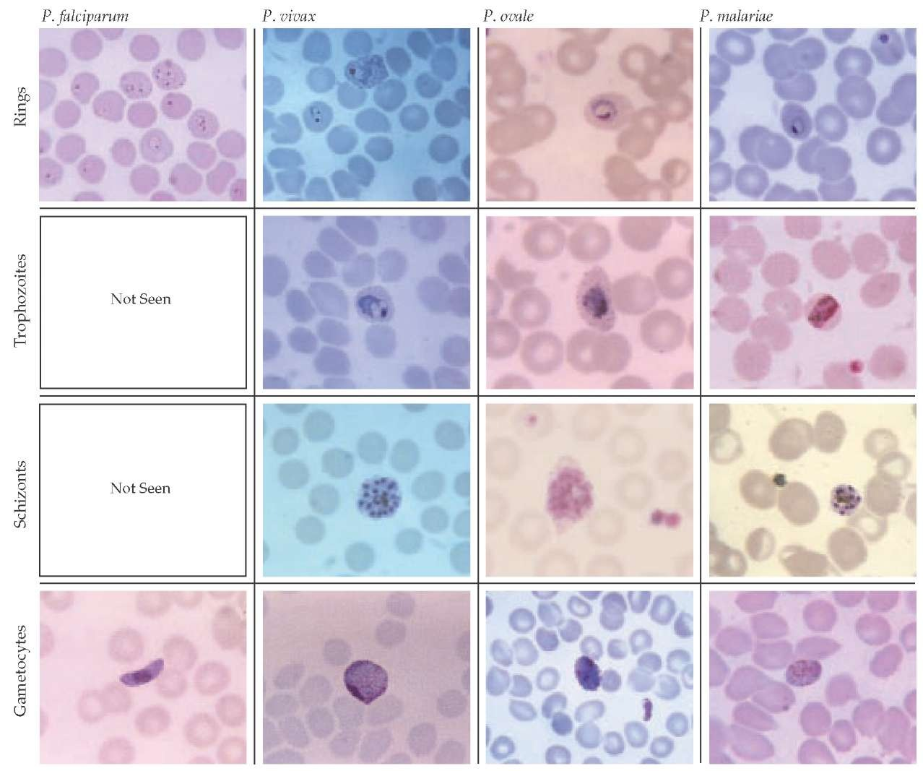

Slide 13
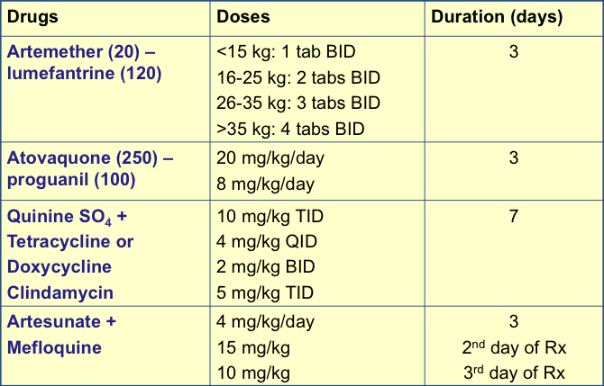
Anti malarial treatment

Slide 15
Chloroquine
600 mg base at hour 0 followed by 300 mg base at hour 6, 2nd day, and 3rd day of treatment +
Primaquine (for P. vivax and P. ovale only)
0.3-0.6 mg base/kg daily for 14 days

Slide 16
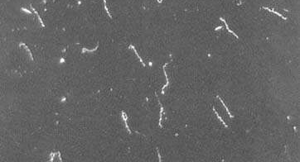
Leptospirosis

Slide 17
Risk factors for exposure
Occupational groups
Farmers, ranchers, abattoir workers, trappers, veterinarians, loggers, sewer workers, rice-field workers, military personnel
Recreational activities
Freshwater swimming, canoeing, kayaking, trail biking, hunting
Household environment
Pet dogs, domesticated livestock, rainwater catchment systems, rodent infestation

Slide 18
Pathogenesis
Route of transmission:
Abrasion & cuts in skin
Mucous membrane/Conjunctiva
Intact skin after prolong immersion in water
Inhalation of aerosol/water
Ingestion
Toxin production:
LPS
Hemolysin
Cytotoxin
Outer envelope:
Antiphagocytic component
Outer membrane protein:
Interstitial nephritis
Immune complex mediated inflammation:
Interstitial nephritis
Vasculitis

Slide 19
Clinical manifestations
 | Anicteric leptospirosis |  | Icteric leptospirosis Weil’s syndrome
(Incubation period 2-20 days) Fever | Leptospiremic phase 3-7 days | Immune phase 0-30 days | Leptospiremic phase 3-7 days | Immune phase 0-30 days
Associated symptoms | Myalgia Headache Nausea, Vomiting Abdominal pain Conjunctival suffusion | Meningitis Uveitis Rash | Jaundice Hemorrhage Acute renal failure Myocarditis Hemorrhagic pneumonitis Meningoencephalitis Hypotension
Leptospires present in | Blood |  | Blood
 | CSF |  | CSF
 |  | Urine |  | Urine

Slide 20
Laboratory diagnosis
Culture
Antibody detection
  Screening test
  MSAT, IHA, IFA, LA, ELISA, LEPTO dipstick
  Confirmation test
  Microscopic agglutination test
Antigen detection
Polymerase chain reaction (PCR)
Pathology

Slide 21
TREATMENT
Mild form
  Doxycycline
  Amoxicillin
  Erythromycin
Moderate-to-severe form
  Penicillin G
  Doxycycline
  Ceftriaxone

Slide 22
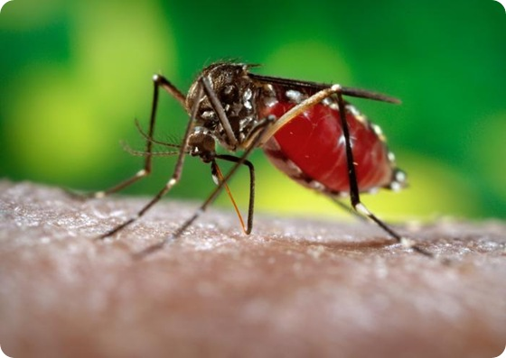
DENGUE

Slide 23
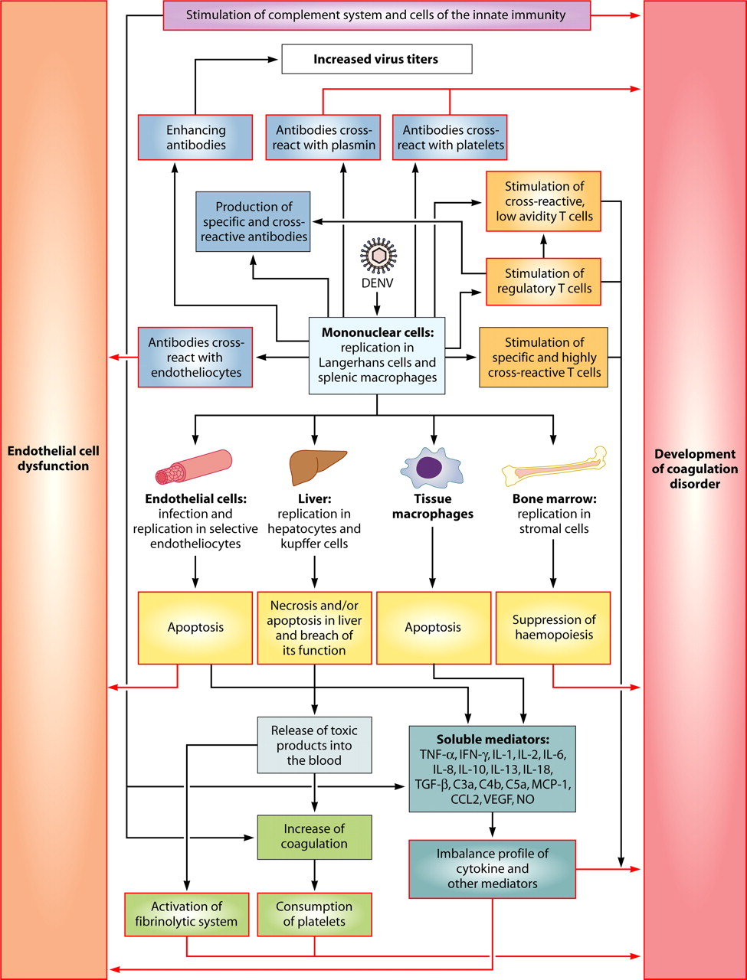

Slide 24
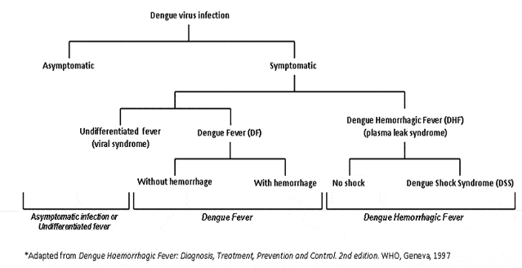
Clinical spectrum

Slide 25
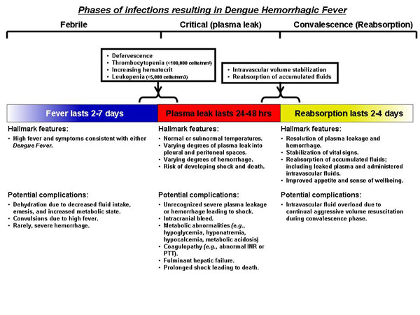
Phases on infection

Slide 26
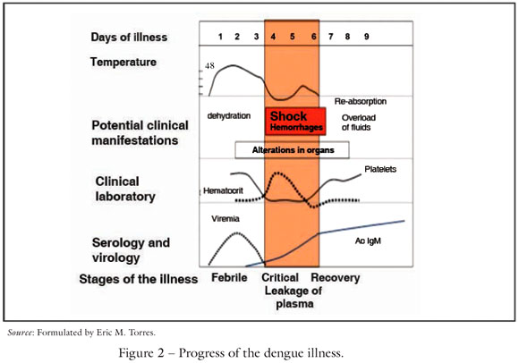
Clinical manifestation

Slide 27
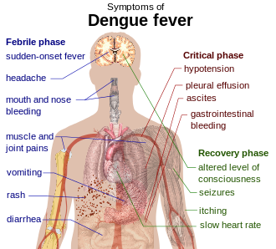
Clinical manifestation

Slide 28
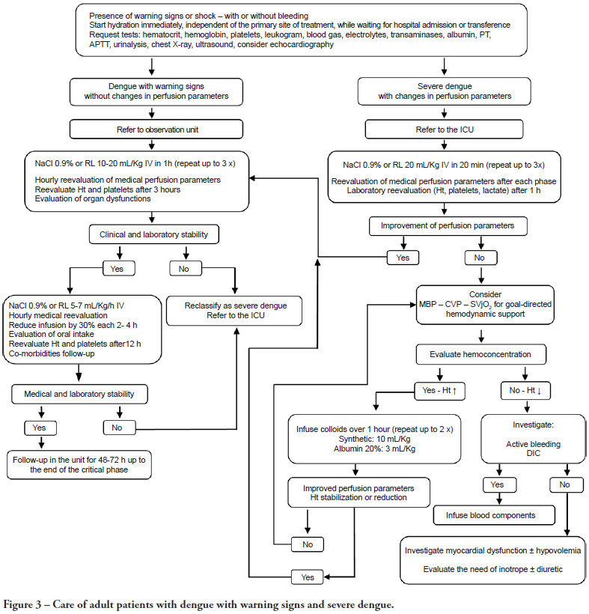
Treatment

Slide 29

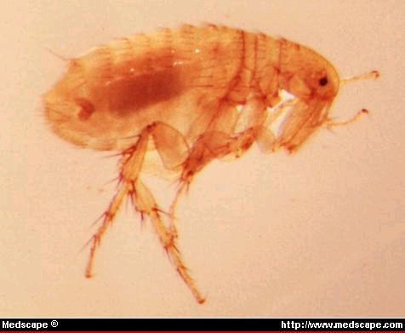
Rickettsioses
Scrub typhus
  Orientia tsutsugamushi
  Vector: Trombiculid mite (chigger): Leptothrombidium spp.
Murine typhus
  Rickettsia typhi
  Vector: Xenopsylla cheopsis
Spotted fever rickettsioses
  R. helvetica, R. honei, R. felis, R. conorii
  Vectors: Ticks

Slide 30
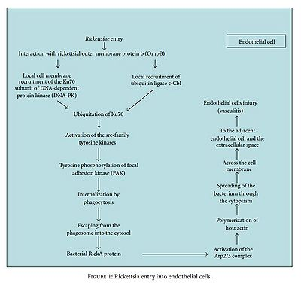
Pathogenesis

Slide 31
Pathogenesis of rickettsioses
Vector bites and feeds and regurgitate bacteria into skin bite site.
Bacteria are carried via lymphatics/small blood vessels to general circulation where they invade endothelial cells (primary target)
Spread to contiguous endothelial cells, smooth muscle cells, and phagocytes
Spread via the
microcirculation and invade
all organ systems
Vasculitis resulting in local
thrombus formation and end
organ damage.

Slide 32
Clinical presentations
Fever
Myalgia
Headache
Nausea/vomiting
Abdominal pain
Diarrhea
Conjunctival suffusion / subconjunctival hemorrhage
Lymphadenopathy
Rash
Hepatomegaly
Splenomegaly
Jaundice
Altered consciousness
Seizure
Hypotension

Slide 33
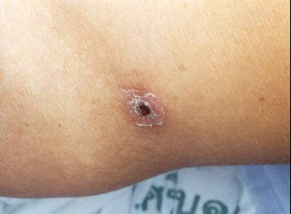
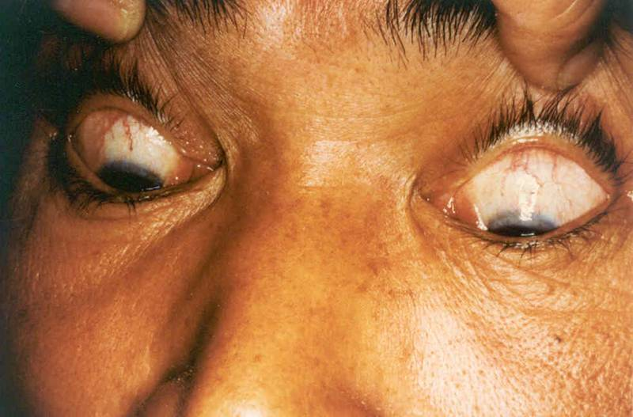
Clinical presentations

Slide 34
Laboratory diagnosis
Culture
Antibody detection
  Weil-Felix test:
    OX-K for scrub typhus
    OX-19 for murine typhus
  Latex agglutination test, dot-blot ELISA
  Confirmation tests: IFA, IIP
Polymerase chain reaction (PCR)
Pathology

Slide 35
Treatment
Scrub typhus
Doxycycline
Chloramphenicol
Rifampicin
Azithromycin
Murine typhus
Doxycycline
Chloramphenicol

Slide 36
Enteric fever
Typhoid fever
Salmonella Typhi
Paratyphoid fever
Salmonella Paratyphi A, B, and C

Slide 37
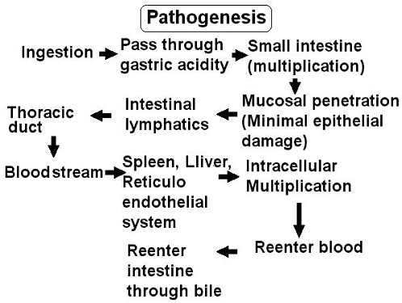
Pathogenesis

Slide 38

Symptoms of enteric fever
Symptoms | Typhoid fever (%) | Paratyphoid fever (%)
Fever | 89-100 | 92-100
Headache | 43-90 | 60-100
Nausea | 23-36 | 33-58
Vomiting | 24-35 | 22-45
Abdominal cramp | 8-52 | 29-92
Diarrhea | 30-57 | 17-68
Constipation | 10-79 | 2-29
Cough | 11-36 | 10-68

Slide 39

Signs of enteric fever
Symptoms | Typhoid fever (%) | Paratyphoid fever (%)
Abdominal tenderness | 33-84 | 6-29
Splenomegaly | 23-65 | 0-74
Hepatomegaly | 15-52 | 16-32
Relative bradycardia | 17-50 | 11-100
Rose spots | 2-46 | 0-3
Rales & rhonchi | 8-84 | 2-87
Epitaxis | 1-21 | 2-13
Meningism | 1-12 | 0-3

Slide 40
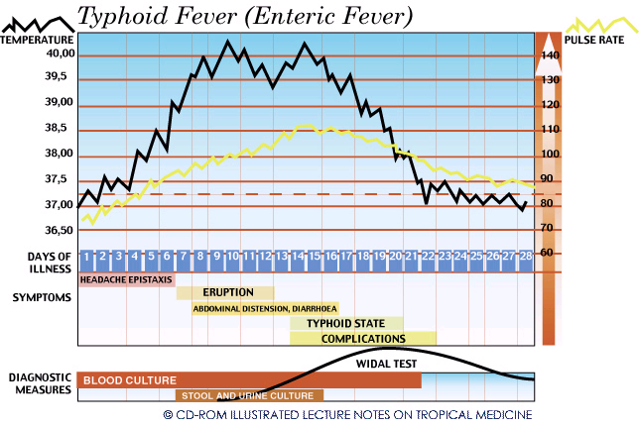

Slide 41
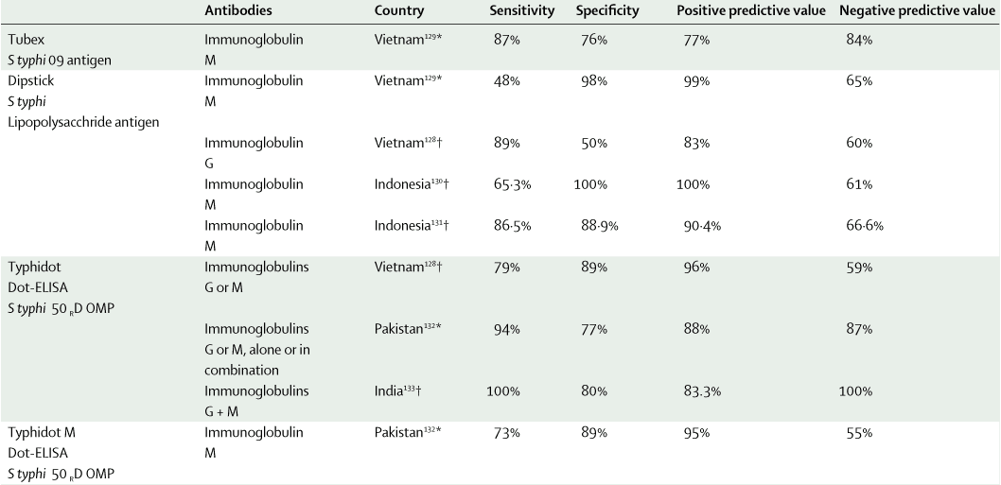
Laboratory diagnosis
Culture – Gold standard: Blood, BM, duodenal string test
Antibody detection
  Widal test – poor sensitivity & specificity
  Rapid serological diagnostic test

Slide 42
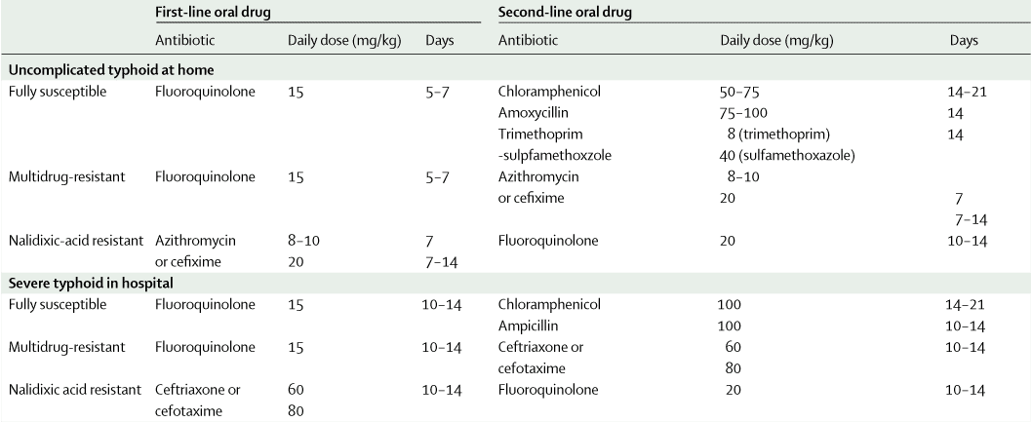
Treatment

Slide 43
Syndromic approach to tropical fever

Slide 44
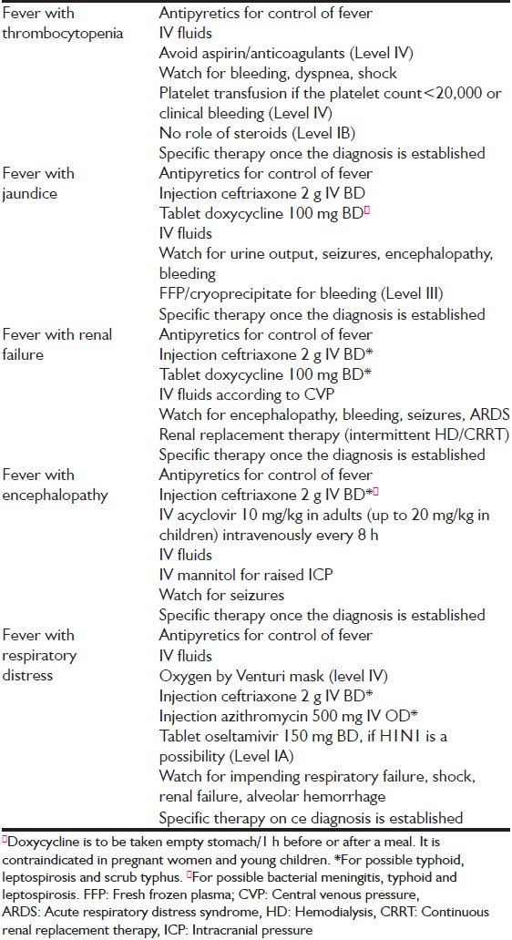

Slide 45
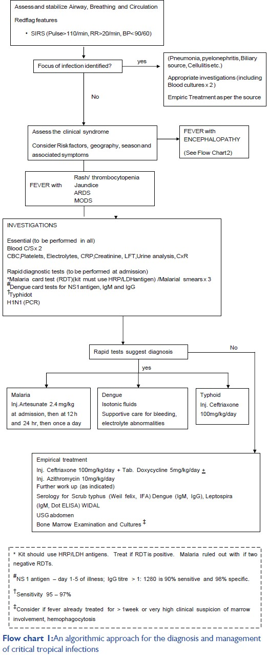

Slide 46
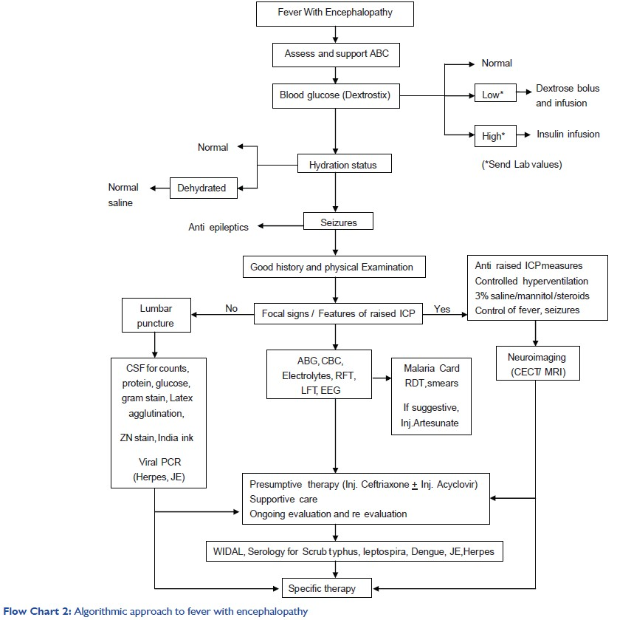

Slide 47
Thank you

