Slide 1
POSTEXPOSURE PROPHYLAXIS
OF BLOOD BORN INFECTIONS
HBV, HCV, AND HIV
DR.SANDEEP

Slide 2
INTRODUCTION
Avoiding occupational blood exposures is the primary way to prevent transmission of hepatitis B virus (HBV), hepatitis C virus (HCV), and human immunodeficiency virus (HIV) in health-care settings
However, hepatitis B immunization and postexposure management are integral components of a complete program to prevent infection fol- lowing bloodborne pathogen exposure and are important elements of workplace safety

Slide 3
health-care personnel (HCP) are defined as persons (e.g.,
employees,
students contractors,
attending clinicians,
public-safety workers,
Volunteers
whose activities involve contact with patients or with blood or other body fluids from patients in a health-care, laboratory, or public-safety setting.

Slide 4
Types of injuries
percutaneous injury
-- a needlestick or
--- cut with a sharp object
contact of mucous membrane or nonintact skin
- exposed skin that is
--- chapped,
--- abraded, or
---afflicted with dermatitis

Slide 5
potentially infectious:
cerebrospinal fluid,
synovial fluid,
pleural fluid
peritoneal fluid
pericardial fluid,
amniotic fluid.

Slide 6
Feces,
nasal secretions,
saliva,
sputum
sweat,
tears,
urine
risk for transmission of HBV, HCV, and HIV infection from these fluids and materials is extremely low

Slide 7
For human bites, the clinical evaluation must include the possibility that both the person bitten and the person who inflicted the bite were exposed to bloodborne pathogens.
Transmission of HBV or HIV infection only rarely has been reported by this route

Slide 8
PREVALENCE OF BLOODBORNE VIRUS INFECTION IN PATIENTS
Generally higher in hospitalized patients than general population
Varies with geographic area
Varies with patient risk factors(injecting drug use, multiple sex partners)

Slide 9
Risk of HBV, HCV and HIV Transmission after Occupational Percutaneous Exposure
HBV risk varies depending on e-antigen status of source person
– If e-antigen positive, risk is up to 30% – If e-antigen negative, risk is 1-6%
- HCV risk is 1.8% (range of 0 - 7%)
- HIV risk is 0.3%(rangeof0.2-0.5%)

Slide 10
POSTEXPOSURE MANAGEMENT
Clear policies/procedures
– Confidentiality of exposed and source persons – Management of exposures
– Posted in visible place
Training of healthcare personnel
Rapid access to
– clinical care
– postexposure prophylaxis (PEP)
– testing of source patients/exposed persons
Injury prevention assessment

Slide 11
ELEMENTS OF POSTEXPOSURE MANAGEMENT
Wound management
Exposure reporting
Assessment of infection risk
– type and severity of exposure
– blood borne infection status of source person
Appropriate treatment, follow-up, and counseling

Slide 12
POSTEXPOSURE MANAGEMENT:
WOUND CARE
Clean wounds with soap and water
Flush mucous membranes with water
No evidence of benefit for:
– application of antiseptics or disinfectants
– squeezing (“milking”) puncture sites
Avoid use of bleach and other agents

Slide 13
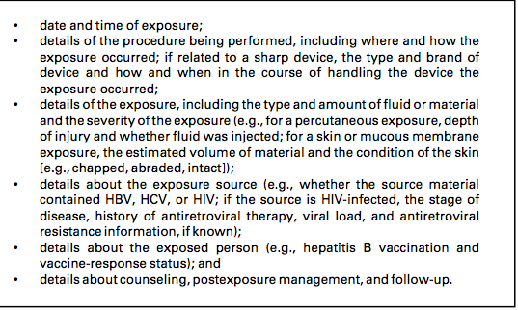
RECOMMENDATIONS FOR THE CONTENTS OF THE OCCUPATIONAL EXPOSURE REPORT

Slide 14
AVERAGE RISK OF HIV INFECTION TO HEALTHCARE PERSONNEL BY EXPOSURE ROUTE
Percutaneous
Mucous membrane
Non-intact skin
--- 0.3 %
-- 0.09 %
-- < 0.1

Slide 15
Risk Factors for HIV Transmission After Percutaneous Exposure to HIV- Infected Blood:
Risk Factor
Deep injury
Visible blood on device
Procedure involving needle placed in artery or vein
Terminal illness in source patient
Postexposure use of zidovudine
Adjusted Odds ratio (95% CI)
---- 15 (6.0-41)
---- 6.2 (2.2-21)
---- 4.3 (1.7-12)
---- 5.6 (2.0-16)
---- 0.19 (0.06-0.52)

Slide 16
ANIMAL STUDIES OF PEP EFFICACY
Data have been difficult to interpret and extrapolate to humans, but provide encouraging evidence of the effectiveness of PEP
Reduced PEP effectiveness if:
– Large dose of inocula
– Delay in time to PEP
– Shortened duration of PEP
– Decreased dose of PEP

Slide 17
HUMAN STUDIES OF HIV PEP EFFICACY
Little information on efficacy of PEP in humans
Seroconversion infrequent following occupational
exposure to HIV-infected blood
Study of converters vs non converters showed use of zidovudine (ZDV) was associated with an 81% decrease in the risk for HIV infection

Slide 18
POSTEXPOSURE MANAGEMENT: BASELINE HIV TESTING OF EXPOSED PERSON
EIA standard test or ELISA
Direct virus assays not recommended
– p24 antigen
– PCR for HIV RNA

Slide 19
INITIATION OF HIV PEP
Regard as an urgent medical concern
– If indicated, start PEP as soon as possible after exposure (hours rather than days)
Interval after which PEP is no longer likely to be effective in humans is unknown
– initiating PEP even days or weeks after an exposure should be considered

Slide 20
RE-EVALUATION OF HIV-EXPOSED PERSON
Consider re-evaluation of the exposed person within 72 hours
    –additional information about the source person may become available
    –if the source person has a negative HIV antibody test, stop PEP

Slide 21
SITUATIONS WHERE PEP IS RARELY, IF EVER, WARRANTED
Intact skin contact with blood and potentially infectious body fluids
Exposure to unknown source in populations where HIV prevalence is low
Low-risk exposure to unknown source

Slide 22
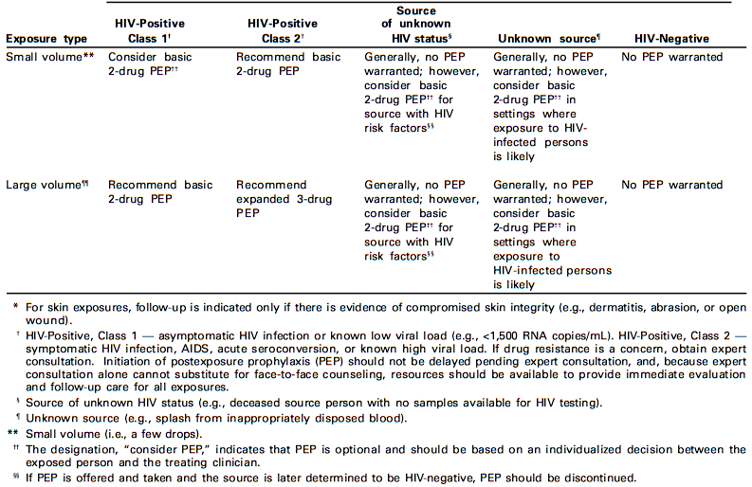
Recommended HIV postexposure prophylaxis for mucous membrane exposures an nonintact skin*exposures

Slide 23
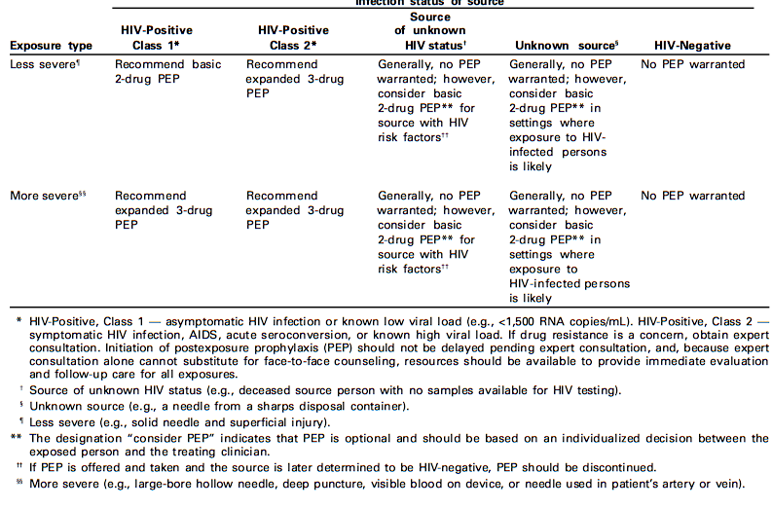
Recommended HIV postexposure prophylaxis for percutaneous injuries

Slide 24
HIV PEP Considerations in Pregnant Exposed Women
General principles
– pregnancy is not a contraindication for PEP
– exposed person should make informed decision about PEP
Choosing regimen is more complex
– may exacerbate physiologic changes in pregnancy – short/long-term effects on fetus/newborn unknown
  – most data are on zidovudine
  – some drugs contraindicated during pregnancy

Slide 25
HUMAN STUDIES OF HIV PEP: PREVENTION OF PERINATAL TRANSMISSION
ZDV administered during pregnancy, labor, and delivery reduced transmission by 67%
(Connor EM, et al. N Engl J Med 1994;331:1173-80.)
Protective effect only partially explained by reduction in maternal viral load
Protective effect observed when ZDV given only to newborn within the first 48-72 hours of life
(Wade NA, et al. N Engl J Med 1998;339:1409-14.) ( Musoke P, et al. AIDS 1999;13:479-86.) (Guay LA, et al. Lancet 1999;354:795-802.)

Slide 26
Post HIV exposures will warrant a two-drug regimen using two nucleoside analogues (e.g., ZDV and 3TC; or 3TC and d4T; or d4T and ddI). The addition of a third drug should be considered for exposures that pose an increased risk for transmission
BASIC REGIMEN
• Zidovudine ( ZDV; AZT) + Lamivudine ( 3TC)
— ZDV: 600 mg per day, in two or three divided doses, and
— 3TC: 150 mg twice daily.

Slide 27
ALTERNATE BASIC REGIMENS
Lamivudine(3TC)+Stavudine(d4T)
— 3TC: 150 mg twice daily, and
— d4T: 40 mg (if body weight is <60 kg, 30 mg twice daily) twice daily.
Didanosine(ddI) + Stavudine (d4T)
— ddI: 400 mg (if body weight is <60 kg, 125 mg twice daily) daily, on an empty stomach.
— d4T: 40 mg (if body weight is <60 kg, 30 mg twice daily) twice daily.

Slide 28
EXPANDED REGIMEN
Basic regimen plus one of the following:
Indinavir(IDV)
— 800 mg every 8 hours, on an empty stomach
Nelfinavir(NFV)
  — 750 mg three times daily, with meals or snack, or
  — 1250 mg twice daily, with meals or snack.

Slide 29
ANTIRETROVIRAL AGENTS GENERALLY NOT RECOMMENDED FOR USE AS PEP
• Nevirapine(NVP)
— 200 mg daily for 2 weeks, then 200 mg twice daily. ----
---- associated with rash (early onset) that can be severe and progress to Stevens- Johnson syndrome,
-- severe hepatotoxicity

Slide 30
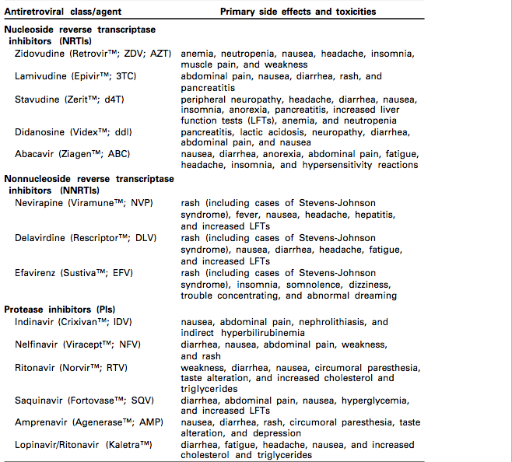

Slide 31
HIV-antibody testing should be performed for at least 6 months postexposure (e.g., at 6 weeks, 12 weeks, and 6 months). Extended HIV follow-up (e.g., for 12 months) is recommended for HCP who become infected with HCV following exposure to a source co-infected with HIV and HCV.
Monitoring and Management of PEP Toxicity. If PEP is used, HCP should be monitored for drug toxicity by testing at baseline and again 2 weeks after starting PEP
Minimally, lab monitoring for toxicity should include a complete blood count and renal and hepatic function tests

Slide 32
Certain drugs should be avoided in pregnant women. Because teratogenic effects were observed in primate studies, EFV is not recommended during pregnancy. Reports of fatal lactic acidosis in pregnant women treated with a combination of d4T and ddI have prompted warnings about these drugs during pregnancy.
Because of the risk of hyperbilirubinemia in newborns, IDV should not be administered to pregnant women shortly before delivery.

Slide 33
Monitoring for evidence of hyperglycemia should be included for HCP whose regimens include any PI; if the exposed person is receiving IDV, monitoring for crystalluria, hematuria, hemolytic anemia, and hepatitis also should be included.
If toxicity is noted, modification of the regimen should be considered after expert consultation; further diagnostic studies may be indicated

Slide 34
If an exposed woman is breast feeding, she should be counseled about the risk of HIV trans- mission through breast milk, and discontinuation of breast feeding should be considered, especially for high-risk exposures.
NRTIs are known to pass into breast milk, as is NVP; whether this also is true for the other approved antiretroviral drugs is unknown.
Notes:
Additionally

Slide 35
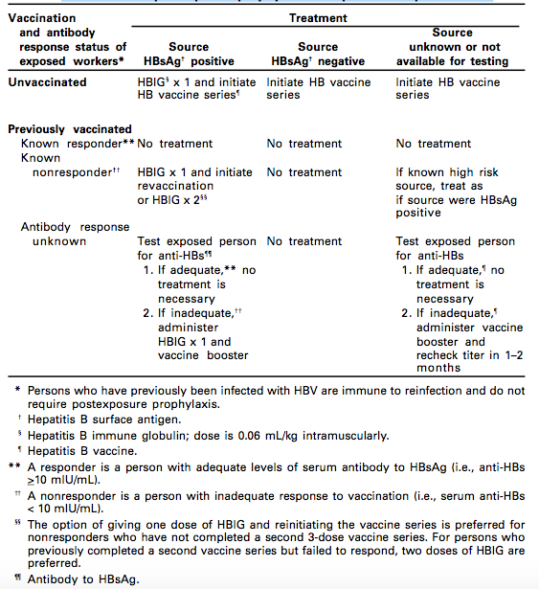
Recommended postexposure prophylaxis for exposure to HBV

Slide 36
POSTEXPOSURE MANAGEMENT FOR HCV
the Advisory Committee on Immunization Practices (ACIP) reviewed available data re- garding the prevention of HCV infection with IG and concluded that using IG as PEP for hepatitis C was not supported . This conclusion was based on the following facts:
No protective antibody response has been identified following HCV infection.
Previous studies of IG use to prevent post-transfusion non-A,non-B hepatitis might not be relevant in making recommendations regarding PEP for hepatitis C.
Experimental studies in chimpanzees with IG containing anti-HCV failed to prevent transmission of infection after exposure.

Slide 37
In an experiment designed to model HCV transmission by needl estick exposure in the health-care setting, high anti-HCV titer IG administered to chimpanzees 1 hour after exposure to HCV-positive blood did not prevent transmission of infection .
No clinical trials have been conducted to assess postexposure use of antiviral agents (e.g., interferon with or without ribavirin) to prevent HCV infection, and antivirals are not FDA-approved for this indication .

Slide 38
In the absence of PEP for HCV, recommendations for postexposure management are intended to achieve early identification of chronic disease and, if present, referral for evaluation of treatment options.
However, a theoretical argument is that intervention with antivirals when HCV RNA first becomes detectable might prevent the development of chronic infection.
Data from studies conducted outside the United States suggest that a short course of interferon started early in the course of acute hepatitis C is associated with a higher rate of resolved infection than that achieved when therapy is begun after chronic hepatitis C has been well established

Slide 39
PERFORM FOLLOW-UP TESTING AND PROVIDE COUNSELING
• Advise exposed persons to seek medical evaluation for any acute illness occurring during follow-up.
HBV exposures
• Perform follow-up antiHBs testing in persons who receive hepatitis B vaccine.
— Test for anti-HBs 1–2 months after last dose of vaccine.
— Anti-HBs response to vaccine cannot be ascertained if HBIG was received in the previous 3–4 months.

Slide 40
HIV exposures
  Perform HIV-antibody testing for at least 6 months post exposure (e.g., at baseline, 6 weeks, 3 months, and 6 months).
  Perform HIV antibody testing if illness compatible with an acute retroviral syndrome occurs.
  Advise exposed persons to use precautions to prevent secondary transmission during the follow-up period.
  Evaluate exposed persons taking PEP within 72 hours after exposure and monitor for drug toxicity for at least 2 weeks.

Slide 41
HCV exposures
  Perform baseline and follow-up testing foranti-HCV and alanineamino- transferase (ALT) 4–6 months after exposures.
  Perform HCV RNA at 4–6 weeks if earlier diagnosis of HCV infection desired.
  Confirm repeatedly reactive anti-HCV enzyme immunoassays (EIAs) with supplemental tests.

Slide 42
RECOMMENDATIONS FOR HEALTHCARE FACILITIES
Establish a bloodborne pathogen management policy
Implement management policies (e.g., training, hepatitis B vaccination, exposure reporting, PEP access, etc.)
Establish laboratory capacity for bloodborne virus testing
Select and use appropriate PEP regimens
Provide access to counseling for exposed personnel
Monitor adverse events and seroconversion
Monitor exposure management programs
(e.g., time between exposure and evaluation, testing of source persons, completion of follow-up)

Slide 43
CONCLUSION
Bloodborne viruses
Can produce chronic infection
Transmissible in healthcare settings
Occupational exposure management is complex
Preventing Transmission of Bloodborne Viruses in Healthcare Settings
--- Promote hepatitis B vaccination
--- Treat all patients as potentially infectious
--- Use barriers to prevent blood/body fluid contact
---- Prevent percutaneous injuries
---- avoiding occupational blood exposures

Slide 44
THANK YOU

