Slide 1

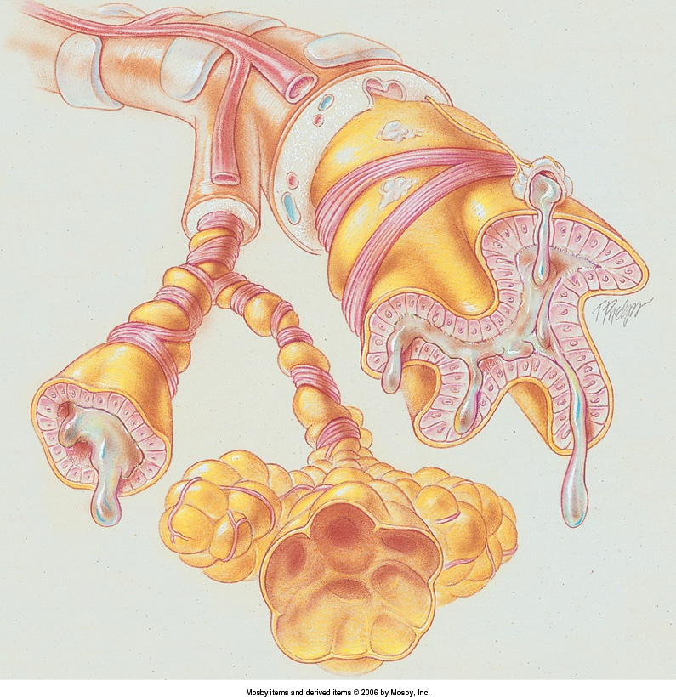
Bronchial Asthma
Dr. Kusum Shah
Dept. of Respiratory Medicine

Slide 2
Definition
Epidemiology
Risk factors
Pathology & pathogenesis
Diagnosis
Management

Slide 3
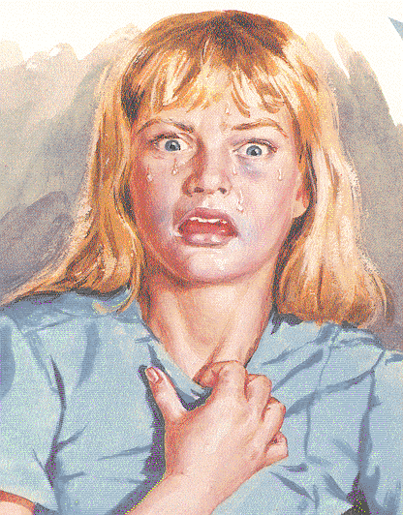
Defining Asthma
Obstructive lung disease with characteristics of:
  Airway obstruction; reversible in most patients
  Chronic airway inflammation (eosinophils)
  Increased airway responsiveness
Onset of symptoms can occur at any age
NAEP - Guidelines for the Diagnosis and Management of Asthma 1991
Netter’s Anatomy

Slide 4

Etiology
Extrinsic asthma
  Allergic or atopic asthma
Intrinsic asthma
  Nonallergic or nonatopic asthma

Slide 5

  Genetic abnormalities which lead to excessive production of allergen-specific antibodies (Ig E) is called atopy - significant factor in asthma genesis in many patients. A lot of cases of atopy are inherited, and recent epidemiological studies showed steady increase in number of people with high serum level of Ig E.

Slide 6

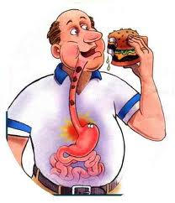

Intrinsic Asthma
(Nonallergic or Nonatopic Asthma)
Infections
Exercise and cold air
Industrial pollutants or occupational exposure
Drugs, food additives, and food preservatives
Gastroesophageal reflux
Sleep (nocturnal asthma)
Emotional stress
Premenstrual asthma

Slide 7
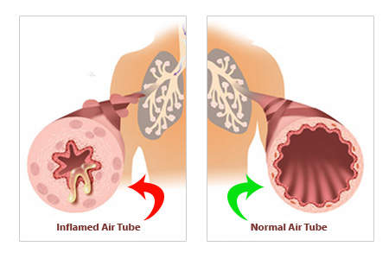
Pathophysiology
Trigger Factor
.
Mast cell
Mediators : histamine,prostaglandin,leukotrienes,
as well as cytokines
Sustained Inflammatory response
Contraction of airway smooth muscles (Bronchoconstriction

Slide 8
Some allergens which may cause asthma
Spittle, excrements,
hair and fur
of domestic
animals
House-dust mites which live in carpets, mattresses and upholstered furniture
Plant pollen
Dust of book depo-sitories
Food components (stabilizers, genetically modified products)
Pharmacological agents (enzymes, antibiotics, vaccines, serums)

Slide 9
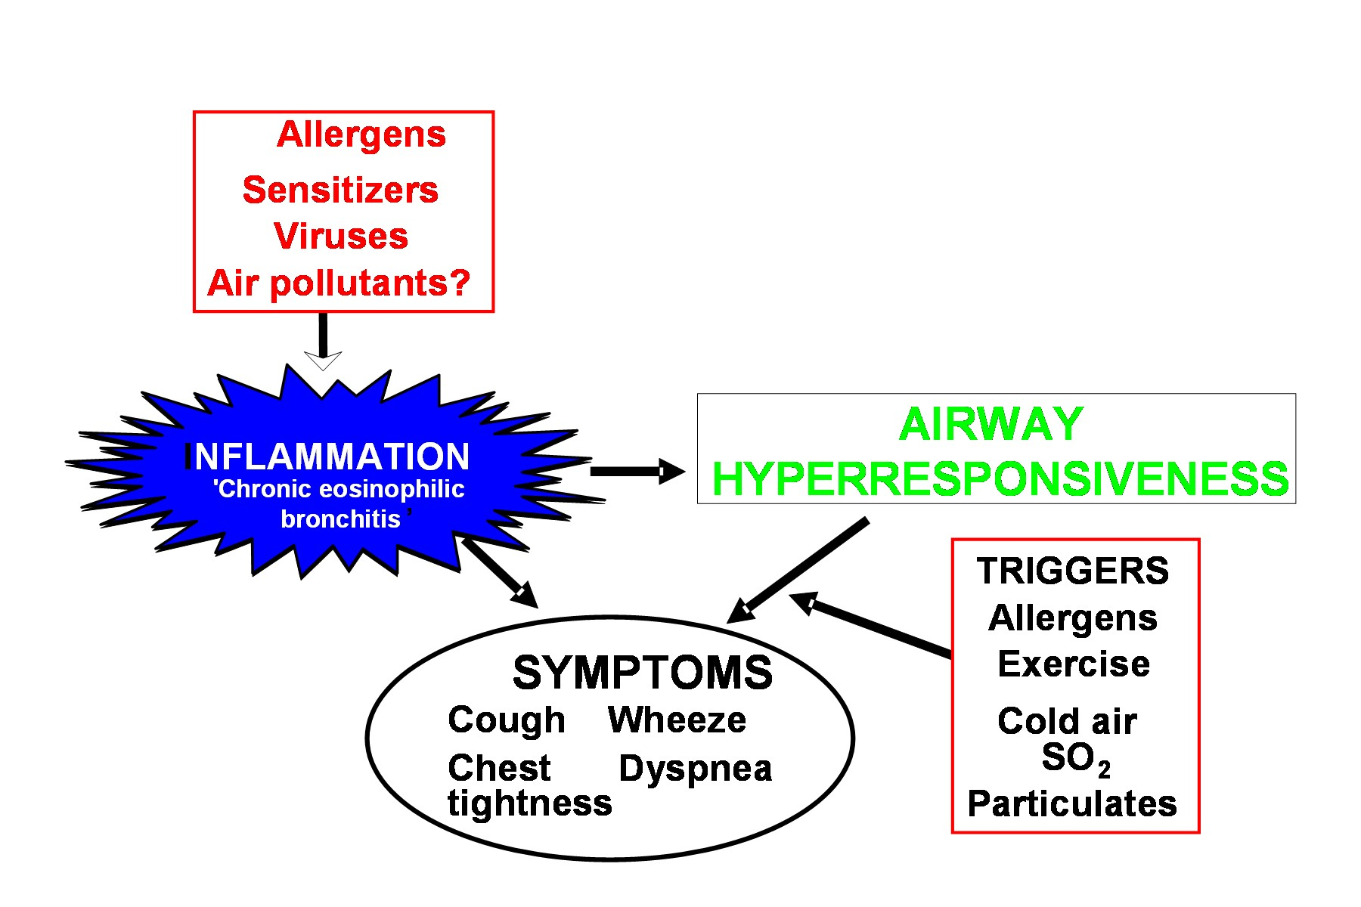
Mechanisms: Asthma Inflammation
Source: Peter J. Barnes, MD

Slide 10
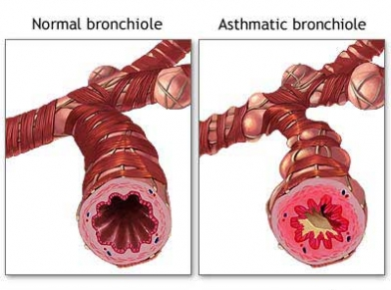
Pathophysiology (Cont.)
Airway wall swelling (mucosal edema)
Airway hyper responsiveness
Chronic changes
Hypertrophy of the smooth muscles, thickening of the basement membrane
Airway remodeling
There is good evidence that asthma occurs in families.

Slide 11
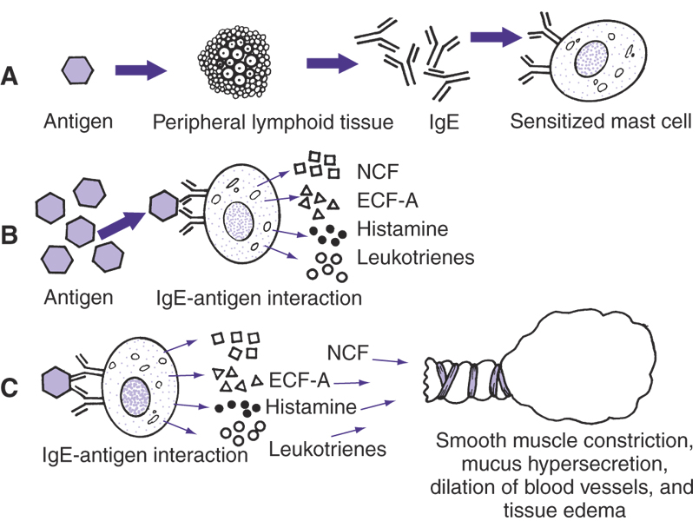
Figure 13-2. The immunologic mechanisms in asthma.

Slide 12

Clinical features :
wheezing attacks and episodic shortness of breath. Symptoms are usually worst during the night.
Cough is a frequent symptom that sometimes predominates and is often misdiagnosed as bronchitis.
There is a wide range of variation in the frequency and duration of the attacks. Some patients have chronic symptoms.
Clinical signs:
May be normal(in between the attacks).
Hyper inflation of chest , use of accessory muscles .
Expiratory rhonchi
Associated signs as nasal polyps, flexural eczema.

Slide 13

How To Diagnose Bronchial Asthma ?
Consultation skill
Relevant History
-Symptom
-history of allergic disease
-Family history
-Environmental history
-Exclusion of other medical condition

Slide 14
Investigations :
There is no single satisfactory diagnostic test for all asthmatic patients.
Respiratory function tests:
Measurements of peak expiratory flow (PEF) . diurnal variation in PEF .

Slide 15
Lung function assessment
Spirometry is the most helpful, preferred method for establishing diagnosis.
Increase in FEV1 of > 12% and 200 ml after inhaled bronchodilator.
Many asthma patients are negative and repeat testing is advised
  forced expiratory volume in 1 second (FEV1) and peak expiratory flow (PEF), which
  are measured during spirometry at forced breathing-out.

Slide 16
Increase in FEV1 and PEF after inhalation of bronchodilators (β2-agonists) of 15% and more is specific for asthma.

Slide 17
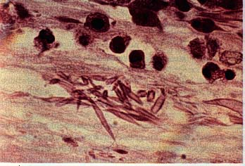
2. Blood
Patients with asthma may have an increase in the number of eosinophils in peripheral blood (> 0.4 × 109/L).
3. Sputum examination
    Eosinophils
    Charcot-Leyden crystals
Needle shaped crystals -
Represents breakdown products of eosinophils
    Casts of mucus from small airways
      called Kirschman spirals

Slide 18
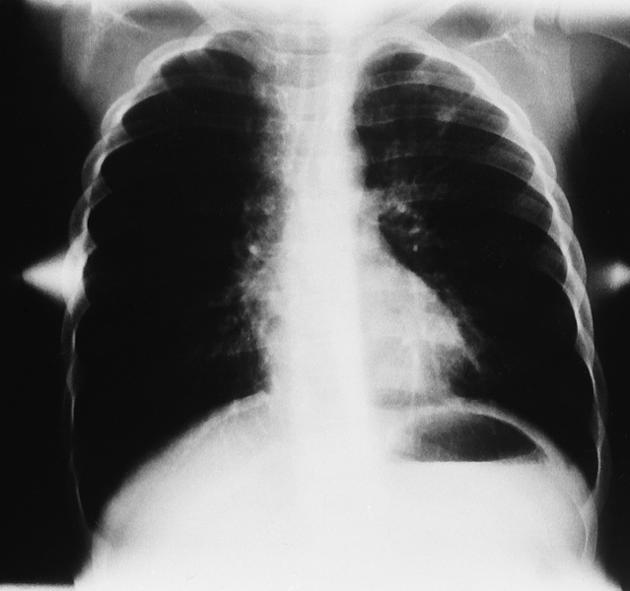
4.Radiologic Findings
There are no diagnostic features of asthma on the chest X-ray, although over inflation is characteristic during an acute episode or in chronic severe disease.
A chest X-ray may be helpful in excluding a pneumothorax, which can occur as a complication.
Chest radiograph
Increased anteroposterior diameter
Translucent (dark) lung fields
Depressed or flattened diaphragm

Slide 19
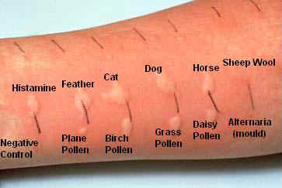

5.Skin tests:
Skin-prick tests should be performed in all cases of asthma to help identify allergic causes.
6.Bronchoprovaction testing.
  Methacholine, histamine or
  inhaled mannitol
.

Slide 20
Questions to Consider in the Diagnosis of Asthma
Recurrent attacks of wheezing?
Troublesome cough at night?
Wheeze or cough after exercise?
Wheeze or tightness after exposure to allergens or pollutants?
Does the cold “go to the chest” or take more than 10 days to clear?
Are symptoms improved by asthma treatment?

Slide 21
Classify Asthma Severity
Mild intermittent Asthma (step1)
Symptoms < than twice weekly
Mild persistent Asthma (step2)
Symptoms > than twice weekly
Moderate persistent Asthma (step3)
Daily symptoms
Severe persistentAsthma(step4)
Continual symptoms
From McCance KL, Huether SE: Pathophysiology: The biologic basis for disease in adults and children, ed 4, St. Louis, 2002, Mosby.

Slide 22
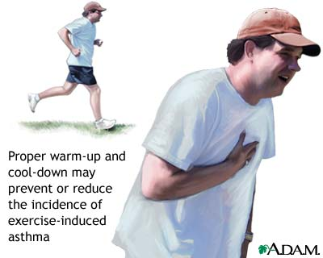
Exercise-Induced Asthma
EIB It occurs when bronchial tubes constrict about 5 minutes after beginning exercise.
symptoms:
Are limited to periods of sustained physical activity or vigorous exercise that lasts a few minutes or longer
May be relieved by a period of rest, although they may persist for minutes or hours after stopping exercising
Treatment:
Short acting bronchodilator prior to exercise
No daily treatment required

Slide 23
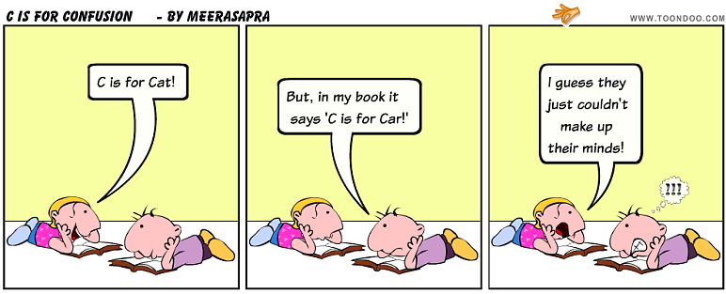
Diagnostic Challenges
Cough variant asthma
  Chronic cough, often at night
Exercise induced bronchospasm
  Exercise challenge
Asthma in the elderly
  COPD vs asthma
Occupational asthma
  correlate symptoms with occupation

Slide 24
Differential diagnosis
  cardiac,
  uremic,
  hysteric asthma,
  systemic vasculitis,
  broncho-carcinoma,
  carcinoid
  chronic obstructive lung diseases.

Slide 25

Treatment Goals
Achieve and maintain control of symptoms night and day
Maintain normal activity levels, including exercise
Have productive and physically active life
Maintain pulmonary function as close to normal as possible
Prevent asthma exacerbations
Avoid adverse effects from asthma medications
Prevent asthma mortality

Slide 26
Drug therapy
2 drug categories are used:
Antiinflammatory drugs
(basic)
Bronchodilators
Are divided into:
3 groups:
hormone-containing
(corticosteroids)
β2-agonists
anticholinergic drugs
nonhormone-containing
(cromones, leukotriene
receptor antagonists)
methylxanthines

Slide 27
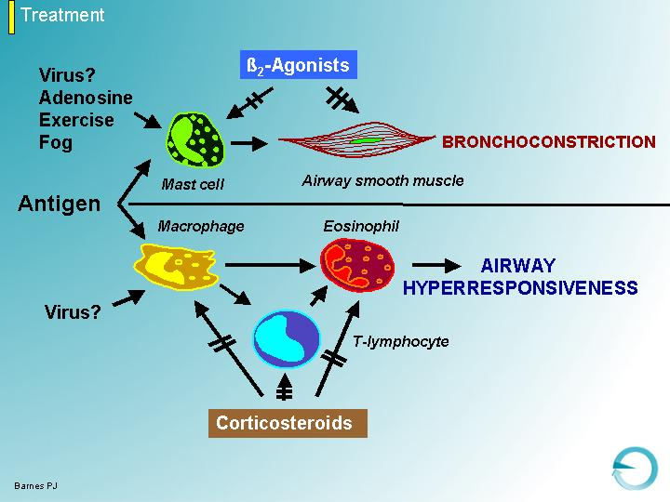
BIOLOGICAL RATIONALE FOR COMBINATION THERPAY

Slide 28
Smooth
muscle
dysfunction
Airway
inflammation
Long-Acting
Beta₂-Agonists
Inhaled Corticosteroids

Bronchoconstriction
Bronchial hyperreactivity
Hyperplasia/Hypertrophy
Inflammatory mediator release
Inflammatory cell infiltration/activation
Mucosal edema
Cellular proliferation
Epithelial damage
Basement membrane thickening











Symptoms/Exacerbations

Slide 29
Bronchodilators
β2-agonists
Anticholinergic
drugs
Stimulates
β2-adrenergic
receptors of bronchi
reduce tonus
of vagus
Smooth
muscle
relaxation
Methylxanthines
inhibit phosphodiesterase

Slide 30
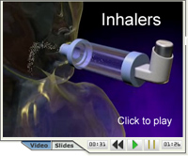
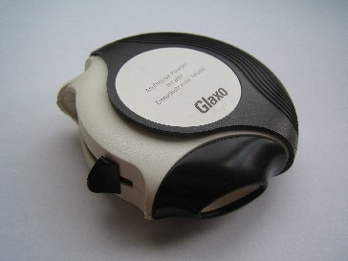
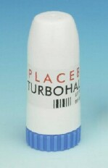
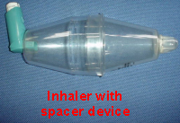

Slide 31
Inhaled β2-agonists are the basic drug group among bronchodilators.
  Short-acting (duration of action 5-6 h) salbutamol, fenoterol
  Long-acting (> 12 h) β2-agonists - salmoterol, farmoterol

Slide 32
Anticholinergic drugs (ipratropium bromide, atrovent, troventol)
Methylxanthines in comparison with other bronchodilators have the less bronchodilating potential. There are long-acting (>12 h) - (theopec, theolong, theodur, euphilong) as well as short-acting (aminophylline, theophylline) drugs in this group.

Slide 33
Combined inhaled drugs (corticosteroids with β2-agonists) – seretid, simbicort – with use of delivery devices (nebulasers, turbuhalers, spacers, spinhalers, sinchroners) enhance the effectiveness of asthma therapy.

Slide 34
Relievers
Rapid- acting β2-agonists
Anticholinergics
Systemic glucocorticoids
Theophylline

Slide 35
Stepwise Approach
Review treatment every 1 to 6 months, and gradually step down treatment
If asthma controlled not maintained, then a step up in treatment may be warranted

Slide 36
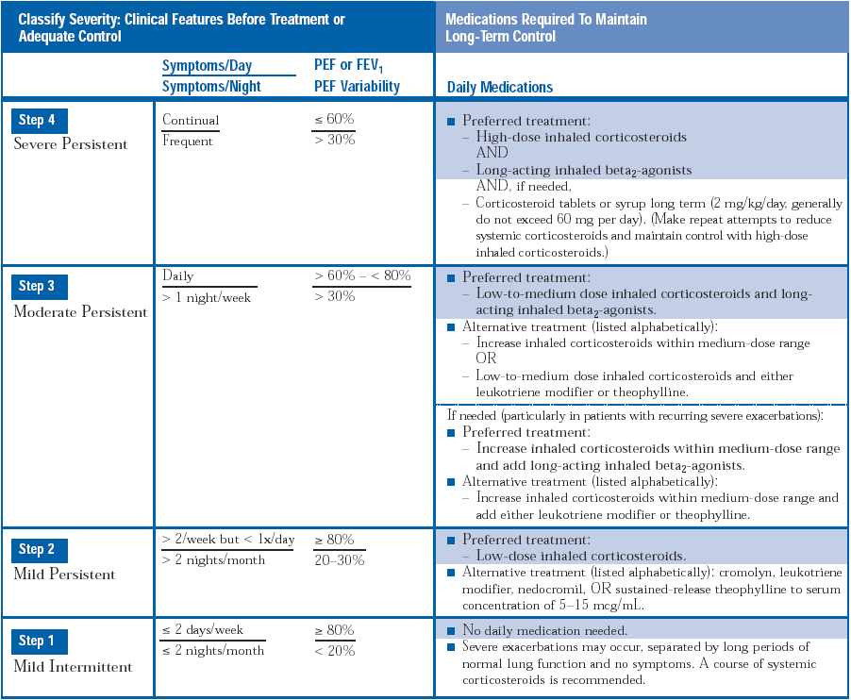

Slide 37
Acute Severe Asthma
Acute severe asthma, or "status asthmaticus", is a devastating clinical condition ultimately resulting in life-threatening hypoxaemia that does not respond well to immediate care
Life-threatening features
Silent chest
Cyanosis
Bradycardia (especially despite β₂ agonist)
Exhausted appearance
PEFR <30% of predicted

Slide 38
Immediate management:
Oxygen therapy by tight fitting facemask (60%).
Nebulised salbutamol 2.5 +/- 0.5mg ipratropium
Start Glucocorticoid therapy - Prednisolone 30-60mg p.o. or Hydrocortisone 200mg i.v.
Urgent chest X-ray to exclude pneumothorax
Urgent blood gas
Reassess in 15 min or if life-threatening features appear
Consider i.v. Aminophylline if life-threatening features or fails to improve after 15-30 minutes
Ventillation Support

Slide 39
Factors Affecting Compliance
Route of drug administration (oral vs inhaled)
Complexity of drug regimen
Side effects of medications
Support of family and health care professionals
Reasons for Poor Asthma Control
Inhaler Technique
Compliance
Environment
Also assess for an alternative diagnosis
“All that wheezes is not asthma, and not all asthma wheezes”

Slide 40
Refractory Asthma
American Thoracic Society defined asthma as severe and refractory if the patient meets at least one of the following major criteria:
Takes oral corticosteroids continuously or nearly continuously (> 50% of year)
Takes high-dose inhaled corticosteroids.

Slide 41
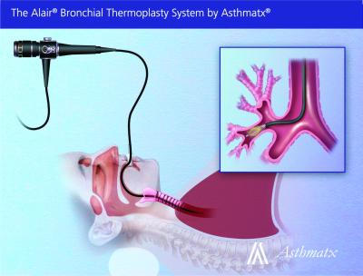
Newer treatment modalities
bronchial thermoplasty
it involves three sessions of bronchoscopy, each lasting up to 1 hour, during which the smooth muscle layer is methodically ablated from the airway using radiofrequency energy.
delivery of controlled, therapeutic radiofrequency energy to the airway wall, thus heating the tissue and reducing the amount of smooth muscle present in the airway wall.
Miller JD, Cox G,Vincic L,Lombard CM,Loomas BE,Danek CJ
. A prospective feasibility study of bronchial thermoplasty in the human airway.Chest 2005; 127:1999–2006.

Slide 42
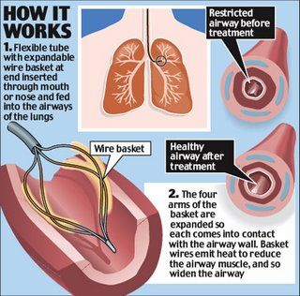

Slide 43

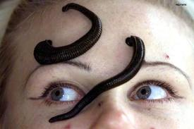
Evidence based medicine

Slide 44
EFFECTIVENESS AND SAFETY OF BRONCHIAL THERMOPLASTY IN THE TREATMENT OF SEVERE ASTHMA: A MULTICENTER, RANDOMIZED, DOUBLE-BLIND, SHAM-CONTROLLED CLINICAL TRIAL. AM J RESPIR CRIT CARE MED 181:116–124.
CASTRO M, RUBIN et al. AIR2 trial | Oxford Centre for Evidence-Based Medicine 2011 Levels of Evidence Level 2Evidence | Mean Asthma Quality of Life Questionnaire (AQLQ) scores during 12 months after treatment with bronchial thermoplasty or sham bronchial thermoplasty. Possible scores range from 1 (worst) to 7 (best). A change of 0.5 points is considered clinically meaningful | This study showed that bronchial thermoplasty was feasible, relatively safe, and produced better clinical outcomes in patients with severe asthma when medical therapies did not control their symptoms.

Slide 45
Prognosis
In case of early detection and adequate treatment the prognosis for the disease is favourable.
It becomes serious in severe persistent and poorly controlled (insensitive for corticosteroids) asthma.

Slide 46

Prophylaxis
  Preservation of the environment, healthy life-style (smoking cessation, physical training) – are the basis of primary asthma prophylaxis. These measures in combination with adequate drug therapy are effective for secondary prophylaxis.

Slide 47

Key Messages
Asthma is an inflammatory disease
Environmental factors are important
Objective measures are needed
Health education is crucial
Emphasis on recognition and avoidance of triggers

Slide 48
MCQ
1. Leukotriene antagonist, in comparison to other classes of drugs used in treating asthma, has a therapeutic efficacy comparable to which ONE of the following?
(A) Long acting beta agonist.
(B) Short acting beta agonist.
(C) Low dose inhaled steroids.
(D) High dose inhaled steroids.
(E) Oral steroids.
2. Which of the following is the CORRECT use of oral prednisolone for an exacerbation of asthma in a medium to high risk asthma patient?
(A) Prednisolone 10 mg every morning for 5-7 days.
(B) Prednisolone 5 mg every morning for 2 weeks.
(C) Alternate day prednisolong 5 mg in the morning for 2 weeks.
(D) Prednisolone 60 mg per day for 3 days and tailing off over a week.
(E) None of the above

Slide 49
3.Which of the following is a key pathological feature of bronchial asthma?
(A) Airway epithelium destruction occurs.
(B) Diffusing lung capacity for carbon monoxide is typically low.
(C) Neutrophils and macrophages take part in the inflammatory cascade.
(D) Emphysema is a constant feature.
(E) None of the above
4. . Which of the following is clinical feature of bronchial asthma?
(A) Flattening of the diaphragm.
(B) Increased retrosternal space on the chest X-ray.
(C) Exhaled nitric oxide greater than 16 parts per billion.
(D) Lung hyperinflation.
(E) Bullae on chest CT.
5. Which of the following is a feature of “allergic asthma”?
(A) The bronchospasm is triggered by intrinsic allergens.
(B) Most children with asthma are atopic and IgG sensitisation is common.
(C) Extrinsic asthma is the predominant form of the disease among adults with late onset asthma.
(D) Sensitisation to one or more indoor allergens carries the strongest risk factor for asthma in the population.
(E) None of the above is correct.

Slide 50
6.characteristic pathological changes in asthma include all except
A inflammatory cell infiltration
B edema of the mucosa
C hypertrophy of bronchial smooth muscle
D alveolar edema
E mucus plugging

Slide 51
MCQ:
1. Which of the following is recommended as the initial and primary therapy in patients with persistent asthma?
(A) Inhaled salmeterol xinafoate.
(B) Inhaled ipratropium.
(C) Inhaled formeterol fumarate.
(D) Inhaled corticosteroids.

Slide 52
2: What device is used with inhalers to maximize the amount medication delivered to the lungs?
A. Stretcher
B. Spacer
C. Enducer
D. Shunt

Slide 53
3. Salbutamol is a/an:
A. Beta 2 agonist
B. Beta 2 antagonist
C. Corticosteroid
D. Leukotreine receptor antagonist

Slide 54
4. ______ is a recognised complication of long term corticosteroid therapy
A. Osteoporosis
B. Haemoptysis
C. Asthma
D. Heart disease

Slide 55
5. Which of the following drugs is not administered via inhalation
A. Ipratropium
B. Beclomethasone
C. Prednisolone
D. Salbutamol

