Slide 1
Iron deficiency anaemia
Dr. Sunil Pathak
Associate Professor
Dept of Paediatrics

Slide 2
What is Iron and Why is it important?
Iron is among the abundant minerals in the earth’s crust
Iron exist in two stable forms in body
  Relatively inactive ferric state (Fe3+)
  Biochemically active ferrous form(Fe2+)
Because of this unique ability of existence in two forms in body, many enzymes in the body contain iron or require it as a cofactor.

Slide 3
Iron have several vital functions
  Carrier of oxygen from lungs to tissues
  Transport of electrons within calls
  Co-factor of essential enzymatic reactions:
    Neurotransmission
    Synthesis of steroid hormones
    Synthesis of bile salts
    Detoxification processes in the liver
  Cytochromes a, b and c, cytochrome P450, catalase, xanthine oxidase, NADH dehydrogenase, etc. are iron containing enzymes
  Iron require for normal psychomotor and cognitive development

Slide 4
What is Iron deficiency?
Is the state in which the content of iron in the body is less than normal
Three stages of iron deficiency*:
  Iron depletion : storage iron is decreased or absent but serum iron, transferrin saturation and blood hemoglobin are normal
  Iron deficiency without anaemia : decreased or absent iron storage, low serum iron and transferrin saturation but without frank anaemia
  Iron deficiency anaemia : decreased or absent iron stores, low serum iron and transferrin saturation and low blood hemoglobin
Rare conditions like idiopathic pulmonary hemosiderosis or paroxysmal nocturnal hemoglobinuria iron deficiency occur without iron depletion
* Oski FA. Iron deﬁciency in infancy and childhood. N Engl J Med 1993; 329: 190

Slide 5
High risk groups
Infants
Toddlers (most vulnerable)
Preschool children
Adolescents
Women of childbearing age groups
Pregnant women
Lactating mother

Slide 6
Consequences of iron deficiency
In fetal life:
  Increase risk of premature delivery and LBW(1)
In infancy:
  Affect growth
  Impaired neurological development like psychomotor and cognitive development (2-4)
1.Lindsay H Allen:Anemia and iron deficiency: effects on pregnancy outcome, Am J Clin Nutr May 2000
vol. 71 no. 5 1280s-1284s
2.de Andraca I, Castillo M, Walter T. Psychomotor development and behaviour in iron deﬁcient anaemic infants. Nutr Rev 1997;55: 125
3.Beard J. Iron deﬁciency alters brain development and functioning. J Nutr 2003; 133 (5 suppl. 1): 1468S
4.Yager JY, Hartﬁeld DS. Neurologic manifestations of iron deﬁciency in childhood. Pediatr Neurol 2002; 27: 85

Slide 7
In toddler and preschool children:
  Learning disabilities and delayed psychomotor development(5)
  Associated risk of lead poisoning because of PICA
In adolescence:
  Reduced work capacity(6)
  Affect secondary growth spurts
Impaired immunity (high risk of infection)(7)
5. Sally Grantham-McGregor³ and Cornelius Ani:A Review of Studies on the Effect of Iron Deficiency on Cognitive Development in Children, J. Nutr. February 1, 2001
vol. 131 no. 2 649S-668S
6. Jere D. Haas and Thomas Brownlie IV:Iron Deficiency and Reduced Work Capacity: A Critical Review of the Research to Determine a Causal Relationship, J. Nutr. February 1, 2001
vol. 131 no. 2 676S-690S
7. Lorna G. Macdougall, R. Anderson, G.M. McNab, J. Katz:The immune response in iron-deficient children: Impaired cellular defense mechanisms with altered humoral components, The Journal of Pediatrics,Volume 86, Issue 6, June 1975, Pages 833–843

Slide 8
Magnitude of problem in India
Age group | Prevalence of anaemia
Children 6 to 35 months | 79
Children 6 to 59 months | 69.5
All women 15-49 years | 55.3
Ever married women15-49 years | 56
Pregnant mother 15-49 years | 58.7
Lactating mother 15-49 years | 63.2
12-14 years | 68.6
15-17 years | 69.7
15-19 years | 55.8
Source:NFHS 3
*National Nutrition Monitoring Bureau Survey (NNMBS), 2006

Slide 9
Aetiology
Increased blood loss | Increased requirement | Inadequate dietary intake | Decreased intestinal absorption
Uterine Gastrointestinal Renal tract Nose lungs | Spurts of growth in infancy, childhood and adolescence Prematurity Pregnancy and lactation | Poor economic status Anorexia | Partial or total gastrectomy Achlorhydria Intestinal malabsorption such as in celiac disease

Slide 10
Dietary Iron
Haem Iron
Non-haem Iron
Haem Iron is present in Hb containing animal food like meat, liver & spleen
Non-haem Iron is obtained from cereals, vegetables and beans

Slide 11
Haem Iron absorption
Absorption of Haem iron has constant absorption rate of 20-30% without any influenced by iron balance of the subject or by ingestion of other food items
The haem molecule is absorbed intact and the iron is released in the mucosal cells

Slide 12
Non haem iron absorption
It is strongly influenced by
  Iron status of the body
  Solubility of iron salts
  Integrity of gut mucosa
  Presence of absorption inhibitors or facilitators

Slide 13
Inhibitors of absorption
Food containing polyphenol compounds:
  Cereals like sorghum and oats
  Beverages like tea, coffee, cocoa and wine
  Fruits like strawberry, banana and melon
Food containing phytic acid:
  bran
  Cereals like wheat, rice, maize & barely
  Legumes like soya beans, black beans & peas
Cow’s milk due its high calcium & casein contents

Slide 14
Mechanism of inhibition
The dietary phenols & phytic acids compounds bind with iron
Deceasing free iron in the gut and forming complexes that are not absorbed

Slide 15
Promoters of iron absorption
Foods containing ascorbic acid like citrus fruits, broccoli and dark green vegetables
  Mechanism: ascorbic acid reduces iron from ferric to ferrous forms, which increases its absorption
Foods containing muscle protein
  Mechanism: cysteine containing peptides released from partially digested meat, reduces ferric to ferrous salts and form soluble iron complexes

Slide 16
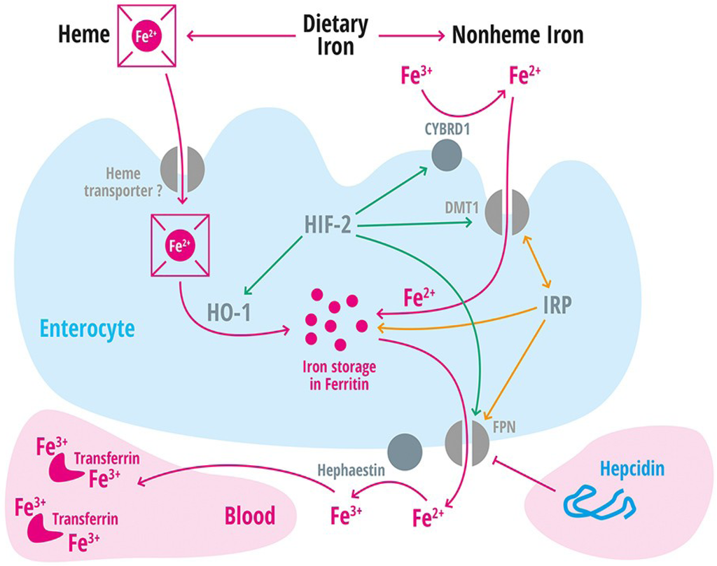

Slide 17
Hepcidin
Is a 25 amino acid disulphide rich peptide synthesized in the liver
Act as a systemic iron regulatory hormone by regulating iron transport from iron exporting tissues into plasma
Its synthesis increased by iron loading & presence of infection and decreased by anaemia and hypoxia
Low level of Hepcidin enhanced iron absorption and release of iron from stores by increased expression of ferroportin
Abnormal iron homeostasis in various condition like hemochromatosis, anaemia of inflammation and chronic diseases, is due to dysregulation of Hepcidin production

Slide 18
Clinical features
Symptoms related to iron deficiency anaemia:
  Decreased appetite
  Fatigue
  Irritability
  Pale skin colour
  Shortness of breath, etc.
Symptoms related to iron deficiency:
  Decreased work performance
  Headache
  Paraesthesia
  Breath holding spells
  Dysphagia
  Pica
  Poor attention span, poor response to sensory stimuli and behavioural & developmental milestones retardation
  Hyperactivity syndromes like restless leg syndrome tourttr syndrome and ADHD

Slide 19
Physical findings
Pallor
Glossitis
Stomatitis
Angular cheilitis
Koilonychia
Retinal haemorrhages and exudates

Slide 20
Diagnosis
Parameter | Finding
CBC | Low haemoglobin Microcytic, hypochromic RBC Anisocytosis Target cells occasionally Elongated hypochromic elliptocytes (pencil cell) RDW increased Thrombocytopenia or thrombocytosis Reticulocyte count normal or decreased
Bone marrow | Decreased or absent hemosiderin
Serum iron | Low or normal
Iron binding capacity | Increased
Transferrin saturation | Decreased
Serum ferritin | Less than or equal to 10 mcg/l
Erythrocyte zinc protoporphyrin | Increased

Slide 21
Serum ferritin:
  Low level is virtually diagnostic for iron deficiency
  But it is also acute phase reactant so also elevated in chronic inflammation, liver disease or malignancies independent of iron status
  So in patient with such condition it is not reliable indicator for diagnosis

Slide 22
Transferrin saturation:
  Transferrin is a protein whose primary function is to transport iron from iron storage sites in the reticuloendothelial system to the bone marrow for use in erythropoiesis
  Transferrin saturation is defined as the ratio of serum iron to the total iron binding capacity
  Transferrin saturation=(Serum iron/TIBC)*100

Slide 23
Erythrocyte zinc protoporphyrin:
  Is a product of abnormal haem synthesis
  Can be used for screening IDA
  advantage:
    portable measurement
    cost effective
  Limitation:
    difficulty in automating the assay
    Increases in lead toxicity
    Falsely elevated in patients with elevated serum bilirubin or on regular haemodialysis

Slide 24
The threshold concentrations of erythrocyte protoporphyrin by age groups at which iron deficient erythropoiesis occurs according to Centres for Disease Control and Prevention (CDC) recommendations and the 97.5th percentile of the distribution of values in healthy subjects
Age | Recommended threshold (µg/dl red cells) | 97.5th percentile (µg/dl red cells)
0–12 months | >80 | 40
1–2 years | >80 | 32
2–9 years | >70 | 30
10–17 years (girls) | >70 | 34
Soldin OP, Miller M, Soldin SJ. Paediatric reference ranges for zinc protoporphyrin. Clinical Biochemistry, 2003, 36:21–25.

Slide 25
Management
Treatment of iron deficiency anaemia
  Oral iron therapy
  Parenteral iron therapy
  Blood transfusion
Oral therapy is preferred as iron deficiency anaemia is a disorder of long duration and slow progression

Slide 26
Oral Iron therapy
Dose of iron therapy:
  For treatment: 4-6 mg/kg/day elemental iron
  For routine supplements: 2-4 mg/kg/day elemental iron
Duration of therapy:
  Atleast 3 months after the blood count has returned to normal
Failure to treatment:
  Poor compliance (most common)
  False diagnosis
  Coexistence of other abnormality like thalassemia trait

Slide 27
Oral iron preparation
Conventional oral iron preparations
  ferrous sulphate(15mg)
  Ferrous fumarate(9mg)
  Ferrous gluconate(26mg)
Less commonly used preparations:
  Ferrous succinate(9mg)
  Ferrous lactate
  Ferrous glutamate
  Colloidal ferric hydroxide
Newer oral iron preparation:
  Iron polymaltose complex
  Ferrous bisglycinate(17mg)
  Sodium feredetate (21mg)
  Carbonyl iron
  Values in bracket indicate amount of preparation provide 3 mg of elemental iron

Slide 28
Iron preparation available
Brand name | Iron content
Livogen | Ferrous fumarate
Autrin | Ferrous fumarate
Tonoferon
Ferronia XT | Ferrous gluconate
Hemsi | Ferrous fumarate

Slide 29
Parenteral iron
Indiacations:
  Intolerance to oral preparations
  Rapid iron correction required
  Active inflammatory bowel disease
  Noncompliance with oral preparations
  Follow up of the patient is impossible
Contraindications:
  Anemias not due to iron deficiency
  Iron overload
  Hypersensitivity to parenteral iron preparations
  Severe allergy or anaphylactic reactions
  Clinical or biochemical evidence of Liver damage
  Acute or chronic infection
  neonates
Parenteral iron should be given in following dose
Weight in kg*4*hemoglobin deficit in gm/dl

Slide 30
Prevention of iron deficiency
Dietary modification
Food fortification
Iron supplementation

Slide 31
Diet and nutrition education
Eat more fruits and vegetables
No coffee or tea with meals
Programmes should be targeted to at risk groups
Reduce phytic content of cereals and legumes by fermentation

Slide 32
Food fortification
Iron compounds used in food fortification
  Freely water soluble
    Ferrous sulphate, gluconate, lactate & ferric ammonium citrate
  Poorly water soluble
    Ferrous fumarate, succinate & saccharate
  Water insoluble
    Ferric pyrophosphate, ferric orthophosphate & elemental iron

Slide 33
Which form of iron to use in fortification?
Ideally a safe, cheap, highly bioavailable iron which causes no organoleptic side-effects should be used
Freely water soluble iron are the most bio-available, but causes unacceptable colour and flavour change in many foods
Insoluble iron compounds are inert with no organoleptic effects but it is poorly absorbed
Cost wise elemental iron is the cheapest
  Ferrous sulphate has good absorption & high bioavailability
  Drawbacks: GIT disturbances & staining of teeth

Slide 34
Iron supplementation
Routine iron supplementation required in high risk groups
Dose for iron supplementation is 2-4 mg/kg/day
Current practice:
  In normal healthy infants: supplementation is started at 3 months of age till 1 year
  In preterm infants: supplementation is started at 15 days of age till 1 year

Slide 35
Author | Study design | Level | Result | outcome
Susana Martins, Stuart Logan, Ruth E Gilbert | Iron therapy for improving psychomotor development and cognitive function in children under the age of three with iron deficiency anaemia | 1 | Five trials, including 180 children with IDA, examined the effects of iron therapy on measures of psychomotor development between 5 and 11 days of commencement of therapy. Data from four trials could be pooled. The pooled difference in pre to post treatment change in Bayley Scale PDI between iron treated and placebo groups was -3.2 (95%CI -7.24, 0.85) and in Bayley Scale MDI, 0.55 (95% CI -2.84, 1.75). Two studies, including 160 randomised children with IDA, examined the effects of iron therapy on measures of psychomotor development more than 30 days after commencement of therapy. Aukett et al reported the mean number of skills gained after two months of iron therapy, using the Denver test. The intervention group gained 0.8 (95% CI -0.18, 1.78) more skills on average than the control group. Idjrandinata et al reported that the difference in pre to post treatment change in Bayley Scale PDI between iron treated and placebo groups after 4 months was 18.40 (95%CI 10.16, 26.64) and in Bayley Scale MDI, 18.80 (95% CI 10.19, 27.41). | There is no convincing evidence that iron treatment of young children with IDA has an effect on psychomotor development discernable within 5-11 days. The effect of longer term treatment remains unclear but the data would be compatible with clinically significant benefit. There is urgent need for further randomised controlled trials with long term follow up

Slide 36
Author | Study design | Level | Result | outcome
David I Thurnham, Linda D McCabe, Sumanto Haldar, Frank T Wieringa, Christine A Northrop-Clewes, and George P McCabe | Adjusting plasma ferritin concentrations to remove the effects of subclinical inflammation in the assessment of iron deficiency: a meta-analysis | 1 | In the 2-group analysis, inflammation increased ferritin by 49.6% (CRP) or 38.2% (AGP; both P < 0.001). Elevated AGP was more common than CRP in young persons than in adults. In the 4-group analysis, ferritin was 30%, 90%, and 36% (allP < 0.001) higher in the incubation, early convalescence, and late convalescence subgroups, respectively, with corresponding correction factors of 0.77, 0.53, and 0.75. Overall, inflammation increased ferritin by ≈30% and was associated with a 14% (CI: 7%, 21%) underestimation of ID. | Measures of both APP and CRP are needed to estimate the full effect of inflammation and can be used to correct ferritin concentrations. Few differences were observed between age and sex subgroups.

