Slide 1
DENGUE
DR. POOJA
ASSISTANT PROFESSOR
DEPT OF PAEDIATRICS

Slide 2
ARBOVIRUS
Arthropod-borne viruses (arboviruses) are viruses that can be transmitted to man by arthropod vectors .
WHO definition - Viruses that are maintained in nature principally, or to an important extent, through biological transmission between susceptible vertebrate host by hematophagous arthropods or through transovarian and possibly venereal transmission in arthropods.

Slide 3
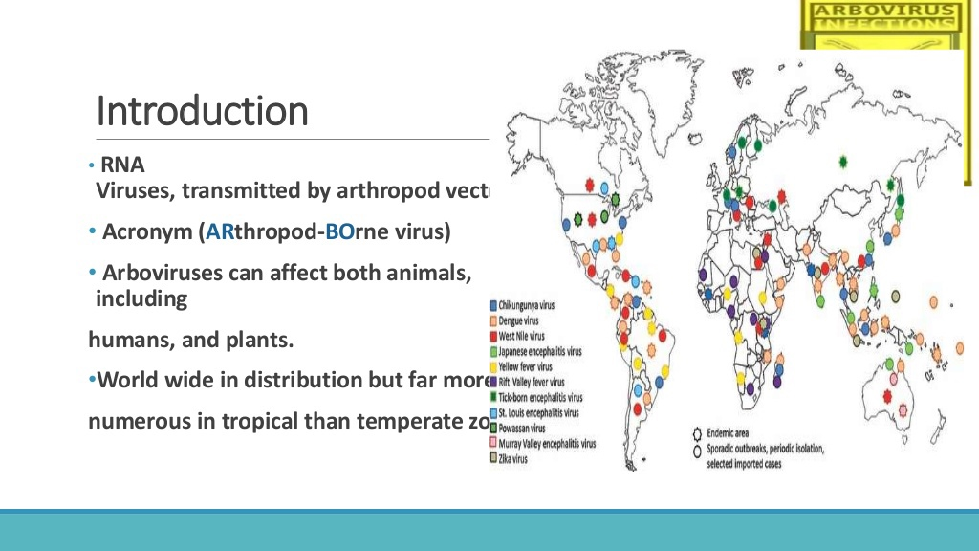

Slide 4
They can multiply in the tissues of the arthropod without evidence of disease or damage
The vector acquires a lifelong infection through the ingestion of blood from a viremic vertebrate
All arboviruses have an RNA genome, and most have a lipid-containing envelope and consequently are inactivated by ether or sodium deoxycholate
Inclusion in this group is based on ecological and epidemiological considerations and hence it contains viruses of diverse physical and chemical properties

Slide 5
source NVBDCP data 2020
BURDEN OF VBD IN LAST THREE YEARS
DISEASES | 2017 |  |  | 2018 |  |  | 2019
 | CASES | DEATHS | % DEATHS | CASES | DEATHS | % DEATHS | CASES | DEATHS | % DEATHS
MALARIA | 8,44,558 | 194 | 0.02 | 4,29,928 | 96 | 0.02 | 3,38,494 | 77 | 0.02
DENGUE | 1,88,401 | 325 | 0.17 | 1,01,192 | 172 | 0.16 | 1,57,315 | 166 | 0.10
CHIKUNGUNYA | 67,769 | 0 | 0 | 57,813 | 0 | 0 | 81,914 | 0 | 0
KALA-AZAR | 5,758 | 0 | 0 | 4,386 | 0 | 0 | 3,143 | 0 | 0
JE | 2,181 | 254 | 11.64 | 1,678 | 182 | 10.84 | 2,545 | 266 | 10.45

Slide 6
CLASSIFICATION
FAMILY | GENUS | VIRUS OF MEDICAL IMPORTANCE
TOGAVIRIDAE | ALPHAVIRUS | CHIKUNGUNYA, EEE, WEE, SINDBIS VIRUS
FLAVIVIRIDAE | FLAVIVIRUS | DENGUE, JEV, YFV, WNV, ST. LOUIS ENCEPHALITIS VIRUS
BUNYAVIRIDAE | BUNYAVIRUS | BUNYAMWERA, CALIFORNIA ENCEPHALITIS VIRUS
REOVIRIDAE | COLTIVIRUS | COLORADO TICK FEVER VIRUS

Slide 7
EPIDEMIOLOGY
VIRUS | RESERVOIR | VECTOR | DISEASE
Chikungunya | Monkeys | Mosquito | Chikungunya Fever
Dengue | Monkeys, Man | Mosquito | Dengue fever
Japanese Encephalitis | Wild birds, pigs | Mosquito | Encephalitis
Kyasanur Forest Disease | Forest birds, animals | Tick | Hemorhagic fever
Sindbis | - | Mosquito | Sindbis fever

Slide 8
VIROLOGY
ARBOVIRUS | GENOME TYPE | CAPSID SHAPE | ENVELOPED? | VIRAL ENTRY | INFECTED CELLS
CHIKUNGUNYA VIRUS | +ssRNA | ICOSAHEDRAL | YES | MEMBRANE FUSION | EPITHELIAL CELLS , ENDOTHELIAL CELLS , PRIMARY FIBROBLASTS AND MACROPHAGES
DENGUE VIRUS | +ssRNA | ICOSAHEDRAL | YES | MEMBRANE FUSION | LANGERHANS AND WHITE BLOOD CELLS
JAPENESE ENCEPHALITIS VIRUS | +ssRNA | ICOSAHEDRAL | YES | MEMBRANE FUSION | NEURAL CELLS
RIFT VALLEY FEVER VIRUS | +ssRNA | ICOSAHEDRAL | YES | MEMBRANE FUSION | WBCs
WEST NILE VIRUS | +ssRNA | ICOSAHEDRAL | YES | MEMBRANE FUSION | NEURAL CELLS
YELLOW FEVER VIRUS | +ssRNA | ICOSAHEDRAL | YES | MEMBRANE FUSION | HEPATOCYTES AND WBCs
ZIKA VIRUS | +ssRNA | ICOSAHEDRAL | YES | MEMBRANE FUSION

Slide 9
Chikungunya is a viral disease transmitted to humans by infected mosquitoes. It is caused by the chikungunya virus (CHIKV).
A CHIKV infection causes fever and severe joint pain. Other symptoms include muscle pain, joint swelling, headache, nausea, fatigue and rash.
Joint pain associated with chikungunya is often debilitating, and can vary in duration.
There is currently no vaccine or specific drug against the virus. The treatment is focused on relieving the disease symptoms.
The disease mostly occurs in Africa, Asia and the Indian subcontinent more from states Andhra Pradesh, Karnataka, Maharashtra, Tamil Nadu, Madhya Pradesh and Gujarat.
The proximity of mosquito breeding sites to human habitation is a significant risk factor for chikungunya.
CHIKUNGUNYA

Slide 10
Chikungunya is spread through bites from Aedes mosquitoes, and the species A. aegypti was identified as the most common vector followed by A.albopictus.
Vertical transmission
Transmission via infected blood products
TRANSMISSION

Slide 11
PATHOGENESIS
Replicates in fibroblasts, monocytes, macrophages, NK cells, epithelial and endothelial cells.
T and B lymphocytes are not susceptible
Replication is inhibited by interferon
Produces clinical manifestations after 48 hours of bite
High viremia for first 2 days, declines around day 3 or 4, disappears by day 5
Hemagglutination and neutralising antibodies can be detected after day 5 with declining viremia

Slide 12
Clinical manifestations begin 3-7 days after a mosquito bite
The onset is abrupt
High fever with chills, myalgia, headache, photophobia, may remit after a gap of 4-10 days ( saddleback fever )
Severe joint symptoms (hands, feet, ankles, wrists) -symmetric bilateral polyarthralgia or arthritis.
Most pediatric patients are relatively asymptomatic, but all ages are vulnerable to classic disease.
Headache
Myalgias
Conjunctivitis
Weakness
Lymphopenia
Maculopapular rash.
SIGNS AND SYMPTOMS

Slide 13
Dengue
West Nile
Enterovirus diseases
Leptospirosis
Rickettsial disease
Measles
Parvovirus disease
Rheumatologic diseases
Other alphavirus diseases (e.g., Ross River virus) in endemic areas.
DIFFERENTIAL DIAGNOSIS

Slide 14
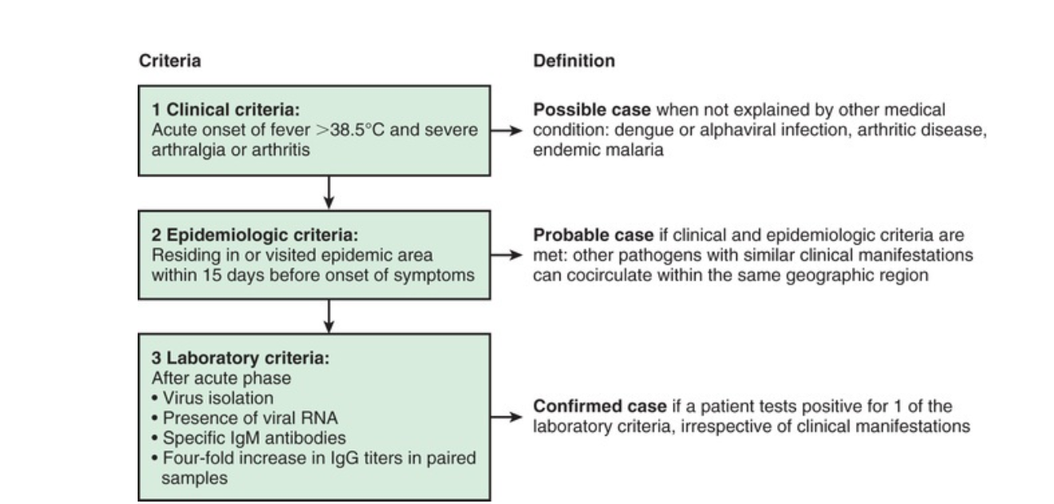
DIAGNOSIS
TEXTBOOK OF PEDIATRICS NELSON, PAGE

Slide 15
There is no specific antiviral drug treatment for chikungunya.
Treatment is directed primarily at relieving the symptoms, including joint pain using anti-pyretics, optimal analgesics ( NSAIDS) and fluids.
In unresolved arthritis refractory to NSAIDS, chloroquine ( 10mg/kg/day) has proved to be useful.
There is no commercial chikungunya vaccine till date.
TREATMENT

Slide 16
VACCINE
In 2000, a live-attenuated CHIKV vaccine was developed by the US army and used in a randomized, double-blind, placebo-controlled trial. Seroconversion rates were high (98%), but the vaccine temporally was associated with arthralgia in 8% of vaccines.¹ For these reasons, further assessment of the vaccine was discontinued. Currently, alternative strategies for the development of a safe and efficacious chikungunya vaccine continue to be investigated.
PREVENTION

Slide 17
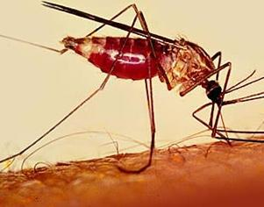
DENGUE

Slide 18
INTRODUCTION
Dengue is the most rapidly emerged mosquito-borne viral disease of great public health concern in India.
Dengue – Name originated from the swahili word for “ Bone breaking fever”.
It is a major public health concern throughout tropical and subtropical regions of the world.

Slide 19
Every year, thousands of cases of Dengue Fever occur all over the country giving rise to a significant number of deaths and morbidity.
Last year alone, there were 20,000 deaths; 264 disability-adjusted life years (DALY) per million populations
( acc to NVBDCP data 2020 )

Slide 20
as per the data from the National Vector Borne Disease Control Programme (NVBDCP).
CASES OF DENGUE
2017 | 2020
1.88 lakh ( highest in last 5 years ) | 39,419 ( reduction of 79% )
DEATHS DUE TO DENGUE
2017 | 2020
325 | 56 ( reduction of 83% )

Slide 21
DENGUE VIRUS
Dengue viruses are categorised under the genus flavivirus. These viruses contain single stranded RNA and are small in size.
There are four dengue serotypes DENV-1 , DENV-2 , DENV-3, DENV-4.
Although all four serotypes are antigenically similar, still they are different enough to elicit cross-protection for a few months after infection by any one of them.

Slide 22
CROSS REACTIVITY
Two types of antibodies are produced, neutralizing and non- neutralizing.
Neutralization requires a threshold level of antibodies.
The neutralizing antibodies can protect against a specific serotype of the virus.
The non-neutralizing antibodies bind to but do not neutralize an infecting virus.
After the formation of virus-antibody complex, viral entry is enhanced into the dendritic cells and macrophages.
Once inside the cell, the virus replicates and generates higher virus titres in the blood. This phenomenon is known as Antibody-Dependent Enhancement (ADE) of infection.
Dengue virus-specific CD4+ and CD8+ T cells lyse dengue virus-infected cells and produce IFN-gamma,TNF-alpha, and lymphotoxin, all of which results in a "Cytokine storm" and ultimately leads to more severe disease.

Slide 23
MOLECULAR EPIDEMIOLOGY
The four dengue virus types (DENV1-4) called as dengue virus serotypes form a phylogenetic group and differ in nucleotide sequence from each other.
Serotype : Subtype/Genotype
DENV-1: Three
DENV-2: Six
DENV-3: Four
DENV-4: Four

Slide 24
VECTOR
Dengue viruses are transmitted from an infected person to others by the bite of the female Aedes aegypti mosquito.
The female aedes aegypti mosquito,being highly domesticated tropical mosquito, prefer to lay eggs in artificial containers commonly found in and around homes. Under optimal conditions , the adult emerges in seven days.
Climate also plays major role for virus transmission.

Slide 25
Climatic conditions, particularly temperature and rainfall have major impact on the life cycle , breeding and transmission of diseases.
The average survival of aedes aegypti is 30 days and can fly up to limited distance of 400 meters.
Aedes aegypti breeds around households, water storage containers, water reservoirs, overhead tanks , coolers, unused tyres coconut shells, disposable cups etc, are important in producing large numbers of adult mosquitoes in close proximity to human dwellings.

Slide 26
ENVIRONMENTAL FACTORS
The population of aedes aegypti fluctuates with rainfall and water storage. Its survives best between 16 c and 30 c and relative humidity of 60-80%.
Aedes aegypti is highly anthropophilic and rests in cool shady places. A lower environmental temperature increases the extrinsic incubation period which, in turn, decreases the transmission.

Slide 27
HOST FACTOR
The dengue virus infects humans and several species of lower primates. In Asians, disease is more severe in children.
Travel to dengue endemic areas is most important risk factor. However, if the patient develops fever more than two weeks after travel, it is unlikely to be dengue infection.

Slide 28
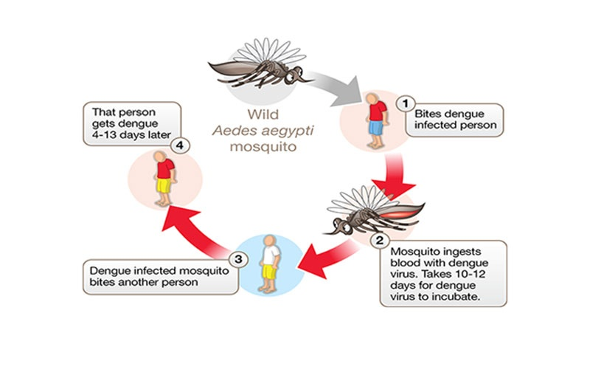
TRANSMISSION
Because of high level of viremia resulting from dengue virus infection of humans, viruses are efficiently transmitted between mosquitoes and humans without the need for an enzootic amplification host.
Optimal temperature for transmission > 16° C

Slide 29
PATHOPHYSIOLOGY OF DENGUE FEVER
Various mechanisms are proposed to explain the signs and symptoms observed in a patient, and most have the following central themes:
Antibody-dependent enhancement (ADE)
Cytokine Storm
Vasculopathy
Coagulopathy

Slide 30
Dengue virus has three principal proteins that are targeted by the host immune response.
E protein-specific antibodies cause neutralization of infection and block attachment to cell receptors.
NS1 is not found in the virion; NS1-specific antibodies are therefore incapable of neutralization of infection but can direct complement-mediated lysis of infected cells.
Pre-M–specific antibodies bind to partially matured virions only and show poor neutralization of infection but can mediate ADE.

Slide 31
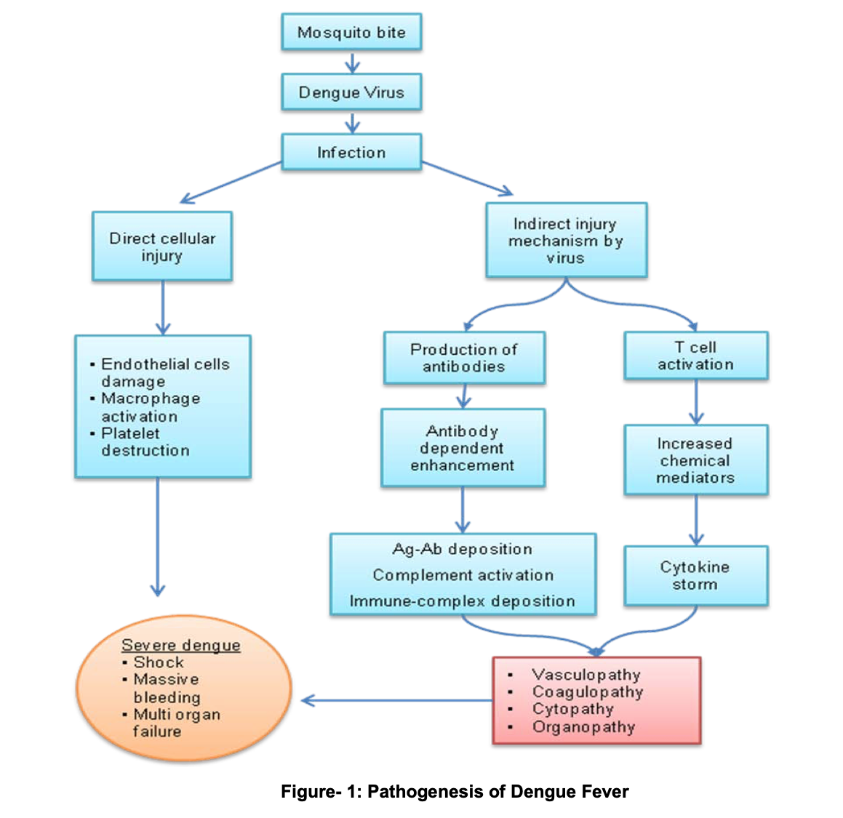

Slide 32
CLINICAL FEATURES
Probable Dengue fever:
A case compatible with the clinical description of dengue fever during the outbreak and/or Non- ELISA based NS1/IgM positive is only probable dengue fever due to poor sensitivity and specificity.
Confirmed Dengue Fever:
A case compatible with the clinical descriptions of dengue fever with at least one of the following:
• Demonstration of dengue virus antigen in a serum sample by NS1-ELISA
• Demonstration of IgM antibody titer by ELISA in the single serum sample
• IgG seroconversion in paired sera after 2 weeks with a fourfold increase of IgG titer • Detection of viral nucleic acid by PCR
• Isolation of the virus (virus culture positive) from serum, plasma or leucocytes).

Slide 33
Natural Course of Dengue Infection
The clinical course of illness passes through the following three phases:
Febrile phase
Critical phase
Convalescent phase

Slide 34
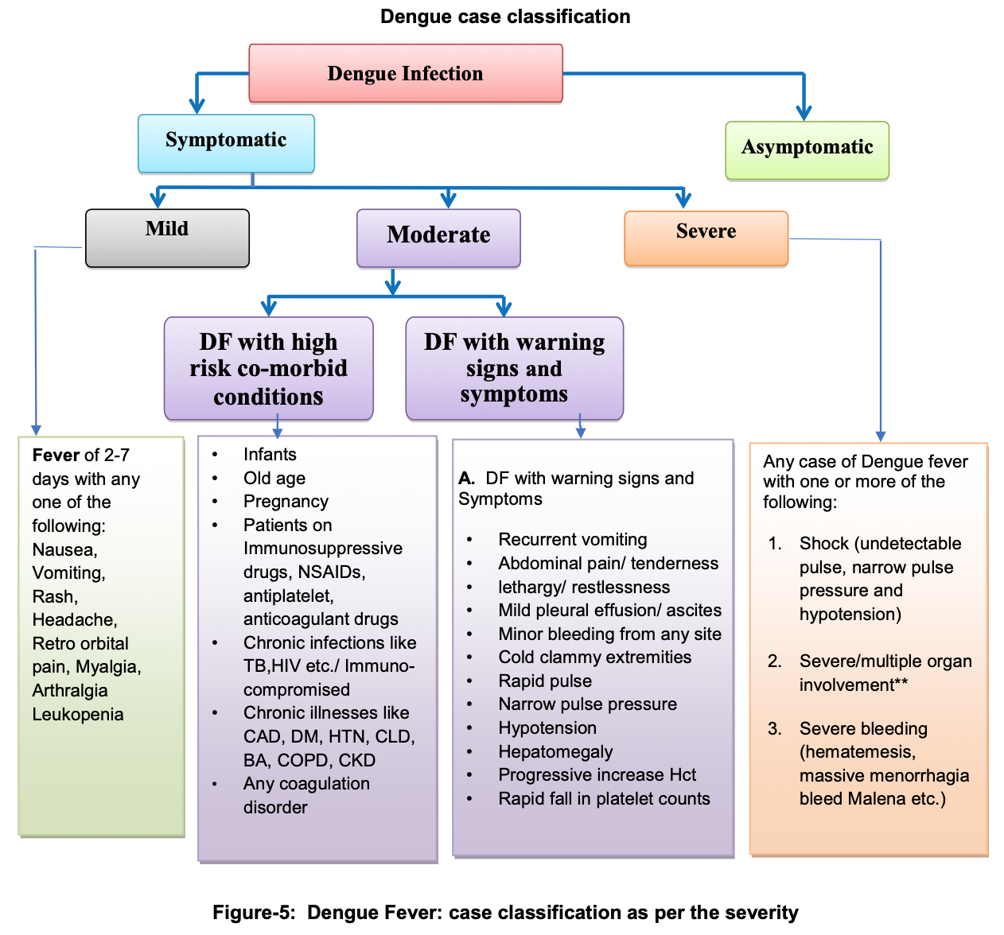

Slide 35
FEBRILE PHASE
Sudden rise in temperature - biphasic, lasting 2-7 days, commonly associated with
Headache,
Flushing,
Retro-orbital pain
Rash,
Myalgia,
Maculopapular or rubelliform rash which usually appear after 3rd or 4th day of fever and is commonly seen on the face, neck and another part of the body, it generally fades away in the latter half of febrile phase.
Unusual haemorrhagic manifestations or severity may be seen in persons with coinfection with other organisms or in those having co- morbid illnesses.

Slide 36
CRITICAL PHASE (Leakage phase)
After 3 to 4 days of onset of the fever
Plasma leakage and haemoconcentration —-> bleeding, hypotension and fluid accumulation in pleural, pericardial or abdominal cavities.
High morbidity and mortality are usually seen in cases with multiple organ involvement or severe metabolic derangements.
The period of plasma leakage usually lasts for 36-48 hrs.

Slide 37
CONVALESCENT PHASE ( RECOVERY PHASE )
the extracellular fluid, which was lost due to capillary leakage, returns to the circulatory system
signs and symptoms of the patient improve
starts after 6-7 days of fever and lasts for 2-3 days
Longer convalescence period may be expected in some patients with severe shock, multiple organ involvement and other complications requiring specific treatment
The patient may develop pulmonary oedema due to fluid overload during this phase, especially if the fluid replacement rate is not reviewed and revised periodically

Slide 38
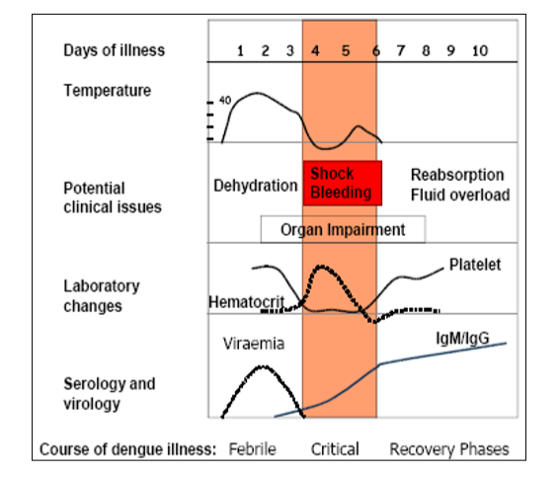
CLINICAL COURSE OF DENGUE

Slide 39
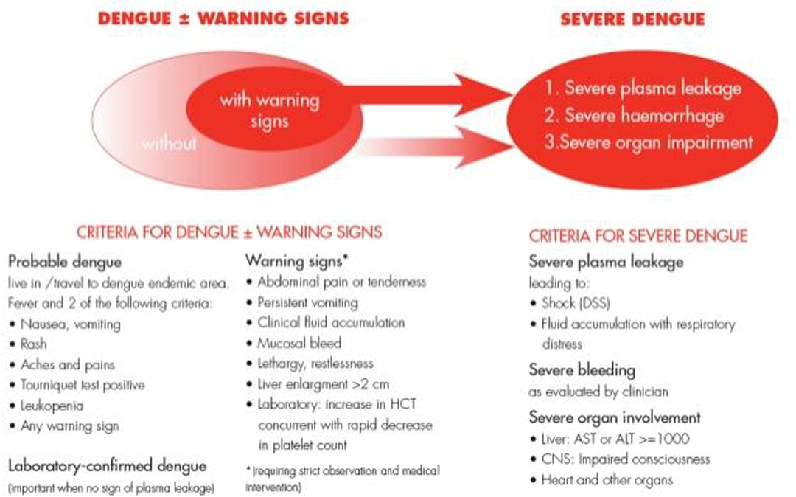

Slide 40
Why Co-infection: A Public Health Challenge
Difficult to distinguish symptoms and signs because of their overlapping initial clinical presentations and laboratory parameters.
They both have an unpredictable clinical course and both generally require in-hospital monitoring for management. A high index of suspicion will be required to identify Dengue- COVID-19 co-infections.
Most of the hospitals are busy with managing COVID-19 at present, and a very little window is open to tackling another disease outbreak.
Most of the cases of COVID-19 and dengue are asymptomatic (about 80%). In a setting of coinfection, one might enhance the severity of the other.

Slide 41
IV fluid therapy is challenging in coinfected patients due to early development of ARDS/pulmonary oedema.
Treatment with Low molecular weight heparin for management of COVID-19 may enhance bleeding in the presence of dengue, especially with low platelet count.
False positivity is also reported among co-infection, which may create a diagnostic challenge.
Both viral diseases do not have any specific antivirals drugs or any vaccine.

Slide 42
Dengue primarily gets transmitted by mosquito bite, initially infects the LHCs in the dermis or the peripheral blood monocytes which later on carries the viral particle to draining lymph node and primes the T cell and B cell.
On the other hand, the route of entry of coronaviruses is the respiratory tract. Both the viruses multiply in the host cellular cytoplasm.
In a setting of the dysfunctional immune response, both can cause a cytokine storm that leads to both local and systemic tissue damage.

Slide 43
Both infections exhibit the following characteristics- Antibody-dependent enhancement (ADE), cytokine storm, vasculopathy, and coagulopathy.
Chance of cross-reactive antibody formation, so false positivity can't be ruled out at this moment.
If fever for less than 5 days NS1 and PCR should be tested.
If a patient presents after 5 days IgM for dengue should be tested.
To term it a co-infection on 21-35 days, COVID-19 antibody titer can be measured as it will be proven that SARS-CoV-2 has primed the immune cells of the body.

Slide 44
CLINICAL CHARACTERISTICS
Both diseases, dengue and COVID-19 appear as a brief febrile illness with
Thrombocytopenia
Shortness of breath (more prevalent in COVID-19)
Bleeding signs (more prevalent in dengue).
Leucopenia or a normal leucocyte count is detected during routine testing for both disorders.
Decrease in platelet count is a characteristic of dengue illness, but it is also present in a considerable proportion of COVID infections.

Slide 45
Both COVID-19 and dengue infection are associated with coagulopathy and vasculopathy,
With coagulopathy and a higher risk of thrombosis being more prevalent in COVID-19 infections, which has resulted in the widespread usage of Low Molecular Weight Heparin (LMWH).
However, when dengue co-infection occurs, which is frequently associated with thrombocytopenia and an increased risk of bleeding, the usage of LMWH becomes problematic.

Slide 46
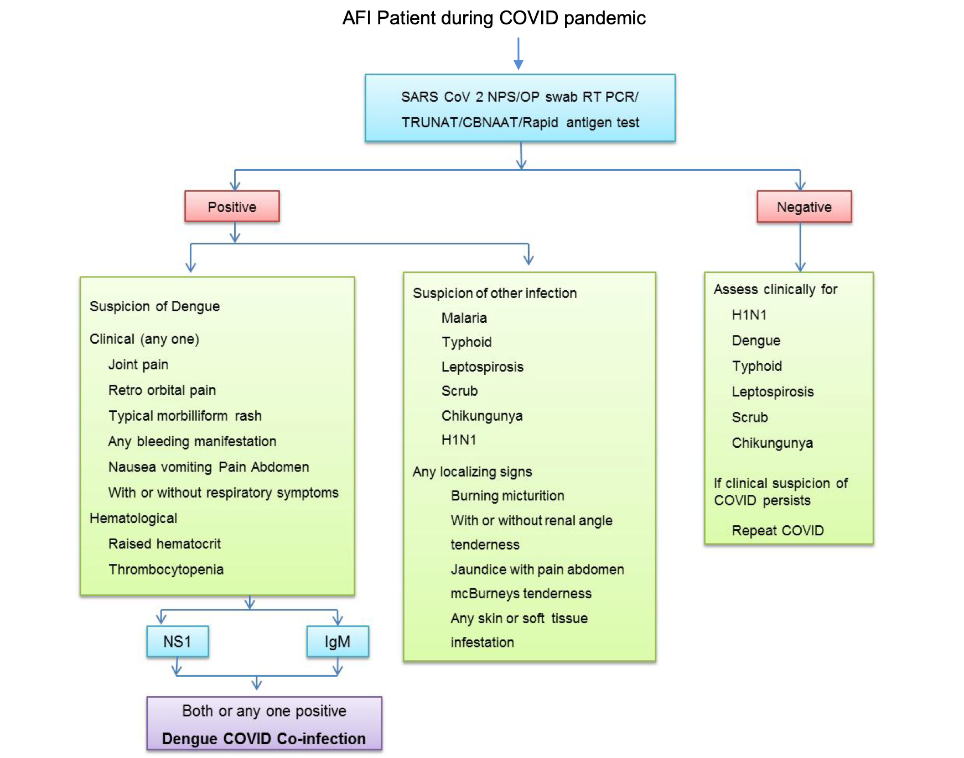
Diagnostic approach to Co-infection

Slide 47
Clinical considerations for co- infection with dengue and COVID-19
Rule out co-infection using an appropriate diagnostic tool in order to commence appropriate specialised care and therefore decrease morbidity and death.
Early clinical diagnosis and recognition of warning signs of dengue severity (abdominal pain or tenderness, persistent vomiting, clinical fluid accumulation, mucosal bleed, lethargy or restlessness, liver enlargement >2 cm, and increase in haematocrit).

Slide 48
Mild to moderate dengue and COVID co-infected patients should be constantly followed, particularly in a hospital setting, as they can rapidly advance to a severe stage and should be referred to a higher centre at an early stage by identifying warning signals.

Slide 49
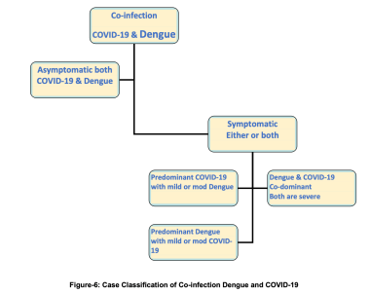
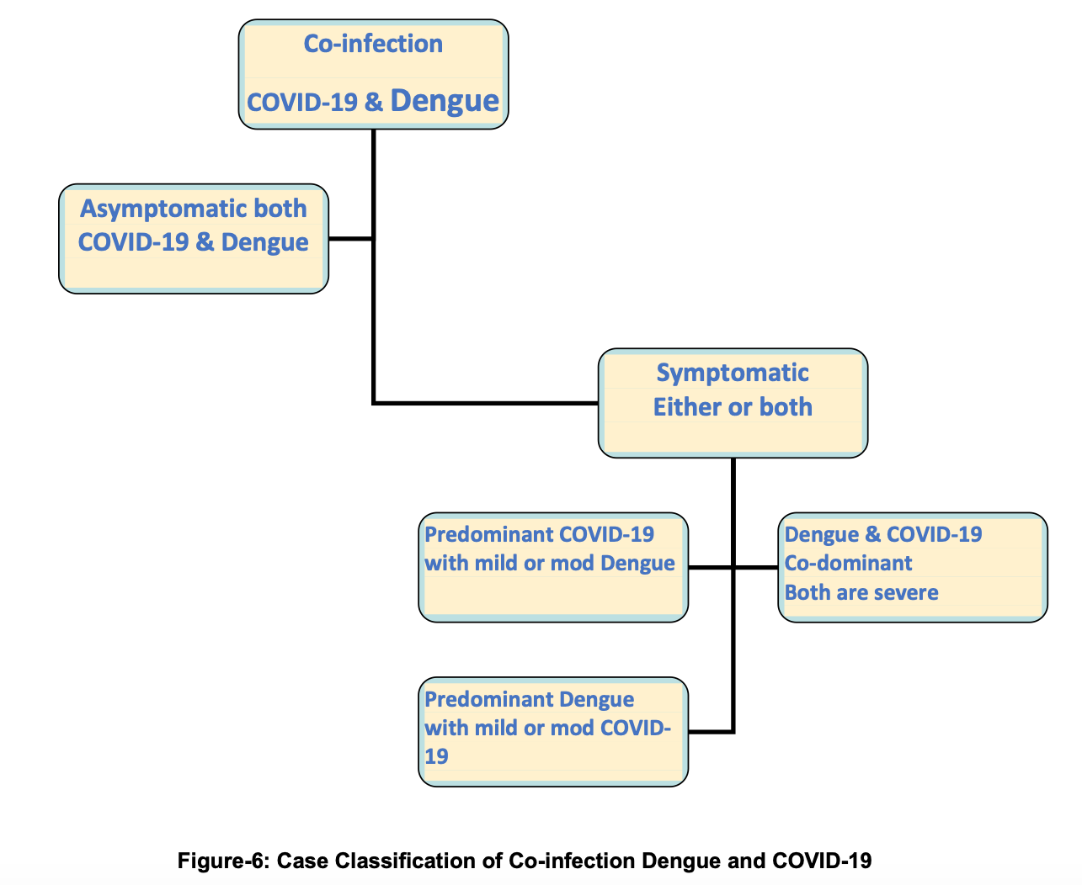
Case Classification of Co-infection (COVID-19 & Dengue)
It is observed that about 70 – 80% of COVID-19 and dengue cases are asymptomatic. So, a large portion of the co-infected population may be asymptomatic for both the diseases. However, the presence of one infection could enhance the symptoms and severity of others.

Slide 50
Case Classification of co-infection
Asymptomatic Co-infection
Symptomatic co-infection
  Predominant Corona Viral Diseases (P-CVD)
  Predominant Dengue Viral Disease (P-DVD)
  Co-dominant co-infection of Covid-19 and Dengue (CDCI)
For all the above categories, a confirmed case will only be labelled, if microbiologically proven by RTPCR/CBNAAT/ RAT in case of COVID-19 and by NS1Antigen or IgM (ELISA based) for dengue. Among those cases where clinical presentation is suggestive but testing is negative, will come under the probable category.

Slide 51
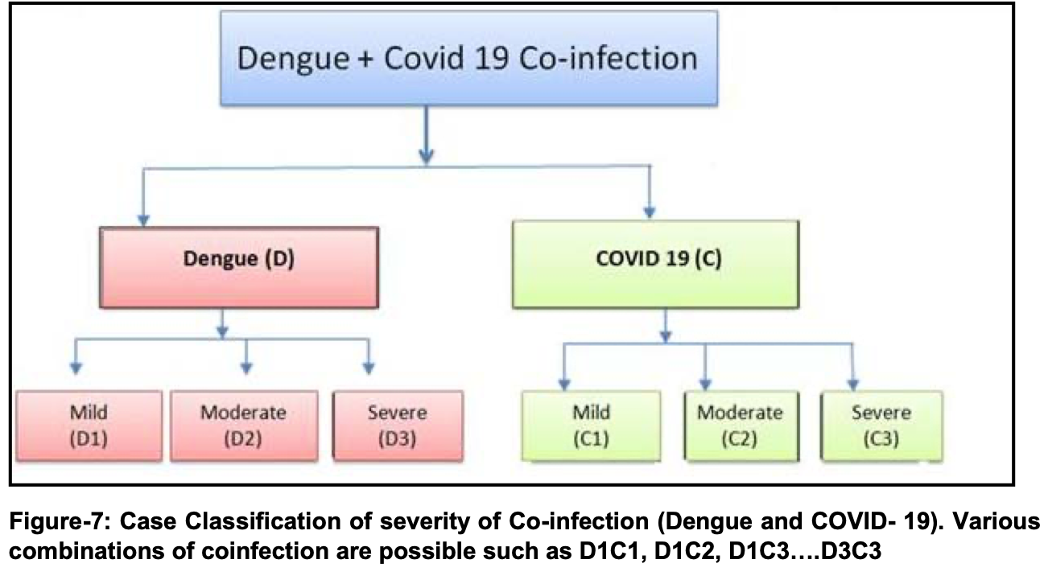
TREATMENT
The treatment protocol is planned as per the dominancy and severity of infection either dengue, COVID-19 or both

Slide 52
D1 - Mild Dengue
Dengue infection without warning signs. Patients with fever, body aches, rashes or minor bleeding may be treated symptomatically.
Fever and body aches are best treated with paracetamol.
Salicylates and other non-steroidal anti-inflammatory drugs (NSAIDs) should be avoided as these may predispose to mucosal bleeds.
The patient should be encouraged to drink plenty of fluids.
There is no specific antiviral therapy.
The primary care physician/ health care worker should monitor the patient for warning signs, along with haematocrit and platelet counts.

Slide 53
D2 - Moderate Dengue
Dengue with warning signs. Patients with suspected dengue infection who have any of the
following features should be admitted to the hospital:
Abdominal pain or persistent tenderness vomiting
Fluid accumulation in pleural cavity, abdomen or subcutaneous tissues
Mucosal bleeds
Lethargy, restlessness or irritability Liver enlargement >2 cm.
Progressive increase in haematocrit with a concurrent decrease in platelet count.
Crystalloids are the preferred fluids.

Slide 54
D3 - Severe dengue
Patients presenting or developing any of the following complications are diagnosed to have severe dengue infection. Severe plasma leakage leading to
• Shock delayed capillary refill or oliguria
• Fluid accumulation in serosal cavities with respiratory distress
Severe bleeding manifestations
Severe organ involvement
o Liver: Hepatomegaly, liver failure, AST or ALT>1000units CNS: Impaired consciousness
o Heart: Myocardial dysfunction

Slide 55
INVESTIGATIONS
Complete blood count- Hb, TC, DLC, Platelet, haematocrit, PBS study
A drop of platelet count <100000 cells/cumm usually found in between 3-10 days of illness.
A rise of haematocrit occurs in critical phase particularly in shock cases. Increase by 20% or more is objective evidence of plasma leakage. Haematocrit may become normal or decrease if there is haemorrhage.
There is drop in total number of WBC and neutrophil with relative lymphocytosis and increase atypical lymphocyte towards the end of febrile phase.

Slide 56
Additional tests when indicated include :
Liver function test—transaminase leve may be mildly elevated.
Coagulation profile. Both APTT and PT may be prolonged in severe haemorrhagic manifestation.
Low fibrinogen and elevated fibrin degradation product levels are signs of DIC.
Urea creatinine and serum electrolyte— ( Na⁺ K⁺ Ca²⁺ Bicaronate), lactate
BUN is elevated in prolong shock.
Hyponatremia is most common electrolyte abnormality in DHS and DSS.
Hypocalcemia.

Slide 57
LABORATORY DIAGNOSIS
Diagnostic methods Timing of tests
Virus isolation (culture) 1 -5 days
Genome detection (PCR) 1 -5 days
Antigen detection (NS1) 1 -5 days
Antibody detection (IgM) After 5 days
IgG Acute sera 1-5 days
Convalesent sera after 15 days

Slide 58
MONITOR
Vital signs and peripheral perfusion (1–4 hourly until the patient is out of the critical phase),
Urine output (4–6 hourly),
Haematocrit (before and after fluid replacement, then 6–12 hourly),
Blood glucose, and other organ functions (such as renal profile, liver profile, coagulation profile, as indicated).

Slide 59
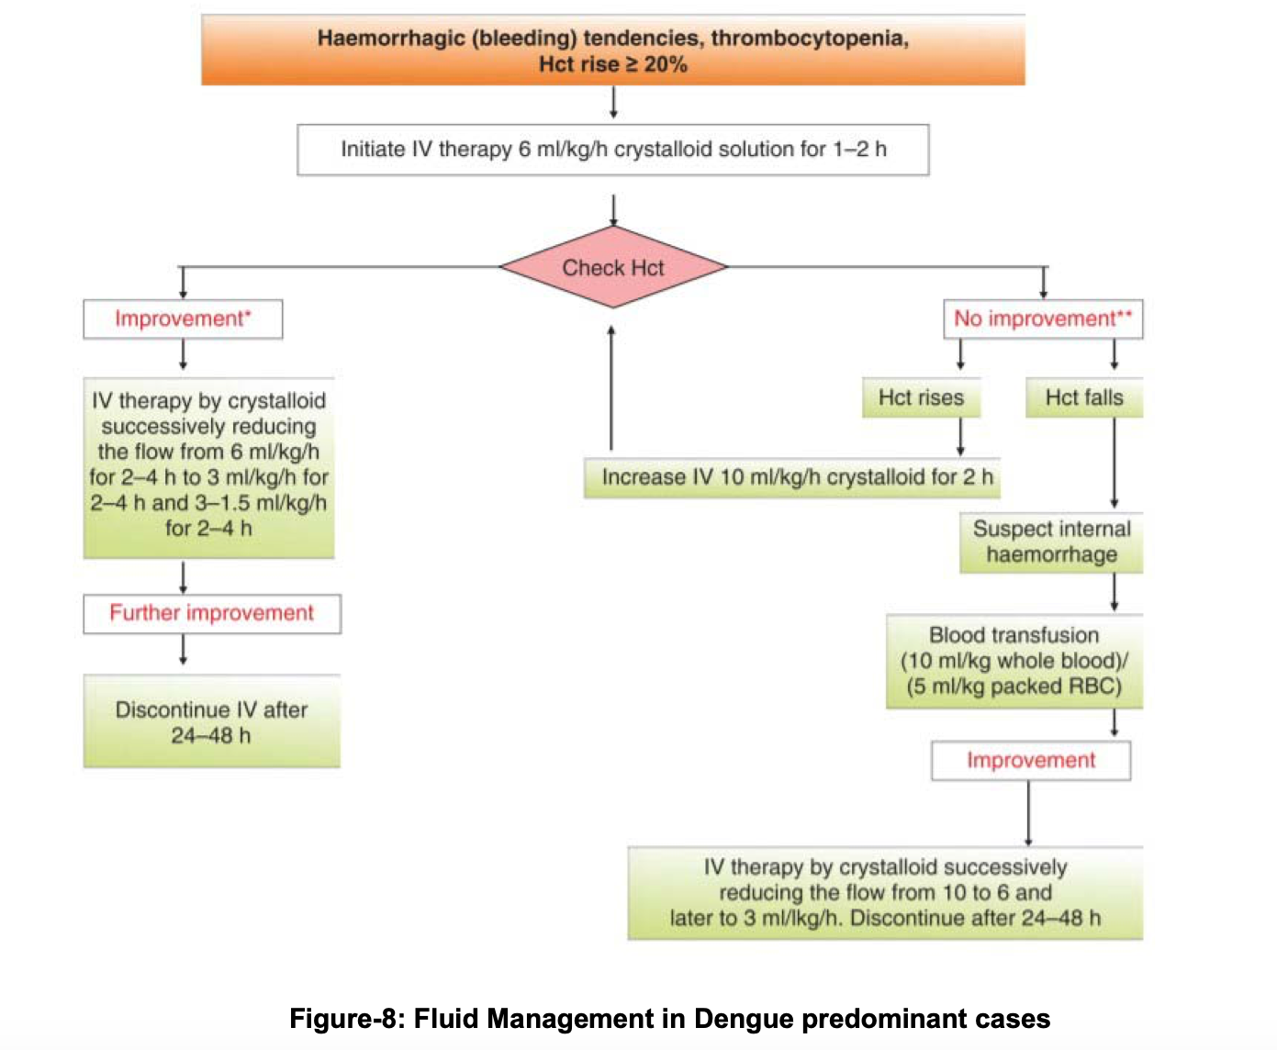

Slide 60
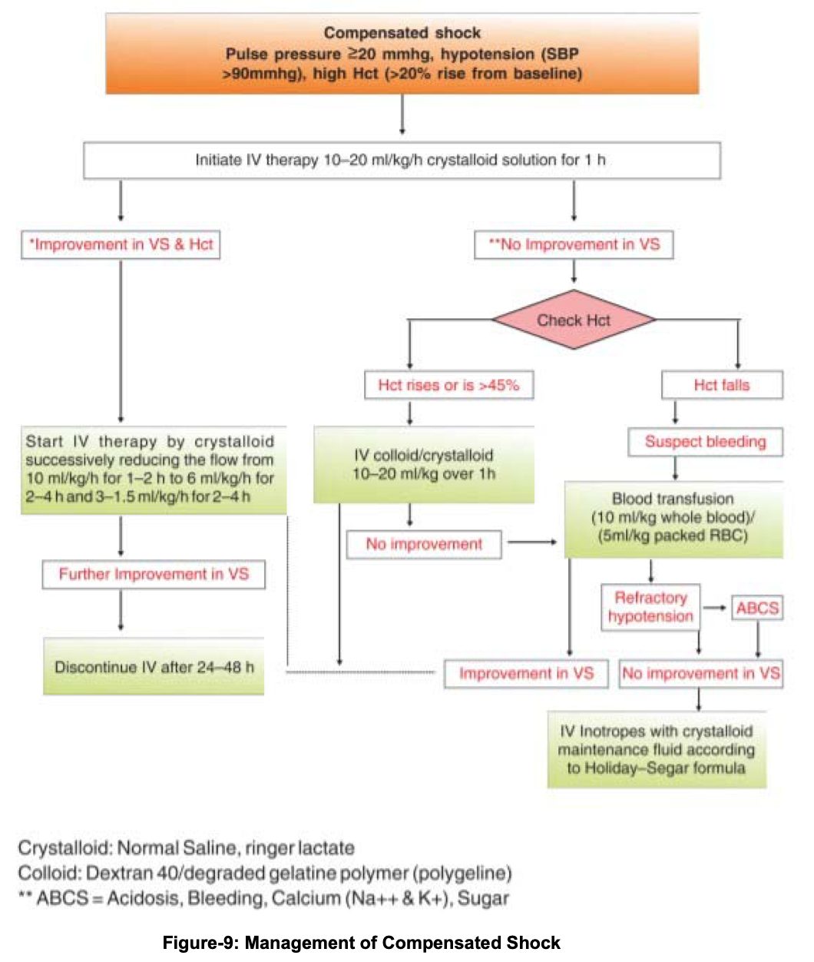

Slide 61
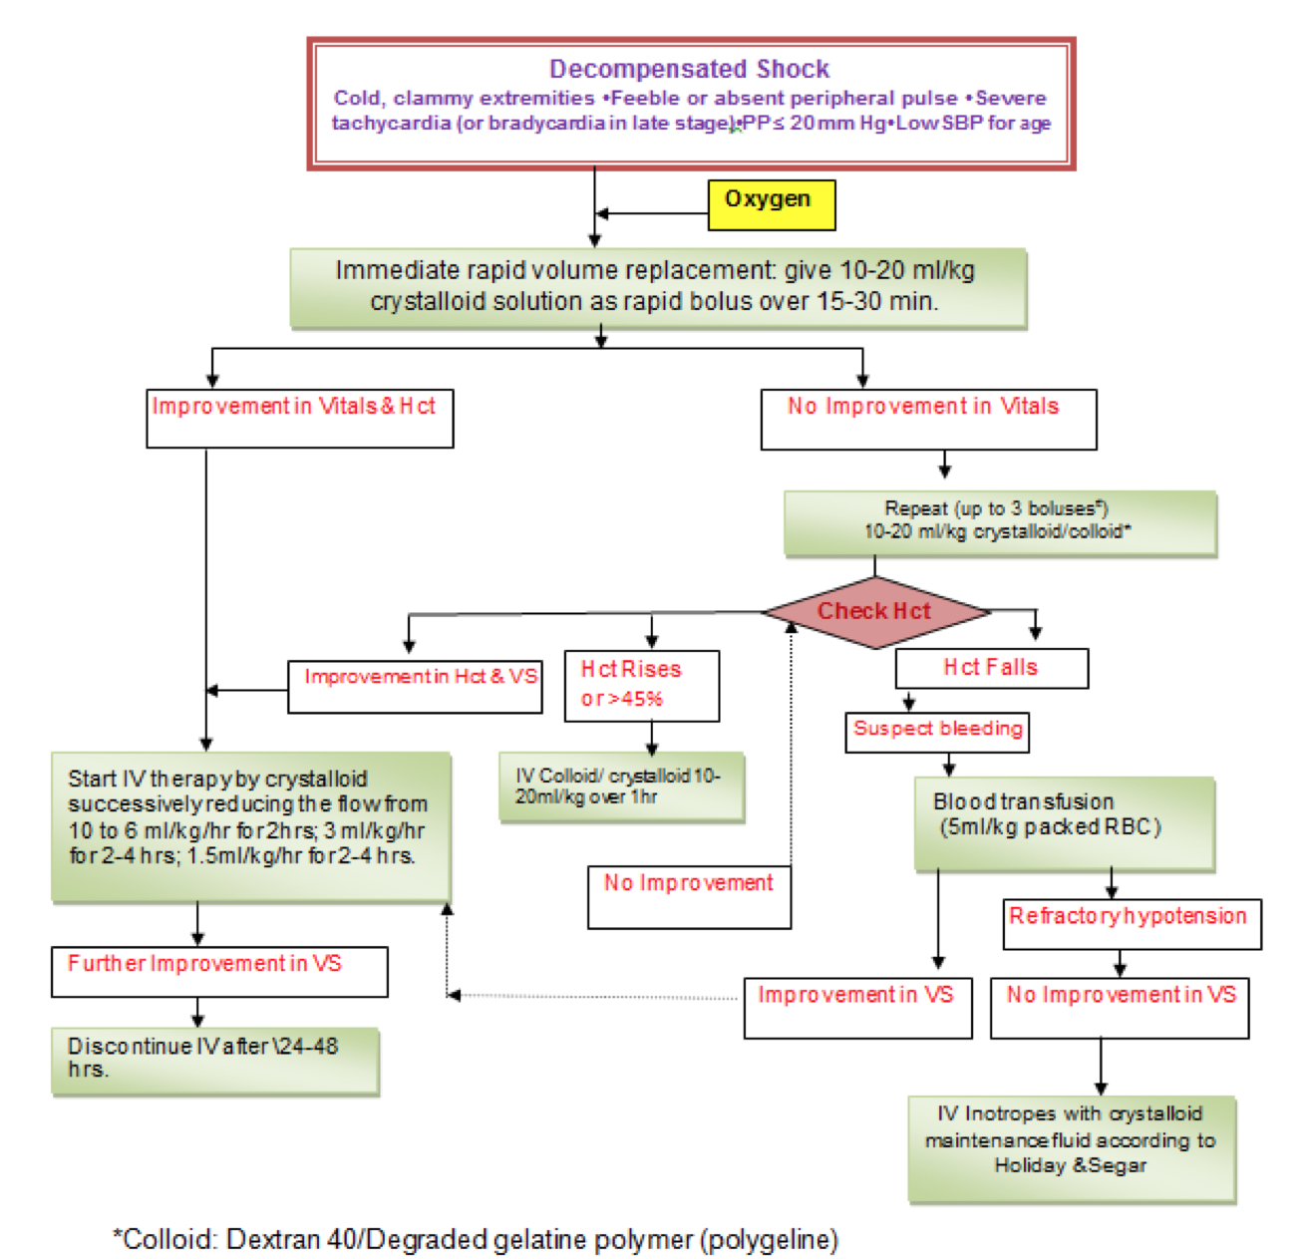

Slide 62
COMPLICATIONS
Haemorrhage: Mucosal bleeding may occur in any patient with dengue but, if the patient remains stable with fluid resuscitation/replacement, it should be considered as minor.
Prophylactic platelet transfusions for severe thrombocytopaenia in otherwise hemodynamically stable patients have not been shown to be effective and are not necessary.

Slide 63
SEVERE BLEEDING CAN BE RECOGNIZED BY :
Persistent and/or severe overt bleeding in the presence of unstable hemodynamic status, regardless of hematocrit level.
a decrease in haematocrit after fluid resuscitation together with unstable haemodynamic status;
refractory shock that fails to respond to consecutive fluid resuscitation of 40-60 ml/kg;
hypotensive shock with low/normal haematocrit before fluid resuscitation

Slide 64
Electrolyte and acid-base imbalances through vomiting and diarrhoea or to the use of hypotonic solutions for resuscitation and correction of dehydration. Hyponatraemia, hypokalaemia, hyperkalaemia, serum calcium imbalances and metabolic acidosis can occur.
Patients who present with convulsion and/or coma may have Encephalopathy

Slide 65
Considerations for certain treatment interventions
Fluid therapy- The amount of fluid to be provided in co-infection cases is determined by the patient's haemodynamic condition and degree of severity. For the majority of co-infection cases, one may follow national recommendations for clinical therapy of dengue fever. Only in the presence of SARI with COVID-19 should we exercise caution with intensive fluid administration, as this results in a deterioration of oxygenation. In such instances, close clinical monitoring of fluid status is necessary. For early resuscitation of COVID-19 patients in shock, aggressive fluid resuscitation is suggested.

Slide 66
LMWH- Once the platelet count falls below 1 lakh, we must exercise extreme caution with the administration of LMWH, which may be withheld depending on the patient's clinical status.
The decision to provide LMWH and the dosage should be made in conjunction with close monitoring using D-dimer readings. LMWH must be discontinued immediately in any incidence of co-infection with active bleeding.

Slide 67
Corticosteroids- Steroids, particularly dexamethasone, have been demonstrated to be beneficial in severe COVID-19 instances and are thus advised. Dengue fever is a viral infection, and hence its progress will be unaffected. As a result, the usage of steroids may be continued in accordance with COVID-19 management criteria.

Slide 68
THANK YOU

