Slide 1
HYPOTHERMIA IN NEWBORN
Dr.AVINASH BOTHRA
ASSISTANT PROFESSOR
DEPT OF PAEDIATRICS, SBKS MI&RC

Slide 2
Introduction
Significant problem in neonates at birth and beyond
Mortality rate – twice in hypothermic neonates
Contributes to significant mortality and morbidity

Slide 3
SIGNS – SYMPTOMS
Mild Hypothermia – irritability, peripheral cyanosis, cold extremities
Peripheral vasoconstriction – acrocyanosis, cold extremities, decreased peripheral perfusion, poor pulse, shock
CNS depression – lethargy, bradycardia, apnea, poor feeding
Increased Pulmonary Artery Pressure – respiratory distress, tachypnea
Thrombocytopemia, DIC - bleeding
Decreased immunity - septicemia
Chronic hypothermia – weight loss, failure to thrive

Slide 4
Why Newborns Are Prone to Hypothermia?
Larger surface area per unit body weight
Decreased thermal insulation due to lack of subcutaneous fat. (LBW neonates)
Decreased amount of brown fat. (LBW neonates)

Slide 5
Heat Production – Non-shivering Thermogenesis
Heat is produced by increasing metabolism especially in brown fat.
Brown fat – specialized fat, having large number of mitochondria, present at nape, between scapulae, axillae, around kidneys
Hypothermia – skin sensory fibers – hypothalamus – motor signals to brown fat areas – oxidation of brown fat – adrenaline, glucose, oxygen is required for oxidation – heat produced.
Blood is warmed as it passes through the brown fat and it in turn warms the body.

Slide 6
Heat Loss – 4 ways
Conduction
Convection
Evaporation
Radiation

Slide 7
Neutral Thermal Environment
Environmental temperature at which with minimal heat production (requires glucose and oxygen) body temperature is maintained.
Neutral thermal environmental temperature depends on age of newborn and birth weight
Comfortable environmental temperature for neonates – 28 to 30 C

Slide 8
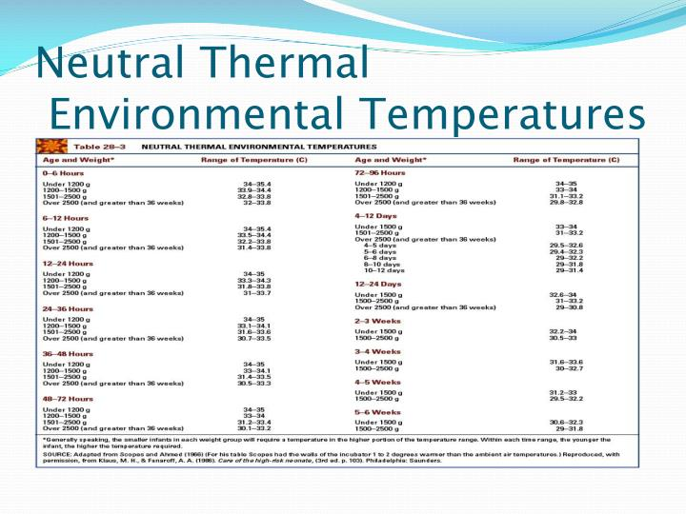

Slide 9
Normal Axillary Temperature
Normal axillary temperature is 36.5-37.5°C.
Hypothermia - below 36.5 degree centigrade.
Cold stress 36.0°C to 36.4°C
Moderate hypothermia 32.0°C to 35.9°C
Severe hypothermia <32°C
Hyperthermia > 37.5 C

Slide 10
Temperature Recording
Axillary temperature recording for 3 minutes is recommended for routine monitoring.
Rectal temperature measurement is unnecessary in most situations.

Slide 11
Diagnosis of Hypothermia by Human Touch
Feel by Touch Trunk | Fell by Touch Extremities | Interpretation
Warm | Warm | Normal
Warm | Cold | Cold Stress
cold | cold | Hypothermia

Slide 12
Prevention of Hypothermia – Warm Chain
Warm Delivery Room (> 25 C)
Warm Resuscitation
Immediate Drying
KMC – Skin –to-Skin contact
Breast Feeding
Bathing postponed
Full Clothings
Mother & Baby together
Professional Alert
Warm Transportation

Slide 13
Study | Journal, Authors | Level of Evid | Results | Conclusions
Randomized trial of plastic bags to prevent term neonatal hypothermia in a resource-poor setting. | Pediatrics. 2013 Sep;132(3):e656-61. doi: 10.1542/peds.2013-0172. Epub 2013 Aug 26 Belsches TC¹, Tilly AE, Miller TR, Kambeyanda RH |  | Neonates randomized to plastic bag (n = 135) or to standard thermoregulation care (n = 136) had similar baseline characteristics (birth weight, gestational age, gender, and baseline temperature). Neonates in the plastic bag group had a lower rate of hypothermia (60% vs 73%, risk ratio 0.76, confidence interval 0.60-0.96, P = .026) and a higher axillary temperature (36.4 ± 0.5°C vs 36.2 ± 0.7°C, P < .001) at 1 hour after birth compared with infants receiving standard care. | Placement in a plastic bag at birth reduced the incidence of hypothermia at 1 hour after birth in term neonates born in a resource-poor setting, but most neonates remained hypothermic.

Slide 14
KMC
Assists in maintaining temperature
Facilitates breast feeding
Improves mother baby bonding
Rapid weight gain (growth)
Faster development
Decreases risk of nasocomial sepsis
Decreases risk of apnea

Slide 15
Study | Journal, Authors | Level of Evid | Results | Conclusions
Kangaroo mother care to reduce morbidity and mortality in low birthweight infants | Cochrane Database of Systematic Reviews 2014, Issue 4. Art. No.: CD002771. DOI: 10.1002/14651858.CD002771.pub3. Agustin Conde-Agudelo¹, José L Díaz-Rossello² | 1 | Eighteen studies, including 2751 infants, fulfilled inclusion criteria. Sixteen studies evaluated KMC in LBW infants after stabilization, one evaluated KMC in LBW infants before stabilization, and one compared early onset KMC with late onset KMC in relatively stable LBW infants. Thirteen studies evaluated intermittent KMC and five evaluated continuous KMC. At discharge or 40-41 weeks' postmenstrual age, KMC was associated with a reduction in the risk of mortality (typical risk ratio (RR) 0.60, 95% confidence interval (CI) 0.39 to 0.92; eight trials, 1736 infants), nosocomial infection/sepsis (typical RR 0.45, 95% CI 0.27 to 0.76), hypothermia (typical RR 0.34, 95% CI 0.17 to 0.67), and length of hospital stay (typical mean difference 2.2 days, 95% CI 0.6 to 3.7). At latest follow up, KMC was associated with a decreased risk of mortality (typical RR 0.67, 95% CI 0.48 to 0.95; 11 trials, 2167 infants) and severe infection/sepsis (typical RR 0.56, 95% CI 0.40 to 0.78). Moreover, KMC was found to increase some measures of infant growth, breastfeeding, and mother-infant attachment. There were no significant differences between KMC infants and controls in neurodevelopmental and neurosensory impairment at one year of corrected age. Sensitivity analysis suggested that the inclusion of studies with high risk of bias did not affect the general direction of findings or the size of the treatment effect for the main outcomes. | The evidence from this updated review supports the use of KMC in LBW infants as an alternative to conventional neonatal care mainly in resource-limited settings. Further information is required concerning effectiveness and safety of early onset continuous KMC in unstabilized or relatively stabilized LBW infants, long term neurodevelopmental outcomes, and costs of care.

Slide 16
Study | Journal, Authors | Level of Evid | Results | Conclusions
The impact of newborn bathing on the prevalence of neonatal hypothermia in Uganda: a randomized, controlled trial. | Acta Paediatr. 2005 Oct;94(10):1462-7 Bergström A¹, Byaruhanga R, Okong P. | 2 | Bathing of newborns in the first hour after delivery resulted in a significantly increased prevalence of hypothermia, defined as temperature <36.5 degrees C, at 70 and at 90 min postpartum despite the use of warmed water and the application of the STS method. There was no neonatal mortality. Aside from the bathing procedure, no background factor potentially predisposing the newborns to hypothermia was identified. | Bathing newborn babies shortly after birth increased the risk of hypothermia despite the use of warm water and STS care for thermal protection of the newborn.

Slide 17
Prevention of Hypothermia During Transport
Axillary Temp – 36.5 – 37.5⁰ C, Feet – warm to touch
Methods
  Skin to skin contact (KMC)
  Covering the baby fully with clothes
  Improvised containers – thermocol box, polythene bag
  Transport incubator – ideal, often not available
If neonate passes urine or stool – dry him immediately, and change the clothes
Prevent draught of air from fan, windows and doors
Frequent breast feeding also helps to maintain body temperature

Slide 18
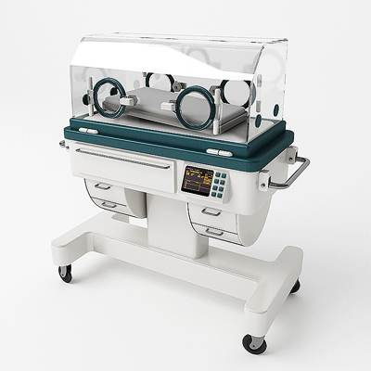
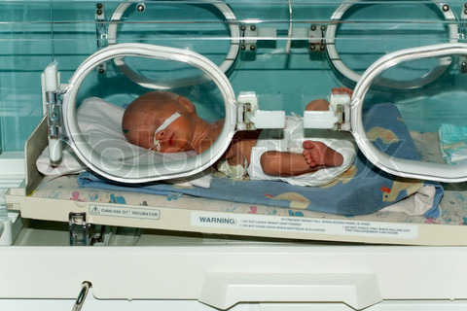
Incubator

Slide 19
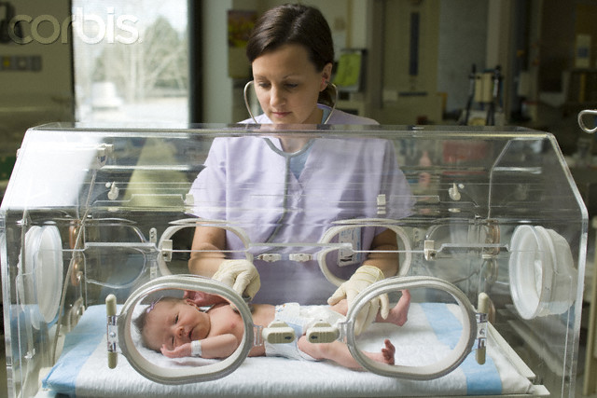

Slide 20
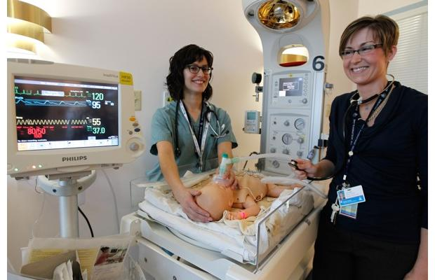
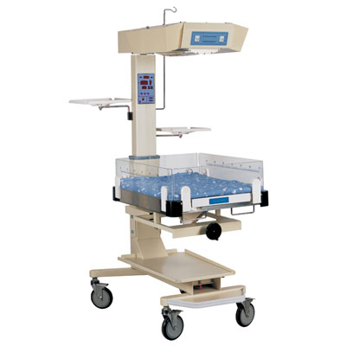
Radiant warmer

Slide 21
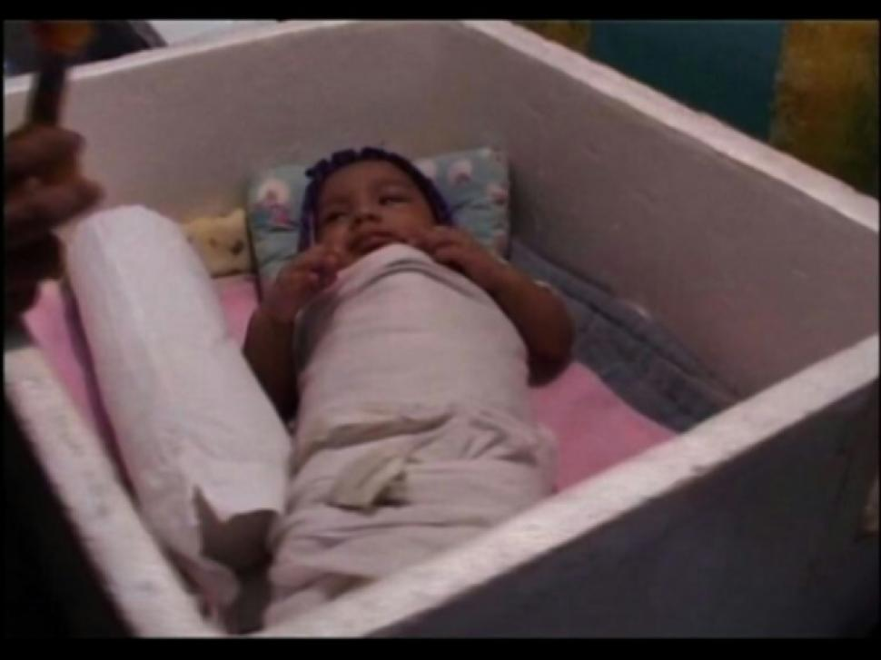
Thermocol Box

Slide 22
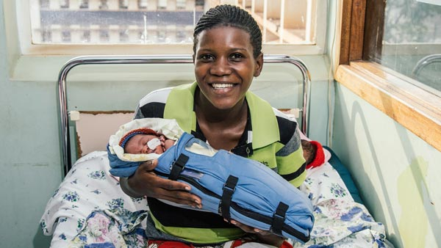
Thermopad

Slide 23
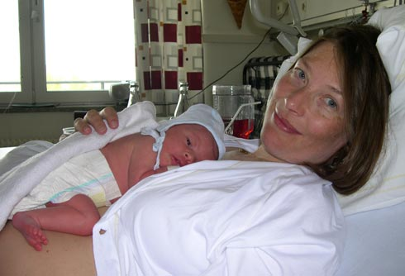
Kangaroo Mother Care

Slide 24
SIGNS – SYMPTOMS
Mild Hypothermia – irritability, peripheral cyanosis, cold extremities
Peripheral vasoconstriction – acrocyanosis, cold extremities, decreased peripheral perfusion, poor pulse, shock
CNS depression – lethargy, bradycardia, apnea, poor feeding
Increased Pulmonary Artery Pressure – respiratory distress, tachypnea
Thrombocytopemia, DIC - bleeding
Decreased immunity - septicemia
Chronic hypothermia – weight loss, failure to thrive

Slide 25
Management – Cold Stress
KMC, if not possible then,
Cover adequately with warm clothes
Breast feeding – frequent
Warm room
Take measures to decrease heat loss

Slide 26
Management – Mod Hypothermia
KMC
Warm room
Take measures to decrease heat loss
Provide extra heat – 200 W bulb, heater, radiant warmer, incubator

Slide 27
Management – Sev Hypothermia
Provide extra heat – radiant warmer or incubator
Rapidly warm till 34 C, then slow rewarming
Take measures to decrease heat loss
IVF – 10% dextrose
Oxygen
Inj. Vitamin K
If still hypothermic – consider antibiotics assuming sepsis

Slide 28
Hyperthermia
Problem during summer months
Rarely due to infection in term neonates
Remove heat source
Undress neonates – partially or fully
If temperature more than 38 – sponge with tap water
Measure temperature hourly till becomes normal

Slide 29
Conclusions
Prevent hypothermia, maintain warm chain
Ensure close monitoring and stricter preventive measures for LBW and sick neonates
Early detection by human touch and prompt remedial measures are key for reducing this preventable morbidity

Slide 30
MCQ. 1
Following statements are true for thermogenesis in newborn except
Heat is produced by brown fat
Intact hypothalamus is important for heat production
Heat is produced by shivering
Heat production requires oxygen and glucose

Slide 31
MCQ. 2
In newborn, heat loss occurs by following ways except
Conduction
Convection
Radiation
Transportation

Slide 32
MCQ. 3
Normal axillary temperature of newborn is
36.5 – 37.5 C
36 – 37 C
37.5 – 38.5 C
35.5 – 36.5 C

Slide 33
MCQ. 4
On clinical examination, newborn is considered hypothermic when
Trunk is cold and extremities are cold
Extremities are cold, and trunk is warm
Head is cold and extremities are cold
Head is cold and extremities are warm

Slide 34
MCQ. 5
Following statements are true for hyperthermia in newborn except
Hyperthermia is commonly due to high environmental temperature
Hyperthermia usually indicates presence of infection
Hypothermia is a more common problem than hyperthermia
Hyperthermia is less problematic than hypothermia

