Slide 1
LOW BIRTH WEIGHT NEONATES
DR MANISH RASANIA

Slide 2
LBW – Low Birth Weight
Definition: birth weight < 2500 grams
Incidence: 30 – 40 %
Subgroups:
< 1500 grams – VLBW (very low birth weight)
< 1000 grams – ELBW (extremely low birth weight)

Slide 3
Significance
LBW neonates have higher mortality and morbidities.
75% of neonatal deaths and 50% of infant deaths occur amongst LBW infants.
LBW babies are more prone to
Malnutrition
Recurrent infections
Neurodevelopmental delay

Slide 4
Types of LBW
Preterm:
Born before 37 completed weeks of gestation. Account for 1/3rd of LBW. (10 – 12% of all live births)
SFD (Small For Date) / IUGR (Intrauterine growth retardation):
Birth weight <10th centile for gestational age.
Account for 2/3rd of LBW.
Most IUGR are full term. Few IUGR are preterm.

Slide 5
PREMATURE NEONATES

Slide 6
Introduction
Definition: Neonate born before 37 completed weeks of gestation is called as preterm (PT) neonate.
Classification: Late PT ≥ 34 – 37 wks, Mod PT 32 – 34 wks, Very PT 28 – 32 wks, Extreme PT < 28 wks
Incidence – about 10 – 12% of all deliveries
Contribution to neonatal mortality – 20%
Morbidities – high risk of malnutrition, recurrent infections, and neurodevelopmental disabilities
More the prematurity – more are the immediate and late complications, more chances of the mortality and morbidities
Notes:
Incidence of LBW – 30 – 40 precent of all deliveries, out of which preterm accounts for 1/3 of LBW neonates.
75% of neonatal deaths and 50% of infant deaths occur amongst LBW neonates.
Indirect contribution to neonatal mortality – more than 50% of neonatal deaths (sepsis contributes to 50% of neonatal deaths, many of the septic neonates are premarure)

Slide 7
CAUSES
Spontaneous – most common
Induced – Early induction of labour or caesarean delivery . E.g, fetal distress / hypoxia, mother having eclampsia, pre-eclampsia.

Slide 8
Risk Factors for Spontaneous Preterm Delivery
Multiple pregnancies
Infections – particularly of amniotic membrane, lower genital tract, UTI (urinary tract infection)
Chronic conditions – diabetes, high Blood Pressure
Smoking, alcohol, substance abuse
Previous history of preterm birth
Stress – physical / mental
Mother – underweight, overweight, < 18 years, > 35 years
Cervical incompetence, short cervix

Slide 9
Prevention of Preterm Birth
Good and regular antenatal care
Counselling on healthy balanced diet
Avoidance of tobacco, alcohol & substance abuse
Adequate rest
Dealing with stress with relaxation technique
Maintenance of hygiene
Regular antenatal visits to identify and manage risk factors such as pregnancy induced complications, infections
Cervical encirclage from 14th week till 9th month

Slide 10
Identification of Preterm
LMP (last menstruation period)
Add 9 mo + 7 days to LMP = EDD = 40 weeks.
Highly accurate provided mother is knowing LMP, and past menstruation periods are regular
1st trimester USG (ultrasonography)
From measurement of crown – rump length (CRL) (from top of head to bottom of buttocks)
± 1 week accuracy
New Ballard Score
6 physical & 6 neurological criteria
± 2 week accuracy

Slide 11
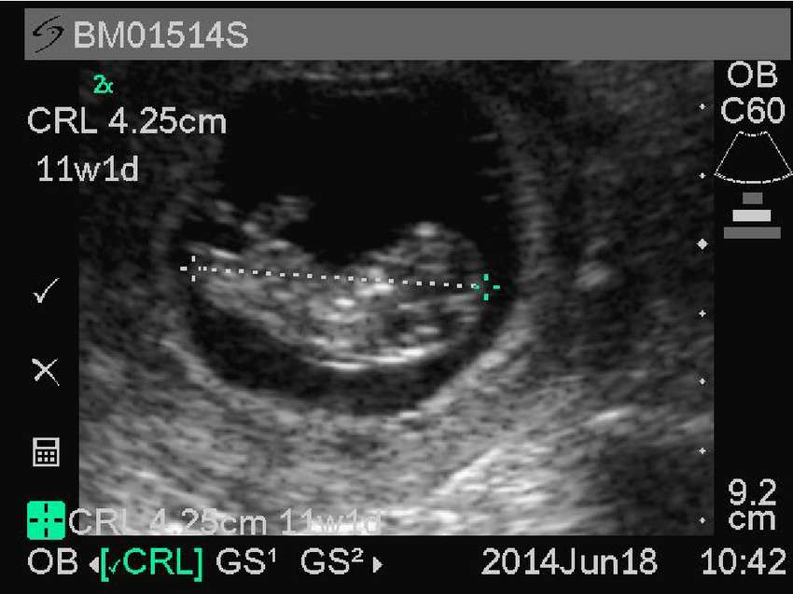
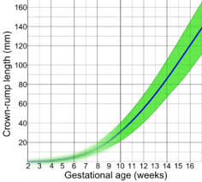
1st Trimester USG - Crown Rump Length

Slide 12
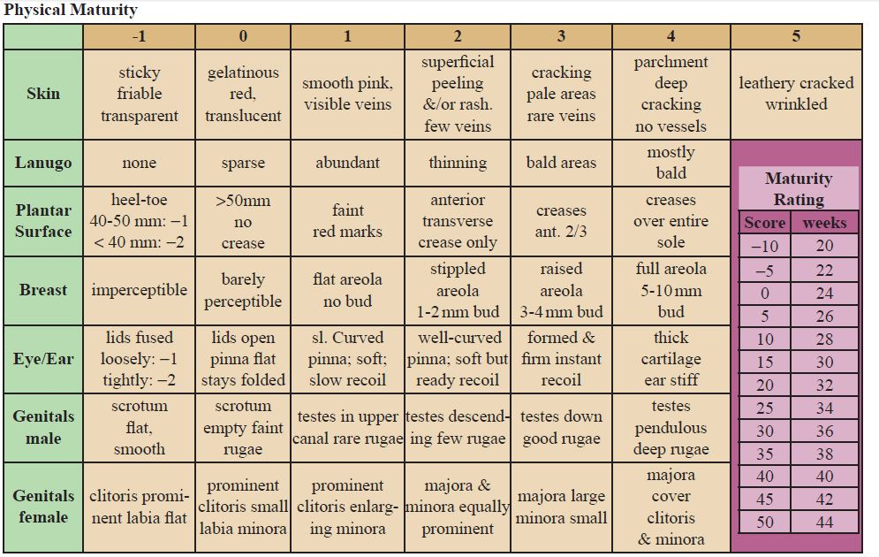

Slide 13
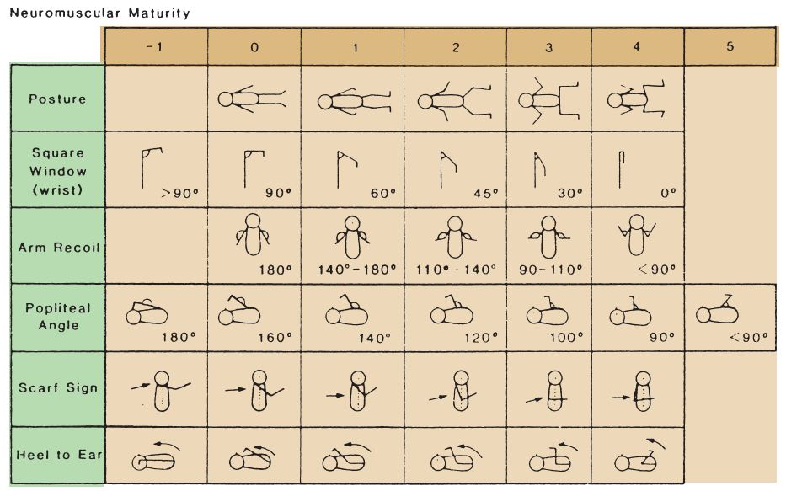

Slide 14
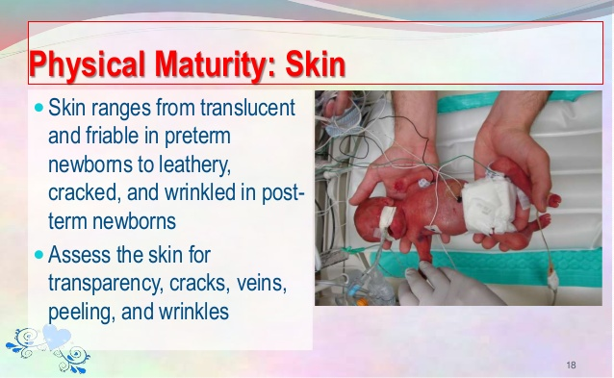

Slide 15
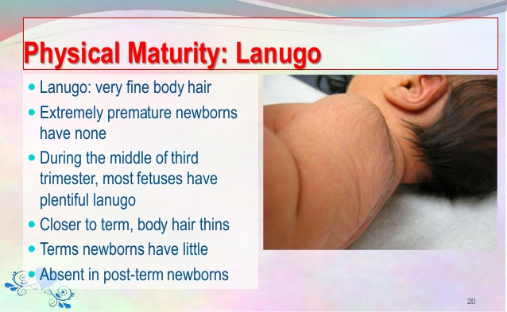

Slide 16
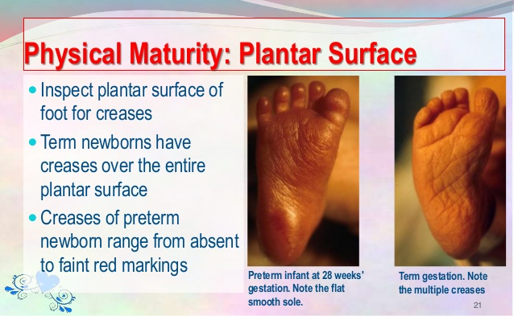

Slide 17
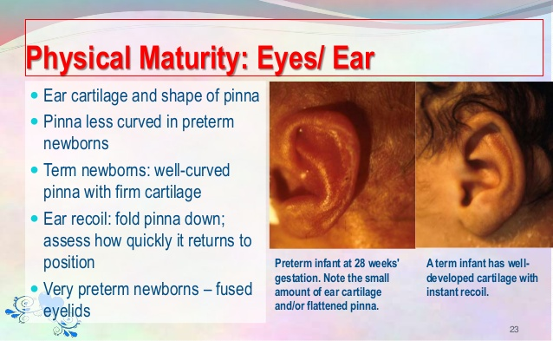

Slide 18
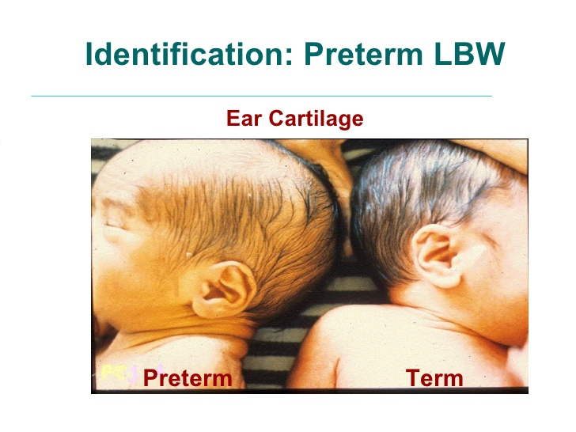

Slide 19
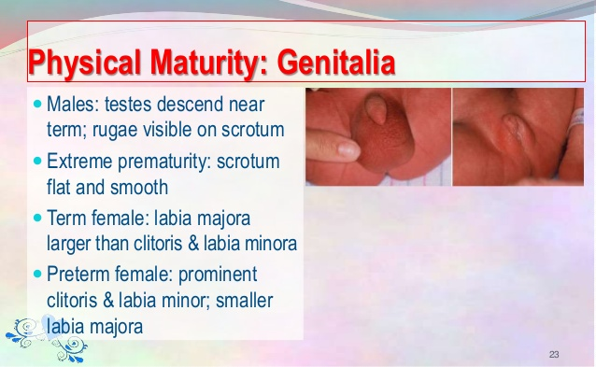

Slide 20
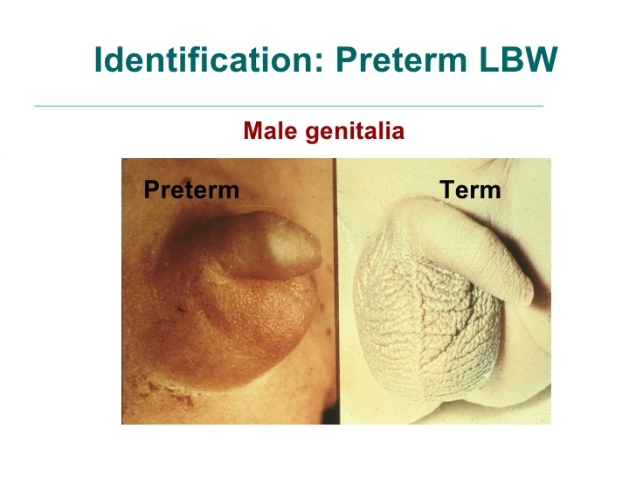

Slide 21
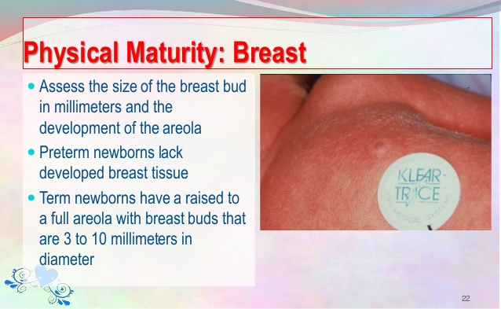

Slide 22
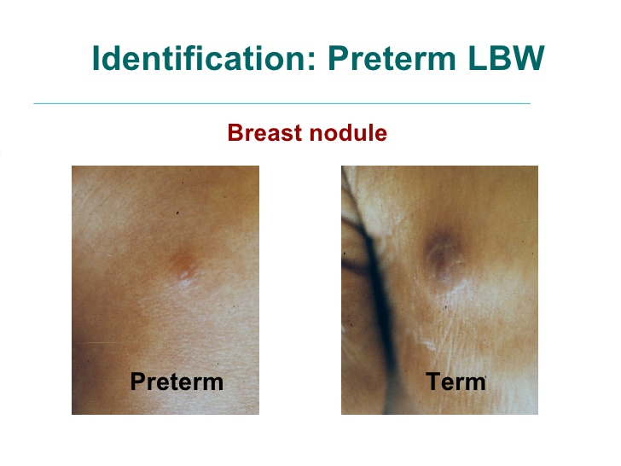

Slide 23
Complications of Prematurity
Birth Asphyxia
RDS (Respiratory Distress Syndrome)
Hypothermia
Hypoglycemia
Hypocalcemia
Apneic Spells
IVH (intraventricular hemorrhage)
Infections
Feeding difficulties
Hyperbilirubinemia
ROP (retinopathy of prematurity)
CP (cerebral palsy), MR (mental retardation)
Minor disabilities
Malnutrition
Recurrent infections

Slide 24
Antenatal Care - Steroids
Induces surfactant production and accelerates maturation of lungs and other fetal tissues, resulting in substantial reduction of RDS, IVH, NEC (necrotizing enterocolitis).
2 doses of betamethasone 12 mg IM 24 hours part, or 4 doses of dexamethasone 6 mg IM 12 hourly
Given to pregnant women 24 to 34 weeks’ gestation who are at high risk of preterm delivery within next 7 days.
Effect is best if delivery occurs 24 hours after the last dose, and within 7 days. Though incomplete doses may improve outcome.
Contraindications – chorioamnionitis
Repeated doses are contraindicated as it is associated with neurotoxicity and poor long term neurodevelopmental outcome.

Slide 25
Special Care during Resuscitation
Gentle handling – to prevent IVH
Prevention of hypothermia – wipe gently mainly head, do not wipe much, wrap in polythene bag
Prevention of lung injuries and oxygen toxicity – use small sized preterm Ambu bag, do not give excess pressure, give CPAP (continuous positive pressure ventilation) instead of ventilation if chest retrations are there, use Neopuff for giving CPAP or Ventilation in delivery room, use minimal required FiO2 to maintain target SpO2. (use of blender)

Slide 26
Need for NICU Care
Preterm with gestational age < 34 weeks
Birth weight < 1.8 kg
Any sick preterm
Preterm with Gestational Age < 30 weeks, birth weight < 1.2 kg, who are in need of ventilator care, surfactant therapy – are better managed in level 3 NICU (neonatal intensive care unit).

Slide 27
Management
75% of premature neonates can be saved with simple cost effective measures in primary health care set up (those between 30 – 34 wks, wt between 1.2 – 1.8 kg & not in need for respiratory support).
Essential newborn care at birth & in postnatal period – resuscitation, thermal care, feeding support, aseptic precautions
Antenatal steroids
KMC (Kangaroo Mother Care)
Breast feeding, katori spoon feeding, gavage feeding
Antibiotics – to mother when PROM (premature rupture of membranes), to baby when sepsis

Slide 28
Initial Stabilization - prevention of hypothermia
Keep neonate under radiant warmer, servocontrol mode, skin temperature set at 36.5 – 37.5
Use of incubator care – better for extreme pretems, with it humidity can be provided, maintenance of temperature is smooth and even, it decrease insensible water loss, reduces unnecessary stimulation and noise. It is associated with high risk of sepsis, if proper care in disinfecting incubator is not taken.

Slide 29
Management of RDS
CPAP – should be started as early as possible – when Silvermann respiratory distress score is ≥ 4, neonate is not maintaining SpO2 with 3 liter head box/nasal cannula oxygen, having significant apneas in spite of caffine
Start CPAP with 5 cm H2O PEEP and 40% FiO2, increase pressure if required (to max 8), increase FiO2 if required to max 60%
Give surfactant if SpO2 is not maintained with 5 cm CPAP and 40% FiO2. (early surfactant therapy – INSURE technique – intubate, give surfactant, extubate and put back to CPAP)

Slide 30
RDS:
Ventilator care – indicated for neonates with Silvermann score > 6, not maintaining SpO2 with 8 cm CPAP and 60% FiO2, pCO2 > 50 mmHg, recurrent apnea in spite of CPAP, extermely premature neonates with RDS, severe RDS
When one needs to put neonate on ventilator for RDS – Surfactant therapy is a must
Use natural surfactant – Survanta/Neosurf/Curosurf in a dose suggested by manufacturer

Slide 31
Study | Journal, Authors | Level of Evid | Results | Conclusions
Avoidance of mechanical ventilation by surfactant treatment of spontaneously breathing preterm infants (AMV): an open-label, randomised, controlled trial. | Lancet. 2011 Nov 5;378(9803):1627-34. doi: 10.1016/S0140-6736(11)60986-0. Epub 2011 Sep 29. Göpel W¹, Kribs A, Ziegler A, Laux R, Hoehn T, Wieg C, Siegel J, Avenarius S, | 2 | 108 infants were assigned to the intervention group and 112 infants to the standard treatment group. All infants were analysed. On day 2 or 3 after birth, 30 (28%) infants in the intervention group were mechanically ventilated versus 51 (46%) in the standard treatment group (number needed to treat 6, 95% CI 3-20, absolute risk reduction 0·18, 95% CI 0·30-0·05, p=0·008). 36 (33%) infants in the intervention group were mechanically ventilated during their stay in the hospital compared with 82 (73%) in the standard treatment group (number needed to treat: 3, 95% CI 2-4, p<0·0001). The intervention group had significantly fewer median days on mechanical ventilation, (0 days. IQR 0-3 vs 2 days, 0-5) and a lower need for oxygen therapy at 28 days (30 infants [30%] vs 49 infants [45%], p=0·032) compared with the standard treatment group. We recorded no differences between groups for mortality (seven deaths in the intervention group vs five in the standard treatment group) and serious adverse events (21 vs 28). | The application of surfactant via a thin catheter to spontaneously breathing preterm infants receiving continuous positive airway pressure reduces the need for mechanical ventilation.

Slide 32
Fluids & Electrolytes
Total Fluid Requirement (TFR) on day 1 –
< 1000 gm: 100 ml/kg/day
1000 – 1500 gm: 80 ml/kg/day
> 1500 gm: 60 ml/kg/day
Add 20 ml/kg for insensible loss under radiant warmer
Restrict TFR in preterms with respiratory distress to prevent CLD (chronic lung disease), opening up of PDA (patent ductus arteriosus)
Increase TFR by 15 ml/kg/day daily till 150 ml/kg/day (usually by day 7), then increase by 10 ml/kg/day till maximum of 180 ml/kg/day
Monitor daily weight, urine output, serum sodium, blood urea, urine output, urine specific gravity, ABG (arterial blood gas) – and decide about TFR.

Slide 33
Fluids & Electrolytes ….
Type of fluid – start with 10% dextrose, 5% dextrose in extreme preterm neonates. Further need is based on RBS (random blood sugar) readings
Sodium – initial 48 hours – sodium free fluid, then add sodium of 2 – 3 mEq/kg/day. Give less sodium especially in neonates who are extreme preterms and those who have RDS.
Sodium requirement may increase after 7 days of life especially in extreme preterms because of inability of renal tubules to reabsorb filtered sodium.

Slide 34
Fluids & Electrolytes ….
Potassium – potassium free fluid for initial 48 hours. Then start potassium at 2 m Eq/kg/day.
Further potassium need is based on urine output, RFT (renal function test), serum potassium levels.
Calcium – start from day 1, at a rate of 4-6 ml/kg/day in 2 or 3 divided doses – diluted and given slowly

Slide 35
Role of TPN (total parenteral nutrition)
TPN should be started in those VLBW AND ELBW neonates in whom we do not expect to reach good amount of enteral feed (at least 50% of TFR) by day 3 of life, and by day 5 of life for neonates weighing > 1500 gms.
Limitations – strict aseptic precautions are required in preparation, ideally to be prepared under laminar air flow. High risk of sepsis and metabolic derangements if not prepared as per need; and especially when lipids are also given.
Best to decide as per your set up limitations and as per condition of neonate; and your predicted outcome.

Slide 36
Feeding of Preterm - Stable
> 34 weeks (> 1.8 kg) – start direct breast feed, offer spoon feed if required
32 – 34 weeks ( 1.5 – 1.8 kg) – start with spoon feed, OGT (orogastric tube) feeding if required
30 – 32 weeks (1.2 – 1.5 kg) – start with OGT feeding
< 30 weeks (< 1.2 kg) – start with iv fluid, start trophic feed at 10-20 ml/kg/day as early as possible (from day 1 or 2)

Slide 37
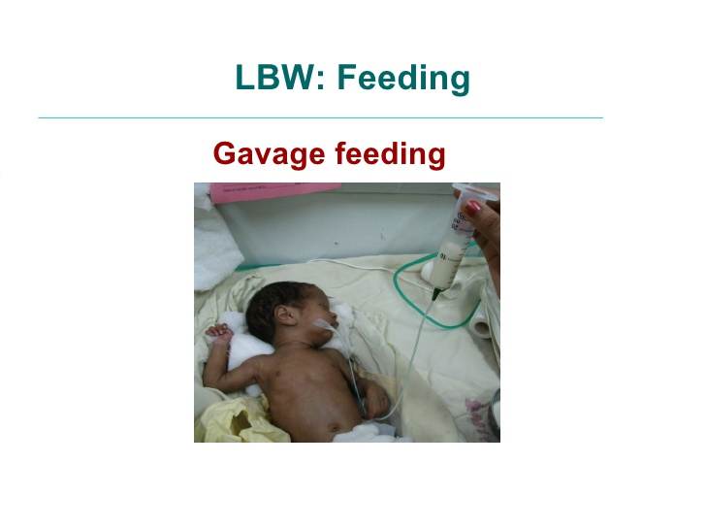

Slide 38

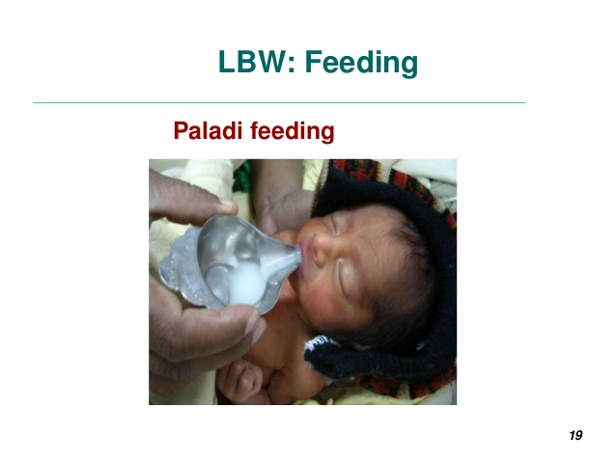
Spoon feeding – Paladi feeding

Slide 39
Feeding of Preterm - Unstable
If neonate is unstable hemodynamically and is in need of large doses of ionotropes – do not start feed. Once the need of ionotropes is reduced – start trophic feeds, and slowly advance as tolerated.
Give 2 hourly feed
If tolerated, Advance feed at 10-20 ml/kg/day for those below 1500 gms, 20 – 30 ml/kg/day for those above 1500 gms

Slide 40
Study | Journal, Authors | Level of Evid | Results | Outcomes
Randomized trial of donor human milk versus preterm formula as substitutes for mothers' own milk in the feeding of extremely premature infants. | Pediatrics. 2005 Aug;116(2):400-6. Schanler RJ¹, Lau C, Hurst NM, Smith EO. | 2 | Of 243 infants, 70 (29%) received only MM; group DM included 81 infants and group PF included 92 infants. Because of poor weight gain, 17 infants (21%), all in group DM, were switched to PF. There were no differences in birth weight, gestational age, multiple births, and age at attainment of feeding of 50 mL/kg among groups. There were no differences between group DM and group PF in LOS and/or NEC, other infection-related events, hospital stay, or number of deaths. Group DM received a greater intake of milk and more nutritional supplements but had a slower rate of weight gain, compared with group PF. Compared with groups DM and PF, group MM had fewer episodes of LOS and/or NEC and total infection-related events and a shorter duration of hospital stay. Group MM also had fewer Gram-negative organisms isolated from blood cultures than did the other groups. | In this randomized, blinded trial of feeding of extremely premature infants, we found that, as a substitute for MM, DM offered little observed short-term advantage over PF for feeding extremely premature infants. Advantages to an exclusive diet of MM were observed in terms of fewer infection-related events and shorter hospital stays.

Slide 41
Cardiovascular Support
Based on CRT (capillary refill time), pulse volume, urine output, NIBP (noninvasive blood pressure) monitoring, and ECHO monitoring – start dopamin or dobutamin; titrate the dose as per requirement

Slide 42
Apnea Management
Start caffeine immediately in neonates weighing < 1200 gms & < 30 weeks, continue till postconceptional age of 34 weeks
In neonates > 1200 gms & > 30 weeks – start caffeine if frequent or deep apnea is observed.

Slide 43
PDA Management
For neonate < 1000 gms – start medical management (indomethacin or ibuprofen) as soon as PDA is detected, even if PDA is not hemodynamically significant and neonate is asymptomatic.
For neonate > 1000 gms – give treatment if neonate is symptomatic or PDA is hemodynamically significant on ECHO

Slide 44
Hyperbilirubinemia in Preterm
Start prophylactic phototherapy for ELBW neonates
Birth Weight | Phototherapy | Exchange
< 1000 gms | Prophylactic from day 1 | 10-12 mg%
1000-1500 gms | 7-9 mg% | 12-15 mg%
1500-2000 gms | 10-12 mg% | 15-18 mg%
2000-2500 gms | 13-15 mg% | 18-20 mg%

Slide 45
Sepsis - Suspicion and Management
Start antibiotics if significant risk factors for sepsis is present or neonate is receiving invasive care
Suspect sepsis if there is any deterioration in course of illness
As developed signs of sepsis are not obvious in preterm neonates – regularly check for septic screen; especially for those who are not stable, who are on invasive care, who have not reached near full feeds
Change the antibiotics as per requirement, based on blood culture report or your nursery’s nasocomial bacterial environment

Slide 46
Sepsis - Prevention
Strict aseptic precautions at all levels
Hand washing
Strict infection prevention & control protocols
Aseptic precautions while doing procedures
Minimize invasive care, TPN
Use of CPAP in place of ventilator care
Minimizing frequent blood sampling
Good skin care
Early trophic feeds
Early reaching full feeds
Judicious use of antibiotics to prevent nasocomial bacterial resistance

Slide 47
Developmentally Supportive Care Practices (stable neonates)
Nesting neonate or Swaddling
Non nutritive sucking
Kangaroo Mother Care
Early stimulation therapy
Massaging
Pain prevention and management

Slide 48
Multivitamins & Micronutrients
Multivitamins – to be started once on full feeds/ after day 7
Calcium, phosphorus – to be started once on full feeds/ after day 7
Iron – 2 mg/kg/day to be started from day 14 in neonates with B.wt < 1500 gms, and from 1 month of life in neonates with B.wt > 1500 gm
Notes:
AAP recommends vitamin D supplementation of 400 IU daily for all neonates up to 1 year of age.
ESPGHAN recommends vitamin D – 800 – 1000 IU daily for LBW neonates.
WHO recommends no additional benefit of vitamin D of more than 400 IU in VLBW neonates.
Calcium – 120 – 140 mg/kg/day, phosphorus – 60 – 90 mg/kg/day
Zinc – no strong evidences to use it for improvement of growth and neurodevelopmental outcome
When EBM – fortified with HMF – additional multivitamins, calcium, phophorus is not required. Iron is required.

Slide 49
Weight Gain Pattern of Preterm
Preterm loses weight during first week of life – cumulative weight loss of 10-15%, then weight gain starts at 10-15 gm/kg/day – reaches birth weight by 14 days of life.
Many sick neonates may loose weight little more, and reach birth weight by 20 days of life.

Slide 50
Discharge Criteria
After 34 weeks of completed gestational age
After 1500 gms of weight
There is consistent weight gain in last 3 days
Stable, able to take recommended amount of feeds with spoon, comfortably within 20 – 30 minutes.
Mother is confident to take care at home

Slide 51
Counseling Prior to Discharge
Temperature maintenance – clothing, KMC, avoid bathing, daily sponging, massage twice daily
Feeding advise
Prevention of infections – hand washing, avoidance of visitors, etc
Danger signs – early recognition and to come back immediately when seen
Vaccination – when?
Follow up visits – when?
Special care visits – when? Like ROP screening, follow up USG, developmental assessment, etc.

Slide 52
Follow Up Monitoring
Follow up visits – once a week till reaches 1.8 to 2 kg, then once 2 weekly till 2.5 kg weight, then once a month
Growth monitoring – monitoring of weight, head size and length. Wright’s or Ehrenkranz’s or modified Fenton’s growth charts are used to monitor postnatal growth. WHO charts can be used once preterm reaches 40 weeks of corrected gestational age.

Slide 53
Follow Up ….
Assessment of feeding & counsel if required
Any new problem
Neurological assessment
Developmental assessment, Counseling for Early stimulation therapy
ROP follow up check up – if required
USG brain follow up, or MRI – if required
Hearing evaluation – BERA at 3 months

Slide 54
Vaccination in Preterm
BCG, Hepatitis B, OPV to be given at the time of discharge
There should not be any delay in vaccination. Further vaccines should be as per chronological age rather than postconceptional age

Slide 55
IUGR NEONATES

Slide 56
IUGR
Definition:
Neonate with birth weight less than 10th centile for their gestational age
Neonate with birth weight less than 3rd centile for gestational age – severe IUGR

Slide 57
Identification
Physical features – emaciated look, loose folds of skin, lack of subcutaneous fat
Plotting on weight for gestational age chart (intrauterine growth chart)

Slide 58
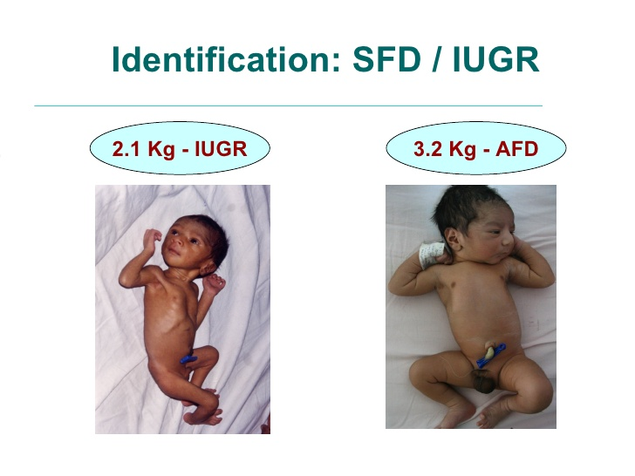

Slide 59
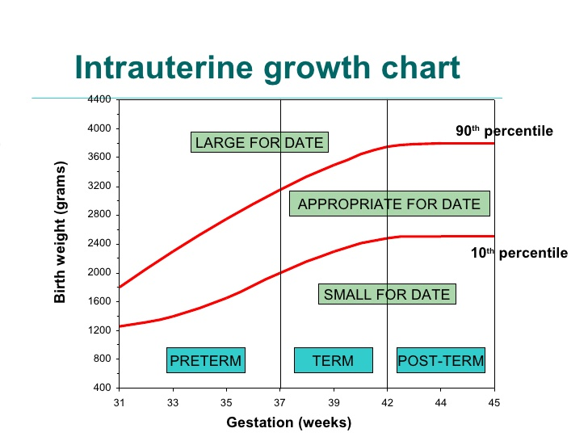

Slide 60
Etiology – Risk Factors – Maternal Causes
Before Pregnancy
During Pregnancy
Poor nutritional status – low prepregnancy weight, small maternal size (wt < 45 kg, ht < 140 cm), maternal anemia
Low socioeconomic status
Parity – none & > 5 births
Recent pregnancy
Poor nutritional status – poor weight gain during pregnancy, maternal anemia
Mod to heavy physical work
Chronic illnesses – diabetes, malabsorption, chronic renal dis, chronic infections
PIH
Smoking, alcohol
Teratogenic drugs

Slide 61
Risk Factors - Placental Factors
Placental insufficiency / infarction – toxemia, diabetic vasculopathy, postmaturity, abruptio placenta
Placental malformations
Placental infections

Slide 62
Risk Factors – Fetal Causes
Genetic & chromosomal abnormalities
Intrauterine infections - TORCHS, HIV, malaria, Tb
Major Congenital Malformations
Multiple Pregnancies

Slide 63
TYPES OF IUGR
SYMMETRICAL
ASYMMETRICAL
Up to 28 weeks of pregnancy, fetal growth occurs due to cell multiplication (increase in cell numbers).
After 28 weeks – growth is mainly by cell hypertrophy (increase in cell size)

Slide 64
SYMMETRICAL IUGR
If growth is affected in early pregnancy – neonate is proportionately small – weight, length and head size are equally affected (all below 10th centile for gestational age).
Subsequent growth can not be much improved in spite of providing good nutrition & environment. Such neonate remains permanently physically and mentally retarded.
Causes of symmetric IUGR – genetic or chromosomal causes, intrauterine infections, congenital malformations, teratogenic drugs
20 – 30% of IUGR neonates
PI (Ponderal Index) – normal (>2)
PI = (wt in Gm × 100) / (length in cm)³

Slide 65
ASYMMETRICAL IUGR
If growth is affected after 28 weeks of pregnancy – neonates weight is affected, but height and head size remains normal (head – brain spared).
If good nutrition and environment is provided after birth – there will be very good catch up growth.
Causes – maternal and placental factors
70 – 80% of IUGR neonates
PI – low (<2)

Slide 66
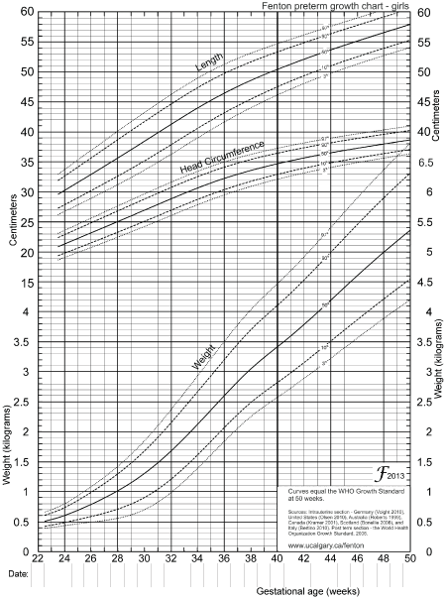

Slide 67
PROBLEMS
Birth Asphyxia
Meconium Aspiration Syndrome, Persistent Pulmonary Hypertension of Newborn
Hypothermia
Hypoglycemia
Hypocalcemia
Polycythemia
Septicemia
Long term complications – growth retardation, neurodevelopmental retardation, metabolic syndrome in early adult life – Hypertension, diabetes, obesity, dyslipidemia

Slide 68
MANAGEMENT
Neonatal resuscitation
Essential newborn care – prevention of hypothermia, prevention of infections,
Early frequent breast feeding – 2 hourly. If not able to take breast feeding – spoon feeding, gavage feeding
KMC
Management of complications if present – asphyxia, MAS, PPHN, hypoglycemia, polycythemia
IUGR neonates hardly loose any weight. Start gaining weight after 3 to 4 days of life.

Slide 69
Prevention – Care Before Pregnancy
Providing care to women before & between pregnancies
Healthy eating & physical activities
Diagnosis and management of chronic diseases (HT, diabetes) before pregnancy
Correction of anemia before pregnancy

Slide 70
Prevention – During Pregnancy
Regular and good ANC
Nutritious diet
Iron and folic acid supplementation
Enough rest
Avoidance of smoking, alcohol, teratogenic drugs
Early diagnosis and management of pregnancy associated illnesses & infections
Improved personal hygiene

Slide 71
THANK YOU!

Slide 72
Q.1
Incidence of LBW neonates in India is
30 – 40 %
20 – 30%
10 – 20 %
40 – 50 %

Slide 73
Q.2
Following are the problems of premature neonate except
Respiratory Distress Syndrome
Feeding Difficulties
Meconium Aspiration Syndrome
Apnea of prematurity

Slide 74
Q.3
Following are the problems of IUGR except
Birth Asphyxia
Meconium Aspiration Syndrome
Hypoglycemia
Respiratory Distress Syndrome

Slide 75
Q.4
Cumulative weight loss at the end of 7 days of life in preterm is
5 – 7 %
7 – 10 %
10 – 15 %
15 – 20 %

Slide 76
Q.5
Antenatal steroids prevent all except
RDS
IVH
NEC
Apnea

Slide 77
MCQ. 6
Contraindications of antenatal steroids is
Maternal hypertension
Maternal diabetes
Maternal UTI
chorioamnionitis

Slide 78
MCQ. 7
Neonate with birth weight of 1.2 kg, who is in NICU under warmer, requires following amount of total fluids on day 1 of life
100 ml/kg/day
80 ml/kg/day
120 ml/kg/day
60 ml/kg/day

