Slide 1
NEPHROTIC SYNDROME:
Dr. Dipika Bhil
Assistant Professor
Dept of Paediatrics

Slide 2
STEROID SENSITIVE NEPHROTIC SYSTEM: REVISED GUIDELINES
Indian Pediatrics Journal, March 20, 2021
Notes:
New Guidelines have been Published for both Steroid sensitive and steroid resistant nephrotic syndrome and we’ll be looking at them one by one.

Slide 3
GUIDELINES
Definition
How to evaluate?
How to treat: First episode, relapses, frequent relapses and steroid dependence.
Complications and it’s management
Infections
Immunization
Kidney Biopsy
Transition of care
Notes:
These guidelines update the existing ispn recommendations published in 2008. The guidelines combine eb.recommendations and expert opinion.

Slide 4
DEFINITION
ISPN 2008
ISPN 2020
Nephrotic range proteinuria, Hypoalbuminemia (<2.5 g/dl) , Cholesterol >200 mg/dl and Edema
Nephrotic range proteinuria, Hypoalbuminemia (<3 g/dl) and Edema
Notes:
NS is characterized by

Slide 5
NEPHROTIC RANGE PROTEINURIAS
Urine spot protein to creatinine ratio: >2 mg/mg in first morning sample.
Protein excretion rate of >40 mg/m²/hr or >1g/m²/day in a timed sample
Urine Protein Dipstick of +3 or +4
Notes:
And if we want to expand on the definition,
Normal is <0.2

Slide 6
ETIOLOGY
Annual incidence ranging from 1.2 to 16.9 per 100,000 children.
Primary or Idiopathic
Underlying systemic illness (5-10%)
Minimal change disease (80%)
FSGS (7-8%)
Mesangioproliferative GN (7-8%)
Therapy with Prednisolone results in complete remission of proteinuria in 85-90% patients termed Steroid Sensitive Nephrotic Syndrome. (SSNS)
Notes:
Kidney biopsy reveals
More than 90% children with minimal change disease, 50% with mesangioproliferative GN, and 30% with FSGS have steroid sensitive disease

Slide 7
EVALUATION
Suspicion: Recent onset oedema, Puffiness around the eyes, more in the mornings
Complaints: Fever, Abdominal Pain, Rash, Arthralgia, Oliguria, Hematuria, History of drugs and infections
Family History: NS, Asthma, Allergies, Renal disease
Height, Weight and BP should be recorded.
Notes:
Would suggest an underlying cause eg SLE and IgA vasculitis.
Weight monitoring helps is assessment for edema.

Slide 8
EVALUATION
Confirmation: Nephrotic range proteinuria : URINE ANALYSIS, RFT, SERUM ALBUMIN
Work up for etiologies: Hematuria, SLE (C3,C4,ANA), Hep B, C , HIV
Notes:
Confirmation By your definition, if all this satisfies the range in the definition, it will be our confirmation
Persistent microscopic hematuria or red cell casts suggests disease other than minimal change nephrotic syndrome, like infection related GN, C3 glomerulopathy, systemic lupus or vasculitis

Slide 9
EVALUATION
Complications: Hypovolemia (Tachycardia, Thready pulse, Cold Peripheries, fall in BP, CBC: Hematocrit), Peritonitis ( CBC, Ascitic Tap)
Evaluation Before initiation of Treatment: Tuberculin test: If positive: Chest Xray (Hilar lymphadenopathy, Fibro cavitatory lesions, Miliary TB) : If positive confirm by microbiology: If positive, start treatment , If negative : INH prophylaxis
Notes:
With an estimated prevalence of bacteriologically positive pulmonary tuberculosis of 296 per 100,000 population in India, the risk of latent tuberculosis infection in childhood is high

Slide 10
EVALUATION
Relapse: Recent Infection : LRTI ( Chest Xray)
Genetic Study: Clinical exome sequencing
Indications: < 3 months old
Infant: Steroid Resistant
Family History +
Extra renal features : syndromic
Calcineurin inhibitor resistant
Notes:
>50% : NPHS I, NPHS II, WT 1, COQ 2, PLCE 1, LAMB 2,

Slide 11
EVALUATION
Subsequent evaluation: Parents are instructed to monitor the child’s urine at home, using dipstick or boiling test, and are explained the features of a relapse.
During remission, they are advised to screen for proteinuria 2-3 times a week; the child is also examined every day during infections, or if edema is present.
Notes:
>50% : NPHS I, NPHS II, WT 1, COQ 2, PLCE 1, LAMB 2,

Slide 12
Essential at onset
Urinalysis
Complete blood counts
Blood urea, creatinine, electrolytes, total protein, albumin, total cholesterol
Tuberculin test
Additional evaluation, at onset or relapse
Chest radiography: Positive tuberculin test or history of contact; suspected lower respiratory tract infection
Renal ultrasonography: Planned for kidney biopsy; presence of gross hematuria; suspected renal vein thrombosis
Complete blood counts: Suspected systemic infection or hypovolemia
Blood urea, creatinine, albumin, electrolytes: Severe edema; hypovolemia/dehydration; oliguria/anuria; prolonged (>72 h) diuretic therapy
Complement C3, C4, antinuclear antibody, antistreptolysin O: Gross, persistent microscopic hematuria; sustained hypertension; suspected secondary cause (systemic lupus, IgA vasculitis, C3 glomerulopathy)
Serum transaminases; hepatitis B surface antigen; antibody against hepatitis C virus: History of jaundice or liver disease
Periodic monitoring, if relapsing illness
Blood creatinine; albumin, electrolytes
Notes:
Investigations in Patients with Steroid Sensitive Nephrotic Syndrome

Slide 13
KIDNEY BIOPSY
Persistent microscopic hematuria, gross hematuria, or acute kidney injury not attributed to hypovolemia;
Systemic features: fever, rash, arthralgia, low complement C3;
(iii) Initial or late corticosteroid resistance; and
(iv) Prolonged (>30-36 months) therapy with calcineurin inhibitors (CNI), or reduced kidney function during their use.
(v) Prior to initiating therapy with CNI
Notes:
An age of onset of more than 12-years is often cited as an indication for performing a kidney biopsy. Review of literature in adolescent onset nephrotic syndrome suggests that a combination of features, including persistent microscopic hematuria, low C3 and steroid resistance, detects all patients with membranous nephropathy or proliferative GN This might obviate the need for a kidney biopsy in adolescents presenting with typical nephrotic syndrome that is steroid sensitive. Since infants (<12-months-old), including those with congenital nephrotic syndrome, are likely to show histological features other than minimal change disease or an underlying genetic change, we advise next-generation sequencing in these patients [10]. Patients with onset of idiopathic nephrotic syndrome beyond infancy should receive therapy with prednisolone, and are advised to undergo kidney biopsy if they show steroid resistance.

Slide 14
KIDNEY BIOPSY
Light microscopy and immunofluorescence examination on all kidney biopsies is recommended.
Electron microscopy is required in patients with gross or persistent microscopic hematuria, low C3 and suspected disorders of glomerular basement membrane.
An adequate biopsy specimen should preferably include the corticomedullary junction and approximately 20 glomeruli to exclude the diagnosis of FSGS
Notes:
Apart from renal histology, the biopsy provides information on extent and morphology of glomerulosclerosis and associated tubulointerstitial changes. The diagnosis of IgA nephropathy, C3 glomerulopathy and early membranous nephropathy is suggested by immunofluorescence studies.

Slide 15
TREATMENT: FIRST ATTACK
Choice of drug: Oral Prednisolone
How much? :
60 mg/m²/day daily dosage in 1-2 divided doses for 6 weeks OR 2 mg/kg/day for 6 weeks (max dose 60 mg/day)
AND
For next 6 weeks 40 mg/m2/day on alternate days as a single morning dosage or 1.5 mg/kg/day (max dose 40 mg/day) and then discontinued.
Notes:
A 4 yr old presents to us, we have evaluated, ruled out tb, it is idiopathic , no secondary etiology and we have proven the diagnosis
It can either be body surface area based or wt based, BSA preferred as weight based underestimates the dose required
Prednisolone is best given following food; therapy with antacids, ranitidine or proton pump inhibitors is not routinely required.

Slide 16
DEFINITIONS
REMISSION | Urine protein nil or trace (Up/Uc <0.2 mg/mg) for 3 consecutive early morning specimens
RELAPSE | Urine protein >3+ (Up/Uc >2 mg/mg) for 3 consecutive early morning specimens, having been in remission previously
FREQUENT RELAPSES | Two or more relapses in the first 6-months after stopping initial therapyª; ≥3 relapses in any 6-months; or ≥4 relapses in one yr
STEROID DEPENDENCE | Two consecutive relapses when on alternate day steroids, or within 14 days of its discontinuation
STEROID RESISTANCE | Lack of complete remission despite therapy with daily prednisolone at a dose of 2 mg/kg (or 60 mg/m²) daily for 6 weeks
Notes:
OF DISEASE COURSE AND SEVERITY IN NEPHROTIC SYNDROME

Slide 17
COMPLICATED RELAPSE | Relapse associated with life-threatening complications: (i) hypovolemia requiring inpatient care, (ii) severe infection (peritonitis, cellulitis, meningitis), or (iii) thrombosis
SIGNIFICANT STEROID TOXICITY | Hyperglycemia (fasting glucose >100 mg/dl, post prandial glucose >140 mg/dL, or HbA1c >5.7%) [12]; obesity (body mass index >95th percentile or 1.645 SDS for age [13]); short stature (height <⁻2 SDS for age [13]) with height velocity (<⁻3 SDS for age [14]); raised intraocular pressure; cataract(s); myopathy; osteonecrosis; or psychosis
DIFFICULT-TO-TREAT STEROID SENSITIVE DISEASE | Both of the following: (i) frequent relapses, or significant steroid toxicity with infrequent relapses; and (ii) failure of ≥2 steroid sparing agents (including levamisole, cyclophosphamide, mycophenolate mofetil)

Slide 18
TREATMENT: RELAPSE
Rule out and treat the underlying cause
Steroids: 60 mg/m²/day OR 2 mg/kg/day daily dosage in 1-2 divided doses until remission is achieved (max dose 60 mg/day)
AND
For next 4 weeks 40 mg/m2/day or 1.5 mg/kg/day
on alternate days as a single morning dosage
Notes:
Almost one-half of the relapses are precipitated by minor infections, usually of the upper respiratory tract. Treatment of infection may rarely induce remission, avoiding the need for corticosteroid therapy.
Remission usually achieved by around 7-10 days and daily therapy is seldom necessary beyond 2 weeks.

Slide 19
TREATMENT: FREQUENT RELAPSES AND STEROID DEPENDENCE
Long-term corticosteroids
In patients with frequent relapses, it is suggested to taper prednisolone to a dose of 0.5-0.7 mg/kg on alternate days, for 6-12 months.
• In patients receiving long term alternate-day prednisolone, it is recommended to administer the same dose daily for 5-7 days during fever or respiratory tract infection.
2. Non corticosteroid therapies: Failing therapy with alternate-day prednisolone, steroid toxicity or complicated relapses.
Notes:
These patients are at risk of morbidity associated with multiple relapses and corticosteroid toxicity. Both these disease entities are discussed under the same umbrella of management.

Slide 20




Frequently relapsing, steroid dependent nephrotic syndrome
Prednisolone on alternate days; daily during infections
Hyperglycemia:FG>100,PPG>140,HbA1C>5.7%
BMI>95th centile
SS, Ht<-2SD, HV <-3SD
Raised IOP
Cataract, Myopathy,Osteonecrosis, Psychosis
Relapse a/w life threatening complications:
Hypovolemia requiring inpatient care.
Severe infection (peritonitis,cellulitis,meningitis)
Thrombosis
Frequent relapses; steroid toxicity
Steroid threshold >1 mg/kg alternate days
>1
complicated relapse
Significant steroid toxicity
No
Yes
Levamisole
Frequent relapses
Mycophenolate mofetil
Mycophenolate mofetil
Cyclophosphamide
Difficult-to-treat disease
Cyclosporine, tacrolimus
Rituximab
Notes:
If we have a child fitting the definition of fr or sdns then the first choice of treatment would be
Minimum leve;l of steroid that is required to maintain a nephrotic child in remission
Older age, peripubertal male:MFM,

Slide 21
Medication | Dose | Duration | Adverse effects | Recommended monitoring
Prednisolone | 0.5-0.7 mg/kg on alternate day | 6-12 mo | Cushingoid features; short stature; hypertension; raised intraocular pressure; glucose intolerance; cataract; elevated transaminases | Screen for side effects, hypertension Anthropometry q 3-6 mo; eye evaluation q 6-12 mo; blood sugar and transaminases q 3-6 mo
Levamisole | 2-2.5 mg/kg on alternate day | 2-3 years | Leukopenia, ANCA positive vasculitis, high transaminases, seizures | Blood counts^ q 2-3 mo; transaminases q 4-6 mo
Cyclophosphamide | 2-2.5 mg/kg/day orally | 8-12 weeks | Leukopenia, alopecia, infections; discolored nails; hemorrhagic cystitis; gonadal toxicity and malignancies | Blood counts q 2 weeks^{c} Maintain hydration; discontinue during significant infections Co-administer with prednisolone 1 mg/kg AD
Mycophenolate mofetil | 600-1200 mg/m²/day in divided doses; AUC >45 mg·h/L | 2-3 years | Abdominal pain, diarrhea, nausea, weight loss; viral warts; leukopenia; elevated transaminases | Screen for adverse effects Blood counts^{c} and transaminases q 3-6 mo

Slide 22
Cyclosporine | 4-5 mg/kg/day in divided doses; trough 80120 ng/mLª | 2-3 years
Tacrolimus | 0.1-0.2 mg/kg/d in divided doses; trough 4-8 ng/mLª | 2-3 years
Both: Nephrotoxicity, hyperkalemia, hepatotoxicity Cyclosporine: Gingival hyperplasia, hypertrichosis; hypertension; dyslipidemia Tacrolimus: Tremors, seizures, headache; diarrhea; glucose intolerance; hypomagnesemia | Screen for cosmetic side effects, tremors, diarrhea, hypertension Creatinine, potassium at 2-4 weeks, q 3-6 mo Liver function tests, glucose, uric acid, magnesium and lipids q 3-6 mo
Rituximab | 375 mg/m², slow IV infusion | 2 doses, 1-week apart^{d} | Chills, fever; serum sickness; bronchospasm Acute lung injury Neutropenia; P. jirovecii pneumonia; reactivation of hepatitis B or JC virus; hypogammaglobulinemia | Pre dose: Blood counts, transaminases; hepatitis and HIV serology; immunoglobulin G (IgG) level Post therapy: CD19 counts; blood counts; IgG; consider cotrimoxazole prophylaxis

Slide 23
TREATMENT: COMPLICATIONS
1. EDEMA
Grade: <7%: mild
8-15% : moderate
>15% : severe
Patients with severe edema have marked hypoalbuminemia (serum albumin < 1.5 g/dL), along with ascites and anasarca that interferes with daily activities.
Intravascular volume depletion is common in patients with moderate or severe edema , and should be assessed before instituting therapy with diuretics.
Notes:
classified based on appearance and percentage weight gain from baseline

Slide 24
TREATMENT: COMPLICATIONS
2. HYPOVOLEMIA:
Symptoms: Abdominal pain, nausea, vomiting, dizziness and lethargy.
Examination: Tachycardia, pallor, cold peripheries, delayed capillary refill and postural hypotension, and rarely shock . On the other hand, patients with hypervolemia have refractory anasarca, hypertension and dyspnea .

Slide 25
TREATMENT: COMPLICATIONS
2. HYPOVOLEMIA:
Two urinary indices may help assess intravascular volume: fractional excretion of sodium (FENa) and potassium index(>0.6%). FENa <0.6 indicate high aldosterone activity, characteristic of hypovolemia.The indices are not reliable with recent diuretic therapy and while receiving IV fluids.
Other parameters of volume status include changes in hematocrit, urea to creatinine ratio, inferior vena cava diameter and collapsibility, and bioimpedance analysis.

Slide 26
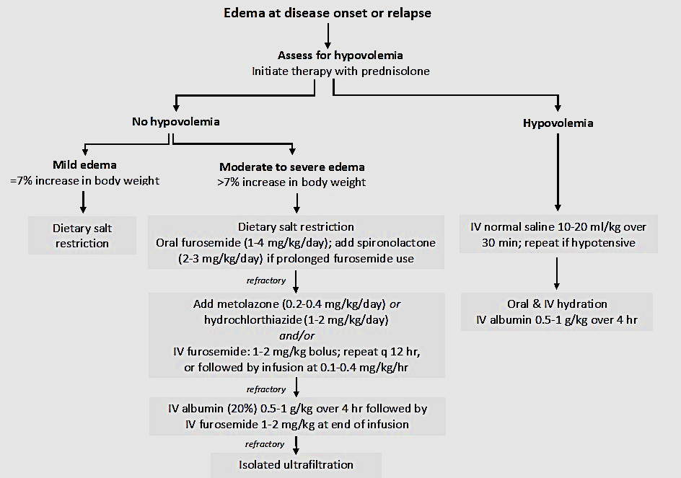
Notes:
furosemide-refractory edema be managed as follows: (i) combination of loop diuretics with thiazide; (ii) co-administration of human albumin with IV furosemide
(1-2 mEq/kg/day; 15-35 mg/kg salt), fru:ascending limb loh.
. In patients unresponsive to oral furosemide, assessed as absence of diuresis within 2-4 hr of its administration, switching to IV therapy may elicit a response.

Slide 27
TREATMENT: COMPLICATIONS
3. INFECTIONS
Infections | Organisms | Diagnosis | Treatment
Peritonitis | S. pneumoniae, S. pyogenes E. coli, Gram negative bacteria | Ascitic fluid: >100 white cells/mm³, >50% neutrophils Ascitic fluid: Culture, latex agglutination, PCR | Ceftriaxone or cefotaxime for 7-10 d Ampicillin and gentamicin/amikacin for 7-10 d
Pneumonia | S. pneumoniae, S. aureus, H. influenzae Influenza H1N1 M. tuberculosis | Chest X ray; blood culture; sputum for Gram stain and culture Throat swab for H1N1 by PCR Tuberculin test; pleural tap, gastric aspirate, sputum: acid fast bacilli, CBNAAT | Oral: Amoxicillin, coamoxiclav, cefuroxime for 10-14 d^ Parenteral: Ceftriaxone; or ampicillin and amikacin for 7-10 d^ Oseltamivir for 5 d Therapy as per National Tuberculosis Elimination Program [16]
Notes:
Contributing factors include the use of immunosuppressive agents, anasarca, and urinary losses of IgG and complement factors, that predispose to infection with encapsulated organisms

Slide 28
3. INFECTIONS
Cellulitis | S. aureus, S. pyogenes H. influenzae Gram negative bacteria | Pus for culture, sensitivity Blood culture | Parenteral: Coamoxiclav; cloxacillin with ceftriaxone for 7-10 d^
Sepsis | S. pneumoniae, Gram negative bacteria | Complete blood counts; Creactive protein, procalcitonin; blood culture | Ceftriaxone and amikacin for 10-14 d
Varicella | Varicella zoster virus | Clinical | IV acyclovir (1500 mg/m²/day in three doses) or oral acyclovir (80 mg/kg/day in four doses) for 7-10 d

Slide 29
Severe acute respiratory syndrome coronavirus-2 (sars-cov-2) infection
While children show mild disease, patients on immunosuppression constitute a high-risk group that is predisposed to adverse outcomes.
Affected patients are at risk of AKI, particularly if associated with hypovolemia or aggressive use of diuretics.
In absence of specific therapy for SARS-CoV-2 infection, most expert groups advise reduction of immunosuppression to acceptable levels, balancing the risk of disease relapses against infection.

Slide 30
VACCINATION
Age appropriate killed , Subunit and Inactivated vaccine can be given anytime irrespective of wether the child is on steroids or not.
But immunological response will be reduced when compared to other kids.

Slide 31
Immunosuppression | Advice
Receiving high dose prednisolone (≥2 mg/kg/d; ≥20 mg/day if >10 kg) for <14 d | Vaccinate immediately after discontinuing treatment
Receiving high dose prednisolone (≥2 mg/kg/d; ≥20 mg/day if >10 kg) for >14 d | Vaccinate 1-month after discontinuing corticosteroids
Receiving low-moderate dose prednisolone (<2 mg/kg/d or equivalent; <20 mg/d) | No live vaccines, until discontinuation of steroid therapy
Low-dose alternate day prednisolone and pressing need for vaccine | Live vaccine may be administered
Patients receiving cyclophosphamide | Avoid live vaccines until off therapy for 3 months
Patients receiving calcineurin inhibitors, levamisole or mycophenolate mofetil | Avoid live vaccines until off therapy for 1 month
Notes:
Principles of immunization with live vaccines

Slide 32
Therapy with rituximab | Avoid live vaccines until after B-cell recovery (~6-9 months)
Immunocompetent siblings and household contacts | Do not administer oral polio vaccine; may receive measles-mumps-rubella, rotavirus and varicella vaccines
Household contacts older than one year | Administer influenza vaccine annually

Slide 33
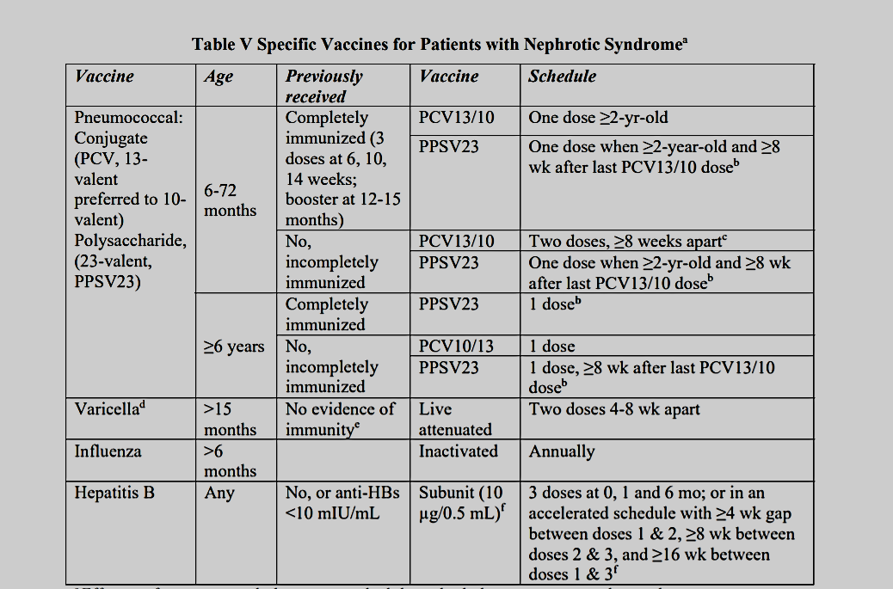
Notes:
Specific Vaccines for Patients with Nephrotic Syndromea

Slide 34
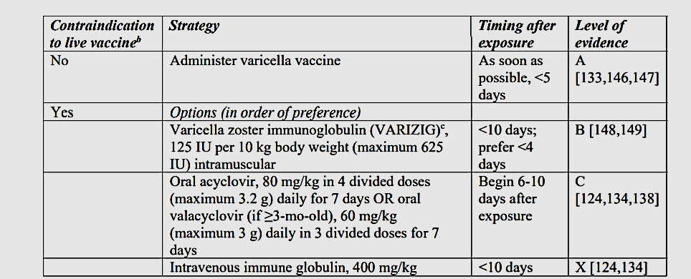
Notes:
Post-Exposure Management of Unimmunized Patients with Nephrotic Syndrome Exposed to Varicellaa

Slide 35
TRANSITION OF CARE
5-42% patients may continue to have active disease in adulthood
Risk factors for illness persisting beyond 18-yr of age include early age at onset, and frequently relapsing or steroid dependent course.
There is significant risk of short stature (15%), obesity (10%), hypertension (6-46%), metabolic bone disease (9-63%), diabetes mellitus (2%), ocular complications (10%), infertility and malignancies.
Notes:
Given the risk of disease persistence and prevalence of complications, it is advised to transfer the care of adolescents with relapsing disease to ‘adult’ nephrologists by 18-yr of age.

Slide 36
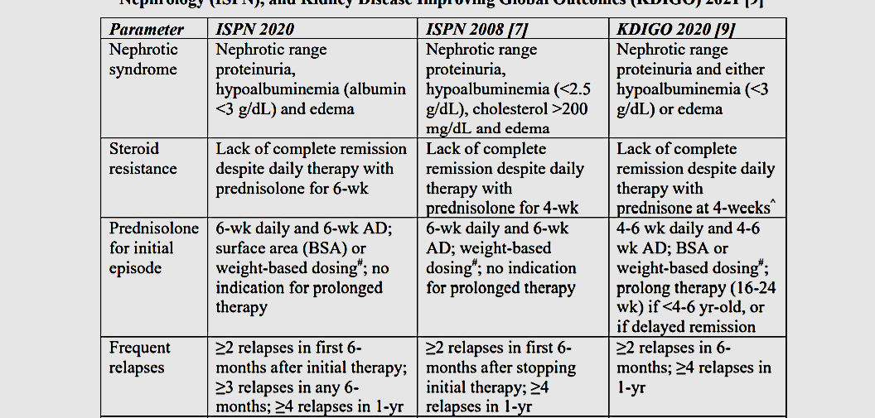
CHANGES SUMMARIZED

Slide 37
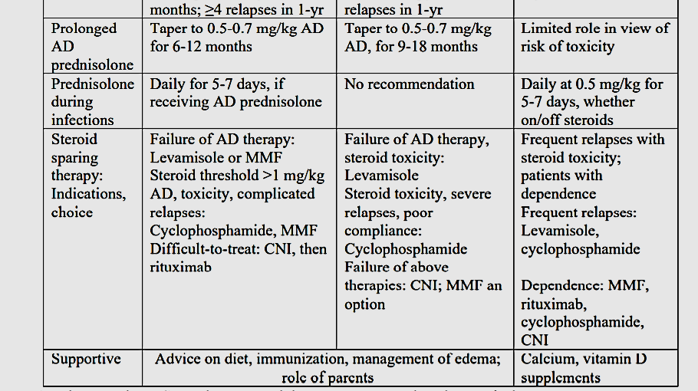
CHANGES SUMMARIZED

Slide 38
STEROID RESISTANT NEPHROTIC SYSTEM: REVISED GUIDELINES
Indian Pediatrics Journal, January 04, 2021

Slide 39
DEFINITION
ISPN 2009
ISPN 2021
Lack of complete remission despite therapy with daily prednisolone at a dose of 2 mg/kg (or 60 mg/m²) daily for 4 weeks.
Lack of complete remission despite therapy with daily prednisolone at a dose of 2 mg/kg (or 60 mg/m²) daily for 6 weeks.
Notes:
NS is characterized by

Slide 40
DEFINITION
Initial steroid-resistance: Failure to achieve complete remission after 6-weeks initial therapy with prednisolone.
Late (secondary) steroid-resistance: Initially steroid-sensitive; steroid resistance in a subsequent relapse
Notes:
NS is characterized by

Slide 41
INITIAL EVALUATION
Urinalysis, including microscopy
Spot urine protein to creatinine ratio; or24-hr urine protein excretion
Complete blood counts
Blood creatinine, albumin, electrolytes, fasting glucose, glycosylated hemoglobin (HbA1c)
Total, low density and high-density cholesterol; triglycerides
Calcium, phosphate, alkaline phosphatase
Hepatitis B surface antigen; hepatitis C and human immunodeficiency virus antibodies

Slide 42
INITIAL EVALUATION
Ultrasonography of kidneys
Kidney biopsy(light, immunofluorescence, electron microscopy); avoided in selected patients*
Investigations in selected children: Complement C3, C4; antinuclear antibody
Genetic tests
Notes:
Biopsy may be avoided in patients with familial steroid-resistance or with extrarenal features, where genetic diagnosis is preferred. A biopsy is also not required in patients with congenital nephrotic syndrome

Slide 43
GENETIC STUDIES
INDICATION:
Congenital NS
Initial steroid-resistance with onset during infancy;
Family history of steroid-resistance,
Extrarenal features,
Non-response to calcineurin inhibitors,
Prior to transplantation
METHODS: Next-generation sequencing (NGS) panels, Clinical exome sequencing (Mendeliome gene panel), Sanger Sequencing

Slide 44
TREATMENT
Calcineurin inhibitors (CNI) are recommended as first-line therapy for patients with initial or late steroid resistance.
Then we continue therapy with CNI for at least 24-months if partial or complete remission is achieved.
CNI therapy should be withheld or discontinued for patients with AKI stage 2-3 or estimated glomerular function rate (eGFR) persistently below 60 ml/min/1.73m2.

Slide 45
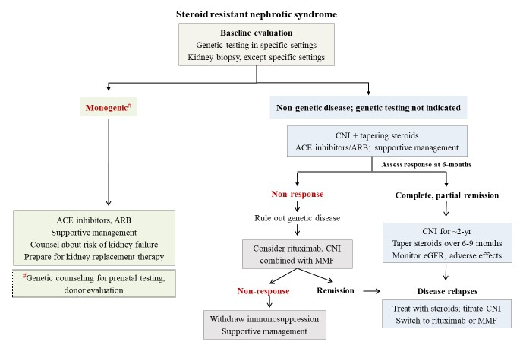
TREATMENT

Slide 46
TREATMENT
IV cyclophosphamide in patients with non-availability of CNI, either due to its cost or adverse effects.
Oral cyclophosphamide is not recommended for therapy of patients with steroid-resistance.

Slide 47
TREATMENT
Treatment of CNI-Resistant Nephrotic Syndrome:
In patients with non-genetic forms of SRNS and non-response to therapy with CNI, additional treatment with either IV rituximab or oral MMF is suggested.
Patients receiving combined therapy with CNI and either rituximab or MMF should receive prophylaxis with cotrimoxazole (5 mg/kg trimethoprim on alternate days) for 3-6 months.
Notes:
MMF in patients with SRNS is less satisfactory than in steroid-sensitive disease.

Slide 48
TREATMENT
Immunosuppressive Therapy with Pathogenic or Likely Pathogenic Variants:
It is not recommended that patients with monogenic disease receive therapy with calcineurin inhibitors or other immunosuppressive agents.
Analysis of pooled data shows that compared to non-genetic disease, those with genetic forms of SRNS are not likely to respond to CNI. Patients with monogenic forms of SRNS, irrespective of response are more likely to progress to kidney failure than those with non-genetic illness.

Slide 49
TREATMENT
Angiotensin Converting Enzyme Inhibitors and Angiotensin Receptor Blockers:
Use of ACE inhibitors is associated with 30-40% reduction in proteinuria in a doseand time-dependent manner, ARB may be used as effectively.
Dual blockade with ACE inhibitors and ARB further reduces proteinuria, but is associated with side effects such as hypotension, AKI and hyperkalemia, and is not recommended .
Notes:
All patients with SRNS should receive therapy with
Since proteinuria is a risk factor for progressive kidney disease, its reduction is important for renoprotection

Slide 50
TACROLIMUS | 0.1-0.2 mg/kg/day in 2-divided doses; maximum initial dose 4 mg/day; trough level 4-8 ng/mL*
CYCLOSPORINE | 3-5 mg/kg/day in 2divided doses; maximum initial dose 200 mg/day; trough level 80-120 ng/mL
PREDNISOLONE ONALTERNATE DAYS | 1.5 mg/kg for 4-wks; 1 mg/kg for 4-wks; taper to 0.3-0.5 mg/kg for ~6-9 months
CYCLOPHOSPHAMIDE | 500-750 mg/m² IV; every month for 6months
RITUXIMAB | 375 mg/m² everywk for 2-4 doses
MYCOPHENOLATE MOFETIL | 600-1200 mg/m²/day in 2-divided doses

Slide 51
THROMBOTIC COMPLICATIONS
The risk of thromboembolic complications in nephrotic syndrome is ~3% in children, compared to 25% in adults, with most events within the first 3-months of illness.
Risk factors for thrombosis include congenital nephrotic syndrome, heavy proteinuria, membranous nephropathy, central venous catheters and coexisting heart disease.
Thrombolysis followed by anticoagulation is considered in patients with life or limb-threatening thrombosis.
Therapy is initiated with enoxaparin at a dose of 1.5 mg/kg/dose (2-months) subcutaneously, every 12-hr
Notes:
We do not recommend routine thromboprophylaxis in children with SRNS.
Non-pharmacological measures such as ambulation, hydration and use of compression stockings are encouraged; central venous catheters and arterial punctures should be avoided

Slide 52
CARDIOVASCULAR MORBIDITY
Steroid resistance is associated with multiple cardiovascular risks, including hypertension, dyslipidemia, hypoalbuminemia, hypercoagulable state and steroid-induced obesity.
Strategies to reduce this risk include minimizing residual proteinuria, managing hypertension, weight reduction to achieve BMI <6%)

Slide 53
STRESS DOSING OF GLUCOCORTICOIDS
Patients, who have received oral corticosteroids for more than 2-weeks within the past one-year, should receive additional steroid dosing during conditions associated with physiological stress.
Additional steroids is recommended in situations where physiological stress is expected (fever ≥38°C, inadequate oral intake, lethargy, dehydration, invasive surgery, dental surgery, trauma and large burns).
Notes:
children receiving corticosteroids for varied indications for more than 14-days had biochemical evidence of suppressed hypothalamo-pituitary axis (HPA) [86]. The duration of HPA suppression might last up to two years, and vary with dose and duration of treatment.

Slide 54
TRANSPLANTATION
It is to be considered in all patients with SRNS and stage 5 CKD.
Genetic testing be performed before transplant to assist in donor selection and predict the risk of recurrence in allograft.
In a patient with prior allograft recurrence, the decision for re-transplantation should be taken after discussing the risks and benefits with treating physicians, patient and family.
In patients with allograft recurrence,initiation of plasma exchanges, increasing the dose of CNI, with or without additional use of rituximab is suggested.

Slide 55
CONGENITAL NEPHROTIC SYNDROME
Patients with congenital nephrotic syndrome present at birth or in first 3-months of life.
Infants are born prematurely with large placenta, and show massive proteinuria, hypoalbuminemia and anasarca.
Antenatal ultrasonography may show hyperechoic kidneys; amniocentesis reveals high alpha-fetoprotein.
There may be dysmorphic features or comorbidities.
Most patients develop kidney failure by the age of 2-8 years.

Slide 56
CONGENITAL NEPHROTIC SYNDROME
Almost 70-80% patients with congenital nephrotic syndrome have a genetic cause; mutations in NPHS1, NPHS2,WT1, LAMB2 and PLCE1 account for ~90% cases.
Exome sequencing using an extended SRNS gene panel is recommended.
Rarely, the condition is secondary to intrauterine infections with cytomegalovirus, rubella, toxoplasma and syphilis.

Slide 57
CONGENITAL NEPHROTIC SYNDROME
Management includes maintaining euvolemia, optimizing nutrition, and therapy of complications.
Patients should receive high energy (110-120 Cal/kg) and protein (3-3.5 g/kg/d) diet, orally or by feeding gastrostomy.
Supplements of thyroxine, vitamin D and calcium are required.
Infants should receive all primary immunization and bacterial infections are treated promptly.

Slide 58
 | Current ISPN | ISPN 2009 [5]
Definition: Duration of prednisone therapy | 6 weeks daily | 4 weeks daily
Kidney biopsy | All; except if monogenic SRNS identified | All patients
Genetic testing | Specific subsets of initial SRNS, congenital NS; not in late SRNS | Specific forms of initial SRNS
Immunosuppression in monogenic SRNS | Not advised; may continue after counseling if partial remission | Not discussed
Estimated GFR, ml/min/1.73 m² | At diagnosis; q 3-6 months Avoid immunosuppression if eGFR<60 | At diagnosis
First line: Calcineurin inhibitors (CNI) | Duration of therapy at least 2yr | Duration: 2-3 yr
Cyclophosphamide | IV cyclophosphamide may be used; oral not advised | IV therapy has low efficacy; oral not used

Slide 59
Indications for mycophenolate mofetil | (i) Prolonged CNI use and disease relapses; (ii) CNIresistant SRNS | No recommendation
Use of rituximab | (i) Prolonged CNI use & disease relapses; (ii) CNIresistant SRNS; (iii) allograft recurrence | No recommendation
Prednisone alternate day | Taper over 6-9 months | Taper over 1-1.5 yr
Statins; in addition to dietary advice | LDL cholesterol >160 mg/dL; >130 mg/dL if cardiovascular risk factors | Total cholesterol >200 mg/dL, or LDL >130 mg/dL
CNI-resistant disease | Rule out monogenic cause; consider rituximab; addition of MMF | Not discussed
Renal transplantation | Evaluation of recipient, donor; managing recurrent FSGS | Not discussed

Slide 60
THANK YOU

