Slide 1
Atlas of Common Neonatal Problems
Dr. Manish Rasania

Slide 2
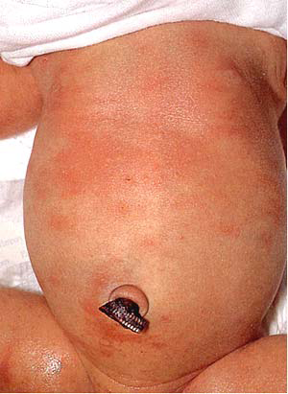
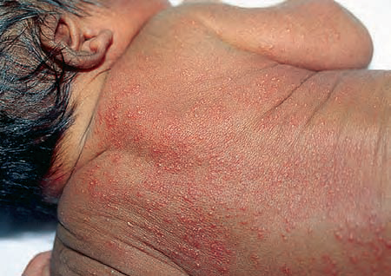
Erythema Toxicum
FT healthy 3days old NB with maculopapular rash on trunk and back
Notes:
Benign inflammatory skin disease of unknown cause. It is observed in about 40% of otherwise healthy full term babies, usually appears between day 2 to 4, lesions are more on trunk and back. Basic lesion is a small papule – 1 – 3 mm, that may evolve into pustule in 10% cases with prominent halo of erythema, flea bite appearance. It resolves spontaneously within 2 – 3 weeks without treatment.

Slide 3
Study | Journal, Authors | Level of Evidence | Result | Outcome
Prospective Study of Erythema Toxicum Neonatorum: Epidemiology and Predisposing Factors | Pediatric Dermatology Volume 29, Issue 2, pages 166–168, March/April 2012 Benigno Monteagudo M.D.¹, Javier Labandeira M.D., Ph.D.², Miguel Cabanillas M.D.¹, Antonio Acevedo M.D.³and Jaime Toribio M.D., Ph.D.² | 3, prospective study | We performed a prospective study of 1,000 neonates investigated in the first 72 hours of life in the health area of Ferrol (northwest of Spain) to assess the prevalence of erythema toxicum neonatorum, the anatomical sites most frequently involved, the influence of different maternal and neonatal parameters, day of life of medical examination, and type of delivery (vaginal or Cesarean). | Overall prevalence of erythema toxicum neonatorum was 16.7%. Lesions most frequently involved the trunk, buttocks, and proximal areas of limbs. A higher prevalence of this dermatosis was found in Caucasian newborns (p = 0.01) and those with higher birthweight (p < 0.05), greater gestational age (p < 0.05), vaginal delivery (p < 0.05), maternal age of <30 years (p = 0.28), and fewer than two previous pregnancies (p = 0.12).

Slide 4
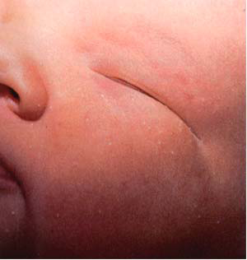
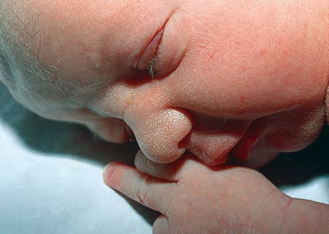
Milia
Full term newborn with small whitish yellow papular spots around eyes and on nose
Notes:
Sebaceous gland plugging. Small, whitish yellow, papular. Commonly around eyes and midface. Management - Reassurance.

Slide 5
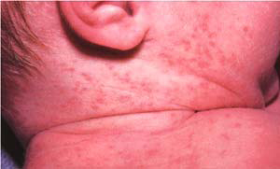
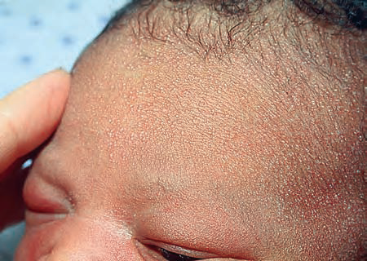
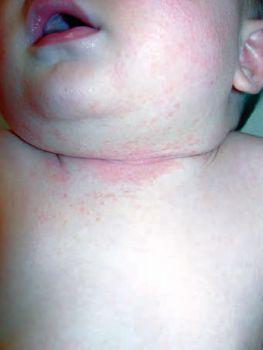
Miliria Rubra – Prickly Heat
Erythematous papulo pustular lesions on face, neck & trunk during summer months
Notes:
Miliaria crystallina in a newborn from overheating. Can occur following sunburns. Presents as generalized small clear vesicles that
are easily ruptured with no surrounding erythema. (as against miliria rubra – where base is erythematous, has deeper involvement, papulopustular )
Deeper epidermal or dermal layers; sweat gland obstruction. Erythematous, papulopustular. Face, neck, trunk.
Management - Reassure; decrease heat, humidity, tight clothing.
Air conditioning. Light cotton clothing. Cool baths.

Slide 6
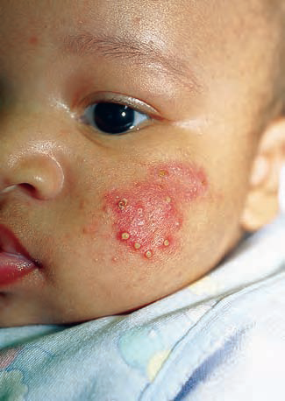
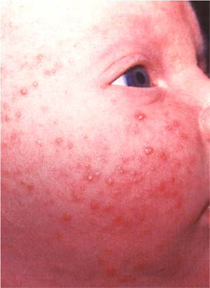
Acne Neonatorum
Notes:
Because of transplacental transfer of maternal androgens. Sebaceous gland response to maternal hormones. Differential diagnosis – CAH. Often resolves spontaneously without treatment. Daily cleaning to be done.

Slide 7
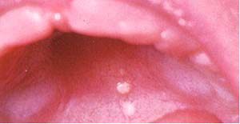
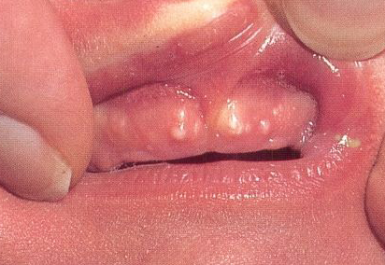
Epstein’s Pearls
Pearl like small whitish yellow lesions on hard palate & gums
Notes:
Mucus gland plugging. 2-3 mm, round, white or yellow. Gum margins; hard palate – Common. Management - Reassure; resolve spontaneously.

Slide 8
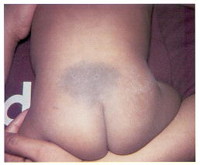
Mongolian Spots
Flat bluish gray discoloration of skin on sacro - gluteal area
Notes:
Benign transient lesions. Flat bluish gray discoloration of skin, mostly on sacrogluteal area. Lesions fade gradually and disappear by 5 – 6 years of age.

Slide 9
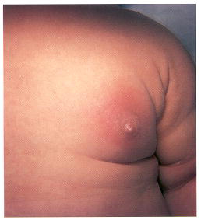
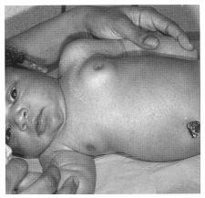
Bilateral Physiological Enlargement of Breasts - Neonatal Mastitis
FT newborn with bilateral nontender enlargement of breasts
Newborn with unilateral tender red enlargement of breast
Notes:
Usually a unilateral, erythematous, and tender enlargement of breast in a full-term infant. Rare during first week. Mostly presents during 2nd – 3rd week. Signs of inflammation - warm, swollen, erythematous, tender, and firm.
Physiologic enlargement of the breasts is bilateral with no signs of inflammation, result from stimulation by maternal hormones that cross the placenta during gestation. Breast engorgement occurs in both male and female term infants and usually subsides within several weeks without any treatment. Breast engorgement does not occur in premature infants. Retrograde entry of bacteria present on the skin through the ducts into deeper hypertrophied glandular tissue leads to cellulitis or abscess formation. Repeated manipulation of the engorged breast to express the milky discharge (“witch’s milk”) may be a contributory factor. Staph aureus is the responsible organism in most of the cases. Antistaphylococcal antibiotics (cloxacillin, amoxycillin clavulanic acid) are required for 7 – 10 days. Incision and drainage is required if there is abscess formation.

Slide 10
Phimosis
Physiological
Skin gradually loosens, no treatment is required

Slide 11
Vaginal Bleeding
Due to sudden withdrawal of maternal hormones
Occurs on 3rd to 7th day of age
Small quantity
Self limiting, no treatment is required

Slide 12
Epiphora – Persistent Tearing
Due to blockage of nasolacrymal duct
Persistent watering from eye
Local frequent massaging results in cure 6 - 8 months
Syringing operation needed in some cases if no cure by massaging

Slide 13
Excessive Sleepiness
Neonates sleep about 20 – 22 hours. They take feed for 15 – 20 min, and go to sleep for 2 – 3 hours.
Sudden lethargy/poor activity or poor feeding, in a baby who was feeding adequately, is a danger sign, manifestation of a serious illness like septicemia or hypoglycemia.

Slide 14
Excessive Crying
Hunger
Unpleasant sensation of a full bladder before passing urine
Painful evacuation of hard stools
Discomfort of wet napkins
Abdominal Colic
Insect Bites
Nose Block
Unapparent Trauma
Excessive inconsolable crying or a high pitched cry is indicative of serious disorder like meningitis or intestinal obstruction or a painful inflammatory condition.

Slide 15
Infantile Colic – Evening Colic
Severe paroxysmal crying mainly in the late afternoon.
Behavioural problem, begins after 2- 3 weeks of life and peaks at age 2–3 months, stops by 4th – 5th month.
Infant is otherwise healthy and well fed. Exclude other causes of excess crying.
Parental Reassurance & Education
Gentle swinging or rocking, placing baby in prone position & gentle patting, soft music, car driving, or walking in the stroller may be helpful. Quite environment.
Phenobarbital elixir and dicyclomine have been found to be somewhat helpful, but their use is to be discouraged because of the risk of adverse reactions. Dicyclomine has been associated with apnea in infants and is contraindicated below 6 months .
Simethicone (helps in elimination of gas)has not been shown to ameliorate colic.
A trial of ranitidine might be of help if gastroesophageal reflux is contributing to the child’s discomfort.

Slide 16
Study | Journal, Authors | Level of Evid | Results | Outcome
Randomised controlled trial of infantile colic treated with chiropractic spinal manipulation | Arch Dis Child 2001;84:138-141 doi:10.1136/adc.84.2.138 E Olafsdottirª, S Forshei^{b}, G Flugeª, T Markestadª | 2 | One hundred infants with typical colicky pain were recruited to a randomised, blinded, placebo controlled clinical trial. Nine infants were excluded because inclusion criteria were not met, and five dropped out, leaving 86 who completed the study. There was no significant effect of chiropractic spinal manipulation. Thirty two of 46 infants in the treatment group (69.9%), and 24 of 40 in the control group (60.0%), showed some degree of improvement. | Chiropractic spinal manipulation is no more effective than placebo in the treatment of infantile colic. This study emphasises the need for placebo controlled and blinded studies when investigating alternative methods to treat unpredictable conditions such as infantile colic.

Slide 17
Regurgitation
Regurgitation of small amount of milk/curd after feeds is normal. It is not projectile.
Burping for few minutes decreases regurgitation.
Persistent vomiting/bile stained vomiting associated poor feeding/activity, excess crying, abdominal distension, not passage of stool – danger sign, can be due to sepsis, NEC or intestinal obstruction.

Slide 18
Diarrhea
Passage of semi-loose greenish yellow stools with some gas during the third and fourth day after birth – called as transitional diarrhea, which is normal.
Passage of small amount of stool each time after taking feed (may be up to 8 – 10 times/day), which is due to exaggerated gastrocolic reflex, is normal.
If baby is playful, active and gaining weight adequately, no treatment is required.
Babies receiving water or top feed esp.ly if with bottle are prone for infective diarrhea. Recent change in consistency of stool, excess crying, not gaining weight adequately, sick look – indicative of infective diarrhea.

Slide 19
Constipation
Every baby has a variable bowel habit.
Babies receiving breast milk pass two to six golden yellow sticky semi-loose stools.
Not passing stool for few days (up to 7 days) is normal provided there is no excess crying/vomiting/abdominal distension.
Sometimes constipation is due to Hirschsprung disease, anal stenosis or congenital hypothyroidism.

Slide 20
Physiological Jaundice
Appearance after 24 hours of life
Predominantly indirect hyperbilirubinemia
Rate of progression < 5 mg% per 24 hours
Highest bilirubin level < 15 mg%
Complete disappearance before 14 days of life
Notes:
More than 80% of neonates develop jaundice. Commonest cause of it is physiological jaundice. Other pathological causes are – blood group incompatibility in mother and baby, G6PD deficiency, breast milk jaundice, cephalohematoma, hepatitis in neonate, extrahepatic biliary atresia, etc. Physiological jaundice is because of immaturity of liver during initial days of life, along with excessive bilirubin production due to more number of red cells in neonates with lower life span of red cells, and increased enterohepatic circulation of bilirubin due to absence of gut flora in neonates. Physiological Jaundice do not require treatment. It requires reassurance only.

Slide 21
Significant Jaundice
Notes:
Picture shows Soles are yellow – indicates serum bilirubin level of more than 15 mg%.
Appearance of jaundice is cephalopedal. Means jaundice first appears on face – when bilirubin is 5 mg% & above, then on chest when bilirubin is 8 mg% & above, on abdomen when bilirubin is around 10 mg% & above, on upper and lower limbs when bilirubin is 12 mg% & above, and on palms and soles when bilirubin is above 15 mg%. This is because skin of face is thinnest, so face is jaundiced first with lower bilirubin level. Skin of palm / sole is thickest, so jaundice appears there only when bilirubin is increased to 15 mg% and above.
When appearance of jaundice is within 24 hours of life (even though jaundice is mild) Or Jaundice is present on palms / soles (it indicates severe / high jaundice) Or Jaundice is persistent after 14 days of life (even though jaundice is mild) – it is called as significant / pathological jaundice. Such neonates require hospitalization for investigations to find out the cause & treatment.

Slide 22
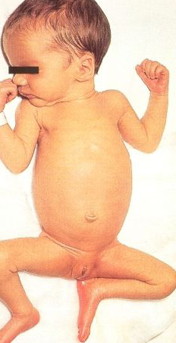
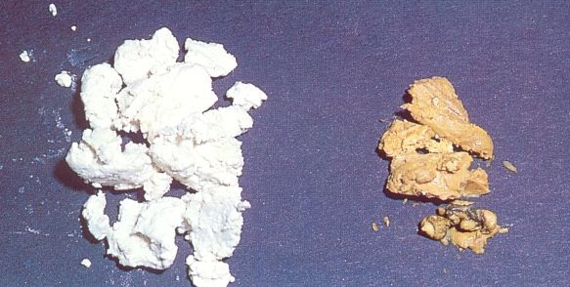
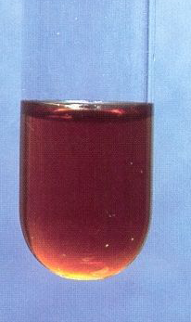
Biliary Atresia
2 weeks old full term newborn otherwise healthy with mod – sev jaundice passing white stool and dark urine

Slide 23
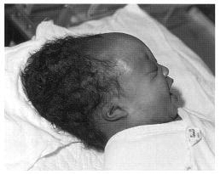
Caput Suceedenium
Full term normally delivered baby with soft swelling of entire scalp on day 1 of life
Notes:
Edema or swelling of the soft tissues over the presenting part of the body during delivery. It is present at birth. Diffuse swelling, not well demarcated. It crosses suture line/midline. Overlying skin may show discoloration (petechiae, purpura, ecchymosis). It resolves spontaneously within few days.
Subgaleal hemorrhage - A caput may be difficult to distinguish from the rare but serious subgaleal hemorrhage.
Subgaleal hemorrhage is a collection of blood in the soft tissue space between the galea aponeurotica and the periosteum of the skull.
Newborns with subgaleal hemorrhage show signs of central nervous system trauma (hypotonia, seizures) and significant anemia (pallor, lethargy), and they deteriorate rapidly.

Slide 24
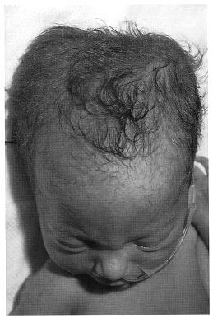
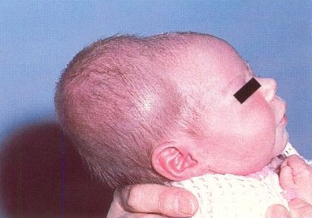
Cephalohematoma
Large baby delivered by primi mother with difficulty – develops scalp swelling over right parietal bone, noticed on day 2, gradually increased after few days
Notes:
Traumatic subperiosteal hemorrhage during prolonged or difficult delivery. Swelling usually appears several hours after birth (subperiosteal bleeding being a slow process). Swelling is limited to surface of one cranial bone, & does not extend beyond suture lines of affected bone. Does not extend across midline. Sharply demarcated. No discoloration of overlying scalp. A linear skull fracture is present in about 5 – 10%. Associated intracranial hemorrhage is rare. Cephalhematoma of a significant size may be associated with Anemia & Hyperbilirubinemia. It gradually resolves in 2 to 12 weeks A pressure dressing does not hasten absorption of hematoma, and may contribute to skin breakdown and infection. Needle aspiration or incision and drainage of cephalhematoma is contraindicated because of the risk of introducing infection. No specific therapy is required for the underlying linear skull fracture. A radiograph may be taken at 4 to 6 weeks to ensure closure and to exclude formation of a leptomeningeal cyst.

Slide 25
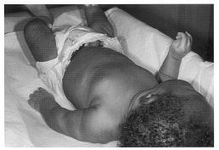
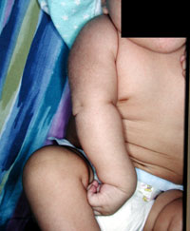
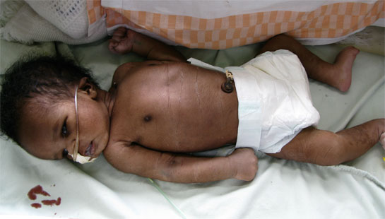
Erb’s Palsy
Large baby delivered by Primi mother with difficulty – absent movement of one of the upper limbs noticed with preservation of grasp reflex
Notes:
Stretch or avulsion injury to brachial plexus during birth mostly seen in large full-term newborns of primi mothers following a prolonged and difficult labor. Erb’s palsy is most common (in 70 – 80%) with paralysis of upper arm (C5,C6). Complete palsy (paralysis of entire arm) is seen in 20%. Lower arm paralysis (C8, T1) – Klumplke in 8%. Spontaneous recovery rates of 70% to 90% are reported, especially when paralysis is secondary to edema or hemorrhage surrounding the nerve fibers. First signs of recovery appear within a couple of weeks in most patients, and full function usually returns within 3 months. The earlier the beginning of recovery, the better the long-term prognosis. Main goal of therapy is prevention of contractures by intermittent partial immobilization and appropriate positioning. Arm should be abducted 90 degrees with external rotation at the shoulder, full supination of the forearm, and slight extension at the wrist with the palm turned toward the face. This position can be maintained either by pinning a towel over the wrist and fixing it to the mattress or by using a brace or splint during the first 1 to 2 weeks. Active physical therapy should be avoided in the immediate post-delivery period because of a painful traumatic neuritis. Gentle passive exercises should be started by 7 to 10 days of life. With laceration of the nerve, damage is usually permanent, and surgical reconstruction of the plexus (e.g., nerve grafting, neuroplasty, and neurolysis) should be considered in infants who show no evidence of spontaneous recovery after 3 to 6 months.
Radiographs of the clavicle, humerus, and shoulder indicated to exclude fracture or dislocation.
Electromyography assesses severity of the injury and determines the prognosis in patients who show no improvement in 6 to 8 weeks.
Nerve root avulsion or rupture can be demonstrated by MRI.

Slide 26
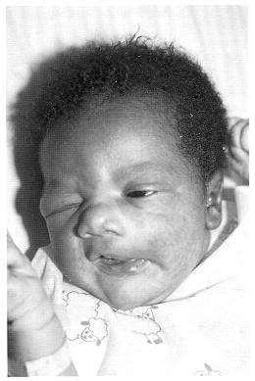
Facial Palsy
Big baby delivered by forceps with difficulty – noticed to have asymmetric face with not able to close eye on one side & absent nasolabial fold
Notes:
Peripheral facial palsy is more common. It may be complete (involving the entire side of the face) or partial (a small branch of the nerve is injured, and weakness is limited to the forehead, eyelid, or mouth) Usually due to hemorrhage and edema rather than avulsion. During labor and delivery: peripheral portion of the facial nerve may be compressed over the stylomastoid foramen (through which it emerges) or where the nerve traverses the ramus of the mandible. After forceps delivery—with prolonged application of forceps blade, especially when fetal head has been grasped obliquely. After spontaneous delivery—with prolonged pressure exerted by maternal sacral promontory. Failure of eye closure on the affected side is usually the first noticeable sign of peripheral facial palsy. Facial asymmetry is diagnosed by observation of the crying newborn.
Nasolabial folds are asymmetric with facial nerve palsy. Prognosis is excellent; high rate of spontaneous recovery. Resolution usually occurs within several days; total recovery may require several weeks or months.

Slide 27
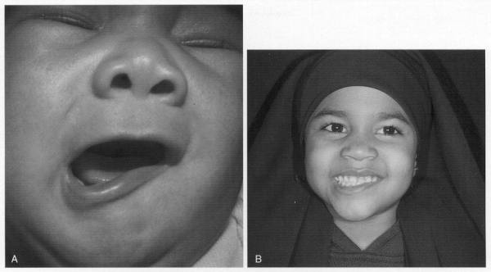
Congenital Hypoplasia/Aplasia of Depressor Anguli Oris
Notes:
Asymmetric crying facies at birth. The left corner of the mouth fails to move downward and outward with crying. The nasolabial folds are symmetric, and the neonate is able to close both eyes (unlike the patient with facial palsy) Mild asymmetry of the angle of the mouth is still visible at 8 years of age. This patient’s asymmetry was remarkable at birth and has improved greatly over the years.

Slide 28
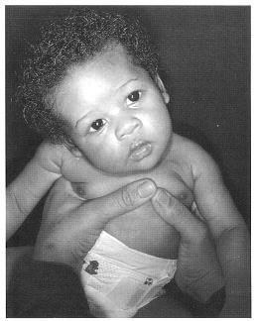
Torticollis – Twisted Neck
2 month old girl born by FTND with difficulty, always keeps head on one side only and chin to opposite side
Notes:
Difficult breech or vertex delivery of large infants involving hyperextension of the SCM muscle may result in tearing and bleeding within the muscle. Since the SCM muscle is contained within a separate facial compartment, bleeding may result in compartment syndrome with subsequent ischemia, infarction, fibrosis, and contracture of the muscle.
Mass is palpable in mid portion of muscle after 10 – 14 days. Increase in size during first 2 – 4 weeks, then gradually decrease, disappear by 5 – 8 months. With subsequent fibrosis torticollis develops. Head tilts toward the affected side and the chin elevates and rotates to the opposite side.
Gentle stretching exercises to lengthen the contracted muscle (as early as possible). Tilt the head toward the opposite shoulder, Rotate the chin toward the affected side, Maintain the corrected position for 5 to 10 seconds at each attempt. A program of 10 to 15 attempts four times daily is usually sufficient in most patients. Stimulate the infant to turn the head spontaneously toward the affected side (e.g., by hanging a musical mobile on that side). Conservative therapy is continued for at least 6 months. Most infants treated conservatively usually show complete recovery within 2 to 3 months.
Surgical intervention - Options include muscle lengthening, release of contractures, and excision of the affected muscle and distal tenotomy.
Surgery should be considered for patients who do not improve with stretching exercises.

Slide 29
Skin Pustules
Notes:
Skin pustules are due to staphylococcal infection. It requires oral antistaphylococcal antibiotics.

Slide 30
Boil
Notes:
Boil is due to staphylococcal infection. It requires hospitalization. Management is incision and drainage, along with antistaphylococcal antibiotics.

Slide 31
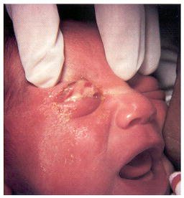
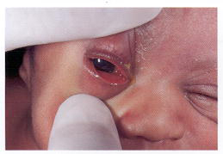
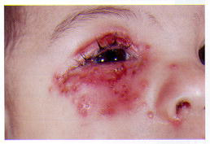
Ophthalmia Neonatorum – Conjunctivitis in Newborn
Notes:
Causes – bacterial, gonococcal, chlamydial, herpes. It is largely due to direct inoculation of the neonate’s conjunctival sac by the organism during passage through an infected birth canal.
Gonococcal – incubation period 2 – 5 days. Bilateral intense lid edema, marked conjunctival injection, and chemosis. Thick, mucopurulent, and copious discharge. May be associated with other distant foci of infection (meningitis, arthritis, anorectal infection).
Systemic antibiotic therapy - A single dose of ceftriaxone 25 to 50 mg/kg (maximum 125 mg) given intravenously or intramuscularly.
Adjunctive therapy: irrigation of eyes with saline several times a day until the purulent discharge subsides.
Topical antibiotic therapy alone is not adequate and is not necessary once the patient has received systemic antibiotic therapy.
Suspect co-infection with C. trachomatis if patient fails to respond satisfactorily despite adequate therapy.
Mother and her sexual partner(s) must be evaluated for STDs including C. trachomatis, and treated appropriately.
Complications – corneal ulceration, panophthalmitis, blindness, septicemia, meningitis, arthritis, endocarditis.
Prophylaxis – prophylactic eye drops/oint – silver nitrate/ erythromycin/ tetracycline. Neonates born to mothers who have gonorrhea at the time of delivery should receive a single dose of parenteral antibiotic (as mentioned above) in addition to the ocular prophylaxis.
Chlamydial - Incubation period: 5 to 14 days. Mild to moderate hyperemia of conjunctiva. Swelling of lids, chemosis. Greater involvement of palpebral than bulbar conjunctiva. Mild to copious mucopurulent discharge. Corneal is rarely affected. Vision is usually not affected. Diagnosis by Giemsa stain of the conjunctival scraping Identifies characteristic intracytoplasmic inclusion bodies that may be present in the epithelial cells of the conjunctiva. Treatment – unlike gonococcal conjunctivitis hospitalization is not required. Topical therapy alone is inadequate (does not eliminate infection at other sites). Systemic therapy eliminates infection in eyes as well as in other infected sites (pharyngitis, pneumonia). Erythromycin 50 mg/kg/day for a total of 10 to 14 days. With systemic therapy, there is no need to use topical therapy. Mother and her sexual partner(s) must be evaluated for STDs and treated appropriately. Without treatment, acute inflammation continues for several weeks and then enters a subacute stage of mild conjunctival infection with minimal purulent discharge.
Herpes simplex virus conjunctivitis: Systemic acyclovir as well as topical therapy.

Slide 32
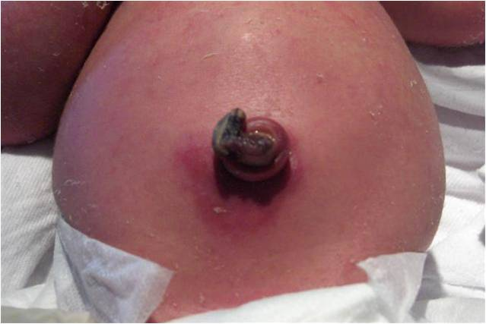
Umbilical Infection
Notes:
It is caused by staphylococcus. Management is oral antistaphylococcal antibiotics for 5 days, and local cleaning.

Slide 33
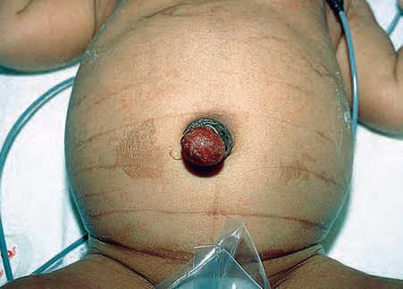
Umbilical Granuloma
Notes:
Pink papule or nodule within the umbilical stump that bleeds easily. Develops at the site of the umbilical cord remnant after it falls off.
Pathogenesis Inadequate healing at umbilical stump with subsequent endothelial cell proliferation and inflammation (granulation tissue).
Treatment - Silver nitrate application. Cryocautery, ligature and excision have been reported to be successful
Prognosis Can resolve spontaneously but usually requires treatment. Persistence indicates the presence of an umbilical remnant.

Slide 34
Abdominal Distension
Notes:
It can be due to intestinal obstruction Or necrotizing enterocolitis. It requires hospitalization.

Slide 35
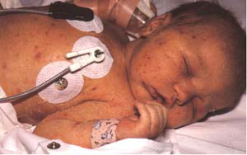
Petechiae
Notes:
Petechiae are due to thrombocytopenia. Most commonly thrombocytopenia is due to septicemia. It requires hospitalization.

Slide 36
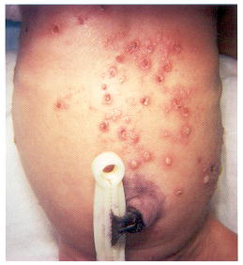
Neonatal Herpes
FTND baby on day 10 of life develops vesicular lesions with poor feeding, less activity, seizures. Mother had painful ulcerative lesions in genital area.
Notes:
Infection is usually acquired at birth from mother with infected genital lesions. Localized infection to skin, mouth and eyes – seen in 1/3 cases usually appears between 3rd – 6th day. Disseminated infection is seen in 1/3 cases, presents as sepsis. Localized CNS infection is seen in 1/3 cases, presents as encephalitis during 2nd – 3rd week. Skin lesions are often absent. Tzank smear is useful for rapid diagnosis. CSF examination and ophthalmologic consultation are indicated. Mortality from untreated neonatal infection: about 50%. Major sequelae in survivors
a. Half of the survivors of those with CNS involvement have neurologic sequelae Microcephaly, Hydranencephaly, Seizure disorder
b. Blindness
Treatment - Hospitalization, Acyclovir 30 mg/kg/24 hours in three divided doses intravenously for minimum of 14 days, Ophthalmologic consultation

Slide 37
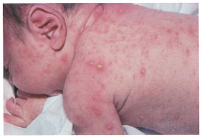
Neonatal Varicella
12 day old baby develops papulovesicular lesions mainly on trunk, with lethargy and poor feeding. Mother had vesicular lesions on trunk with severe itching 2 days prior to delivery
Notes:
12 days old newborn whose mother developed varicella 2 days before delivery.
Neonatal varicella: Due to fetal exposure near the time of delivery with maternal infection between 5 days prior to and 2 days following delivery.
23–62% risk of developing disease with exposure.
Cutaneous findings from 1 to 16 days. papulovesicular lesions which can become hemorrhagic or necrotic.
High risk for disseminated disease: pneumonitis, hepatitis, encephalitis.
Diagnosis – clinically with relevant maternal history. Tzank smear of vesicles showing multinucleated giant cells. Viral culture.
Treatment - Acyclovir. Isolation
Prevention – VZIG to neonate given within 72 hours.
Neonatal varicella – 10–30% mortality

Slide 38
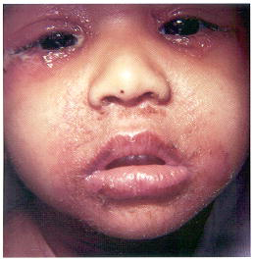
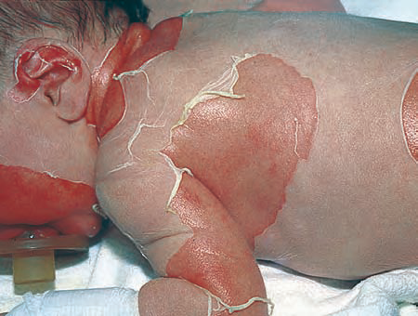
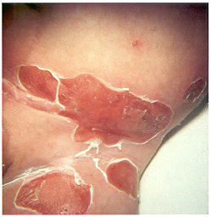
Staphylococcal Scalded Skin Syndrome (SSSS)
2 month old infant presents with sudden high fever, cough, followed by crusting around mouth & eyes, followed by rash – generalized, tender & erythematous, after 24 hours flaccid blister develops that exfoliates like thin wet tissue paper. Stroking over skin also leads to blister formation.
Notes:
potentially serious but highly treatable toxin-mediated manifestation of a localized infection with certain strains of staphylococci. Staphylococcus aureus phage II, types 71 and 55. The organism produces an epidermolytic toxin called exfoliatin. Most commonly affected persons are infants and children less than 5 years of age because of their renal immaturity and inability to excrete the toxin. The organism colonizes the mucous membranes of the nasopharynx, eyes, and selected areas (e.g., umbilical stump, circumcision sites), producing a localized infection. The toxin is produced from that vantage point. The toxin circulates and attaches to the cells of the epidermis, disrupting the latter.
CLINICAL FEATURES - 1. Sudden onset of fever and irritability 2. Prominent crusting around the eyes and mouth occurs early. Periorificial crusting is early and prominent. As seen in photograph. 3. Rash Generalized tenderness and erythema (staphylococcal scarlatina). Within 24 to 48 hours, flaccid blisters develop and then exfoliate in sheets, leaving a scalded-looking surface. The borders of the exfoliating skin are rolled like wet tissue paper.
LABORATORY - 1. Culture from colonized sites may be positive 2. Blood culture, if done, is usually negative.
TREATMENT 1. Hospitalization and dermatology consultation 2. IV beta lactamase-resistant antibiotic (e.g., oxacillin or vancomycin)
3. Monitoring and replacing of fluid and electrolyte deficits.
Differentiation from – TEN – occurs in older child, after certain drug exposure, exfoliating skin is necrotic (black), level of split – fullthickness epidermis, high mortality (30%)

Slide 39
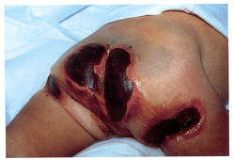
Echthyma Gangrenosum
Notes:
A cutaneous manifestation of Pseudomonas septicemia. The characteristic skin lesions are ulcers with a black eschar surrounded by erythema. (Bullae and hemorrhagic pustules that evolve into necrotic ulcers with black eschar surrounded by an erythematous halo) commonly at perineal (anogenital) area. Predisposing factors for pseudomonal septicemia - Individuals with immunosuppression for a variety of reasons like –
Debilitated preterm newborns, Patients with cystic fibrosis, Patients with congenital immune disorders, Malnourished infants, severe burns.
TREATMENT
1. Hospitalization; surgical and dermatological consultations
2. Antibiotics intravenously: cefotaxime, gentamicin, amikacin, piperacillin.
3. Appropriate wound care
4. Skin grafting as necessary

Slide 40
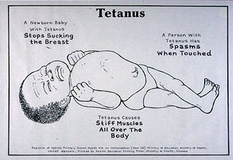
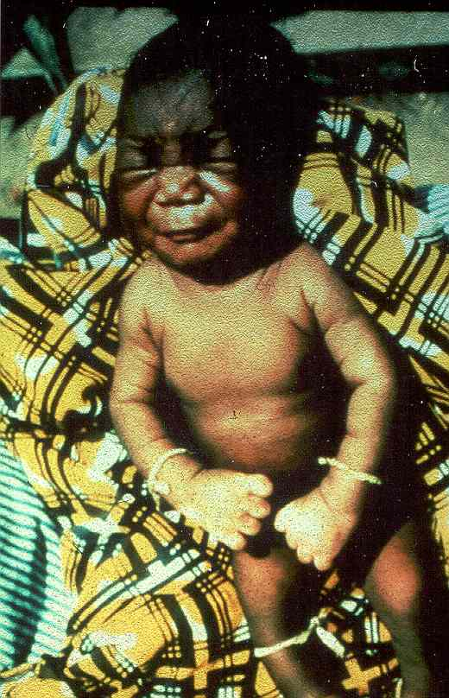
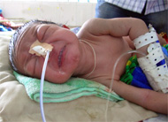
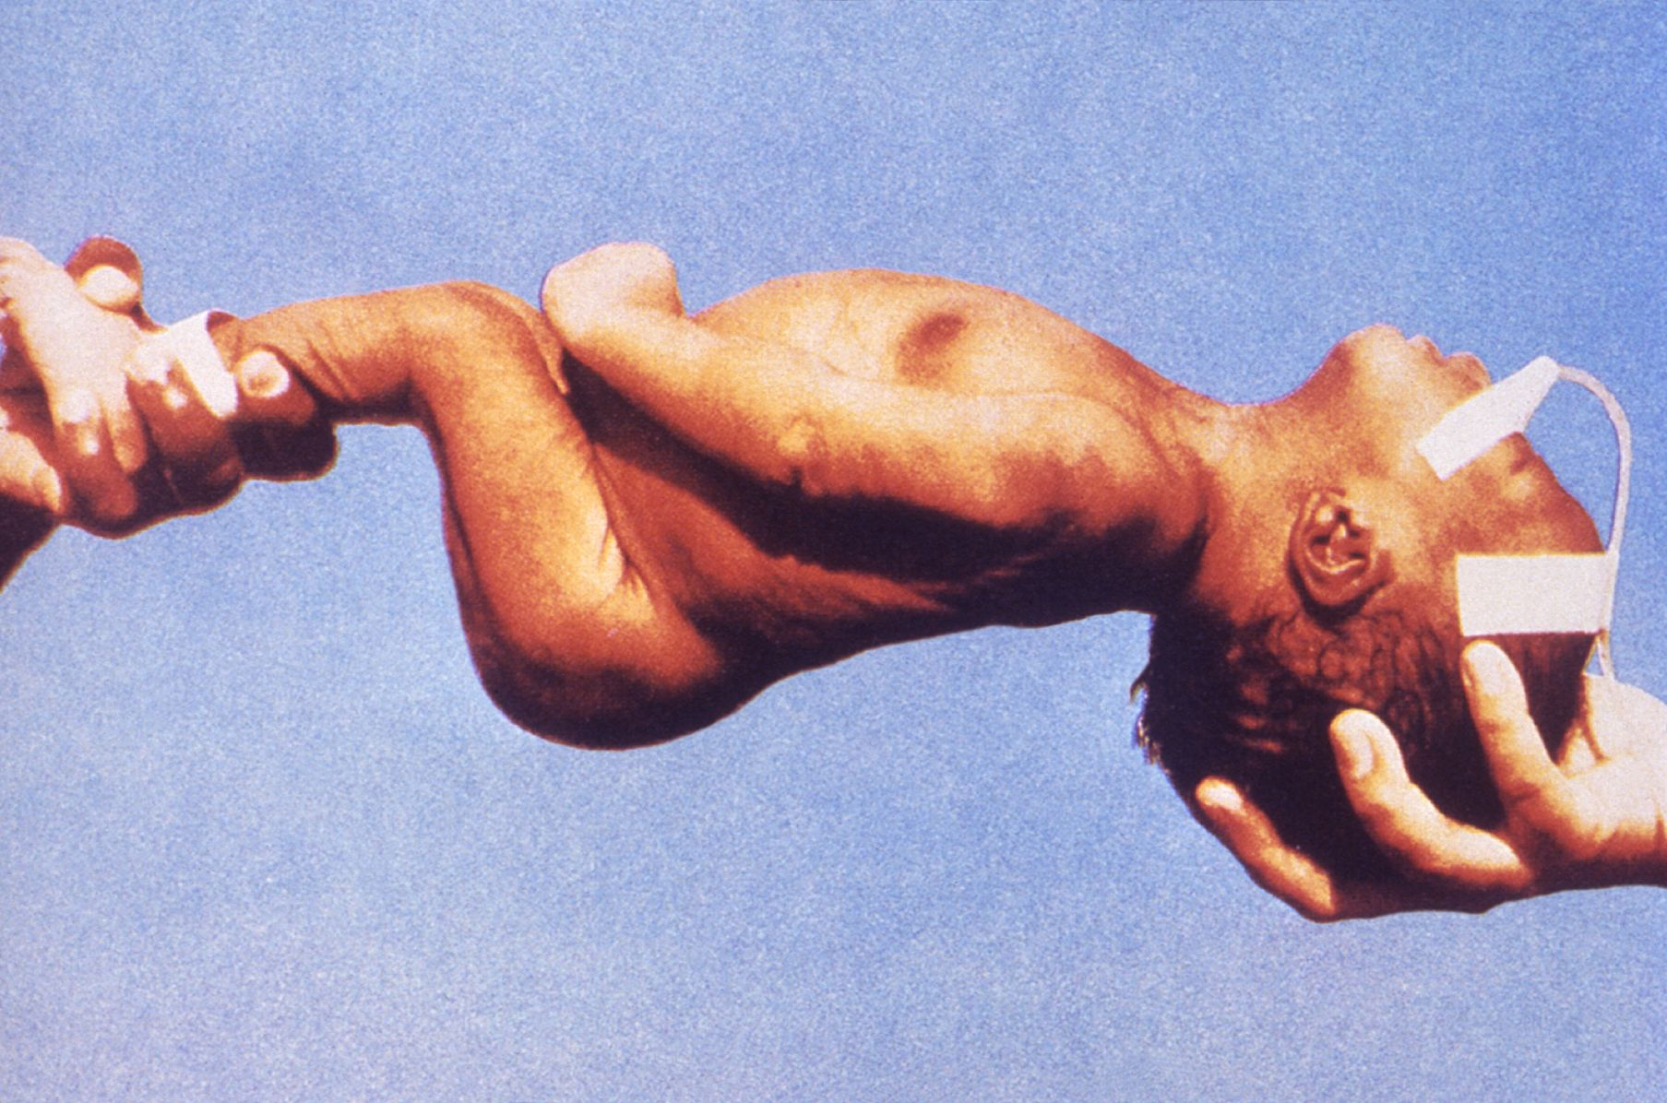
Tetanus Neonatorum
Notes:
It occurs when mother has not taken tetanus toxoids during pregnancy, and after birth bay’s umbilical cord is cut without aseptic precautions (example with unsterile scissor / blade). It is a serious condition associated with very high mortality. Problem is manifested at the end of first week of life – there is lock jaw so that baby is unable to open his mouth – so baby stops suckling at breast. There is generalized repeated severe spasm of whole body with opisthotonos. There is generalized stiffness / rigidity. Treatment is antitetanus immunoglobulin, penicillin, metronidazole, diazepam / midazolam to control spasms.

Slide 41
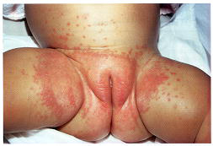
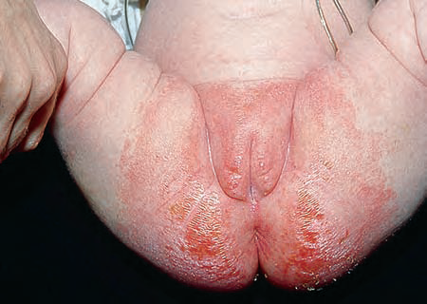
Diaper Dermatitis
Absence of satellite lesions
Sparing of creases
Notes:
Diaper dermatitis – it is due to prolonged contact with urine and feces (contact irritant dermatitis), that macerates and destroys the epidermis and with it the normal barrier function of the skin. (fabric of diaper and friction are sometimes important, but not much imp) Lesions are erythematous raised papular, without satellite lesions. Intertriginous area (creases) is spared. Complications – secondary candida infection TREATMENT – 1. Frequent diaper changes 2. Use of barrier creams or ointments—zinc oxide, hydrophilic petrolatum with every diaper change 3. Hydrocortisone cream twice a day for 3 days in the presence of severe inflammation 4. Nystatin cream for candidal infection 5. No need to change to cloth diapers because the new disposable diapers are superabsorbent.

Slide 42
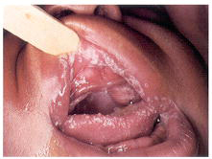
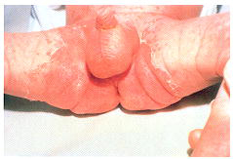
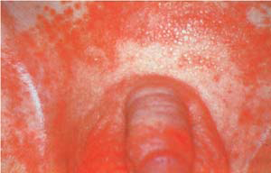
Candidiasis
Satellite lesions (raised red papules)
Involvement of creases
Notes:
Candida dermatitis - Beefy red, macular to slightly raised eruptions, Sharp border, raw with Satellite lesions (1-2 mm papules/pustules) hallmark of candida infection. Involves intertriginous areas(as against diaper dermatitis does not). Sites – Perineum, Scrotum and labia (always involved), Upper thighs, Buttocks. KOH preparation shows pseudohyphae and spores. Treatment – topical antifungal cream.

Slide 43
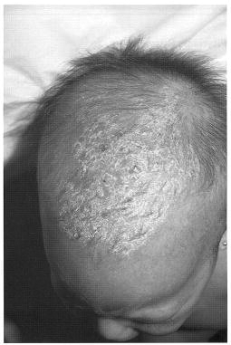
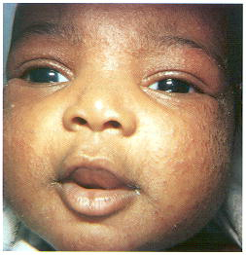
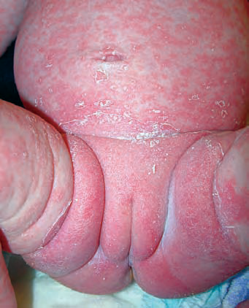
Seborrheic Dermatitis (Dandruff, Cradle Cap)
Greasy scales & papules on scalp & face
Notes:
A disorder of unknown etiology that is seen in the extreme edges of the pediatric age group(very young infants and adolescents). It is believed that increased activity of the sebaceous glands occurs in individuals with seborrheic dermatitis. There is increased epidermal cell turnover. The lesions consist of greasy scales and papules on the scalp and face. The lesions consist of greasy scales with erythema of the scalp. The other areas involved are the eyebrows, central oval of the face, ears, neck, postauricular fold, intertriginous areas where the lesions appear as scaly papules. In adolescents, seborrheic dermatitis appears as fine diffuse scales (dandruff) and scaly papules on the central oval of the face.
TREATMENT - 1. Keratolytic shampoo 2. Warm mineral oil compresses over the scalp 3. Topical low to midpotency corticosteroid solution applied to the scalp, or cream applied to nonhairy areas 4. In severe cases, fluocinolone acetonide 0.01% topical oil may be prescribed. 5. Ketoconazole shampoo and cream can be used in adolescents.
Usually resolves in several weeks to months. Histiocytosis X should be kept in mind especially if pruritus is present, hepatosplenomegaly is present and child is sick looking.

Slide 44


Natal Teeth
Notes:
Teeth present at birth are called natal teeth. Etiology is unknown in many. Most common location is in mandibular central incisor area. Complication - Detachment and aspiration of the tooth. Ulceration on sublingual aspect of tongue due to contact with sharp teeth edges during sucking. Interference with nursing due to abrasion or biting of the mother’s nipple. If possible, natal teeth should not be removed because they are primary teeth, and if removed they will not be replaced. Removal of the natal teeth leaves a defect for several years until the permanent teeth appear. Removal may alter position of the permanent teeth and dental arch, requiring orthodontic treatment in later years. Many of these teeth exfoliate spontaneously because they have erupted superficially owing to inadequate root formation.
Indications for removal - Risk of aspiration (detachment due to excessive mobility or looseness). Ulceration on the tongue. Interference with mother’s ability to breastfeed.

Slide 45




Glaucoma - Cataract - Retinoblastoma
Notes:
Glaucoma - increase in intraocular pressure in the anterior chamber. Anterior chamber is an aqueous fluid-filled space between the cornea and the iris. Aqueous humor is produced by the ciliary body at the posterior base of the iris. It passes through the pupil and exits through the trabecular meshwork and Schlemm’s canal, which is located at the junction of the cornea and the iris anteriorly (iridocorneal angle). Blockage of the outflow of aqueous humor for any reason causes a rise in intraocular pressure. Primary Glaucoma - About 50% of cases. An isolated developmental defect of drainage apparatus in anterior chamber angle Absence of any systemic or other ocular disease. Secondary Glaucoma - About 50% of cases. Glaucoma associated with systemic or ocular disease. Bilateral involvement is seen in 90% of infants. Epiphora (excessive tearing), Photophobia , Blepharospasm (voluntary eyelid closure), Corneal hazziness, Megalocornea (A corneal diameter of >10 mm in a term infant or >12 mm in an infant at 1 year), Buphthalmos or “ox-eye” (increase in size of eyeball). COMPLICATIONS - 1. Visual field loss and diminished visual acuity result from Optic nerve damage, Deprivation amblyopia, Corneal opacities, Corneal scarring 2. High degree of myopia, astigmatism (secondary to increased axial length of globe). Treatment is primarily surgical. The earlier the onset of glaucoma, the poorer the visual prognosis. Infantile glaucoma results in blindness if left untreated or not treated promptly.
Cataract – opacity of lens. Causes – TORCH infections, Galactosemia, Idiopathic, Inherited, Down’s syndrome, trauma, steroids, hypoparathyroidism. COMPLICATIONS - Irreversible sensory deprivation amblyopia. Surgical removal is indicated for visually significant cataract
Must be treated as soon as possible (often within days of birth), and not later than 17 weeks of age. Risk of irreversible deprivation amblyopia if not treated early. Red reflex should be examined by direct ophthalmoscopy in newborns and at each of the infant’s regularly scheduled visits in the first years of life. The only sign of galactose kinase deficiency may be a cataract.
Conditions associated with leukokoria (white pupillary reflex) - Cataract, Retinoblastoma, Retinopathy of prematurity, Persistent hyperplastic primary vitreous, Retinal detachment, Severe uveitis
Retinoblastoma - A malignant neuroectodermal tumor arising from the nuclear layer of the retina. Retinoblastoma gene is a recessive suppressor gene (also called recessive oncogene) located on the long arm of chromosome 13. Retinoblastoma results from loss of both copies of a recessive oncogene. About 40% cases are hereditery, and 60% are sporadic mutations. Mean age of diagnosis for hereditery cases – 12 months, for sporadic cases – 21 months. Clinical features – leukokoria, strabismus. Multidisciplinary approach including ophthalmologist, pediatric oncologist, radiation oncologist, and geneticist. Treatment is individualized depending on the size, location, and number of tumors. Therapeutic options – enucleation, radiation therapy, cryotherapy, phtocoagulation, systemic chemotherapy for orbital spread or didtant metastasis. Overall cure rate for retinoblastoma itself is over 90%. Prognosis for vision depends on size and location of tumor at initiation of treatment. Presence of leukokoria should be considered presumptive evidence of retinoblastoma until proven otherwise. Every child with strabismus must have a funduscopic examination after pupillary dilatation to rule out intraocular tumor. PREVENTION 1. Genetic counseling for the patient and family with hereditary form of retinoblastoma 2. Prenatal diagnosis for the retinoblastoma genome. 3. If a germinal mutation is confirmed, periodic examination of the opposite eye is indicated.

Slide 46



Atopic Dermatitis - Eczema
Notes:
Atopic Dermatitis - A chronic or relapsing skin disorder characterized by dryness of the skin and pruritus. Etiology Unknown. Genetic predisposition with Personal or family history of asthma or allergic rhinitis. Onset occurs before 5 years of age in 85%; before 1 year of age in 60%.Severity of atopic dermatitis varies. Main trigger factors – irritants, heat & humidity, infections, allergens – housedust, mites, pollens, molds, Stress, anxiety, psychosocial problems, food hypersensitivity – seen in 10% of children, mostly young infants, mainly to cow’s milk protein (milk & milk products), eggs, peanut(nuts), wheat. Citrus fruits, tartrazine, azo dyes.
Skin Lesions- Pruritus, Dry skin (xerosis), Erythematous Excoriated plaques May be lichenified and hyperpigmented. Infantile Form Onset at 6–8 weeks of age Face commonly involved Diaper area commonly spared Distribution of lesions: more extensor than flexor. Childhood Form Flexural in distribution, Neck Wrists Antecubital areas Popliteal areas. Most children have elevated serum IgE levels. Those whose eczema is made worse by aeroallergens have positive results on skin tests for specific allergens. The radioallergosorbent test (RAST) is not helpful in diagnosing food allergy unless the result is negative (food allergy excluded).
Treatment –
Dry skin care – brief bath < 5 min, Mild unscented soap, Patting (not rubbing) the skin dry, Use of emollients (moisturizers) as soon as the child leaves the bath – minimum 2 times a day – optimally several times a day.
Topical steroids – use ointments than creams, apply once or maximally twice, apply steroid first, then emollient over it, Midpotency (classes 4 and 5) to high-potency (classes 1,2 and 3) steroid ointments are used for 3 to 7 days, followed by low-potency (classes 6 and 7 - hydrocortisone) ointments for 1 to 2 weeks. Use only class 6 and 7 ointments(hydrocortisone) on the face. Topical steroids are used only when lesions are active, discontinued in remissions.
Antihistaminics – best given at night time with double dose – hydroxyzine, diphenhydramine. Low sedating antihistaminics (levocetrizine, loratidine) may be given to school going children.
In the majority of children, the disease improves with age. Severe intractable atopic dermatitis may be associated with certain immunodeficiency disorders.

Slide 47




Notes:
Previous slide – milder form of infantile eczema, severe infantile eczema, eyelid eczema
This slide – nummular eczema, Lichen simplex chronicus with typical lichenification, atopic dermatitis in older child with involvement of antecubital area, Childhood eczema – lichenified, pruritic
plaque on the neck,

Slide 48





Notes:
Pitiriasis Alba, Pitiriasis Alba, White dermatographism – reactive vasoconstriction after stroking the skin in an atopic patient, Dennie’s lines – extra skin folds on lower lid. Keratosis pilaris – keratotic, follicular, slightly erythematous papules on upper legs
Minor clinical features is helpful in diagnosing mild or atypical cases of atopic dermatitis:
a. Dennie’s lines b. Periorbital darkening c. Pityriasis alba d. infra-auricular fissure e. Follicular accentuation f. Keratosis pilaris
g. Hyperlinear palms h. Ichthyosis vulgaris i. Headlight sign j. White dermographism

Slide 49




Hemangiomas – Capillary (Strawberry), Cavernous
Notes:
Hemangioma is a benign tumor consisting of proliferating immature capillaries. Natural course – Lesions increase in size in first 6 to 12 months.
Involution starts after first year. 50% of hemangiomas are completely involuted by 5 years of age. 70% by 7 years of age. 90% by 9 years of age. Three Types of Hemangioma 1. Superficial (“strawberry”) hemangioma Most common type. Lesion appears between 2nd and 4th weeks of life Asymptomatic, Enlarging, Blanching, Compressible, Red plaque or tumor 2. Deep (cavernous) hemangioma - Lesion present at birth. Overlying skin may be normal or slightly bluish 3. Mixed superficial and deep. Location Hemangiomas are more common on the face and upper part of the body.
Complications of Hemangioma Ulceration (with lesion in an area of friction). Secondary infection (if hemangioma is ulcerated). Compromise of a vital function (lesion by its location causing obstruction). Example: laryngeal obstruction, periorbital hemangioma obstructs vision. Kasabach-Merrit syndrome - A rapidly enlarging deep hemangioma, Trapping of circulating platelets and coagulation factors leads to DIC, which in turn leads to life-threatening hemorrhages. Multiple cutaneous hemangiomas may be associated with visceral hemangiomas (GI, liver, lung, CNS)
LABORATORY
1. MRI or CT scan of head - Indicated in patients with hemangiomas covering a large area of the face and scalp. Rules out structural brain abnormalities.
2. Early direct laryngoscopy - In patients with hemangiomas located in the “beard area” (preauricular areas, chin, anterior neck, and lower lip). To rule out laryngeal involvement.
3. Platelet count must be done in patients with very rapidly enlarging lesions as in Kasabach-Merritt syndrome.
TREATMENT most involutes spontaneously. Treatment is indicated in few cases.
1. Indications for treatment - a. Life- and function-threatening hemangiomas - Impairment of vision, hearing, urination, or defecation, Airway compromise, Congestive heart failure, Kasabach-Merritt syndrome b. Hemangiomas in certain anatomic locations that often leave permanent scars or deformities, especially of the nose and lip c. Large facial hemangiomas d. Ulcers
2. Forms of treatment a. Oral Prednisone 2 to 4 mg/kg/day, single dose in the morning for 4 weeks, then gradually tapering it to alternate days b. Intralesional injection of triamcinolone acetonide 1 to 3 mg/kg every 2 weeks times 3 c. Interferon alpha 2a: 1 - 3 million U/m²/day subcutaneously. A 10% incidence of spastic diplegia with the use of interferon alpha 2a has been reported. d. Tunable pulse dye laser has been used on very early lesions with inconsistent results. e. Systemic antibiotics and local wound care are indicated for ulcerated lesions.

Slide 50


Notes:
Hemangioma – segmental vascular plaque associated with closure of the eyelid. This child required oral steroids to keep the eyelid open
Hemangiomas in the beard area and chest can be associated with tracheal hemangiomas

Slide 51


Port-Wine Stain
(Capillary Vascular Malformation)
Notes:
Purplish-red Flat; present at birth. Do not enlarge, but remain stable. Permanent dilatation of mature capillaries. Consider neurological evaluation if involves head.

Slide 52





Congenital Pigmented Nevus – Nevus of Ota/Ito
Notes:
A pigmented hamartomatous lesion that is present at birth. Surface is rough with prominent skin markings and Coarse terminal hair may be present as against nevus of ota/ito (where surface is flat bluish black macule as seen in photo of girl – very rare chance of malignant transformation), Mongolian spots, Café-au-lait spots (as in photo – brown flat macule on limb, > 6 are significant for diagnosis of neurofibromatosis).
LABORATORY 1. MRI of head - Indicated for large lesions anywhere on the body to exclude intracranial melanosis and Dandy-Walker malformation 2. Spinal MRI - Indicated for CPN of any size that overlies midline or paraspinal area of the back to exclude underlying spinal or spinal cord defect
COMPLICATIONS - Transformation into malignant melanoma. With giant CPN: risk is 6% to 10% With small CPN: <1% With intermediate CPN: probably between these figures. Small: <2 cm Intermediate: 2–20 cm Giant: >20 cm or involving one whole anatomic area.
TREATMENT
Refer the patient to a dermatologist and a plastic surgeon.
Surgical excision - Recommended for giant CPN, especially those on the torso. The optimal time for surgery is the first decade of life. Intermediate CPN may be observed or excised. Small CPN may be observed for changes unless there is a family history of melanoma or lesion is in an area that is difficult to observe (e.g., scalp, genitalia)

Slide 53





Ichthyosis
Notes:
A hereditary skin disorder characterized by dryness and excessive scaling. PATHOGENESIS 1. Increased epidermal cell turnover 2. Increased adhesiveness of the cells of the stratum corneum 3. Abnormal transepidermal water loss 4. Abnormalities of protein and lipid composition and metabolism affecting the cells and intercellular matrix of the stratum corneum
There are five major types of ichthyosis. Each is distinguished from the others by mode of inheritance, age of onset, and characteristics and distribution of scales. Ichthyosis vulgaris & X-linked ichthyosis are more common. Lamellar ichthyosis, Nonbullous congenital ichthyosiform erythroderma, Epidermolytic hyperkeratosis are less common.
TREATMENT - 1. Emollients (e.g., ammonium lactate cream, urea cream) 2. Keratolytics (e.g., salicylic acid in petrolatum) 3. Oral retinoids (e.g., acitretin) 4. Genetic counseling
PROGNOSIS - 1. Chronic 2. Severe forms may be debilitating

Slide 54





Epidermolysis Bullosa
Notes:
A hereditary skin disorder characterized by bullae formed as a result of friction or minor mechanical trauma. There are three major types of epidermolysis bullosa, all differing in mode of inheritance, clinical presentation, and findings on skin biopsy, direct immunofluorescence, and electron microscopy. Most present at birth or in early infancy.
a. Epidermolysis bullosa simplex (EBS) – 4 variety. EBS of hands& feet, Generalized EBS, EBS herpetiformis. These 3 variety improves with age. EBS with neuromuscular involvement variety (associated with muscular dystrophy, myasthenia gravis) – has poor prognosis.
b. Junctional epidermolysis bullosa (JEB) – generalized lesions. Mucosal involvement of GIT and respiratory tract. Prognosis – poor.
c. Dystrophic epidermolysis bullosa (DEB) - generalized lesions. Mucosal involvement of GIT and respiratory tract. Prognosis – poor.
TREATMENT Treatment is mainly palliative. Refer the patient to a dermatologist.
1. Avoidance of trauma and heat
2. Low doses of systemic corticosteroids
3. Antisepsis of eroded areas
4. Plastic surgery on “mitten hands”
5. Esophageal dilatation
6. Enteral feeding including gastrostomy in selected patients
7. Genetic counseling

Slide 55

Down’s Syndrome
Notes:
Down’s syndrome is due to trisomy 21. It is more common when mother becomes pregnant at elderly age – more than 35 years of age. It is commonly because of meiotic non disjunction of ovum. They have characteristic facial feature (slanted eyes, depressed nose, low set ears, open mouth), broad short hands, single transverse palmer crease, saddle gap between first and second toe with sole crease between them. They are mentally subnormal. They are likely to have congenital malformations – particularly congenital heart defects (common AV canal defects, ventricular septal defect), gastrointestinal malformations (duodenal atresia, Hirschsprung disease). There are more prone for respiratory tract infections. There are higher chances of leukemia in them. There is no curative treatment. Management is supportive, with management of associated problems if present. Average life expectancy in recent years has increased to 50 years and beyond.

Slide 56


Slide 57



Congenital Hypothyroidism - Cretinism
Notes:
Congenital hypothyroidism is mainly because of congenital absence of thyroid gland Or due to hypoplastic ectopic thyroid gland. Neonate is normal at the time of birth. There can be prolonged neonatal jaundice, large birth weight baby, constipation, hoarse cry. If condition is not detected in neonatal period, then typical cretin faces develops with puffy face, large protruding tongue, short stature, distended abdomen, umbilical hernia, excessive weight gain, nonpitting edema, etc. If not diagnosed and treatment is not started in neonatal period – they will become permanently mentally retarded. Incidence in India is higher (1 in 2600 live births, compared to 1 in 4000 in other countries). Early diagnosis and early treatment is important to prevent permanent mental retardation. For early identification universal thyroid screening is to be done of all neonates. Treatment is life long l-thyroxine supplementation. Thyroxine if started late, it will not prevent / change mental retardation.

Slide 58

Thank You!

Slide 59
Question 1
Following statements are true for erythema toxicum except –
It is a common cause of maculopapular rash in newborn
It occurs in healthy term neonates
It appears in first week of life
It requires antibiotic treatment

Slide 60
Question 2
Following statements are true for infantile colic except –
It is a behavioural problem
It occurs commonly in evening
Dicyclomine is the treatment of choice
It commonly occurs after 2 to 3 weeks, and persists till 4 to 5 months

Slide 61
Question 3
Following is considered as diarrhea in neonate –
Passage stool with recent change in consistency
Passage of semi-loose greenish yellow stools with some gas on day 3 – 4 of life
Passage of small amount of stool each time after taking feed
Passage of stools more than 8 times per day

Slide 62
Question 4
Following statements are true for physiological jaundice except –
It appears after 24 hours of life
It is predominantly direct type of hyperbilirubinemia
Highest bilirubin is < 15 mg%
It completely disappears before 14 days of life

Slide 63
Question 5
Following statements are true for cephalohematoma except –
It is a generalized scalp swelling
It appears after 24 hours of life
It may result in hyperbilirubinemia
It resolves by its own within few weeks

