Slide 1
Schizophrenia
By:
dr. Lakhan kataria
Professor & Head
Department of psychiatry
Sbks mi & rc

Slide 2
Definition
The schizophrenia is a disorders characterized in general by fundamental and characteristic distortions/ schism of thinking, perception and affect that are inappropriate or blunted. Clear consciousness and intellectual capacity are usually maintained although certain cognitive deficits may evolve in the course of time.

Slide 3
Schizophrenia occurs with regular frequency nearly everywhere in the world in 1 % of population and begins mainly in young age (mostly around 16 to 25 years).
Schizophrenia is defined by
  a group of characteristic positive and negative symptoms
  deterioration in social, occupational, or interpersonal relationships
  continuous signs of the disturbance for at least 6 months
  Kaplan and Sadock's Comprehensive Textbook of Psychiatry

Slide 4
History
Emil Kraepelin: This illness develops relatively early in life, and its course is likely deteriorating and chronic; deterioration reminded dementia (“Dementia praecox”) but was not followed by any organic changes of the brain, detectable at that time.
Eugen Bleuler: He renamed Kraepelin’s dementia praecox as schizophrenia (1911); he recognized the cognitive impairment in this illness, which he named as a “splitting of mind”.
  Kurt Schneider: He emphasized the role of psychotic symptoms, as hallucinations, delusions and gave them the privilege of “the first rank symptoms” even in the concept of the diagnosis of schizophrenia.
  Kaplan and Sadock's Comprehensive Textbook of Psychiatry

Slide 5
Blueler’s 4 ‘A’
Bleuler maintained, that for the diagnosis of schizophrenia are most important the following four fundamental symptoms:
  affective blunting
  disturbance of association
  autism
  ambivalence
These groups of symptoms, are called “four A’ s” and Bleuler thought, that they are “primary” for this diagnosis.

Slide 6
The other known symptoms, hallucinations, delusions, which are appearing in schizophrenia very often also, he used to call as a “secondary symptoms”, because they could be seen in any other psychotic disease.

Slide 7
Course of illness
Course of schizophrenia:
  continuous without temporary improvement
  episodic with progressive or stable deficit
  episodic with complete or incomplete remission
Typical stages of schizophrenia:
  prodromal phase
  active phase
  residual phase

Slide 8
Criteria for diagnosis
Characteristic symptoms: Two (or more) of the following, each present for a significant portion of time during a 1-month period (or less if successfully treated):
  delusions
  hallucinations
  disorganized speech (e.g., frequent derailment or incoherence)
  grossly disorganized or catatonic behavior
  negative symptoms, i.e., affective flattening, alogia, or avolition
Note: Only one Criterion A symptom is required if delusions are bizarre or hallucinations consist of a voice keeping up a running commentary on the person's behavior or thoughts, or two or more voices conversing with each other.

Slide 9
Social/occupational dysfunction: For a significant portion of the time since the onset of the disturbance, one or more major areas of functioning such as work, interpersonal relations, or self-care are markedly below the level achieved prior to the onset (or when the onset is in childhood or adolescence, failure to achieve expected level of interpersonal, academic, or occupational achievement).
Duration: Continuous signs of the disturbance persist for at least 6 months. This 6-month period must include at least 1 month of symptoms (or less if successfully treated) that meet Criterion A (i.e., active-phase symptoms) and may include periods of prodromal or residual symptoms. During these prodromal or residual periods, the signs of the disturbance may be manifested by only negative symptoms or two or more symptoms listed in Criterion A present in an attenuated form (e.g., odd beliefs, unusual perceptual experiences).

Slide 10
Schizoaffective and mood disorder exclusion: Schizoaffective disorder and mood disorder with psychotic features have been ruled out because either (1) no major depressive, manic, or mixed episodes have occurred concurrently with the active-phase symptoms; or (2) if mood episodes have occurred during active-phase symptoms, their total duration has been brief relative to the duration of the active and residual periods.
Substance/general medical condition exclusion: The disturbance is not due to the direct physiological effects of a substance (e.g., a drug of abuse, a medication) or a general medical condition.

Slide 11
Prevelance of schizophrenia in specific population
General population 1%
Non-twin sibling of a schizophrenia patient 8%
Child with one parent with schizophrenia 12%
Dizygotic twin of a schizophrenia patient 12 %
Child of two parents with schizophrenia 40%
  Monozygotic twin of a schizophrenia patient 47%
  Kaplan and Sadock's Comprehensive Textbook of Psychiatry

Slide 12
Good Prognosis Poor Prognosis
Late onset Young onset
Obvious precipitating factors No precipitating factors
Acute onset Insidious onset
Good premorbid social, sexual, Poor premorbid social, sexual,
and work histories and work histories
Mood disorder symptoms Withdrawn, autistic behavior
Married Single, divorced, or widowed
Family history of mood disorders Family history of schizophrenia Good support systems Poor support systems
Positive symptoms Negative symptoms
Neurological signs and symptoms
History of perinatal trauma
No remissions in 3 years
Many relapses
History of assaultiveness

Slide 13
Positive and negetive symptoms of schizophrenia
Negative Positive
Alogia Hallucinations
Affective flattening Delusions
Avolition-apathy Bizarre behaviour
Anhedonia-asociality Positive formal thought disorder
Attentional impairment

Slide 14
Etiology of schizophrenia
The etiology and pathogenesis of schizophrenia is not known
It is accepted, that schizophrenia is a disorder where origin is multifactorial:
  internal factors – genetic, inborn, biochemical
  external factors – trauma, infection of CNS, stress

Slide 15
Dopamine hypothesis
The most influential and plausible are the hypotheses, based on the supposed disorder of neurotransmission in the brain, derived mainly from
  that can induce state closely resembling paranoid schizophreniathe effects of antipsychotic drugs that have in common the ability to inhibit the dopaminergic system by blocking action of dopamine in the brain
  dopamine-releasing drugs (amphetamine, mescaline, diethyl amide of lysergic acid - LSD)
Classical dopamine hypothesis of schizophrenia: Psychotic symptoms are related to dopaminergic hyperactivity in the brain. Hyperactivity of dopaminergic systems during schizophrenia is result of increased sensitivity and density of dopamine D2 receptors in the different parts of the brain.

Slide 16
Dopamine hypothesis revisited: various neurotransmitter systems probably takes place in the etiology of schizophrenia (norepinephric, serotonergic, glutamatergic, some peptidergic systems); based on effects of atypical antipsychotics especially.
Stahl's Essential Psychopharmacology, fourth edition.

Slide 17
Contemporary hypothesis
Contemporary models of schizophrenia conceptualize it as a neurocognitive disorder, with the various signs and symptoms reflecting the downstream effects of a more fundamental cognitive deficit:
  the symptoms of schizophrenia arise from “cognitive dysmetria” (Nancy C. Andreasen)
  concept of schizophrenia as a neurodevelopmental disorder (Daniel R. Weinberger)

Slide 18
Neurodevelopmental model
Neurodevelopmental model supposes in schizophrenia the presence of “silent lesion” in the brain, mostly in the parts, important for the development of integration (frontal, parietal and temporal), which is caused by different factors (genetic, inborn, infection, trauma...) during very early development of the brain in prenatal or early postnatal period of life.
It does not interfere too much with the basic brain functioning in early years, but expresses itself in the time, when the subject is stressed by demands of growing needs for integration, during formative years in adolescence and young adulthood.
Stahl's Essential Psychopharmacology, fourth edition.

Slide 19
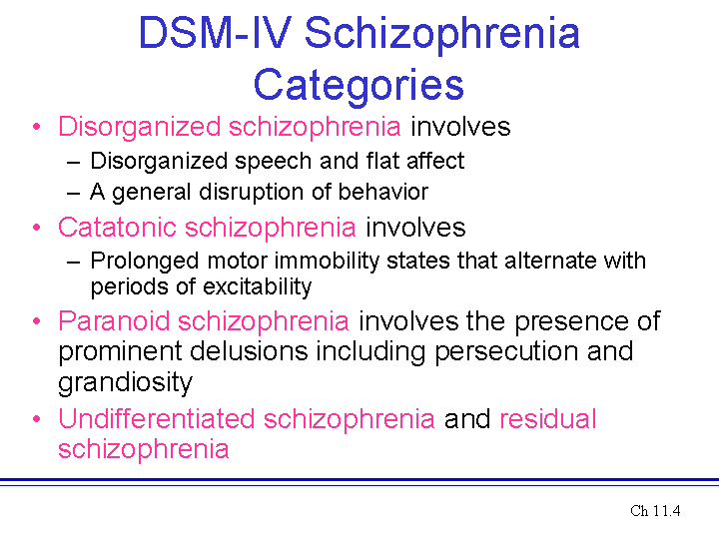

Slide 20
1]A person is able to clearly hear his own thoughts as if spoken to him. This is called:
A)1st person delusion
B)2nd person delusion
c)2nd person hallucination
D)1st person hallucination

Slide 21
2]Visual hallucination is mostly suggestive of:
A)Organic brain disorders
B)Schizophrenia
C)Bipolar Mood Disorder
D)Personality disorder

Slide 22
3]Which of following is not a good prognostic factor for Schizophrenia:
A)Presence of precipitating factor
B)Auditory hallucination
C)Young age of onset
D)Negative symptoms

Slide 23
4]A 45 year old female was diagnosed having schizophrenia she told that someone who is not visible is talking about her and always describing the thing what she is doing like commentator. what this phenomena is called?
A)Visual hallucination
B)1st person Auditory hallucination
C)2nd person auditory hallucination
D)Tactile hallucination

Slide 24
5]Delusion is a disorder of-
A)Thought
B)Perception
C)Insight
D)Cognition

Slide 25
Answer Key
1] – D
2] – A
3] – D
4] – C
5] – A

Slide 26
THANK YOU!

