Slide 1
HEAD INJURY
By Dr Lokesh kumar jain, under the guidance of Dr Dinesh Chauhan(HOD & Professor), Dept of Anaesthesia, SBKS MIRC.

Slide 2
World wide, Head injury is one of the leading cause of mortality and morbidity.
Despite new advanced in monitoring and treatment strategies, outcome in head injury patients remains very poor.
According to the Traumatic Brain Foundation(TBF), the use of evidence based protocols had reduced mortality from 50% to 25% over the span of few decades.

Slide 3
PATHOPHYSIOLOGY OF TBI
PRIMARY AND SECONDARY INJURIES.
Primary injury.- It is the initial Injury (physical or mechanical) on the brain parenchyma and skull, which leads to inflammatory cascade leading to cerebral edema, axonal injury and decreased CPP.
Secondary injury- It is consequences of primary injury, electrolyte abnormalities, hypoxemia, glycemic imbalance, hypotension, loss of autoregulation, increased ICP, hypocarbia or hypercarbia.
Patient outcome correlates with the severity of the primary injury. Rapid and efficient TBI stratification and management decreases effects of primary injuries and prevents secondary injuries.

Slide 4
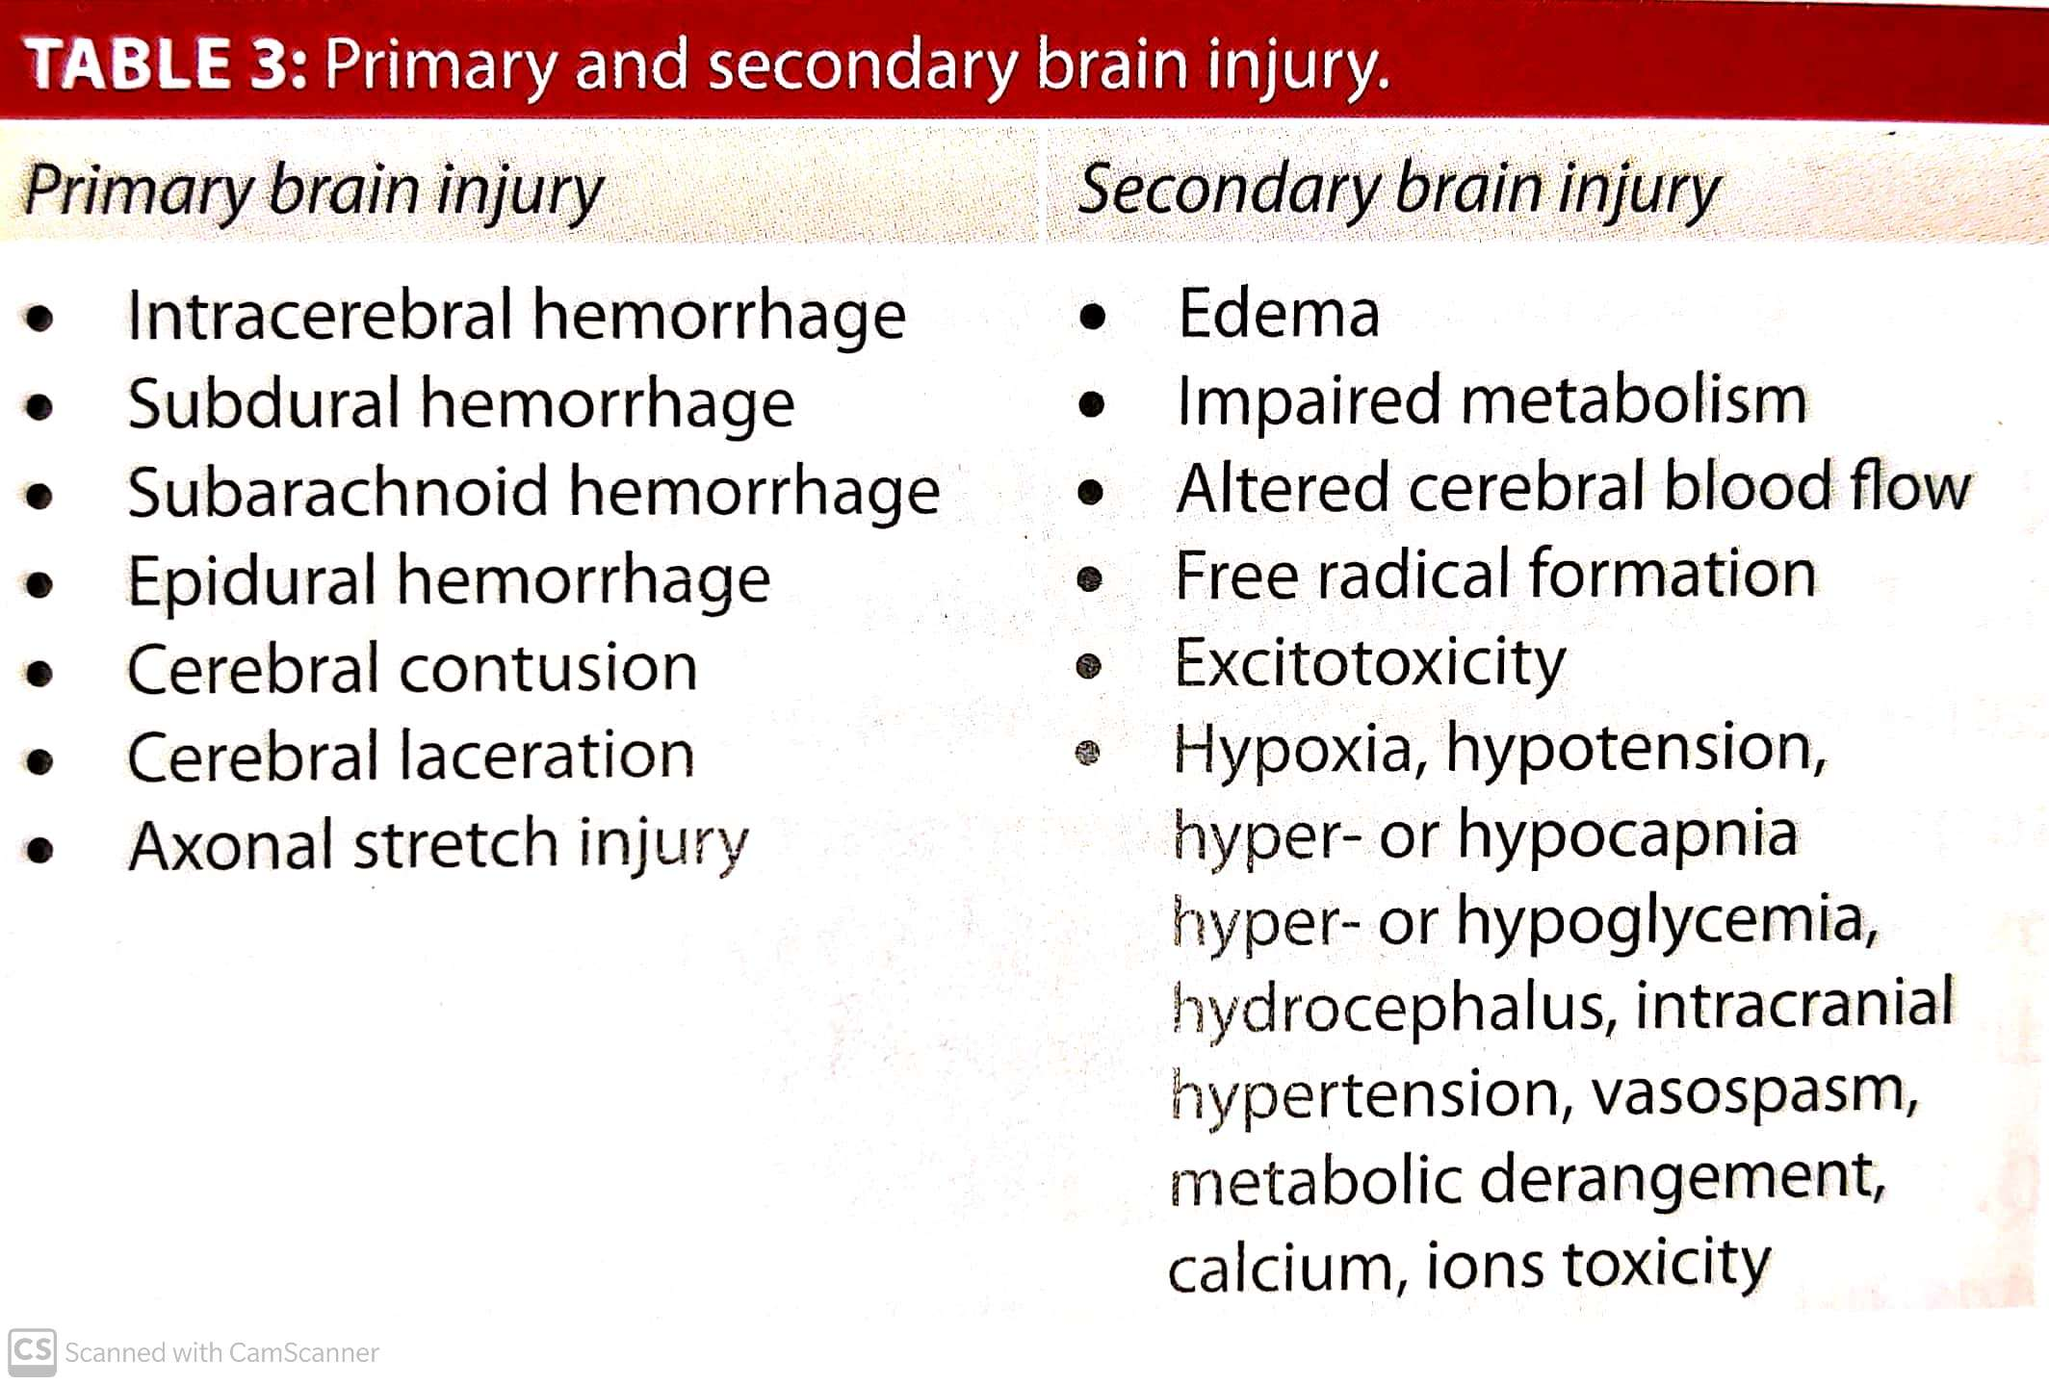

Slide 5
TBI may also be classified according to whether its blunt or penetrating.
Penetrating injury may vary depending on site , depth and energy, but is generally fatal if it bilaterally travers the mid brain.
Although initial mortality from penetrating is higher, outcome in survivors in both groups are similar.

Slide 6
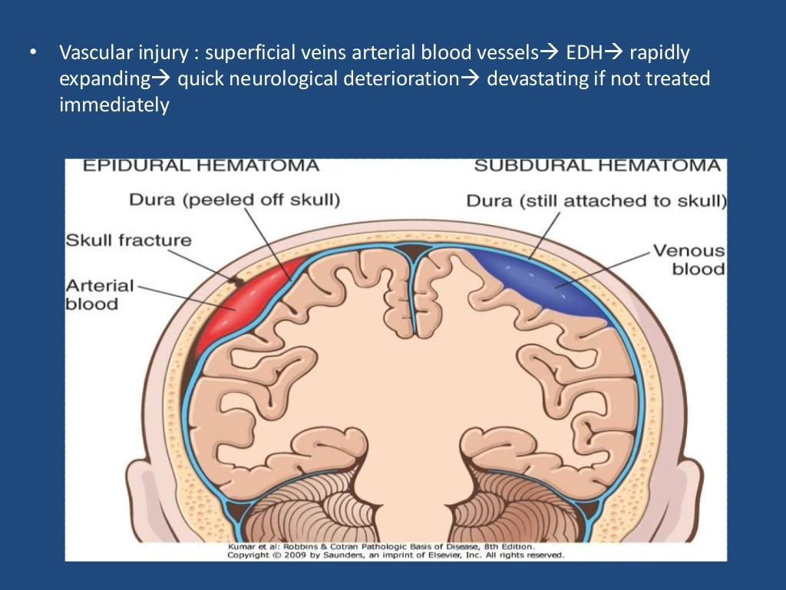

Slide 7
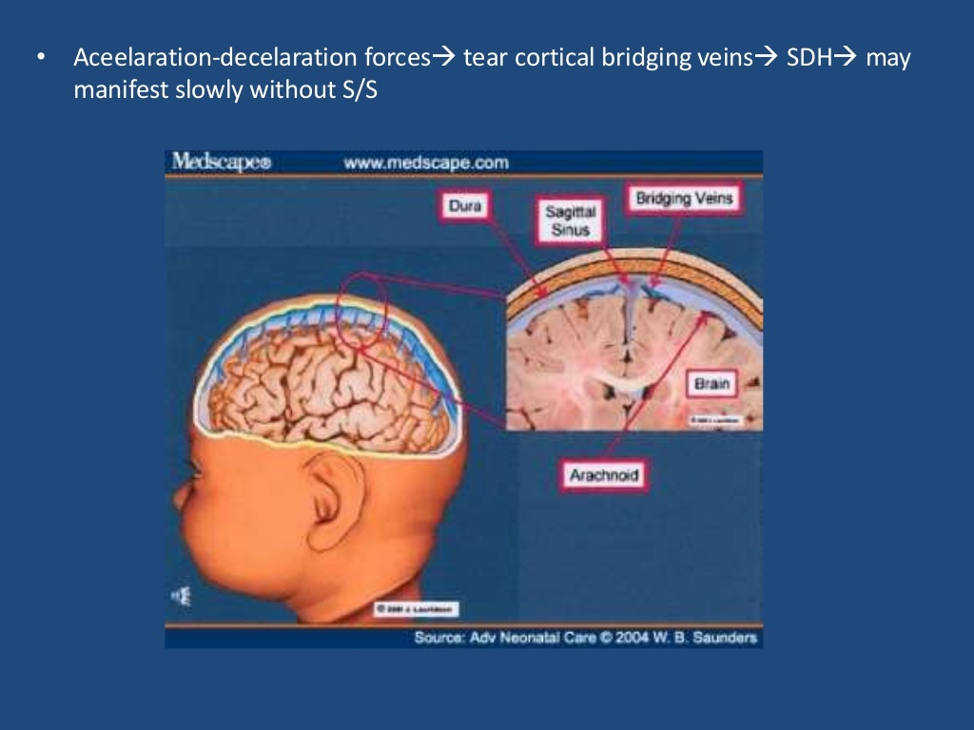

Slide 8
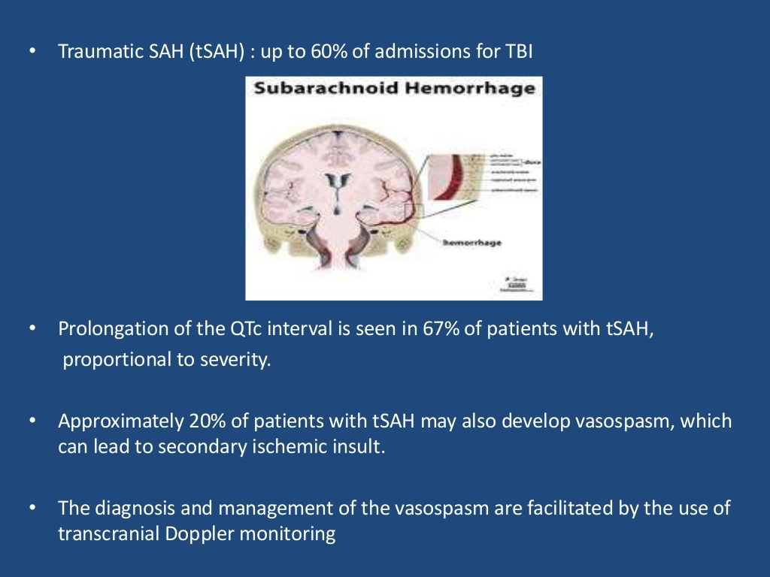

Slide 9
EVALUATION OF A HEAD INJURY PATIENT
Focused history and physical examination.
History taking should include the following:
Neurological state(consciousness, pupillary response) and vital parameters at the scene and during transport.
Estimated blood loss
Nature of treatment at scene and transit
Use of airbags, seat belts, crash helmets
Time ,place, mechanism, vehicle speed(in relation to accident)
Past medical history
Suspected influence of drugs or alcohol
Possible medical reason for the accident(ex: fits, heart attack, spontaneous ICH, stoke)
Use of anticoagulants /antiplatelet therapy.

Slide 10
Physical examination:
Careful airway assessment
Through neurological(baseline sensation, motor function and presence of new Focal and Deficits) – degree of TBI &CSI.
During first assessment:
Recognize critical signs of other trauma and related injuries such as bleeding, pneumothorax, cardiac tamponade etc.

Slide 11
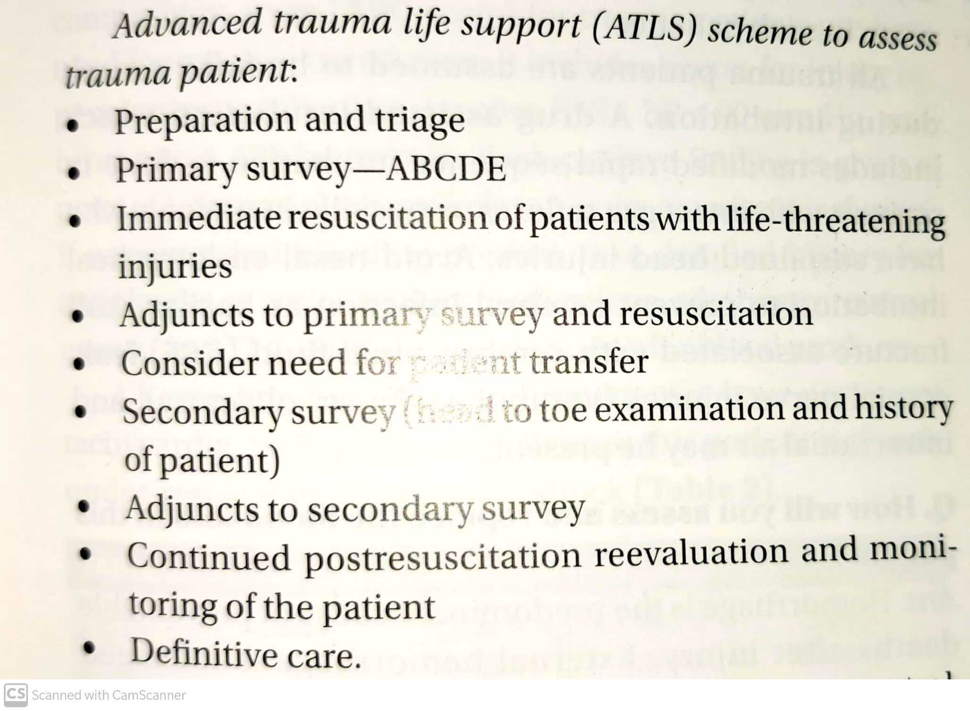

Slide 12
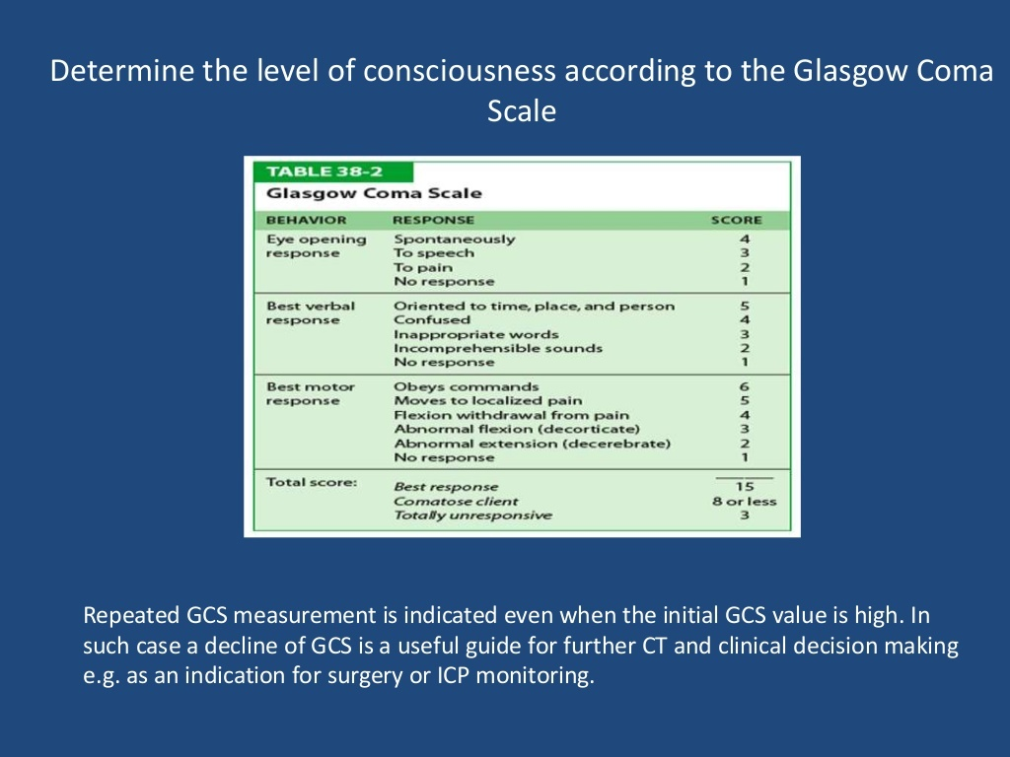

Slide 13
Mild brain injury(GCS 13-15)
Moderate injury (GCS 9-12)
Severe injury (GCS <8)

Slide 14
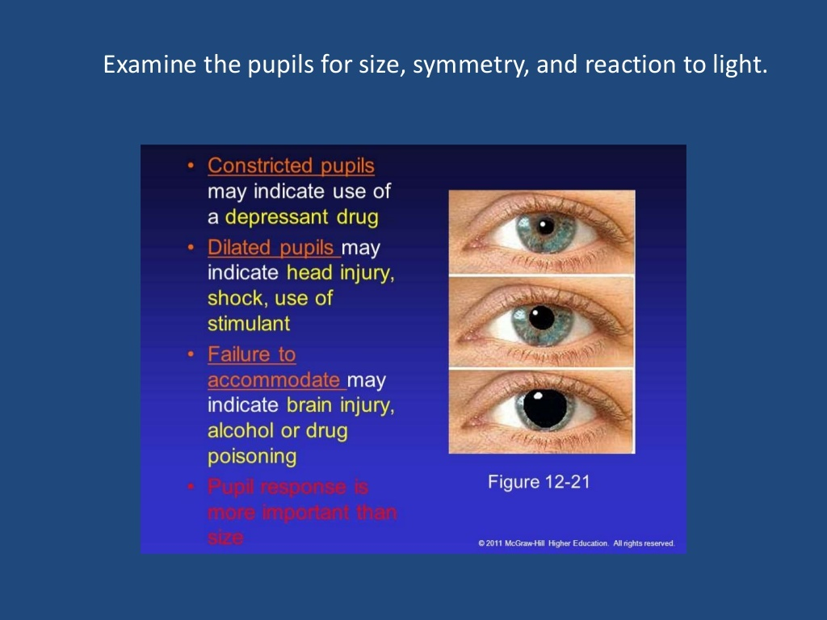

Slide 15
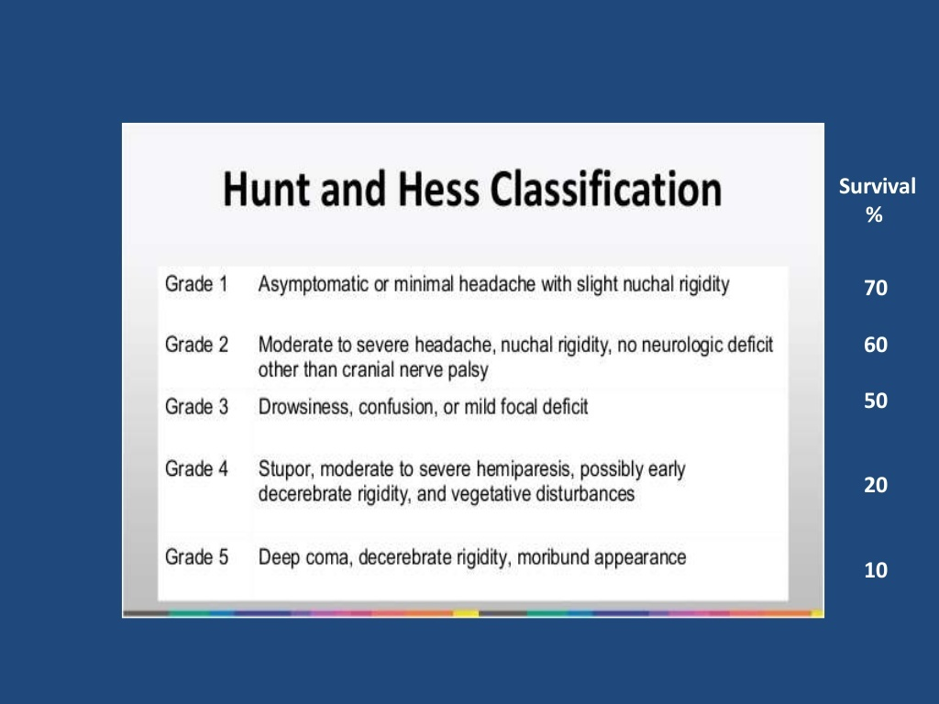
The Hunt and Hess scale is a grading system used to classify the severity of a subarachnoid hemorrhage based on the patient's clinical condition.
The scale ranges from a score of 1 to 5.
It is used as a predictor of prognosis/outcome with a higher grade correlating to a lower survival rate.

Slide 16
Cervical spine injury(CSI) after TBI
Early assessment of cervical spine integrity is essential to rule out a hidden cervical spine fracture, specially in a TBI patient.
Studies show correlation between CSI and poor GCS – Maintain a high degree of suspicion for CSI in a TBI patient with low GCS.
On examination of cervical spine look for
Tenderness along the spine.
A gap or step deformity in the continuity of the spine.
Other mass effect due to edema, haematoma or muscle spasm.

Slide 17
Imaging in CSI patients
Improves efficiency in treating TBI patients.
There are two well establishes guidelines for obtaining cervical spine radiographic imaging of TBI patients. The National emergency X radiography utilization study(NEXUS) and the Canadian C spine rule.
The NEXUS study concluded that a patient was at low risk for CSI if none of the following 5 critical criteria are present.
Low risk criteria for CSI(NEXUS) if following are absent.
Midline cervical tenderness
Focal neurological deficits
Altered mental status
Evidence of intoxication
Distracting injury present diverting attention from neck pain.

Slide 18
CANADIAN C- SPINE RULE
It is a clinical decision tool for cervical spine evaluation.
Here radiography is mandated if
Age >65 yrs
Dangerous mechanism of injury.
Paresthesia in extremities.

Slide 19
IMMEDIATE ASSESSMENT AND TREATMENT
Secure(or maintain) the patients airway.
Optimize the patients ventilation and circulation.
Initiate hemodynamic resuscitation and fluid administration.
Identify intracranial and extracranial injuries.
Prioritize of injuries
Collect information about the injury and relevant past history.
Continue to (re)assess patients consciousness.

Slide 20
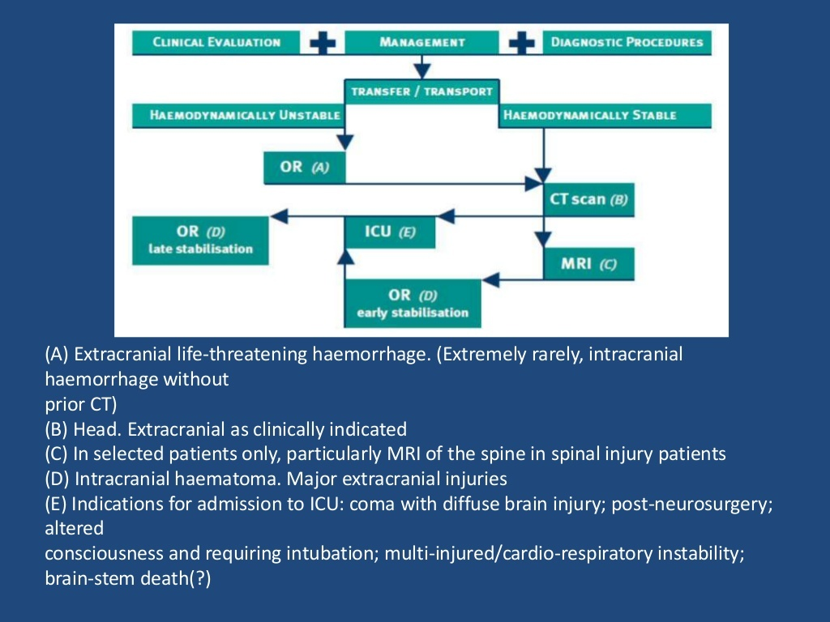

Slide 21
SECURING THE AIRWAY.
If radiological activity cannot be done,(hemodynamic instability or airway emergency) it is assumed to be unstable cervical spine until proven otherwise.
Prevention of further neurological injury is critical – Maintaining the spine alignment, protecting the spinal cord and stabilizing the cervical spine.
Cervical spine may stabilize the spine, interferes with Direct Laryngoscopy. So anterior portion of collar must be removed leaving the posterior portion of the collar.

Slide 22
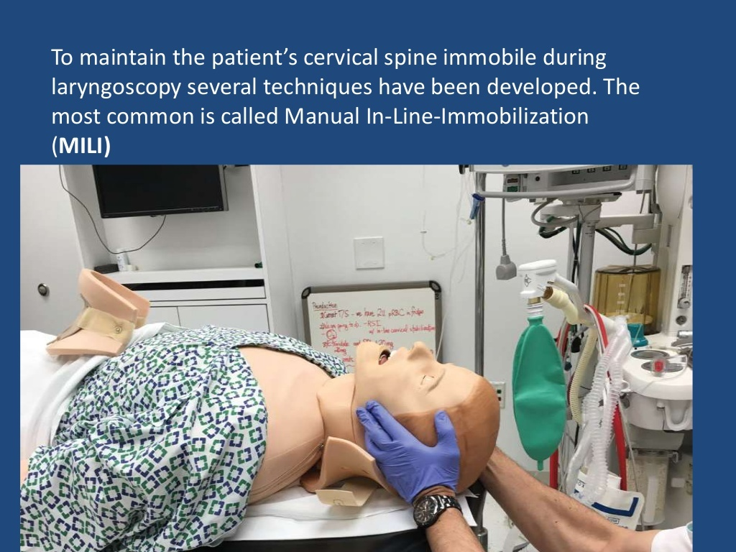
Manual In line Immobilization(MILI) TECHNIQUE.
The technique consists of hand cradling the occiput and with the tip of the fingers stabilizing the mastoid process.

Slide 23
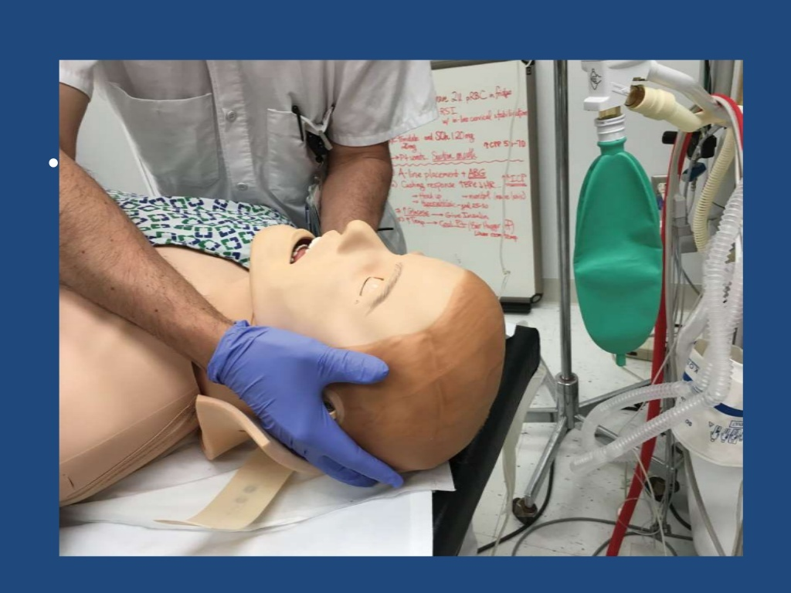
Alternatively, by standing at the side of a supine patient, an assistant can cradle the mastoid process and place his or her fingertips on the occiput

Slide 24
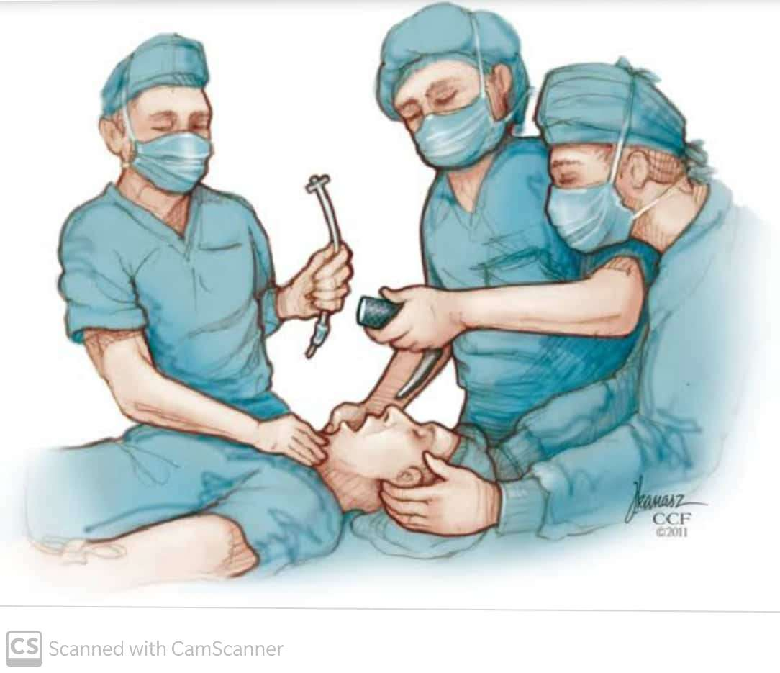
Another maneuver that can be used in combination with MILI, consists of the application of cricoid pressure, plus removal of the anterior half of the cervical collar and manual posterior cervical spine support.

Slide 25
The use of MILI has less impact obtaining a view of the vocal cords during laryngoscopy compared to immobilization with axial traction with a sandbag, tape, collar.
Many practioners prefered surgical airway or nasal intubation with flexible bronchoscope due to possibility of spinal injury during oral intubation.
COMPLICATIONS:
Suspected skull based fractures- E.T tube inserted blindly may find the path to brain.
Trauma to nares may lead to epistaxis – blocks view of vocal cords.
Therefore orotracheal intubation with RSI and direct laryngoscopy with MILI is the safest choice in such cases.

Slide 26
VENTILATION In Head Injury
Securing the airway has three major goals:
Prevention of aspiration of gastric contents
Prevention of hypercarbia
Prevention of hypoxia
Hypoxia and hypercarbia lead to increase of catecholamines which lead to vasodilation – increase ICP.
Hypoxia has direct correlation with poor outcome in head injury patients.
It is recommended to avoid PO2<60 with Spo2>90% in such paitents.

Slide 27
VARIOUS TYPES OF MONITORING
Temperature monitoring – lower oesophageal or tympanic membrane
ICP monitoring by placing intraparenchymal probe or intraventricular cathether and maintaining <20mm hg.
Cerebral oxygenation is measured by jugular venus oxygen saturation, PET, Near infrared spectroscopy, direct brain tissue oxygenation.
NG tube specially in bad facial injuries.

Slide 28
BLOOD PRESSURE MANAGEMENT
Cerebral perfusion pressure(CPP)= MAP(Mean arterial pressure)- ICP(Intra cranial pressure) .
Normal ICP= 5-13 mm hg.
If CPP decreases, the tissue oxygenation is further compromised.
Treatment should be focused on maintaining CPP within normal range and decreasing ICP.
Current recommendation is to maintain SBP>90 MM HG and CPP in between 50-70 mm hg to prevent further brain hypoxemia.
Brain tissue hypoxia is corrected by increasing Fio2, blood transfusion, ionotropic support and decreasing ICP.

Slide 29
Management of hypotension with vasopressor is common. The choice although is unclear.
Fluid resuscitation is the mainstay of therapy.(hypertonic saline is optimal)
Ideal medication to hypertension should be easily titrable and should not cause cerebral vasodilation which further leads to increase in ICP.
Commonly used anti hypertensive drugs are proparonolol, esmolol, labetolol, nicardipine.
Nitroglycerine, nitroprusside, hydralazine should be avoided.

Slide 30
IntraCranial pressure(ICP)
It is seen in head trauma, hydrocephalus, intracranial hemorrhage, sub arachnoid hemorrhage from ruptured brain aneurysm, intra cranial tumors, cerebral edema.
Normal ICP: 5-13 mm Hg.
S/S of ICP:
New onset of focal neurological deficits.
Decreased consciousness.
Inappropriate pupillary responses and vomiting.
Cardiac or respiratory arrest
Cushing’s triad of bradycardia ,hypertension and bradyapnea
Signs of brain herniation.

Slide 31
MANAGEMENT OF ICP
The brain trauma foundation (BTF)states that increased ICP>20 mm hg leads to increased mortality and poor outcome.
If ICP>20 mm hg, the fastest way to reduce is by draining CSF, from CSF drain if possible, but chances of infection is high.
Elevate the patients head and maintain a neutral position to improve venous return.
Slow administration of mannitol 0.25-1gm/ kg in stable patients over 15 minutes leads to ICP reduction, transient increase in oxygen transport and increase in CBF.
Hyperventilation can also be used to decrease ICP (maintain pco2 near 35mm hg ). Excess hyperventilation should be avoided as it leads to cerebral vasoconstriction and oxygen deprivation.

Slide 32
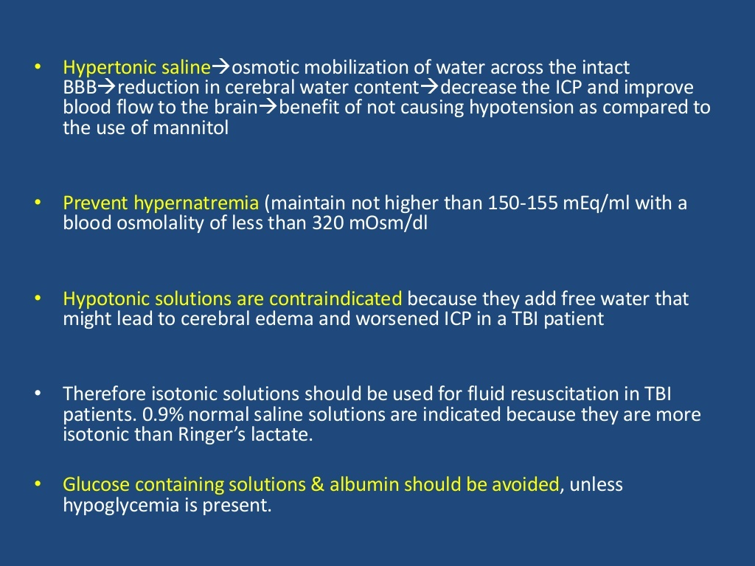

Slide 33
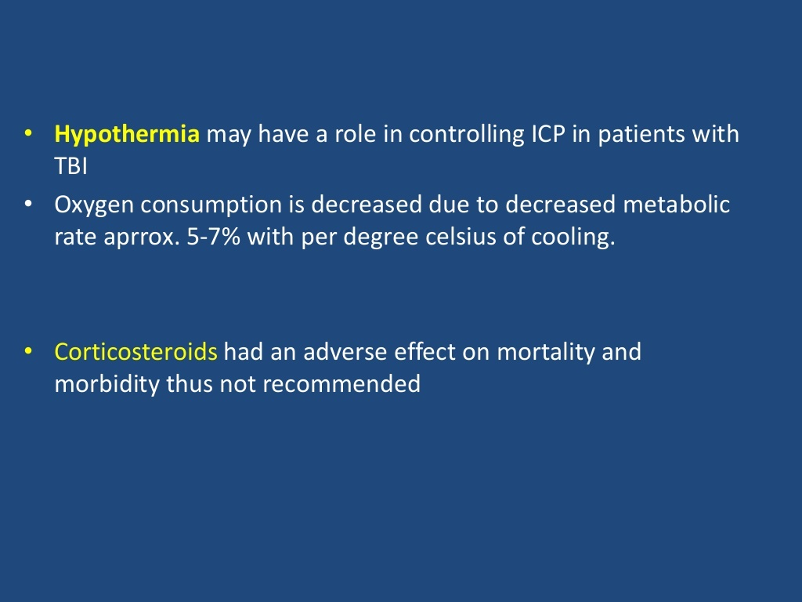

Slide 34
COAGULOPATHY AND HB LEVEL.
In cases of head injury, coagulopathy is seen through the systemic release of by products from neuronal death such as tissue factor and phospholipids which impairs coagulation and platelets function which leads to DIC.
It is exacerbated by colloid infusion.
Coagulation parameters should be measured immediately and if any abnormality is found should be treated immediately.
INR should be maintained in range up to 1.4
Platelets should be maintained above 75000.
Hb should be maintained above 7g/dl to prevent tissue hypoxia of brain cells.

Slide 35
Hemoglobin levels should be maintained at or above 7 g/dl to avoid a decrease in brain oxygen delivery.
No neurological improvement after traumatic brain injury at six months when utilizing erythropoietin and transfusion thresholds of 10 g/dl versus 7 g/dl.
Additionally, the risk for transfusion related reactions and infection increased with more liberal transfusion parameters; thus, treatment should be guided by clinical judgment and blood transfusion should occur if hemoglobin levels reach values below 7 g/dl.

Slide 36
Head injury patients may also develop acute endogenous coagulopathy(EAC) due to activation of protein c pathway.
EAC is characterized by anticoagulant derangement and hyperfibronlysis.
Also when multiple injuries are found and patient is unstable despite crystalloid infusion , balanced transfusion of blood products should be considered early.
Balanced transfusion involves use of plasma, platelets and packed red cells(1:1:1) with aim to effective reconstitute blood whole blood.

Slide 37
Glycemic control
The presence of hyperglycemia might produce an increase in neuronal metabolism and increase neuronal death after TBI.
These events occur due to increased tissue acidosis through
anaerobic metabolism,
the creation of free radicals,
increased blood brain barrier permeability.
Therefore the ideal blood glucose level should range from 80-180mg/dl.

Slide 38
Thermoregulation
Hyperthermia- it is important to remember that fever worsens the severity of brain injury by increasing cerebral metabolic rate.
Early hyperthermia after TBI has been found to be a possible predictor of paroxysmal sympathetic hyperactivity.
The BTF recommendation is to avoid hyperthermia and to maintain normothermia with antipyretics and surface cooling devices.
Hypothermia- it show improved outcomes in animal models, but not in human models.

Slide 39
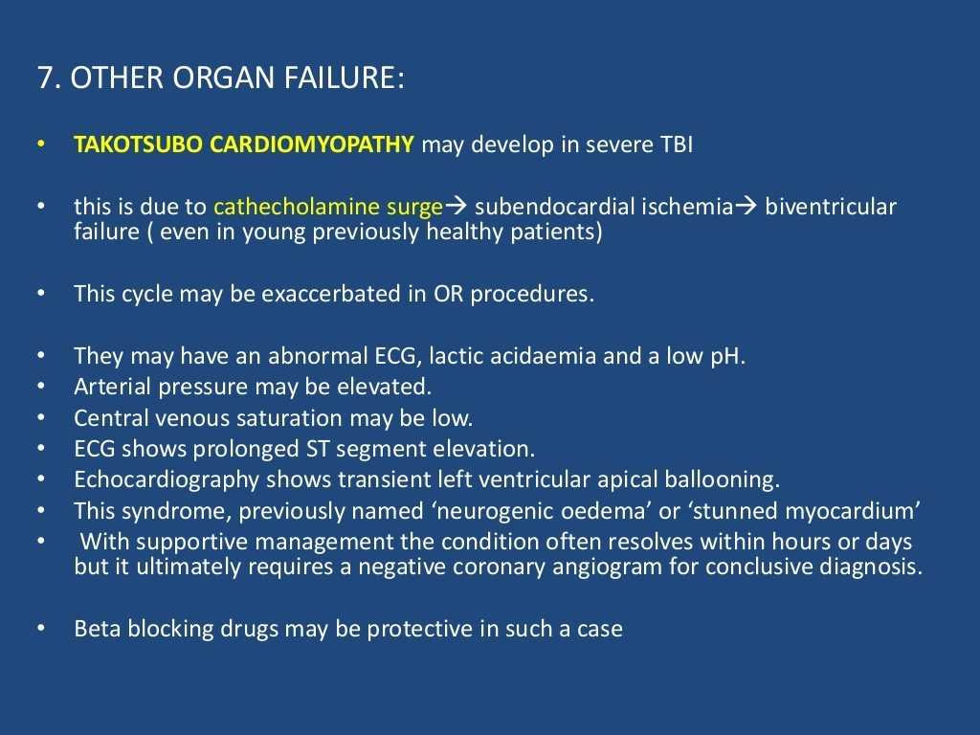

Slide 40
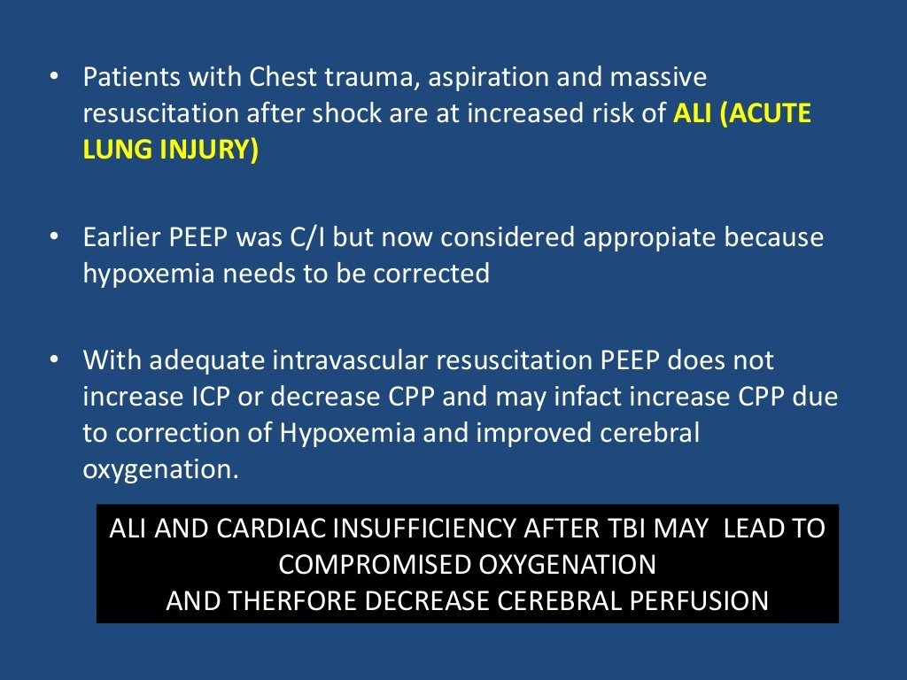

Slide 41
Preoperative management
Anesthetist should avoid hypercarbia, rationale the use of sedatives or hypnotic drugs such as BZD, Narcotics prior to induction of anesthesia.
Adequate pre oxygenation should be done as it is mainly difficult intubation due to emergent cases or unstable cervical spine status.
Prophylatic antiobiotic cover to prevent infection before induction.
Patient should be intubated by stabilizing the cervical spine in case of unknown etiology of the trauma.

Slide 42
Intraoperative management
Patient is usually induced using RSI with a combination of sedatives and low cardiodepressant effects( Midazolam, Propofol, ketamine), analgesic(fentanyl) and muscle relaxtion(succinyl scholine.)
Beside routine ASA monitors, its recommended to take arterial line and adequate intravenous access (ideally 18G)
If intravenous line is difficult, use of central line(femoral is preferred) as it prevents trendenburg positioning.
If it fails , intra ossessous approach in tibial or humerus is done.

Slide 43
Choice of Anesthetic Drugs
1. PROPOFOL
Propofol is indicated as a sedative agent in the TBI patient with a secure airway.
Advantage- quick onset and offset of action that facilitates neurologic assessment. Propofol might be beneficial in this group of patients, because it might decrease neuronal oxidative stress. The clinician should be aware of propofol’s sympathetic blockade resulting in hypotension.
Complication- propofol infusion syndrome. This condition occurs generally if propofol is delivered for more than 48 hours, at doses above 4 mg/kg/hr.
Propofol may be indicated in the treatment of refractory status epilepticus with a recommended starting loading dose of 1 mg/kg.

Slide 44
2. KETAMINE
ketamine had a deleterious effect in patients with increased ICP.
Early studies concluding that ketamine increased CBF and ICP were based on small sample sizes with higher than recommended induction doses. Recent studies do not show an increase in ICP after its administration.
The entire contrary, they reported potential benefits with the use of ketamine including, the blockade of reuptake of catecholamines, which can prevent hypotensive episodes by maintaining mean arterial pressure and cerebral perfusion pressure within normal range.
Ketamine should be avoided in hypertensive TBI patients due to the risk of further elevating blood pressure and consequently increasing ICP. In TBI patients with suspected elevated ICP and low-to-normal blood pressure, ketamine use might be indicated to preserve normotension during induction of anesthesia.

Slide 45
3. ETOMIDATE:
It is another appropriate induction agent choice in hemodynamically unstable patients.
It is important to remember that etomidate may cause a dose dependent inhibition of 11-beta-hydroxylase and 17-alpha-hydroxylase leading to adrenal suppression.
This complication can occur after a single dose and may cause maximal adrenal suppression 4 to 6 hours after its administration.
4. THIOPENTONE SODIUM:
It decrease the systemic hemodynamic response to intubation, blunt increases in ICP, and decrease the cerebral metabolic rate for oxygen (CMRO₂).
It cause cardiovascular depression leading to hypotension.
It has cerebroprotective action against regional cerebral ischaemia.
It is effective in refractory seizures.

Slide 46
Muscle relaxants
A rapid sequence induction is commonly performed in this group of patients.
Succinylcholine, is the neuromuscular blocking agent of choice for this purpose. Patients developed a transient increase in ICP. Despite this potential side effect, the benefit of its rapid onset and duration of action and the prevention of coughing during direct laryngoscopy greatly outweighs its negative effect.
If a clinician decides to avoid succinylcholine, then the administration of Rocuronium 0.9-1.2 mg/kg will achieve same intubating conditions like succinylcholine at 60-90 seconds, with this drug there is no transient increase in ICP however muscle paralysis might last for 30 to 40 minutes.

Slide 47
Opioids are used during induction of anesthesia to suppress airway reflexes, decrease required dose of induction agents and inhalation anesthetic maintenance as well as to blunt the sympathetic response to direct laryngoscopy.
Fentanyl, Sufentanil, and Remifentanil are commonly used in TBI patients.
Careful opioid titration should be observed to avoid hypotension secondary to a reduction in sympathetic tone and potential histamine release from these agents.

Slide 48
Maintenance of anesthesia
During maintenance of anesthesia, intravenous and inhalation anesthetics can be used safely in the care of TBI patients while observing the guidelines set by the BTF.
Intravenous anesthetics such as sodium thiopental, etomidate, midazolam and propofol decrease Cerebral Blood Flow (CBF), Cerebral Blood Volume (CBV), Cerebral Metabolic Rate (CMRO2 ) and Intracranial Pressure (ICP) under controlled ventilation conditions.
They achieve these effects by producing cerebral vasoconstriction and acting at the neurons’ GABA receptors to open chloride channels.
Dexmedetomidine, an alpha 2 receptor agonist, it exerts its effects in the locus coeruleus. Despite its sedative and anxiolytic action it preserves adequate respiratory function when compared with BZD or narcotics. This property makes it an ideal agent in the non intubated TBI patient.

Slide 49
Inhalation Anesthetics (IAs) produce a dose dependent increase in CBF called “uncoupling effect” that may lead to increase ICP.
This effect can be avoided by titrating IAs to levels below 1 Minimal Alveolar Concentration (MAC)
While nitrous oxide is the only inhalation anesthetic that produces an increase in CMRO2(cerebral metabolic rate of O2), the rest, isoflurane, sevoflurane and desflurane decrease CMRO2. Therefore, the use of nitrous oxide should be avoided in TBI patients.
BTF clinical guidelines should be followed while administering anesthesia to this group of patients, especially avoiding hypoxemia, PaO2 below 60 mmHg, oxygen saturation below 90%, hypercarbia and hypotension, (systolic blood pressure below 90 mmHg).

Slide 50
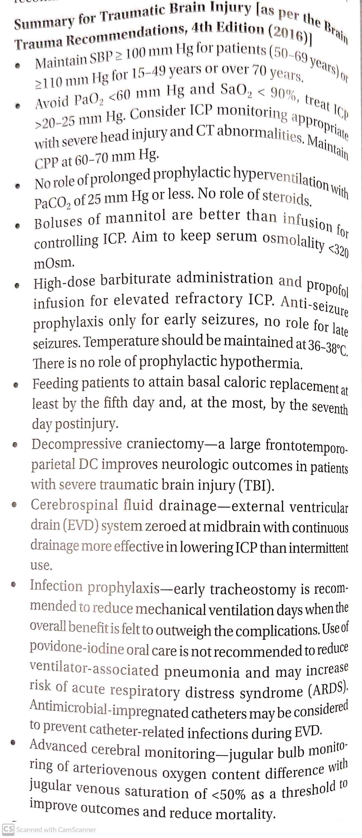

Slide 51
THANK YOU

