Slide 1
RENAL TRANSPLANT AND ANAESTHESIA
BY: Dr. Dharmishtha Chakarani
Under guidance of Dr. Malini Mehta Ma’am (professor in department of Anaesthesia)

Slide 2
Functions of the kidney
Regulate ionic composition of plasma
Maintain fluid volume
Elimination of nitrogenous wastes and drugs
Erythropoetin production
Maintenance of pH

Slide 3
The first kidney transplantations were performed in the 1950’s; however renal transplantation did not become widespread until the development of effective immunosuppression in the 1960’s.
The first description of anesthesia for kidney transplantation appeared in the early 1960s between identical twins.
The only monitors used then were a blood pressure cuff and electrocardiogram (ECG), and the recipient received spinal anesthesia.
Since then, kidney transplantation has become the most common organ transplant surgery performed.

Slide 4
Indications for Kidney Transplantation
All patients suffering from ESRD (CKD V) should undergo renal transplantation unless absolutely contraindicated.
Kidney transplantation is indicated in patients with chronic renal failure or more appropriately chronic kidney disease (CKD) refers to a decline in the glomerular filtration rate (GFR) caused by a variety of diseases such as diabetes mellritus (40%), hypertension (27%), chronic glomerulonephritis (13%), cystic kidney disease (3.5%), interstitial nephritis (4%) and other diseases such as obstructive uropathy, lupus nephritis and human immune deficiency virus.
Patients with GRF below 15 ml/min/1.73m2 ( often said to be have end stage renal disease ) are dependent on dialysis for survival until they receive a successful transplant.

Slide 5
Etiology of ESRD in Renal Transplant recipient
Total cases(%)
Diabetec glomerulonephropathy
Other glomerulonephritis
Polycystic kidney disease
Chronic pyelonephritis
Obstructive uropathy
Alport’s syndrome
Lupus nephritis
Miscellaneous including unknown
43.6
23.2
5.8
5.4
3.4
2.1
1.6
14.9

Slide 6
Contraindications:
Relative
Absolute:
age >70 years
Have an active infectious process,
Have cirrhosis, chronic liver disease or active hepatitis.
Are active substance abusers.
Have active tuberculosis.
COPD and whose risk for anesthesia outweighs the potential benefits of transplantation.
Severe diffuse atherosclerotic or CAD not amenable to surgical repair, CABG or PTCA.
LVEF of <20%.
Any psychosocial or behavioral abnormalities
Those who are morbidly obese (BMI > 35).
Uncontrolled malignancy
Active HIV infection
Life expectancy<2yrs due to other illness

Slide 7
Outcome
Kidney transplantation is the most important, cost effective methods of treating ESRD.
Confers a 40% to 60% decrease in the death rate compared with patients remaining on dialysis.
Current post transplant survival for adults is 96% for living donor kidney transplants and 90% for deceased donor transplants
The overall graft survival rate among cadaver kidney transplant recipients at 3 years is greater than 88%, and it is approximately 93% in recipients who receive a kidney from a living donor.

Slide 8
Clinical problems relevant to anesthesia for renal transplantation
1. Cardiovascular disease: The two main cardio vascular effects of CRF are arterial hypertension and ischemia heart disease. Patients receiving antihypertensive or antianginal treatment should receive their regular therapy as part of premedication.
2. Anemia: Normochromic, normocytic anemia of complex origin usually due to erythropoiesis, decreased RBC life span. At a Hb concentration of 6 to 8 g/100ml, the oxygen carrying capacity of the blood is about 50% normal. Anemia should be corrected before surgery.
3. Respiratory system: Pulmonary congestion and edema and pleuritis often are seen with a resultant hypoxemia and hypocapnia.

Slide 9
4. Acid-Base status and electrolyte imbalance: Patients with renal failure have an impaired ability to excrete water, electrolytes and free acids. The presence of a metabolic acidosis with its associated electrolyte disturbances ( hypothermia, hypochloremia, and hyperkalemia ) may cause problems with respect to the adequacy of reversal of residual neuromuscular blockade at the end of anesthesia.
5. Coagulation: Platelet dysfunction, decreased level of platelet factor III resulting in poor adhesiveness and thrombocytopenia shows no alteration in prothrombin or partial thromboplastin time, but the bleeding time is prolonged. Platelet transfusion and cryoprecipitate should be given to correct uremic coagulopathy.
6. Central nervous system: Peripheral neuropathies associated with postural hypotension and disequilibrium syndrome may be present with uremia.

Slide 10
7. Endocrine system: Diabetic nephropathy and uremic osteodystrophy may be present in these patients .
8. Gastrointestinal tract: Anorexia, nausea, vomiting, delayed gastric emptying and ascities. Patients are benefited with histamine H2 receptor antagonist as part of premedication.
9. Immune system: Due to immunosuppresersant drugs, sepsis remains a major cause of morbidity and mortality strict aseptic technique should be used for all invasive procedures.
10. Problems of dialysis: Main sequele are excessive or persistent heparinization, abnormal fluid shifts, β2 microglobulinemia, dialysis disequilibrium syndrome, hepatitis, HIV, leucopenia and hypocomplementemia.

Slide 11
Types of donor
Cadaveric kidney donor
Living donor

Slide 12
Guidelines: Donor Evaluation
Before donation, the live donor must receive a complete medical and psychosocial evaluation, receive appropriate informed consent and be capable of understanding the information presented in that process to make a voluntary decision. All donors should have standard tests performed to ensure donor safety.
Hypertension-Patients with BP > 140/90 mm of Hg are generally not acceptable as donors .
Obesity- Patients with body mass index >35kg/m2 should be discouraged from donating , especially when other co-morbid conditions are present.
Dyslipidemia – Dyslipidemia should be included along with other risk factors in donor risk assessment, but dyslipidemia alone does not exclude kidney donation

Slide 13
Acceptable donor renal function- GFR <80ml/min generally precludes donation. DTPA renal scan for GFR and renal angiography for the study of both kidneys ,urinary bladder and renal vessels are done in all cases
Urinalysis for protein- A 24 hour urine protein >30mg is a contraindication to donation
Urinalysis for blood- Patients with persistent microscopic hematuria should not be considered for kidney donation. Diabetes- Individual with a history of diabetes or blood sugar (F) >126mg/dl or (PP) 200mg/dl should not donate. Stone disease- An asymptomatic potential donor with history of single stone may donate if no hypercalcuria/cystinuria or no UTI. Malignancy- Usually excluded from live kidney donor.

Slide 14
Urinary tract infection- Donor urine should be sterile before donation.
Live unrelated donors- No restriction of live kidney donation based on the absence of an HLA match.
Determination of cardiovascular risk- Major/intermediate predictors of CVS risk as per AHA standards are contraindicated for donation. Minor predictors like old age, abnormal ECG , uncontrolled hypertension warrant individual consideration.
Assessment of pulmonary issues- Increased risk of post operative pulmonary complication is associated with FEV 1 <70% or FVC <70% of predicted or ratio of FEV1/FCV <65%.
Smoking cessation and alcohol abstinence- Smoking/alcohol should be avoided for a minimum of 4 weeks before donation to decrease risk of postoperative morbidity.

Slide 15
CADAVERIC KIDNEY DONATION
Kidneys are the last organs to be recovered in multiple organ recovery.
After the thoracic organs and liver have been retrieved, it is advisable that the kidney and pancreas are recovered en bloc and separated on the back table

Slide 16
LIVING KIDNEY DONATION
Higher success rates.
An assessment of the donor’s renal function by a nephrologist is mandatory in all cases.
Psychiatric evaluation of the donor’s motivation, fitness, and his ability to understand the risks of the operation.
ABO blood group & HLA matching is the initial criteria for donor selection

Slide 17
Exclusion criteria for living donors
Absolute contraindications
Relative contraindications
Age < 18 years
Uncontrolled hypertension
Diabetes mellitus
Proteinuria (> 300 mg/24 h)
Abnormal GFR compared to normal range for age
Microscopic haematuria
High risk of thromboembolism
Medically significant illness (chronic lung disease, recent malignant tumour, heart disease)
History of bilateral kidney stones
HIV positive
Active chronic infection (e.g., tuberculosis, hepatitis B/C, parasitic)
Obesity
Psychiatric disorders

Slide 18
Surgical techniques in living-donor nephrectomy
Classic transperitoneal approach, either through a midline, or through a left or right subcostal incision.
Sub-/supracostal extraperitoneal approach (left or right).
Dorsal lumbar approach, in which the incision can be performed either underneath the 12th rib, resecting the 12th rib, or above the 12th rib (extraperitoneal, extra pleural).
Laparoscopic approach, which can be either transperitoneal or retroperitoneoscopic.

Slide 19
ANAESTHESIA FOR LIVING DONOR NEPHRECTOMY

Slide 20
Donor is not going to be benefited from organ donation, so SAFETY is the prime
concern to the anaesthesiologist.

Slide 21
Living Renal Transplant
Considerations are for both donor and recipient.
- Surgery is done as an elective procedure either as open or laparoscopic donor nephrectomy.
- Preparation of both patients occurs months earlier, involving potential donor selection, optimization and assessment of both donor and the recipient’s medical condition
- A few days prior to surgery, induction of immunosuppressive therapy is initiated for the recipient
Donor
- Problems associated with laparoscopic surgery.
- Infusion of mannitol prior to warm ischaemia.
- Mode of analgesia either for open nephrectomy or laparoscopic.

Slide 22
Amount of fluid infusion and maintenance of appropriate perfusion pressure.
- Aim for urine output of more than 100ml/hour.
Special Considerations for Laparoscopic Donor Nephrectomy
- There are concerns regarding transient deterioration in renal function to recipient kidneys procured via laparoscopic technique.
- Laparoscopic Donor Nephrectomy poses different problems compared to open techniques due to the presence of pneumo-peritoneum and subsequent increase in intra-abdominal pressures (IAP).
- Raised IAP was shown to reduce renal blood flow (RBF), glomerular filtration rate (GFR) resulting in oliguria and the magnitude of this decrease is affected by IAP used, volume status and position.
- Various studies had suggested that collapsed venal system as a cause and vigorous fluid administration up to 2L/h was suggested.

Slide 23
the effect of different timings of fluid administrations and found that overnight hydration and subsequent intraoperative 13ml/kg/h crystalloid infusion, with 6 ml/kg bolus colloid infusion before anaesthetic induction AND before pneumoperitoneum resulted in better cardiovascular parameters and improved graft function.
- Besides volume of fluids infused, adequate perfusion pressure is paramount in the face of IAP. A mean arterial pressure amounting to the added IAP may be required during period of pneumo-peritoneum.
- Use of vasopressor (Ephedrine or Phenylephrine) should be avoided as far as possible but may be used as an interim measure to treat refractory hypotension in the initial stages of procedure. Single bolus will have a duration of action of up to 10 minutes but multiple ephedrine boluses could last up to 2-3 hours.

Slide 24
Recommendation
- Overnight hydration should be instituted at the start of fasting.
- Caution with induction doses of propofol especially for hypertensive donors.
- Volumes of up to 20 ml/kg/h is to be used intra-operatively.
- A minimum of IAP values to be added to of pre-operative Mean Arterial Pressure (MAP) as Perfusion Pressure during pneumo-peritoneum.
- Concurrent administration of 200ml of 20% mannitol after induction of anaesthesia to finish before arterial clamping

Slide 25
Pre-anaesthetic Evaluation
History
Physical examination
Laboratory investigations:
Complete haemogram
FBS/PPBS
Urea/Creatinine
Serum electrolytes
LFT
Coagulation profile
CXR
12-lead ECG
2D- ECHO

Slide 26
Goals of Anaesthesia
Stable hemodynamic
Avoidance of hypotension & hypovolemia
Elimination of surgical stress response
Maintain Renal blood flow
Maintain urine output 2ml/kg/hr
Excellent postoperative analgesia
Rapid and complete recovery.

Slide 27
Monitoring
Routine ASA standard monitors (NIBP, 3-lead ECG, ETCO2, SpO2, Temperature)
CVP monitoring (Used in some center)
Foley catheter for urine out put

Slide 28
Premedication
H2 blocker (inj Ranitidine 50 mg IV)
Inj Clonidine (1mcg/kg) in case of laparoscopic assisted nephrectomy
Inj Fentanyl (2mcg/kg) – Attenuate laryngscopy surge
Inj Glycopyrrolate
Preoperative hydration by balanced salt solution-BSS overnight before surgery

Slide 29
Induction
Avoidance of hypotension and laryngoscopy stress elimination is utmost goal.
IV induction by titrated dose of Propofol (2- 3mg/kg), Thiopentone (4-5 mg/kg), Etomidate (0.2-0.3 mg/kg) can be used.
Muscle relaxation achieved by either Succinylcholine (1-1.5mg/kg) or Rocuronium (0.9-1.2 mg/kg)

Slide 30
Maintenance of Anaesthesia
Endotracheal intubation with a cuffed ET tube and controlled ventilation to achieve a ETCO2 30- 40mmHg is technique of choice
Anaesthesia is maintained by O2-Air with inhalation anaesthestic (Isoflurane) or Propofol infusion 100-300 mcg/kg/min.
Analgesia is maintained by incremental dose of fentanyl (0.5mcg/kg).
Liberal fluid administration (10-20ml/kg/hr)
Heparin 100U/kg 5min before renal artery clamping

Slide 31
Position
Classic kidney position i.e. lateral position with the side to be operated up and a bolster below the flank

Slide 32
Methods to augment Renal Blood Flow
Avoid hypotension & hypovolemia
Attenuate surgical stress response (Regional supplementation may be considered)
Inj Mannitol 1-1.5gm/kg infusion during hilum dissection.
Inj Furosemide 20-40 mg iv (10 min before renal artery clamping)
Dopamine (0.5-3mcg/kg/min) infusion
Liberal fluid administration by Isotonic BSS

Slide 33
Reversal
Reversal of residual NMB done by Neostigmine+ Glycopyrrolate
Extubation done on OT table when patient awake, warm and calm and free from residual NMB.

Slide 34
Postoperative Analgesia
Thoracic Paravertebral block
Thoracic Epidual Analgeia
IV PCA by opioid
NSAIDs (ketorolca, diclofenac)
IV PCM (1gm TDS)

Slide 35
PRESERVATION OF HARVESTED KIDNEY

Slide 36
Kidney from living donor flushed with preservative solution or iced Ringer's lactate solution containing heparin and mannitol.
The cold ishaemia time in a living donor should be restricted to 20-30 minutes while the warm ischemia time should not exceed 3- 5 minutes.

Slide 37
BRAIN DEAD ORGAN DONATION

Slide 38
Most potential deceased donors are previously healthy individuals who have experienced brain death and do not have an extracranial malignancy or untreatable infection.
Less than 5% of deaths satisfy these criteria, and only 10% to 20% of these eligible subjects actually become organ donors.

Slide 39
Definition
Brain death is defined as the irreversible loss of function of the brain, including the brainstem.

Slide 40
Diagnostic criteria
Prerequisites. Brain death is the absence of clinical brain function when the proximate cause is known and demonstrably irreversible.
1. Clinical or neuroimaging evidence of an acute CNS catastrophe that is compatible with the clinical diagnosis of brain death
2. Exclusion of complicating medical conditions that may confound clinical assessment (no severe electrolyte, acid-base, or endocrine disturbance)
3. No drug intoxication or poisoning
4. Core temperature ≥ 32° C (90°F)

Slide 41
The three cardinal findings in brain death are coma or unresponsiveness, absence of brainstem reflexes, and apnea.
Brainstem Reflexes That Should Be Absent in Brain Death:
Pupillary response to light
Corneal reflex
Oculocephalic reflex (doll's eye response)
Oculovestibular reflex (caloric response)
Gag and cough reflex
Facial motor response

Slide 42
Managing cadaveric renal transplant recipient
Mainly revolves around the preparation of the recipient and their optimization.
short preparation time
High induction dose of immuno-modulative drugs to be started.
‘Cold ischaemic time’ (as defined as the time when the kidney is cooled with a cold perfusion solution and ends after the organ reaches physiological temperature during implantation procedures) as an estimate of a successful transplant, even though it is not always the case. The longer ‘cold ischaemic time,’ is usually associated with a higher incidence of delayed graft function.
All considerations for preparations for an emergency surgery.
Acid prophylaxis and aspiration risks.
Extent of acidosis and adequacy of dialysis.
Azotaemia and its correction.

Slide 43
Extent of Anaemia and the degree of decompensation.
- Cardiovascular system instability accentuated by the administration of anaesthetics. Up to 25% of all Chronic Kidney Disease patients are at risk of having diseased coronary arteries and a full cardiovascular system work-up should be done.
- Choice of mode of analgesic therapy.
- Electrolyte disturbances namely chloride, calcium and potassium due to the fluids infused or the disease process itself.
- Type and amount of fluids infused
- Hypothermia as a result of cold perfusion

Slide 44
Hypovolaemia and Hypotension post extraction during dialysis.
- Thymoglobulin infusion accentuates hypotension if given at high rates.
- Mannitol infusions and diuretics.
- Methylprednisolone infusion during anastomosis and its completion before reperfusion.
- Reperfusion of grafted kidney.

Slide 45
Goals of management ;
Initiation of early immunosuppressive therapy
Adequate volume as replacement for post dialysis extraction and fasting deficit
Adequate perfusion pressure
Avoidance of vasopressors as far as possible
Achieving a short ‘cold ischaemic’ time as possible

Slide 46
Intraoperative Management: Goals
Systolic blood pressure greater than 100 mm Hg (mean 70 to 110 mm Hg)
PO₂ greater than 100 mm Hg
Urine output greater than 100 mL/hr (1 to
1.5 mL/kg/hr)
Hemoglobin concentration greater than 100 g/L
Central venous pressure (CVP) 5 to 10 mm Hg
FIO₂ less than 40% (if tolerated) for lung retrieval
Glucose concentrations less than 200 mg/dL (or even <150 mg/dL)

Slide 47
Anesthesiologist
should use
urine output, and use
standard
monitors, measure
invasive measurements of arterial pressure and CVP (frequently with a pulmonary artery catheter).

Slide 48
Long-acting NDMR should be used for optimal intra-abdominal and intrathoracic exposure.
Bradycardia in brain-dead patients does not respond to atropine, so a direct-acting chronotrope such as isoproterenol must be readily available.
Patients declared brain-dead do not have pain perception, so analgesia is not required.

Slide 49
Volatile anesthetics or narcotics may facilitate hemodynamic stability.
The changes in HR and BP that may occur with surgical stimulation are the result of intact spinal reflexes.
Hemodynamic changes can be easily controlled with vasoactive agents.

Slide 50
ANAESTHESIA FOR RENAL TRANSPLANT

Slide 51
Preoperative Considerations
CBC, platelet count, electrolytes,
serum serum function
glucose, BUN,
creatinine, PT, aPTT, INR, liver
tests, urinanalysis, ECG, chest radiograph and 2D Echocardiogram.
Diabetic patients with ESRD are evaluated for the presence of coronary artery disease.
Dobutamine stress echocardiography-DSE may be considered in high risk cases

Slide 52
Monitoring
Standard ASA monitors
CVP measurement
ABP measurement in very high risk cases
AV fistula, if present must be taken care of

Slide 53
Premedication
Antisecretory agent (action unaltered in CKD)
H2 blocker (action unaltered in CKD)
Midazolam alteration,
(No pharamacokinetic increased sensitivity due to
pharmacodynamic alteration)
Metoclopromide (significant reduction in clearance and prolongation of the terminal half life)

Slide 54
Induction
Low albumin levels increase in free fraction
Uremia altered BBB increase the levels of unbound drug crossing the BBB into CNS
Dose of induction agents may need to be adjusted according to the volume status, acidic pH and increased sensitivity of the nervous system to these drugs

Slide 55
Thiopentone
elimination, increased
No change in distribution or
free drug due to
decrease albumin
Propofol higher dose is required (due to increase plasma volume)
Ketamine
elimination
Etomidate
elimination
No change in distribution or
No change in distribution or

Slide 56
Rapid sequence induction while cricoid pressure is method of choice hypotension
maintaining
Risk of
Patients with hypertension and CAD are at high risk of large fluctuations in HR and BP.
Short acting beta adrenergic blocker esmolol and short acting opioids like fentanyl, remifentanil have been effective for blunting the hemodynamic response to intubation.

Slide 57
Muscle Relaxant
Succinylcholine can be safely used (if K+ < 5 mmol/l)
When choosing a non depolarizing agent for maintenance, it is better to use ones that are independent of renal clearance mechanisms (Cisatracurium, atracurium, mivacurium).
Cisatracurium is the NMB of choice

Slide 58
Maintenance of Anaesthesia
O2+Air+inhalation anesthetic or propofol infusion is the choice
Isoflurane or desflurane is the choice
Transient impairment of renal concentrating ability and renal tubular injury in patients receiving sevoflurane and enflurane
Fentanyl, sufentanil, alfentanil and remifentanil are suitable for intraoperative pain control

Slide 59
Fluid Management
Postdialysis patients have intravascular volume depletion.
Appropriate volume amount is more important than the kind of fluid.
liberal hydration policy is employed intraoperatively.
The SBP is maintained between 130-160 mm of Hg, CVP between 10-15 mm of Hg and mean pulmonary artery pressure of 18-20 mm of Hg to optimize cardiac output and renal blood flow.

Slide 60
Crystalloids solutions are usually preferred to correct fluid and electrolyte imbalance
In situations of severe hypovolemia, colloids may be used.
Balanced crystalloids should be alternated with normal saline (0.9%) as large volumes of saline could lead to hypercholraemic acidosis.
Isotonic BSS maintains renal perfusion better than 0.9% NaCl.
Potassium containing soln. should be avoided.

Slide 61
Colloid in Kidney Transplant
All colloids can induce renal function impairment.
The mechanism for HES-induced renal dysfunction may be swelling and vacuolization of tubular cells and tubular obstruction due to the production of hyperviscous urine.
The risk of high plasma colloid osmotic pressure and subsequent renal dysfunction increases with repeated doses of highly concentrated, slowly degradable HES of high molecular weight and high degree of substitution.

Slide 62
HES compounds given at a maximum dose of
15 ml/kg/day to organ donors have no detrimental influences on graft function in kidneys
Treatment with HES needs to be accompanied by sufficient amounts of crystalloid solution.
Gelatin substitutes may be a safer option

Slide 63
Hypotension may occur after unclamping the iliac vessels and reperfusion of the graft.
It is critical that patient is well hydrated, as renal function is critically dependent on renal perfusion.

Slide 64
CVP may decline
25%-50%
1-2 hrs after
fluid
revascularization despite
aggressive
management, the cause may be redistribution of fluids, changes in vascular permeability or increased nitric oxide levels.
Increased hydration works by atrial distention and subsequent release of ANP and increased renal perfusion
Transfusion when required should be preferably
with packed cells that washed, leucodepleted,
are saline and
irradiated
cytomegalovirus negative.

Slide 65
Immediate urine production is seen in over 90% of living donor kidney and between 40%- 70% of cadaveric transplants.
Decrease in urine production at the latter stages of closure of surgical wound, a decrease in urine output strongly suggests mechanical impingement of the graft, vessel or ureter.

Slide 66
Mannitol in Renal Transplantation
Mannitol induces osmotic diuresis and also has a protective effect on the tubular cells of the transplanted kidney from ischemic injury.
Mannitol enhances the release of vasodilatory prostaglandins in the kidney and may act as a free radical scavenger.
250 ml of mannitol 20% given immediately before vessel clamp removal reduces the incidence of ARF, as indicated by a lower requirement of post- transplant dialysis

Slide 67
Loop diuretics in transplantation
Loop diuretics are thought to counteract the increased response of antidiuretic hormone to surgical stress
They exert their pharmacological effect in the ascending loop of Henle.
In kidney transplantation, Furosemide is commonly given during the vascular anastomosis to stimulate diuresis, although it is unknown whether it actually improves early function.

Slide 68
Only indication for loop diuretics is removal of fluid overload that is contributing to organ dysfunction in the lung and heart.
Loop diuretics in extended dosages may even be
harmful
disturb
for the kidney, because they may the protective corticomedullary
redistribution of blood flow.
There is no evidence that loop diuretics shorten the duration of ARF, reduce the subsequent requirement for dialysis, or improve outcomes in patients with ARF

Slide 69
Dopamine in Renal Transplant
low dose dopamine is commonly used to stimulate DA ₁ dopaminergic receptors in the kidney vasculature to induce vasodilatation and increased urine output.
Utility of this approach is questioned in that a newly transplanted, denervated kidney may not respond to low dose dopamine

Slide 70
Intraoperative Problems
Intraoperative Hypotension: Common problem in these patients. Causes are:
Hypovolemia
Acidosis
Myocardial dysfunction
Fistula effect of the grafted kidney
Release of inflammatory mediators from the ischemic limb

Slide 71
Excessive intraoperive bleeding
Causes are:
Platelet dysfunction
Desmopressin
(0.03IU/kg) of SDP infusion
Coagulopathy infusion
Acidosis
Hypothermia
Cause of bleeding should be confirmed by TEG
Cryoprecipitate or FFP

Slide 72
Post operative Care
All renal transplant patients should have muscle relaxants fully reversed, be extubated and taken to the postoperative recovery area.
Renal transplant patients generally have a low incidence of postoperative ICU admission— around 1%.

Slide 73
Immediate Postoperative Complication
Delayed reversal (Due to acidosis, hypermagnesemia)
Hypotension (Due to hypovolemia, acidosis)
Perioperative MI
Inadequate graft function
Pulmonary edema
Intractable nausea and vomiting
Excessive bleeding

Slide 74
Postoperative Pain Management
Postoperative pain is usually mild to moderate after kidney transplantation.
Choice of intraoperative anesthetic influenced postoperative pain control—patients who received propofol had better recovery of psychomotor function and used PCA more effectively than patients receiving isoflurane.

Slide 75
Patient Controlled Analgesia (PCA) with fentanyl or sufentanil is the choice.
NSAIDs are contraindicated.
Avoid morphine and pethidine.
Intercostal nerve blocks did not change the use of patient-controlled analgesia or pain scores after surgery

Slide 76
Role of Regional Anaesthesia
Risk of epiduaral/ intrathecal hematoma due to preexisting coagulopathy or platelet dysfunction.
Patient discomfort also prolonged surgery
Not preferred now-a-days.
a concern for

Slide 77


Slide 79
Donor kidney-
The number of living donors has exceeded that of cadaver donors because of low morbidity after kidney donation and availability of minimally invasive approach like laproscopic donor nephrectomy and the recent robotic hand assisted donor nephrectomy.
Living related donor transplant are performed electively with donor and recipient anesthetized simultaneously but in separate rooms.
The traditional approach is a subcoastal lateral incision.
The left kidney is preferred because of better surgical exposure and longer vascular supply.
Position is lateral with table flexed and kidney rest elevated.
One or two large peripheral venous lines usually suffice and invasive monitoring is not required.

Slide 80
To maintain good diuresis, fluid administration is generous (10-20 ml/kg/hr) using isotonic crystalloids intra operatively.
Loop diuretics and/or mannitol may be used to promote diuresis from the grafted kidney.
Mannitol improves renal blood flow, acts as a free radical scavenger and reduces the incidence of impaired renal function immediately after transplant.
Postoperative pain is usually mild to moderate and managed in most cases using intravenous opioids.
Deceased donor kidneys are preserved using hypothermia and pharmacologic inhibition to slow down metabolic processes.
Cold ischemia time should be kept below 36-40 hours in case of cadaveric donors often which the incidence of delay graft function increases significantly.
Kidney from living donor may be flushed with preservative solution or iced Ringer’s locate solution containing heparin and mannitol.
The cold ischemia time in a living donor should be restricted to 20-30 minutes while the warm ischemia time should not exceed 3-5 minutes.

Slide 81
Peri-operative management of Recipient patient :
Influence of renal disease on pharmacokinetics and pharmacodynamics of drugs used during anesthesia.
Many important changes occur in the uptake, disposition, metabolism and excretion of drugs given to patients with chronic renal failure, as follows:
1. Altered absorption of oral drugs due to gastric status.
2. Altered apparent volumes of distribution
3. Altered plasma protein binding and free drug fraction.
4. Altered drug and xenobiotic metabolism.
5. Altered drug elimination.

Slide 82
Preoperative assessment
Preoperative assessment should lead to optimization of any persistent serious complication, such as congestive heart failure, ECG abnormalities resulting from myocardial ischemia and autonomic dysfunction in patients with diabetes mellitus.
Patients maintained on hemodialysis usually undergo a dialysis session at some point during the 24 to 36 hour period before transplantation.
Predialysis and postdialysis weight and electrolyte status should be recorded.
Functional shunts or fistula should be protected carefully during surgery with sphygmomanometer cuff placed on other arm.
Immunosuppressive therapy (thymoglobulin) may be instituted during the perioperative period.

Slide 83
Premedicant drugs
Anticholinergic drugs- Atropine and glycopyrolate can be used as single dose.
Antacids and prokinetic drugs- H2-histamine receptor antagonists such as ranitidine and proton pump inhibitors such as omeprazole can be used safely. Metoclopromide is eliminated via kidney unchanged. Significant side effects may occur after its use hence should be avoided .
Benzodiazepines- Diazepam action is prolonged in chronic renal failure, however midazolam given slowly can be used

Slide 84
Anesthesia for kidney transplant:
General anesthesia with endotracheal intubation is the preferred anesthetic method for kidney transplantation.
The goals of anesthesia are to facilitate an adequate depth of anesthesia while maintaining hemodynamic stability and to provide appropriate muscle relaxation to facilitate surgical conditions.
Patients with ESRD are considered a risk for aspiration of gastric contents secondary to the presence of uremic gastropathy and other conditions, such as obesity and diabetes.
An oral nonparticulate antacid and intravenous administration of an H2 blocker, such as ranitidine, should be given before induction of anesthesia.
A rapid sequence induction of anesthesia with continous cricoid pressure is the preferred
Succinylcholine can be used safely in standard doses in patients with ESRD when potassium levels are within normal limits (usually method of induction for general anesthesia.
A modified rapid sequence induction with rocuronium 0.8- 1.2mg/kg intravenously is an appropriate substitute for succinylcholine when hyperkalemia or other contraindication to succinylcholine exists.

Slide 85
The hemodynamic response to laryngoscopy can be attenuated with supplemental fentanyl, esmolol, lidocaine or nitroglycerine titrated to effect.
Following the stress of tracheal intubation, kidney transplant patients may develop hypotension before surgical incision, especially in patients who have been rendered hypovolemic from recent dialysis or in patients receiving rennin-angiotensin blocking drugs.
Intraoperative monitoring consist of ECG, SpO2, central venous pressure and intra-arterial blood pressure monitoring.
Pulmonary artery catheter or transesophageal echocardiographic monitoring may be considered in patients with advanced CAD and pulmonary hypertension with ventricular dysfunction.
The insertion of a central line provides reliable venous access for intra vascular fluid resuscitation and transfusion and access for administration of immunosuppression drugs and vasoactive infusions.
Large bore venous access is necessary for appropriate intravascular volume administration in the perioperative period

Slide 86
Maintenance of anesthesia is performed using a combination of intravenous and inhaled anesthetics.
Isoflurane and desflurane are safe anesthetic agents.
Analgesia during intraoperative period can be provided with fentanyl, sufentanil and remifentanil, because their pharmacokinetics and pharmacodynamics are not affected by renal insufficiency.
Appropriate neuromuscular blockade during kidney transplantation is important for optimizing surgical conditions. Atracurium and cisatracurium are the muscle relaxant of choice in patients with ESRD. Both vecuronium and rocuronium have prolonged duration of action in renal failure patients.

Slide 87
The surgical procedure involves placement of the renal allograft usually in the right inguinal region.
The external iliac vein and artery are identified and mobilized.
Heparin may be administered before clamping of the vessels.
The external iliac vein is clamped first and the renal vein anastomosis is performed. During the anastomosis of the renal vessels, expansion of intravascular volume with normal saline should be initiated.
Furosemide and mannitol are administered before reperfusion to stimulate diuresis.
After completion of the vascular anastomoses, the donor graft ureter is implanted in to recipient bladder which is filled with antibiotic saline irrigation solution.

Slide 88
At the end of the surgery, the patient is reversed with neostigmine and glycopyrolate.
Extubation should occur after the patient demonstrates the ability to protect the airway.
After extubation, the kidney transplant recipient requires carefully monitoring in the post anesthesia care unit.
Close monitoring of the urine output in the initial post operative period is important.
The major post operative anesthetic complications are vomiting and pulmonary aspiration; cardiac arrhythmias, which can lead to cardiac arrest; pulmonary edema; hypotension and hypertension; and delayed respiratory depression.

Slide 89
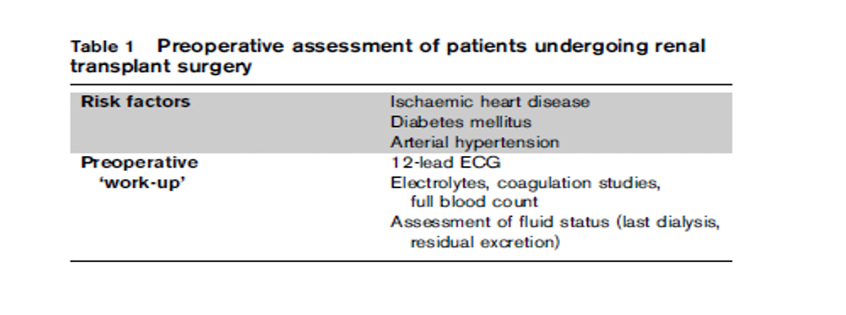
Summery

Slide 90
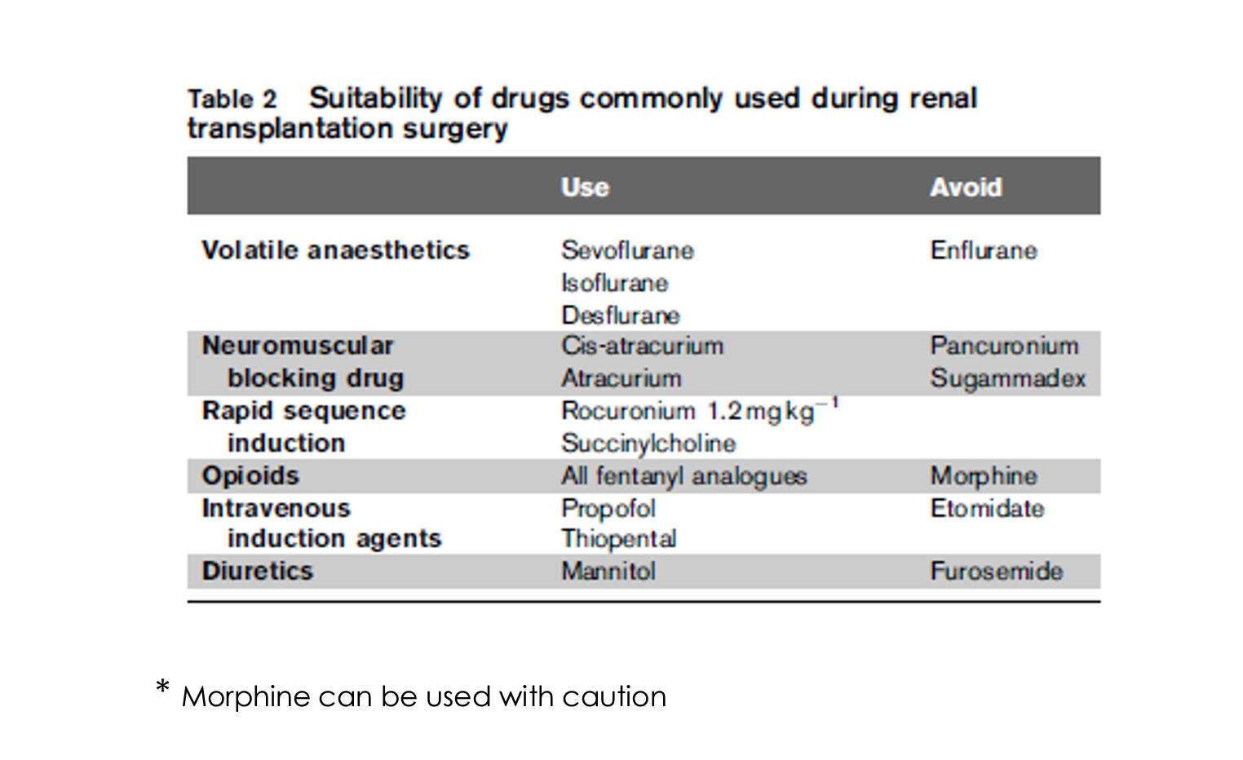

Slide 91
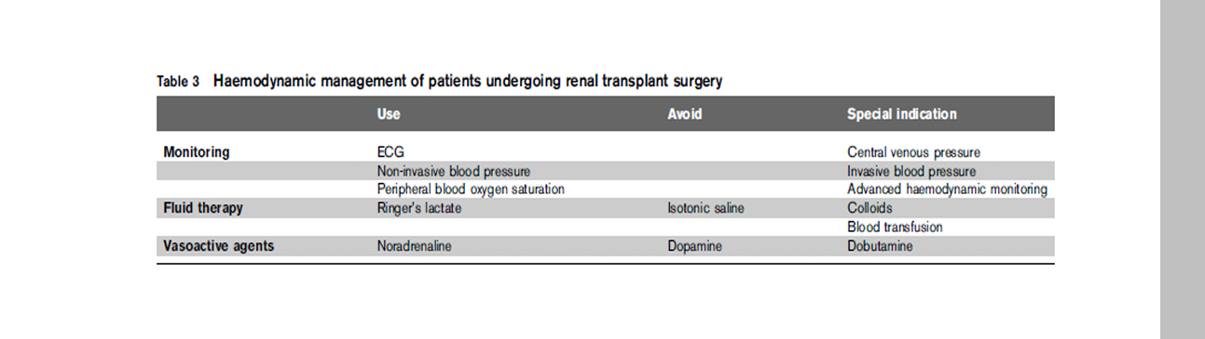

Slide 92
Thank you

