Slide 1

Anesthesia management for
Pituitary tumor
Dr. A. Anjali
Under the guidance of
Dr. Jayshri Desai mam

Slide 2

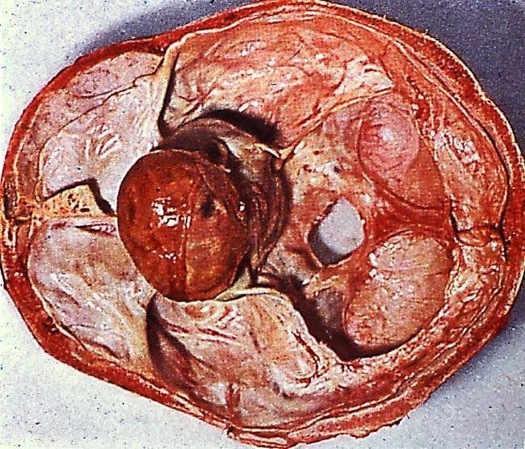

Pituitary adenomas are common, 1 in 1000

Benign

Slow growing, but can invade adjacent
structures( cavernous sinus)
Carcinomas : RARE

Slide 3
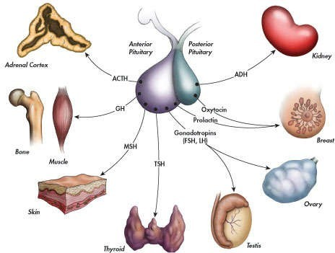
Pituitary Gland:
Master Endocrine Gland

Slide 4
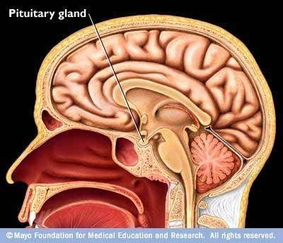
Cont.
Lies within pituitary fossa or sella turcica
Floor & anterior wall of sella – Roof of sphenoid sinus
Posterior wall – clivus
Lateral wall – cavernous sinus
Roof – Diaphragmatic sella

Slide 5
Hormones secreted
Anterior lobe (adenohypophyses)
-- Luteinizing hormone (LH)
-- Follicle-stimulating hormone (FSH)
-- Growth hormone (GH)
-- ACTH
-- Thyroid-stimulating hormone (TSH)
-- Prolactin
-- Melanocyte-stimulating hormone.
Posterior lobe:
-- Oxytocin—formed in hypothalamus
-- Vasopressin.

Slide 6
Most commonly adenomas—prolactinoma and nonsecreting adenomas
• Nonpituitary tumors—craniopharyngiomas
• Rathke’s pouch cysts
• Hyposecretion of hormones due to:
-- Tumor compression
-- Necrosis after postpartum hemorrhagic shock (Sheehans syndrome)
-- Head injury
-- Radiation/surgical/chemical hypophysectomy.
–– Order in which endocrine function lost (GnRH >GH > ACTH > TSH)
–– Endoscopicc endonasal approach has fewer nasal dental and cosmetic problems and
postoperative diabetes insipidus incidence.

Slide 7
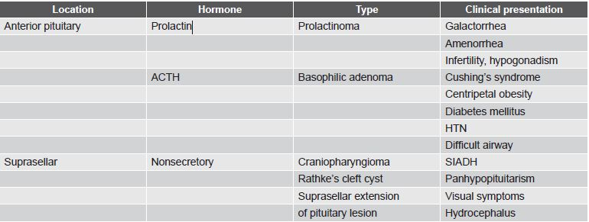
Hypersecretion of hormones

Slide 8
PREOPERATIVE ANESTHETIC CONSIDERATIONS
General
• Remote airway
• Raised ICP
• Oropharyngeal packing
• Use of submucosal epinephrine to decrease bleeding.
Acromegaly
• OSAS
• Hypertension
• Diabetes mellitus and glucose intolerance
• Increased ventilation-perfusion mismatch
• Peripheral neuropathy
• Skeletal muscle weakness
• Osteoporosis
• Poor ulnar collateral blood flow

Slide 9
• Difficult airway in Acromegaly is due to:
–– Dental malocclusion
–– Enlarged tongue and epiglottis
–– Thich pharyngeal and laryngeal soft tissues
–– Enlarged jaw
–– Thick vocal cords
–– Subglottic narrowing
–– Thyroid enlargement
–– Rarely RLN palsy.

Slide 10
Cushing’s
• HTN; Fragile skin
• OSAS; Perioperative steroid cover
• DM; Osteoporosis
• Obesity and GERD
• Raised intravascular volume state
• Increased infection
• Muscle weakness
• Electrolyte imbalance.
Correct hypothyroidism preoperatively

Slide 11
 | Type of Adenoma | Secretion | Pathology
 | Corticotrophic | ACTH,POMC | Cushing’s syndrome
 | Somatotrophic | GH | Acromegaly
 | Thyrotrophic ( Rare ) | TSH | Hyperthyroidism (asymptomatic)
 | Gonadotrophic | LH,FSH | Asymptomatic
 | Lactotrophic or Prolactinomas ( most common) | Prolactin | Galactorrhoea,hypogona dism, amenorrhoea, impotence, infertility
 | Null cell adenomas | No secretion

Slide 12
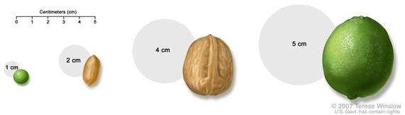
Classification:
By nature:
Benign,
Invasive adenomas,
Carcinomas
By activity:
Non functioning,
functioning
By size:
Micro adenoma, < 1cm,
Macro adenoma, > 1cm

Slide 13
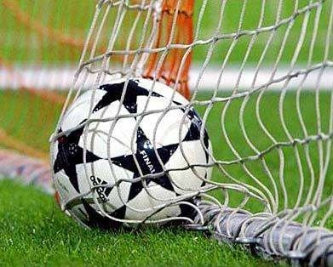
Goals of pituitary surgery:
To remove as much as tumor
as possible to relieve compression
& to eliminate hormonally active tissue
Avoid additional neurological damage
To protect healthy pituitary tissue

Slide 14
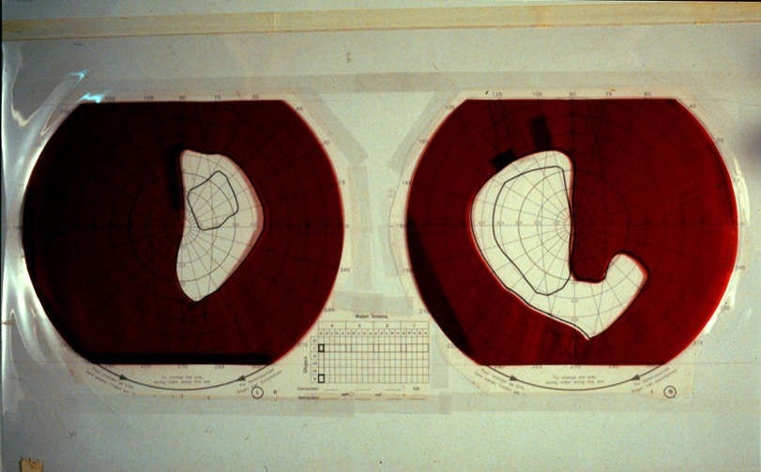
Pre operative assessment:
:-Visual function
:-Signs and symptoms of raised ICP
:-Endocrine studies, effects of hormonal hypersecretion
:-Co morbidities
- in acromegaly , Cushing’s syndrome

Slide 15
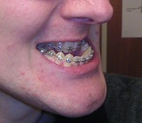
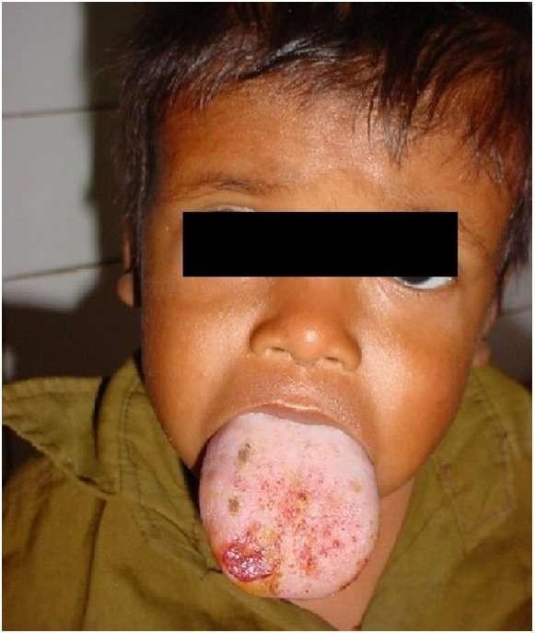
Anesthetic issues :
Anatomical changes:
Prognathism and macroglossia
thickening of the pharyngeal, laryngeal soft tissues, vocal cords
reduction in the size of laryngeal aperture
hypertrophy of periepiglottic folds
Recurrent laryngeal nerve palsy
enlarged thyroid: 25%

Slide 16
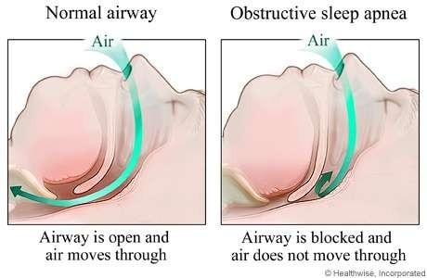
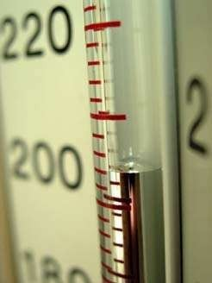
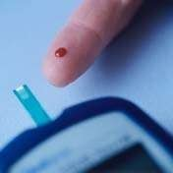
:- OSA

:- Hypertension

:- Glucose intolerance

Slide 17

Acromegaly
Increased skull size, enlarged lower jaw
Mal occlusion of teeth
Macroglossia, prognathism, thickened pharyngeal & laryngeal tissues
Hypertension, Cardiomegaly
Impaired LV function
Impaired Glucose tolerance
Proximal myopathy, difficult cannulation
Enlarged thyroid

Slide 18
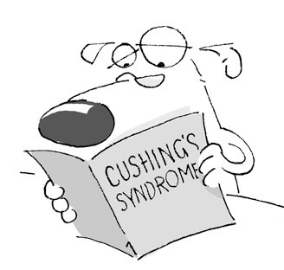
Cushing’s syndrome
Appearance
Impaired Glucose tolerance
Hypertension, ECG changes, LVH, ASH
Hypernatremia, hypokalemia, alkalosis
OSA, GERD
Proximal myopathy
Cannulation

Slide 19
Surgical approach:
S
• Under radiological control, surgeon enters sphenoidsinus
• Reaches pituitary fossa by removing bony floor
• After incising dura, tumor is removed and nasal packs inserted.
Trans sphenoidal approach
  Sublabial
  Endonasal
Trans ethmoidal approach
Trans cranial
  Subfrontal
  Pterional

Slide 20
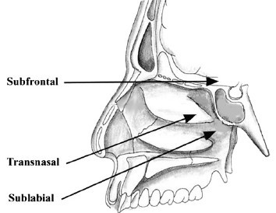

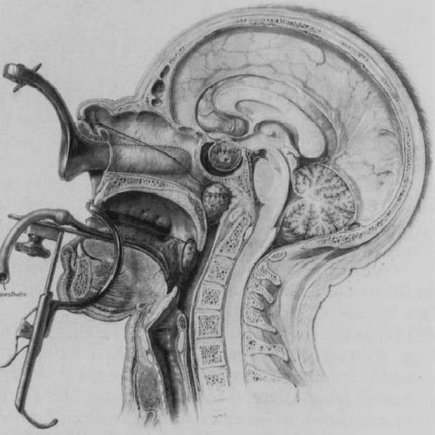
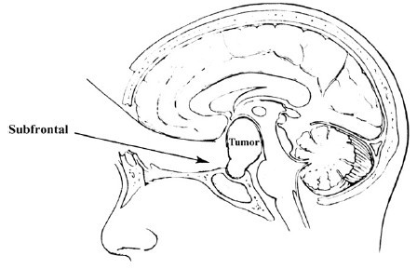
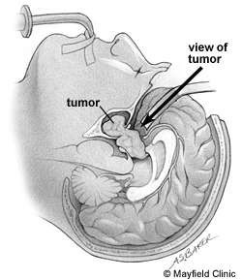

Slide 21
Preoperative Preparation
• Make note of visual disturbances and cranial nerve
palsies preoperatively
• Prophylactic antibiotic cefuroxime 1.5 g IV
• Bruising may occur on IV access
• Avoid sedation if difficult airway anticipated
• Antiaspiration prophylaxis:
–– IV metaclopramide 10 mg
–– IV ranitidine 1 mg/kg.
• Standard NPO guidelines and consent
• Train patient to breathe via mouth preoperatively.

Slide 22
Induction
• Thiopentone 3–5 mg/kg or propofol 1–2 mg/kg
with fentanyl 1–2 μg/kg and vecuronium 0.1 mg/kg
• Smaller size RAE tube used to minimize chances of
airway trauma
• RAE tube secured to lower jaw at corner of mouth
opposite surgeon’s dominant hand
• ETT fixed at left corner of mouth for right-handed
surgeons
• Small esophageal stethoscope and temperature
probe can lie with ETT
• Cover entire bundle with towel clipped below lower
lip to protect it from preparation solutions
• Fiberoptic intubation if difficult airway anticipated
• Throat pack placed to prevent blood accumulation
in stomach (vomiting) and glottis (coughing at
extubation

Slide 23
Anesthetic management
Hemodynamic stability
Maintenance of cerebral oxygenation
Facilitate surgical conditions
Prevent of intra operative complications
Rapid emergence to facilitate early neurological assessment

Slide 24
Preoperative Preparation
• Make note of visual disturbances and cranial nerve palsies preoperatively
• Prophylactic antibiotic cefuroxime 1.5 g IV
• Bruising may occur on IV access
• Avoid sedation if difficult airway anticipated
• Antiaspiration prophylaxis:
–– IV metaclopramide 10 mg
–– IV ranitidine 1 mg/kg.
• Standard NPO guidelines and consent
• Train patient to breathe via mouth preoperatively.

Slide 25
Induction
• Thiopentone 3–5 mg/kg or propofol 1–2 mg/kg with fentanyl 1–2 μg/kg and vecuronium 0.1 mg/kg
• Smaller size RAE tube used to minimize chances of airway trauma
• RAE tube secured to lower jaw at corner of mouth opposite surgeon’s dominant hand
• ETT fixed at left corner of mouth for right-handed surgeons
• Small esophageal stethoscope and temperature probe can lie with ETT
• Cover entire bundle with towel clipped below lower lip to protect it from preparation solutions
• Fiberoptic intubation if difficult airway anticipated
• Throat pack placed to prevent blood accumulation in stomach (vomiting) and glottis (coughing at extubation)

Slide 26
Vasoconstrictor (Moffett’s solution/Xylometazoline)
into each nostril to improve surgical access
• Lumbar drain placed if suprasellar extension
• Proper eye cover as exophthalmos increases chances
of corneal abrasion.
Monitoring
• SpO2: Nerve stimulator at lower extremity
• ETCO2: Temperature
• ECG: Urine output
• NIBP
• IBP—check status of collateral circulation
• Intraoperative visual evolved potential in surgeries
near visual pathway.

Slide 27
Ventilation
• IPPV with ETT
• If no suprasellar extension:
–– Modest hyperventilation to PaCO2 30–35 mm Hg
–– Decreases brain volume
–– Minimizes degree to which arachnoid bulges into sella.
• If supassellar extension present:
–– Normocapnea/hypercarbia which helps to deliver lesion into sella for excision.

Slide 28
Position
• Supine
• Slight head up tilt to avoid venous engorgement and venous air embolism.
Maintenance
• Valsalva maneuver after resection to check for CSF leak
• O2 + Air + Isoflurane + Remifentanil 0.05–2 μg/kg/min
• If suprasellar extension present, 10–40 ml saline/air injected via lumbar drain to increase intraventricular pressure and prolapse suprasellar part of tumor into surgical field
• Also air delineates brainstem from pituitary gland on fluoroscopy
• Mucosal surface of nose infiltrated with LA + epinephrine
• Watch during infiltration for arrhythmias
• Deep planes at time of incision, made under lower lip
• Deliberate hypotension facilitates repair.

Slide 29
Hemodynamics
• Blood loss less unless carotid artery/cavernous sinus ruptures
• If intraoperative diabetes insipidus occurs, fluid management is hourly maintenance fluid plus 2/3rd of previous hour urine output (1/2 NS or 5% Dextrose fluid of choice)
• If hourly fluid requirement > 350–400 ml, use desmopressin.

Slide 30
Extubation
• Fully awake extubation after full reversal
• Remove throat pack and thorough suctioning
• Extubate after return of spontaneous respiration and airway reflexes
• Smooth emergence especially if CSF space has been opened
• Avoid repeated Valsalva maneuvers (coughing, vomiting) which reopens CSF leak and increases risk of meningitis.

Slide 31
POSTOPERATIVE
Management
• CSF drainage via lumbar drain or 24–48 hrs if CSF leak occurs during surgery
• IV fluid maintenance
• Avoid vomiting—antiemetics.
Monitor
• SpO2, NIBP, ECG, Temperature
• Foley’s catheter and urine output
• Electrolytes and serum osmolarity.
Analgesia
• Morphine 0.1–0.2 mg/kg is Analgesic of choice
• Avoid high-dose opioids—sedation causes airway obstruction.

Slide 32
Complications
• Hemorrhage from cavernous sinus/carotid artery
• Postoperative hematoma:
–– Presents as postoperative visual defects/changes in mental status
–– Tight surgical packing of sella causes backward pressure on brainstem and optic nerve.
• Diabetes insipidus:
–– If damage occurs to posterior lobe of pituitary
–– Usually occurs within 4–12 hrs postoperatively and is transient
–– Suspect if > 1 L dilute urine (Specific Gravity < 1.005) within 12 hrs
–– Associated with plasma sodium concentration > 143 mEq/L
–– Plasma osmolarity >295 mosm/kg with urine osmolarity < 300 mosm/kg with high urine output ≥ 2 ml/kg/hr confirms diagnosis.

Slide 33
other complications
Venous air embolism
• Cranial nerve palsies
• Aiway obstruction:
–– Especially if preoperative OSAS
–– Occurs due to nasal pack which usually stays for 24–48 hrs
–– Obligate oral breathing required which may not be adequate if patient has upper airway obstruction due to large tongue/increased pharyngeal soft tissues
• SIADH, hypopituitarism
• CSF leak, meningitis, headache, PONV.

Slide 34
Cont:
Airway management:
4 grades described in acromegaly:-
Grade 1 – No significant involvement
Grade 2 – Nasal & pharyngeal mucosal hypertrophy with normal glottis
Grade 3 – Glottic stenosis or VC paresis
Grade 4 – Glottic & soft tissue abnormalities
.

Slide 35
Cont:
Throat pack
Preparation of nasal mucosa
Lumbar drain (in patients with significant suprasellar extension )
Position

Slide 36
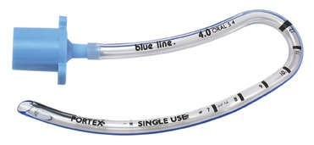
Maintenance:
Any technique suitable for intracranial procedures
Extra cautious in presence of raised ICP
Short acting agents
Normocapnia
RAE tube south

Slide 37
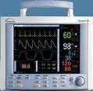
Monitoring:
Standard
ABP
Filling pressures
( Cushing’s disease )
VEP ( Visual evoked potential )
PNS

Slide 38
Emergence from anesthesia
Smooth and rapid
Removal of pack, pharyngeal suction
Extubation in a semi seated position

Slide 39
Operative complications:
False aneurysm ( Rx: endovascular / clipping )
Damage to pons( minimised by frequent fluoroscopy)
In transcranial:
Frontal lobe ischemia- prolonged traction Seizures ( subfrontal )
Anosmia ( olfactory tract damage )

Slide 40
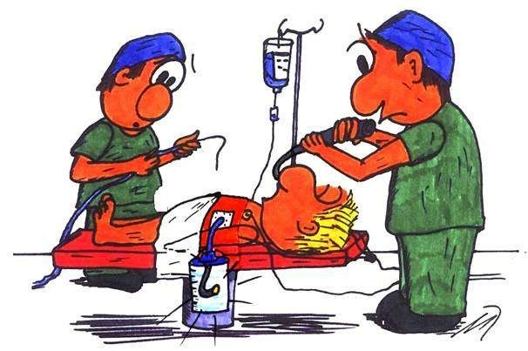
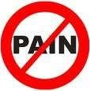
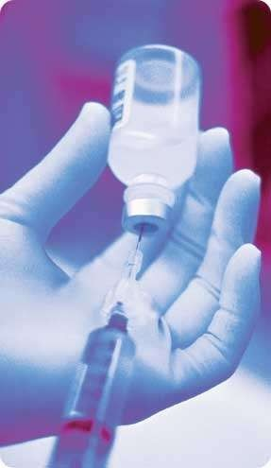
Post op care:
Airway management
Analgesia
Hormone replacement

Slide 41
THANK YOU

