Slide 1
ANAESTHESIA FOR MICROLARYNGEAL SURGERY
By – Dr. Gayatri Vasagadekar
Under the guidance of – Dr. Jatin Patel

Slide 2
INTRODUCTION
Advances and demands of the new surgical techniques and an expanding patient population that was previously considered unsuitable for surgery have created novel challenges for the anesthesiologist.
Anesthesia and airway management for laryngeal surgery require the anesthesiologist to be adept with various methods of managing the difficult airway and performing airway exchange, to competently execute intraoperative ventilation strategies, to be proficient with inhalational and total intravenous anesthesia, and to quickly tailor anesthetic techniques to the various durations of the surgical cases.

Slide 3
The expert ability to safely share the patient’s airway with the surgeon, in conjunction with an good knowledge of possible immediate intraoperative and early postoperative complications of laryngeal surgery, greatly contributes to safe patient management in the perioperative period.
Patients for DL-scopy and micro-laryngeal surgery are posted for the procedure for diagnostic or therapeutic purposes. They may present with hoarseness of voice, change of voice, difficulty in breathing, and inspiratory or expiratory stridor. These patients may have associated congenital and acquired conditions other than airway disease, such as smoking-related pulmonary conditions, hypertension, ischemic heart disease, endocrinopathies like diabetes mellitus and thyroid diseases, and cardiac anomalies.

Slide 4
The main anesthetic considerations are as follows:
Adequate preoperative evaluation and optimization
Maintaining adequate depth of anesthesia intraoperatively to maintain stable hemodynamics in a still patient.
To share the airway in such a way to give good visualization to the surgeon so as to diagnose the pathological conditions
To give enough time to the surgeon to diagnose and treat the airway diseases
Protection of lower airway from blood and debris.
Postoperative monitoring and early recovery to fast track the patient.

Slide 5
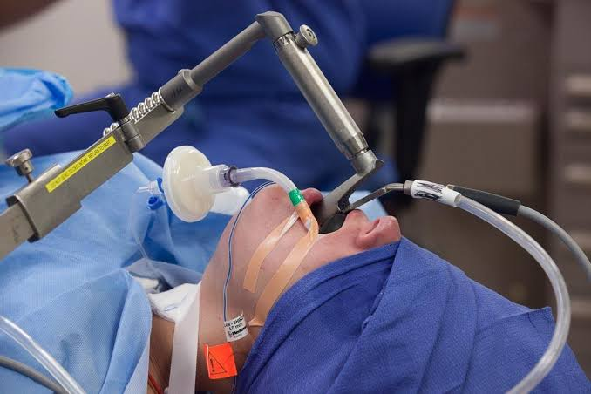
MICROLARYNGEAL SURGERY

Slide 6
PREOPERATIVE EVALUATION
A thorough medical evaluation is necessary for all patients requiring anesthesia. These patients may present with history of hoarseness of voice, voice change (low pitch, coarse fluttering – subglottic/ high pitch, cracking voice, aphonia – glottis), stridor (inspiratory or expiratory). Patients may present with dysphagia. History of previous endoscopic procedures and their outcome is very important. When the lesions occur in or near the airway, there is possibility of life-threatening airway obstruction during the induction of anesthesia. Also, because of manipulation, the airway lesions can cause bleeding or edema, which results in airway occlusion.
The difficulties may occur during intubation of trachea. Hence the oropharynx should be evaluated carefully. The range of motion of neck should be examined carefully to assess difficulties with airway management.

Slide 7
The radiological investigations and records, such as CT scan, MRI, X-ray will help to assess the potential difficulties in securing the airway and endotracheal intubation.
Microlaryngeal surgery encompasses a wide range of laryngeal procedures that can be organized in two broad categories: phonomicrosurgery (i.e., benign and malignant vocal cord lesions, laser laryngeal surgery, and vocal cord augmentation) and laryngeal framework surgery (i.e., vocal cord paralysis and motion disorders, scarring, stenosis of the glottic, subglottic, and tracheal areas, and laryngeal trauma).

Slide 8
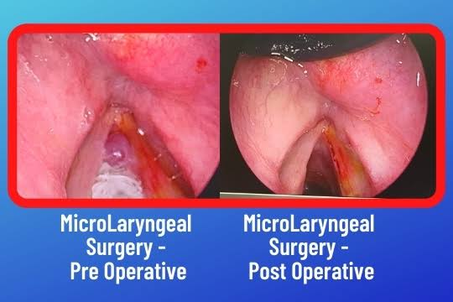
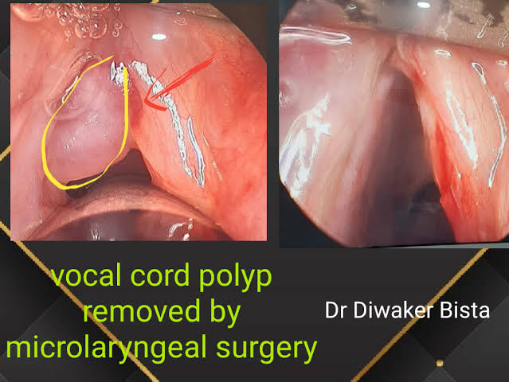

Slide 9
AIRWAY MANAGEMENT FOR MICROLARYNGEAL SURGERY
In contrast to direct laryngoscopes used by the anesthesiologists, which are designed only to identify the glottic opening, operating laryngoscopes can provide excellent and wide laryngeal exposure and allow diagnostic examination, biopsy, and operation on structures in the larynx and pharynx, with minimal distortion of the areas of surgical interest.
The handles of these laryngoscopes are integrated with the blades and have a wide proximal aperture that facilitates the passage of instruments during suspension laryngoscopy.
Many types of laryngoscopes exist, each offering certain advantages for its intended application, such as the ability to better expose supraglottic, glottic, or subglottic areas.

Slide 10
With the use of these laryngoscopes, systematic endoscopy of the larynx and pharynx frequently proceeds in three stages, progressing from handheld examination to suspension laryngoscopy and then to microlaryngoscopy using the operating microscope for image magnification, biopsy, microsurgery, or laser surgery.
Patients presenting for diagnostic direct laryngoscopy and microlaryngeal surgery frequently have a difficult airway.
Video laryngoscopy reliably improves laryngeal exposure by at least one grade, allows continuous observation of the entire intubation procedure by the entire team, and may therefore be a near-ideal technique for managing difficult airways in patients presenting for microlaryngeal surgery.

Slide 11
Although advanced airway management techniques can be highly successful when direct laryngoscopy fails, the patient’s unfavorable anatomy may not be modifiable for the surgical exposure, which requires the use of the largest operating laryngoscope and placement of the patient’s head in the Boyce-Jackson position using a combination of cervical flexion and atlanto-occipital extension.
If suspension laryngoscopy fails or if the location of the lesion is not easily accessible, it can be performed, to the extent microlaryngeal surgery permits, with the help of the flexible fiberoptic bronchoscope (FFB) inserted through the laryngeal mask airway (LMA).

Slide 12
The intubating laryngeal mask airway (iLMA) offers certain advantages, such as a rigid, wide metal tube that can accommodate a large diameter FFB, optimal alignment of the iLMA aperture with the glottic opening, diminished hemodynamic responses compared with suspension laryngoscopy, and superior ventilation capabilities.
An ETT with a smaller inner diameter (ID) (e.g., 5.0-mm ID microlaryngeal tracheal [MLT] tube) is typically required to maximize the surgical view. Placement of MLT tubes through the iLMA can be achieved with the help of a small-diameter FFB; however, passage of the ETT through the laryngeal inlet into the trachea is blind
Use of optical stylets (e.g., Bonfils, Clarus Video System) may also be beneficial in that regard, because the ETT will follow the trajectory of the stylet navigated under direct vision through the vocal cords.

Slide 13
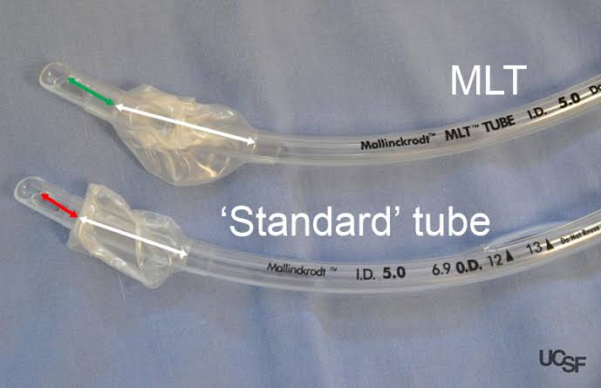
MICROLARYNGEAL TRACHEAL TUBE

Slide 14
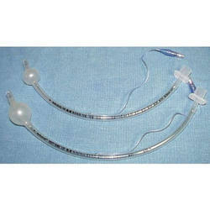

Slide 15
If an asleep approach to the difficult airway is chosen, several preformulated alternative airway management plans must be in place before induction of anesthesia. If the airway is marginal, the patient’s neck should be prepped, and the surgical team should be present on induction, ready to perform an emergent cricothyrotomy or tracheostomy, or to employ rescue techniques such as the use of the surgical anterior commissure scope or a rigid bronchoscope.
The anterior commissure scopes (e.g., Holinger, Benjamin Slimline, Jackson) have great leverage capabilities, incorporate the recessed lighting and concurrent rigid microsuction, and can be very effective in handling poor laryngeal exposure or glottic obstruction. The anterior flare at the distal oval end allows these scopes to be used as a conduit for orotracheal intubation when the bougie introducer or the ETT is passed directly down the lumen.

Slide 16
In experienced hands, rigid bronchoscopy may be used to rescue failed direct laryngoscopy and failed intubation and to manage a “cannot intubate, cannot ventilate” (CICV) situation.
It also serves as an indispensable tool for managing acute airway obstruction resulting from foreign bodies, hemoptysis, or tumors. After the bronchoscope is placed into the patient’s trachea by the surgeon, manual or JV can commence in a safe manner through the lumen of the bronchoscope.
Subsequent airway exchange to the ETT can be performed using a bougie introducer.

Slide 17
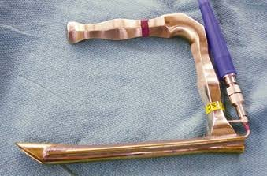
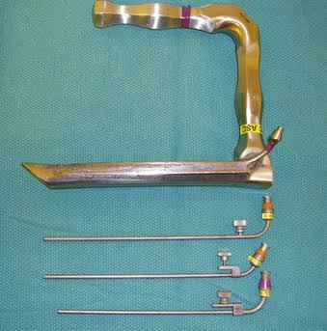
Holinger anterior commissure scope

Slide 18
Ventilation Techniques and Strategies for Microlaryngoscopic Surgery :
I. Awake airway surgery (conscious sedation)
II. Asleep airway surgery (general anesthesia)
Endotracheal intubation (cuffed microlaryngeal tracheal [MLT] tube)
Tubeless techniques
Spontaneous ventilation : Inhalational anesthesia (insufflation) Total intravenous anesthesia.
Apneic intermittent ventilation.
Jet ventilation :
Supraglottic
Subglottic
Low frequency
High frequency
Superimposed high frequency

Slide 19
Technique | Advantages | Disadvantages
Awake airway surgery | Avoidance of general anesthesia. Unobstructed surgical field and free surgical access to the larynx Increased patient cooperation. Ability to evaluate dynamic airway function. Ability to monitor voice quality throughout the surgery. Convenience for the surgeon and the patient Cost savings | Success depends on good topical/regional anesthesia of the airway Local anesthetic–induced side effects. Lack of powered magnification Lack of precision afforded by a still surgical field May require conscious sedation Loss of patient cooperation may result in injury Limited ability to handle major intraoperative complications, such as bleeding and edema
Endotracheal intubation (microlaryngeal tracheal tube) | Adequate surgical field and surgical access to the larynx in most cases. Still surgical field Adequate airway protection. Control of patient immobility and vocal cord movement with adequate NMB Stable and controlled ventilation technique. Ability to continuously and reliably monitor Fio2, Etco2, PIP, and anesthetic gases Suitable for prolonged procedure | Largely unsuitable for surgery of the posterior glottic pathology (e.g., posterior glottic or subglottic stenosis, transglottic tumor) Unsuitable for laser if the need arises May not be used according to the surgeon’s preference

Slide 20
Technique | Advantages | Disadvantages
Spontaneous ventilation (insufflation and total intravenous anesthesia) | Unobstructed surgical field and free surgical access to the larynx Ability to evaluate dynamic airway function and obstruction Suitable for laser surgery | Unprotected lower airway. Precision surgery difficult or impossible in the moving surgical field Contamination of operating room environment with anesthetic gases, if insufflation technique is used Difficulty controlling adequate depth of anesthesia and absence of patient movement Inability to continuously and reliably monitor Fio2, Etco2, and anesthetic gases.
Apneic intermittent ventilation | Unobstructed surgical field and free access to the larynx Still surgical field Control of patient immobility and vocal cord movement with adequate NMB. Ability to intermittently control gas exchange Suitable for laser surgery | Unprotected lower airway. Possible airway trauma and disruption of the surgical field due to repeated passage of the endotracheal tube. Possible propensity for intraoperative laryngospasm Inability to continuously and reliably monitor Fio2, Etco2, and anesthetic gases. Best reserved for short, uncomplicated cases.

Slide 21
Technique | Advantages | Disadvantages
Jet ventilation (JV) | Unobstructed or minimally impeded surgical field and surgical access to the larynx. Still surgical field. Control of patient immobility and vocal cord movement with adequate NMB. Ability to monitor and control Fio2, Etco2, driving pressure, PIP, and PEEP with automated jet ventilators Suitable for prolonged procedures. | Sole dependence on total intravenous anesthesia. Association with most major (e.g., barotrauma) and minor intraoperative anesthesia-related complications. Dependence on sophisticated automated jet ventilators for safe use Limitations of manual JV and transtracheal JV. Significant experience and presence of two operators often require.

Slide 22
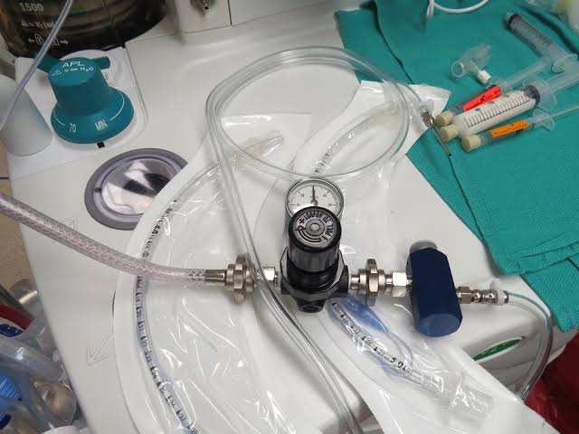
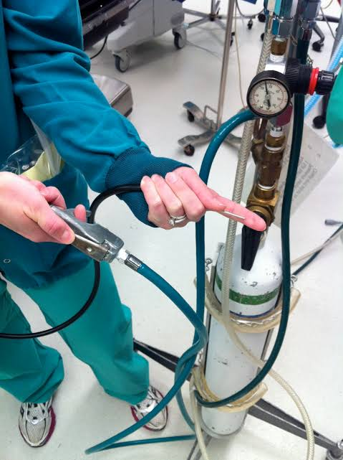
JET VENTILATION TECHNIQUE

Slide 23
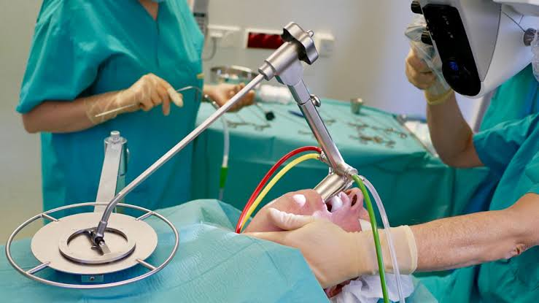

Slide 24
INDUCTION AND MAINTENANCE
In most patients, standard intravenous induction can be safely performed. Difficulty in maintaining the airway during inhalational induction in patients with large, pedunculated tumors, granulomas and cysts should be anticipated, even if preoperative symptoms of airway obstruction are mild, and early application of continuous positive airway pressure (CPAP) can help to stent the airway open.
If the patient’s airway is reassuring, TIVA with propofol and an opioid is most commonly used during induction and maintenance of anesthesia for microlaryngeal surgery. TIVA offers many practical advantages, such as delivering a stable, consistent level of anesthesia in cases of JV and other settings in which the delivery of inhalational anesthetics is compromised.

Slide 25
TIVA facilitates maintenance of induced hypotension, resulting in improved surgical visibility; ensures rapid return of protective airway reflexes; promotes rapid awakening and early post anesthesia recovery; and decreases the incidence of postoperative nausea and vomiting.
A propofol-based anesthetic results in profound depression of pharyngeal and laryngeal musculature and reflexes, and it effectively blocks the catecholamine release and hyperdynamic cardiovascular responses.
Compared with conventional weight-based manual infusions, target-controlled infusions allow easier and more rapid titration of analgesia to the individual patient’s responses, avoiding overshoot, improving the time course of the drug effect, and facilitating perioperative hemodynamic control.

Slide 26
Sevoflurane can be effectively combined with remifentanil and alfentanil for microlaryngeal surgery, producing good operating conditions, cardiovascular stability, and rapid emergence from anesthesia.
Compared with other inhalational anesthetics, sevoflurane may be preferred for outpatient microlaryngeal surgery. It improves the quality of postoperative patient recovery and shortens the discharge time, is associated with a reduced incidence of coughing compared with desflurane, and produces less somnolence and postoperative nausea and vomiting compared with isoflurane.

Slide 27
Neuromuscular Blockade :
Full muscle relaxation facilitates smooth endotracheal intubation, which should be accomplished in patients presenting for microlaryngeal surgery.
For very short diagnostic procedures, for which muscle relaxants can be completely avoided, a bolus dose of 3 to 4 µg/kg of remifentanil administered over 90 seconds and followed by an intravenous bolus of 2 to 2.5 mg/kg of propofol should provide excellent conditions for endotracheal intubation.
For most adult microlaryngeal surgical procedures, maintenance of a high degree of NMB is strongly preferred and is most commonly achieved by administration of intermittent intravenous bolus doses of intermediate-acting, non-depolarizing neuromuscular blockers or succinylcholine infusion.

Slide 28
EMERGENCE FROM GA
If endotracheal intubation was performed, smooth, nonstimulating emergence from anesthesia constitutes one of the most challenging tasks. Patient’s straining, bucking, or coughing with the ETT in situ results in an attempted forceful glottic closure, which may provoke additional trauma to and ulceration of the mucosal surface of the vocal cords, leading to wound formation.
Emergence phenomena such as a patient’s agitation and uncontrolled head movements and postextubation laryngospasm may exacerbate the surgically compromised vocal cords further.
Subsequent vocal cord wound healing leads to remodeling of the superficial layer of the vocal cord lamina propria and the epithelium, which may result in formation of vocal cord nodules, polyps, and cysts.

Slide 29
Three strategies can facilitate smooth tracheal extubation. First, the patient’s trachea can be extubated at a deep plane of anesthesia, and the airway supported by a mask until the patient resumes spontaneous ventilation and emerges from anesthesia.
The second approach (i.e., Bailey maneuver), with the patient still anesthetized, involves insertion of a supralaryngeal airway (usually an LMA) behind the existing ETT, removal of the ETT, and administration of the supraglottic ventilatory support until the patient resumes spontaneous ventilation and awakens from anesthesia.
With the third, pharmacologic approach, the anesthesiologist relies on a low-dose remifentanil infusion to blunt the tracheal responses and to promote smooth extubation and awakening at the end of surgery.

Slide 30
COMPLICATIONS
Major Complications : Intra-operative
Loss of the airway
Major barotrauma complications
Hypoxemia and hypercarbia
Major hemodynamic instability (e.g., myocardial ischemia, stroke)
Intraoperative awareness
Massive bleeding
Tracheobronchial tree perforation
Esophageal perforation
Pulmonary aspiration

Slide 31
Major Complications : Postoperative
Airway obstruction
Laryngospasm
Negative pressure pulmonary edema
Pulmonary aspiration
Minor Complications : Intraoperative
Oropharyngeal mucosal trauma
Dental trauma
Minor barotrauma complications (subcutaneous emphysema, gastric distention)
Minor hemodynamic instability (e.g., transient arrhythmias, vasovagal events)
Laryngospasm Corneal abrasion

Slide 32
Minor Complications : Postoperative
Sore throat
Cranial nerve dysfunction (e.g., lingual, glossopharyngeal, hypoglossal)
Respiratory compromise
Hemoptysis
Temporomandibular joint disorder aggravation

Slide 33
THANK YOU

