Slide 1
Labor Analgesia
By dr. Ganesh c naik
Under the guidance of dr. Anuja agrawal maam

Slide 2
Stages of labor
First stage of labor
  Starts with true labor contractions and ends with complete dilatation of the cervix(10cm)
Second stage of labor
  From full dilatation of the cervix to the delivery of baby
Third stage of labor
  From delivery of the baby to the explusion of placenta
Fourth stage of labor
  First four hours after delivery of placenta

Slide 3
First stage of labor
  Visceral pain due to uterine contraction and cervical dilatation
  Involves up to T10 – L1 dermatomes–
  Primarily in lower abdomen, referred to lumbosacral/gluteal or thighs
Second stage of labor
  Perineal pain due to compression of pelvic and perineal structures
  Involves T10 – S4 segments
  Carried via pudendal nerve to spinal cord T10-S4 segments

Slide 4
Components of Labor Pain
Visceral Pain
  Due to dliatation of cervix and lower uterine segment
  Transmitted by small unmyelinated C fibres
  Pain referred to T10 – T12 (lower abdomen, Sacrum and back)
  Pain is not always sensitive to opiod
Somatic pain
  Due to distension of pelvic floor, perineum, vagina
  Transmitted by fine, myelinated A-delta fibres
  Sharp in character and easily localised (T10 –L1)
  More resistant to opioids

Slide 5
Labor Pain Pathways
Visceral pain
  Un-myelinatef c fibres
  Sympathetic chains(T10-L1)
  Posterior nerve roots
  Dorsal horn of spinal cord
  Spino thalamic tract

Slide 6
Somatic pain
  Transmitted by fine,myelinated, rapidly transmitting A-delta fibres
  Transmission occurs to S2-S4 via pudendal nerves and perineal branches of posterior cutaneous nerve of thigh
  Afferent fibres are carried to L1 and L2 roots via ilio inguinal and genitofemoral nerve
  From dorsal horn cells transmitted via spino thalamic tract to brain

Slide 7
Factors Affecting Severity of Labor Pain
Parity
  Nulliparous women experience more severe pain
Prior education
  Reduces the intensity of pain
Severity of labor pain
  Increases with progression of labor
    Cervical distension
    Increase in uterine pressure during contraction

Slide 8
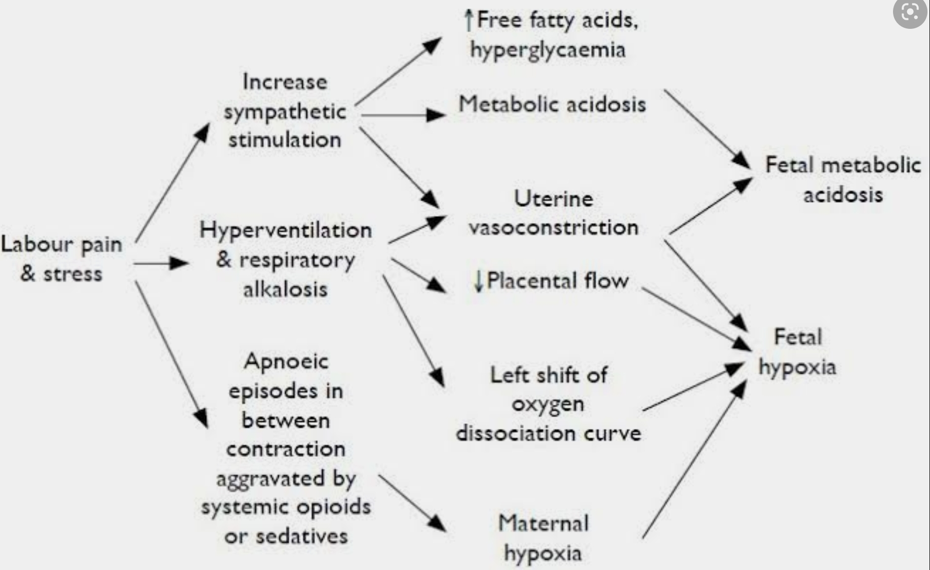

Slide 9
Beneficial effects of Labor Analgesia
Cardiovascular system
  Reduces circulating catecholamines
    Improved peripheral circulation
    Better uteroplacental circulation
Respiratory system
  Waxing and waning pattern of breathing due to labor pain is avoided
  Hyperventillation and respiratory alkalosis is not seen
  Prevents leftward shift in maternal ODC curve
  Oxygen delivery to fetus is increased

Slide 10
Metabolic effects
  Metabolic acidosis and ketosis are reversed
Psychological effects
  Relieves the fear and anxiety associated with labor pain
    Post partum depression
    Elective cesarean sections during subsequent pregnancies

Slide 11

Labor analgesia techniques
Nonpharmacological techniques
  Water immersion
    Involves immersing the parturient in warm water deep enough to cover the abdomen
    Enhances relaxation and reduce labor pain
    Water is kept at or slightly above body temperature
    Anaesthesia is provided due to warmth infuencing nociceptive input to brain
  Offered to
    Healthy parturients
    Uncomplicated pregnancy
    Between 37 -41 weeks of gestation
  Usually safe but used cautiously due to risk of infection

Slide 12
Acupuncture
  Involves placement of needles at specific points on the body called acupuncture points
  It is associated with pain relief and reduced need of pharmacological analgesia
Transcutaneous Electrical Nerve Stimulation(TENS)
  Involves transmission of low voltage electrical impulses to skin via surface electrodes
  Impulses are generated with help of a hand held battery powered generator
  Parturient is allowed to adjust the frequency, intensity and waveform of the impulses
  Mechanism of action
    Relieves pain through gate control theory
    Nociceptive inhibition at pre synaptic level in the dorsal horn
    Blocks impulses to target cells in substantia gelatinosa
    Stimulates endorphins release in Brain

Slide 13
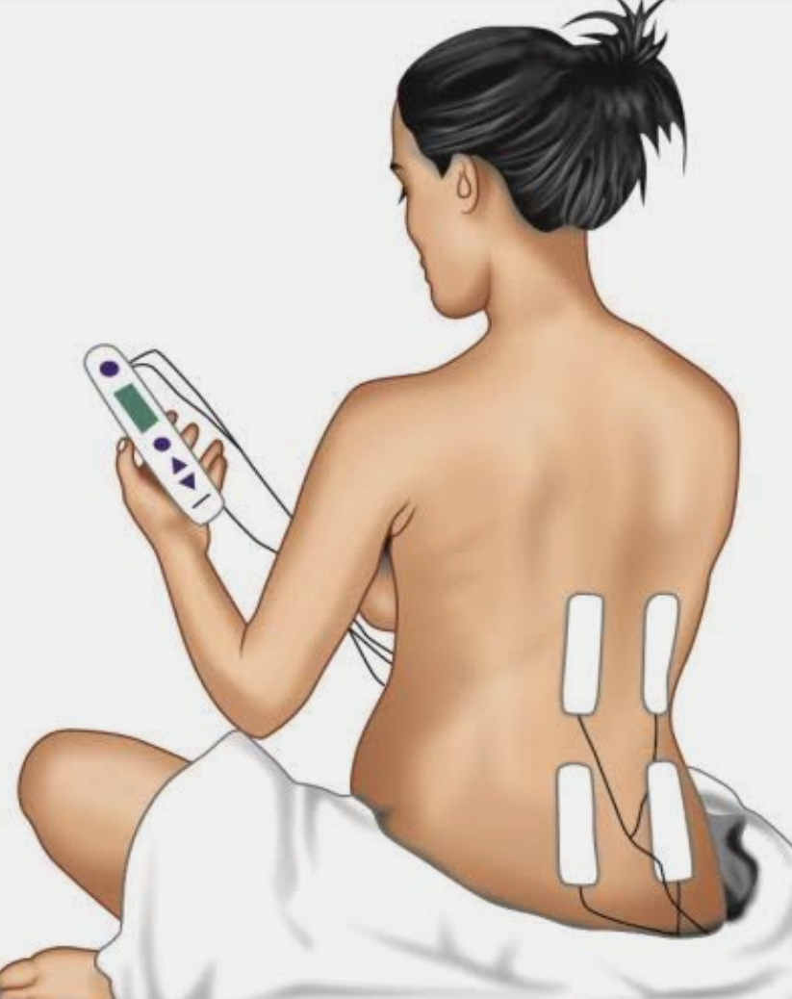
Method:
  One pair of electrodes is placed paravertebrally between T10 – L1
  Second pair is placed between S2- S4
  Parturient controls the intensity of current using a dial
  Continuous stimulation is self applied during contractions
  Intermittent, pulsing stimulation is used in between contractions
  Stimulation causes a buzzing or pricking sensation
  This reduces the awareness of contraction pain thus providing analgesia.

Slide 14
Pharmacological analgesia
Meperidine
Most commonly used parenteral opioid
  50–100 mg IM
  Peak onset of action 40–50 mins
  25–50 mg IV
  Onset of action 5–10 mins
  duration of action 3–4 hrs
Lesser respiratory depression
Loss of beat-to-beat variability in FHR tracings.

Slide 15
Fentanyl: – 25–30 µg IV, Onset 3–5 mins, duration 30–60 mins
  Can be given S/C, orally or transdermally
  Reasonable analgesia with minimal neonatal depression
  Mild maternal sedation at 50–100 µg.
Remifentanil: – Mostly as PCIVA
  Bolus of 0.4 µg/kg with lockout time of 1 min
  Continuous infusion of 0.05 µg/kg/min with 25 µg bolus,
  lockout time of 5 mins
  No adverse effects
  crosses fetomaternal barrier

Slide 16
Nalbuphine
  Agonist-antagonist
  Partial ĸ agonist
  potent µ antagonist
  minimal affinity
  10 mg IV/IM
  2–3 mins onset of action
  duration of action up to 6 hrs

Slide 17
Promethazine
  Most commonly used phenothiazine
  25–50 mg IV to prevent emesis
  Potentiates analgesic effects of opioids.
Ketamine:
  0.5–1 mg/kg every 2–5 mins to total of 1 mg/kg in 30 mins
  Supplements incomplete neuraxial block
  Hypertension, psychomimetic effects
  Not routinely used.

Slide 18
Tramadol: – 1–2 mg/kg IV/IM
  Duration of action 2–3 hrs
  Weak µ agonist: 10% as potent as morphine
  Less respiratory depression->not seen at 1–2 mg/ kg doses.
Benzodiazepines
  Causes sedation, hypnosis, cyanosis and amnesia
  Not routinely used.

Slide 19
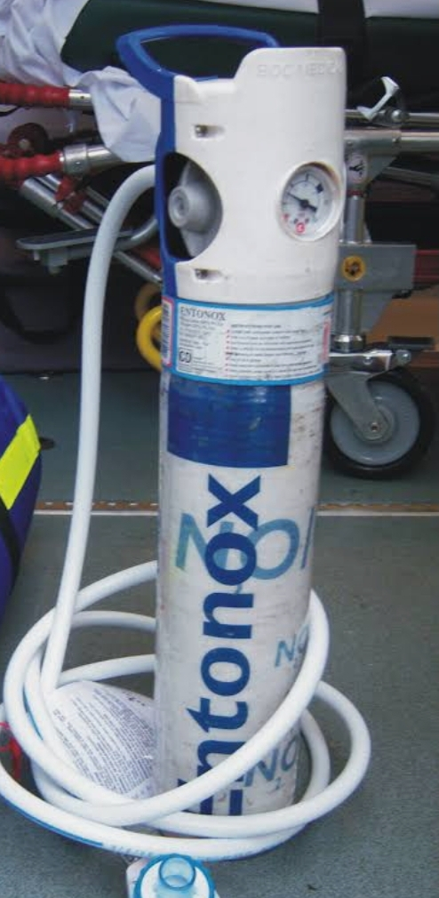
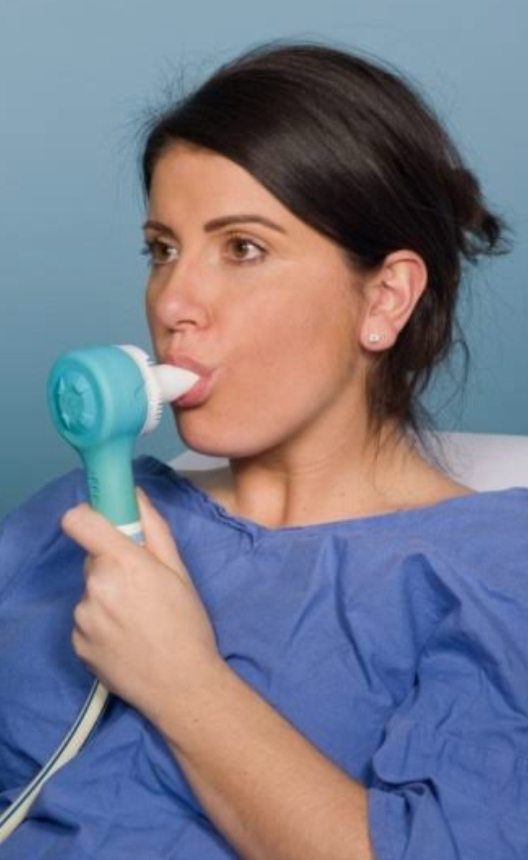
INHALATIONL ANALGESIA
Entonox
  50% N2O: O2 mixture
  Was used both as sole analgesic and as adjuvant earlier
  Maximal effect after 45–60 mins
  Important to use entonox at early onset of contraction
  Use discontinued after peak of contraction
  Causes nausea, dizziness, dysphorea, lack of cooperation
  OT pollution
  Not routinely used
  Used now as adjunct or when regional analgesia not possible.

Slide 20
Volatile anesthetics
  Not routinely used
  Sevoflurane 0.8% most commonly used
  Isoflurane and enflurane (0.2–0.25%)
  desflurane (0.2%)
    Causes more intense sedation, unpleasant smell, OT pollution
    Unconsciousness and loss of airway reflexes occur if accidental overdose
    PCIA uses sevoflurane and special vaporizes.

Slide 21
REGIONAL ANAESTHESIA
Epidural Analgesia
  Indicated when patient is in active labor
    Cervix 5–6 cm dilated in primigravida
    Cervix 3–4 cms in multigravida.
  T10–L1 level required for 1st stage of labor
  S2–S3 level required in 2nd stage of labor
  Good analgesia
  minimal motor block
  reduced stress response.

Slide 22
Advantages
  Good analgesia
  Stable therapeutic analgesic level without fluctuations in pain relief
  Minimizes motor block and allows greater patient mobility
  Minimzes hypotensive epiosodes
  Reduces stress response
  Avoids parenteral drug therapy
Disadvantages
  Subarachnoid puncture or migration of catheter
  Longer time for onset of analgesia
  Catheter related infections

Slide 23
Epidural Analgesia regimen
Initial bolus
  10 to 15 ml bupivacaine 0.0625 – 0.125% with 50-100 mcg fentanyl
  10 to 15 ml ropivacaine 0.1 – 0.2 % with 50 – 100 mcg fentanyl
Maintainance dose
  Buiivacaine 0.0625 – 0.125% with 1-2 mcg/ml at 10 -15 ml/hr
  Alternatively intermittent boluses may be injected as per requirement

Slide 24
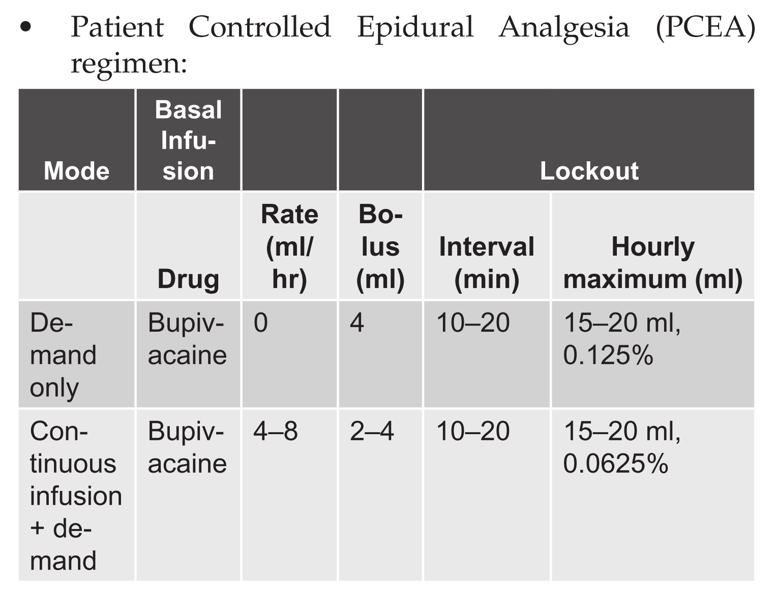

Slide 25
Subarachnoid block
Used for
  Multiparous women in active labor (6–9 cm dilated)
  Primipara fully dilated and significant pain
  Patients in early labor, 2–4 cm dilated, prior to active phase
Saddle block used if
  Forceps delivery
  Repair of vaginal/rectal tears postpartum
  Removal of placenta.

Slide 26
Continuous spinal analgesia
  Rarely used due to high incidence of complications
  Requires placement of catheters via 17 to 18 G needles which increases the risk of PDPH
  Induction
    Hyperbaric bupivacaine 2.5-7.5 mg
  Maintainence
    0.5-1.5 ml 0.1-0.25% bupivacaine
    10-20 mcg fentayl may be added
  Continuous infusions
    0.0625-0.125% bupivacaine with 2 mcg/ml fentanyl
    Continuous infusion given at 1-5ml/hr

Slide 27
Combined Spinal Epidural
Includes intrathecal injection of drugs to initiate spinal analgesia
Followed by insertion of epidural catheter to allow
  Maintainence of analgesia
  Conversion to surgical anaesthesia
Indication
  Very early stage of labor when local anesthetics are avoided
  Advanced stage when rapid analgesia required
  Difficult epidural as it reduces failure rate of epidural.

Slide 28
Advantages:
  Rapid onset of analgesia
  Makes ambulation possible due to limited motor block
  Reduces epidural complications: - Patchy block - Poor sacral spread.
Disadvantages
  Complications due to dural puncture
  Risk of total spinal
  Complications due to intthecal spread of opiods
  Risk of maternal respiratory depression
  Increased risk of fetal bradycardia

Slide 29
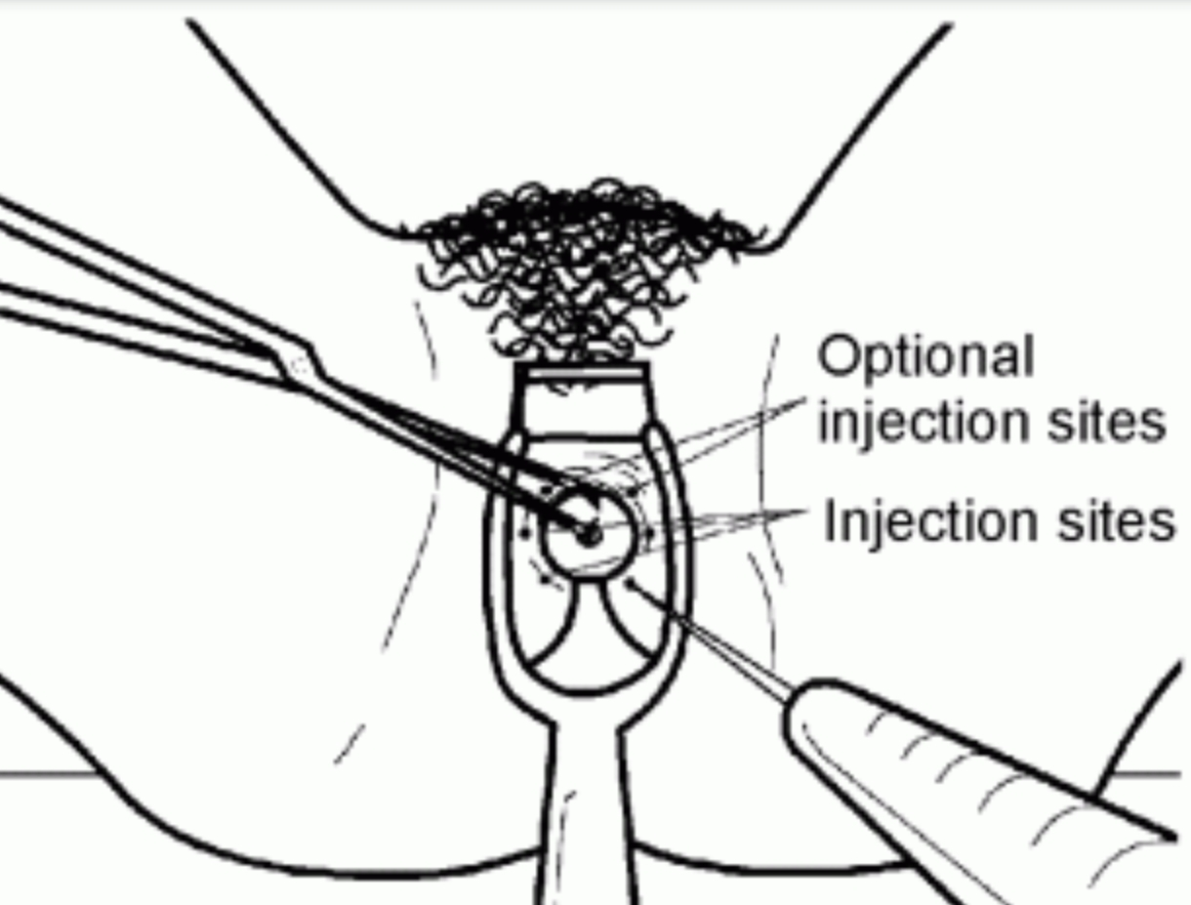
Paracervical Block
  Alternative where neuraxial blockade contraindicated
  Simple to perform, does not affect progress of labor
  Local anesthetic injected submucosally into fornix for vagina, lateral to cervix
  Close proximity of injection site to uterine artery makes it technically difficult
  Blocks transmission through paracervical ganglion
  Good for 1st stage of labor
  No pain relief offered during 2nd stage of labor

Slide 30
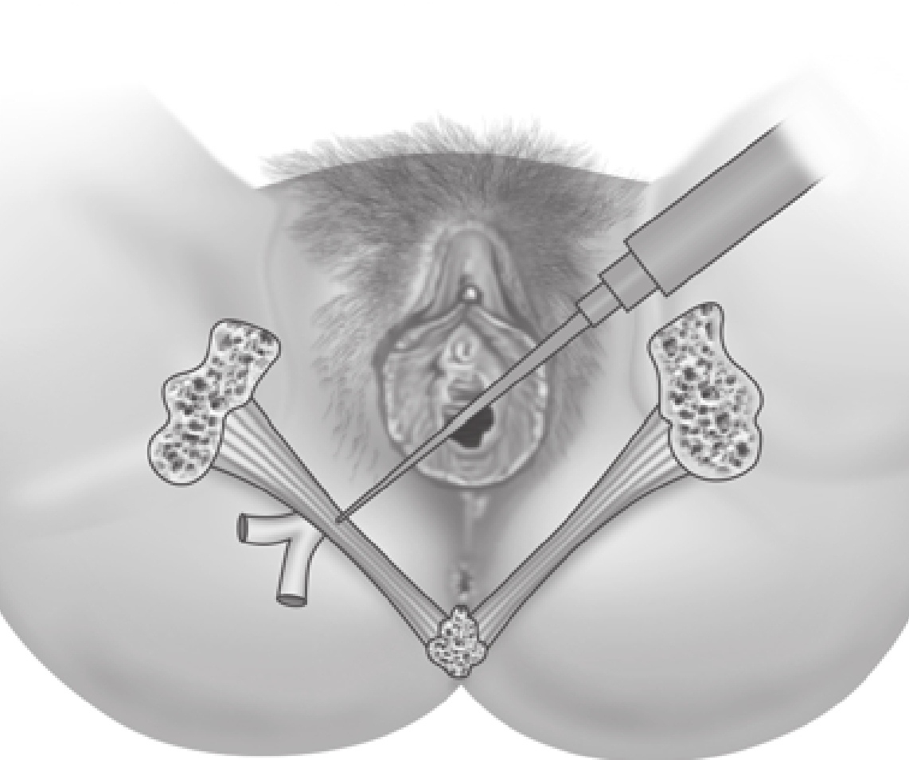
Pudendal Nerve Block
  Through transvaginal approach in lithotomy position
  Ischial spine palpated transvaginally/transrectally
  Needle placed transvaginally under ischial spine on each side
  Advanced 1–1.5 cm through sacrospinous ligament
  10 ml of 1% lidocaine injected
  Local anesthetic deposited behind sacrospinous ligament
  Satisfactory for vaginal delivery and outlet forceps delivery

Slide 31
Walking Epidural
Combined spinal epidural technique, used for labor analgesia which allows maternal ambulation
Also called minimal motor block epidural.
Indication
  Early in labor when local anesthetics are not preferred
  Late in labor when immediate analgesia required
  Difficult epidural as it reduces failure rate of epidural
  Where rapid analgesia required and epidural catheter may be useful for later intervention (trial for forceps extraction where cesarean section may follow).

Slide 32
Criteria for Ambulation
  No obstetric or medical contraindications
  Maternal desire to ambulate
  Presence of second person to walk with patient
  Ambulate only when spinal anesthesia with opioids
  Avoid when spinal anesthesia with local anesthetics
  Ability to perform sustained straight leg raising test > 10 sec
  Ability to perform partial knee bends at bedside
  < 10% change in BP from supine to sitting position.

Slide 33
Myths of labor analgesia
They cause permanent back pain
  Labor and relaxing effects of harmones can cause back pain ,Epidural is not proven to cause permanent back pain
Risk of paralysis
  Most epidurals are uneventful and uncomplicated
Harm to infant
  Low dose and low concentration of local anaestheics and opiods are used which are considered safe for the baby

Slide 34
They slow the labor
  Epidurals dont slow down the mechanics of labor , they lengthen the time it takes for the second stage of labor because of less sensatio of pain
Risk of C section
  Epidurals doesnot increase the risk of Cesarean delivery
Time frame for epidural
  No specific time range for epidural, It just requires mother to stay still for smties for the insertiion of epidural

Slide 35
Epidural and headache
  Post dural puncture headache is a known risk factor for individuals recieving epidural but it has an incidence of about 1.5 % .

Slide 36
Thankyou

