Slide 1
ICP MONITORING
BY DR.CHANDINI D
UNDER THE GUIDANCE OF
DR.MALINI MEHTA MAM

Slide 2


Slide 3
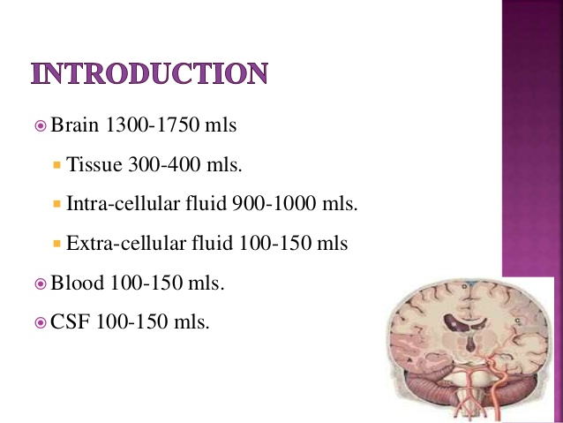

Slide 4


Slide 5
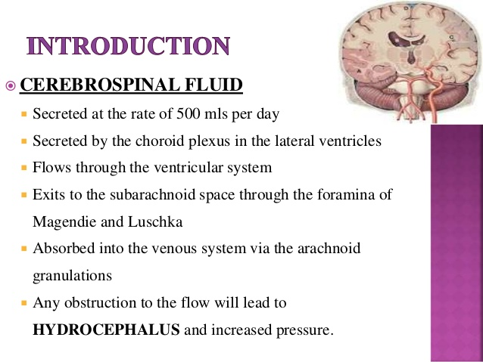

Slide 6
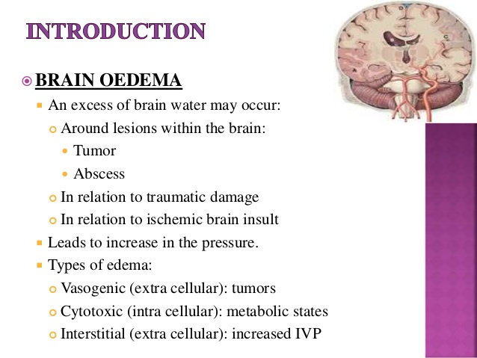

Slide 7
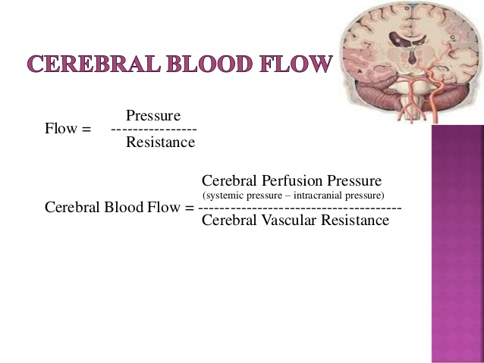

Slide 8
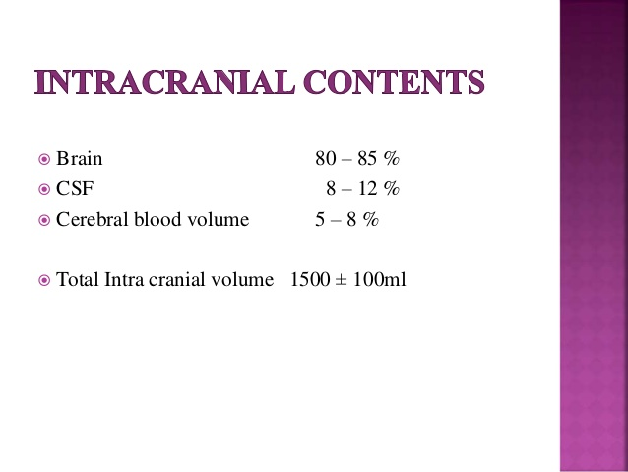

Slide 9


Slide 10


Slide 11
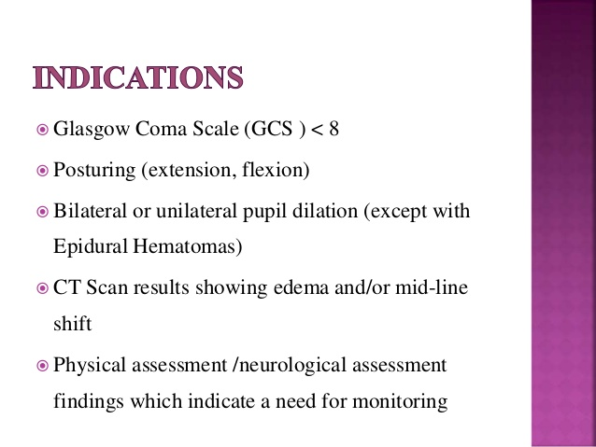

Slide 12


Slide 13
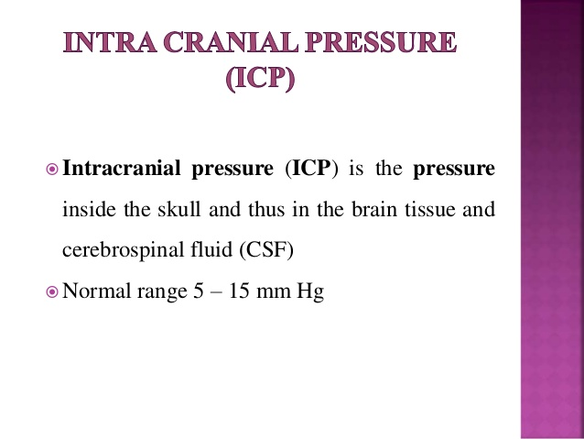

Slide 14
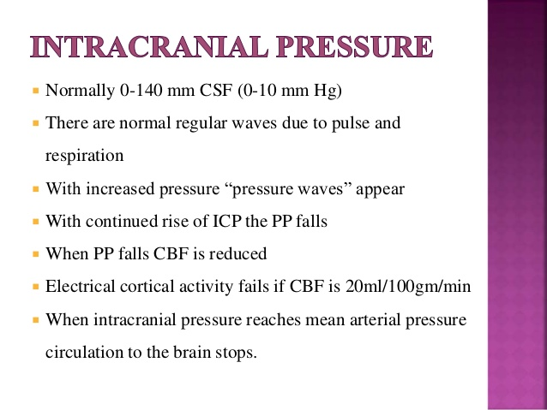

Slide 15
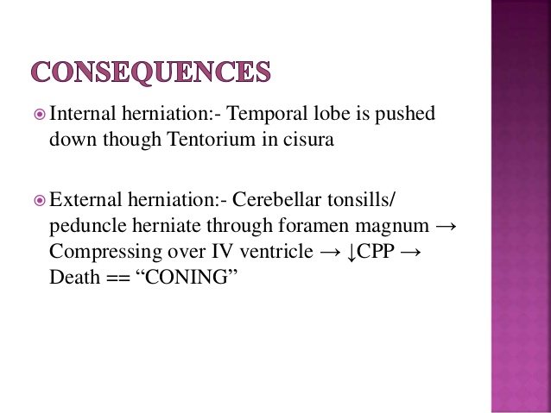

Slide 16


Slide 17
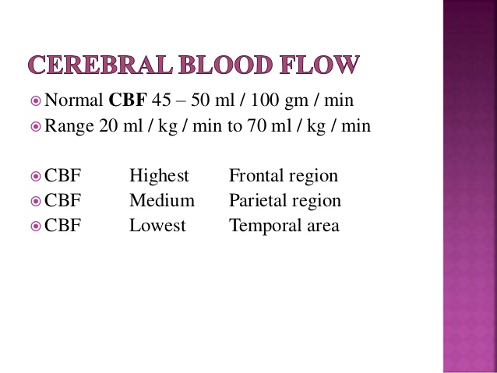

Slide 18


Slide 19
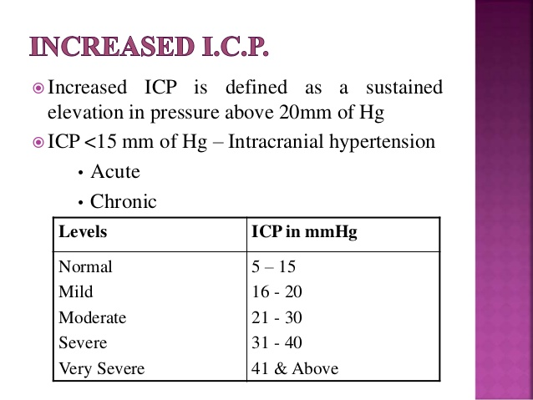

Slide 20


Slide 21


Slide 22


Slide 23
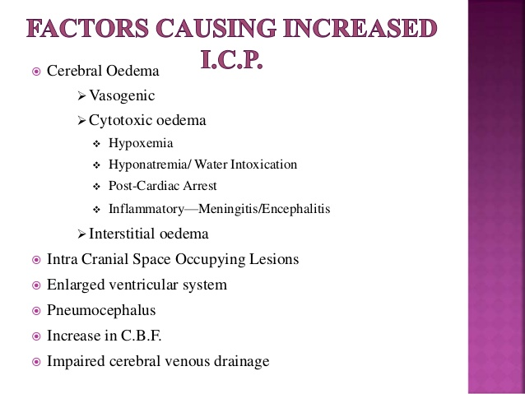

Slide 24


Slide 25
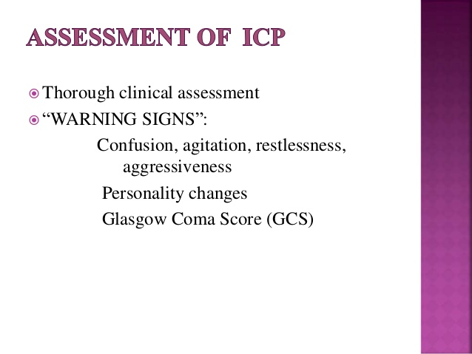

Slide 26
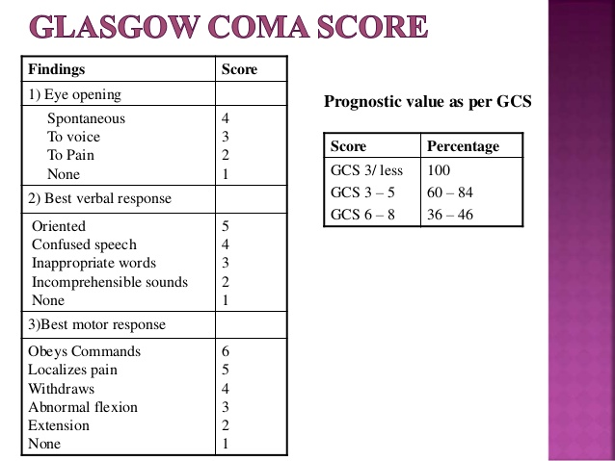

Slide 27


Slide 28
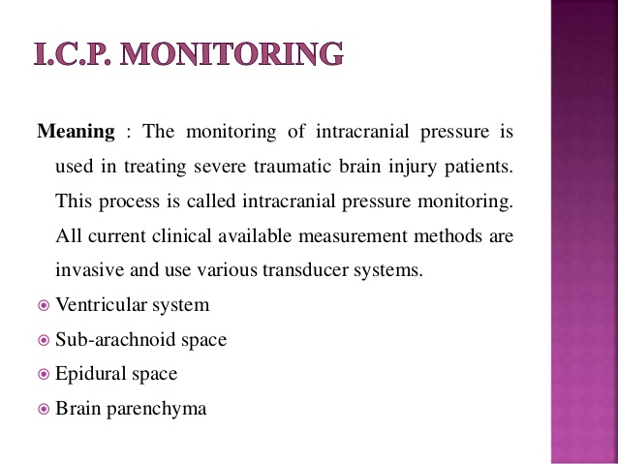

Slide 29
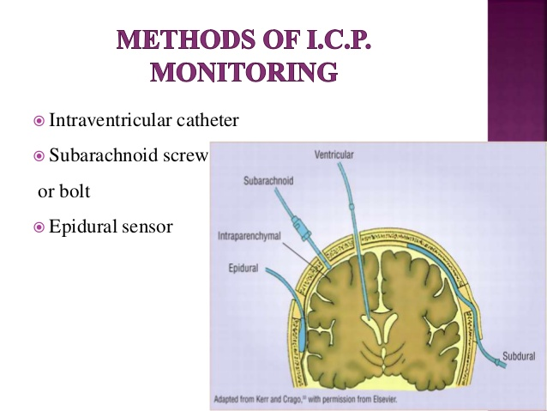

Slide 30
INVASIVE METHODS OF ICP MONITORING
❖ INTRAVENTRICULAR DEVICES
❖ SUBARACHNOID DEVICES
❖ EPIDURAL/SUBDURAL DEVICES
❖ PNEUMATIC SENSOR(SPEGEILBURG BRAIN PRESSURE MONITOR)
❖ FIBEROPTIC CATHETER TIP TRANSDUCERS(CAMINO INTRACRANIAL PRESSURE MONITORS)
❖ IMPLANTED MICROCHIP TRANSDUCERS(CODMAN SENSORS)

Slide 31
❖ Several different invasive methods to measure ICP exist. Each type of device, depending on the intracranial location and method of pressure transduction, has its advantages and disadvantages.
❖ Modern ICP monitors can be classified on the basis of pressure transduction method into, strain gauge or fibreoptic technology based monitors.
❖ The strain gauge pressure transduction can be external (intraventricular drains), or internal (catheter tip microchip).
❖ Another classification may be into – fluid coupled devices (connected to an external strain gauge), or non-fluid coupled devices (fibreoptic or catheter tip microstrain gauge)

Slide 32
INTRAVENTRICULAR DEVICES
❖ Invasive monitoring using the EVD technique, where a catheter is placed into one of the lateral ventricles through a burr hole, is considered the gold standard of ICP monitoring, and is the standard against which newer monitors are calibrated. It is a fluid coupled device connected to an external strain gauge, and can be re-calibrated in vivo against an external reference at any time.
❖ Direct intraventricular ICP monitoring is the most reliable method in current use, and has the advantage of minimal expense with maximum accuracy. In addition to monitoring the ICP, it can also be used for therapeutic CSF drainage intermittently to control the ICP, and to instil medications intrathecally, e.g. antibiotic administration in ventriculitis, or instillation of thrombolytics in case of intraventricular haemorrhage or clotting at the proximal catheter.

Slide 33
DISADVANTAGES
❖ It is the most invasive of all available techniques, as the ventriculostomy penetrates the meninges and brain, with the risk of bacterial transmission through the fluid coupling. Strict adherence to aseptic technique while insertion, use of antibiotic impregnated catheters, subcutaneous tunnelling of the catheter, sterile occlusive dressing over the incision points, minimal manipulation, flushing or accessing of the CSF drainage tubing – have all been known to reduce infection rates.
❖ Currently, catheters impregnated with silver nanoparticles are also being used to reduce the risk of catheter associated ventriculitis, but larger, multi-centric studies are needed to draw any firm conclusions on the same.
❖ Routine change of EVD catheters, or antibiotic prophylaxis is not recommended at presen

Slide 34
❖ Another disadvantage of the intraventricular method is that EVD placement may be difficult in young patients with compressed or slit-like ventricles, due to cerebral oedema. The ICP waveform may be dampened in these cases, and the values recorded may be low due to artefact effect.
❖ Caution should be exercised for overshunting, especially in patients with poor grade SAH (subarachnoid haemorrhage) who need an EVD for the relief of acute hydrocephalus, where over-drainage may lead to aneurysmal rebleed. Also, CSF overdrainage in patients with large unilateral mass lesions may lead to hemispheric shifts and herniation.
❖ The potential risks of haemorrhage, misplacement, and obstruction of the catheter, are other complications of intraventricular catheter placements.

Slide 35
SUBARACHNOID DEVICES
❖ The subarachnoid bolt (or Richmond screw) is a hollow screw that goes into the skull abutting the dura. The dura is perforated to fill the bolt with CSF, which is then connected to a closed fluid filled tubing and a pressure transducer.
❖ These devices may be quickly and easily placed, without invading the brain, and thus have lower infection rates. But, they are prone to errors such as ICP underestimation, misplacement of the screw, and occlusion by debris.Their popularity has therefore declined in the recent years.

Slide 36
EPIDURAL/SUBDURAL DEVICES
They are an attractive option, as they are the least invasive, and can be easily and quickly placed. But, their questionable accuracy and reliability, coupled with the increasing baseline drift over time, makes them less popular choices as compared to intraventricular or intraparenchymal devices.

Slide 37
Pneumatic sensor (Spiegelberg Brain Pressure Monitor)
❖ This is a fluid filled catheter transducer system, which uses a distal air filled balloon tipped catheter to measure ICP . The monitor connects to an internal strain gauge transducer used to measure the internal balloon pressure.
❖ It is a relatively low cost monitor (as compared to the contemporary microtransducers) classically used for epidural and subdural pressure measurements.
❖ A newer version of the monitoring system, using a double lumen intraventricular catheter system, also has the capacity of measuring intracranial compliance, simultaneously permitting CSF drainage as a treatment option.
❖ Studies show that the Spiegelberg air-pouch ICP/ compliance monitor provides ICP and compliance data that are very similar to those obtained using both gold standard methods and intraparenchymal ICP monitors over a range of pathological ICPs.

Slide 38
INTRAPARENCHYMAL DEVICES
This group of devices are non-fluid coupled devices, and can be divided into two subtypes:
• Fibreoptic devices, e.g., the Camino ICP monitor, the Innerspace ICP monitor
• Strain gauge devices, e.g., the Codman MicroSensor, the Raumedic Neurovent P ICP sensor, and the Pressio sensor

Slide 39
ADVANTAGES
❖ These ICP microtransducers can be used at any location – intraventricular, epidural, subdural or intraparenchymal; but those measuring ICP intraparenchymally, usually placed in the right frontal region at a depth of approximately 2 cm, are the most widely used.
❖ The microtransducers are accurate and a close correlation is observed between the ICP measured by them and that using the intraventricular drainage devices.
❖ These can be easily transported, and their recordings are independent of patient positioning.
❖ They are non-fluid coupled, therefore do not require irrigation and have a low risk of infection.
❖ The incidence of clinically significant haemorrhage is also negligible.

Slide 40
DISADVANTAGES
The disadvantages associated with the intraparenchymal monitors are:
(i) They cannot be re-calibrated in vivo
(ii) they measure localised pressure, which may not be reflective of global ICP
(iii) therapeutic CSF drainage is not possible; and
(iv) they may be subject to drift when used for long periods

Slide 41
FIBREOPTIC CATHETER TIP TRANDUCERS
Fibreoptic catheter tip transducer transmits light via a fibreoptic cable towards a displaceable diaphragm. Light is reflected off the diaphragm and the change in light intensity is interpreted in terms of pressure. It requires a dedicated microprocessor-driven amplifier to provide a numerical value and/or continuous waveform display.

Slide 42
DISADVANTAGES
❖ The system is costly and the catheters are disposable.
❖ Moreover, these catheters cannot be re-calibrated once inserted, and a drift (daily baseline drift of 0.3 mm Hg) occurs if the monitoring is to be continued for longer than 5 days.
❖ Also, these catheters are fragile, and if they are acutely bent during insertion or maintenance, or if the patient is restless, they can get damaged.

Slide 43
Implanted microchip transducers (Codman sensors)
These consist of a miniature solid state pressure transducer, mounted on a titanium case, at the end of a 100 cm flexible nylon tube. The transducer tip contains a silicon microchip with diffuse piezoelectric strain gauges. The microsensor monitors ICP at the source – intraparenchymal, intraventricular or subdural, and the information is relayed electronically, rather than through a hydrostatic system or fibreoptics

Slide 44
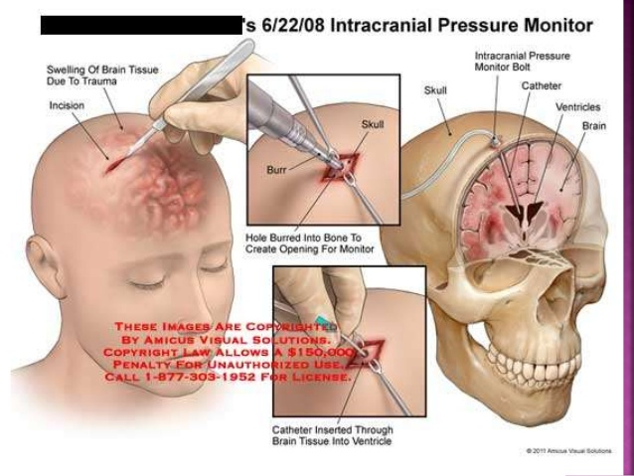

Slide 45
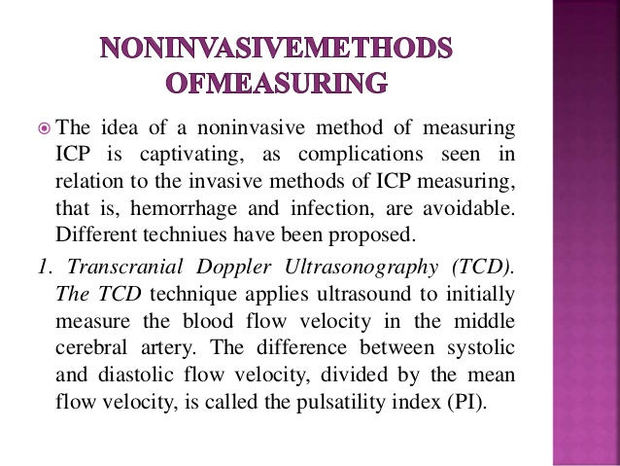

Slide 46
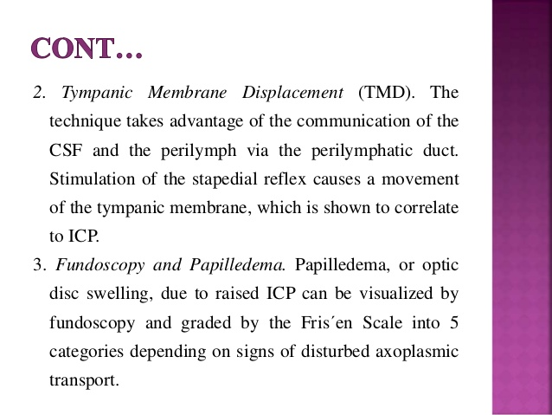

Slide 47
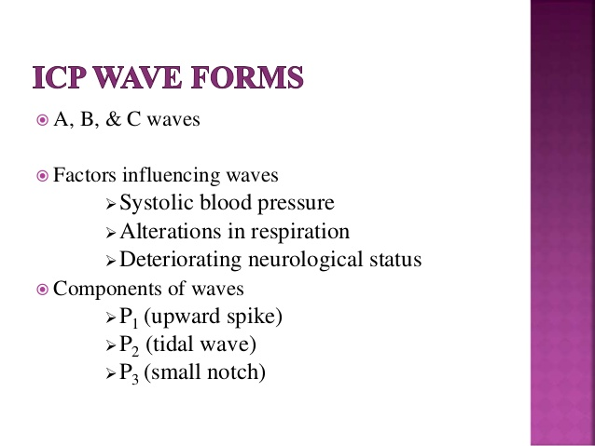

Slide 48
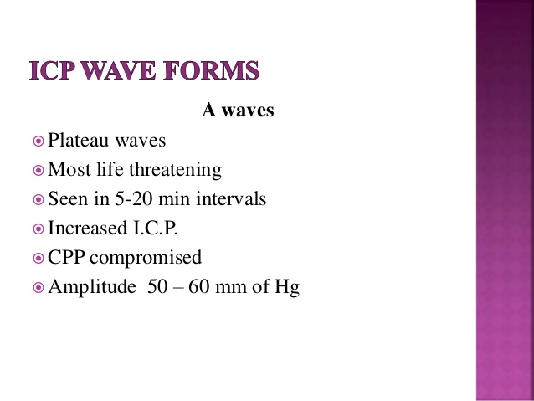

Slide 49
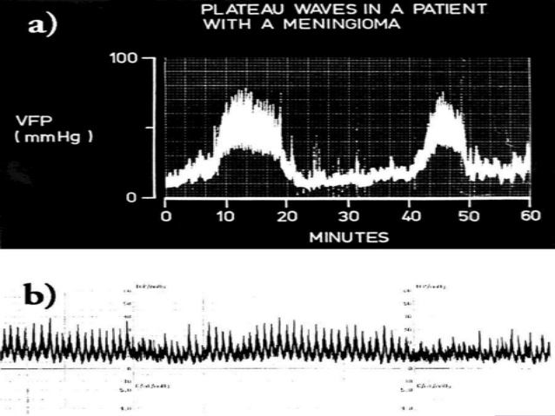

Slide 50
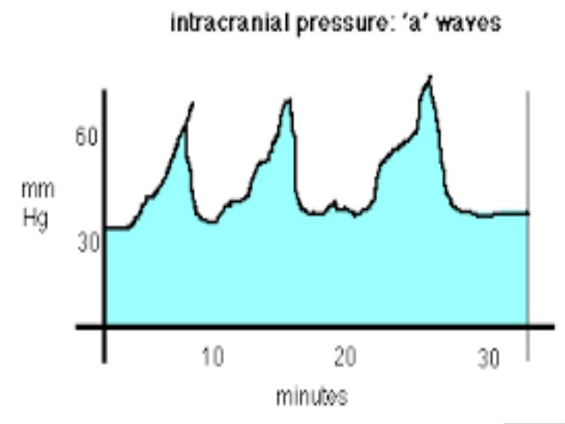

Slide 51
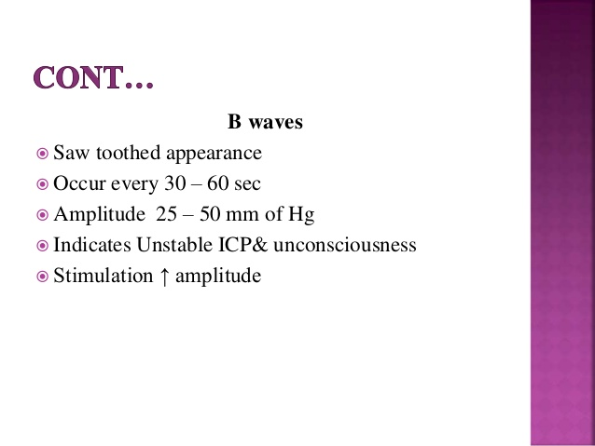

Slide 52
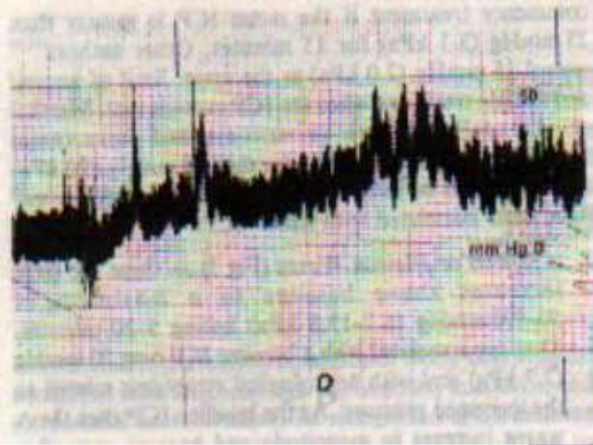

Slide 53
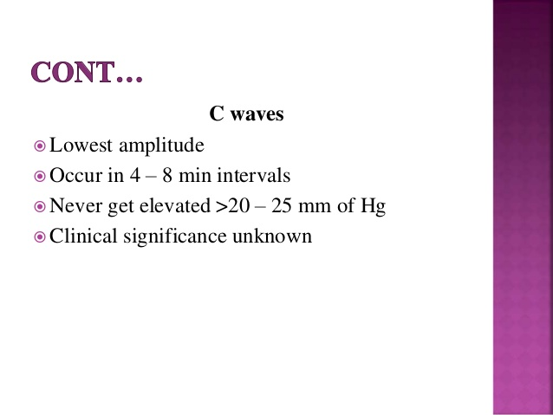

Slide 54
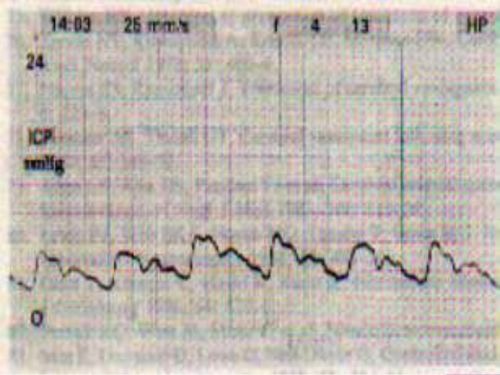

Slide 55
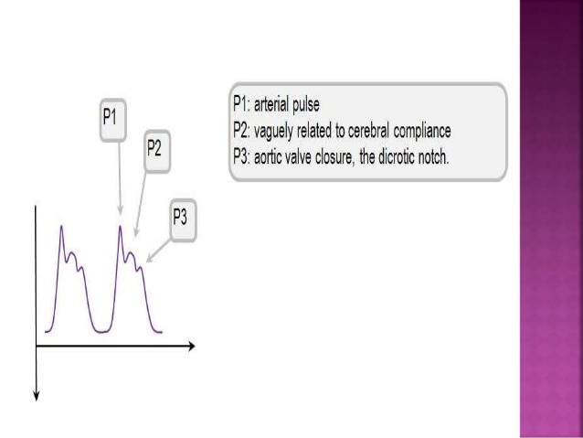

Slide 56
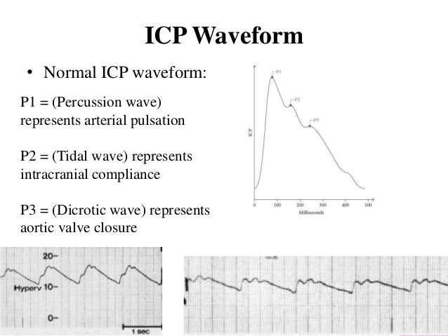

Slide 57
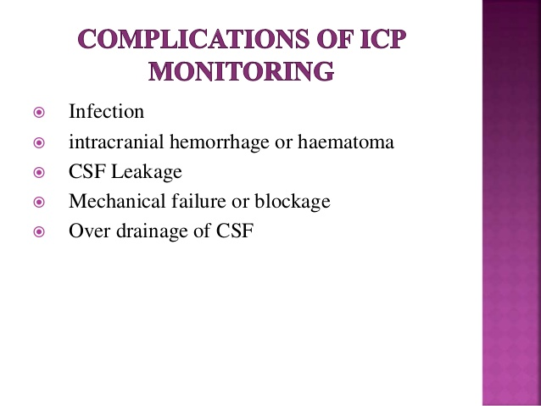

Slide 58


